Slide 1







NEW ICAO WEB SITE
Make a selection by clicking on one of the buttons below

Slide 2

(ACT)

Slide 3
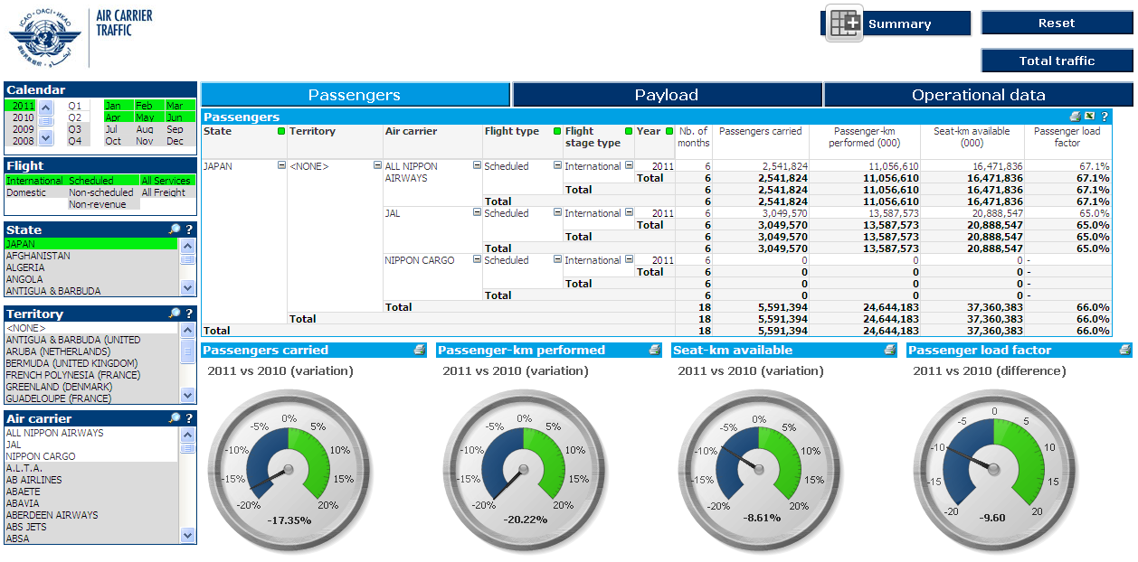
View recently reported data

Slide 4
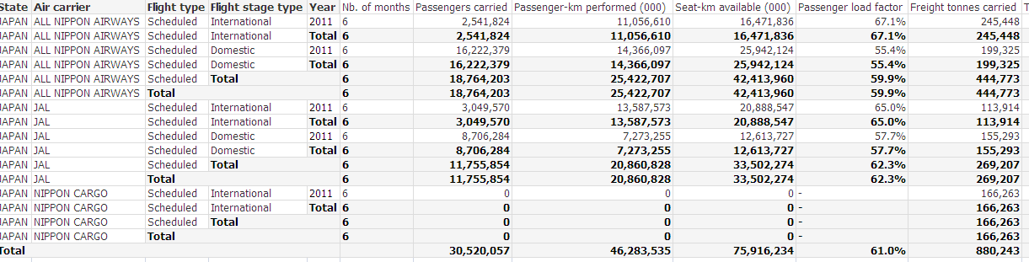
Download your data to Excel

Slide 5
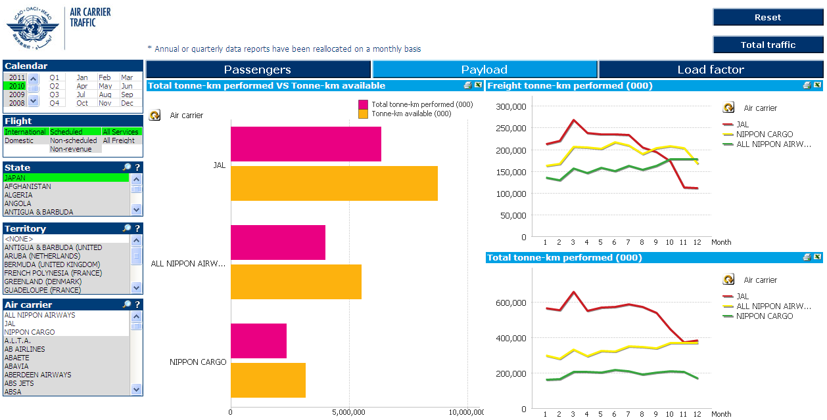
Review development of air carriers from same State

Slide 6
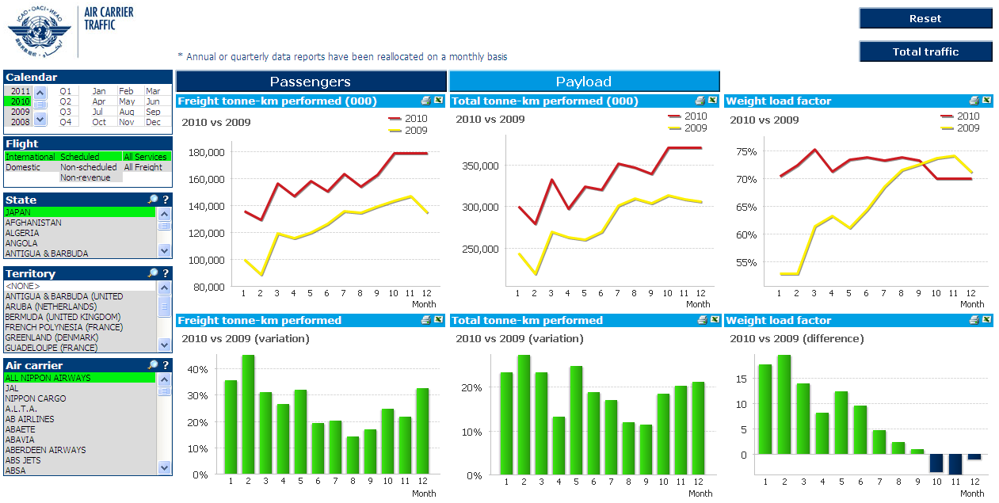
Compare monthly variations

Slide 7
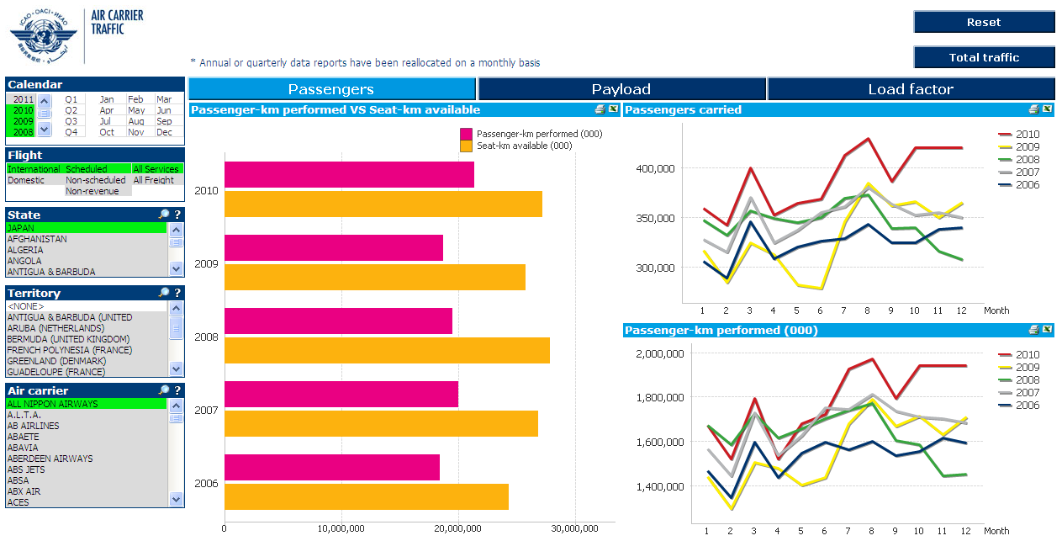
Review annual trends

Slide 8
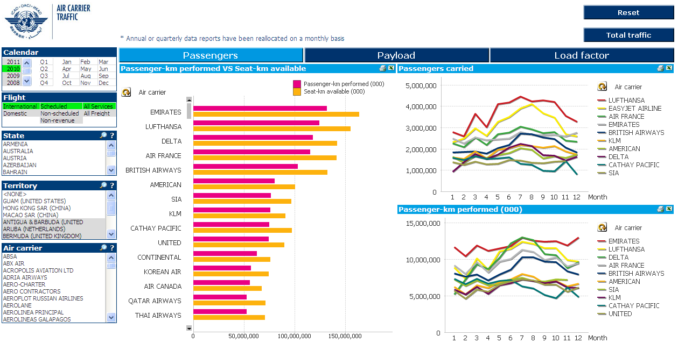
Benchmark competition

Slide 9
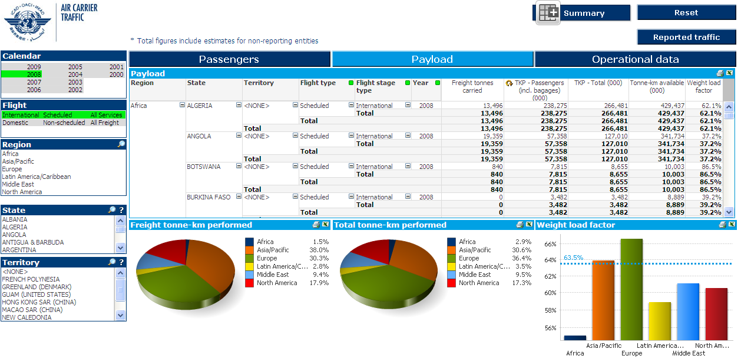
View regional contribution to global air transport

Slide 10
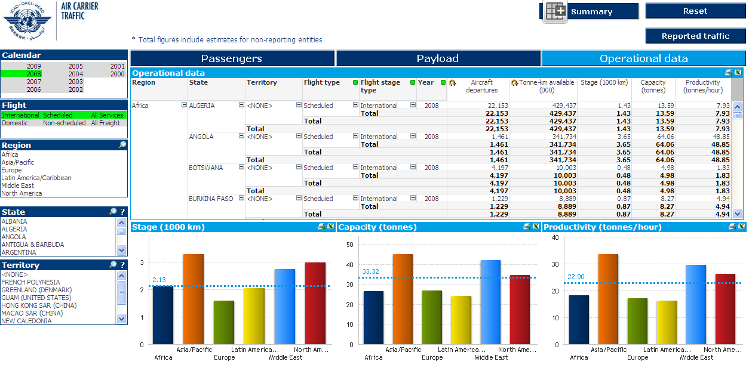
Compare regional variations

Slide 11
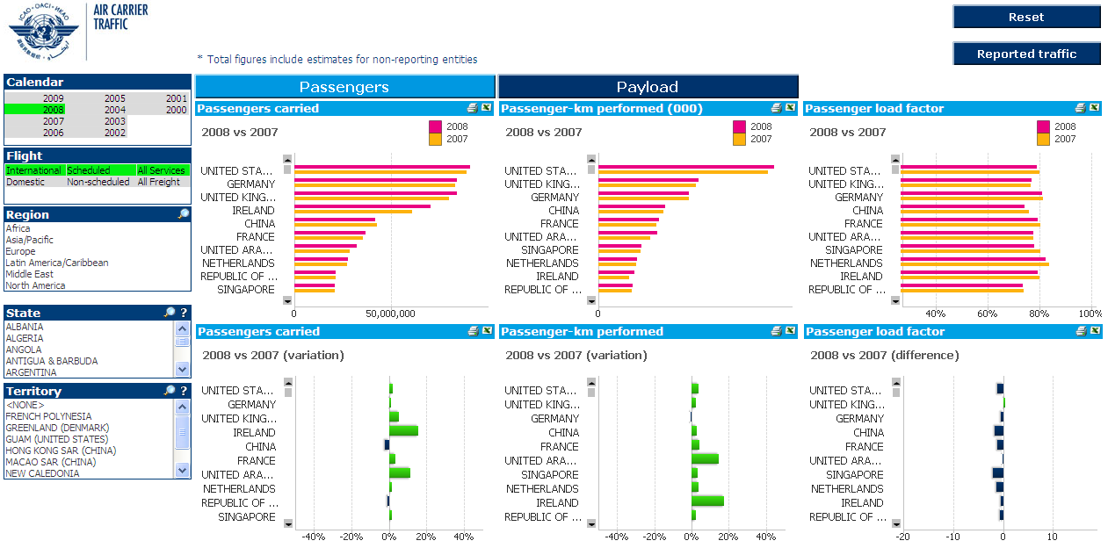
Compare traffic variations by State

Slide 12
Click on slide to continue to next Module

Slide 13

(ACT)

Slide 14
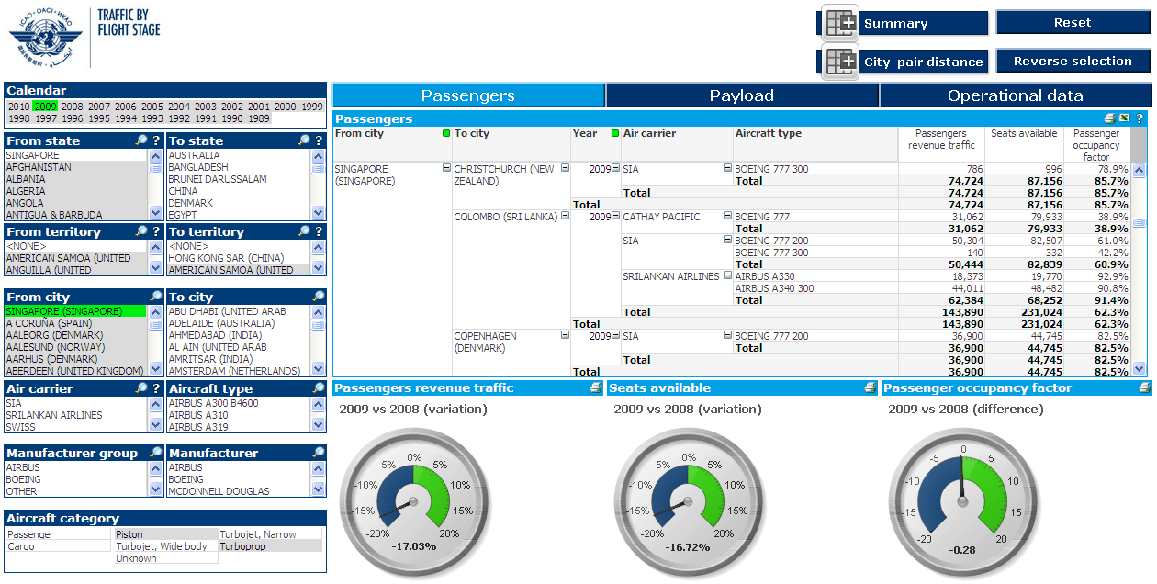
Select data by (i) city-pair

Slide 15
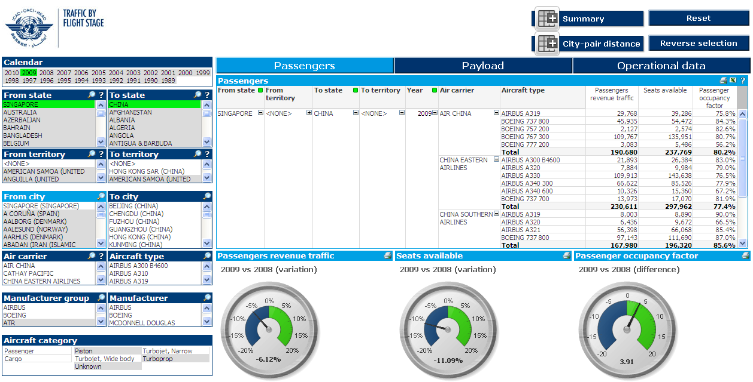
Select data by (ii) country-pair

Slide 16
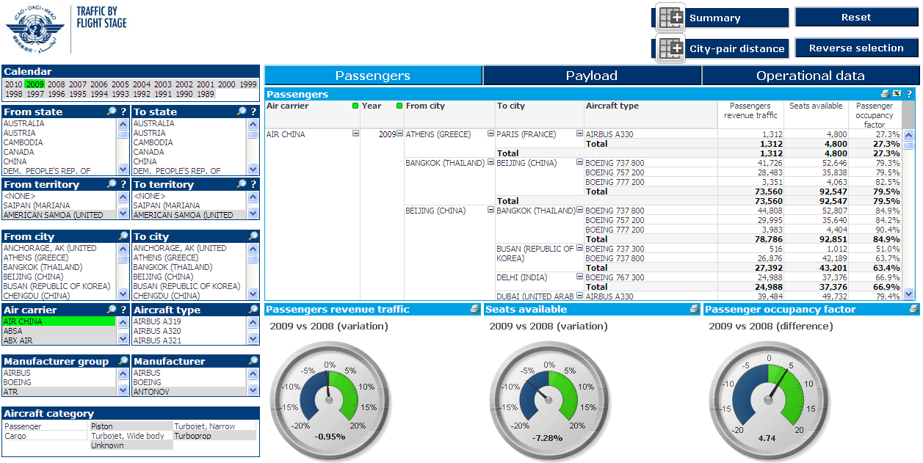
Select data by (iii) air carrier

Slide 17
Download selection into MS Excel

Slide 18
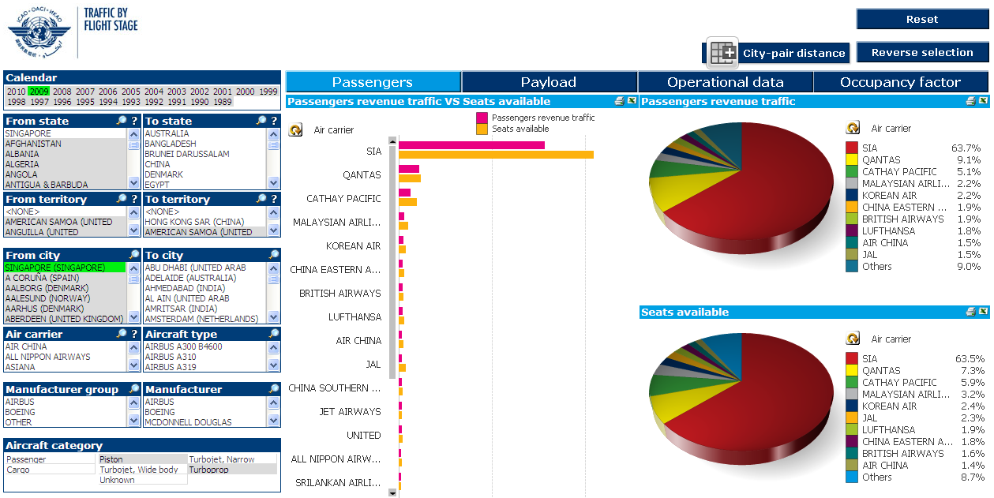
Market penetration by (i) air carrier

Slide 19
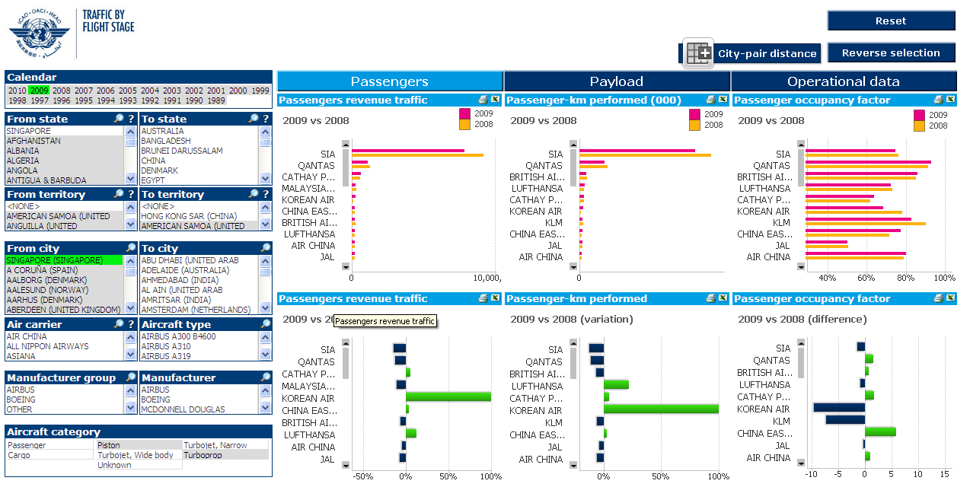
Changes in market penetration

Slide 20
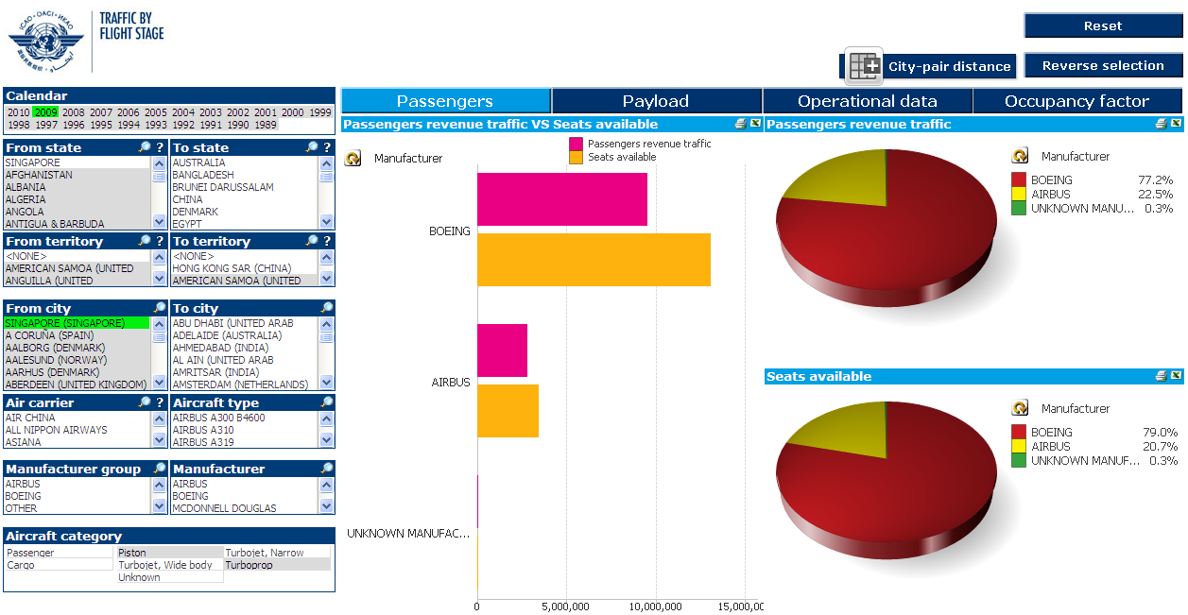
Market penetration by (ii) aircraft manufacturer

Slide 21
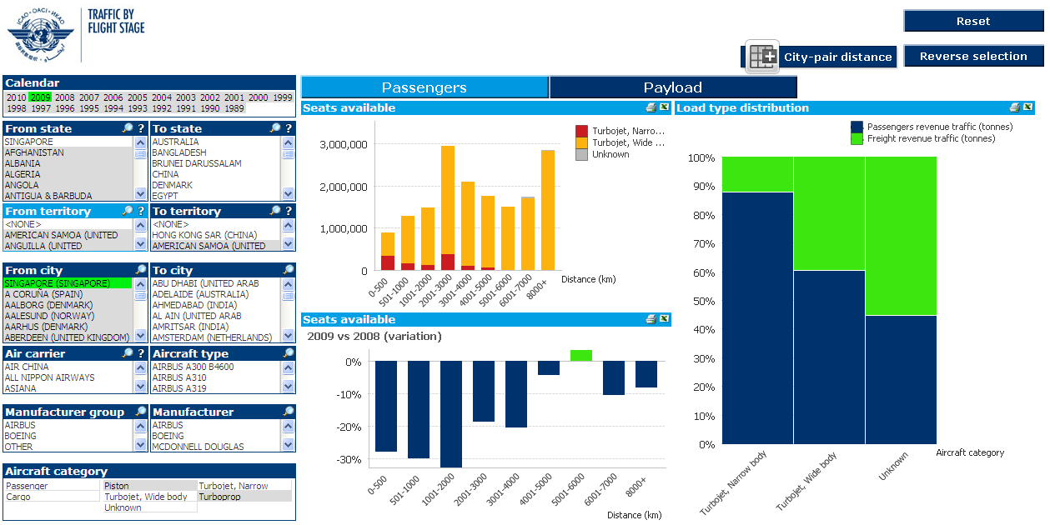
Aircraft utilization from/to a State/city

Slide 22
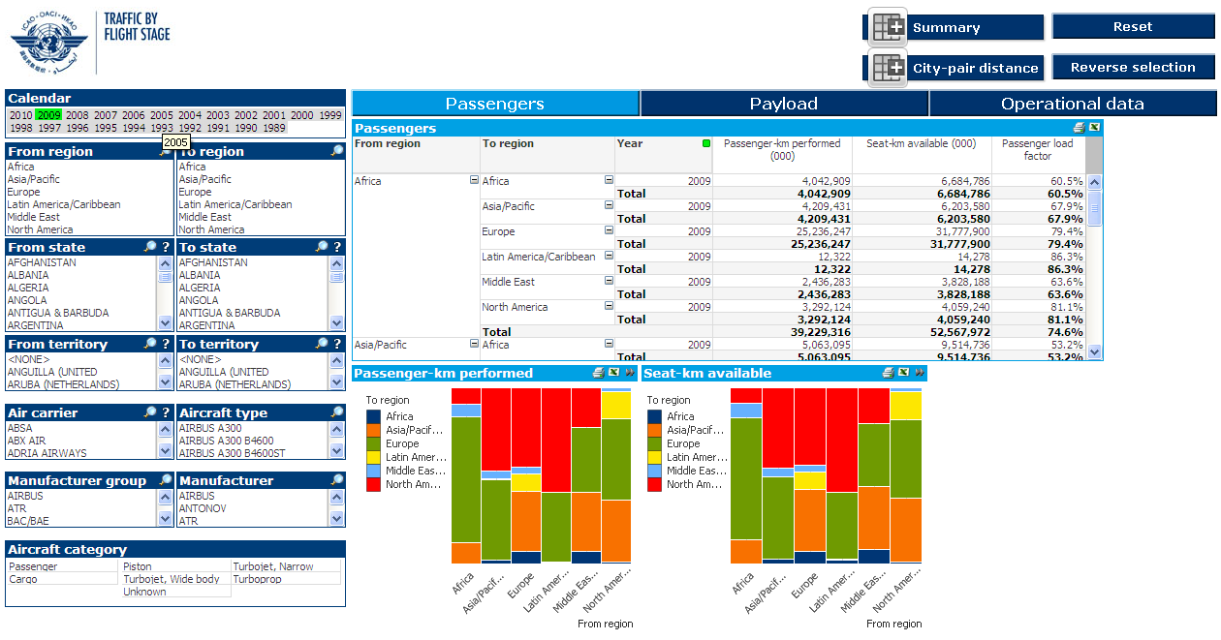
Inter-regional traffic distribution

Slide 23
Click on slide to continue to next Module

Slide 24

(ACT)

Slide 25
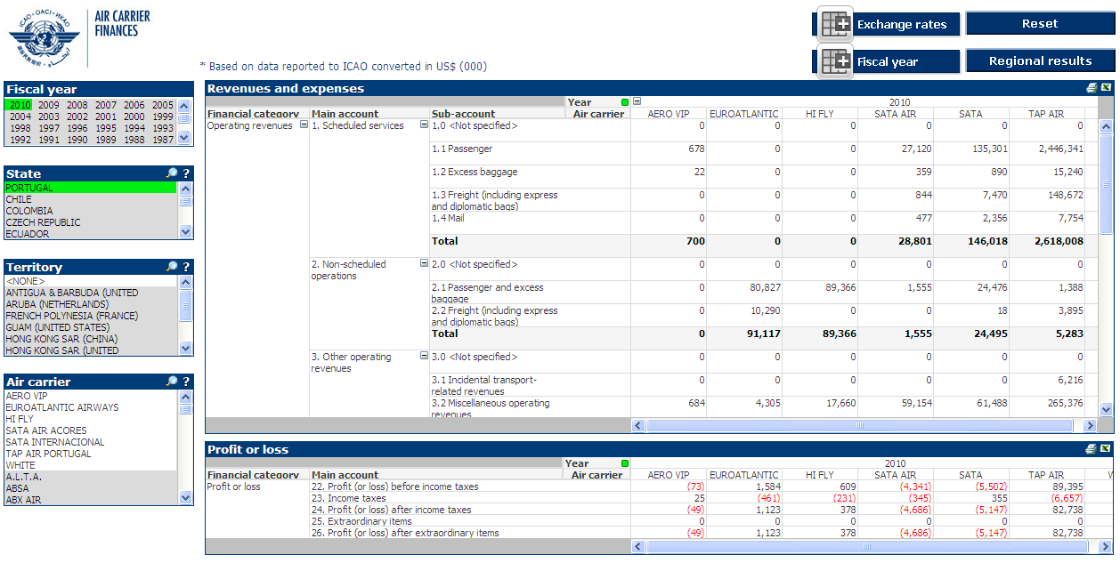
Air carriers profit and loss account

Slide 26
Download selection into MS Excel

Slide 27
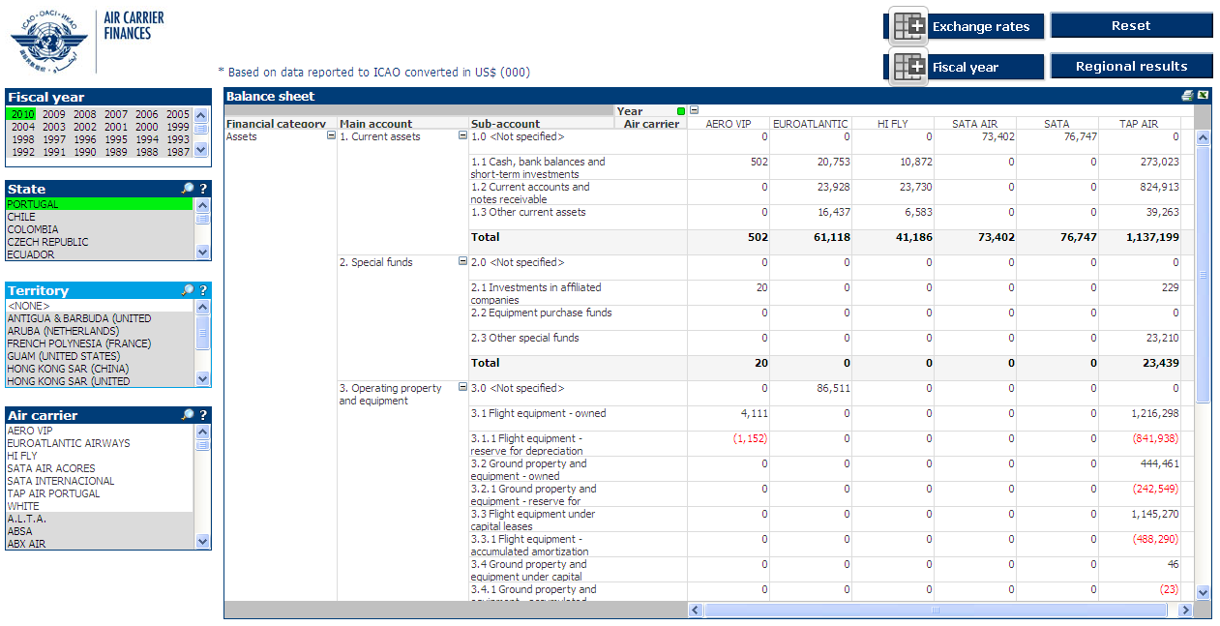
Air carriers balance sheet

Slide 28
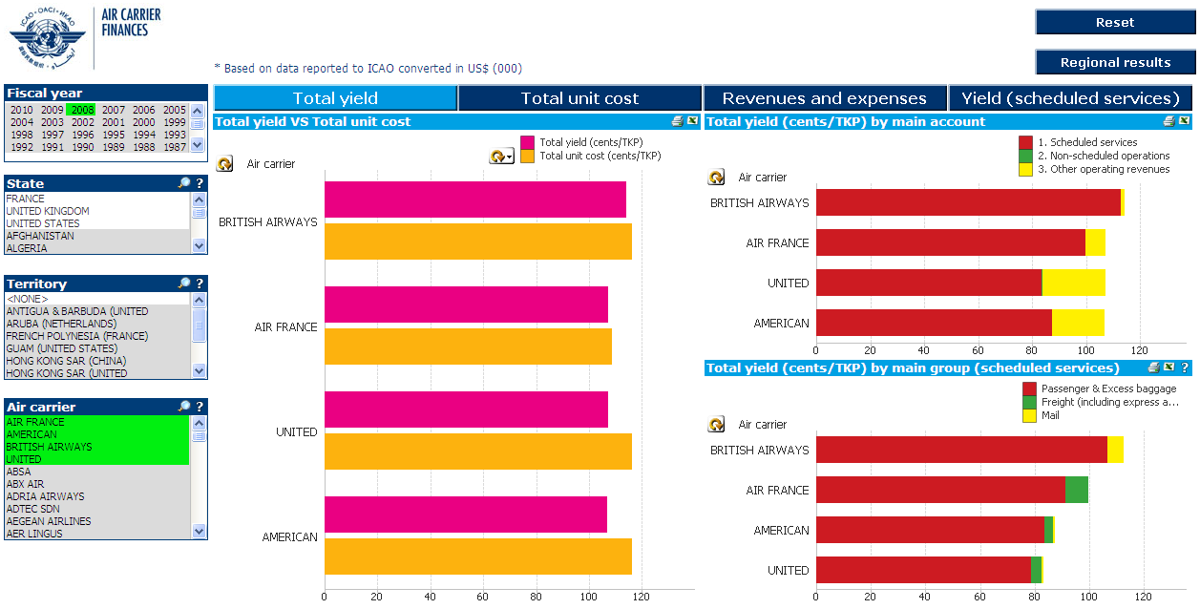
Yield comparison and breakdown

Slide 29
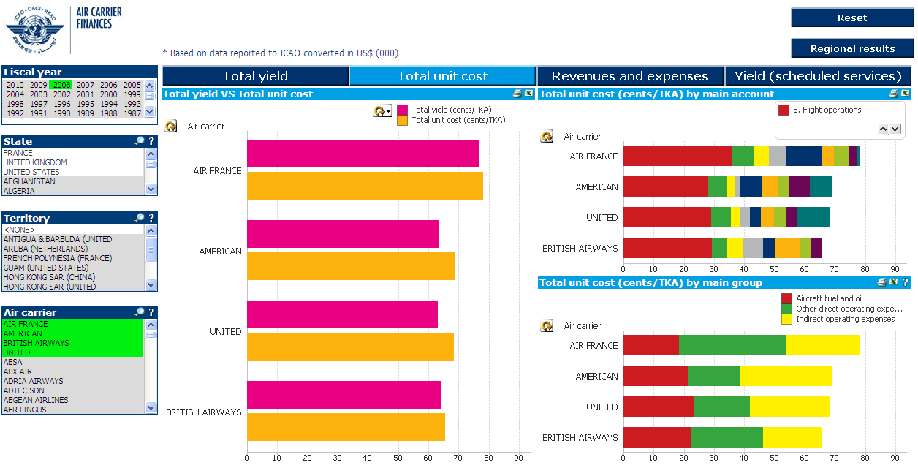
Unit cost comparison and breakdown

Slide 30
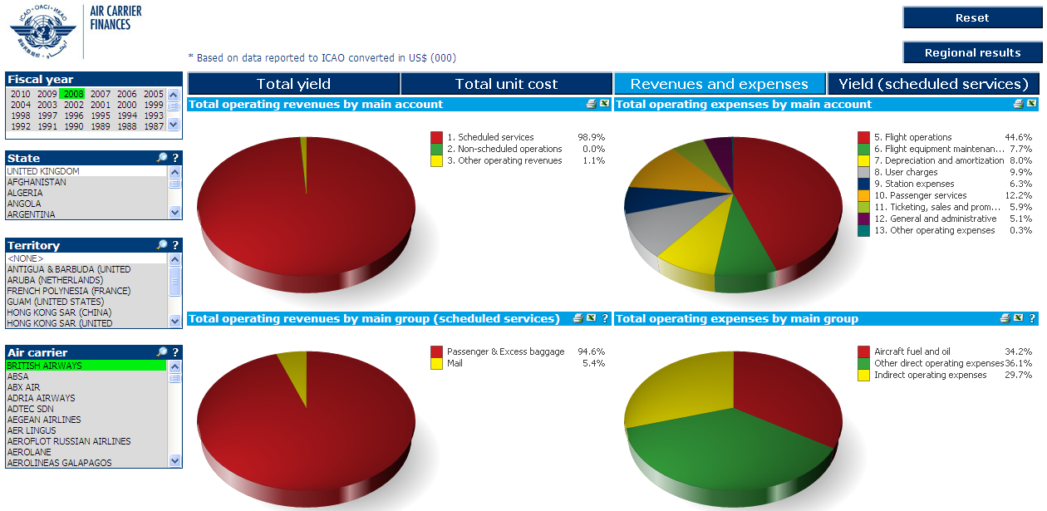
Percentage breakdown of revenues and expenses

Slide 31
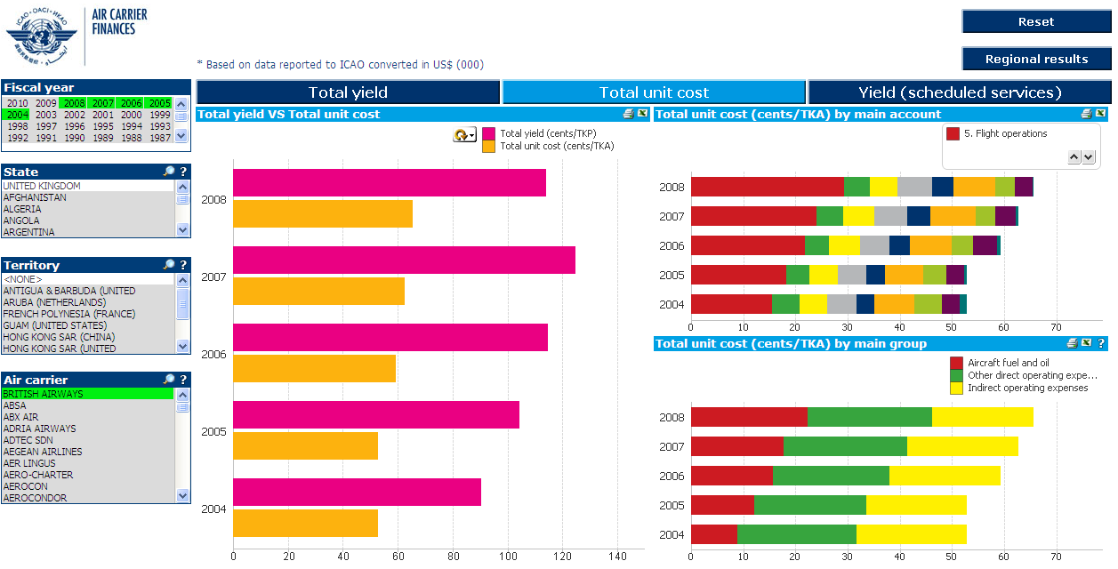
Yearly trend in yields/unit costs

Slide 32
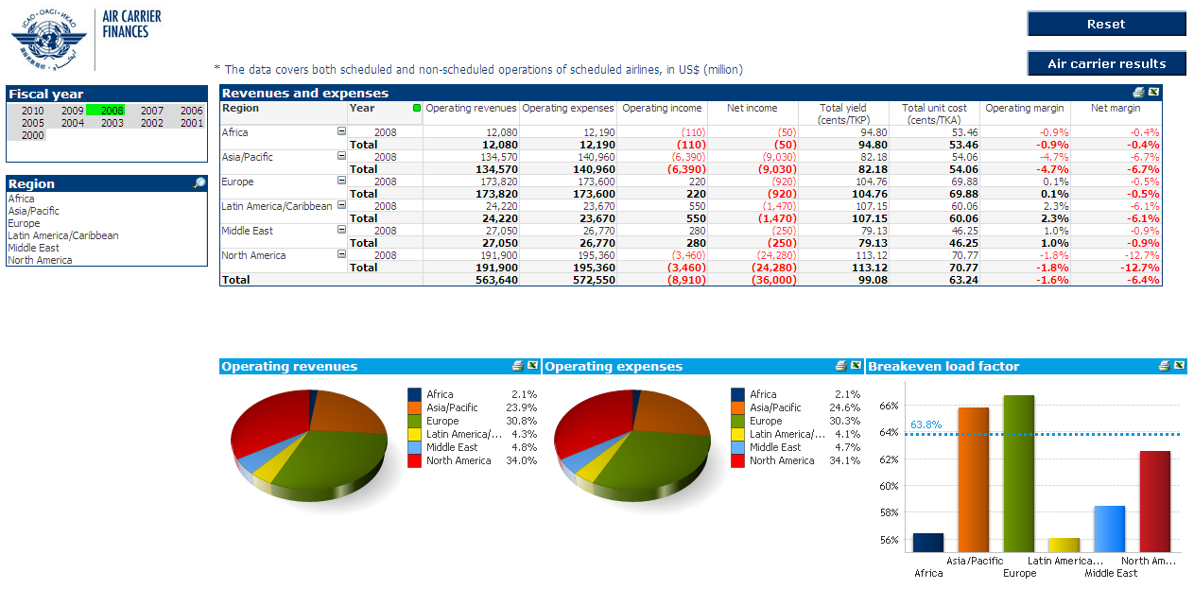
Air carrier revenues and expenses by region

Slide 33
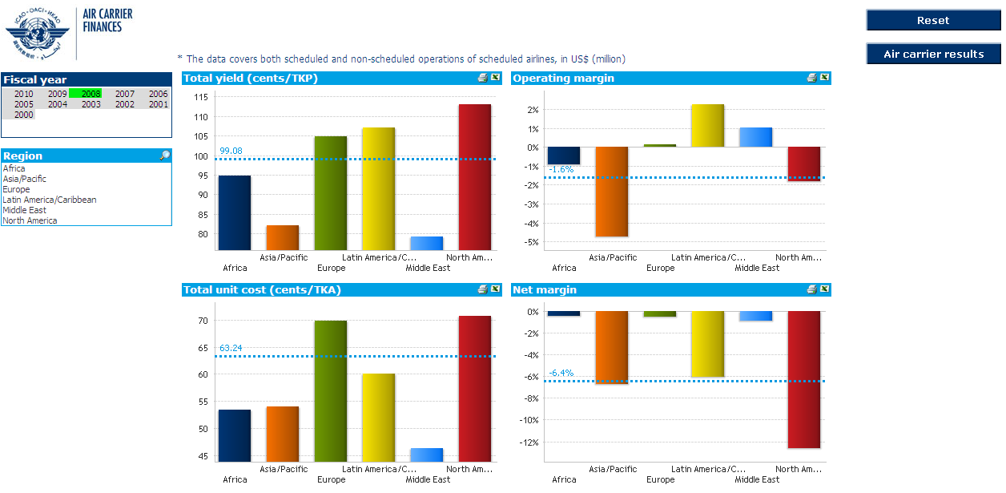
Air carrier financial results by region

Slide 34
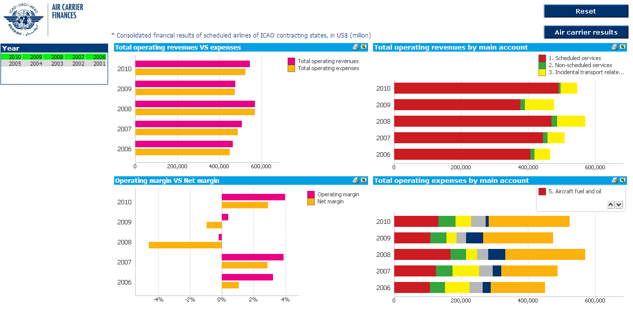
World air carrier trends in revenues and expenses

Slide 35
Click on slide to continue to next Module

Slide 36
(ACT)

Slide 37
See the monthly traffic data reported to date

Slide 38
Check the airport ranking and compare the monthly traffic development

Slide 39
Compare freight and total traffic handled

Slide 40
Compare the monthly traffic development with the previous year

Slide 41
Click on slide to continue to next Module

Slide 42
(ACT)

Slide 43
Select data by city-pair

Slide 44
…or by country-pair

Slide 45
Compare traffic within regions

Slide 46
…and between regions

Slide 47
Check the use of traffic rights

Slide 48
…or the development of cabotage within Europe

Slide 49
Click on slide to continue to next Module

Slide 50
(ACT)

Slide 51
Fleet composition by carrier

Slide 52
Fleet utilization by carrier

Slide 53
Compare air carrier aircraft utilisation by aircraft type

Slide 54
Air carrier personnel by State

Slide 55
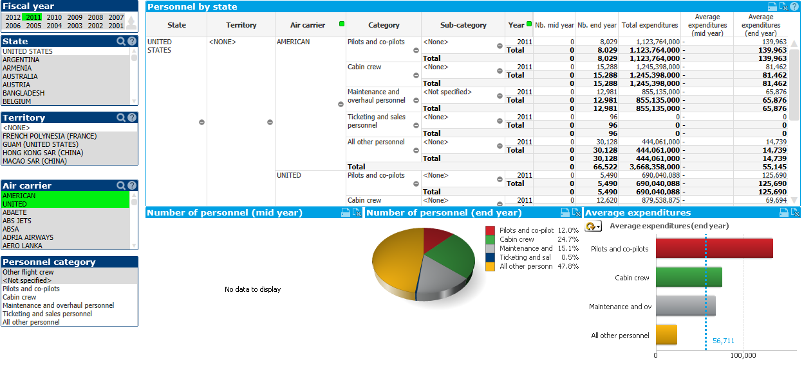
Air carrier personnel by carrier

Slide 56
Click on slide to continue to next Module

Slide 57
For any additional information
please contact
dataplus@icao.int

