Slide 1
Name of State/Territory Second Regional Meeting for National Continuous Monitoring Coordinators (NCMCs)
NCMC/2 – P/*
Presented by ***/NCMC
14 - 16 November 2017

Slide 2
NCMC/2 – P/*
CURRENT SITUATION

Slide 3
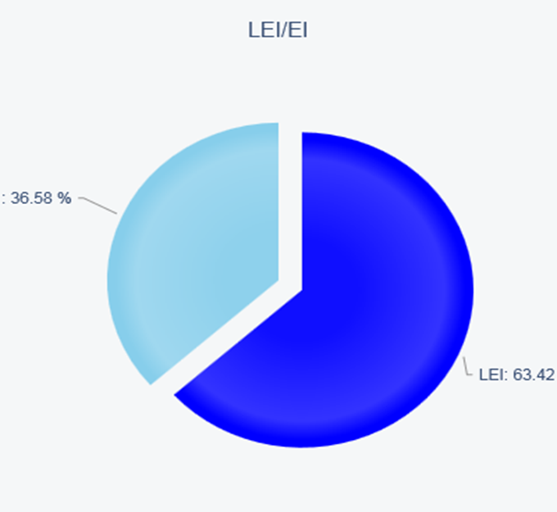
Current Effective Implementation (EI):
NCMC/2 – P/*

Slide 4
NCMC/2 – P/*
Situation of PQs by audit area

Slide 5
NCMC/2 – P/*
Situation of PQs by Critical Element (CE)

Slide 6
NCMC/2 – P/*
Situation of CAP by audit area

Slide 7
NCMC/2 – P/*
Situation of CAP by Critical Element (CE)

Slide 8
Situation of PQs by subgroups: LEG
NCMC/2 – P/*

Slide 9
NCMC/2 – P/*
Situation of PQs by subgroups: ORG

Slide 10
NCMC/2 – P/*
Situation of PQs by subgroups: PEL

Slide 11
NCMC/2 – P/*
Situation of PQs by subgroups: OPS

Slide 12
NCMC/2 – P/*
Situation of PQs by subgroups: AIR

Slide 13
NCMC/2 – P/*
Situation of PQs by subgroups: AIG

Slide 14
NCMC/2 – P/*
Situation of PQs by subgroups: ANS

Slide 15
NCMC/2 – P/*
Situation of PQs by subgroups: AGA

Slide 16
NCMC/2 – P/*
¿Questions?

Slide 17
NCMC/2 – P/*
Thank you

