Slide 1

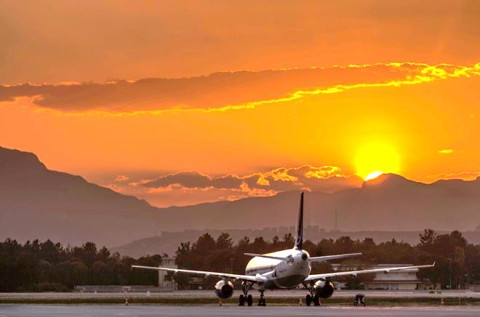
Antalya Airport - Gateway to the Turkish Riviera
Yaşar DÖNGEL ,
ICF Airports, Member of the Board of Directors
19 October 2015

Slide 2
      ICF Airports in brief
      Tourism & Aviation Relationship
      ICF Airports contribution to Antalya Tourism
      Conclusion

Slide 3
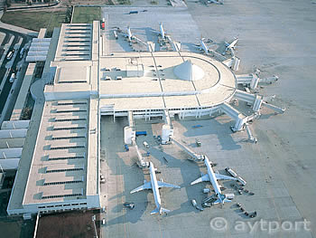
Antalya Airport privatization
ANTALYA AIRPORT
INTERNATIONAL TERMINAL PROJECT
The first PPP project in aviation sector in Turkey, privatized through Built Operate Transfer (BOT) model inaugurated in 1998.
Upon completion of BOT period, ICF Airports awarded operational rights until 2024 with a concession fee of 3.2 billion USD.
Success of Antalya project both for private and public sectors motivated and encouraged for the following PPP projects.

Slide 4



ICF Airports shareholding
50%
50%

Slide 5

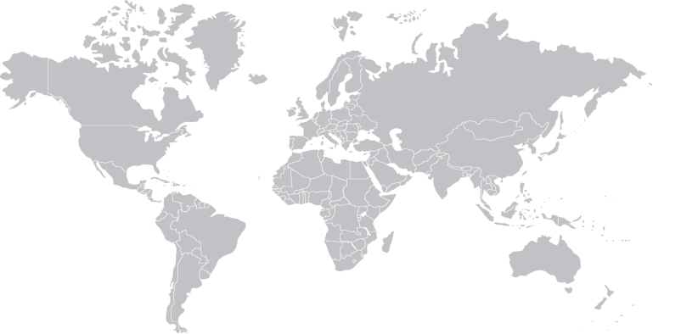
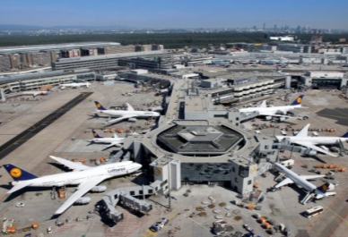

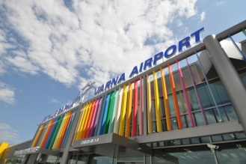
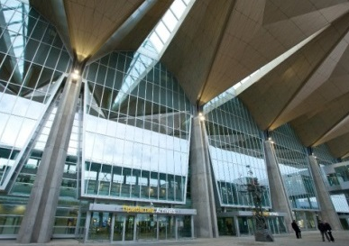
Fraport
From Asia To South America –
Fraport’s know-how is in demand around the world:
PAX 2014 (in mn.)
Frankfurt | 59,6
Delhi | 39,8
Xi'an | 29,2
Antalya | 28,0
Lima | 15,7
St. Petersburg | 14,3
Hanover | 5,3
Bourgas | 2,5
Varna | 1,4
Ljubljana | 1,3
Jeddah (06/2014) | 15,4
Riyadh (06/2014) | 10,4
Total | 222,9
ex Frankfurt | 163,3
Hanover
Ljubljana
St. Petersburg
Varna &
¹Greek Regional
Burgas
FRANKFURT
Malta
Antalya
FRANKFURT
Xi‘an
Pittsburgh
Orlando
Kairo
*
Delhi
Shanghai
Orlando
Cairo
Delhi
Hong Kong
Senegal*
Jeddah
Riyadh
¹Dakar
Lima
Lima
+ 14 Greek Reagional Airports
Airports Other Operations
Majority Stake
Minority Stake
Management Contract
(successful termination of contracts
- CAI, JED, RUH - in 2014)
¹ Operation at DKR and 14 Greek airports to start in 2015

Slide 6

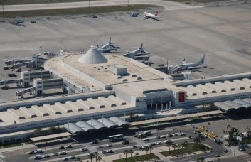
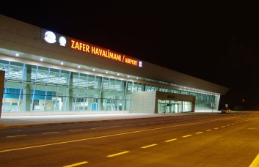


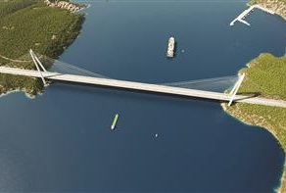
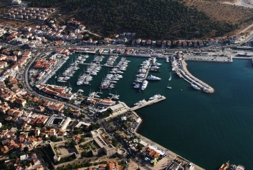
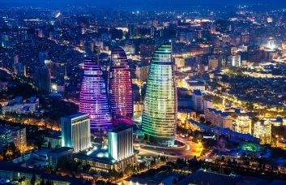

IC İctaş
IC İçtaş has 40 years experience in construction, energy, infrastructure, tourism, industry and real estate development:
Airports (Turkey):
  AYT – 2nd Runway & apron works, T2 & New Domestic Terminal
  İzmir Airport (ADB) – New International Terminal
  Or-Gi Airport (OGU), Ordu-Giresun
  Zafer International Airport (KZR), Afyon-Kütahya-Uşak
Hotels (Turkey):
  IC Green Palace, IC Santai, IC Airport, Antalya
  Bomonti Hilton Hotel Project, İstanbul
Ports, Bridges, Railway & Energy (Turkey & Russia):
  Sea Port in Güllük, Bodrum & Karasu Port, Sakarya (Turkey)
  Çeşme Marina, Izmir (Turkey)
  Ankara-IIstanbul High Speed Railway Project (Turkey)
  Istanbul 3rd Bridge (Turkey)
  12 HEPP (Hydroelectric Power Plant) Projects (Turkey)
  2 Thermal Power Plants in Muğla, Turkey
  Northern Highway (Russia)
Real Estate Development (Turkey & Azerbaijan):
  Bilkent Integrated Health Campus, Ankara (Turkey)
  Haydar Aliyev Business Center, Baku (Azerbaijan)
  Flame Towers, Baku (Azerbaijan)

Slide 7
      ICF Airports in brief
      Tourism & Aviation Relationship
      ICF Airports contribution to Antalya Tourism
      Conclusion

Slide 8





Air Transport Mode
Air transport is the dominant travel mode in international tourism - a reciprocal relationship
Marketshare %
1.1 b
37 m
12 m
98%
73%
>50%
W
TR
AYT

Slide 9
Passenger Growth in AYT
Double digit annual growth rate 1999-2014
mPPA
Int’l % 11,8
Dom % 15,4
Total % 12,4

Slide 10
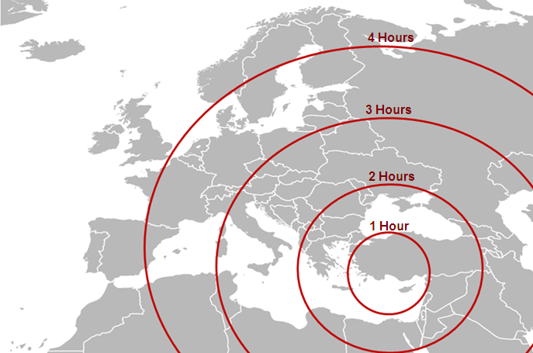
Antalya Airport Range
Source: Google Maps

Slide 11
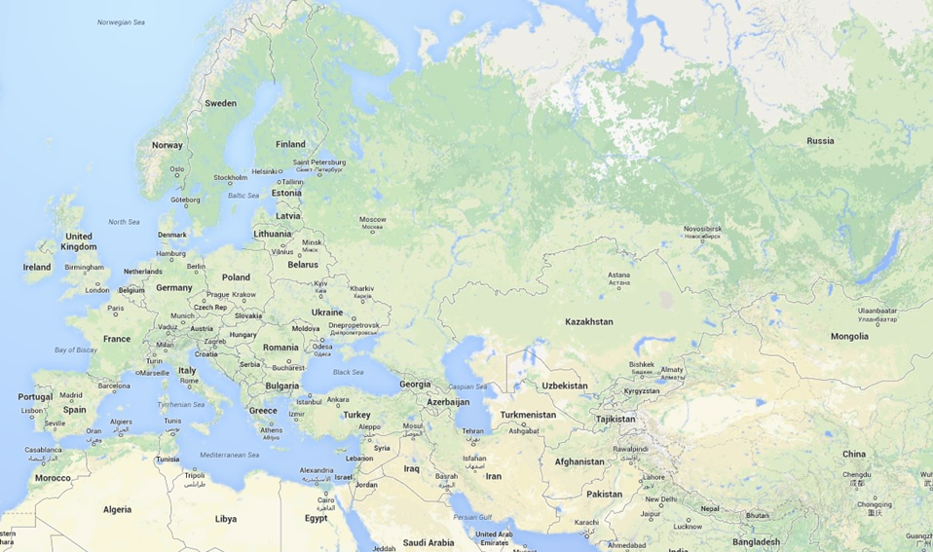
From Antalya Airport...
...to 286 Destinations...
...in 63 Countries...
...with more than 125 Airlines...
...continuously growing...
Antalya
Source: Google Maps

Slide 12
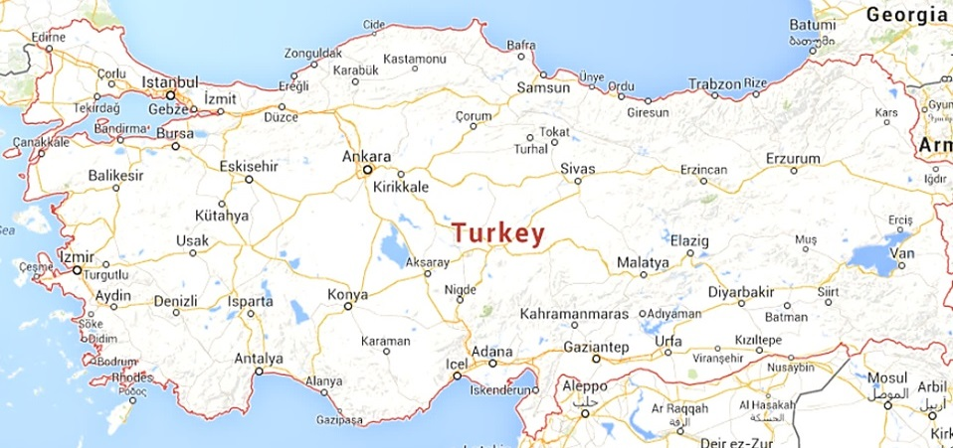
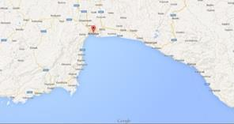
Major Airports in Turkey
Istanbul IST
Airports | 2014 (m pax)
1. Istanbul Ataturk (IST) | 57.0
2. Antalya (AYT) | 28.0
3. Istanbul (SAW) | 23.5
4. Ankara (ESB) | 11.0
5. Izmir (ADB) | 11.0
6. Adana (ADA) | 4.7
7. Dalaman (DLM) | 4.3
8. Bodrum (BJV) | 3.9
Palma de Mallorca (PMI) | 23.1
Istanbul SAW
ANKARA
Izmir
Bodrum
Antalya
Adana
Dalaman
Antalya Airport is the 2nd biggest airport in Turkey,
1st in international tourist arrivals
...and the biggest tourist
destination in the Mediterranean basin.
Antalya
Belek
Manavgat
Kundu
Side
Kemer
Alanya
Tekirova
Kaş
Turkish Riviera
Source: DHMII, www.estadisticasaena.es; ICF internal data for AYT pax

Slide 13
Antalya Airport in Europe
Airports | 2014 (m pax)
1. London Heathrow (LHR) | 73.4
2. Paris (CDG) | 63.8
3. Frankfurt (FRA) | 59.6
4. Istanbul (IST ) | 56.9
5. Amstersdam (AMS) | 54.9
6. Madrid (MAD) | 41.8
7. Munich (MUC) | 39.7
8. Rome (FCO) | 38.5
9. London Gatwick(LGW) | 38.1
10. Barcelona (BCN) | 37.6
11. Moscow (DME) | 33.0
12. Moscow (SVO) | 31.6
13. Paris (ORY) | 28.9
14. Antalya (AYT) | 28.0
Antalya Airport is the 14th
biggest airport in Europe in 2014 in terms of total pax
Source: ACI; ICF internal data for AYT pax
Notes:
13

Slide 14
Antalya Airport in the World
Airports | 2014 (m pax)
1. Atlanta (ATL) | 96.2
2. Beijing (PEK) | 86.1
3. London Heathrow (LHR) | 73.4
4. Tokyo Int. (HND) | 72.8
5. Los angeles (LAX) | 70.7
6. Dubai (DXB) | 70.5
7. Chicago (ORD) | 70.1
8. Paris (CDG) | 63.8
9. Hong Kong (HKG) | 63.4
10. Dallas (DFW) | 62.9
11. Frankfurt (FRA) | 59.6
13. Istanbul (IST) | 56.9
...
56. Antalya (AYT) | 28.0
Antalya Airport is the 56th
biggest airport in the World in 2014 in terms of total pax
(In 2013, AYT rank for 58th)
Source: ACI; ICF internal data for AYT pax

Slide 15
      ICF Airports in brief
      Tourism & Aviation Relationship
      ICF Airports contribution to Antalya Tourism
      Conclusion

Slide 16

Route Development
New Airlines
Existing Airlines
+New Destinations
Existing Airlines,
Existing Destinations
+ Additional frequencies

Slide 17
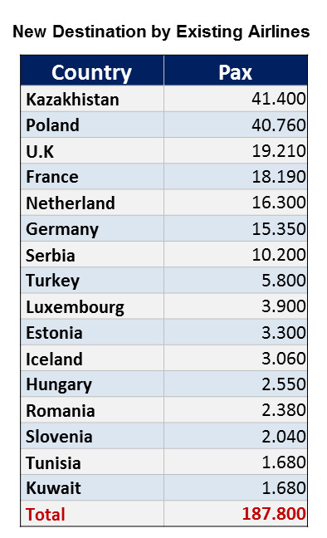
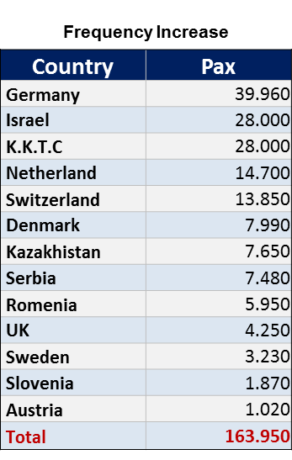
Route Development
Almost 400.000 additional passenger achieved in 2015
New Airlines
Country | Pax
U.K | 37.070
Switzerland | 7.770
Total | 44.840

Slide 18
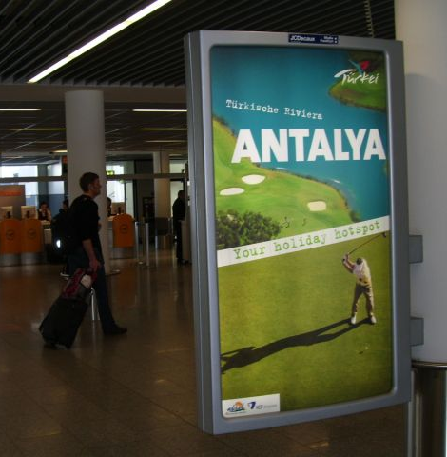

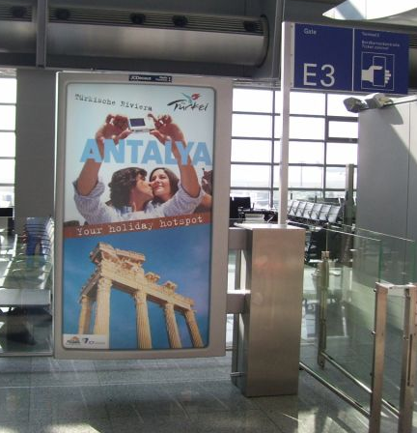
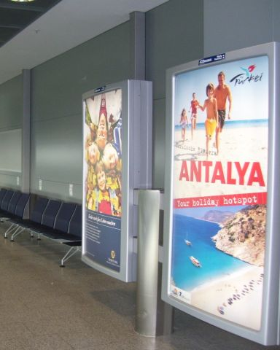
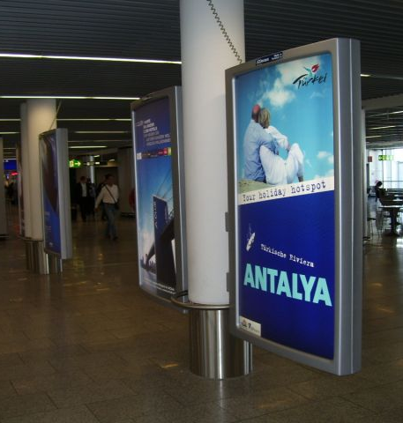
Promotion of Antalya Destination
Advertisement campaigns
in Frankfurt Airport Terminals

Slide 19
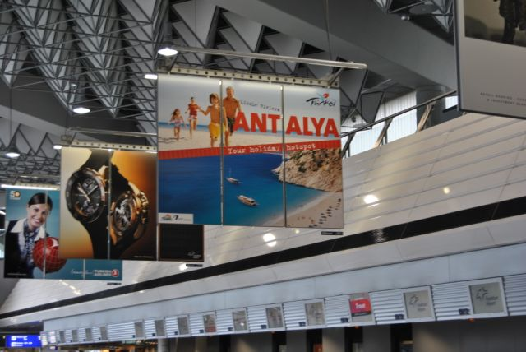
Promotion of Antalya Destination

Slide 20
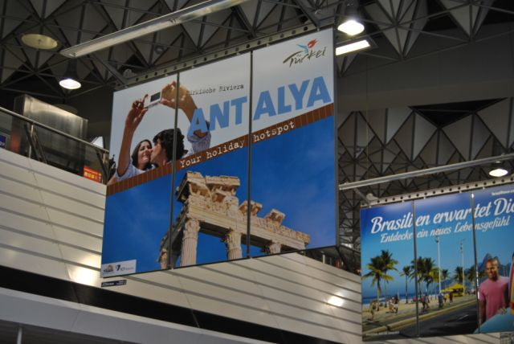
Promotion of Antalya Destination

Slide 21

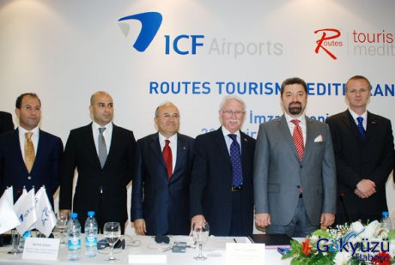
Bridging Aviation and Tourism Sectors
First Ever Routes Tourism Mediterranean event held in Antalya, hosted by ICF Airports

Slide 22




Environment Friendly Airport
ACI - Airport Carbon Accreditation for Level 3+ (Neutrality) (One of the first two airports in Turkey and one of 20 airports in Europe accredited for Level 3+)
Green Airport Company
Certification by Turkish Civil Aviation Authority

Slide 23

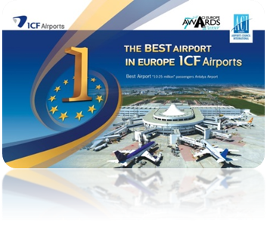
Best Airport in Europe
Best Airport in Europe 2011
in “10-25 million passenger” category

Slide 24
      ICF Airports in brief
      Tourism & Aviation Relationship
      ICF Airports contribution to Antalya Tourism
      Conclusion

Slide 25
Conclusion
The relationship between tourism and aviation is mutually reinforcing and interdependent .
Policy and decision makers of both sectors have to work closely together.
ICF Airports is committed to continue supporting the sustainable development of aviation and tourism sectors in Antalya.

Slide 26

THANK YOU
FOR YOUR ATTENTION

