Slide 1
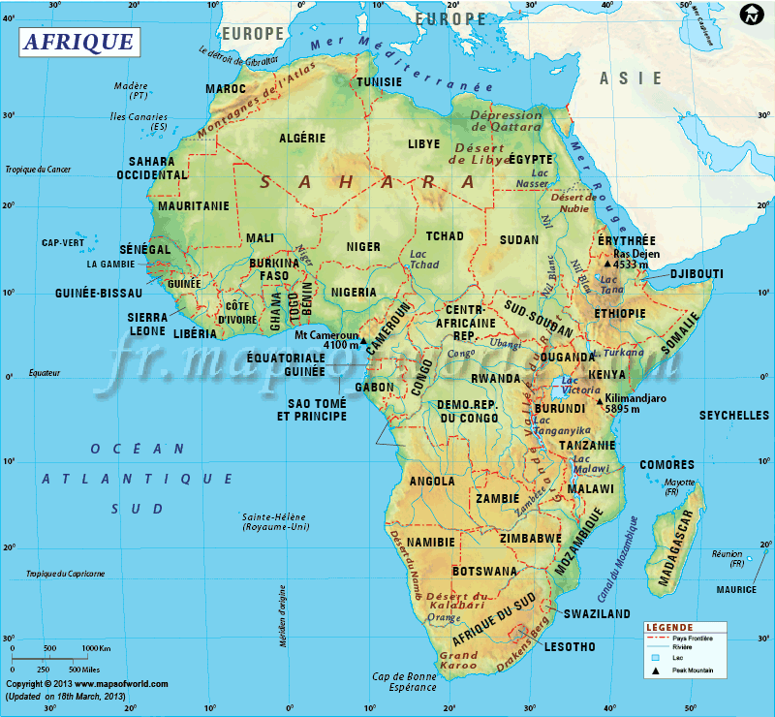
African
Flight Procedure Programme
Concept of Operations
AFRICA
Frédéric Legrand - AFPP Programme Manager - 20 November 2014
Notes:
AFI overview and objectives

Slide 2
Presentation Outline
PBN mature concept
Documentation framework
Level of implementation in Africa
Priorities for Africa
What is needed for Africa?
The African Flight Procedure Programme
Summary and Next Steps

Slide 3

The PBN Concept is Mature
ANC 2004: RNP to PBN concept
2007: ICAO, PBN concept Manual
Today:
Aircraft equipage
State procedure design capability
Procedures implemented

Slide 4
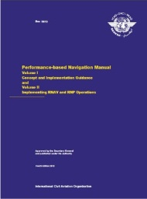
Documentation Framework
PANS Ops Volume II
PBN Manual (Doc 9613) 4th Edition
RNP AR Procedure Design Manual (Doc 9905)
PBN Ops Approval Manual (Doc 9997)
Manual on Use of PBN in Airspace Design (Doc 9992)
CDO Manual (Doc 9931)
CCO Manual (Doc 9993
GNSS Manual (Doc 9849)
Procedure QA Manual (Vol 1 to Vol 6)
(Doc 9906)
4th Edition

Slide 5

What level of implementation for Africa?

Slide 6
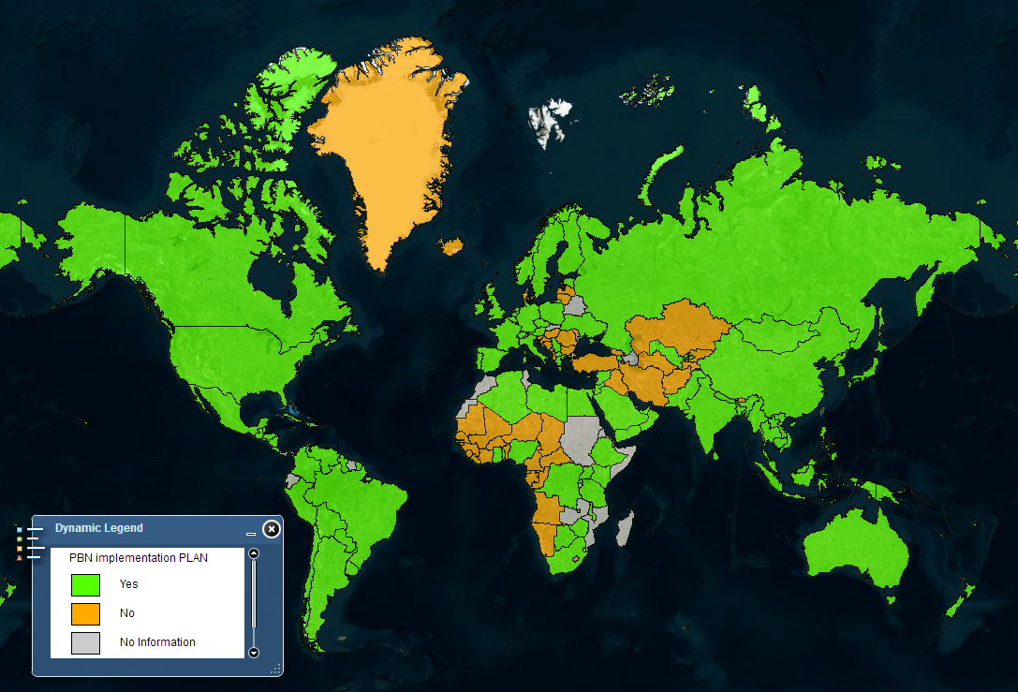
PBN Implementation Plan

Slide 7
National PBN Implementation Plan
Algeria
Egypt
Libya
Nile
Capo Verde
Senegal
Togo
Nigeria
Ethiopia
Ghana
Uganda
Kenya
0°
Seychelles
DRC
Rwanda
Yes
Tanzania
Comoros
No
No information
Mauritius
Mozambique
Madagascar
Reunion
20°
20°
Submitted in 2014
Botswana
Swaziland

Slide 8
National PBN Implementation Plan
2010 Assembly Resolution A37-11 on PBN Implementation
RNP Approach (APV)
% 0f Countries meeting Target

Slide 9
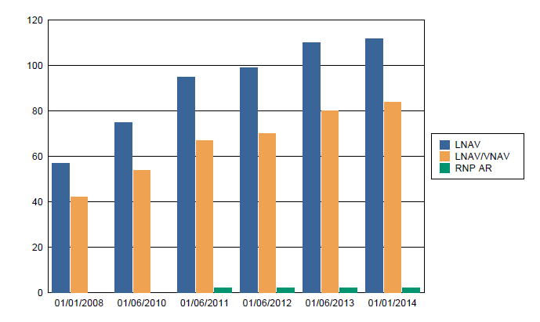
National PBN Implementation Plan
African REGION – PBN Instrument Approaches

Slide 10
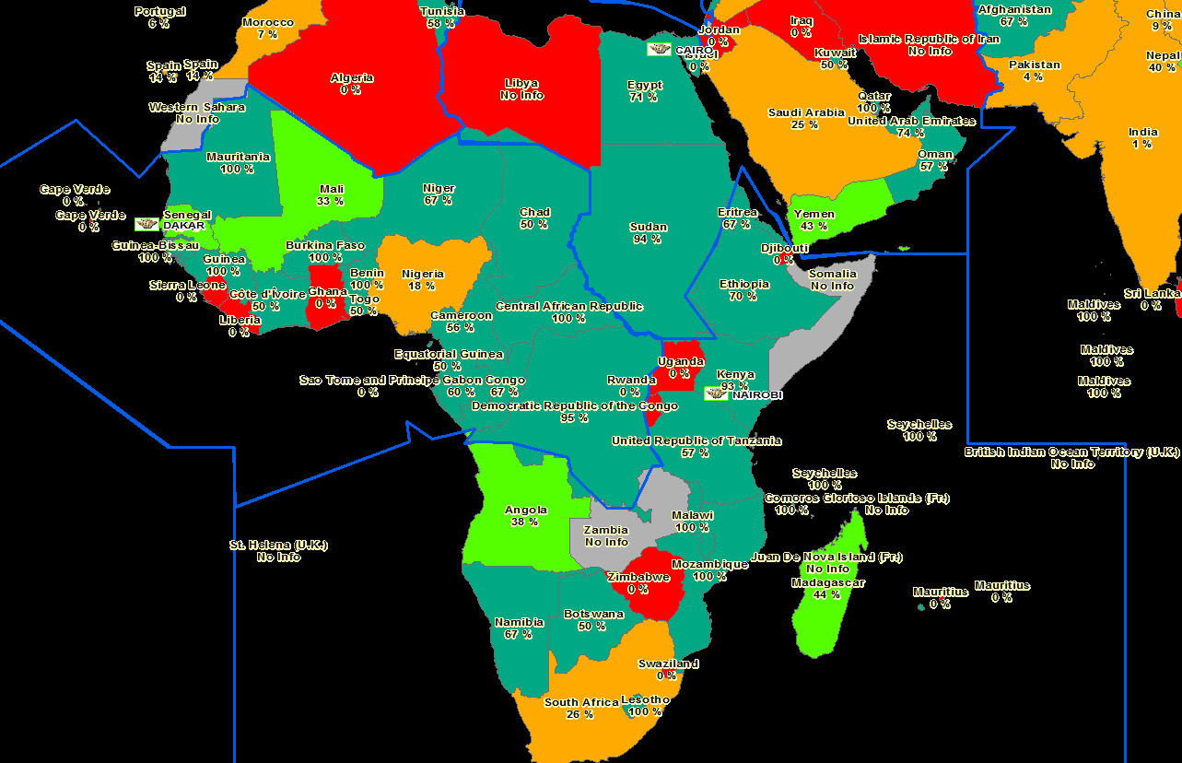
PBN Procedures Implementation

Slide 11

Priorities for Africa
Improve Safety of Approach Operations
  Implement PBN instrument approach procedures to meet A37-11 timelines
Improve efficiency of flight paths
  Airspace optimization
  Properly connecting En Route-to-TMA
  Enable CDO/CCO operation
  Starting Point
  Complete State PBN Implementation Plans where required

Slide 12
What is needed?

Slide 13
African States must have:
A regional, sustainable solution for:
PBN and IFP Procedure Design Capability
Regulatory capability to approve IFP’s
Proper PBN Ops Approval Process
Efficient integration of PBN into African airspace infrastructure

Slide 14
How?

Slide 15
Flight Procedure Programme (FPP)
“the Regional Centre of Excellence in procedure/airspace implementation, focusing on PBN”
To provide
  training in PBN FPD Implementation, based on Doc 9906 (Quality Assurance)
    Necessary Capability building for States and other stakeholders for sustainable development
    Training for FPD service implementation
  Direct design and implementation support as needed

Slide 16

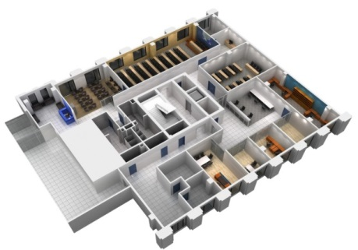
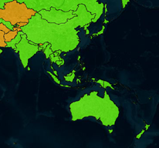
Flight Procedure Programme (FPP)
Based on a proven solution
Asia and Pacific FPP
  Operations since 2009 in Beijing, China
  20+ Member States and increasing
  Conducted training for more than 1000 participants from 20+ States
  On-going supports for PBN implementation projects/ capability building in more than 15 States
APAC FPP

Slide 17
An African FPP customized for Africa by Africa
Supported by the AFI RAN in 2008
Re-energized at the recent Assembly Resolution A38-7 (2013):
  “States are urged to support the establishment of the AFI Flight Procedures Programme (FPP) Office with seconded personnel and financial assistance as a matter of urgency to expedite the implementation of PBN in the region.”

Slide 18
An African FPP customized for Africa by Africa
Formula:
  Run by ICAO WACAF/ESAF
  Seconded Personnel from ESAF and WACAF areas
  Contributions from States and Donors
  Governed by African Steering Committee

Slide 19

African FPP
What was needed:
  Go/ No-Go by 15 May 2014
    Contractual Agreement (Programme Document)
      to be signed 27 May 2014 at AFI Aviation Safety Symposium
      Initial personnel, seconded from ASECNA
    Office facility operational
    Commitments from minimum 5 States
  19 African States signed
An African FPP customized for Africa by Africa

Slide 20
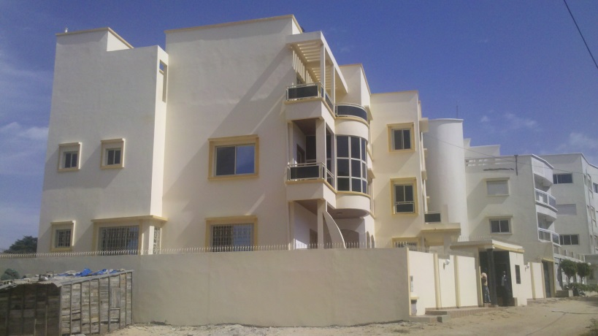
African FPP
Opened for business - 2 June 2014
Initial 3-year duration, renewable
Dakar, Senegal, hosted by ASECNA
Dakar
WACAF
An African FPP customized for Africa by Africa

Slide 21
Now?

Slide 22
African FPP
Management
  Manager
  Team composed of experts from African States in the PBN domains
Support
  ICAO Regional Offices ESAF and WACAF, ATM ROs
African States participation
  Experts seconded
  Funding the Programme
Implementation
  AFPP will propose and participate including guidance
  The States will organize the final implementation
Donors
  France, ASECNA
  AIRBUS
  AFCAC
An African FPP customized for Africa by Africa

