Slide 1
Global Update
Seychelles
Feb 2012
Tom Brady
Air Navigation Bureau
2012 Flight plan implementation status

Slide 2
Topics
Implementation Key dates
Implementation support
Regional progress
Stakeholder position
Issues and Concerns
Next Steps

Slide 3
Key Dates of the Flight Plan Changes
Approval Phase. Complete
Impact assessment.
and requirements Phase. Complete
Solution production Phase. Complete
Solution delivery
and on-site testing. 1 Jan 2012 -31 March 2012
Transition into
operations. 1 April 2012- 30 June 2012
Airspace user implementation. 1 July2012-15 Nov 2012
NEW only ICAO Flight plan. Post 15 Nov 2012

Slide 4
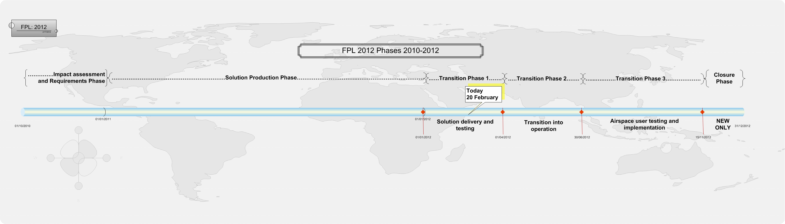

Slide 5
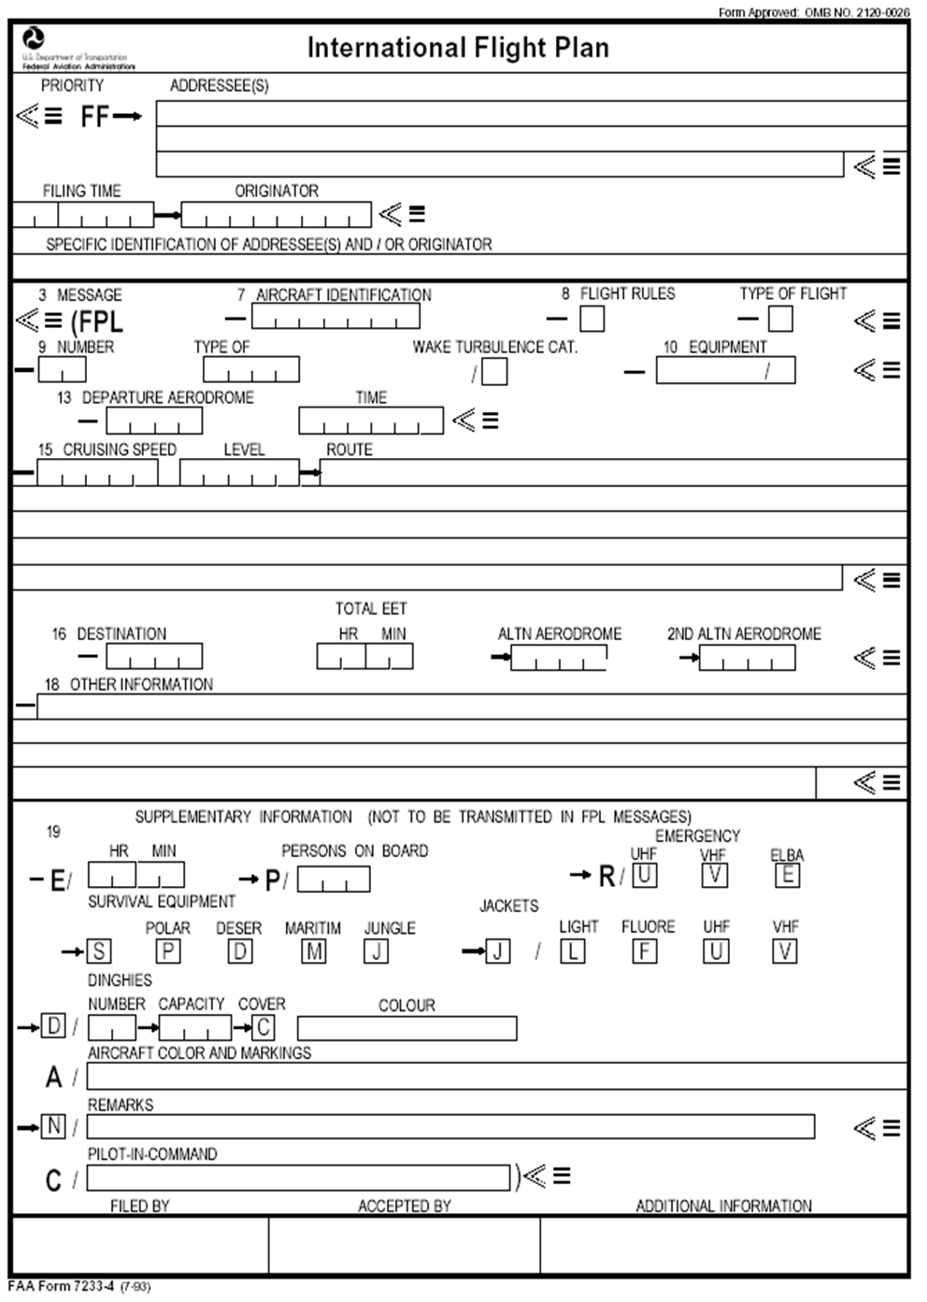
ICAO Flight Plan Form

Slide 6
Implementation support
ICAO Regional offices continue to facilitate seminars, Workshops and Task Force meetings.
The advanced, more detailed Seminars are now complete.
ICAO Regional offices continue to encourage States to provide updates on their implementation progress.
Many States are actively supporting other States.
IATA ,CANSO,ACAC, ASECNA and many other representative bodies are working closely with and providing support to ICAO
Global and regional Vendors are attending all seminars and workshops and the recent conference in Scotland harmonised many of the outstanding differences.

Slide 7
ICAO Regional Progress
All ICAO regions continue to work towards the ICAO timeline for Implementation and Transition.
All States are aware of the project although not all are implementing at the required rate.
Most of the ANSPs will be ready to accept filing of both NEW and PRESENT flight plans from 1 July 2012.
ANSPs unable to accept the NEW Flight Plan from 1 July 2012 may mean a reduced opportunity for Airlines to test.
It has been estimated that in October 2011 only 25% of States had agreed contracts with Vendors, many others were in the tender phase.
States who have manual only capability have received guidance from ICAO and should have no trouble in receiving the NEW flight plan so long as they plan their training.

Slide 8
Stakeholder Position
ICAO HQ and the Regional Offices working closely with aviation representatives and system suppliers.
IATA being regularly briefed and a good exchange of information between ICAO and IATA.
ASECNA, ACAC, EUROCONTROL, CANSO and many others are facilitating meetings and encouraging their States to report their implementation status.
Vendors and system providers are being encouraged to attend seminars and workshops.
More effort is required to ensure other stakeholders such as business, military and general aviation are aware of the impact.

Slide 9
Issues and Concerns
Some ICAO States are still behind the implementation schedule.
Not enough States are signing contracts with their suppliers.
Many States are favoring the “convertor” solution.
Some States are not providing their updated implementation progress to ICAO regional offices for entry into the FITS database.
Lack of contact with some States leads us to believe they are not making sufficient progress.
Maintaining a harmonized implementation of the FPL changes.
Maintaining a harmonized interpretation and application of the FPL changes

Slide 10
Next Steps
Maintain a high profile awareness of the impending changes.
Encourage States to provide the financial resources needed to sign contracts.
Distribute harmonized global guidance as an output from Vendors conference In Scotland 7-8 December.
Identify those states which require support.
Make use of the Strategic Support Team(SST), with the help of other stakeholders, to assist those States who are having difficulty in achieving the implementation timescales.
Identify States who will not be ready by the 15 November 2012
Commence contingency planning.

Slide 11
Questions Please!
Implementation Key dates
Implementation support
Regional progress
Stakeholder position
Issues and Concerns
Next steps
Tom Brady

