Slide 1
5GHz Band Planning for RPAS CNPC
Update on Work in Progress
EUROCAE WG 73 SG3
C3 and Communications Security
Alistair Munro, Airbus DS
ICAO FSMP-WG-F Meeting 33,
25th – 28th August 2015
Montreal, QC, Canada

Slide 2
WG73 (Progress) Update
Vision, strategy and tactics – no shortage of these
  EASA “CONOPS” – 3-pillar approach to categorising RPAS
  European RPAS roadmap
    Who owns it, is it realistic, is it relevant when there are novel approaches (Google, Amazon)?
    Can it be delivered? Is there funding?
  Terms of Reference
    New vision for the small/medium mass RPAS world
      Roadmap for unregulated RPAS
      Still VLL and < 500’? – probably not
    Large ones are still important - MALE2020
Airworthiness (SG1)
  Constructive coordination with JARUS WG7 on AMC-RPAS.1309,
  EASA consultations: SC.RPAS.1309 (CS-VLA), A-NPA for drones
Ops (SG2)
  CA OSED – but alignment with SC-228 not clear

Slide 3
WG73 C3 Group – Progress Update
C3
  C3 CONOPS - minimum baseline, needs elaboration (ER-012)
  C2 RCP Concept finalised (ER-013)
  JARUS WG5 consultation on use of CPDLC by RPAS
C2
  Follow SC-228 – use C2 MOPS as the bottom up baseline
    V1.0 LOS proposals are probably acceptable but need tuning
    Focus on BLOS
  But still need the top-down analysis - MASPS and all the other DO-264 deliverables
    CONOPS and RCP are still the main issues
Security
  Product + operations + accreditation
  Coordination between WG72 (SC-216), SC-228, ICAO RPASP+AVSECP+ACP
  Impact on spectrum management

Slide 4
RCP Concept – What Next?
WG73 “C2 RCP Concept and Methodology” is a companion to JARUS WG5 “Guidance on RPAS C2 link RCP”
  Recognises that there are different types of RPAS and many types of operation
Applying the method will give a limited range of RCP types specific to RPAS for C2 and ATC voice/data – select the most demanding
But what to apply the method to? And how?
  Is there a standard C2 protocol? (No – but yes for voice)
    SC-228 C2 MOPS analysis based on STANAG 4586
    Other options – CoAP, MQTT?
  Is there consensus on RPAS communications architecture? (Yes and no)
Lesson learned: basic services are more complex, data rates and traffic density are higher, than earlier estimates and will become more so.
    Need more spectrum
    Alternative technical solutions

Slide 5
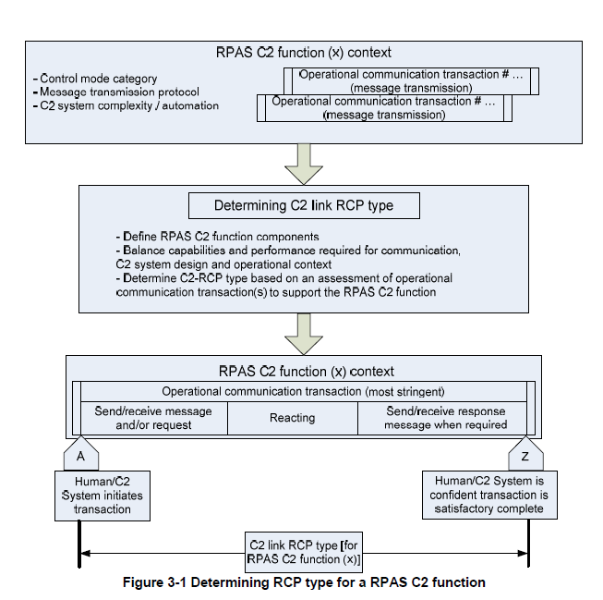
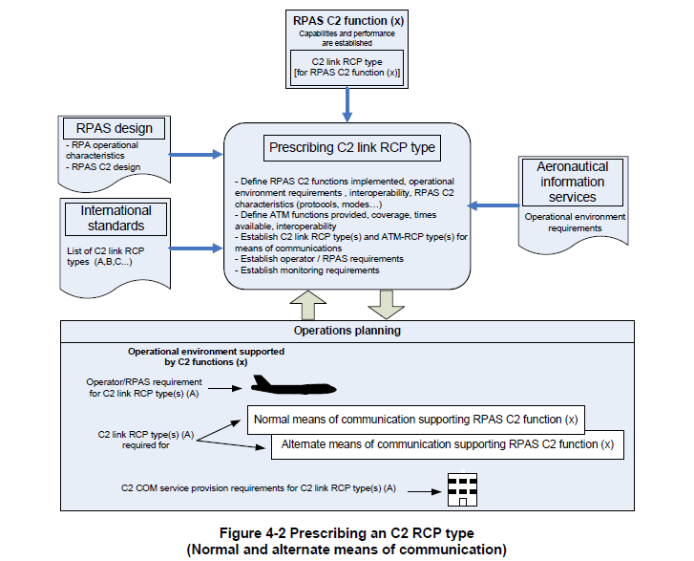
What to do - RCP Type Determination

Slide 6
How to do it – an Integrated Approach
JARUS C2 Link RCP Concept
Uses
Standards and Regulatory bodies
A: Analyse C2 link system
1
Creates
Uses
Researchers
C2 Link RCP Types
Uses
4
Uses
C2 Link Measurements
ED-xxx
MASPS for RPAS C2
2
Uses
C2-RCP-1
3
D: Benchmarking
Creates
C2-RCP-1
C2-RCP-1
B: Build test system
C2-RCP-n
Uses
Uses
Uses
Uses
Creates
C2 Link Prescriptions
RPAS spec
Manufacturers, integrators
Test Systems
Uses
Creates
Creates
RPA
C: Apply methodology
RPS
Datalink
Uses
EUROCAE RCP Methodology

Slide 7
RTCA SC-228 C2 MOPS V1.0
Broad scope – more than test specification for RF equipment, lots of MASPS-like material
  Done without full DO-264 deliverables
Not (yet) specific about RCP
Medium access is TDD – TDMA uplink, FDMA downlink – synchronisation method not clear
Dynamic assignment of frequency
  Aggregating small blocks
  No control channel – will probably need one?
  Will need a non-cellular option?
  Coexistence with BLOS could be problematic
Lessons learned
  EUROCAE should use this MOPS
  Still a long way to go…

Slide 8
Band-planning – BLOS in 5GHz
SAT C2 Link RTN
5030-5062 MHz
LOS C2 Link
5062-5083MHz
SAT C2 Link FWD 5083-5091 MHz
Current proposal is a “conventional” FDD system
Approach and analysis – standard practice and existing baselines (M.2171, SM.377-4, M.2205, M.2237, M.2262)
Preliminary link budgets for LOS and BLOS
  Bandwidths 50kHz/37.5kHz forward, 300kHz return
17 victim/interferer scenarios
Compatibility with SC-228 MOPS?
Impact of outcome of AI1.5?

Slide 9
Security and Spectrum Management
Increasing awareness of “cyber” issues in networked aeronautical communications
  Attacks will be more subtle and difficult to resolve
  Human error/incompetence is the main issue
  Highly automated complex systems may be more vulnerable
Most serious attacks will come from inside
Interconnectivity increases the number of vectors and opportunities
Protect the assets and information, not the perimeter
Security controls must be harmonised and available to all
Not clear who will have overall responsibility: AVSECP, RPASP, CP, OPSP, ….? If any?

Slide 10
To Conclude…
If visions turn into reality…
There will be 10000’s of RPAS
All shapes and sizes
Many at low altitudes and many integrated with ATM
There will be no new spectrum
Have to be more clever about reuse
Use other technical solutions with an integrated harmonised foundation

Slide 11
EUROCAE
Dedicated to Aviation Standardization
Thank you!

