Slide 1
Aircraft Tracking
GADSS Update
FSMP
September 2016
Miguel Marin
A/Chief Operational Safety
ICAO
Notes:
Notes:
Congratulations, you are now in Module 2a of Amendment 1 to Annex 19.

Slide 2
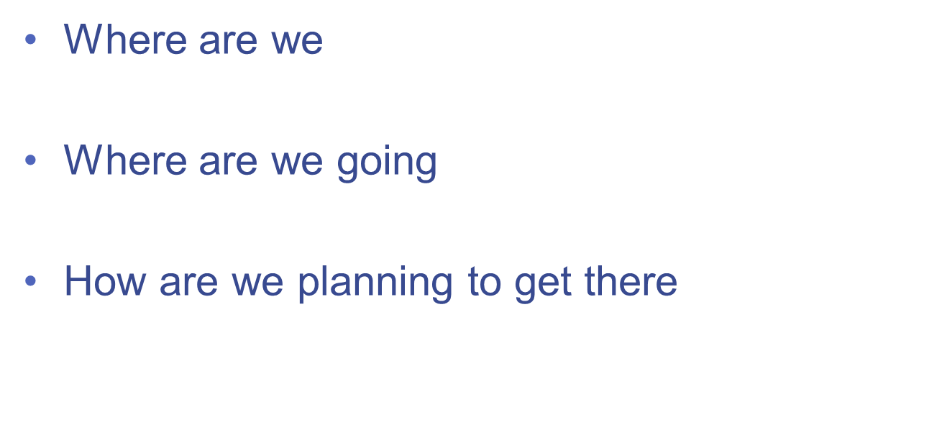
Topics

Slide 3
Retrieval of CVR and FDR Data
Autonomous Distress Tracking
Normal Aircraft Tracking SL
AN 11/1.1.29-15/12
Aircraft Tracking Abnormal Operations
Aircraft Tracking Normal Operations

Slide 4
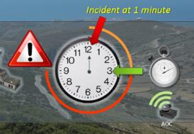
Normal Tracking SARPs
Performance-based Standards and recommended practices for normal flight tracking
Timelines
January 2015
  Preliminary review by ICAO ANC
March 2015
  State Letter
October 2015
  Final review by ICAO ANC
November 2015
  Adopt
March 2017
  Effective
November 2018
  Applicable
  No change to ATC procedures
  Not technology-specific
  Establish operator responsibility to track
  Recommendation to track where ATC gets position information at more than every 15 min
    27 000 Kg and more than 19 Seats
  Standard to track in oceanic areas where ATC gets position information at more than every 15 min
    45 500 Kg and more than 19 Seats
  Data retention for last aircraft location purposes
✓
✓
✓
✓
✓

Slide 5

Graphical Representation
Requirement
to track
Recommendation to track at 15 minute intervals
Requirement to track at 15 minute intervals

Slide 6
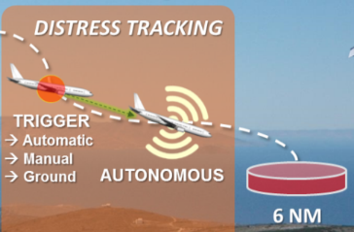
Distress Tracking SARPs
Performance-based Standards and recommended practices for distress flight tracking
Timelines
January 2015
  Preliminary review by ICAO ANC
May 2015
  State Letter
October 2015
  Final review by ICAO ANC
March 2016
  Adopted
July 2016
  Effective
January 2021
  Applicable
  Not technology-specific
  Location of an accident site within 6 NM
  Active
    On flight behaviors that can lead to an accident
    Manually from the air
  Power and position information autonomous from other a/c systems
  Applies to new aeroplanes from 2021
  Incentive for early adoption as an alternative to second ELT
✓
✓
✓
✓
✓
Notes:
For Distress Tracking, these SARPs:
Will again be not limited to any specific technology
Will help identify the location of an accident site within 6 NM
Will be activated automatically based on flight behaviour, or manually from the air or the ground
Will use technology that have power and position information that are autonomous from other aircraft systems
Will apply to new aeroplans from 2021
Will provide incentive to early adopters by being an alternative to the second ELT
In terms of timelines, the ANC has already conducted its preliminary review back in January, and ICAO will issue a State letter regarding these proposed amendments by April of this year. By next year March, the SARPs will hopefully be adopted, and will then be applicable by January 2021

Slide 7
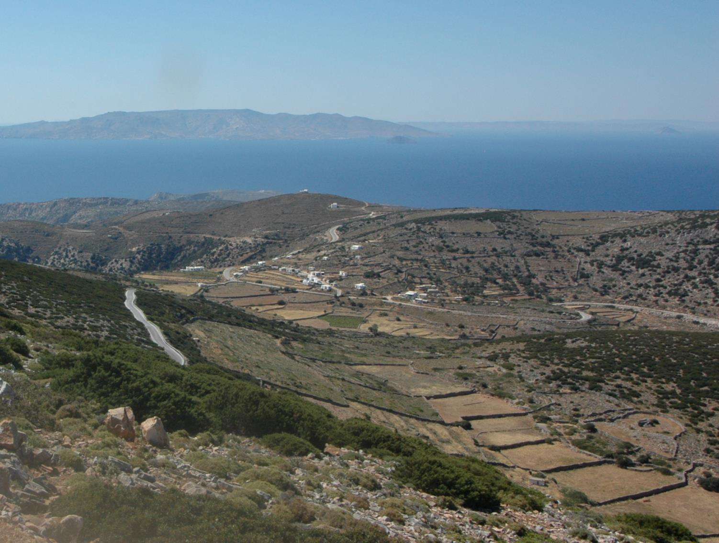



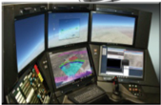
DISTRESS TRACKING
→ Automatic
→ Manual
AUTONOMOUS
6 NM
Aircraft behavior event that if left uncorrected, can result in an accident.
Squawk at
one minute intervals
RESCUE COORDINATION CENTER
Adopted SARP
Notes:
Triggers for the transition to autonomous tracking may be activated automatically, manually, or through actions taken on the ground. Trigger examples include Unusual attitudes, speed or acceleration as well as
Failure of aircraft surveillance and tracking systems, Complete Loss of engine power or Alerts such as ground proximity warnings. Under distress tracking, the frequency of position reports increases to approximately 1 minute intervals to ensure that the location of an accident site can be determined to a degree of accuracy within 6 NM.

Slide 8
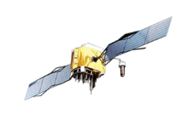

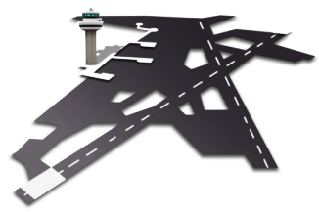


DISTRESS TRACKING
→ Automatic
→ Manual
4D/1 Position information
AUTONOMOUS
  Rescue
  Coordination
  Center
  Local User
  Terminal
  Rescue
  Coordination
  Center
  Mission
  Control
  Center
Distress Tracking Concept
GADSS CONCEPT

Slide 9
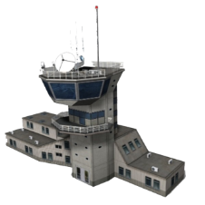

DISTRESS TRACKING
Other
Satellites
→ Automatic
→ Manual
4D/1 Position information
AUTONOMOUS
  Rescue
  Coordination
  Center
  Ground
  Station
  Rescue
  Coordination
  Center
  Mission
  Control
  Center
  Control
  Center
ATC
Airline
Distress Tracking Concept
GADSS CONCEPT

Slide 10




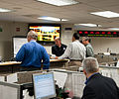



ADT DATA RETENTION LOCATION AND ACCESS
Notes.
ADT systems may initiate 4D/1 data transmissions prior to the distress conditions specified in ED-237 to ensure compliance with the requirement.
Aircraft tracking data under normal or abnormal conditions is retained by the operator. In the event of an incident or accident, this data may need to be provided to SAR and/or incident/accident investigators. To facilitate the RCC’s access to all aircraft tracking data it should be made available in the ADT Data Repository upon request.
Distress
EUROCAE ED-237
ADT 4D/1 Data
Potential distress ¹
Abnormal situation .
Continuous 4D/1 tracking
Operator retained information²
Submit data upon request ^{2.}
ADT DATA REPOSITORY
(To be defined)
4D/1 Data
ACCESS TO ADT DATA
Rescue Coordination Centers RCCs
SAR assets
6 NM radius

Slide 11

ADT DISTRESS ALERTING
Current alerting process
ADT alerting process
ADT DATA REPOSITORY
4D/1 Data
> ATS
Distress
EUROCAE ED-237
> Operator
> External source
Potential distress
> ELT activated
ACCESS TO ADT DATA
> Process in place to initiate alert
> Automatic on-board trigger
> Automatic on-board trigger (ELT compatible)
Rescue Coordination Centers RCCs
ALERT
SAR assets
6 NM radius

Slide 12
What to Expect
GADSS Advisory Group
  Updating the CONOPS
    SL comments and suggestions
    Latest developments in technology
  Identification additional provisions
    Other Annexes
    PANS
  Next version of GADSS (Ver 6.0)
    Expected to be published end of 2016

Slide 13
