Slide 1
Fixed Satellite Service allocations for RPAS C2 Links
-
NACC/CAR/SAM Preparatory Workshop to ITU World Radiocommunication Conference 2023 (WRC-23)
21-22 February 2022

Slide 2
ITU-R Resolution 155 Status Update
Background
  Brief history
  Identified frequency allocations
  ICAO responsibilities
Regulatory considerations
  Principals e.g., operate as a typical FSS Earth station
  Notification and coordination
  Identifying responsibilities
Techncial considerations
  RPA/UA Earth station characteristics
  Protecting incumbent services – pfd mask
  Link Budgets
Resolution 155 WRC-19 overview
Anticipated changes to Resolution 155 for WRC-23
ICAO Position and WRC-23 desired outcome

Slide 3
Brief History
Report ITU-R M.2171, 12/2009 = Characteristics of unmanned aircraft systems and spectrum requirements to support their safe operation in non segregated airspace
  Identified the need for at least 56MHz (and possibly 198MHz) of spectrum for the projected number of UAS/RPAS anticipated to be operating in the 2030 timeframe
  In 2009 only L Band AMS(R)S systems existed but with an inadequate spectrum capacity
  A coprimary AM(R)S and AMS(R)S allocation exists at 5030-5091MHz but to date no satellite systems are operating and some of the band would need to be set aside for AM(R)S
  Already operating Ku and Ka Band FSS systems were identified as a potential solution, but they are not AMS(R)S
Resolution 155, WRC-2015
  Regulatory provisions related to earth stations on board unmanned aircraft which operate with geostationary-satellite networks in the fixed-satellite service in certain frequency bands not subject to a Plan of Appendices 30, 30A and 30B for the control and non-payload communications of unmanned aircraft systems in non-segregated airspaces
Resolution 155, WRC-2019
  Minor update to recognize a second pfd mask to protect terrestrial services based on work carried out during the 2015-2019 study cycle

Slide 4
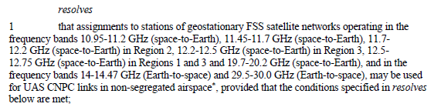
Identified Frequency Allocations
Ku space-to-Earth = 10.95-12.75GHz (region dependent)
Ku Earth-to-space = 14-14.47GHz
Ka space-to-Earth = 19.7-20.2GHz
Ka Earth-to-space = 29.5-30GHz
FSS C Band (3-4GHz/5-6GHz) not considered because of the limited antenna size on the RPA/UA not providing sufficient link margin

Slide 5

ICAO Responsibilities
ICAO SARPs, covering all C2 Link technologies, are being developed within the RPAS Panel
  New Volume VI, in Annex 10, for C2 Link SARPs
  Part I (Procedures) adopted in February 2021 and are now effective
  Part II (Systems) are under development and are anticipated to be adopted in Q1 2025
    Will be in State Letter review by WRC-2023
A companion “Manual on C2 Links for RPAS” is also being developed
  First release to coincide with Part II (Systems) State Letter review in 2023
  Covers key concepts such as C2 Service Providers and Required Link Performance (RLP) and will be regularly updated as new C2 Link technologies are approved

Slide 6
Regulatory Considerations - Principals
Principals
  Only communicate with GSO FSS Satellites in particular Ku and Ka frequency bands
  Do not cause more interference nor claim more protection than any Typical FSS Earth station in that network
  Do not constrain other FSS satellite networks beyond that of Typical FSS Earth stations associated with the network
  Accept the interference from and not cause harmful interference to stations of terrestrial services
  Maintain antenna pointing accuracy without inadvertently tracking adjacent GSO satellites
  Use a network control and monitoring center or similar facility to monitor regulatory compliance
  Ensure that ICAO SARPs consistent with Article 37 of the Convention on International Civil Aviation are satisfied
  Ensure freedom from harmful interference and act immediately to address such cases
  Take practical measures to protect Radio Astronomy sites when using the 14-14.7 GHz band
  Only allow operations within national territories, waters, and airspaces, when authorized by the administration of that territory

Slide 7
Regulatory Considerations - Notification and Coordination
Notification and coordination
  Use Typical FSS Earth Station assignments already included in the notification or modified characteristics that do not change interference envelope
  Use only assignments successfully coordinated under Article 9 with a favorable finding under Article 11
  Do not use assignments for which the notifying administration accepts the interference as a basis for recording under No. 11.32 (See procedure of Appendix 5 § 6.d.i)

Slide 8
Regulatory Considerations - Responsibilities
Identifying responsibilities
  Notifying Administration of the Satellite Network used by the RPA
    Coordinates and notifies network
    Manages interference from their space station(s)
    Prevents interference from the RPA Earth station by ensuring it meets coordination limits
    Secures agreement from Administration of the territory where RPA operates
  Notifying Administration of other Satellite Networks
    Coordinates with notifying administration
    Reports interference to their network(s) to Notifying Administration of the Satellite Network used by the RPA
  Flag Nation of the RPAS
    Ensures SARPs are met by RPAS
  Administration of the territory where RPA operations are conducted
    Provides agreement to operate over their territory
    Reports interference received by their terrestrial services to Notifying Administration of the Satellite Network used by the RPA
  Administration of adjacent/nearby territories to where RPAS operations conducted
    Reports interference received to Administration of the territory where RPA operates
  Administration of the ground feeder link earth station is located
    Secures GES operating authority
    Notifies ITU-R of their Specific Earth station

Slide 9
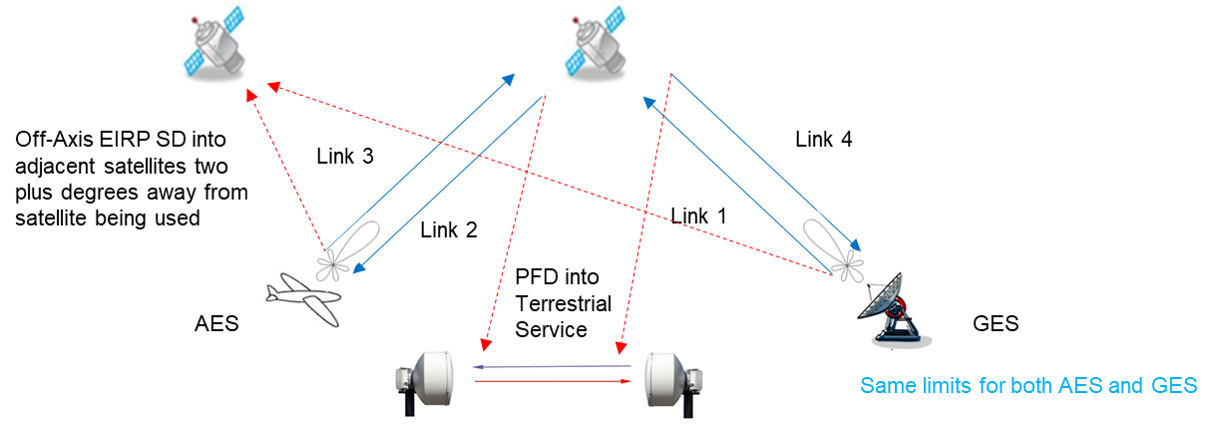
Technical Considerations
Key system elements and influencing parameters
  Satellite with (edge of) coverage (orange): G_{max} (satellite) – x dB (typically -3dB to -5dB)
  Ground Earth Station (GES): Fixed station with large antenna gain/narrow pattern
  Remotely piloted aircraft (RPA), Airborne Earth Station (AES): small, fully steerable antenna with small antenna gain/wide pattern
  Wanted satellite links: blue;
  Unwanted satellite links: red
  Radio relay: green
Terrestrial services e.g., FS (radio relay)

Slide 10
Technical Considerations
Satellite Characteristics
  Existing FSS satellites
    Classical wide beam satellites (low satellite gain): Peak antenna gains in the order of magnitude of 35 dBi (Ku band) and 43 dBi (Ka band), respectively
    High throughput satellites (HPS) with multi-spot beam architecture and high beam gains: Peak antenna gains in the order of magnitude of 40 dBi (Ku band) and 50 dBi (Ka band), respectively
  Typically, transparent satellite payloads without signal processing:
    Only downlink routing of uplink signals
    Transponder settings (e.g., saturated flux density = SFD) according to typical FSS operation
    C2 Links use shared transponder capacity or exclusive transponders (then adapted settings possible)
  Coverage
    full visibility area of the satellite (global beam, multi spot beam subsystem) or
    smaller parts of the visibility in case of regional / spot beams
    Minimum elevation of 15 degrees are recommended with consequent maximum latitudes: ≈ 67°S to 67°N
  Link 1 and Link 4 as classical FSS links (from and to fixed large Earth stations)
  Link 2 and 3 are (possibly adapted) links (to and from the RPA), defining the end-to-end link performance limited by:
    RPA receive G/T (Link 2) limited by antenna size together with the (permissible) satellite EIRP
    RPA uplink EIRP (limited by off axis emission levels from small antenna) together with the satellite G/T (Link 3)

Slide 11
Technical Considerations
GES and AES Characteristics
  GES:
    Hub or gateway stations with large antenna diameters and link management functions incl. uplink power control;
    Antenna sizes 4 m up to 15 m: Gains >> 50 dBi;
    Fully compliant to FSS characteristics based on the ITU-R MIFR (upper half of the performance range) and FSS system implementations;
    Antenna gain pattern according to (mostly better than) Appendix 7 of ITU RR
  AES:
    Fully steerable antennas (reflector based or direct radiating phased array) with pointing performance throughout the full azimuth and elevation range;
    Antenna sizes 40 cm up to 1.3 m: Gains 35 … 48 dBi;
    G/T and EIRP values like VSAT (very small aperture terminals): 13 … 20 dB/K and 55 … 68 dBW, respectively;
    To be compliant with FSS characteristics according to ITU-R MIFR (lowest 30% of the performance range);
    Antenna gain pattern according to Appendix 7 / 8 of ITU-R RR or to an envelope better adapted to the RPA operational case (Bessel function based);
    Performance improvement functions like Uplink Power Control and Adaptive Coding and Modulations necessary;

Slide 12
Technical Considerations
Regulatory Limitations
  General ITU-R limits according to ITU-R RR:
    Satellite downlink: PFD limits (see Article 21) in Ku band
    Further limitations according to Article 21 and 22 ITU RR, like off-axis EIRP limits (Article 22.26, 22.32)
    Antenna gain envelopes according to ITU RR Appendix 7, 8
  Specific limits according to Resolution 155 (Rev. WRC-19) for Ku band uplinks
    Limitation of the off-axis EIRP from RPA / UA for protecting terrestrial services (mainly FS)
    Res. 155, Annex 2, Example b:
    An earth station on board UA in the frequency band 14.0-14.3 GHz shall comply with the pfd limits described below, on the territory of countries listed in No. 5.505:
    15 log (θ +0.9) -124 dB(W/m²/MHz) for 0° ≤ θ ≤ 90°
                where θ is the angle of arrival of the radio-frequency wave (degrees above the horizontal).
    An earth station on board UA:
    – in the frequency band 14.25-14.3 GHz on the territory of countries listed in No. 5.508;
    – in the frequency band 14.3-14.4 GHz in Regions 1 and 3;
    – in the frequency band 14.4-14.47 GHz worldwide,
    shall comply with the pfd limits described below:
    15 log (θ +0.9) -133.5 dB(W/m²/MHz) for 0° ≤ θ ≤ 90°
                where θ is the angle of arrival of the radio-frequency wave (degrees above the horizontal).
                NOTE – The aforementioned limits relate to the pfd and angles of arrival that would be obtained under free space propagation conditions.
  ITU-R Recommendations:
    Off-axis antenna gain envelops according to Recommendation ITU-R S.524 (Ku and Ka band), S.728 (Ku band)

Slide 13
Technical Considerations - Link Budgets 1
Part 2: Link availability / continuity analyses against variable link impairments based on the achieved link margin
➔ Results: Signal degradation times / probabilities;
Achieved versus required link performance
Part 1: Clear sky FSS link budgets, asymmetric design (in favor to link 1, 4 compared to link 2, 3)
Results: Achieved end-to-end link margins, separated for the links
Achieved FSS satellite link performance not fulfilling the requirements
Achieved FSS satellite link performance fulfills the requirements
Part I:
C2 Link performance under time-invariant link impairments
Part II:
C2 Link performance under time-variant link impairments
needed link margin achieved link margin
  Including fixed interference influences (system internal and external) as well as time-variant interference influence towards Ku band RPAs (Link 2) caused by FS stations

Slide 14
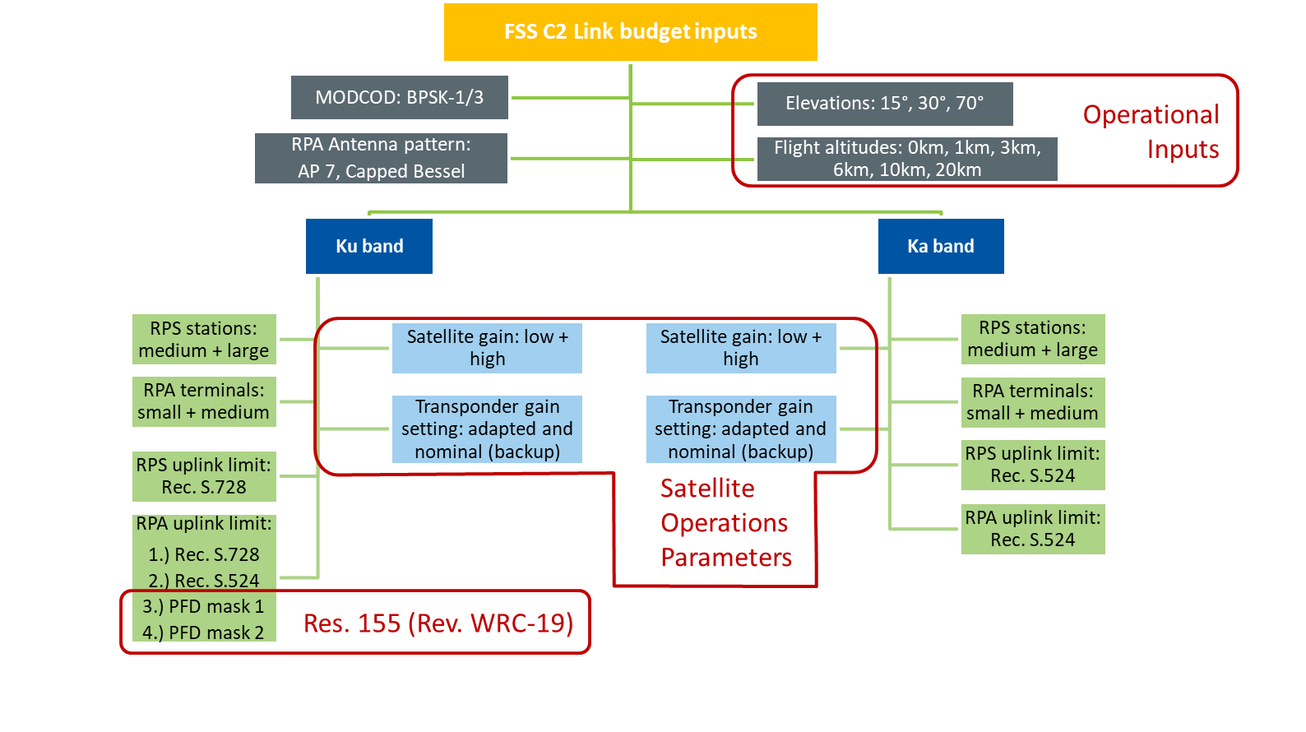
Technical Considerations - Link Budgets 2
Parameter variations (2880 individual link budgets)

Slide 15
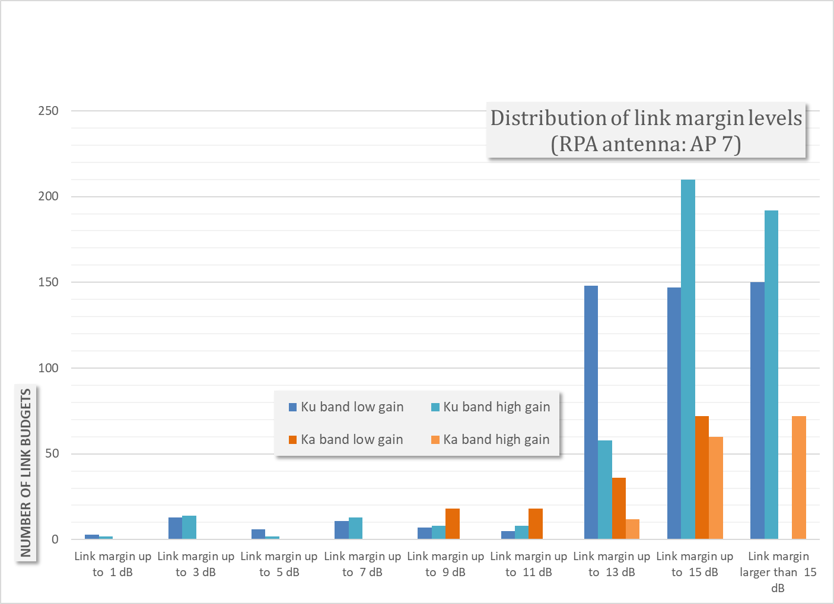
Technical Considerations - Link Budgets 3
FSS based C2 Link budgets with link margins > 0 dB | FSS based C2 Link budgets with link margins > 0 dB
Fulfillment rates for | RPA antenna pattern per AP7 | RPA antenna pattern per Capped Bessel
Ku band low gain satellite | 67% - 69.1% | 72.9% - 73.6%
Ku band high gain satellite | 73.6% - 75.3% | 79.9% - 80.2%
Ka band low gain satellite | 100.0% | 100.0%
Ka band high gain satellite | 100.0% | 100.0%
  Typical 10-15dB achievable link margins still to be compared with the link margins required to meet the (still TBD) needed Availabilities and Continuities for safe flight operation under the influence of time-variant link impairments

Slide 16
Resolution 155 WRC 2015 as adopted
General
  resolves
  1 that assignments to stations of geostationary FSS satellite networks operating in the
  frequency bands 10.95-11.2 GHz (space-to-Earth), 11.45-11.7 GHz (space-to-Earth), 11.7-12.2 GHz
  (space-to-Earth) in Region 2, 12.2-12.5 GHz (space-to-Earth) in Region 3, 12.5-12.75 GHz (space to-
  Earth) in Regions 1 and 3 and 19.7-20.2 GHz (space-to-Earth), and in the frequency bands
  14-14.47 GHz (Earth-to-space) and 29.5-30.0 GHz (Earth-to-space), may be used for UAS CNPC
  links in non-segregated airspace*, provided that the conditions specified in resolves below are met;
  2 that earth stations in motion on board UA may communicate with the space station of a
  geostationary FSS satellite network operating in the frequency bands listed in resolves 1 above,
  provided that the class of the earth station in motion on board UA is matched with the class of the
  space station and that other conditions of this Resolution are met (see also instructs the Director of
  the Radiocommunication Bureau 3 below);
  3 that the frequency bands specified in resolves 1 shall not be used for the UAS CNPC links
  before the adoption of the relevant international aeronautical standards and recommended practices
  (SARPs) consistent with Article 37 of the Convention on International Civil Aviation, taking into
  account instructs the Director of the Radiocommunication Bureau 4;
Ku and Ka FSS Bands
ITU-R Bureau has created the UG class
ICAO RPAS Panel is developing SARPS

Slide 17
At WRC 2015 Resolution 155 was adopted
Coordination
  resolves
  4 that administrations responsible for an FSS network providing UA CNPC links shall
  apply the relevant provisions of Articles 9 (necessary provisions need to be identified or developed)
  and 11 for the relevant assignments, including, as appropriate, assignments to the corresponding
  space station, specific and typical earth station and earth station in motion on board UA, including
  the request for publication in BR IFIC of items referred to in resolves 2 and the course of actions
  identified in that resolves in order to obtain international rights and recognition as specified in
  Article 8;
  9 that the use of assignments of a FSS satellite network for UAS CNPC links shall not
  constrain other FSS satellite networks during the application of the provisions of Articles 9 and 11;
  10 that the introduction of UAS CNPC links shall not result in additional coordination
  constraints on terrestrial services under Articles 9 and 11;
RPAS/UAS Earth Stations (Air and Ground) are to be coordinated using the same process as other FSS networks and not be given any special status during coordination

Slide 18
At WRC 2015 Resolution 155 was adopted
Harmful Interference
  resolves
  13 UAS CNPC links shall:
    – ensure that the use of UAS CNPC links be in accordance with the international standards
    and recommended practices (SARPs) consistent with Article 37 of the Convention on
    International Civil Aviation;
    – take the required measures, consistent with No. 4.10, to ensure freedom from harmful
    interference to earth stations on board UA operated in accordance with this Resolution;
    – act immediately when their attention is drawn to any such harmful interference, as
    freedom from harmful interference to UAS CNPC links is imperative to ensure their safe
    operation, taking into account resolves 11;
    - use assignments associated with the FSS networks for UAS CNPC links (see Figure 1 in
    Annex 1), including assignments to space stations, specific or typical earth stations and
    earth stations on board UA (see resolves 2), that have been successfully coordinated under
    Article 9 (including provisions identified in resolves 4) and recorded in the Master
    International Frequency Register (MIFR) with a favorable finding under Article 11,
    including Nos. 11.31, 11.32 or 11.32A where applicable, and except those assignments
    that have not successfully completed coordination procedures under No. 11.32 by
    applying Appendix 5 § 6.d.i;
    – ensure that real-time interference monitoring, estimation and prediction of interference
    risks and planning solutions for potential interference scenarios are addressed by FSS
    operators and UAS operators with guidance from aviation authorities;
RPAS/UAS C2 Links require careful monitoring and immediate action to be taken to minimize the potential for any safety effects due to harmful interference

Slide 19
At WRC 2015 Resolution 155 was adopted
Non-RPAS/UAS System Protection
  resolves
  8 that earth stations of UAS CNPC links of a particular FSS network shall not cause more
  interference to, or claim more protection from, stations of terrestrial services than specific or typical
  earth stations of that FSS network as indicated in resolves 5 that have been previously coordinated
  and/or notified under relevant provisions of Articles 9 and 11;
  14 that, unless otherwise agreed between the administrations concerned, UA CNPC earth
  stations shall not cause harmful interference to terrestrial services of other administrations (see also
  Annex 2);
  15 that, in order to implement resolves 14 above, power flux-density hard limits need to be
  developed for UAS CNPC links; one possible example of such provisional limits to protect the fixed
  service is provided in Annex 2; subject to agreement between the administrations concerned, that
  annex may be used for the implementation of this Resolution;
  16 that the power flux-density hard limits provided in Annex 2 shall be reviewed and, if
  necessary, revised by the next conference;
  17 that, in order to protect the radio astronomy service in the frequency band
  14.47-14.5 GHz, administrations operating UAS in accordance with this Resolution in the frequency
  band 14-14.47 GHz within line-of-sight of radio astronomy stations are urged to take all practicable
  steps to ensure that the emissions from the UA in the frequency band 14.47-14.5 GHz do not exceed
  the levels and percentage of data loss given in the most recent versions of Recommendations
  ITU-R RA.769 and ITU-R RA.1513;
PFD masks are required to protect the terrestrial services, in particular the FS
Out of band emissions also need to be considered

Slide 20
At WRC 2015 Resolution 155 was adopted
RPAS/UAS System
  resolves
  5 that earth stations of UAS CNPC links shall operate within the notified and recorded
  technical parameters of the associated satellite network, including specific or typical earth stations of
  the geostationary FSS satellite network(s) as published by the Radiocommunication Bureau;
  6 that earth stations of UAS CNPC links shall not cause more interference to, or claim more
  protection from, other satellite networks and systems than specific or typical earth stations as
  indicated in resolves 5 as published by the Bureau;
  7 that, in order to apply resolves 6 above, administrations responsible for the FSS network
  to be used for UAS CNPC links shall provide the level of interference for the reference assignments
  of the network used for CNPC links upon request by an administration authorizing the use of UAS
  CNPC links within its territory;
WP 5B is developing CNPC Link characteristics to enable:
WP 5B to analyze compliance with the appropriate Radio Regulations
ICAO to perform its work on SARPs

Slide 21
At WRC 2015 Resolution 155 was adopted
ICAO
  Resolves
  11 that earth stations on board UA shall be designed and operated so as to be able to accept
  the interference caused by terrestrial services operating in conformity with the Radio Regulations in
  the frequency bands listed in resolves 1 without complaints under Article 15;
  12 that earth stations on board UA shall be designed and operated so as to be able to operate
  with interference caused by other satellite networks resulting from application of Articles 9 and 11;
  18 to consider the progress obtained by ICAO in the process of preparation of SARPs for
  UAS CNPC links, to review this Resolution at WRC-23, taking into account the results of the
  implementation of Resolution 156 (WRC-15), and to take necessary actions as appropriate;
ICAO needs to consider harmful interference in its SARPs
ICAO should attempt to complete its FSS related SARPs amendments prior to 2023

Slide 22
Anticipated changes to Resolution 155 for WRC-23
Clear indication of the regulatory status of UA CNPC assignments within Fixed-Satellite Service Allocations
  Make clear that the Earth Stations In Motion (ESIMs) provisions do not apply
Elimination of any provisions (in Resolution 155) that are no longer necessary
Recognition of off-axis power limits that apply to Ku and Ka band transmissions from the RPA
Finalization of a PFD mask for protecting terrestrial services
Clear identification of administration responsibilities
  Including requirements to prevent harmful interference and use coordinated assignments
Clear identification of ITU-R Radiocommunication Bureau actions
Retention of the existing priority date of protection for UA CNPC assignments
Restructuring and organizing the provisions to make them easier to understand

Slide 23

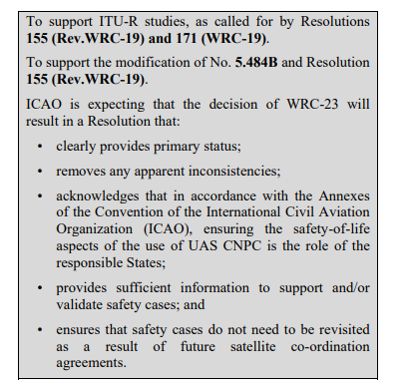
ICAO Position and WRC-23 desired outcome
ICAO Secretary General letter (August 2021) to all member States
ICAO FSS specific SARPs provide for safe operation in the absence of an ITU-R AMS(R)S allocation
The FSS is a mature ready to use service with global coverage and enough spectrum to support RPAS operations well into the future

