Slide 1



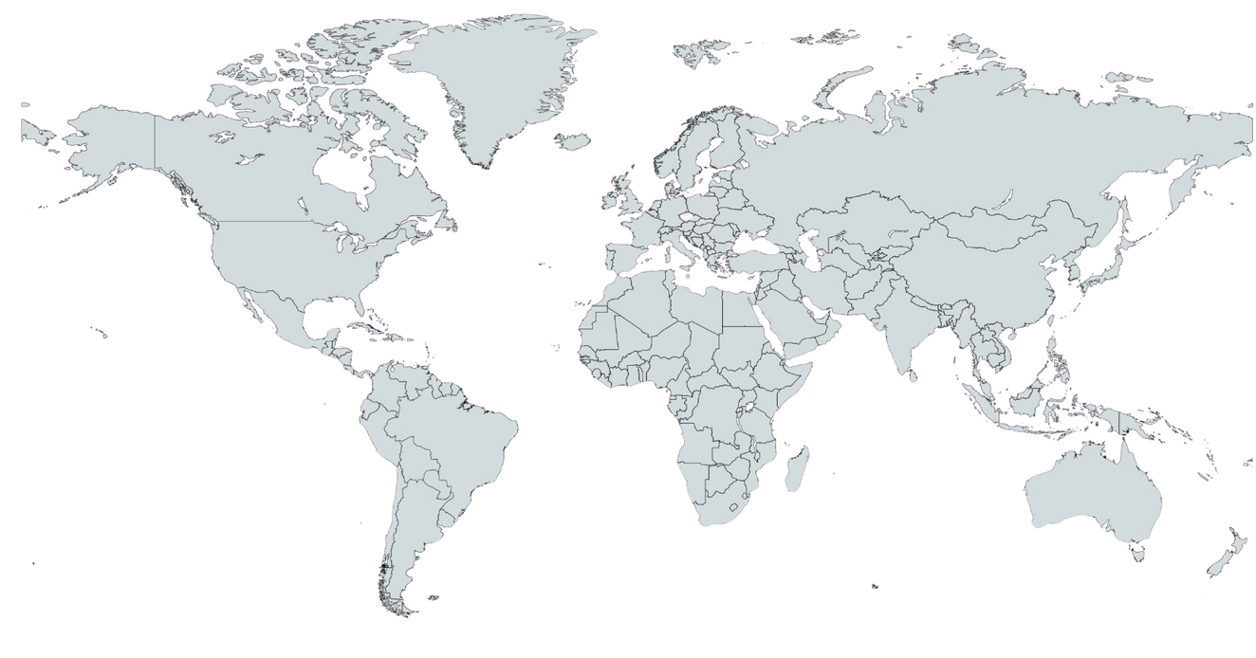
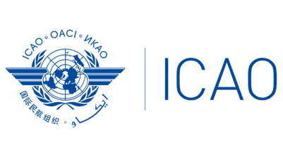
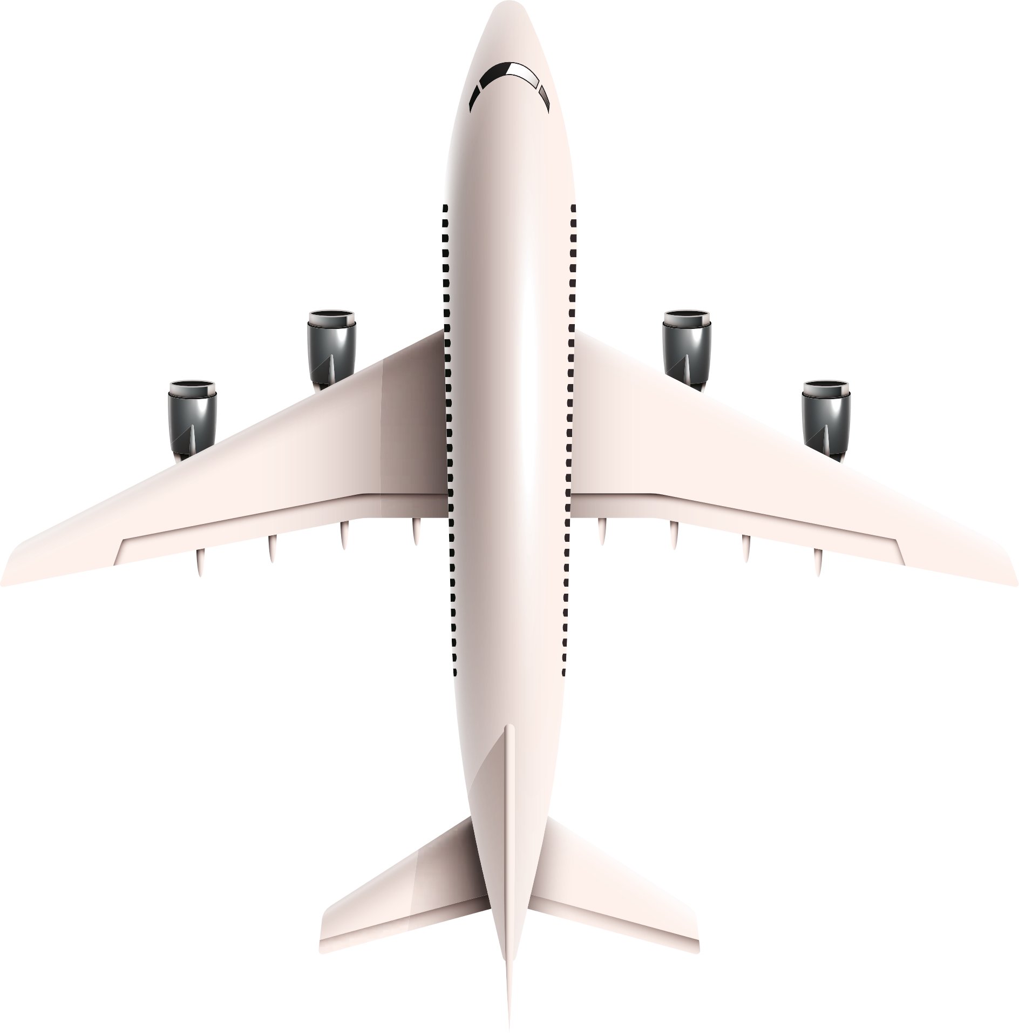
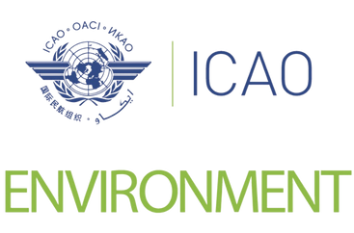
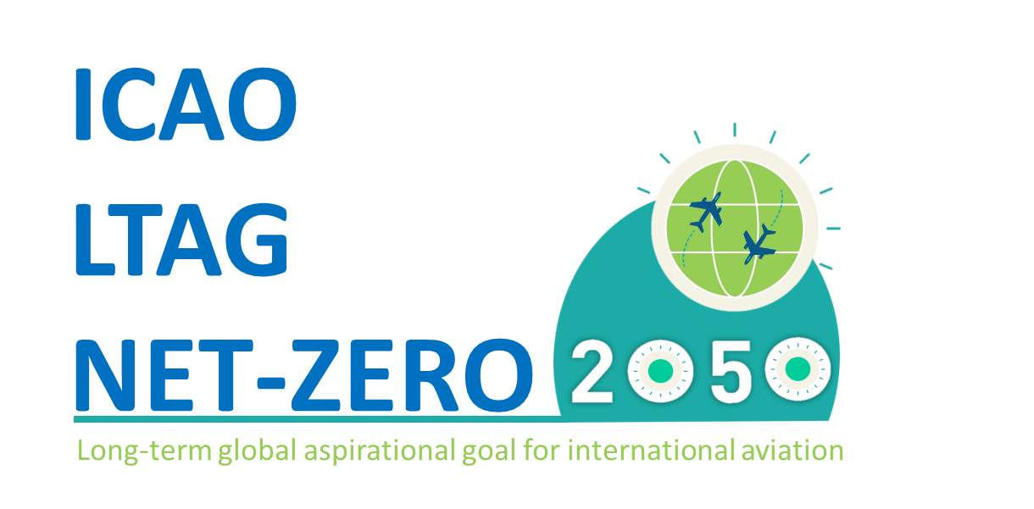




2024
ICAO REGIONAL SEMINAR ON
ENVIRONMENT
  20-21 August 2024 for NACC/SAM Asuncion, Paraguay

Slide 2

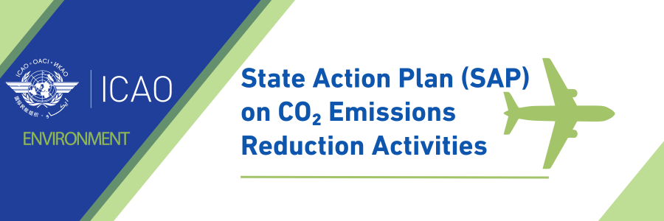
SAM Region activities on
State Action Plans (SAP)
Jorge Armoa
AIM/MET Regional Officer
August, 2024

Slide 3
ICAO North American Central American and Caribbean (NACC) and
South American (SAM) Region States
NACC
SAM
Antigua and Barbuda
Bahamas
Barbados
Belize
Canada
Costa Rica
Cuba
Dominica
Dominican Republic
El Salvador
Grenada
Guatemala
Haiti
Honduras
Jamaica
Mexico
Nicaragua
Saint Kitts and Nevis
Saint Lucia
Saint Vincent and the Grenadines
Trinidad and Tobago
United States
Argentina
Bolivia
Brazil
Chile
Colombia
Ecuador
Guyana
Panama
Paraguay
Peru
Suriname
Uruguay
Venezuela (Bolivarian Republic of)
Total: 13 States
Total: 22 States

Slide 4
State Action Plans (SAP) in numbers (XX Region)
State Action Plans (SAPs)
Current status: # States submitted SAP: 12 (92%) Argentina, Brasil, Bolivia, Chile, Colombia, Ecuador, Guyana, Panamá, Paraguay, Perú, Uruguay, Venezuela # States not yet submitted SAP: 01 (0,08%) Suriname

Slide 5
Examples of Mitigation Measures selected in the SAM Region
AIRCRAFT TECHNOLOGY – Eleven States have proposed technological measures in their SAPs. The use of clean energy at airports to support airport operations, as well as the use of electric vehicles on the aprons are the main technological measures proposed in the States' SAPs.
OPERATIONAL IMPROVEMENTS – The Regional Offices implemented task group for the optimization of airspace. The working group is called GESEA and works on the realignment of routes, implementation of the FRTO module, and EDE, DCT and UPR concepts.
SUSTAINABLE AVIATION FUELS (SAF) AND CLEANER ENERGY
Commitment to reducing CO2 emissions and positioning itself as a possible supplier of biofuels for aviation
“Programa Combustível do Futuro” (Fuel for the Future), creating the Technical Committee Fuel for the Future (CT-CF) in order to manage the Program

Slide 6
Examples of Mitigation Measures selected in the SAM Region
SUSTAINABLE AVIATION FUELS (SAF) AND CLEANER ENERGY
c) the “Programa Combustível do Futuro” has two objectives: introducing the fuel into the Brazilian energy matrix and creating incentives for resources to be applied to projects focusing on the topics covered in the “Programa Combustível do Futuro”. To achieve these objectives,
d) the ProBioQAv Subcommittee was created, which will be detailed as following.e) 4 - Brazilian Network of Biokerosene and Sustainable Hydrocarbons for Aviation (RBQAv - aviation kerosene)
e) Public Investments;
f) The Ministry of Energy of Chile, on the one hand, began in 2019 to develop a National Hydrogen Plan. Chile is decisively supporting the development of this energy resource, which can potentially be used in the airline industry. (2030+)
In this sense, it has carried out legislative steps so that hydrogen is considered as a fuel.

Slide 7
Next steps for SAP
Nomination of State Action Plan Focal Point.
Prepare the initial/updated SAP for submission. Make sure the action plans will be practical and concrete in line with the updated SAP Guidance.
Include innovative measures in the SAP.
Communicate with SAM RO for questions and support.
Contact points:
Answering questions and providing support: actionplan@icao.int
SAM Regional Office:
  Jorge Armoa (jarmoa@icao.int)

