Slide 1
VOLCEX 2024 EXERCISE
SAM Region Work plan
Roxana Vasques
SMN – Argentina
Jorge Armoa
Regional Officer AIM/MET

Slide 2
VOLCEX Exercise – Work Plan
01
Introduction and background to VOLCEX
02
VAAC involved - History of volcanoes
03
Involved States, VAAC associates and other exercise participants
04
Meeting objectives and scope of the Workshop
06
Tasks for States and reference documentation
05
Circuit of the information/timeline proposed for the exercise

Slide 3
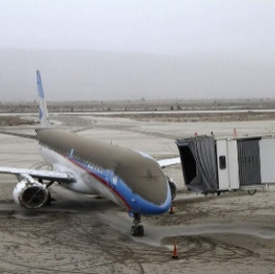
Introduction & background to
VOLCEX
01

Slide 4
Introduction & background to
VOLCEX
The VOLCEX (Volcanic Exercise) is a volcanic eruption drill;.
It is intended to measure the response capacity of the ANS and air transport;.
All parties involved in an air operation must participate (see Section 3);
The procedures and contingency plans adopted at the regional level are tested to minimize the impact of ash clouds on air traffic and to test the response of airport systems in situations with a high number of cancelled or diverted flights;.
Also, the use and dissemination of special aeronotifications on volcanic ash .
01
Notes:
The VOLCEX (Volcanic Exercise) is a volcanic eruption drill in which the response capacity of air transport and Air Navigation Services, among other actors, to an ash cloud caused by the eruption of one or more volcanoes is measured.
This exercise involves airlines, volcanic ash warning center(s), as appropriate, meteorological monitoring offices, volcanological observatories and air navigation service providers, airport operators and international organizations.
The procedures and contingency plans adopted at the regional level are tested to minimize the impact of ash clouds on air traffic and to test the response of airport systems in situations with a high number of cancelled or diverted flights.
Also, the use and dissemination of special aeronotifications on volcanic ash.
The SAM Region (ICAO) states are participating in this one-day exercise.
It is very important to note that in the event of actual major eruptions this exercise will either not be conducted or will be immediately discontinued.
Furthermore, the exercise will have no impact on actual operations and publications related to the exercise should be ignored. In other words, any information issued in the context of these exercises is duly identified as such, in order to be operationally disregarded.

Slide 5
Introduction & background to
VOLCEX
The exercise will have the duration of one day (24 hours);
In case of an actual eruption during the exercise, the exercise will be suspended immediately;
The exercise will have no impact on actual operations and exercise related postings should be ignored. To this end, exercise related messages should be identified as TEST or EXERCISES.
01
Notes:
The VOLCEX (Volcanic Exercise) is a volcanic eruption drill in which the response capacity of air transport and Air Navigation Services, among other actors, to an ash cloud caused by the eruption of one or more volcanoes is measured.
This exercise involves airlines, volcanic ash warning center(s), as appropriate, meteorological monitoring offices, volcanological observatories and air navigation service providers, airport operators and international organizations.
The procedures and contingency plans adopted at the regional level are tested to minimize the impact of ash clouds on air traffic and to test the response of airport systems in situations with a high number of cancelled or diverted flights.
Also, the use and dissemination of special aeronotifications on volcanic ash.
The SAM Region (ICAO) states are participating in this one-day exercise.
It is very important to note that in the event of actual major eruptions this exercise will either not be conducted or will be immediately discontinued.
Furthermore, the exercise will have no impact on actual operations and publications related to the exercise should be ignored. In other words, any information issued in the context of these exercises is duly identified as such, in order to be operationally disregarded.

Slide 6
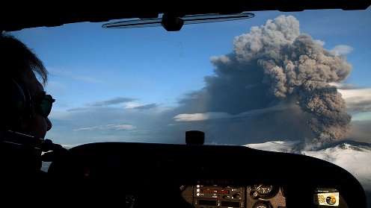
Introduction & background to
VOLCEX
Background to VOLCEX: FICTITUS
In previous years, and as one of the SAM Region Projects, the FICTITUS exercise has been carried out on an annual basis.
Within this framework, the forecasters of the MWOs, under the responsibility of the VAAC Buenos Aires, performed SIGMET WV message practices according to the location of the volcanic ash dispersion cloud.
01

Slide 7
Introduction & background to
VOLCEX
Acronyms
VAAC: Volcanic Ash Advisory Centre
VONA: Volcanic Ash Notice to Aviation
VAA: Volcanic Ash Advisory
VAG: Volcanic Ash Graphic
SVO: State Volcano Observatory
01

Slide 8
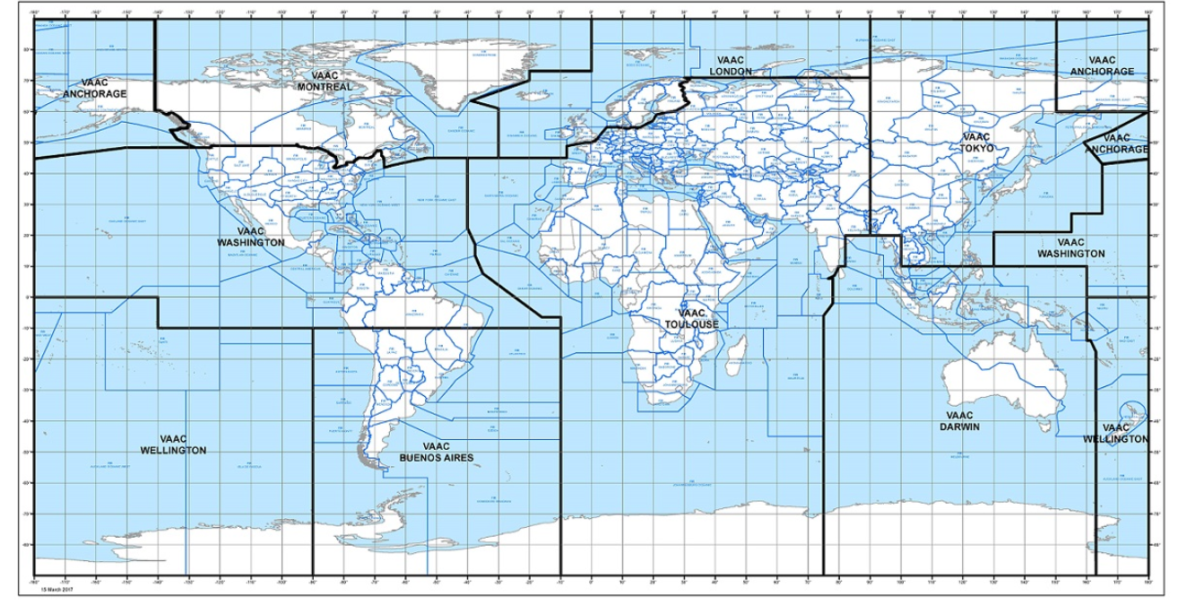
VAAC involved - History of Volcanoes
VAAC of Buenos Aires and Washington
VAACs MAP
02

Slide 9
VAAC involved - History of Volcanoes
History of Volcanoes Erupting in recent years
Tungurahua – Ecuador
Volcán Momotombo – Nicaragua
Cotopaxi – Ecuador
Volcán Calbuco – Chile
Volcán Turrialba – Costa Rica
Volcán de Fuego - Guatemala
Volcan Ubina – Peru
Popocatepel – México
Nevados del Ruiz – Colombia
La Soufrière – San Vicente y la Granadinas
Puyehue Cordon Caulle – Argentina – Chile
Lascar – Chile
Sabancaya - Peru
02

Slide 10
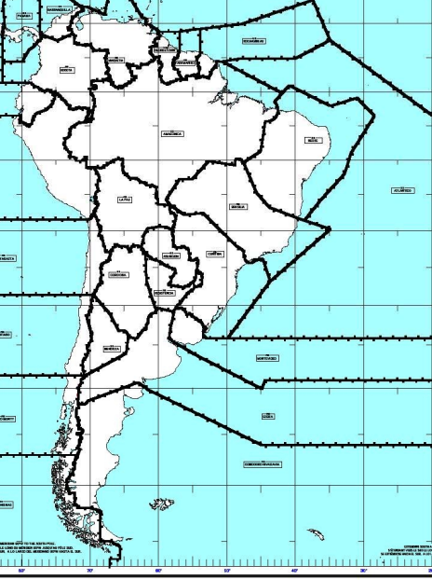
States involved, VAAC Associates and other participants in the exercise
STATES INVOLVED
03

Slide 11
States involved, VAAC Associates and other participants in the exercise
States involved, VAAC Associates
VAAC Buenos Aires
País | Nombre FIR | Código OACI
Argentina | Ezeiza | SAEF
 | Córdoba | SACF
 | Resistencia | SARR
 | Mendoza | SAMF
 | Comodoro Rivadavia | SAVF
Bolivia | La paz | SLLF
Brasil | Curitiba | SBCW
 | Brasilia | SBBS
 | Recife | SBRE
 | Atlántico | SBAO
 | Amazónica | SBAZ
Chile | Antofagasta | SCFZ
 | Santiago | SCEZ
 | Puerto Montt | SCTZ
 | Punta Arenas | SCCF
Paraguay | Asunción | SGFA
Perú | Lima | SPIM
Uruguay | Montevideo | SUEO
03
Notes:
Cuando se indica Estados involucrados, está implicito el involucramiento de:
Autoridad de Aeronáutica Civil
Proveedor de servicios ATS
Proveedor de servicios AIS
Proveedor de servicio MET
etc

Slide 12
States involved, VAAC Associates and other participants in the exercise
States involved, VAAC Associates
VAAC Washington
Country | FIR Name | ICAO code
Colombia | Bogota | SKED
 | Barranquilla | SKEC
Ecuador | Guayaquil | SEFG
Guyana | Georgetown | SYGC
French Guyana | Cayenne | SOOO
Panama | Panama | MPZL
Suriname | Paramaribo | SMPM
Venezuela | Maiquetia | SVZM
03

Slide 13
States involved, VAAC Associates and other participants in the exercise
States involved, VAAC Associates
Others involved in the exercise - Volcanological Observatories
State | Volcano observatory
Argentina | Servicio Geológico Minero Argentino, SEGEMAR, Buenos Aires
Chile | Southern Andes Volcano Observatory (SAVO) Departamento de Ciencias Físicas, Temuco Servicio Nacional de Geología y Minería (SERNAGEOMIN), Santiago
Colombia | Servicio Geológico Colombiano, Observatorios Vulcanológicos y Sismológicos de Manizales, Popayán y Pasto
Ecuador | Instituto Geofísico y Sismológico, Quito
Guatemala | INSIVUMEH Sección Vulcanología, Ciudad de Guatemala
Guyana | Guyana Geology and Mines Commission
Panama | Instituto de Geociencias
Peru | Instituto Geofísico del Perú (IGP), Arequipa
03

Slide 14
States involved, VAAC Associates and other participants in the exercise
States involved, VAAC Associates
Others involved in the exercise
IATA
IFALPA
Aircraft Operators
Aerodrome Operators
CANSO
BRISA
CADENA
03

Slide 15
Meeting Objectives and Scope of the Exercise
Planning the VOLCEX Workshop 2024
Provide guidelines and information to the stakeholders involved in order to establish and organize the development of a collaborative "VOLCEX Workshop" (scheduled for May 2024).
Plan and define the activities associated with the execution of the exercise (scheduled for the second half of 2024);
Highlight the importance of a VOLCEX exercise to improve responses to volcanic eruptions and ash contamination.
Draw the attention of States to test and evaluate the effectiveness of their national procedures in accordance with the ICAO plan (VAAC procedures, NOF, for LMOs, ANSP, Volcano Observatory (SVO), etc.).
04
Notes:
The objective of this preliminary meeting, "VOLCEX Planning Meeting", is to provide guidelines and information to the actors involved in the VOLCEX, in order to establish and organize the development of a collaborative "VOLCEX Workshop" (scheduled for May 2024). The purpose of this workshop is to plan and define the activities associated with the execution of the exercise (scheduled for the second half of 2024).
The objective of the VOLCEX exercise itself, as mentioned in the introduction, is to improve response actions to volcanic eruptions and ash contamination. This includes exercising and improving the regional volcanic ash contingency plan.
It is also an instance that allows each state to test and evaluate the effectiveness of its national procedures in accordance with the ICAO plan (VAAC, NOF, LMO procedures, ANSP, Volcano Observatory (SVO), etc.).
It also assists aviation stakeholders in the use of aeronautical meteorological information (VAA, VAG, SIGMET WV) and aeronautical information (VONA, ASHTAM, AIREP, special on volcanic activity, etc.) related to volcanic ash.
The SAM Regional Office plays the role of promoter of the exercise and its planning, as well as evaluator of the coordination between the different stakeholders involved in the exercise.

Slide 16
Meeting Objectives and Scope of the Exercise
Remind the industry of the messages used to warn about a volcanic eruption event or presence of volcanic ash cloud;
Assist industry in the operational and planning use of aeronautical meteorological information (VAA, VAG, SIGMET WV) and aeronautical information (VONA, ASHTAM, AIREP specials on volcanic activity, etc.) related to volcanic eruption or presence of volcanic ash clouds;
ICAO plays the role of promoter of the exercise and its planning, as well as evaluator of the coordination between the different stakeholders involved in the exercise.
04
Notes:
The objective of this preliminary meeting, "VOLCEX Planning Meeting", is to provide guidelines and information to the actors involved in the VOLCEX, in order to establish and organize the development of a collaborative "VOLCEX Workshop" (scheduled for May 2024). The purpose of this workshop is to plan and define the activities associated with the execution of the exercise (scheduled for the second half of 2024).
The objective of the VOLCEX exercise itself, as mentioned in the introduction, is to improve response actions to volcanic eruptions and ash contamination. This includes exercising and improving the regional volcanic ash contingency plan.
It is also an instance that allows each state to test and evaluate the effectiveness of its national procedures in accordance with the ICAO plan (VAAC, NOF, LMO procedures, ANSP, Volcano Observatory (SVO), etc.).
It also assists aviation stakeholders in the use of aeronautical meteorological information (VAA, VAG, SIGMET WV) and aeronautical information (VONA, ASHTAM, AIREP, special on volcanic activity, etc.) related to volcanic ash.
The SAM Regional Office plays the role of promoter of the exercise and its planning, as well as evaluator of the coordination between the different stakeholders involved in the exercise.

Slide 17
Meeting Objectives and Scope of the Exercise
Remind States of the need for revision of:
1. Methodology/Procedures for Coordination between national and international IRFs.
2. Messages to be issued and communication systems to be used;
3. Information on the status of airports, in relation to local volcanic ash management;
4. Review of procedures for management of deposited volcanic ash to avoid re-suspension of ash.
04
Notes:
The objective of this preliminary meeting, "VOLCEX Planning Meeting", is to provide guidelines and information to the actors involved in the VOLCEX, in order to establish and organize the development of a collaborative "VOLCEX Workshop" (scheduled for May 2024). The purpose of this workshop is to plan and define the activities associated with the execution of the exercise (scheduled for the second half of 2024).
The objective of the VOLCEX exercise itself, as mentioned in the introduction, is to improve response actions to volcanic eruptions and ash contamination. This includes exercising and improving the regional volcanic ash contingency plan.
It is also an instance that allows each state to test and evaluate the effectiveness of its national procedures in accordance with the ICAO plan (VAAC, NOF, LMO procedures, ANSP, Volcano Observatory (SVO), etc.).
It also assists aviation stakeholders in the use of aeronautical meteorological information (VAA, VAG, SIGMET WV) and aeronautical information (VONA, ASHTAM, AIREP, special on volcanic activity, etc.) related to volcanic ash.
The SAM Regional Office plays the role of promoter of the exercise and its planning, as well as evaluator of the coordination between the different stakeholders involved in the exercise.

Slide 18
Meeting Objectives and Scope of the Exercise
Recommendations for the development of the exercise
Workshop participants should provide and/or review prior to the workshop to facilitate/discuss during the workshop:
Name the VOLCEX exercise.
Choice of erupting volcano/s (LAT/LONG).
Week of VOLCEX exercise. Start and end dates and times.
Review national volcanic ash contingency plan procedures should include Contingency agreements between bordering states.
Focal points per country. Leaders and substitutes.
Prepare list of participants with phone number and email per State (AAC, ATS, AIS, MET, AGA, CNS, Volcanological Observatories).
Focal points from industry and professional organizations.
04
Notes:
The objective of this preliminary meeting, "VOLCEX Planning Meeting", is to provide guidelines and information to the actors involved in the VOLCEX, in order to establish and organize the development of a collaborative "VOLCEX Workshop" (scheduled for May 2024). The purpose of this workshop is to plan and define the activities associated with the execution of the exercise (scheduled for the second half of 2024).
The objective of the VOLCEX exercise itself, as mentioned in the introduction, is to improve response actions to volcanic eruptions and ash contamination. This includes exercising and improving the regional volcanic ash contingency plan.
It is also an instance that allows each state to test and evaluate the effectiveness of its national procedures in accordance with the ICAO plan (VAAC, NOF, LMO procedures, ANSP, Volcano Observatory (SVO), etc.).
It also assists aviation stakeholders in the use of aeronautical meteorological information (VAA, VAG, SIGMET WV) and aeronautical information (VONA, ASHTAM, AIREP, special on volcanic activity, etc.) related to volcanic ash.
The SAM Regional Office plays the role of promoter of the exercise and its planning, as well as evaluator of the coordination between the different stakeholders involved in the exercise.

Slide 19
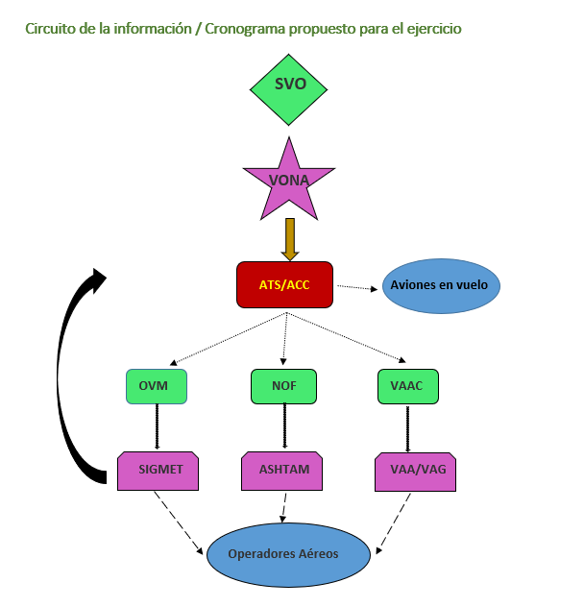
Information flow / Proposed timetable for the exercise
05

Slide 20
Tasks for States and Reference Documentation
Review contingency plans
Invite the actors of the State's own exercise.
Identify roles of:
  Exercise leader,
  From the VAAC(s),
  Of the volcanological observatories,
  Of the ACCs,
  FMUs,
  Of the MWOs,
  NOFs,
  From the aeronautical authority,
  Airline operators,
  Airport operators.
  Press releases and information management on social networks.
Prepare example of:
  VONA, VAA/VAG, SIGMET WV, ASHTAM.
Format of final report of the exercise by State.
06

Slide 21
Tasks for States and Reference Documentation
Reference Documentation:
Annex 3. Meteorological Service for international air navigation. ICAO.
Annex 6. Aircraft operations. ICAO.
Annex 11. Air Traffic Services. ICAO.
Annex 15. Aeronautical Information Services. ICAO
Annex 19. Safety Management. ICAO.
Doc. 4444. Procedures for Air Navigation Services (PANS) - Air Traffic Management. ICAO.
06

Slide 22
Tasks for States and Reference Documentation
Reference Documentation:
Doc. 9691. Manual on volcanic ash clouds, radioactive materials and toxic chemicals. ICAO.
Doc. 9766. Manual on Volcano Surveillance on International Airways - Operational Procedures and List of Points of Contact. ICAO.
Doc. 9974. Flight safety and volcanic ash - Risk management of flight operations where volcanic ash contamination is known or predicted. ICAO.
06

Slide 23
THANKS!

