Slide 1
Updates on SSPIA Integration into USOAP-CMA activities

Slide 2
Outline
Background
Roadmap
The integrated activity

Slide 3
Background
On 4 March 2022, the Council approved the follow-up actions to be taken by ICAO regarding the HLCC 2021 Recommendations (C-WP/15312) which includes integrating SSPIAs into traditional USOAP CMA activities (hereinafter referred to as “integrated activity”) (C-DEC 225/7).
Following this decision, MO presented a transition timeline toward the integrated activity to the Council (April 2022), with the goal to have an official launch in 2025.

Slide 4
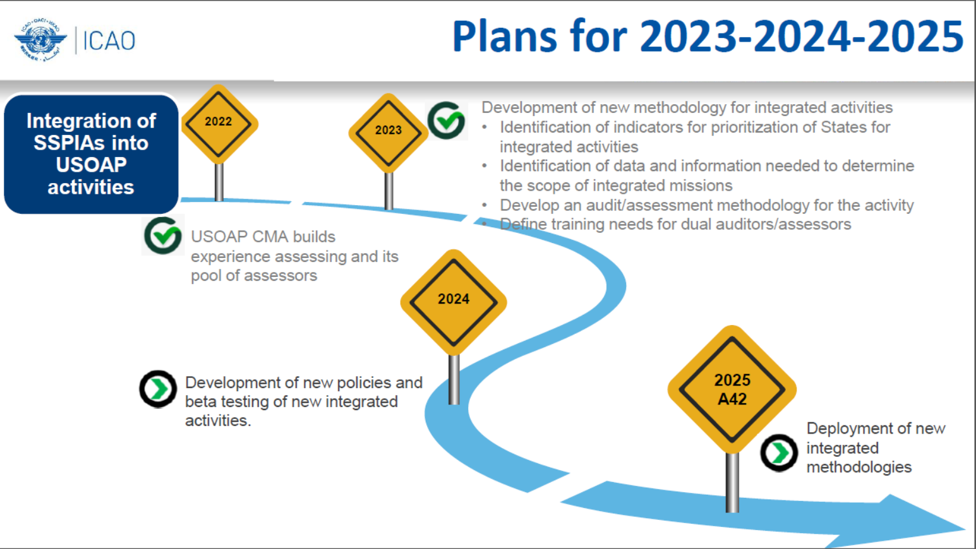

Slide 5
The integrated activity
How does the USOAP mission look like?
  One on-site visit to cover both safety oversight and SSP assessment.
  During on-site visit, safety oversight audit/validation and SSP assessment will be conducted by the same TM(s) for one technical area (additional training will be provided to TMs to be dually qualified for both safety oversight audit/validation and SSP assessment).
How does the report look like?
  One report to include both the effectiveness of safety oversight, i.e. EIs, and the maturity of SSP implementation and maintenance, i.e. MLs.
  The report will include two parts, such as Part I – Safety Oversight, and Part II – SSP, with EIs (overall, by area, by CE) and MLs (overall, by area, by component) provided in Appendices.

Slide 6
The integrated activity
ANB MO is currently working on the details of the integrated methodology.
Workshops or training sessions will be provided to all the ICAO regions on the integrated methodology before being officially launched in 2025.

Slide 7


