Slide 1
USOAP Continuous Monitoring Approach (CMA) Workshop
Module 4
How to Conduct PQ Self-Assessment and
Submit/Update Corrective Action Plans (CAPs)

Slide 2
Objective
The objective of this module is to explain:
  How to conduct PQ self-assessment; and
  How to submit and update CAPs.
Notes:
Validation of trainees understanding?

Slide 3
Outline
How to Conduct PQ Self-Assessment.
How to Submit CAPs.
How to Update CAPs.
Notes:
Validation of trainees understanding?

Slide 4
How to Conduct
PQ Self-Assessment
Notes:
Validation of trainees understanding?

Slide 5
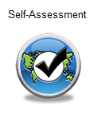
PQ Self-Assessment
PQ self-assessment essentially means that States answer the Protocol Questions (PQs) on the CMA Online Framework (OLF) as a way to assess the state of their civil aviation safety oversight systems.
Specifically, they:
  Assess the “Status of Implementation” of
  each PQ (i.e. Satisfactory, Not Satisfactory
  or Not Applicable);
  Provide “Remarks” to explain “Status”; and
  Attach supporting “Evidence”.
Notes:
Validation of trainees understanding?

Slide 6
PQ Self-Assessment
Before conducting self-assessment on the OLF, States should implement their CAPs and update status of CAP implementation for each PQ finding.
Through the “Self-Assessment” tool on the OLF, States can:
  Indicate/update the status of implementation of each PQ;
  Submit supporting evidence;
  Conduct internal self-audits;
  Prepare for ICAO USOAP CMA activities; and
  Monitor their own civil aviation safety oversight systems.

Slide 7
PQ Self-Assessment
As a priority, States’ PQ self-assessment should focus on:
  “Not Satisfactory” PQs from previous USOAP activity;
  New PQs introduced through PQ amendments (classified as “undetermined PQs”);
  Amended PQs which impact implementation status of PQs; and
  PQs whose implementation status may have changed due to changes in States’ aviation system, regulations and/or procedures.
Notes:
See 2.8.1, Doc 9735, 4th edition.

Slide 8
After Self-Assessment…
ICAO uses the results of a State’s completed self-assessment to prepare for CMA activities.
Through the CMA activities, ICAO reviews and validates a State’s self‒assessment to determine the latest level of efficient implementation (EI) of State’s safety oversight capacity.
ICAO will periodically revise the PQs in order to reflect amendments made to the referenced documents.
It is important for States to always refer to the stated versions of the referenced documents.
Notes:
Re bullet #2 > CMA activities lead to update of a State’s official EL.

Slide 9
How to Conduct PQ Self-Assessment
Go to the USOAP CMA Online Framework (OLF) website using the following link: www.icao.int/usoap.
Click the “Self-Assessment” icon.
Notes:
Validation of trainees understanding?

Slide 10
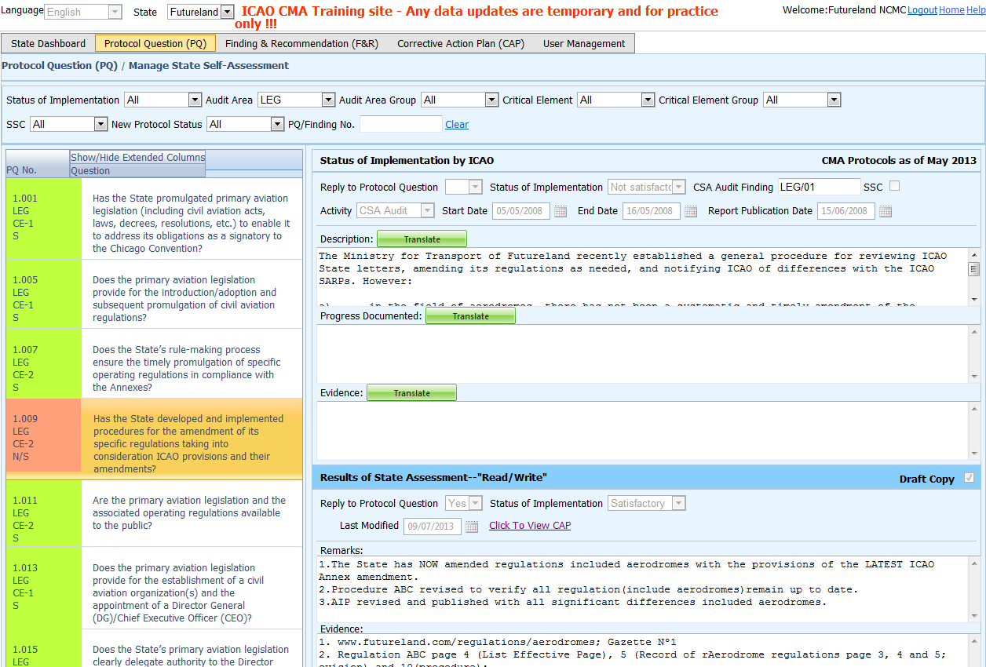
Conducting PQ Self-Assessment
View the toolbar and select the correct options
to obtain the desired information, as shown here.

Slide 11

PQ Self-Assessment — for ICVM
States preparing for an ICVM should conduct a self-assessment
on all “not satisfactory” PQs of selected audit area(s).
Select the option “Not satisfactory” to view the full list of
“not satisfactory” PQs in the selected audit area.

Slide 12
PQ Self-Assessment — for Audit
States preparing for an audit should conduct a self-assessment on all PQs.
Select the option “All” to view all PQs.
Notes:
Selecting ALL PQ when receiving an audit should not have any color codes. They should all be not satisfactory or just have a white color or Undetermined/Not validated

Slide 13
Conducting PQ Self-Assessment
Select the desired PQ.

Slide 14
Conducting PQ Self-Assessment
Refer first to ICAO’s comments from
previous activity report in conducting self-assessment.
Click “Translate” button to obtain
translation of text into desired ICAO language.

Slide 15
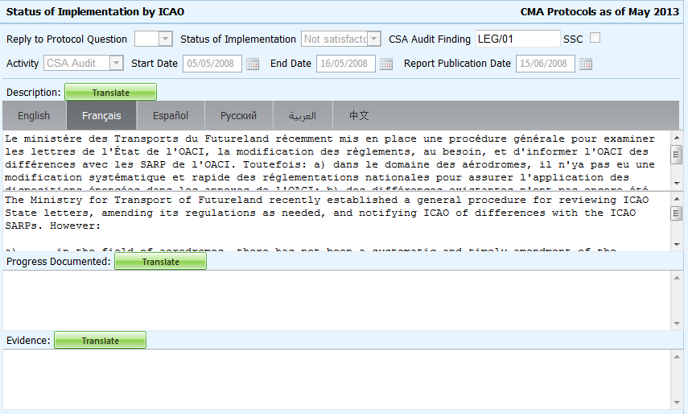
Translation of Text
Click to select the desired language.
The translated text will appear in the top box, while the text in the original language appears in the lower box.
Use the scroll bar to navigate up/down the textboxes.

Slide 16
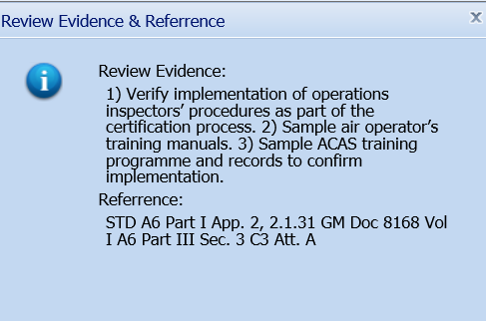
Viewing Guidance and References
To view guidance and references of selected PQ,
double-click the PQ number (first column on left) and
“Review Evidence & References” window will appear.

Slide 17
Example
Review Evidence:
Verify implementation of operations inspectors’ procedures as part of the
certification process.
Sample air operator’s training manuals.
Sample ACAS training programme
and records to confirm implementation.
Reference
STD: A6, Part I App. 2, 2.1.31
A6, Part III Sec 3, C3, Att. A
GM: Doc 8168, Vol I
PQ No. | Question
4.223 OPS CE-6 | Does the aircraft operations organization ensure that the air operator develops an ACAS training programme on ACAS‑equipped aircraft for its pilots?

Slide 18
Conducting PQ Self-Assessment
For “Not Satisfactory” PQs, review the “Description” and “Progress Documented”
under the “Status of Implementation by ICAO” toolbar.
Note.—“Satisfactory” PQs will not have this information.
Notes:
The CAP will often identify the evidence required to satisfy required elements of the PQ.

Slide 19
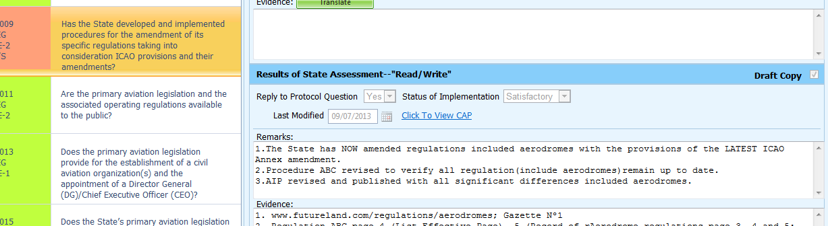
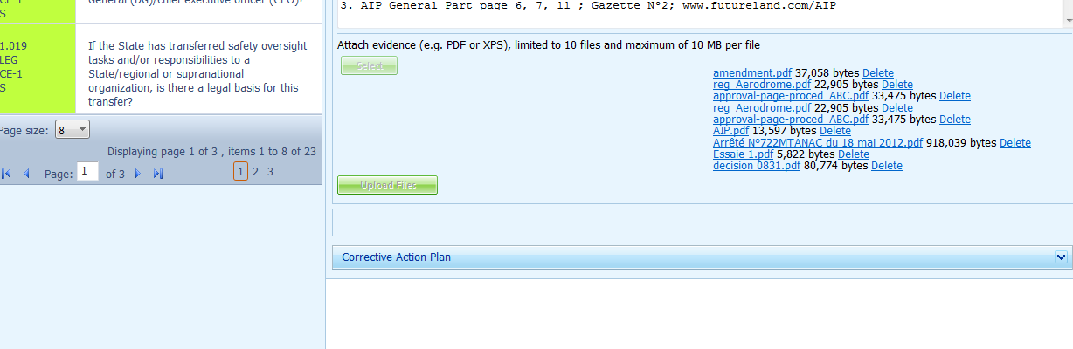
Viewing CAP
To view CAP of related PQ, click “Click To View CAP” link on the right. OR
Scroll to bottom of page to view CAP inside “Corrective Action Plan” box.
Notes:
The CAP will often identify the evidence required to satisfy required elements of the PQ.

Slide 20
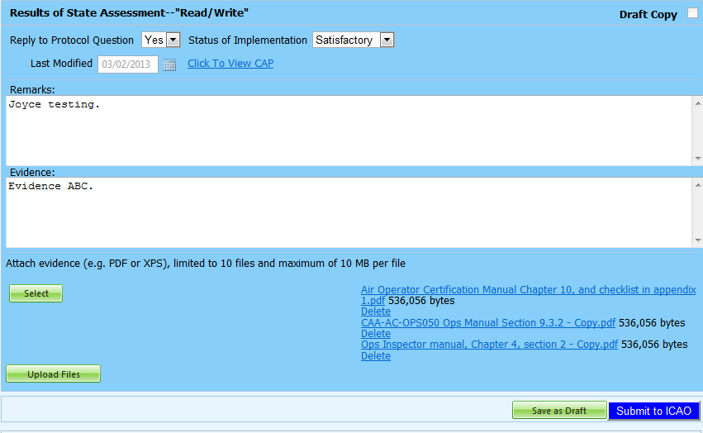
Conducting PQ Self-Assessment
Select “Yes” or “No” to “Reply to Protocol Question” based on
whether or not the State has responded to the relevant PQ.
CAA-AC-OPS050 Contents of an Operations Manual Section 9.3.2(f), describes requirements for air operators to establish an ACAS programme
Inspector guidance is detailed in Operation inspector Manual, chapter 4, section 2
The Air Operator Certification Manual Chapter 10, and checklist in Appendix 1, detail the certification process
Indicate the State’s status of implementation for said PQ.
“Satisfactory” means that the State has complied with all the guidance requirements of the PQ.
“Not satisfactory” applies when State has not fully complied with any of the guidance requirements of the PQ.
“Not applicable” means that the PQ does not apply in the State (e.g. PQ related to ROs and the State does not have any).
“BLANK” indicates the PQ is undetermined, typically for new PQs that have not been audited.
  CAA-AC-OPS050 Contents of an Operations Manual Section 9.3.2(f) includes the CAA requirements.
  Operation inspector manual, chapter 4, section 2
  The Air Operator Certification Manual Chapter 10, and checklist in Appendix 1

Slide 21
Providing Remarks…
Use the guidance in the “Review Evidence & References” box
to prepare and compose “Remarks” to explain “Status of Implementation”.
In the “Remarks” box, provide one sentence to describe progress of implementation for each guidance element outlined in “Review Evidence & References”.
Notes:
The CAP will often identify the evidence required to satisfy required elements of the PQ.

Slide 22
Providing Remarks…
Points to keep in mind when providing “Remarks”:
  The State should provide “Remarks” to explain the reason for the “Status of Implementation” (Satisfactory/Not satisfactory/Not applicable) of the pertinent PQ.
  The “Remarks” should respond, point-by-point and in a single sentence, to each of the corresponding guidance elements found in “Review Evidence & References”.
  If supporting evidence is attached, the State should provide detailed references, such as chapter, page, paragraph, etc.

Slide 23
Providing Evidence…
If necessary, provide/attach evidence to support
corresponding “Remarks” and guidance elements.
Include document name and specific reference(s).
For large documents, include detailed references to
chapters, sections, pages, etc.

Slide 24
Completing PQ Self-Assessment
Copies of references to be attached
for each item of evidence.
CAA-AC-OPS050 Contents of an Operations Manual Section 9.3.2(f), describes requirements for air operators to establish an ACAS programme
Inspector guidance is detailed in Operation inspector Manual, chapter 4, section 2
The Air Operator Certification Manual Chapter 10, and checklist in Appendix 1, detail the certification process
CAA-AC-OPS050 Contents of an Operations Manual Section 9.3.2(f), describes requirements for air operators to establish an ACAS programme.
Inspector guidance is detailed in Operation inspector Manual, chapter 4, section 2
The Air Operator Certification Manual Chapter 10, and checklist in Appendix 1, detail the certification process
  CAA-AC-OPS050 Contents of an Operations Manual Section 9.3.2(f) includes the CAA requirements.
  Operation inspector manual, chapter 4, section 2
  The Air Operator Certification Manual Chapter 10, and checklist in Appendix 1
  CAA-AC-OPS050 Contents of an Operations Manual Section 9.3.2(f) includes the CAA requirements.
  Operation inspector manual, chapter 4, section 2
  The Air Operator Certification Manual Chapter 10, and checklist in Appendix 1
Click “Select” to open window and select file for upload.
Click “Upload Files” to upload.
Until self-assessment is completed,
save your work using the button “Save as Draft”.
Once self-assessment is fully completed, click “Submit to ICAO”.

Slide 25

Example of Completed Self-Assessment
Helpful Tips in Revising/Updating “Remarks”:
Copy the original “Remarks” text to a WORD document.
Revise/update the original text as required.
In the “Remarks” box, add the date of submission.
Below the date, add the subject matter in CAPITAL LETTERS.
Copy and Paste the revised/updated text into the “Remarks” box.
Click “Save as Draft” to save your work.
CAA-AC-OPS050 Contents of an Operations Manual Section 9.3.2(f), describes requirements for air operators to establish an ACAS programme
Inspector guidance is detailed in Operation inspector Manual, chapter 4, section 2
The Air Operator Certification Manual Chapter 10, and checklist in Appendix 1, detail the certification process
  CAA-AC-OPS050 Contents of an Operations Manual Section 9.3.2(f) includes the CAA requirements.
  Operation inspector manual, chapter 4, section 2
  The Air Operator Certification Manual Chapter 10, and checklist in Appendix 1

Slide 26
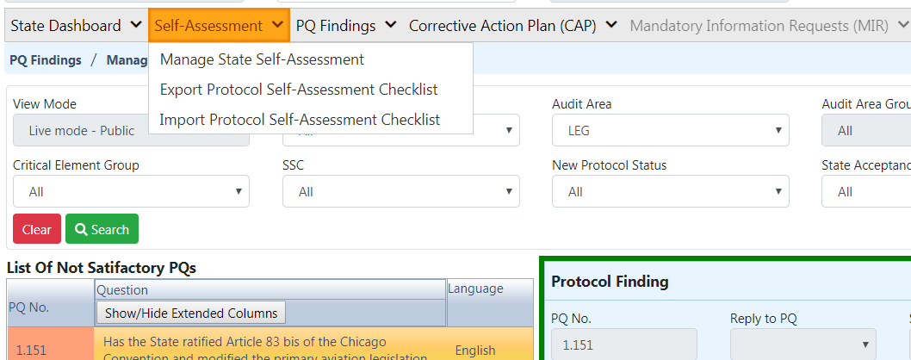
Exporting Self-Assessment Checklist
Under “Self-Assessment” tab, scroll down and select “Export Protocol Self-Assessment Checklist”.

Slide 27
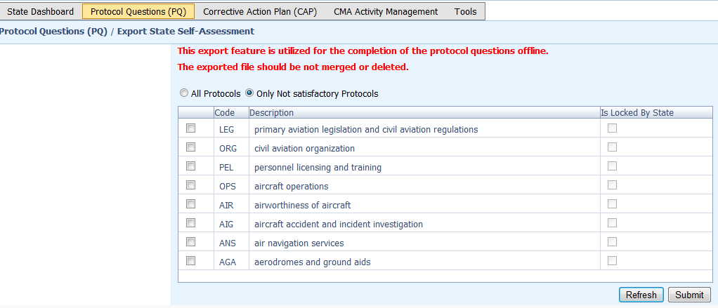
Exporting Self-Assessment Checklist —
“All Protocols”
To view all PQs, Click “All Protocols”.

Slide 28
Exporting Self-Assessment Checklist —
“Only Not satisfactory PQs”
To view “Not Satisfactory” PQs only,
click “Only Not satisfactory Protocols”.

Slide 29
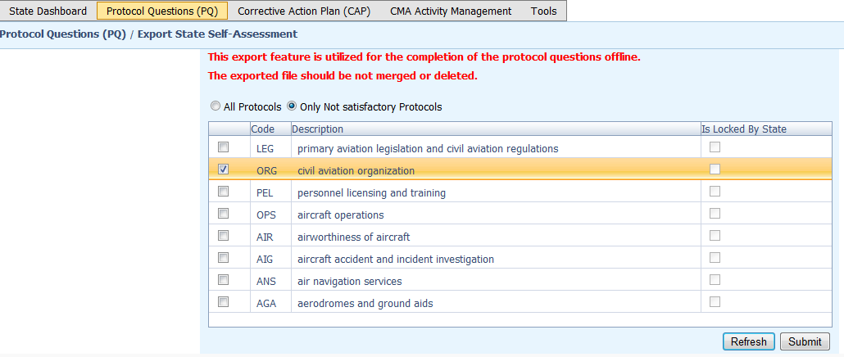
Exporting Self-Assessment Checklist —
Selected PQs
To view PQs of a particular audit area (1 area at a time), check box next to selected audit area.

Slide 30
Exporting Self-Assessment Checklist
Once PQ selection is made, click “Submit” to download file.
!!! Wait a few seconds for the file to download, depending on the Internet speed. DO NOT press the “Submit” button twice.

Slide 31
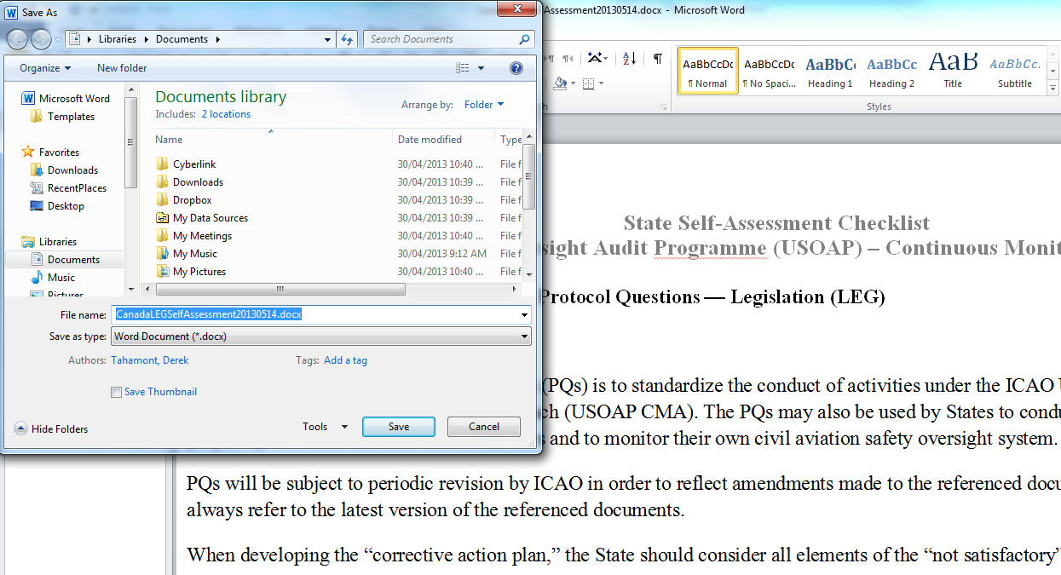
Exporting Self-Assessment Checklist
Save the file in the desired location for use.

Slide 32
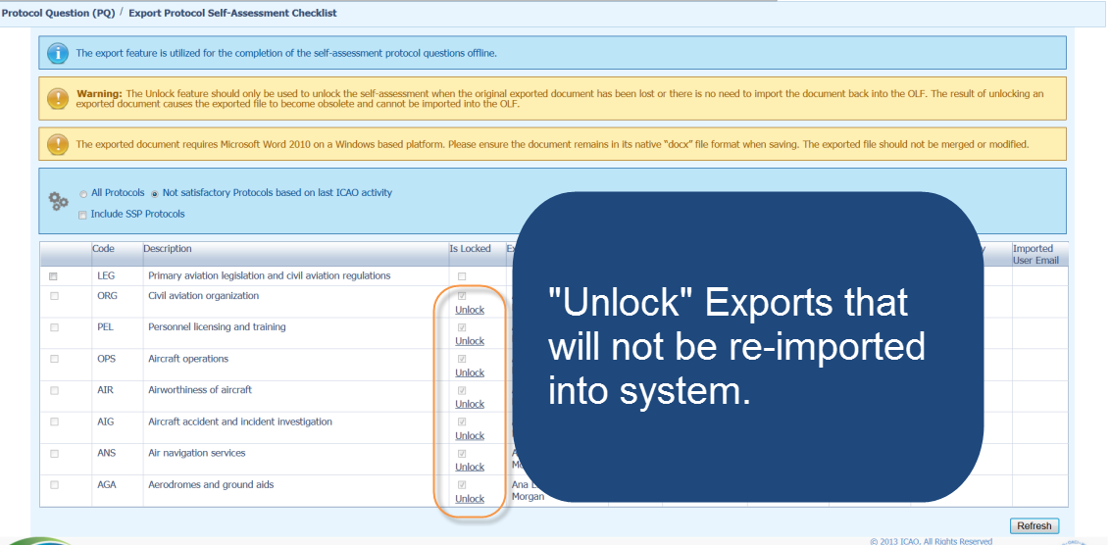
Exporting Self-Assessment Checklist

Slide 33
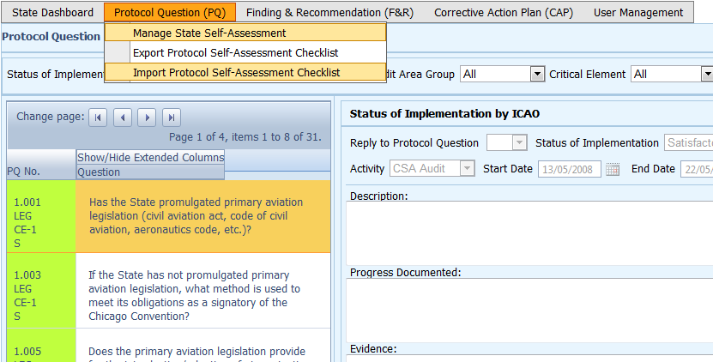
Importing Self-Assessment Checklist
Under “Protocol Question (PQ)” tab, scroll down and select “Import Protocol Self-Assessment Checklist”.

Slide 34
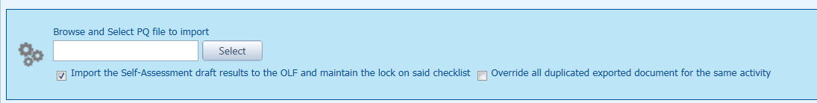
Importing Self-Assessment Checklist
Click “Select” to open window and select file to be imported.

Slide 35
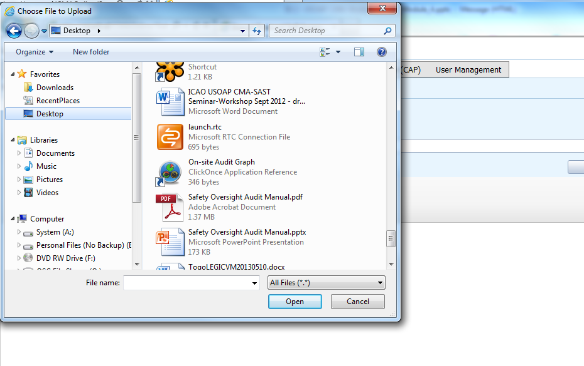
Importing Self-Assessment Checklist
Select file to be imported and close window.

Slide 36
Importing Self-Assessment Checklist
Click “Open” to import the file.

Slide 37
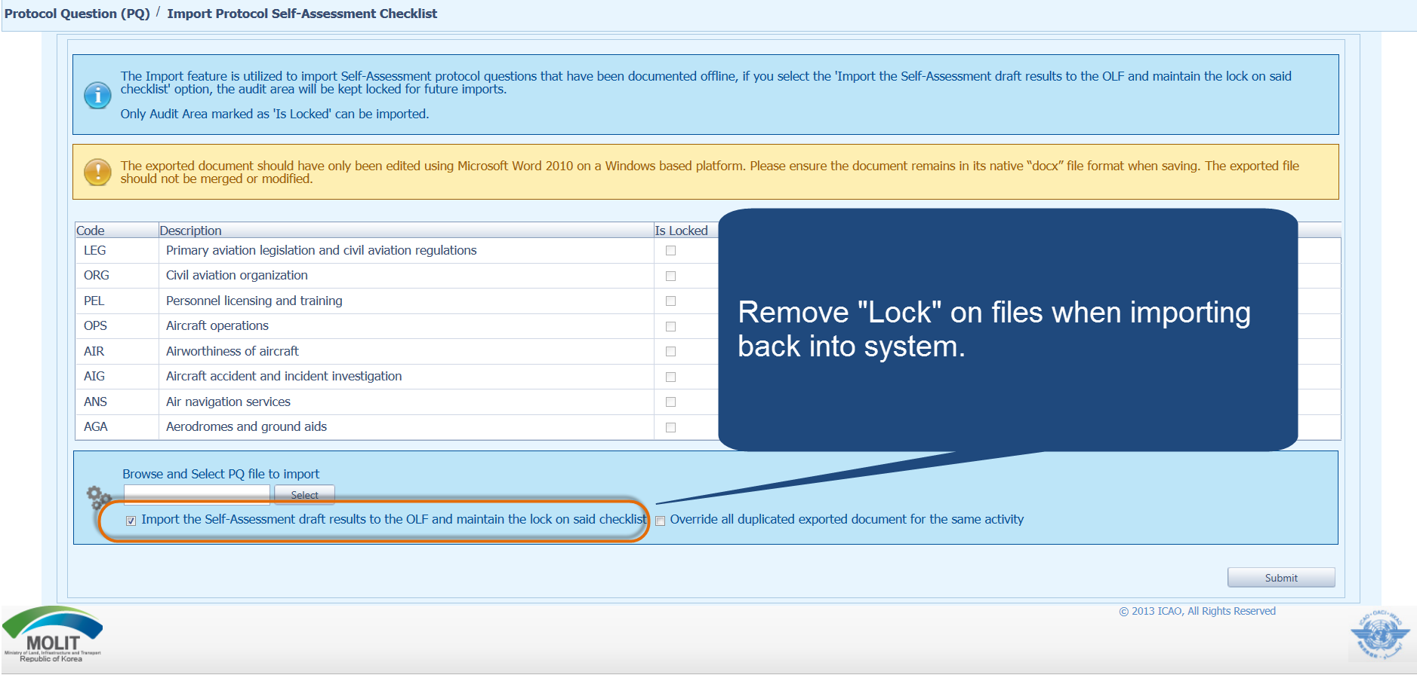
Importing Self-Assessment Checklist

Slide 38
Importing Self-Assessment Checklist
Once filename appears in “Select” field, click “Submit”.

Slide 39

Export/Import Self-Assessment Checklist
Points to keep in mind when exporting/importing files:
  If exported files are to be used solely for information purposes, make sure to manually Unlock the file after exporting.
  Do NOT make any modifications to the structure of the document, entering information ONLY in the prescribed areas.
  Changing the document structure will prevent you from importing said file back into the OLF.
  Do NOT change the document name.
  Once all work on the document is completed, make sure to uncheck the “Import the Self-Assessment draft results to the OLF and maintain the lock on said checklist” button.

Slide 40
How to Submit CAPs

Slide 41
How to Submit CAPs
Why is it important for States to provide effective CAPs and CAP updates?
It is required by the MOU.
It ensures that States fully address PQ findings.
CAP updates allow States to report the level of progress made.
It enables ICAO to determine the next course of action.

Slide 42
Responsibility of State
State is required to:
  Provide a CAP that fully addresses the PQ Finding (Refer to the “Six Criteria for a Good CAP” in slide no. 44);
  Submit to ICAO the progress made in implementation of each CAP; and
  Once CAP is fully implemented, attached the relevant evidence.
Notes:
Progress status

Slide 43
Responsibility of ICAO
ICAO is required to:
  Provide status of submitted CAP (i.e. “CAP does not address the Finding”, “CAP partially addresses the finding”, “CAP fully addresses the finding”, and others );
  Provide status of CAP review (i.e. “not started” or “in progress” or “completed”); and
  Verify if a completed CAP that was submitted meets the 3 requirements for validation.
Notes:
Progress status

Slide 44
Six Criteria for a Good CAP (“RCDSRC”)
Relevant: CAP addresses the issues and requirements related to the finding and corresponding PQ and CE.
Comprehensive: CAP is complete and includes all elements
or aspects associated with the finding.
Detailed: CAP outlines implementation process using
step-by-step approach.
Specific: CAP identifies who will do what, when and in coordination with other entities, if applicable.
Realistic: In terms of contents and implementation timelines.
Consistent: In relation to other CAPs and with the
State’s self-assessment.

Slide 45
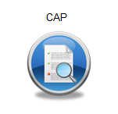
How to Submit CAPs
Go to the USOAP CMA Online Framework (OLF) website using the following link: www.icao.int/usoap.
Click “CAP” icon.
Notes:
Validation of trainees understanding?

Slide 46
How to Submit CAPs
States are required to submit:
  Effective CAPs; and
  Provide regular CAP progress as required by the MOU.
Notes:
Progress status

Slide 47
How to Submit CAPs
States should ensure that CAPs submitted:
  Fully address PQ findings;
  Are relevant, clear, detailed and comprehensive;
  Have realistic target implementation dates; and
  Work systematically towards implementing corrective actions.

Slide 48
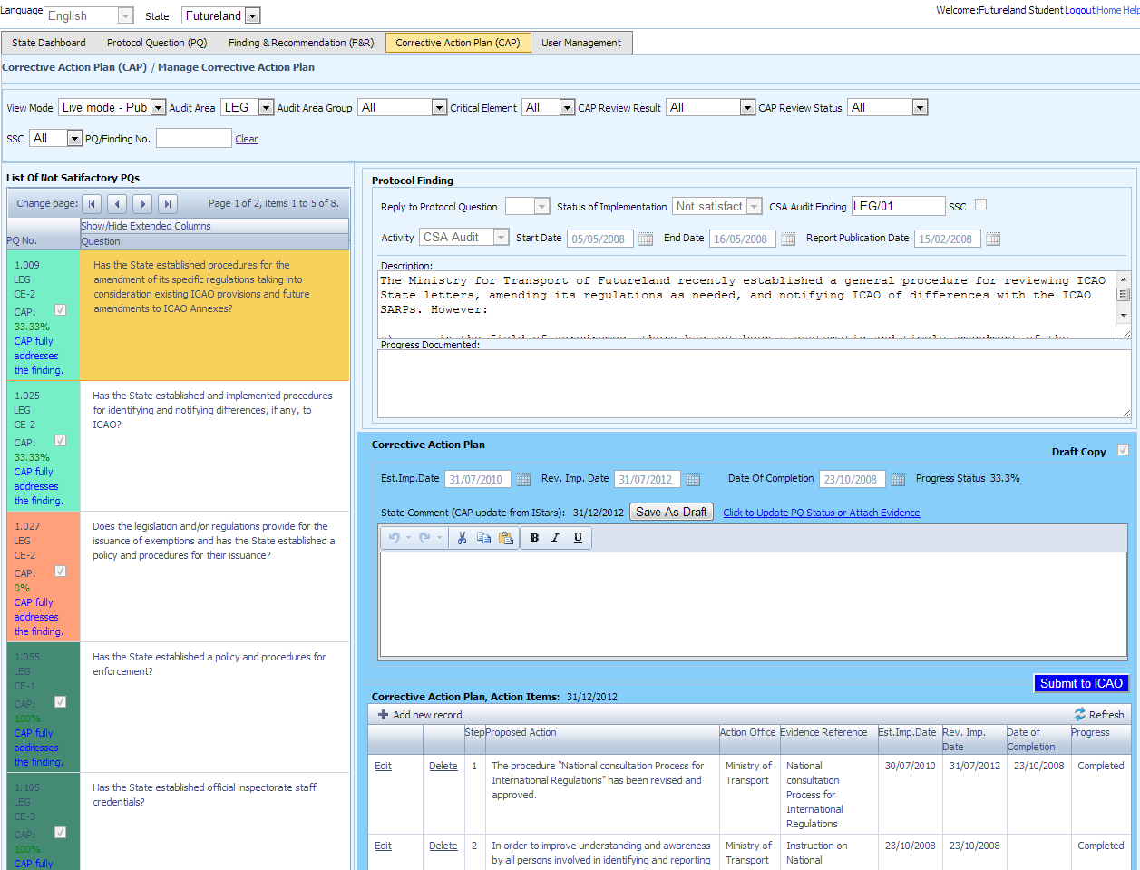

How to Submit CAPs
Review “Description” and “Progress Documented” for pertinent PQ finding from previous USOAP activity.
“Preview mode” vs “Live mode”
Notes:
You must be on preview mode to work on your CAP.

Slide 49
How to Submit CAPs
Select “Corrective Action Plan (CAP)” tab.
Refer to guidance and references of selected PQ.
Double-click PQ number (first column on left) and
“Review Evidence & References” window will appear.

Slide 50
How to Submit CAPs
Provide a realistic “Estimated Implementation Date (EID)”
for each step of the CAP.
Enter the completion date when the CAP is completed.
Enter CAP in a step-by-step format, describing the action and responsible action office per step in clear, concise term.

Slide 51
How to Submit CAPs
Enter comments on CAP submission/update in “State Comments” box, if necessary. Completion of this field is optional.

Slide 52
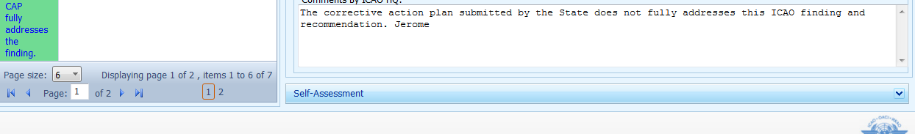
How to Submit CAPs
Scroll down to the bottom of the page and click
“Self-Assessment” link to open “Self-Assessment” box (read only).
Provide any changes impacting the PQ self-assessment and attach evidence as necessary.
Submit to ICAO even if action is not 100% completed so that ICAO can monitor the progress
Save as draft for the continuation of the work later.

Slide 53
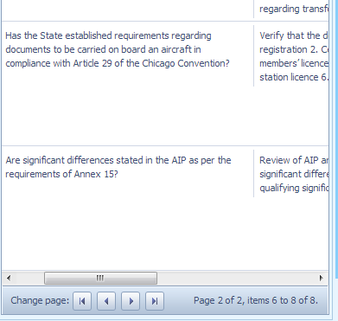
Example
Example
PQ 5.453 (CE-8)
Does the AID initiate a special evaluation or impose special operational restrictions if information obtained from reliability monitoring indicates degraded level of safety?
Guidance
Review examples of action taken.
Note. — If oversight of reliability programmes is not conducted, this PQ is automatically “Not satisfactory”.
.
Reference
GM Doc 9760 Vol. II Part B 7.4

Slide 54
Example
“Description” and “Progress Documented” by ICAO:

Slide 55
Example of Completed CAP
Corrective Action Plan, Action Items: 31/12/2012
Step | Proposed Action | Action Office | Evidence Reference | Est. Imp. Date | Rev. Imp. Date | Date of Completion | Progress
1 | Programme AIR participation in all future reliability meetings held by the air operators. | AID |  | 25/6/2013 |  |  | Completed
2 | Collect and analyse existing reports from reliability monitoring. | AID |  | 13/7/2013 |  |  | Completed
3 | Establish a process to ensure the initiation of special evaluation or imposition of operational restrictions in cases of degraded level of safety. | AID |  | 11/10/2013 |  |  | 25%
4 | Define possible operational restrictions to be taken. | AID |  | 11/10/2013 |  |  | Not started

Slide 56
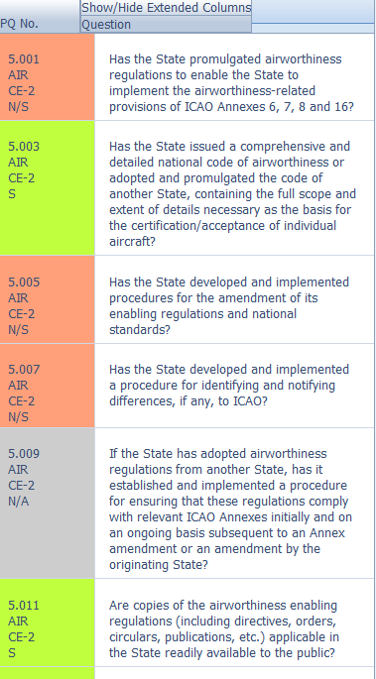
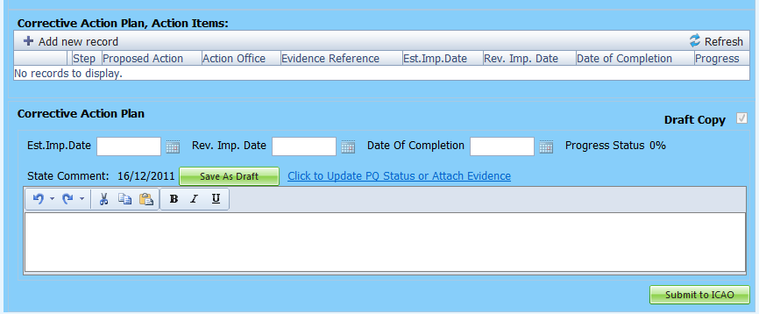
How to Add New CAPs
1 - Select PQ for which a new CAP is to be added.
2 - Click “Add new record”.

Slide 57
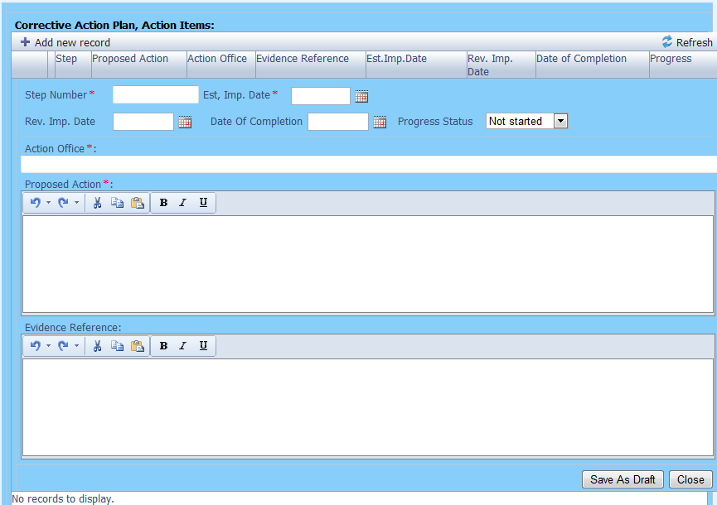
How to Add New CAPs
Fill in the following fields:
Step number: A CAP may have several steps based on complexity of action. Each action will require a separate step to facilitate CAP assessment and validation.
Estimated Implementation Date: This estimated date should indicate when the step is expected to be fully implemented.
Progress status
Action office is the office in charge of completing this step.

Slide 58
How to Add New CAPs
Fill in the following fields:
Proposed Action: Make sure to provide a proposed action item for the corresponding step.
Evidence Reference: Each reference should be clearly indicated (i.e. chapter, section, paragraph, etc.).
Save as draft
Close: To return to the previous page and to add next steps.

Slide 59
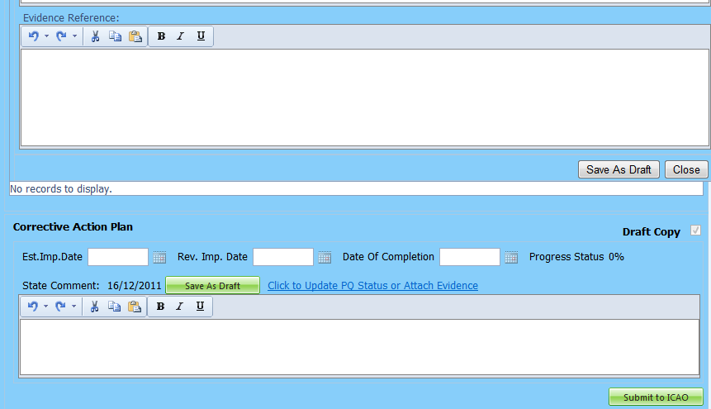
How to Add New CAPs
Click this link to provide self-assessment
and attach evidence.
Provide additional comments, if necessary.
This field is optional.
Click this button when all the steps related to the CAP are completed and ready to be submitted to ICAO.

Slide 60
How to Update CAPs

Slide 61
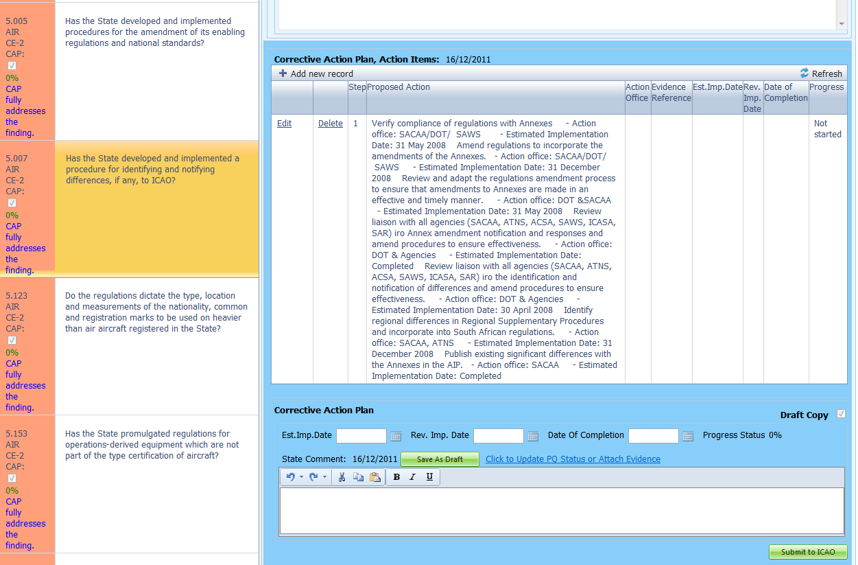
How to Update CAPs
Click “Edit” to revise/update CAPs.
Select the PQ whose CAP is to be revised/updated.

Slide 62
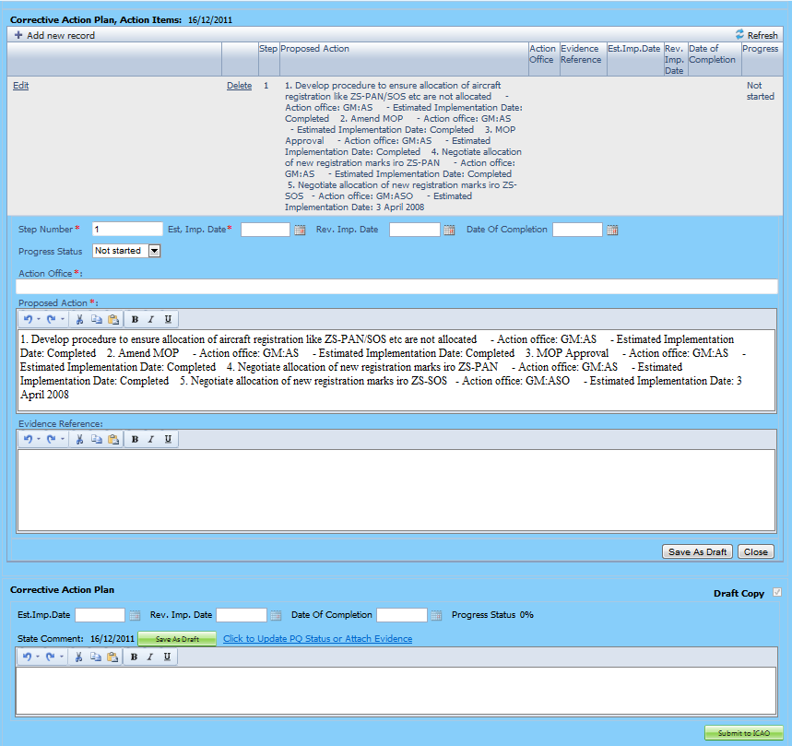
How to Update CAPs
Fill in the following fields:
Step Number: A CAP may have several steps based on the complexity of the action. Each action will require a separate step to facilitate CAP assessment and validation.
Revised Implementation Date: Based on the CAP update, if the EID is no longer realistic, then a revised implementation date should be entered.
Date of Completion: The date when the action was completed should be entered.
Progress Status
Action Office

Slide 63
How to Update CAPs
Fill in the following fields:
Updated Proposed Action: Make sure to provide a proposed action item for each corresponding step.
Evidence Reference: Each reference should be precise and detailed (with chapter, section, paragraph, etc.).
Save as Draft
Close: To return to previous page and to edit other steps.
Submit to ICAO: When all steps are fully edited and ready for submission.
Note.— Evidence may be attached using the instructions mentioned previously.

Slide 64
Review
How to Conduct PQ Self-Assessment.
How to Submit CAPs.
How to Update CAPs.
The system is evolving.
Feedback and suggestions from users is required for the system to mature!
Notes:
Validation of trainees understanding?

