Slide 1
USOAP Continuous Monitoring
Approach (CMA) Workshop
Module 3
CMA Online Framework (OLF) and
Electronic Filing of Differences (EFOD) System

Slide 2
Contents
Overview of CMA Online Framework (OLF)
Functionalities of OLF Modules
Updating EFOD

Slide 3
Overview of CMA
Online Framework (OLF)

Slide 4
CMA Online Framework is…
  A suite of web-integrated applications and centralized database systems which enables:
  Collection of safety-related information and documentation from different sources; and
  Monitoring and reporting of safety oversight activities by ICAO and Member States.

Slide 5
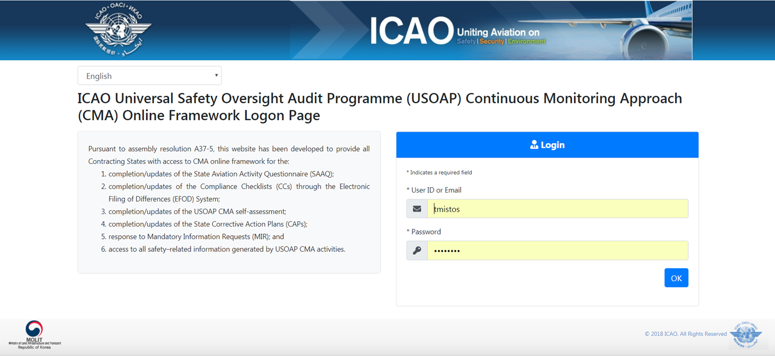
Access through…
ICAO USOAP Restricted Website
(www.icao.int/usoap)

Slide 6
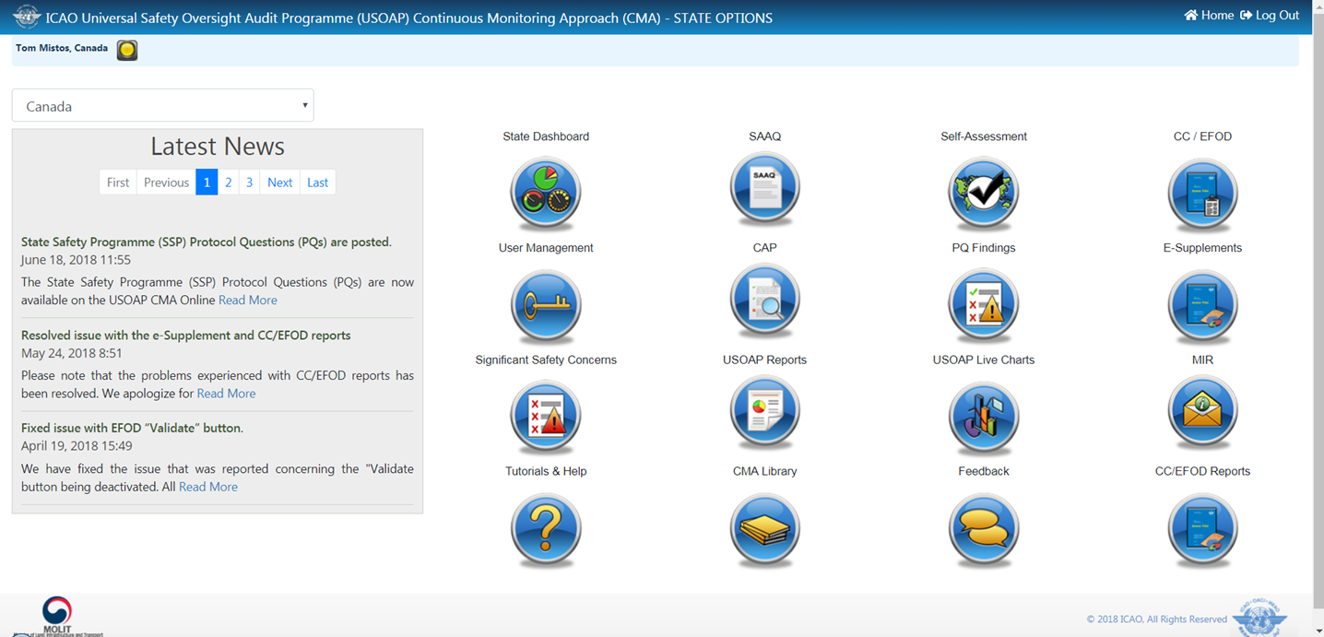
OLF Modules

Slide 7
OLF Functions for States
Manage OLF user accounts.
Keep SAAQ and CC/EFOD up to date.
Provide CAP updates and/or progress per corresponding PQ findings.
Conduct PQ self-assessment.
Respond to MIRs.

Slide 8
Overview of OLF Functionality
Signing of USOAP CMA MOU
Collection of Safety-Related Information
Update on
EI & SSCs
Conduct of on-site CMA activities
Prioritize on-site activities
Between
State & ICAO
From States
From external stakeholders
From ICAO HQ & RO
By ICAO HQ
By ICAO HQ & RO
By ICAO HQ
NCMC Dashboard
Access Control System
MOU
State Profile / SAAQ
CC/EFOD
PQs
MIR
On-Site Audit Manager
State Safety Risk Profile
Offline documents for
CCs and PQs
PQ Findings
SSC
Planning & Scheduling
CAPs
USOAP Library & Final Reports
USOAP Live Reports

Slide 9
Functionalities of OLF Modules

Slide 10

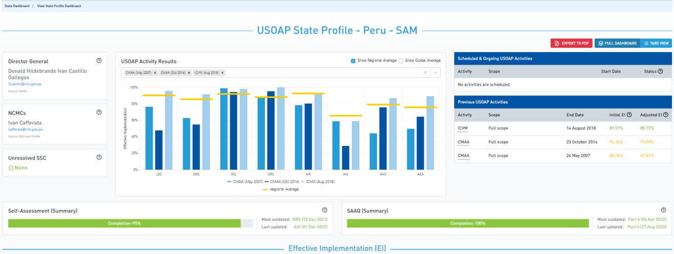
State Dashboard
  States can view:

Slide 11

Access Control
NCMCs: have full control of user accounts
for the State, such as:
  Issue additional user accounts;
  Deactivate invalid user accounts; and
  Set individual user rights/permissions.
Note.—For Annex 9 issues, please coordinate with
Facilitation Section (FAL)/Air Transport Bureau (ATB).
Individual users
  Manage user profile information; and
  Personalize password.
Note.— If you are not an NCMC and want to have access to the OLF,
please contact the NCMC(s) of your State.

Slide 12
Access Control
User account
  composed of “ID” and password.
  Duplicate IDs or email addresses are not acceptable.
Access rights
  3 types: Limited, read-only and read/write.
  CC/EFOD: Access rights may be granted per Annex.
  Access rights may be granted for selected audit areas in each of the 4 OLF modules: Self-Assessment, CAP, PQ Findings and MIR.

Slide 13
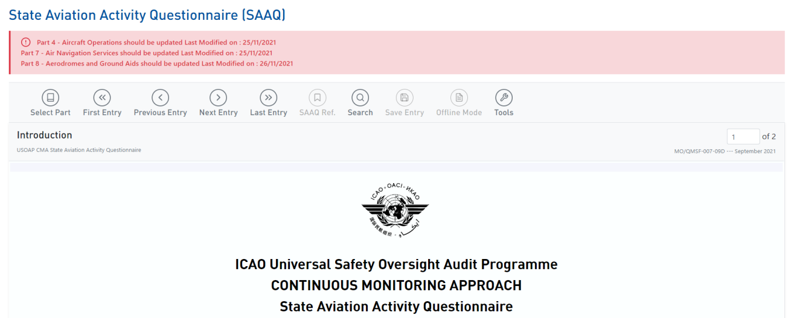
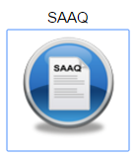
State Aviation Activity Questionnaire
(SAAQ)
States
  Complete and update State Profile and SAAQ.

Slide 14
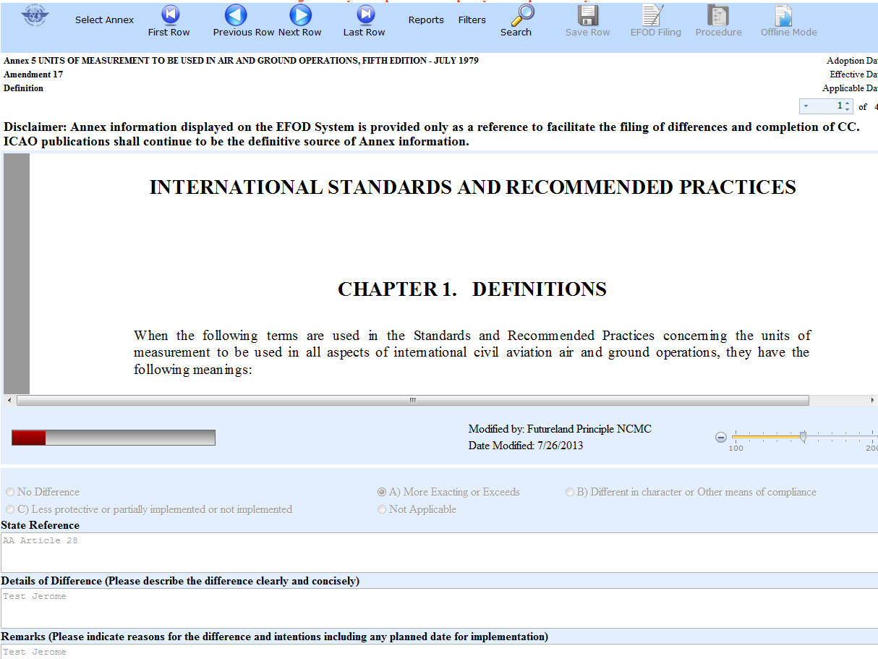
Compliance Checklist /
Electronic Filing of Differences (CC/EFOD)
States
  Indicate compliance with and/or difference to SARPs
  (with details).
  This complies with both Article 38 of the Chicago Convention
  and CMA MOU.
ICAO
  Reviews/monitors the level of
  global compliance/difference.
  Generates e-Supplement.

Slide 15
CC/EFOD
Submit/Update CCs
EFOD
Conduct a preliminary data entry
Online/Offline
Submit/Update CCs
Per Annex
Choose Standards only or All SARPs
Per Annex
Submit official notification to ICAO
To be shared
with other States
To be used for
generation of Supplement
ICAO to monitor and share information on implementation of SARPs

Slide 16
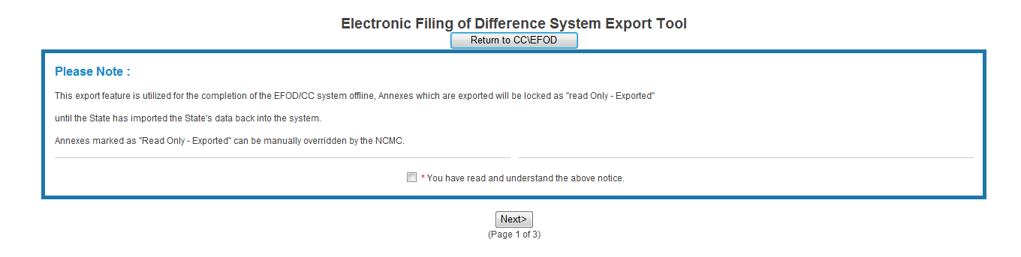
Pre-formatted Word Document
This feature is available only to NCMCs.
  Once the WORD document is downloaded, data in the
  EFOD system is locked.
  To enable users to edit data online, NCMC should upload the WORD document or unlock the data.
Notes:
The user must ”tick” the box in order to move forward.

Slide 17

Self-Assessment
States
  Search and view PQs selected.
  Conduct self-assessment on safety oversight system:
    Update implementation status of PQs (S/NS/NA), with evidence.
    Provide implementation status of new PQs.
    Attach evidence documents.
ICAO
  Keeps PQs up to date.
  Updates status of implementation of State’s PQs based on latest CMA activities.
  Generates State’s Effective Implementation (EI).

Slide 18
Verification by States
In April 2011, per SL AN 1/1-11/28, States were invited to:
  Use EFOD as an alternative means for filing differences to all Annexes (except Annex 17).
  Verify and confirm the data in EFOD which were previously entered through the CCs under USOAP.
States now use the Validation button to file notification of difference.
To date, 186 States have notified their differences via EFOD.

Slide 19
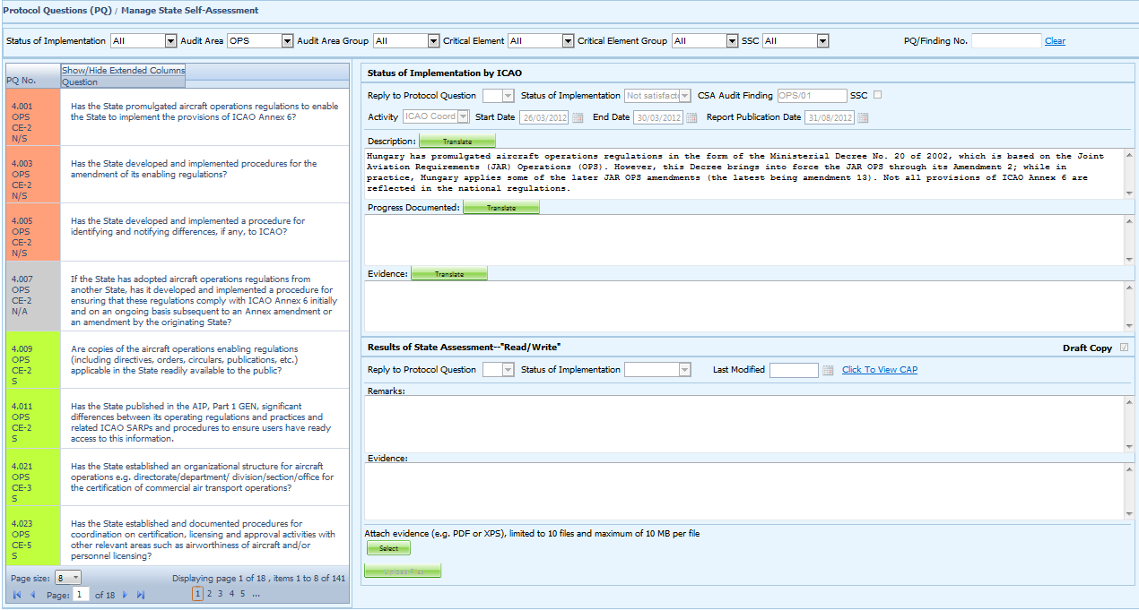
Self-Assessment
Search a PQ
Select a PQ
Status of Implementation by ICAO – View-only
Self-Assessment by States
Upload/attach evidence

Slide 20

Mandatory Information Request (MIR)
ICAO
  Requests States to submit specific information
  and documentation.
  Includes the following information when issuing MIRs:
    Pertinent PQ(s);
    Reason(s) and relevant reference(s); and
    Deadline for submission of requested information.
  Records the result from review of submitted information.
  Updates status of MIR (closed/open/escalated to Findings/SSC).

Slide 21
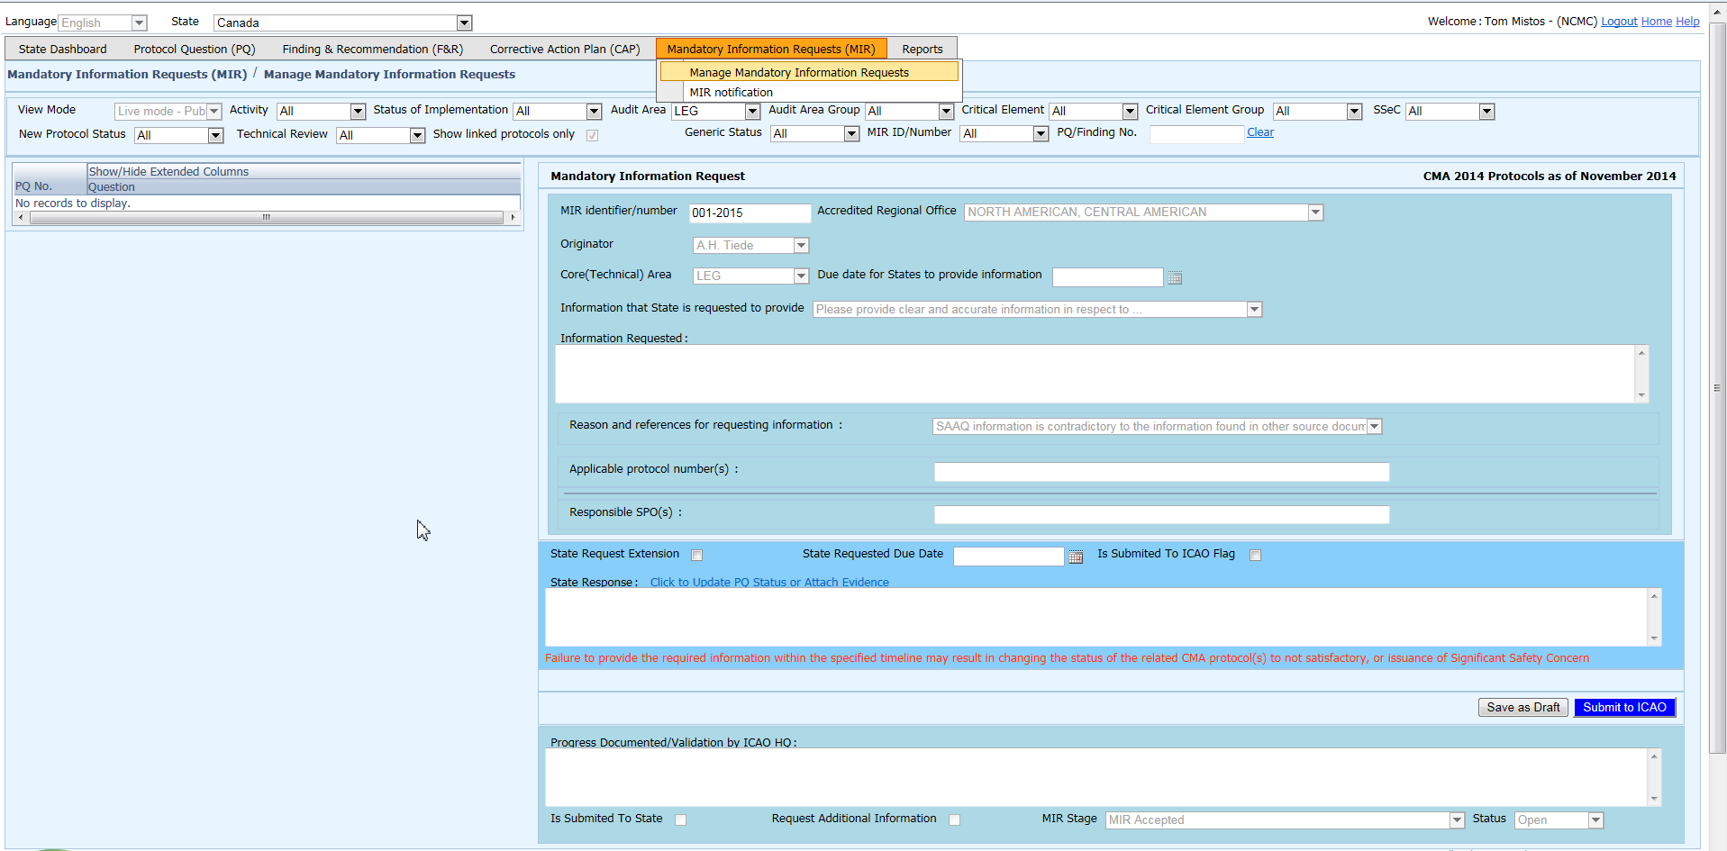
MIR
States
  Respond with evidence requested.
  Provide requested information and/or documentation.
  Request extension of MIR deadline.

Slide 22
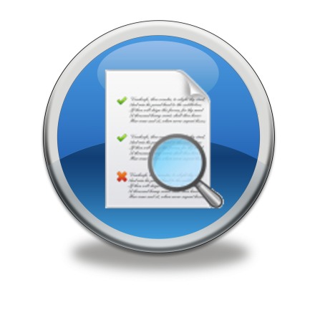
Corrective Action Plan (CAP)
States
  Search and view PQ Finding(s) issued to a State.
  View CAPs submitted during CSA audit cycle.
  Submit/update a CAP to address a PQ Finding:
    A list of proposed actions;
    Action office(s) to the proposed actions;
    Estimated implementation date (dd/mm/yyyy); and
    Revised implementation date, when required.
  Provide regular progress reports on a CAP:
    Completion (%) of each proposed action;
    Date of completion; and
    Supporting evidence (reference).

Slide 23
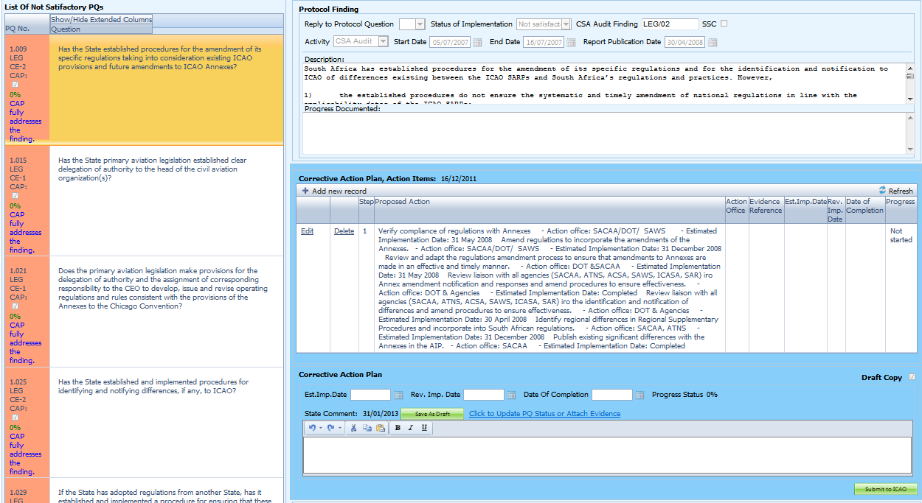
CAP
Select a PQ
Finding by ICAO – View-only
CAP provided by the State

Slide 24
CAP
ICAO
Records status of CAP review (e.g. In progress or Completed).
Records result of review of a proposed CAP and add comments.
Monitors progress of CAP implementation.

Slide 25
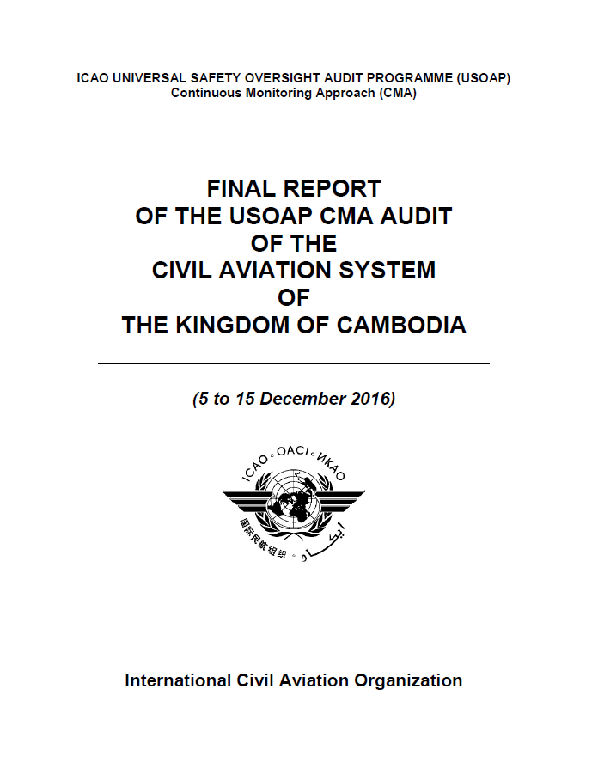

USOAP Reports
Final reports (static)
  Final reports of activities conducted since the first cycle of USOAP.
  Published according to predetermined timeline
  after an activity.

Slide 26
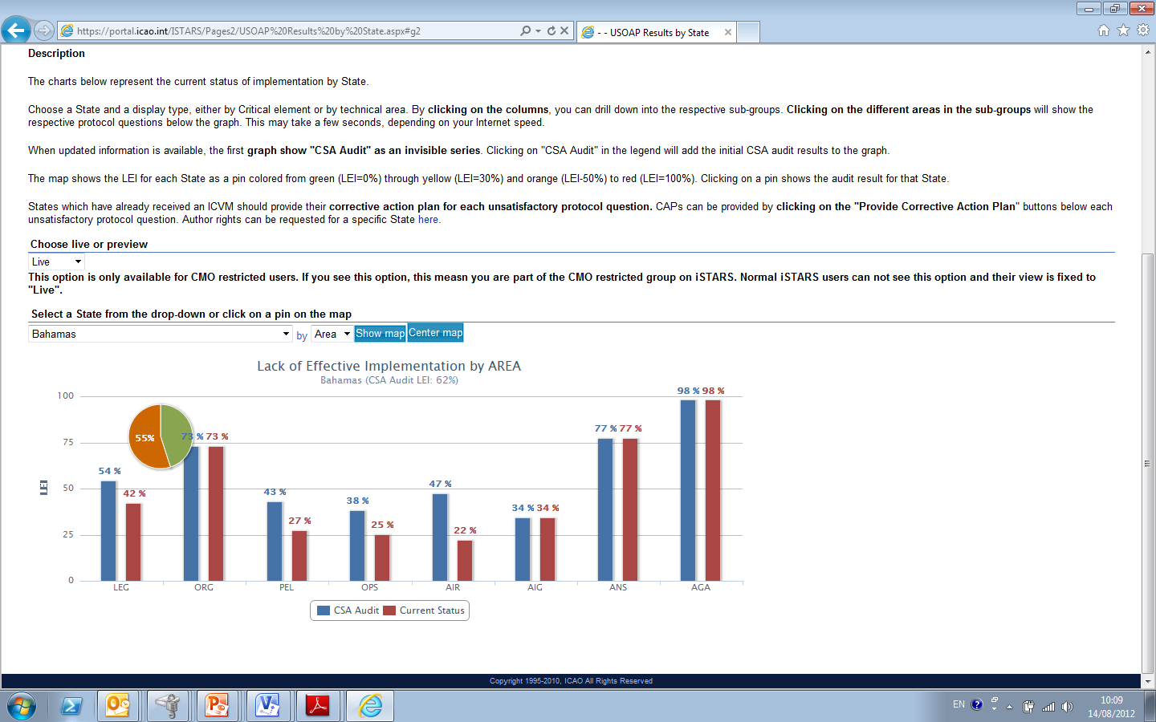

USOAP Live Charts
Dynamic graphic illustrations of USOAP data.
Based on most recent online and/or on-site activity for each audit area/CE.
Note.— When you click the icon, you will be asked to log into the ICAO Portal website (separate user account), where the report resides in iSTARS.

Slide 27

CMA Library
A centralized library for documents related to USOAP CMA, including:
  Assembly and Council Working Papers;
  Doc 9734 — Safety Oversight Manual and
  Doc 9735 — USOAP CMA Manual;
  Generic MOU approved by the Council;
  Master copies of PQs and SAAQ;
  State Letters and Electronic Bulletins;
  and
  USOAP CMA activity schedule.

Slide 28

Feedback
States
  Report issues and send queries about OLF.
ICAO
    Keeps track and manages resolution of all
    reported issues.

Slide 29
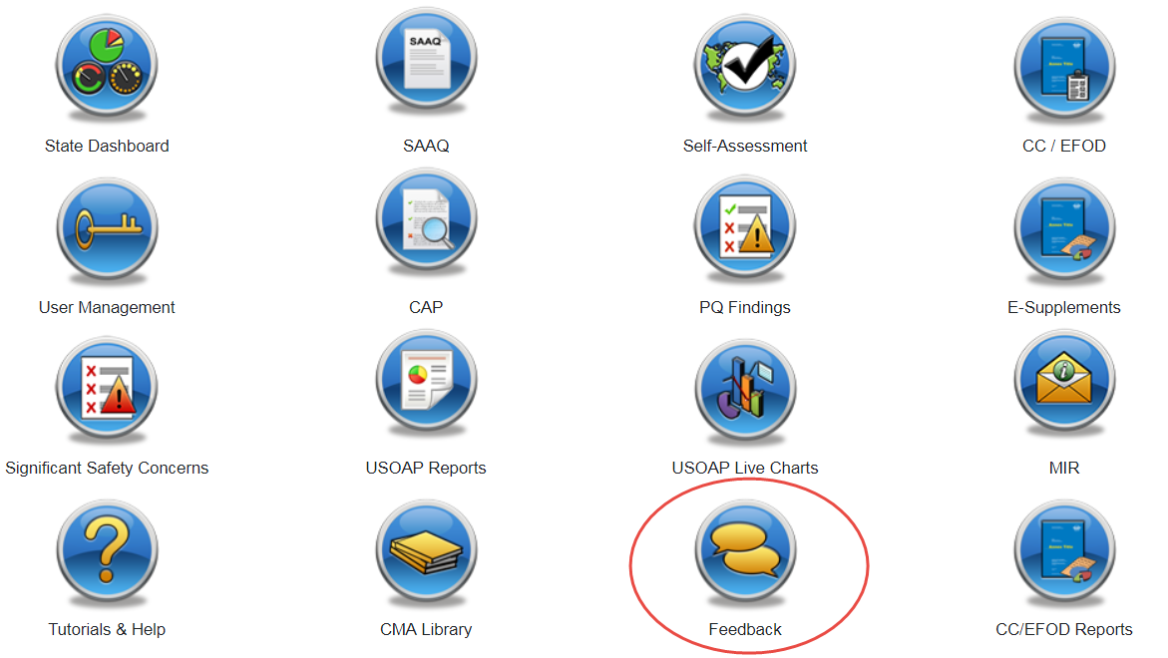
Feedback
Accessible from Home page or Menu Bar

Slide 30
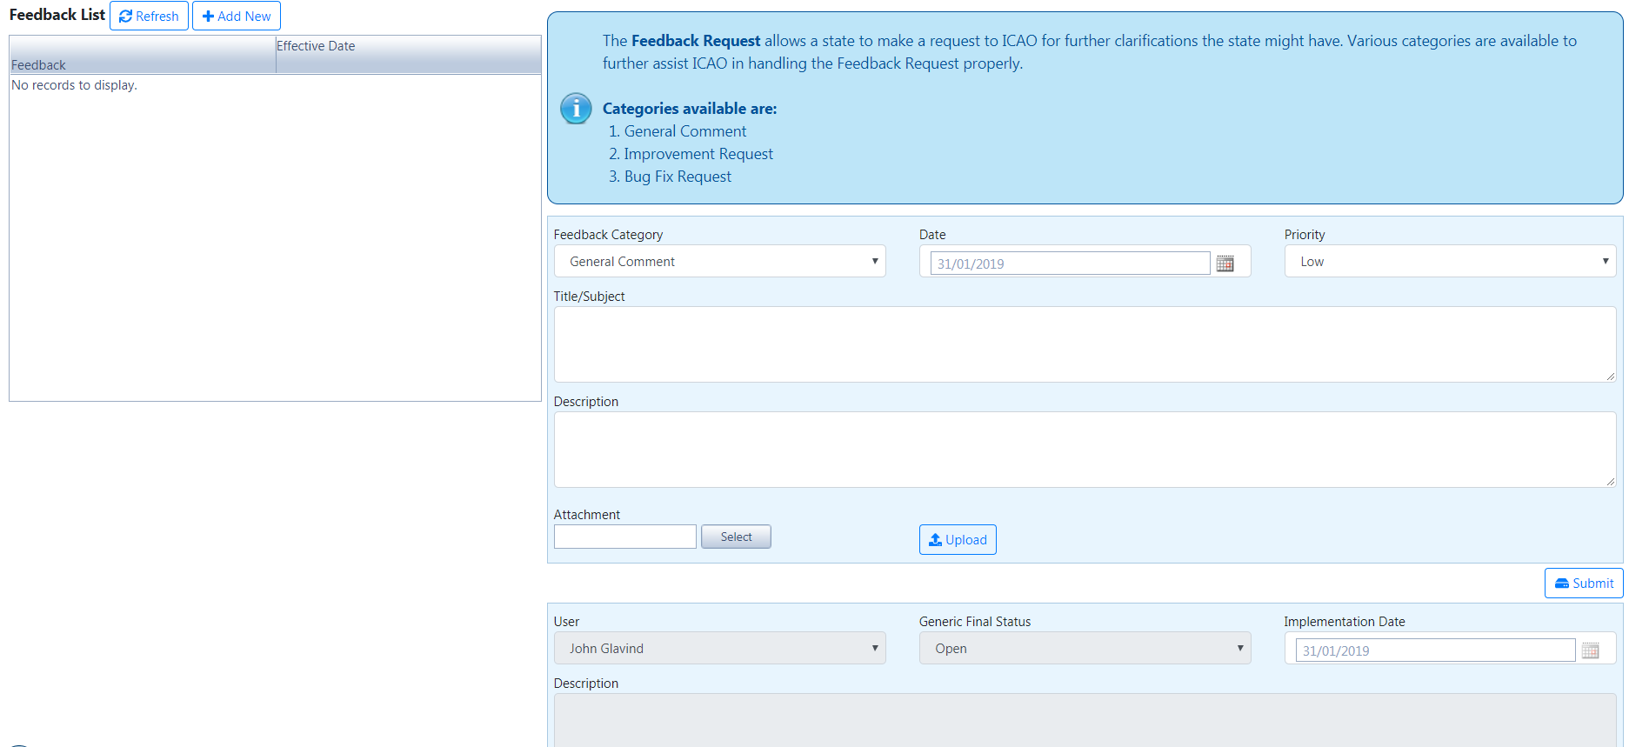
Feedback

Slide 31
Review
Overview of CMA OLF
Functionalities of OLF Modules
Updating EFOD

