Slide 1
USOAP Continuous Monitoring Approach (CMA) Workshop
Module 2
Overview of the USOAP CMA

Slide 2
Objective
The objective of this module is to provide
an up-to-date overview of the USOAP CMA methodology and activities.
Notes:
Validation of trainees understanding?

Slide 3
Outline
  Monitoring and Oversight (MO)
  Critical Elements (CEs) of a State Safety Oversight System
  USOAP CMA Audit Areas and Protocol Questions (PQs)
  USOAP CMA Components
    Collection of Safety Information
    Determination of State Safety Risk Profile
    Prioritization and Conduct of USOAP CMA activities
    Update of Effective Implementation (EI) and Status of Significant Safety Concerns (SSCs)
  Roll-out of SSP Implementation Assessments under USOAP CMA
  USOAP CMA Computer-Based Training (CBT)
  States’ main obligations under USOAP CMA

Slide 4
  Monitoring and Oversight
  (MO)
Notes:
Validation of trainees understanding?

Slide 5
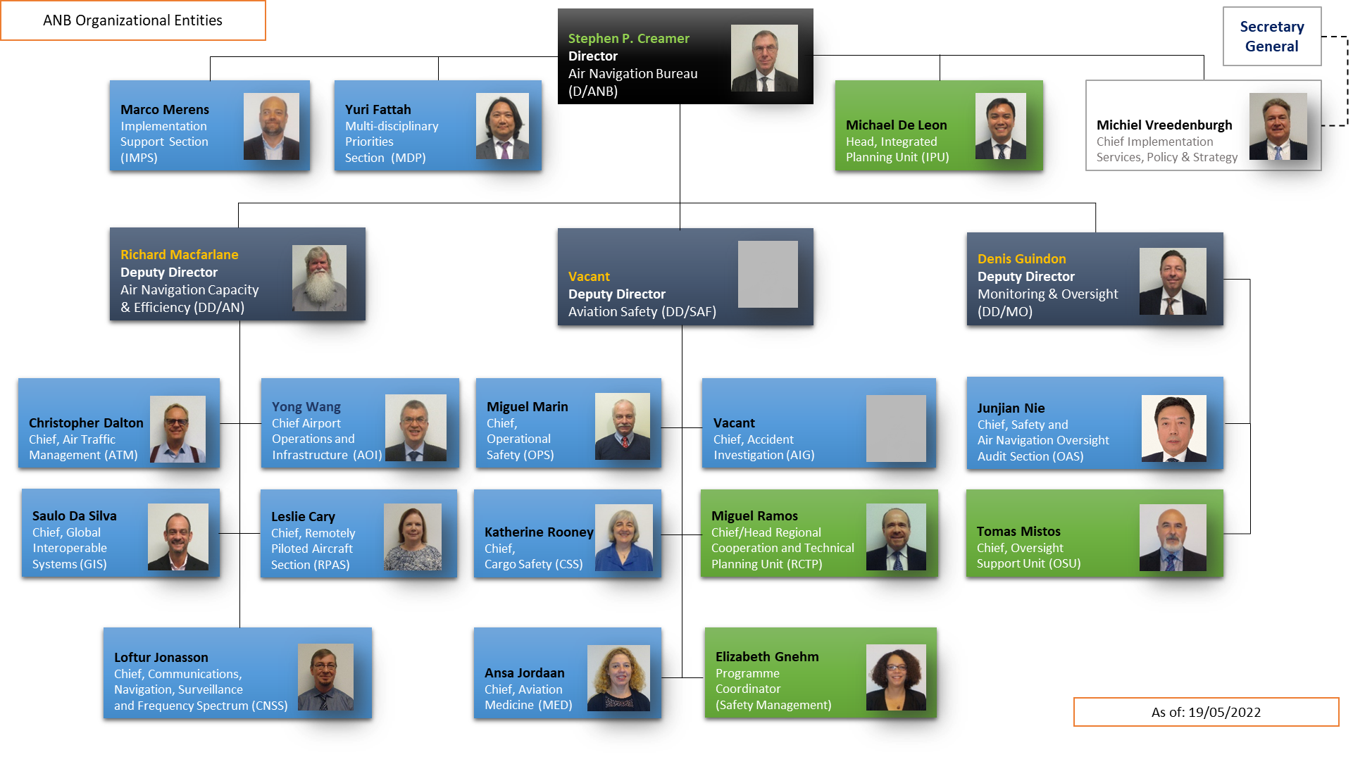
Air Navigation Bureau – Org Chart

Slide 6






Monitoring & Oversight (MO)
Continuous Monitoring
(Online Framework — OLF)
Planning and Scheduling
On-site Activities
Reports, Analyses and Working Papers
Training and
Workshops
Off-site Activities
Notes:
Check with MV what the offsite activities are

Slide 7
  Critical Elements (CEs) of
  a State Safety Oversight System
Notes:
Validation of trainees understanding?

Slide 8
ICAO carries out audits and other monitoring activities to determine the safety oversight capabilities of its Member States by:
  Assessing their effective implementation of the 8 CEs in 8 audit areas (i.e. LEG, ORG, PEL, OPS, AIR, AIG, ANS and AGA) through Protocol Questions (PQs); and
  Verifying the status of the Member States’ implementation of:
    Safety-related ICAO Standards and Recommended Practices (SARPs);
    Associated procedures; and
    Guidance material.

Slide 9

Critical Elements (CEs)
CE-1
Primary
aviation
legislation
CE-2
Specific
operating regulations
CE-3
State system
& functions
CE-5
Technical
guidance,
tools & provision
of safety-critical information
CE-4
Qualified
technical
personnel
ESTABLISH
CE-6
Licensing,
certification,
authorization & approval
obligations
IMPLEMENT
CE-7
Surveillance
obligations
CE-8
Resolution
of safety
issues

Slide 10
Critical Element 1
CE-1: Primary aviation legislation
States shall promulgate a comprehensive and effective aviation law, commensurate with the size and complexity of their aviation activity and consistent with the requirements contained in the Convention on International Civil Aviation, to enable the oversight and management of civil aviation safety and the enforcement of regulations through the relevant authorities or agencies established for that purpose.
The aviation law shall provide personnel performing safety oversight functions access to the aircraft, operations, facilities, personnel and associated records, as applicable, of individuals and organizations performing an aviation activity.

Slide 11
Critical Element 2
CE-2: Specific operating regulations
States shall promulgate regulations to address, at a minimum, national requirements emanating from the primary aviation legislation, for standardized operational procedures, products, services, equipment and infrastructures in conformity with the Annexes to the Convention on International Civil Aviation.

Slide 12
Critical Element 3
CE-3: State system and functions
States shall establish relevant authorities or agencies, as appropriate, supported by sufficient and qualified personnel and provided with adequate financial resources for the management of safety.
States authorities or agencies shall have stated safety functions and objectives to fulfill their safety management responsibility.
States shall ensure that personnel performing safety oversight functions are provided with guidance that addresses ethics, personal conduct and the avoidance of actual or perceived conflicts of interest in the performance of official duties.
Notes:
Recommendation.— The State should take necessary measures, such as remuneration and
conditions of service, to ensure that qualified personnel performing safety oversight functions are
recruited and retained.
Recommendation.— The State should use a methodology to determine its staffing requirements
for personnel performing safety oversight functions, taking into account the size and complexity of the
aviation activities in that State.

Slide 13
Critical Element 4
CE-4: Qualified technical personnel
States shall establish minimum qualification requirements for the technical personnel performing safety-related functions and provide for appropriate initial and recurrent training to maintain and enhance their competence at the desired level.
States shall implement a system for the maintenance of training records for technical personnel.

Slide 14
Critical Element 5
CE-5: Technical guidance, tools and provision of safety-critical information
States shall provide appropriate facilities, comprehensive and up-to-date technical guidance material and procedures, safety-critical information, tools and equipment, and transportation means, as applicable, to the technical personnel to enable them to perform their safety oversight functions effectively and in accordance with established procedures in a standardized manner.
States shall provide technical guidance to the aviation industry on the implementation of relevant regulations.

Slide 15
Critical Element 6
CE-6: Licensing, certification, authorization and approval obligations
States shall implement documented processes and procedures to ensure that individuals and organizations performing an aviation activity meet the established requirements before they are allowed to exercise the privileges of a licence, certificate, authorization or approval to conduct the relevant aviation activity.
Notes:
AIG does not have CE-6 and CE-7 questions because there is no certification or licensing or surveillance activity.

Slide 16
Critical Element 7
CE-7: Surveillance obligations
States shall implement documented surveillance processes, by defining and planning inspections, audits, and monitoring activities on a continuous basis, to proactively assure that aviation licence, certificate, authorization and approval holders continue to meet the established requirements. This includes the surveillance of personnel designated by the Authority to perform safety oversight functions on its behalf.

Slide 17
Critical Element 8
CE-8: Resolution of safety issues
States shall use a documented process to take appropriate actions, up to and including enforcement measures, to resolve identified safety issues.
States shall ensure that identified safety issues are resolved in a timely manner through a system which monitors and records progress, including actions taken by individuals and organizations performing an aviation activity in resolving such issues.

Slide 18
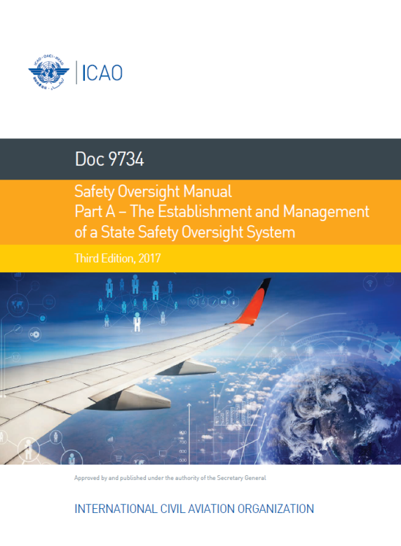
Eight CEs of a State safety oversight system
Definitions of CEs: in Annex 19 — Safety Management, Appendix 1 (2nd edition, July 2016)
Guidance for CEs:
Doc 9734 — Safety Oversight Manual,
Part A — The Establishment and
Management of a State Safety
Oversight System
(3rd edition, 2017)*.
* Available on ICAO-Net and CMA
Library of the CMA OLF.

Slide 19
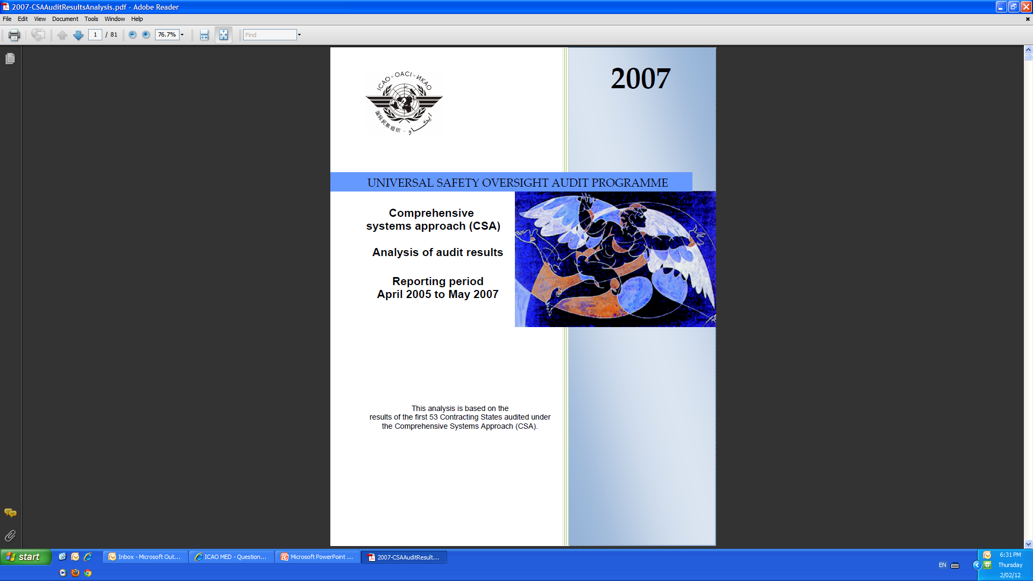
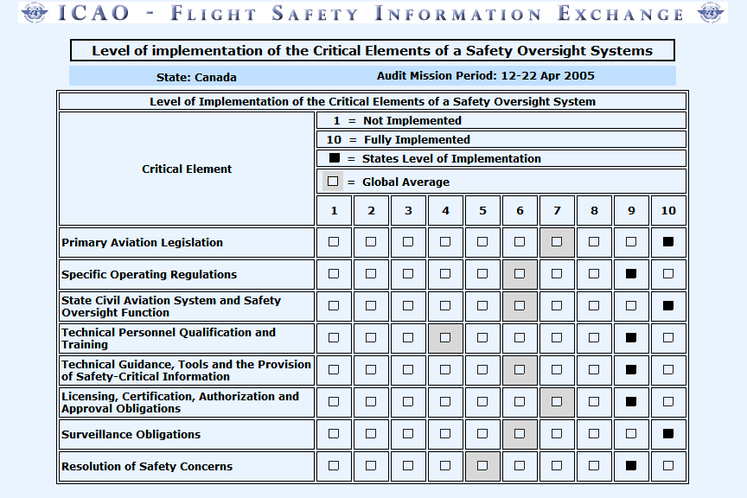
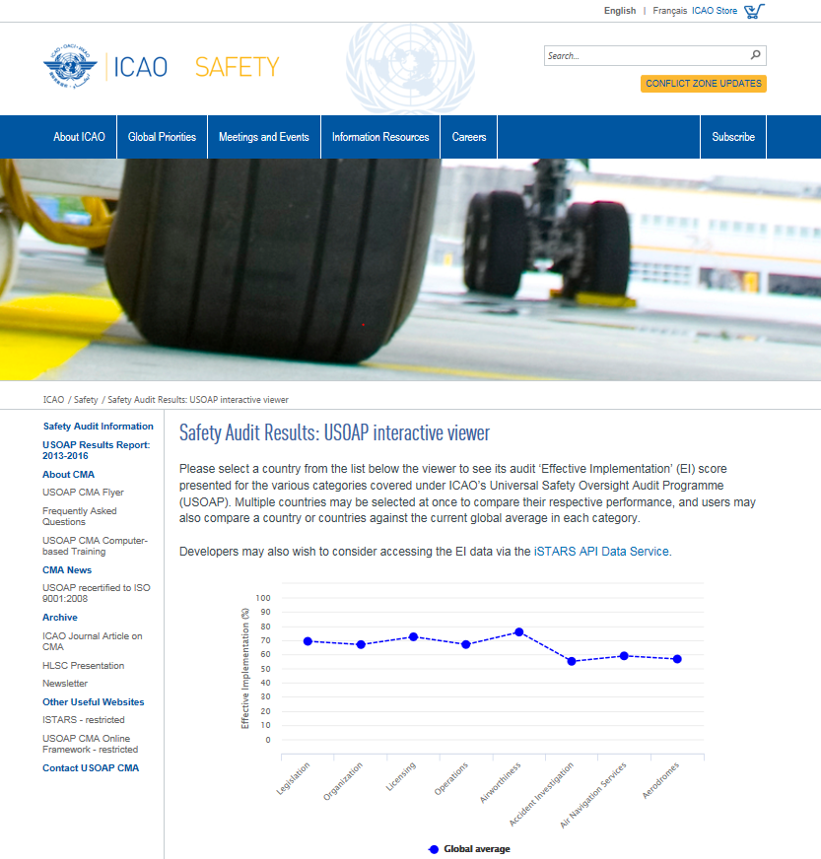
Evolution of Transparency
As of January 2013, safety oversight information is available
on the ICAO public website:
URL: http://www.icao.int/safety/Pages/USOAP-Results.aspx
1997
1998
1999
2000
2001
2002
2003
2004
2005
2006
2007
2008
2009
2010
2011
2012
2013+
ICAO has identified a significant safety concern with respect to the ability of [State] to properly oversee the [insert airlines (air operators); airports; aircraft; or air navigation services, as applicable] under its jurisdiction. This does not necessarily indicate a particular safety deficiency in the [insert airlines (air operators); airports; aircraft; or air navigation services, as applicable] but, rather, indicates that the State is not providing sufficient safety oversight to ensure the effective implementation of applicable ICAO Standards. Full technical details of the ICAO findings have been made available to [State] to guide rectification, as well as to all ICAO Member States to facilitate any actions that they may consider necessary to ensure safety. [State] has undertaken to regularly report progress on this matter to ICAO.
STATES
2005: USOAP CSA Audit results full transparency to all States
SSCs published on the USOAP CMA online framework
Proposed layout of the SSCs for the public to receive State feedback
1997: Voluntary Assessment Programme, Fully Confidential (Annexes 1-6-8)
2006: SSC introduced, fast track notification to all States (restricted website)
1999: USOAP Audit Summary Reports to all States (Annexes 1-6-8)
PUBLIC
2001: Generic, non-State-specific LEI results globally and by region
2014
Unresolved SSCs to be made available to the public in format and conditions approved by Council
2005: Public access to LEI, Critical Element results by State. All States provided consent
2006: Mechanism to make full USOAP results available to the public with State consent. 1st cycle audits 45% of States

Slide 20
  USOAP CMA Audit Areas
  and
  Protocol Questions (PQs)

Slide 21
USOAP CMA Audit Areas
Civil aviation organization (ORG)
Primary aviation legislation and specific operating regulations (LEG)
Air navigation services (ANS)
Annexes 2, 3, 4, 5, 10, 11, 12, 15 and PANS-ATM
Aerodromes and
ground aids (AGA)
Annex 14 and PANS-AGA
Personnel licensing and training (PEL)
Annex 1
Aircraft operations (OPS)
Annexes 6, 9, 18 and
PANS-OPS
Aircraft accident and incident investigation (AIG)
Annex 13
Airworthiness of aircraft (AIR)
Annexes 6, 7, 8 and 16
Notes:
Annex 19 brings all safety management elements from all related annexes.
Add Annex 19 to all areas except LEG/ORG

Slide 22
Protocol Questions (PQs)
  Primary tool used to assess States’ safety oversight capabilities, for each CE.
  Enable standardization in the conduct of USOAP CMA activities.
  Percentage of “Satisfactory” PQs is reflected in the EI.
  Evidence-based approach:
      Show me.
      Lack of evidence or lack of sufficient evidence =
      PQ status becomes or remains N/S.
    N/S PQ generates a finding and since 2014, each finding is PQ-specific.

Slide 23
PQ — Example
PQ No. | Protocol Question | Guidance for Review of Evidence | ICAO References | CE
4.129 | Has the State promulgated regulations for AOC applicants to establish procedures to ensure that the flight manual is updated by implementing changes made mandatory or approved by the State of Registry? | Verify the establishment and implementation of: a) relevant State regulations; b) applicable certification process; and c) operations inspectors’ procedures. | STD A6 Part I, 11.1 Part III, Section II, 9.1 GM A6 Part I, Att. E, 3.4 z) & 6 Part III, Att. E, 3.4 r) & 6 | CE-2
4.103 | Is the organizational structure of an AOC applicant reviewed to ensure that: a) duties, responsibilities and authorities are clearly defined, and b) functional tasks and lines of reporting are clearly delineated and duly documented? | 1) Verify that applicable operations inspectors’ guidance material, manuals, etc. have been developed and implemented. 2) Review exchange of letters with the applicant. 3) Verify that the safety management, quality assurance management and emergency management systems have been: a) established; b) documented; and c) implemented. | STD A6 Part I, 4.2.1.3 Part III, Section II, 2.2.1.3 GM Doc 8335 Part II, C2 Part III, C5 | CE-6
CE number associated with PQ
Examples of evidence to be presented by State
PQ asked by auditor
ICAO References

Slide 24
PQ Amendment
  MO revises and updates PQs on a periodic basis to:
    reflect the latest changes in ICAO provisions; and
    harmonize and improve PQ references and content.
  Revision of PQs incorporates inputs from:
    States;
    ICAO ANB;
    ICAO ROs;
    USOAP mission team members; and
    external stakeholders.

Slide 25

2020 Edition of the PQs
In addition to the periodic revision of USOAP PQs, the 2020 edition of the PQs was mainly a result of the implementation of the recommendations of the Group of Experts for a USOAP CMA Structured Review (GEUSR).
This 2020 edition of the PQs is posted
in the “CMA Library” on the OLF.
The 2020 edition of the PQs became applicable for all
USOAP CMA activities starting after 1 January 2022.
(EB 2021/40, dated 31 December 2021, refers)
Notes:
PQ amendment process – revise this for an ongoing basis, which is linked to SARPs amendment

Slide 26
  USOAP CMA
  Components
Notes:
Validation of trainees understanding?

Slide 27
USOAP CMA Components
  States
  Internal stakeholders
  External stakeholders
  Analysis of safety risk factors
  Evaluation of State’s safety management capabilities
Collection of safety information
Determination of State safety risk profile
  Update of PQ Status
  Update of Status of Significant Safety
  Concern (SSC)
  USOAP CMA audits
  Safety audits
  ICAO Coordinated Validation Missions (ICVMs)
  Off-site activities
  Mandatory
  Information Requests (MIRs)
  Training
Update of EI and status of SSCs
Prioritization and conduct of USOAP CMA activities

Slide 28
USOAP CMA Components
Collection of safety information
Determination of State safety risk profile
Prioritization and conduct of USOAP CMA activities
Update of EI and status of SSCs
Notes:
Validation of trainees understanding?

Slide 29
Collection of Safety Information
  States provide:
    State Aviation Activity Questionnaire (SAAQ);
    Compliance Checklists (CCs) on the Electronic Filing of Differences (EFOD) system;
    Self-assessment; and
    Updated Corrective Action Plans (CAPs).
Notes:
Note: As the State safety programmes (SSPs) evolve, additional safety data will be generated to be used by the USOAP CMA.

Slide 30
Collection of Safety Information
  Internal stakeholders include:
    ICAO Secretariat Bureaus/Sections; and
    Regional Offices (ROs).
Notes:
ROs also provide MO safety related information as a result of their regional activities and States’ action plans.

Slide 31
Collection of Safety Information
  External stakeholders include:
    State civil aviation authorities (e.g. FAA);
    Regional Safety Oversight Organizations (RSOOs) (e.g. EASA); and
    International organizations (e.g. IATA).
  Note.— Some of these organizations conduct audit activities that generate safety information used as indicators for the USOAP CMA.
Notes:
External stakeholders: EASA, EUROCONTROL, Interstate Aviation Committee (IAC), IATA, CANSO, ACI
Expanded agreements facilitate the sharing of safety information that ICAO validates to reduce the duplication of monitoring activities.
Supranational: Example, EU as the regulator for all member States with the impact that the requirements are directly applicable.

Slide 32
USOAP CMA Components
Collection of safety information
Determination of State safety risk profile
Update of EI and status of SSCs
Prioritization and conduct of USOAP CMA activities
Notes:
Validation of trainees understanding?

Slide 33
Main Factors for Determining
State Safety Risk Profile
  EI (determined through previous USOAP CMA activity);
  Existence of SSC(s);
  Level of aviation activities in the State for each audit area;
  Projected growth of air traffic and aviation activities;
  State’s capability to submit CAPs acceptable to ICAO;
  Level of progress made by State in implementing CAPs;
  Major changes in organizational structure of State’s CAA;
  Ongoing or planned assistance projects;
  State’s progress in achieving GASP objective on safety management;
  Air navigation deficiencies; and
  Regional Office (RO) mission reports.

Slide 34
USOAP CMA Components
Collection of safety information
Determination of State safety risk profile
Prioritization and conduct of USOAP CMA activities
Update of EI and status of SSCs

Slide 35
Main Activities under USOAP CMA (Audits)
Activity | On-site, Off site, or Virtual | Description | Remarks
Documentation-Based Audit (DBA) | Off-site | A systematic and objective review of the establishment and/or implementation of a State’s safety oversight system whose security situation precludes an on-site activity by ICAO and/or whose limited level of aviation activities does not warrant an on-site activity | This audit type, by itself, does not result in an effective implementation (EI) score.
Full Scope Audit | On-site | A systematic and objective assessment of a State's safety oversight system, which covers the PQs associated with the entire scope of a State's safety oversight and accident/investigation systems

Slide 36
Main Activities under USOAP CMA (Audits)
(cont.)
Activity | On-site, Off site, or Virtual | Description | Remarks
Focused Audit | On-site Virtual | A systematic and objective assessment of a State's safety oversight system, which covers exclusively a subset of PQs, such as Priority PQs or a specific audit area
Follow-up Audit | On-site Virtual | A systematic and objective assessment of a State's safety oversight system, which covers PQs assessed previously as not satisfactory, not applicable, and/or undetermined.

Slide 37
Main Activities under USOAP CMA (Audits)
(cont.)
Activity | On-site, Off-site, or Virtual | Description | Remarks
Integrated Audit Activity (IAA) | On-site Off-site Virtual | Limited scope, integrated within scheduled mission in a State by ICAO or safety partners*. On-site interview and collection of evidence by SMEs. All collected evidence reviewed by ICAO HQ (OAS). * Organizations which provide technical support to USOAP CMA activities on basis of formal agreement with ICAO (e.g. EASA) | Associated PQs are identified at ICAO HQ (OAS) based on review of past USOAP CMA activities and aspects of the State Profile (e.g., self-assessment, SAAQ, EFOD).

Slide 38
Main Activities under USOAP CMA (Validations)
Activity | On- or Off site | Description | Remarks
ICVM | On-site Virtual | The collection and assessment of evidence of a State’s effective correction of previously identified findings (in one or more audit areas). | Collected evidence is reviewed and validated at ICAO HQ (OAS).
Off-site validation activity (OSVA) | Off-site | The assessment of a State’s effective corrective actions addressing previously identified findings. | Addresses PQs not requiring on-site activity.

Slide 39
Main Activities under USOAP CMA (Validations) (cont.)
Activity | On- or Off site | Description | Remarks
Integrated validation activity (IVA) | On-site Off-site Virtual | Limited scope, integrated within scheduled mission in a State by ICAO or safety partners*. On-site collection and review of evidence by SMEs. All collected evidence reviewed by ICAO HQ (OAS) as part of an off-site validation activity. * Organizations which provide technical support to USOAP CMA activities on basis of formal agreement with ICAO (e.g. EASA). | Associated PQs are identified at ICAO HQ (OAS) based on State’s CAP performance.

Slide 40
Main Activities under USOAP CMA (SSPIAs)
Activity | On- or Off site | Description | Remarks
State Safety ProgrammeImplementation Assessment | On-site | The assessment of the level of maturity achieved by the State, in its SSP implementation and maintenance, by assessing the SSP PQs | SSP PQs are organized by assessment area

Slide 41
Prioritization and Conduct of
USOAP CMA Activities
MO prioritizes CMA activities in States based on:
State’s safety risk profile;
Approved MO budget; and
Available MO resources.

Slide 42
Criteria Used to Select a State for:
CMA Audit | ICVM
State’s safety risk profile
Information submitted by State through PQ self-assessment
Recommendations from RO or ANB sections
Information shared by recognized international organizations
Regional balance
Date of last audit | State’s readiness (via reported progress in CAP implementation)
Significant changes in any audit area within State’s civil aviation system | State’s progress in resolving identified SSCs

Slide 43
Criteria Used to Select a State for an Off-Site Validation Activity
State has PQ findings associated with eligible PQs
(most of the PQs from CEs 1 to 5);
Most (about 75%) of the State’s corresponding CAPs, for the audit area considered, meet the following three conditions:
  CAPs fully address the corresponding PQ findings;
  CAPs are reported by the State as fully implemented; and
  The State has submitted all relevant evidence for the corresponding PQs through PQ self-assessment on the OLF.
Notes:
3.6.4, Doc 9735, 4th edition

Slide 44
Conduct of USOAP CMA Activities —
Scope
Factors determining scope | ICVM | CMA Audit
Level of aviation activity in the State | ✓ | ✓
Any changes to the State’s system |  | ✓
Acceptability of CAPs | ✓
Level of progress reported by the State in CAP implementation | ✓
State’s self-assessment, including submitted evidence | ✓ | ✓
Request by State (cost-recovery activity) | ✓ | ✓
Availability of resources | ✓ | ✓

Slide 45
Conduct of USOAP CMA Activities —
Duration and Team Composition
Factors determining duration and team composition | ICVM | CMA Audit
Scope | ✓ | ✓
Complexity of the State’s system | ✓ | ✓
Number of Not-Satisfactory PQs to be addressed | ✓
Other factors, such as State’s official language | ✓ | ✓

Slide 46
Six Criteria for a Good CAP (“RCDSRC”)
Relevant: CAP addresses the issues and requirements related to the finding and corresponding PQ and CE.
Comprehensive: CAP is complete and includes all elements
or aspects associated with the finding.
Detailed: CAP outlines implementation process using
step-by-step approach.
Specific: CAP identifies who will do what, when and in coordination with other entities, if applicable.
Realistic: In terms of contents and implementation timelines.
Consistent: In relation to other CAPs and with the
State’s self-assessment.

Slide 47
Off-Site Validation Activity
CAPs related to the majority of PQ findings associated with CEs 6, 7 and 8 (collectively known as the “Implementation” CEs) do not qualify for an off-site validation activity.
Such CAPs must be assessed and validated through an on-site activity.

Slide 48
USOAP CMA Components
Collection of safety information
Determination of State safety risk profile
Prioritization and conduct of USOAP CMA activities
Update of EI and status of SSCs

Slide 49

Update of EI
EI calculation:
  Overall EI (%) $= \frac{\text{N}\text{umber} \text{of} \text{S}\text{atisfactory} \text{PQs}}{\text{T}\text{otal} \text{Number} \text{of} \text{Applicable} \text{PQs} }$ X 100

Slide 50
Update of EI
The validation of collected safety information enables ICAO to continuously update a State’s EI.
State’s EI is reported on the OLF.
Notes:
Elaborate between LEI/EI

Slide 51
Mandatory Information Request (MIR)
A MIR is issued by MO under the USOAP CMA process when concerns are raised by internal and/or external stakeholders about aspects of a State’s safety oversight system.

Slide 52
When can a MIR be issued?
Generally, MIRs have been issued for one or more of the following instances (but also not limited to these instances):
Indication of concerns raised by internal and/or external stakeholders about a State’s safety oversight capabilities;
Major changes in a State’s safety oversight system;
Evidence indicating that potential deficiency or an SSC may exist and additional information is required; and
Concerns raised about a State’s lack of compliance in the conduct of its aviation activities; e.g. in the process of an aircraft accident or incident investigation.

Slide 53
State’s Response to a MIR
States are required to respond to a MIR.
Failure by a State to respond to a MIR with:
  complete, clear and relevant information addressing the associated PQs and/or
  within the specified timeframe
  will result in a finding and/or SSC for the State.
In the absence of response by State, the status of all associated PQs becomes Not Satisfactory.

Slide 54
MIR Timelines
Deadline to respond to a MIR will be determined by MO on a case-by-case basis depending on the severity and urgency of the issue.
No deadline extension will be granted in case of serious safety concerns.
Once State submits MIR response that is acceptable to ICAO, ICAO starts review of MIR response.
MIR is closed once ICAO completes review of MIR response.
MIR report production process is then launched.

Slide 55
Upon Receipt of State’s MIR Response…
State’s response to a MIR is reviewed and assessed by ICAO (i.e. relevant SPOs/TOs of OAS/MO).
Assessment of information and other related evidences will lead to one or two of the following scenarios:
  no change in status of associated PQs; and
  change in status of associated PQ/s and a MIR Report is produced; and/or
  in the most serious cases, an SSC is issued and the SSC process is launched.

Slide 56
Graphic Summary of MIR Process (1)
MIR is issued; State normally has one month to respond.
No response
from State;
MIR remains open.
State responds.
ICAO reviews State’s response to MIR.
ICAO issues SSC.
ICAO issues PQ finding/s.
Once ICAO completes review of MIR response, MIR is closed.
SSC process is launched.
MIR report production process is launched.
Step 1 — A MIR is issued…

Slide 57
Graphic Summary of MIR Process (2)
Step 2 — MIR Review and Report Production Process
ICAO reviews State’s response
to MIR.
No change to status of associated PQ/s.
ICAO changes status of associated PQ/s.
ICAO issues
SSC.
ICAO acts on
State non-response to MIR.
SSC process
is launched.
ICAO issues MIR report to State.
Either or both

Slide 58
PQ Status Change
Status of PQs can only be changed following completion of a USOAP CMA activity, namely:
  CMA audit,
  ICVM,
  Off-site validation activity,
  IVA, or
  MIR.

Slide 59
Significant Safety Concerns (SSCs)
Definition of an SSC
“An SSC occurs when the audited State allows the holder of an authorization or approval to exercise the privileges attached to it, although the minimum requirements established by the State and by the Standards set forth in the Annexes to the Chicago Convention are not met, resulting in an immediate safety risk to international civil aviation.”
Reference: EB 2010/7 dated 19 February 2010

Slide 60
Status of SSCs
# of unresolved SSCs (4 States)
4
# of SSCs resolved through corrective actions
taken by the States after being posted on ICAO website
44
# of SSCs resolved through immediate actions taken by the States prior to being posted on the ICAO website
9
Note.— Information was last updated on 01 December 2022.

Slide 61
SSC Mechanism: Identification
Continuous monitoring process
Ongoing monitoring of evidence and information collected from the State and other sources
USOAP CMA on-site activity
Evidence collected points to an SSC
Team leader brings it to the attention of the State as soon as it is discovered.
State may initiate corrective actions immediately.
Team leader provides all relevant information to C/OAS.
Preliminary SSC is
identified
ICAO SSC Committee is convened to validate
Notes:
Identification of Preliminary SSCs by ICAO

Slide 62
SSC Mechanism: Notification
STATES
ICAO SSC COMMITTEE
STATE
Reviews evidence collected and confirms/dismisses within 15 days.
If dismissed >>> No action.
If confirmed >>>
Sends SSC initial
notification letter.
Submits response & evidence. (within 15 days)
Reviews State response
& evidence.
Sends SSC resolution letter.
If suggested immediate actions resolve SSC >>>
OR
Sends SSC confirmation letter.
advises State that SSC will be published on OLF.
If corrective actions deemed insufficient >>>
SSC is published on OLF, Electronic Bulletin and (if unresolved after 90 days) ICAO public website.

Slide 63
SSC Mechanism: ICAO Plan of Action
MARB
ICAO – ANB, TCB
REGIONAL OFFICE
STATE
List of States
referred to MARB.
Determines nature of assistance.
In cooperation with State, develops State-specific ICAO Plan of Action.
Shares ICAO Plan of Action for review to ensure
“one ICAO”.
Reports to Council.
MARB decides next course of action.
Collects and consolidates feedback.
Finalizes and presents
ICAO Plan of Action
to State.
Accepts ICAO
Plan of Action.
Communicates with donors (e.g. State, SAFE, SCAN and others).
Monitors implementation of ICAO Plan of Action.
If ICAO project, drafts, reviews and approves project document .
Implements and monitors project.
Continues participation in USOAP CMA process.
Monitors progress.
Unsatisfactory
Satisfactory
COUNCIL
Notes:
Explain acronyms:
MARB: Monitoring and Review Board
SAFE: ICAO established the Safety Fund, which is a financial mechanism that allows for collection and use of voluntary contributions from ICAO Member States, international organizations, public and private entities associated with international civil aviation in a responsible, consistent, transparent, efficient and timely manner, while minimizing administrative costs. The objective of the Fund is to improve civil aviation safety through a performance-based approach to providing assistance. Contributions to the SAFE may be earmarked for a specific project or objective; general contributions (un‑earmarked) will be used for safety-related projects.
SCAN: The Safety Collaborative Assistance Network (SCAN) was created by ICAO to serve as a forum for the exchange of safety-related information on financial and technical assistance projects and activities. This initiative serves as a communications channel for information sharing amongst donors and assistance providers regarding ongoing projects, as well as for planning future assistance endeavours. SCAN participants include focal points from State governmental agencies, regional groups, manufacturers, financial institutions and aviation organizations.

Slide 64
SSC Mechanism: Resolution
STATES
ICAO SSC COMMITTEE
STATE
Continues to update
progress on CAPs.
Completes State self-assessment.
Reviews State progress & evidence.
Advises ICAO that SSC is resolved.
Recommends conduct of ICVM
to verify implementation.
If corrective actions are
insufficient >>>
OR
If corrective actions resolve SSC >>>
Sends SSC resolution letter.
SSC is immediately removed from USOAP CMA OLF
and ICAO public website.
SSC resolution is published in Electronic Bulletin.
Reports SSC resolution to MARB.

Slide 65
  Roll-out of SSP Implementation Assessments under USOAP CMA

Slide 66
ICAO activities in support of safety management implementation

Slide 67
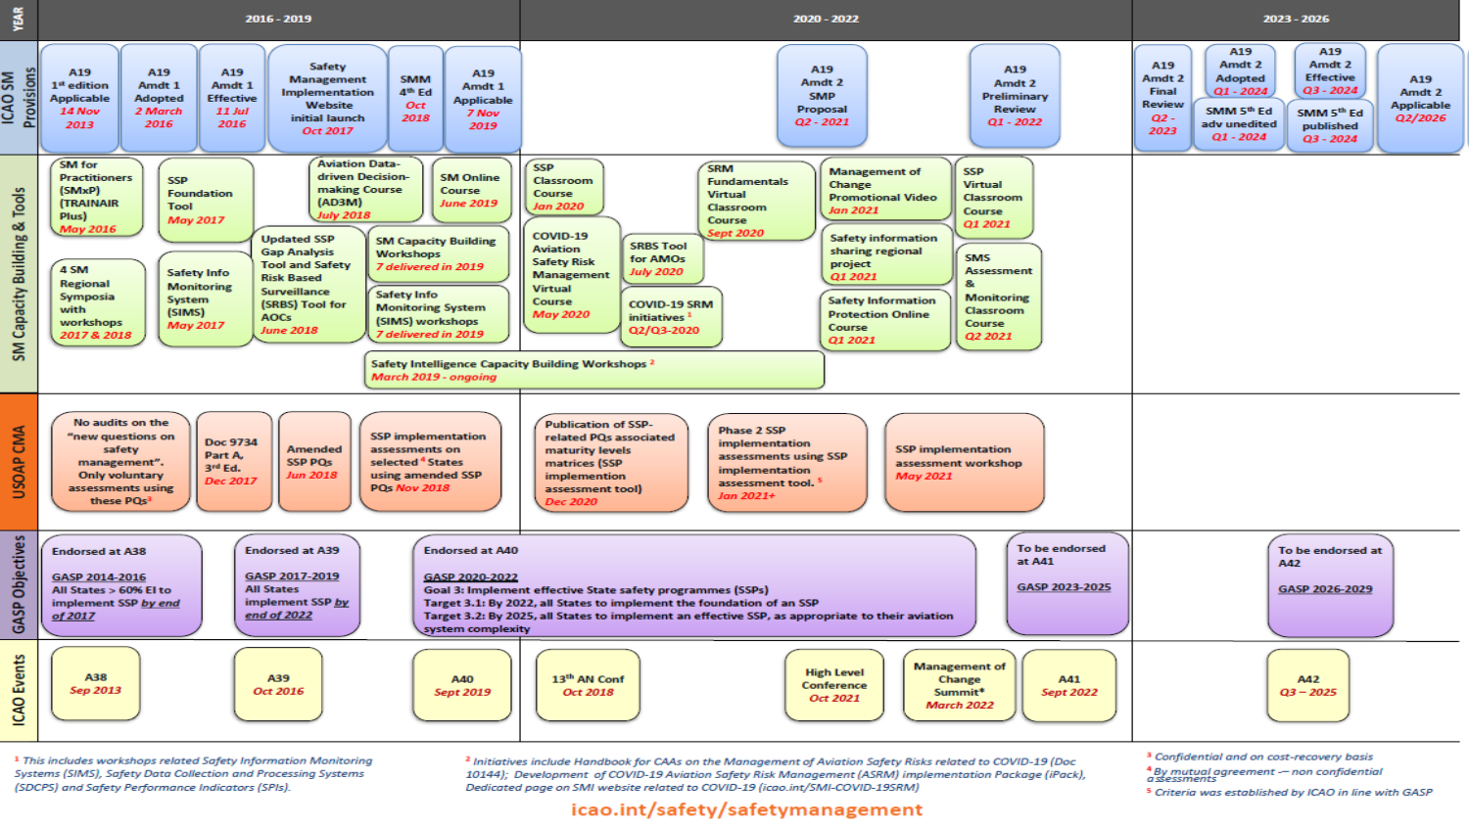
Notes:
Updated 23 May 2018 with inputs from Elizabeth.

Slide 68
SSPIAs under phase 2

Slide 69
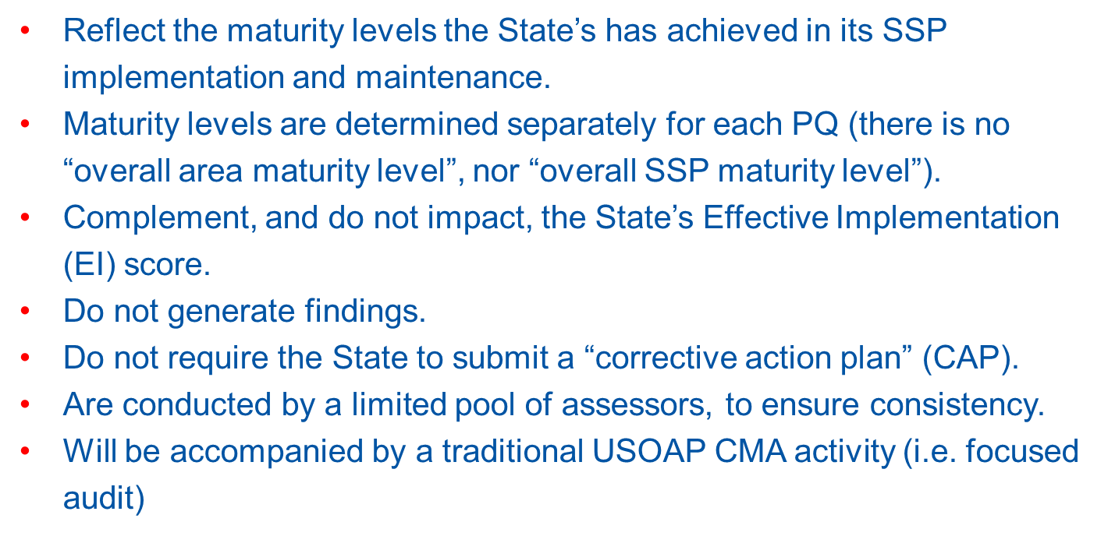

Slide 70

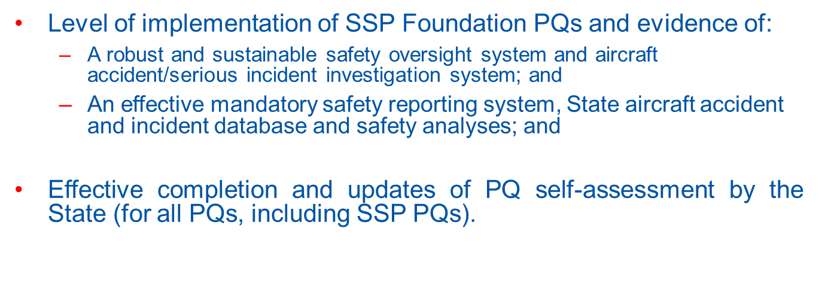

Slide 71
SSP PQs

Slide 72
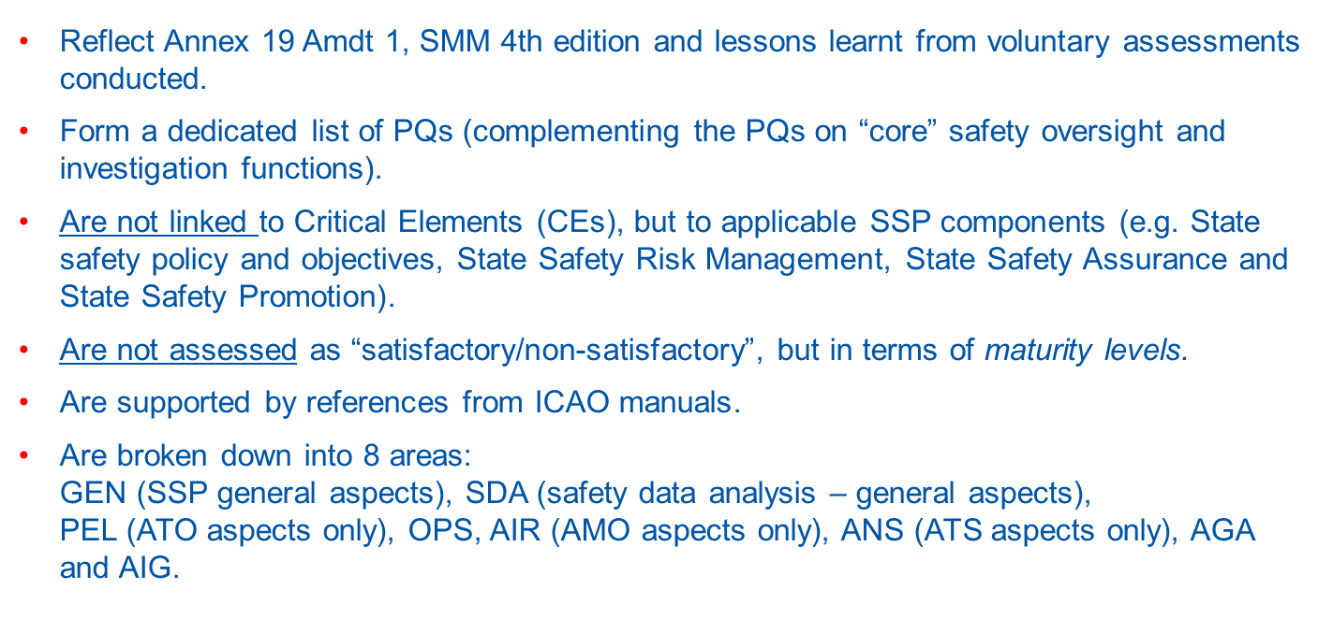

Slide 73
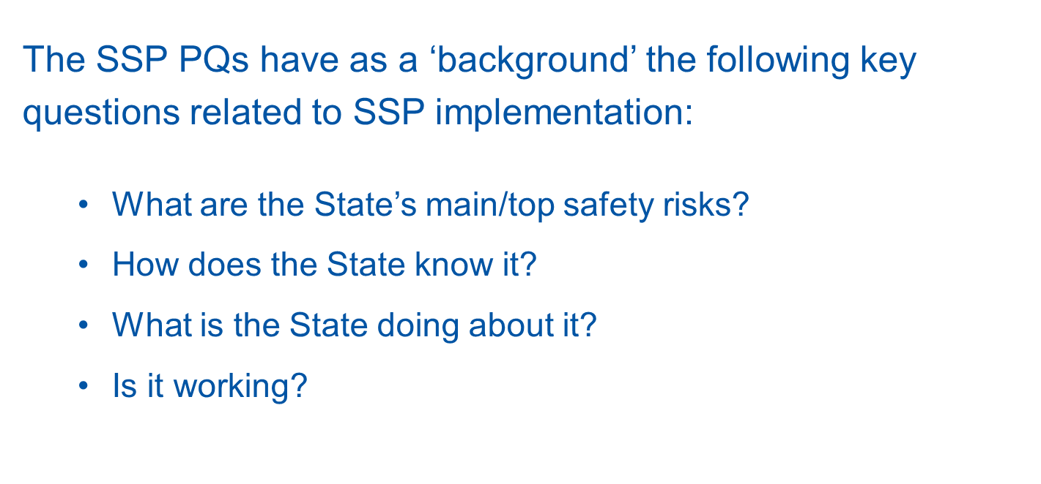

Slide 74
SSP PQs associated maturity levels

Slide 75
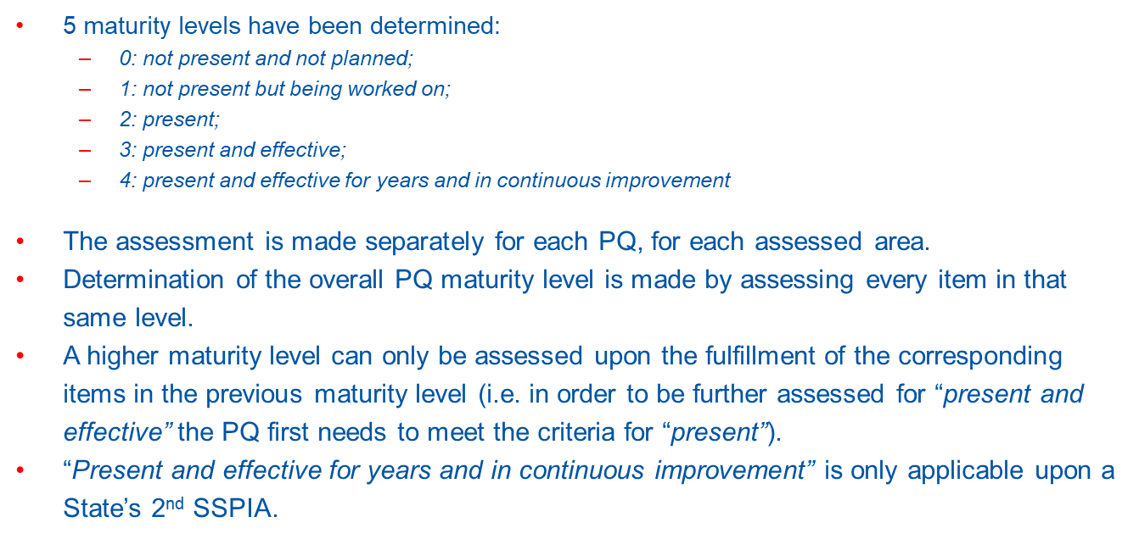

Slide 76
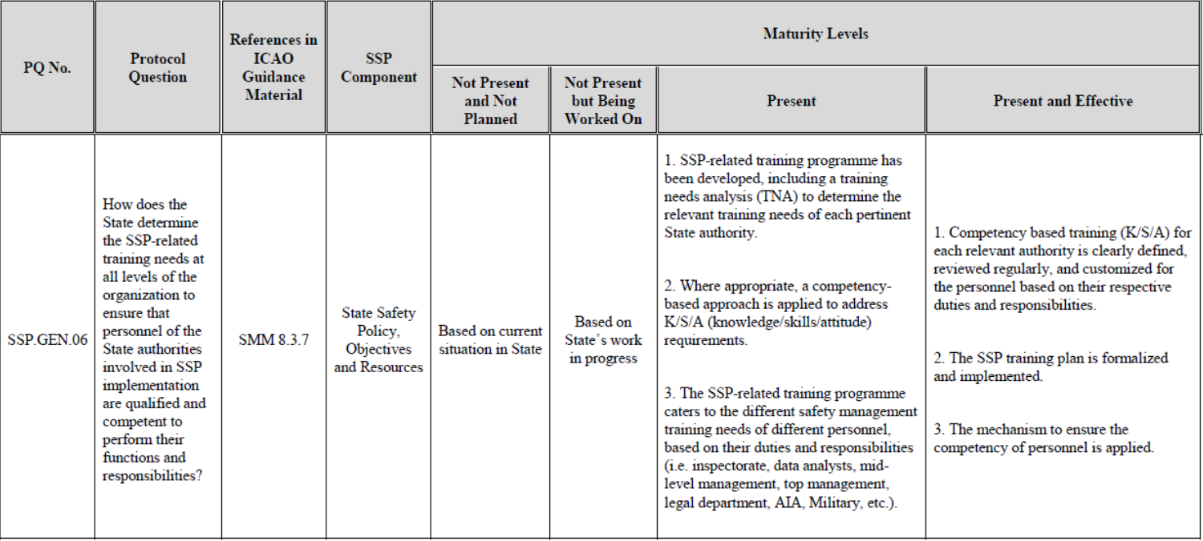

Slide 77
Associated guidance material

Slide 78
Issues | Guidance Material
SSP PQs | SMM, 4th edition
Core “safety-oversight and investigation” aspects | Doc 9734 — Safety Oversight Manual, Part A — The Establishment and Management of a State Safety Oversight System
Methodology for preparation, conduct and reporting of SSP implementation assessments | New edition of Doc 9735 — Universal Safety Oversight Audit Programme Continuous Monitoring Manual

Slide 79
  USOAP CMA
  Computed-Based Training (CBT)
Notes:
Validation of trainees understanding?

Slide 80
USOAP CMA CBT
As per EB 2011/44, the computer-based training (CBT) was launched to:
Provide participants with a thorough understanding of the USOAP CMA methodologies and the essential knowledge required to participate in USOAP CMA activities; and
Serve as an opportunity for States to enhance the competencies of their aviation safety personnel in the areas addressed by USOAP CMA.

Slide 81
USOAP CMA CBT
Assembly Resolution A40-13 urges all Member States to support ICAO in the evolution of the USOAP CMA and, for those able to do so, to second qualified and experienced technical staff to ICAO on a long- or short-term basis.
State-nominated experts who meet stated qualifications and experience criteria for the various audit areas (per SL AN19/34-15/35, 13 May 2015) will be enrolled at no fee.
More information is available at:
https://www.icao.int/safety/CMAForum/Pages/USOAPCMA-CBT.aspx.
Notes:
Remind States to complete the CBT to qualify ICVM experts and auditors to participate in USOAP CMA activities as long/short terms secondees.
CBTs currently exist in OPS (including DG), AIR, AIG, ANS. AGA and we are going through the maintenance to have the next revision available by 2nd quarter 2013.

Slide 82
  States’ Main Obligations
  under USOAP CMA

Slide 83
As per the USOAP CMA MOU and by using the OLF, States shall, in particular:
Continuously update their SAAQ and CCs/EFOD;
Continuously update their CAPs and PQ status (self–assessment), providing all related evidence; and
Reply promptly to MIRs sent by ICAO.

Slide 84
Review
  Monitoring and Oversight (MO)
  Critical Elements (CEs) of a State Safety Oversight System
  USOAP CMA Audit Areas and Protocol Questions (PQs)
  USOAP CMA Components
    Collection of Safety Information
    Determination of State Safety Risk Profile
    Prioritization and Conduct of USOAP CMA activities
    Update of Effective Implementation (EI) and Status of Significant Safety Concerns (SSCs)
  Roll-out of SSP Implementation Assessments under USOAP CMA
  USOAP CMA Computer-Based Training (CBT)
  States’ main obligations under USOAP CMA

