Slide 1
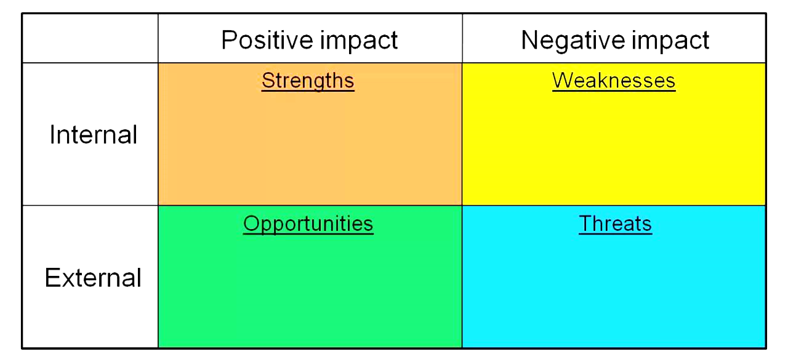
WORKSHOP ON THE APPLICATION AND DEVELOPMENT OF THE VOL. III OF THE CAR / SAM E-ANP INCLUDING KPI FORMULATION FOR THE SAM REGION
Virtual Meeting, September, 15-17, 2020
S W O T ANALYSIS

Slide 2
STRENGHTS ACTIVE REGIONAL PLANS. FRAME ALIGNED TO GLOBAL PLANS (GANP, GASP, GASEP). IMPULSE TO ATM/CNS IMPLEMENTATION AND SUPPORT SERVICES. CNS RESOURCES AND REGIONAL COORDINATION. REGIONAL IP NETWORK – REDDIG. AIRLINES / INDUSTRY DEVELOPED. STATE/STAKEHOLDERS RELATIONSHIP. AUTHORITIES / REGULATORS . REGULATORY STRUCTURE (LARS) REGION INTEGRATED IN SOCIO-POLITICAL ASPECT. REGIONAL IMPLEMENTATION AND FOLLOW-UP FORUMS.
WEAKNESSES LACK OF REGIONAL STRUCTURE ANS MORE RESILIENT. TECHNOLOGY/BACKUP UNITS - BACKUPS . EXCESSIVE ROTATION IN PUBLIC ADMNISTRATION. MANAGEMENT MODEL FOR ANS/AUTHORITY/INDUSTRY. DIFFICULTY COORDINATING BETWEEN SYSTEM ACTORS. CUMBERSOME OR SLOW BUDGET EXECUTION FOR TECHNOLOGY ADMISSION. REQUIRES PROPER PREPARATION T.O.R. MANAGEMENT OF NATIONAL PNNA PLANS. FOCUS OF PROGRAMS/ PROJECTS FOR IMPLANTATION. CNS INTEROPERABILITY STILL IN PROCESS. DEPENDENCE AND GAPS OF TECHNICAL EQUIPMENT AND MAINTENANCE.
INTERNAL

Slide 3
OPPORTUNITIES GANP/ 6 -ASBU. FOUR LAYERS AND INDICATORS. DEVELOPMENT OF REGIONAL/NATIONAL PLANS. CIVIL AVIATION AS A DEVELOPMENT ENGINE. ECONOMIC FOSTERING. ACCESSIBLE FINANCING. INNOVATION, RESEARCH AND DEVELOPMENT IN TECHNOLOGY FOR ANS DELIVERY. TENDENCY TO RESILIENCE AND COST/EFFICIENCY. RESILIENT PROCESSES/LESSONS LEARNED.
THREATS SLOW RECOVERY INDUSTRY/AEROLINEAS (> 2024). REORGANIZATION OF THE AERONAUTICAL MARKET, COMPETITION BY MARKETS. NEW OUTBREAK/PANDEMIA . CHANGES IN THE PATTERN OF MOBILIZATION OF PEOPLE (TELECONFERENCES). LOSS OF USER CONFIDENCE. ECONOMY SLOWED DOWN. CHANGE IN PUBLIC PRIORITIES IN STATES. DEFERMENT OF INVESTMENTS IN ANSP/AIRPORT/INDUSTRY. POLITICAL SITUATIONS OF STATES. POSSIBLE LEGAL INSTABILITY. EXCESSIVE INTERVENTION.
EXTERNAL

Slide 4
 | List | Remarks
Strengths
Weakness
Opportunities
Threats

Slide 5
Strengths

Slide 6
Weakness

Slide 7
Opportunities

Slide 8
Threats

Slide 11
STRENGHTS ACTIVE REGIONAL PLANS. FRAME ALIGNED TO GLOBAL PLANS (GANP, GASP, GASEP). IMPULSE TO ATM/CNS IMPLEMENTATION AND SUPPORT SERVICES. CNS RESOURCES AND REGIONAL COORDINATION. REGIONAL IP NETWORK – REDDIG. AIRLINES / INDUSTRY DEVELOPED. STATE/STAKEHOLDERS RELATIONSHIP. AUTHORITIES / REGULATORS . REGULATORY STRUCTURE (LARS) REGION INTEGRATED IN SOCIO-POLITICAL ASPECT. REGIONAL IMPLEMENTATION AND FOLLOW-UP FORUMS. LEADERSHIP OF RO SAM ICAO. UNIT RESPONSE OF THE REGION/INDUSTRY TO THE HEALTH EMERGENCY. STRUCTURE OF AIR SPACE. SEAMLESS. HARMONIZED ATS CONTINGENCY PLANS. ICAO TECHNICAL COOPERATION – PROJECTS RLA 06 901, SRVSOP, ETC. TECHNICAL DOCUMENTATION / REGIONAL GUIDES. ICAO PORTAL. COMPETENT PROFESSIONAL STAFF, AND EXPERIENCED. AIRPORT OPERATION MODEL. TECHNICAL IMPROVEMENTS/OPERATIONAL SAFETY. REGULATOR VIGILANCIA. REGIONAL HUBS. INFRASTRUCTURE SUPPORTS REGIONAL CONNECTIVITY.
WEAKNESSES LACK OF REGIONAL STRUCTURE ANS MORE RESILIENT. TECHNOLOGY/BACKUP UNITS - BACKUPS . EXCESSIVE ROTATION IN PUBLIC ADMNISTRATION. MANAGEMENT MODEL FOR ANS/AUTHORITY/INDUSTRY. DIFFICULTY COORDINATING BETWEEN SYSTEM ACTORS. CUMBERSOME OR SLOW BUDGET EXECUTION FOR TECHNOLOGY ADMISSION. REQUIRES PROPER PREPARATION T.O.R. MANAGEMENT OF NATIONAL PNNA PLANS. FOCUS OF PROGRAMS/ PROJECTS FOR IMPLANTATION. CNS INTEROPERABILITY STILL IN PROCESS. DEPENDENCE AND GAPS OF TECHNICAL EQUIPMENT AND MAINTENANCE. DISCONTINUED IMPLANTATION IN THE ANS. GAPS IN THE QMS OF MET AND AIM. SSP AND SMS SYSTEMS STILL IN PROCESS. SPECIALIZED TRAINING, SIMULATORS AND OJT (AIM, PANSOPS, ETC.) COSTLY AND/OR ESCAZA. THERE IS NO NEED TO ORIENT GLOBAL PLANS. IMPLEMENTATION ANS (EXAMPLE FUA, ATFM) INCOMPLETE. HUMAN RESOURCES. GAP/GENERATIONAL CHANGE. HUMAN TALENT POLICIES/MANAGEMENT - CAREER PLAN. KNOWLEDGE TRANSFER/TECHNOLOGY. COMMUNICATION / COOPERATION INTERREGIONAL CARIBE - SOUTH AMERICA AND OTHERS. CERTIFICATION OF AIRPORTS AFFECTED BY CONCESSION SCHEME. LIMITED AIR CONNECTIVITY IN THE REGION
INTERNAL

Slide 12
OPPORTUNITIES GANP/ 6 -ASBU. FOUR LAYERS AND INDICATORS. DEVELOPMENT OF REGIONAL/NATIONAL PLANS. CIVIL AVIATION AS A DEVELOPMENT ENGINE. ECONOMIC FOSTERING. ACCESSIBLE FINANCING. INNOVATION, RESEARCH AND DEVELOPMENT IN TECHNOLOGY FOR ANS DELIVERY. TENDENCY TO RESILIENCE AND COST/EFFICIENCY. RESILIENT PROCESSES/LESSONS LEARNED. USOAP AUDITS. TRANSITORY LOW DEMAND PERMITS INTERNAL IMPROVEMENT ACTIVITIES (ADMINISTRATION, PROCEDURES, ATM, ETC.). GREATER ACCESS TO COURSES , VIRTUAL MEETINGS/WORKSHOPS. PARTICIPATION OF EXPERTS, SYNERGY. VIRTUALIZED/AUTOMATED ANS SERVICES. EFFICIENT USE OF RESOURCES AND DATABASE. REGULATOR SURVEILLANCE BY REMOTE MEANS. TENDENCY TO A COLLABORATIVE ENVIRONMENT. INCLUDES TECHNOLOGY SHARING TRAINING. CNS /ATM TECHNOLOGY IN EVOLUTION OR EMERGENCY.
THREATS SLOW RECOVERY INDUSTRY/AEROLINEAS (> 2024). REORGANIZATION OF THE AERONAUTICAL MARKET, COMPETITION BY MARKETS. NEW OUTBREAK/PANDEMIA . CHANGES IN THE PATTERN OF MOBILIZATION OF PEOPLE (TELECONFERENCES). LOSS OF USER CONFIDENCE. ECONOMY SLOWED DOWN. CHANGE IN PUBLIC PRIORITIES IN STATES. DEFERMENT OF INVESTMENTS IN ANSP/AIRPORT/INDUSTRY. POLITICAL SITUATIONS OF STATES. POSSIBLE LEGAL INSTABILITY. EXCESSIVE INTERVENTION. USER TRUST. ATTACKS ON CYBER SECURITY OLIGOPOLY OF CNS/ATM TECHNOLOGY PROVIDERS. DISORDERED MIGRATION TO NEW TECHNOLOGY.
EXTERNAL

