Slide 1
M6 - Visualizations
Nevin MURAD
Associate Analysis Officer
Integrated Aviation Analysis / ANB
ICAO
MARCO MERENS, M.A.E, M.A.M.
Chief, Integrated Aviation Analysis
Air Navigation Bureau
ICAO

Slide 2
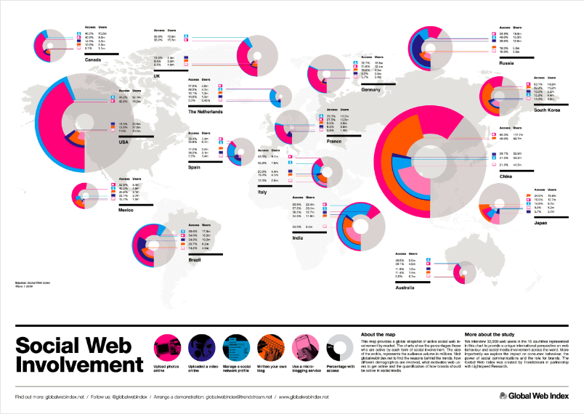
Context
Data visualization involves the creation and study of the visual representation of data or metrics.
Visualization techniques include:
  Basic charts
  Time line charts
  Scatter plots
  Maps
  Next generation charts
The visualization of data through graphs helps the reader understand the information it provides.
Data provided in tables would be considered non-visualized.

Slide 3
Data Visualization 101
Do not use colour as the only means to encode a value
(7% of the population is colour-blind).
Always provide a legend.
Each graph, if taken alone, should provide all relevant information.
Use only one unit per graph. Avoid multiple vertical axes.
Always start your graph at 0.
Do not use 3D.
Avoid using pie charts. Opt for single bar charts instead.
A human will only look at a graph for 2-3 seconds and needs to grasp the information during that short time, otherwise the focus is lost.
The simpler the graph, the better.

Slide 4
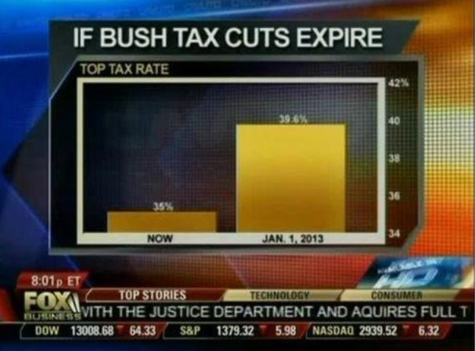
Misinterpretation
When axes do not start at 0 in a column chart, proportions between columns are not accurately represented.

Slide 5
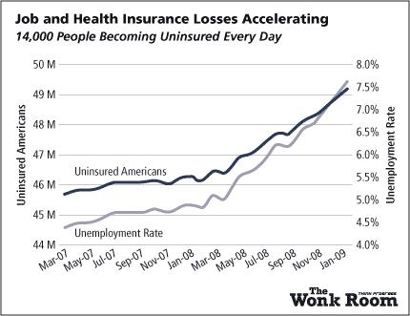
More Misinterpretation
Multiple axes make it difficult to understand which line belongs to which axis.
Not starting at 0 , the intersection point of those 2 lines can be anywhere and has no meaning.

Slide 6
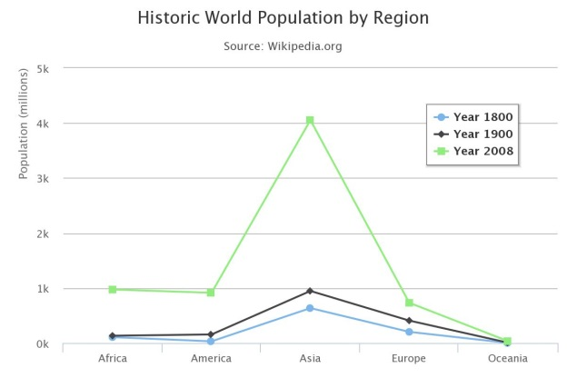
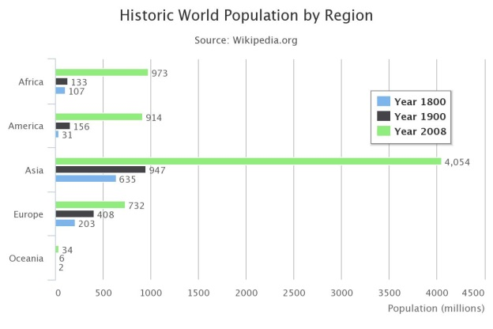
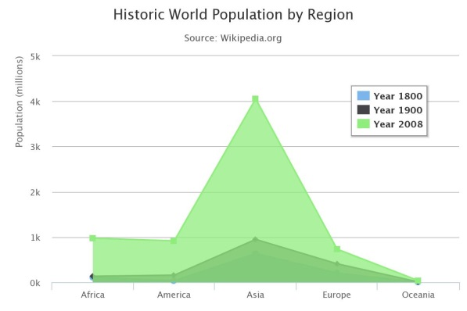
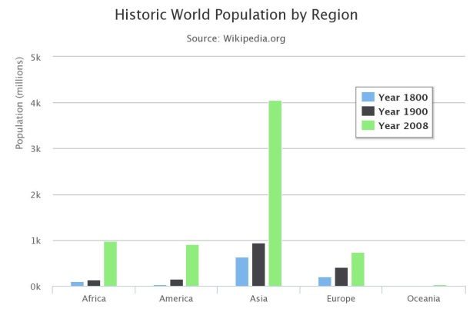
Basic Charts
Basic chart types are:
  Line Bar
  Area Column
If column labels are long, bar charts provide a better layout than column charts.
If the data visualized contains a notion of sequence (e.g. time, size), a line chart may be a good choice.

Slide 7
Basic charts (cont.)
The basic charts are interchangeable.
The best one to use depends on the data and its’ distribution.

Slide 8
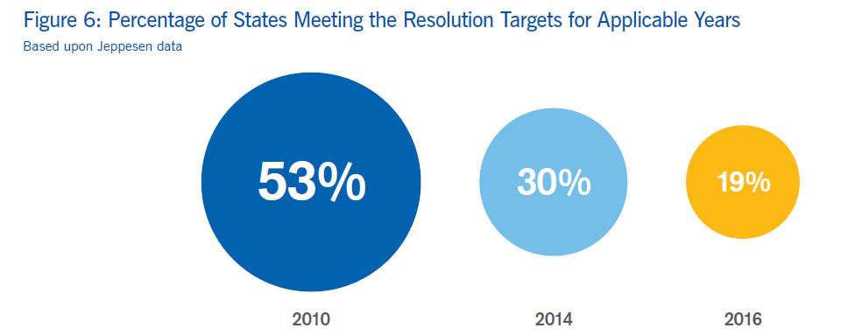


Bubbles
Bubble charts use the area of a circle to represent the value to be displayed.
The area and diameter of the circle should be proportional to the square root of the value to be displayed.
$$Value=πr^{2}$$
$$r \sim \sqrt{Value}$$

Slide 9
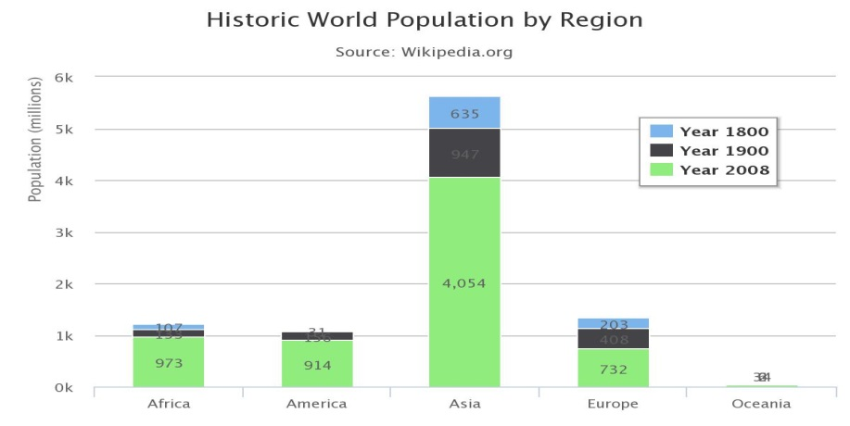
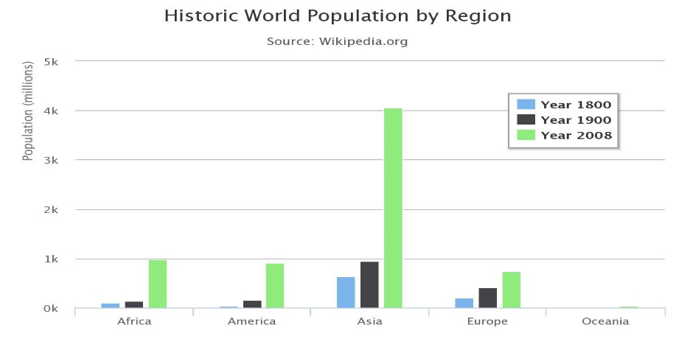
Stacking
Stacking is the representation of a single category of data in a single column, showing metrics one over the other.
Stacking saves space, but lacks clarity compared to unstacked data.
Stacked Data Unstacked Data
Stacking data does not always make sense. The metrics must be the same.

Slide 10
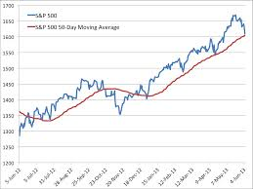
Time Series
Time series are best presented by column or line charts.
Time series charts go from left to right.
Moving averages can be added in addition to the real data.
Points need to be equally spaced. Missing values for some dates need to be noted.

Slide 11
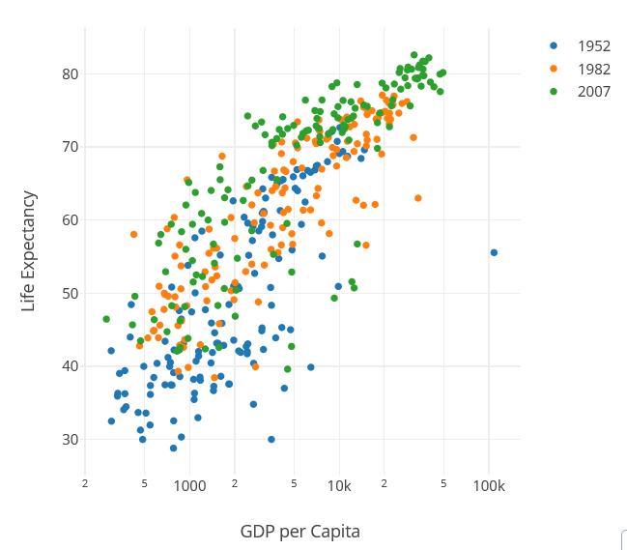
Scatter Plots
Scatter plots are two-dimensional graphs representing two metrics.
Each dot represents a record.
Scatter plots are useful for correlations, but difficult to interpret otherwise.
Scatter plots are used mostly during an initial data exploration phase.
Once the structure of the data is understood, column or bar charts should be preferred over scatter plots.

Slide 12
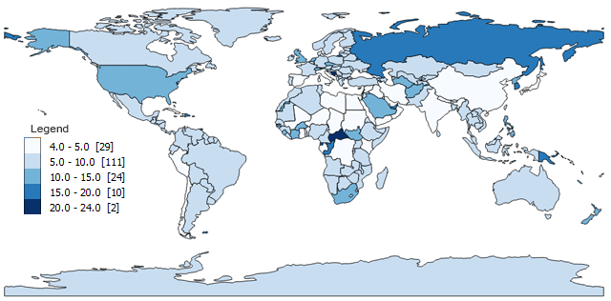
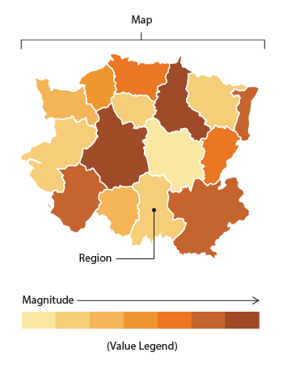
Maps
Maps are powerful visualization tools for georeferenced data.
Data is georeferenced when it contains latitude and longitude, or any other information which would allow it to be placed on a map
(e.g. name of a city).
Geographical Information Systems (GIS) are specialized tools which allow interactive exploration of data.
Choropleth maps are maps where countries or areas are colored according to a value.

Slide 13
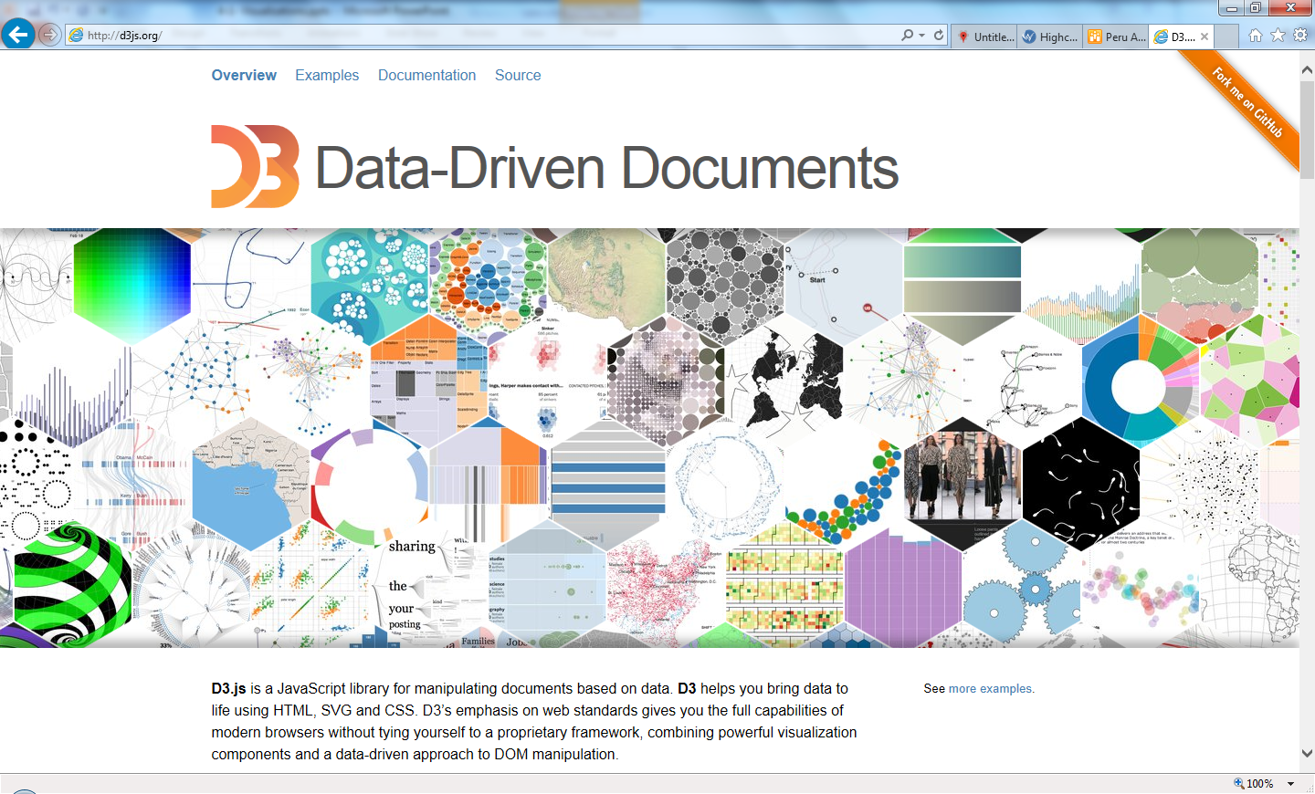
Think Differently. Be Creative.
People remember data better if it is represented in a pleasant and attractive way.
A number of tools and libraries exist which allow anybody to create their own visualization to go beyond the classic bar and column charts.
A good graph is always better than a large table.

Slide 14
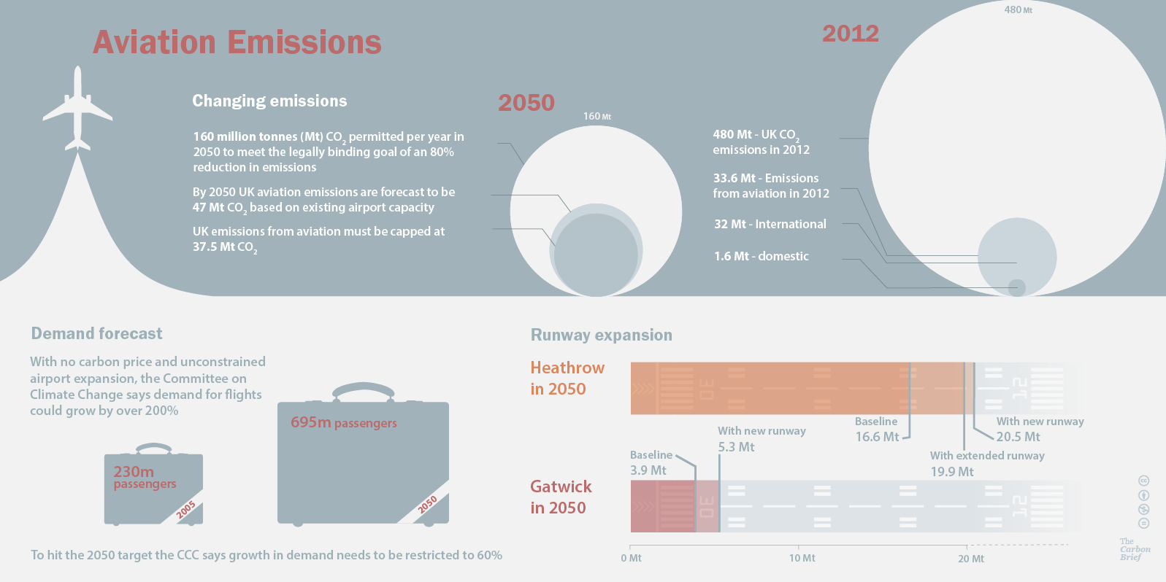
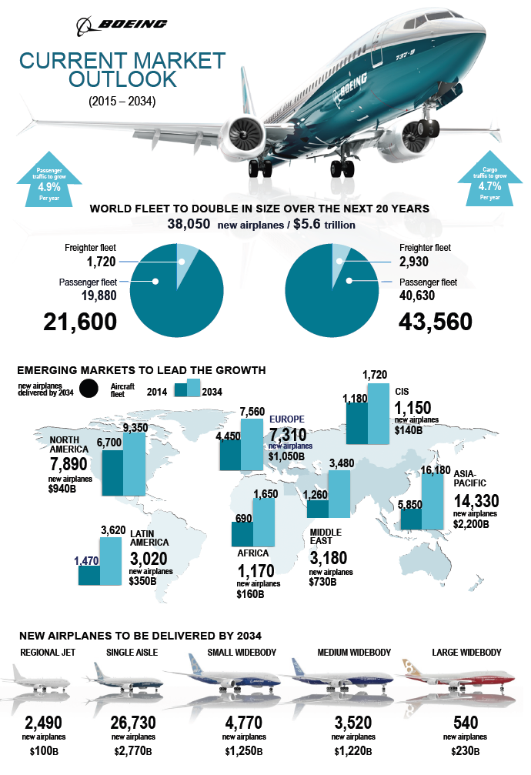
Infographics
Infographics are visualizations which are intended to help general audiences understand complex information. Examples:
Credit: Rosamund Pearce for Carbon Brief
Credit: Boeing
Infographics show data in a beautiful way, and are widely used by the media.

Slide 15
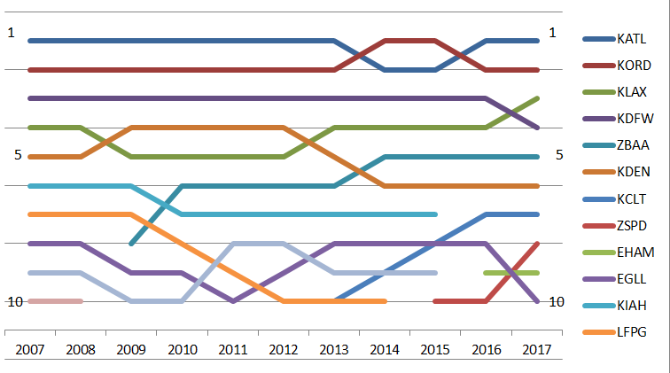
Busiest Airport Analysis Example
Displaying the ranks of the busiest airports worldwide and their trends can be achieved through a time line chart using rank as a metric.

Slide 16
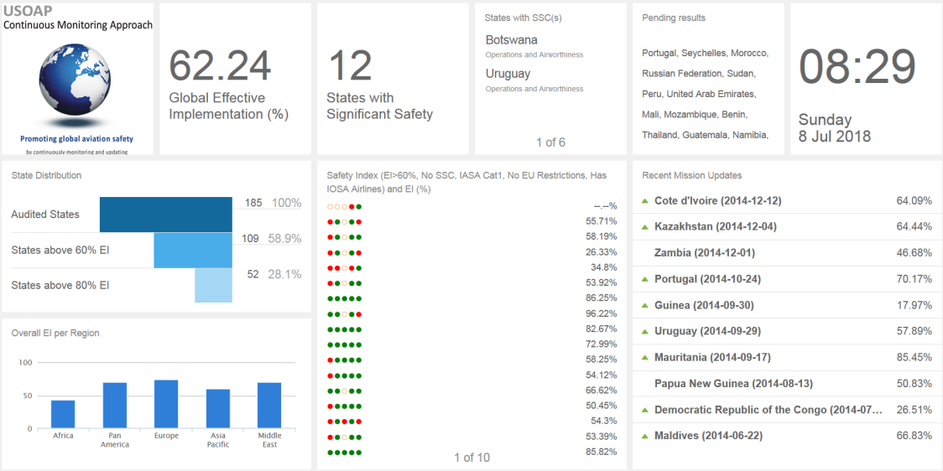
Dashboards
A dashboard is a comprehensive collection and visualization of key statistics, including KPIs.
A dashboard can be built using programming languages and specialized libraries, or by using off-the-shelf software products.
Business Intelligence tools very often contain dashboard features. Low-cost, standalone dashboard tools are also now available.

Slide 17
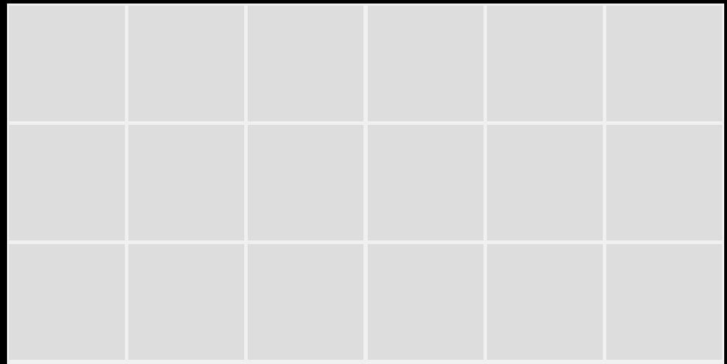
Grid Layout
A dashboard is composed of widgets which have to be placed into a grid.
A grid is generally is a shape of a screen 2 times wider than high
The size of a widget is expressed in grid elements it occupies horizontally and vertically.
The art of creating a dashboard relates to filling up all the grid elements
1x1
2x1
2x2

Slide 18
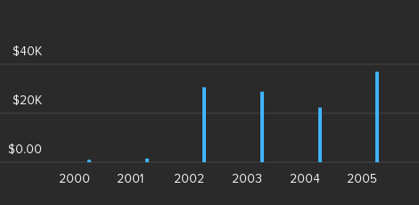
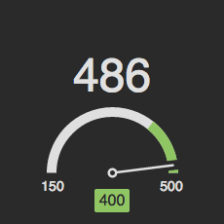

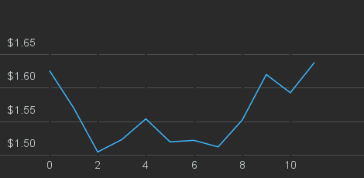
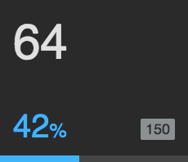
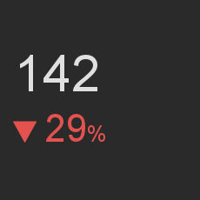
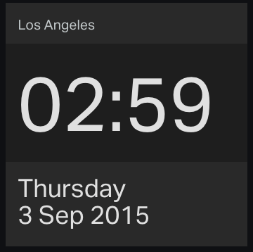
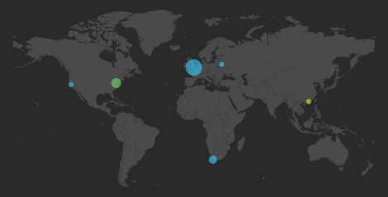
Dashboard Elements - widgets
Data widgets
Graphs
Meters
Numbers
It is crucial to know the time when looking at a dashboard.
Clock
Maps

Slide 19
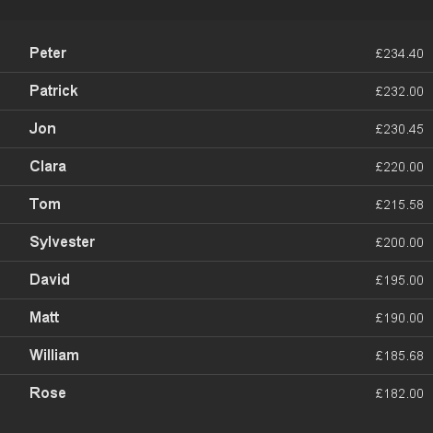

Dashboard Elements – widgets (cont’d)
Text widgets
Lists
Text

Slide 20
Organization
When building a dashboard, here are some elements to consider
  Stay simple, do not overload the dashboard with data
  A dashboard should reflect a theme. Avoid mixing different subjects on one dashboard
  A dashboard is meant to be viewed from far. There is no need for click or drill down events or too much detail

Slide 21
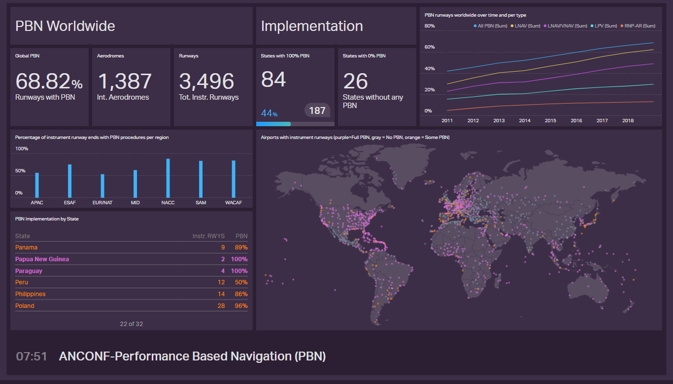
Example: ICAO PBN Dashboard
When building a dashboard, here are some elements to consider
  Stay simple, do not overload the dashboard with data
  A dashboard should reflect a theme. Avoid mixing different subjects on one dashboard
  A dashboard is meant to be viewed from far. There is no need for click or drill down events or too much detail

