Slide 1
Module 5
SIMS
Marco Merens
Chief Integrated Aviation Analysis (IAA)
Air Navigation Bureau (ANB)
Nevin MURAD
Associate Analysis Officer
Integrated Aviation Analysis / ANB
International Civil Aviation Organization (ICAO)
Lima, March 2019

Slide 2
Introduction
Today’s objective:
  Present how we are connecting data to build safety intelligence
  Show examples/potentials of the Safety Information Monitoring System (SIMS)
  Encourage you to join SIMS

Slide 3
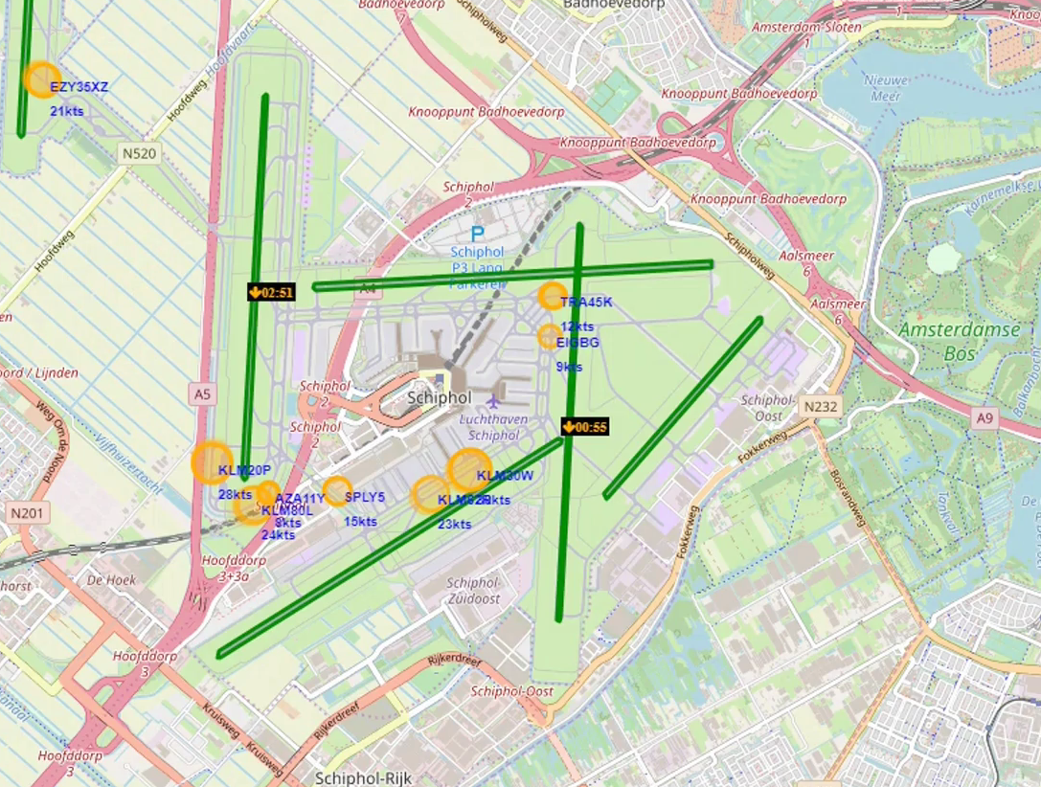
Turning Data into Information
From raw data to information using automation
  Aggregate multiple sources (ADS-B ground)
  Integrate data into information
  Visualize the information for monitoring
https://www.icao.int/safety/iStars/Pages/Real-time-Runway-Safety.aspx

Slide 4


Data Processing
Protect
Manual Entry
Collect
Store
Aggregate
Access
Human
Export
Upload
API
Data feed
Machine
Notes:
Transforming data as input into information as output. As you noticed from my example, we are using machine to feed the data, so there is some form of collection, we store this data, we aggregate with other data, giving it value, and accessibility by visualizing it.
Another way of course is the manual entry or upload of data by humans.

Slide 5



Main Components
The main components of every data processing system are:
data
Indicator
system
Notes:
The main components are data, indicators and a system.
The key component or element here is to have data. You must have heard about the you cannot manage what you cannot measure and if you can't measure it, you can't improve it. This counts as well for aviation safety.
So we use indicators to measure progress towards an objective, I will come back on the use of indicators and finally you will use a system to monitor this progress or any trends.

Slide 6
Is Data a Problem?
What is data
  Numbers, characters, symbols images
  Raw data is unprocessed data
Having not enough or too much data
What it means if air traffic doubles in the next 15 years

Slide 7
What about your data?
Collected data
  Audits and inspections
  Mandatory reporting systems
  Voluntary reporting systems
Recorded data
  Flight Data Analysis
  Radar, ADS-B
Notes:
What about the data that you are currently collecting? The data availability will just become more.
Or even data that you are capable of recording, which has high volume, variety and the velocity which makes it difficult to process using conventional systems.

Slide 8

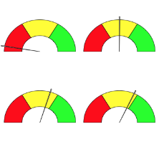



Connecting data to build safety intelligence
Connect
(data, States, service providers)
Monitor
(performance, indicator, improvement)
Identify
(hazards, risks)
Share
(safety information)
Notes:
Yet, we developed the Safety Information Monitoring System, simply SIMS.
It is basically a web platform to facilitate the processing and analysis of safety data, using applications to generate indicators in support for safety management.
It is important to mention that SIMS is not a reporting system.
The SIMS concept functions as follow: States and service providers can connect their collected data to a single platform, where we convert data into information allowing for the monitoring of safety performance using indicators for continuous improvement. Therefore, taking the proactive and risk-based approach, we are able to identify hazards, either existing or potential risks, in order to mitigate these.
A State joining or connecting to SIMS, has the option as well to share their safety information with other participants. We do encourage states to do so, so you can obtain insights not only for safety improvements at national level, but contribute as well to improve safety at regional and global level.
At some point we will be able to for example have SIMS as a centralized safety information using artificial intelligence. Yet, for that data is needed to train the machine. So data remains the key component.

Slide 9
SIMS Applications
Monitor safety information
Notes:
In case of lack of ground coverage, receivers are sent to the State to be placed in the vicinity of the airport to increase the coverage.

Slide 10
Indicators
An indicator is a measurement or value which helps decide whether a given objective is met, or under control.
An indicator uses a metric, which is a specific methodology or algorithm, to calculate the value of the indicator.
Key Performance Indicators (KPIs) are indicators which are used at senior levels of the organization to track overall performance, and define whether global targets are met.
Notes:
As I said before, SIMS uses indicators, for the monitoring of safety performance.
Yet what are indicators?
An indicator measures for measure objectives, targets and if these are met within certain timeframe.
To be able to measure, it has to be quantifiable, be able to count, to calculate the value in terms of numbers, percentage or rate etc.
For example the Global Air Navigation Plan is using a set of key performance indicators and the Global Aviation Safety plan is as well using performance indicators.

Slide 11
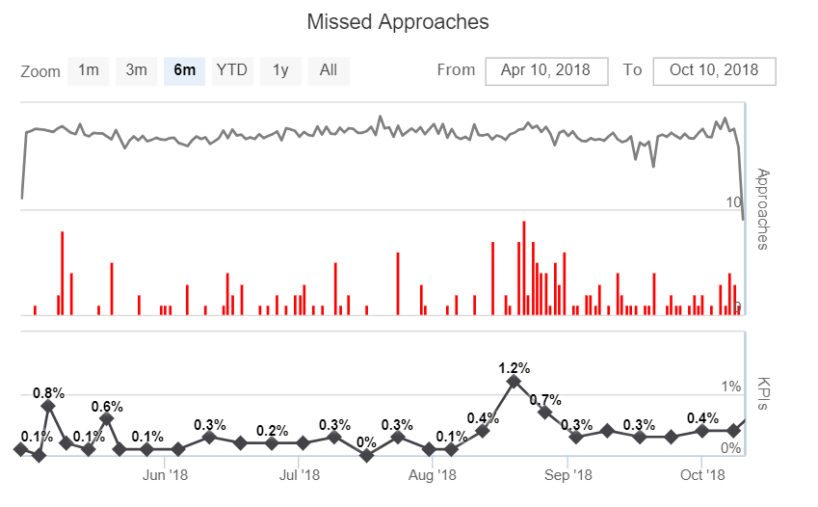
SIMS Example: Missed Approaches
What do you know?
  Indicator : % of missed approaches per day per landing
  Avg. 0.3 % weekly in last 6 months
  Sudden peak for 2 weeks
  No reports received
What would you do?
Notes:
This indicator is under the approach application of SIMS.
So we have the data, this is the indicator, and it is visualized using a system, graphs and charts on SIMS.
So what do we have here.
What do you know?
When missed approaches, safety related things occur, it is important to find the causes or the trigger factors that start these problems in the first place.
Verify the information?!! In this particular case, it was an problem with the antenna.

Slide 12
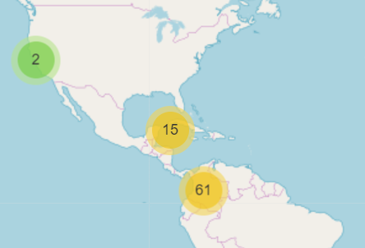
Case Study : TCAS
Data
  Received from States and airlines: date, time in UTC, flight number, longitude, latitude, (type)
Indicator
  Number of TCAS per month
System
  Map visualization
But we can do more!
Notes:
Here I have another case. This is TCAS alerts a new indicator on SIMS. This is currently in the testing phase to be launched on SIMS.
Applying the same principles for data processing, we need a subset of data for which we have a standard template, to calculate the indicator and being able to visualize it on a map.
We have now information, and knowledge of the situation in regards to TCAS alerts.

Slide 13
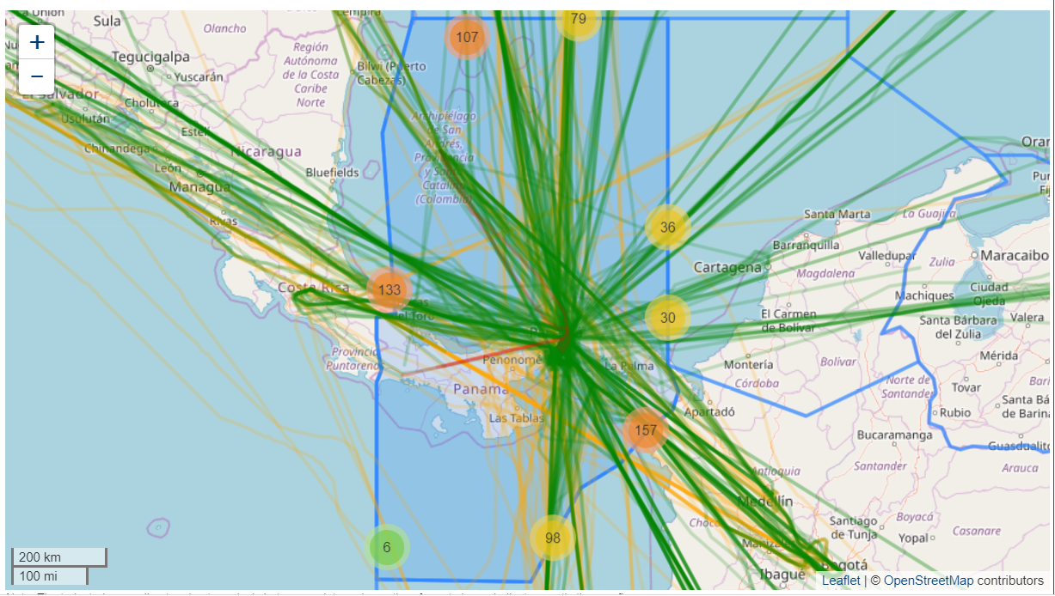
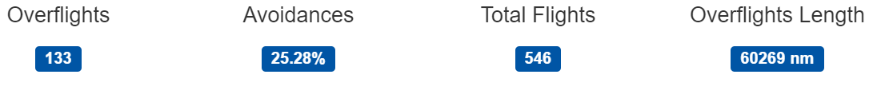
Case Study : TCAS (cont’d)
Panama (MPZL)
A
5
TCAS Alerts
Where is the risk higher
5
B
Notes:
So we are now combining the TCAS indicator with more data to produce or generate new indicators. We can use ADS-B data to add the operations within a particular airspace and as well count the traffic at the crossing boundaries.
Let’s look at this case. It is a small case study. We have here Panama airspace. We have the number of overflights over this airspace and the total flights.
Within this airspace in zone A there has been 5 alerts. Yet in Zone B there has been 5 alerts as well. As we can see, zone A has more traffic than zone B. Based on the above, where is the risk higher? In zone A or Zone B?
Zone B, as in this zone we have less traffic, yet still numbers of alerts. This zone may require further investigation.

Slide 14
New indicator for SIMS: LHD
Similar situation as TCAS
Connect subset of data to SIMS for airspace performance monitoring
Access to safety information anytime
Generate more indicators based on available data
Notes:
Just think about, like in the similar situation as TCAS, we add Large Height Deviation as well on SIMS, using a subset of data and a standard template.
we can then combine this data with TCAS alerts to produce or generate new indicators or to identify hazards and potential risks, this within an airspace or the region.
Access to the information is possible at any time via the ICAO secure portal, with secured access for specific users.

Slide 15

sims@icao.int for more information on how to join SIMS
Thank you
Notes:
Thank you for your attention. If you have any questions now, feel free.
The process is via the ICAO Regional Office. You indicate your interest and the office will send you a letter, and you will respond back confirming your participation and indicating point of contacts of the State and the participating service providers point of contacts. We will follow-up with a kick-off meeting for the implementation, which include how to connect data, access, eventual training etc.

