Slide 1
Module 4
Hazard Identification
Marco Merens
Chief Integrated Aviation Analysis (IAA)
Air Navigation Bureau (ANB)
Nevin MURAD
Associate Analysis Officer
Integrated Aviation Analysis / ANB
International Civil Aviation Organization (ICAO)
Lima, March 2019

Slide 2
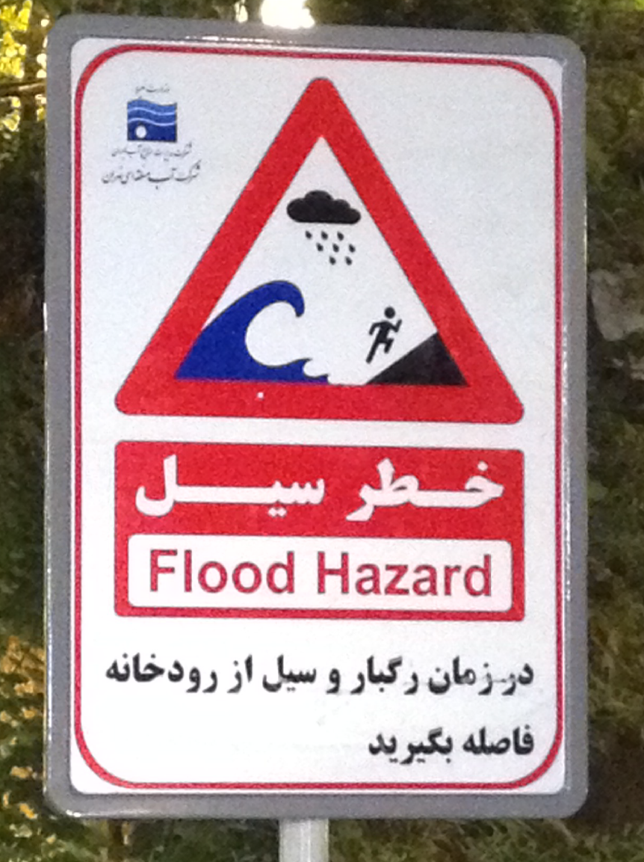
Hazard Definitions
A hazard is
any condition which could cause or contribute to unsafe operation of aircraft or aviation safety-related equipment, products and services (ICAO)
any condition, event, or circumstance which could induce an accident (EUROCONTROL ESARR 4).
any existing or potential condition that can lead to injury, illness, or death to people; damage to or loss of a system, equipment, or property; or damage to the environment.
a condition that might cause (is a prerequisite to) an accident or incident. (FAA AC 120-92A: Safety Management Systems for Aviation Service Providers).
Notes:
The second High Level Safety Conference held in 2015, produced recommendations to ICAO. One of the recommendations were to introduce a phased approach for global information exchange. With this recommendation in mind, ICAO developed the Safety Information Monitoring System, known as SIMS.
We defined the SIMS as a web-based information system with different applications, which generate indicators in support of the State Safety Programme (SSP) and the Safety Management System(SMS).
With SIMS we want to promote the cooperation amongst States and industry for the collections, analysis and sharing of available data pertinent to the monitoring of safety performance. We make available the platform using the secure website of ICAO. The system is free of charge and only participating States will have access to the SIMS website and applications.

Slide 3

Hazard Taxonomy http://www.skybrary.aero/bookshelf/books/2301.pdf
The SM-ICG hazard taxonomy defines 4 categories of hazards:
Organizational (ORG) – Management or documentation, processes and procedures
Environmental (ENV) – Weather or Wildlife
Human (HUM) – Limitation of the human which in the system has the potential for causing harm
Technical (TEC) – Aerodrome, Air Navigation, Operations, Maintenance, and Design and Manufacturing
Notes:
The second High Level Safety Conference held in 2015, produced recommendations to ICAO. One of the recommendations were to introduce a phased approach for global information exchange. With this recommendation in mind, ICAO developed the Safety Information Monitoring System, known as SIMS.
We defined the SIMS as a web-based information system with different applications, which generate indicators in support of the State Safety Programme (SSP) and the Safety Management System(SMS).
With SIMS we want to promote the cooperation amongst States and industry for the collections, analysis and sharing of available data pertinent to the monitoring of safety performance. We make available the platform using the secure website of ICAO. The system is free of charge and only participating States will have access to the SIMS website and applications.

Slide 4
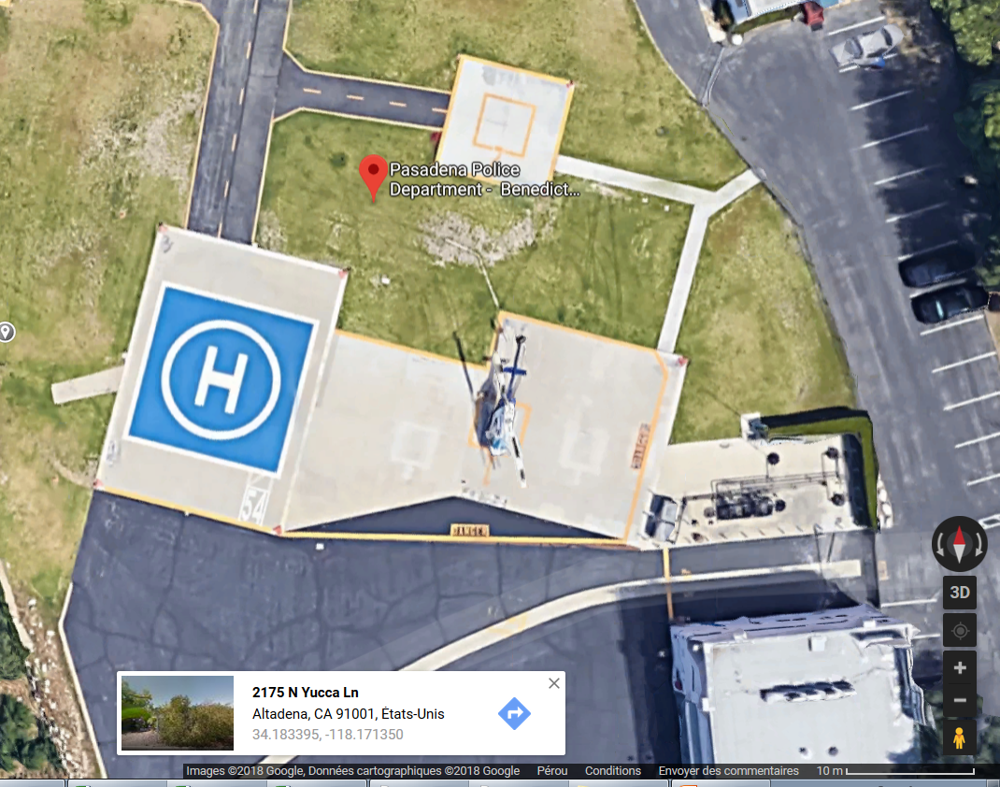
Exercise: Hazard Identification
View the video
What hazards did you identify?
Look at the current layout of the heliport. How did the Police address those hazard
New Heliport layout

Slide 5
Hazard Registry
A hazard registry is typically a list which contains information about known hazards for aviation in a country including:
Id
DateTime of first detection
Description
Category (ORG, HUM, TEC, ENV)
Sub-category (as per taxonomy)
Location (airport, airspace, CAA, organization)
A Hazard Log could be maintained next to the register to track the activity of the hazard (id,starttime,endtime)
Notes:
The second High Level Safety Conference held in 2015, produced recommendations to ICAO. One of the recommendations were to introduce a phased approach for global information exchange. With this recommendation in mind, ICAO developed the Safety Information Monitoring System, known as SIMS.
We defined the SIMS as a web-based information system with different applications, which generate indicators in support of the State Safety Programme (SSP) and the Safety Management System(SMS).
With SIMS we want to promote the cooperation amongst States and industry for the collections, analysis and sharing of available data pertinent to the monitoring of safety performance. We make available the platform using the secure website of ICAO. The system is free of charge and only participating States will have access to the SIMS website and applications.

Slide 6
Hazard Detection Methods
Hazards can be detected:
Reactively through investigation reports
Proactively through surveys, reports, assessments and automatic detections
Notes:
The second High Level Safety Conference held in 2015, produced recommendations to ICAO. One of the recommendations were to introduce a phased approach for global information exchange. With this recommendation in mind, ICAO developed the Safety Information Monitoring System, known as SIMS.
We defined the SIMS as a web-based information system with different applications, which generate indicators in support of the State Safety Programme (SSP) and the Safety Management System(SMS).
With SIMS we want to promote the cooperation amongst States and industry for the collections, analysis and sharing of available data pertinent to the monitoring of safety performance. We make available the platform using the secure website of ICAO. The system is free of charge and only participating States will have access to the SIMS website and applications.

Slide 7
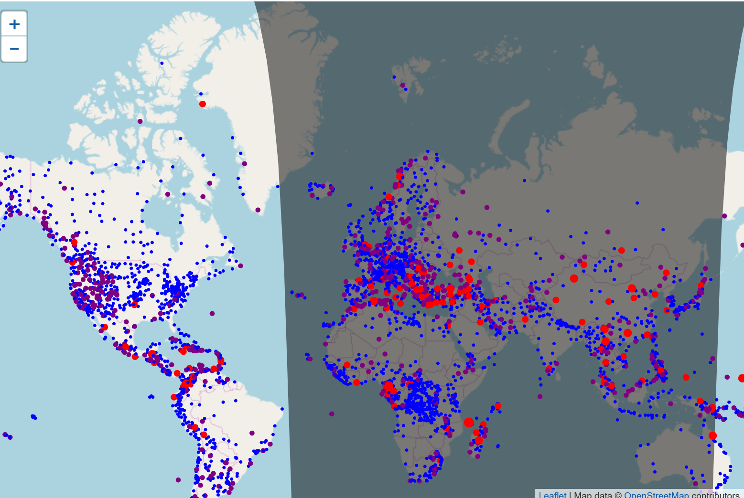
SIMS Hazard Registry
Demo App
Some hazards can be automatically detected by scanning NOTAMS, METARS, USOAP, ADSB etc.
Birds
Hole in RWY
ILS INOP
Storm
On any given day, there are around 5000 hazards in 4000 airports
Low Oversight
Notes:
The second High Level Safety Conference held in 2015, produced recommendations to ICAO. One of the recommendations were to introduce a phased approach for global information exchange. With this recommendation in mind, ICAO developed the Safety Information Monitoring System, known as SIMS.
We defined the SIMS as a web-based information system with different applications, which generate indicators in support of the State Safety Programme (SSP) and the Safety Management System(SMS).
With SIMS we want to promote the cooperation amongst States and industry for the collections, analysis and sharing of available data pertinent to the monitoring of safety performance. We make available the platform using the secure website of ICAO. The system is free of charge and only participating States will have access to the SIMS website and applications.

Slide 8
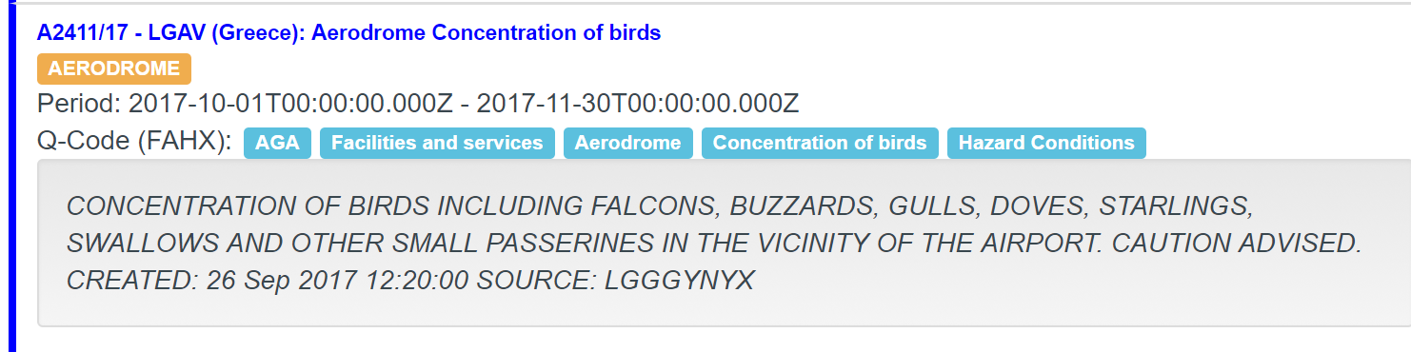
NOTAMS
Hazard Registry Entry
ID: 1
DateTime: 2017-10-01T00:00
Name: Concentration of Birds
Source: NOTAM A2411/17
Description: Variaty of birds in vicinity of airport
Location: LGAV
Category: ENV
Sub-category: Wildlife
Notes:
The second High Level Safety Conference held in 2015, produced recommendations to ICAO. One of the recommendations were to introduce a phased approach for global information exchange. With this recommendation in mind, ICAO developed the Safety Information Monitoring System, known as SIMS.
We defined the SIMS as a web-based information system with different applications, which generate indicators in support of the State Safety Programme (SSP) and the Safety Management System(SMS).
With SIMS we want to promote the cooperation amongst States and industry for the collections, analysis and sharing of available data pertinent to the monitoring of safety performance. We make available the platform using the secure website of ICAO. The system is free of charge and only participating States will have access to the SIMS website and applications.

