Slide 1
Business Analytics for Aviation
Indicators
Nevin MURAD
Associate Analysis Officer
Integrated Aviation Analysis / ANB
ICAO
MARCO MERENS, M.A.E, M.A.M.
Chief, Integrated Aviation Analysis
Air Navigation Bureau
ICAO

Slide 2
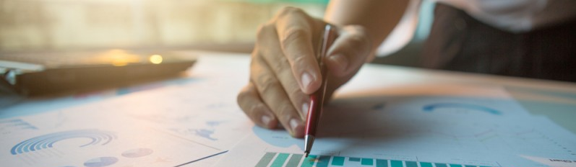
Definitions
An indicator is a measurement or value which helps decide whether a given objective is met, or under control.
An indicator uses a metric, which is a specific methodology or algorithm, to calculate the value of the indicator.
Key Performance Indicators (KPIs) are indicators which are used at senior levels of the organization to track overall performance, and define whether global targets are met.
Traffic growth is an indicator.
5-year compound annual growth rate of commercial scheduled departures is a metric.

Slide 3
Indicator Types
There are two broad types of indicators:
Activity Indicators - help identify whether enterprises/ organizations are taking actions believed to achieve a given objective. Examples:
  Audit score
  Inspection results
  Promotional activities conducted
No single indicator can give the full picture of a situation.

Slide 4
Indicator Types (cont.)
Outcome Indicators - help measure whether such actions are, in fact, taking the organization closer to its objective.
Examples:
  Accident rate
  Number of passengers transported
A business should track a mix of activity indicators and outcome-related indicators to have a holistic views of its operation.
No single indicator can give the full picture of a situation.

Slide 5

Predictive Indicators
KPIs give you information about the current status of the observed system. They rarely give you information about the future, unless they are forecastable.
Predictive indicators are indicators which were shown to be correlated to KPIs, and can therefore be considered as precursors or triggers.
Monitoring predictive indicators allows you to make decisions earlier and drive KPIs future trends.
Bad weather is a predictor for delays and cancelations.

Slide 6
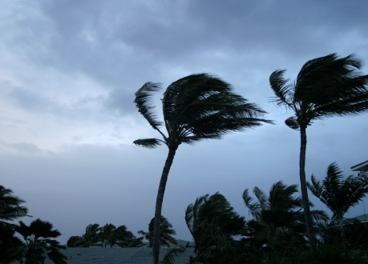




Bad Weather as a Predictor
Bad weather is a major contributing factor to most aircraft accidents, and the cause of the majority of delays.
In aviation, weather is generally considered bad if one of the following situations prevail:
  High winds
  High precipitations, rain or snow
  Low visibility or fog
  Freezing conditions: low temperatures plus humidity
  Dangerous phenomena such as thunderstorm or hail
Indicators can be built counting the number of hours certain conditions prevail per day or month.

Slide 7

Proxy Indicators
Sometimes finding a metric which perfectly represents an indicator is either not possible or overly expensive.
A proxy indicator is an indirect measure or sign that approximates or represents a phenomenon in the absence of a direct measure or sign.
Proxy indicators are generally found through research and deep analysis.
Passenger volume is seen by the United Nations Sustainable Development Goals as a proxy for economic development.

Slide 8
Indicator Development
The indicator development process filters data at every step as follows:
Metrics (sums, counts, averages, etc. of the data) are extracted.
Those metrics are assigned to indicators, based on the extent to which they represent the intention of the indicator.
Next, from those indicators, KPIs are selected and agreed upon at the corporate level. These should be straight-forward enough to enable users to clearly understand reports/results.
During the development, data to be processed gets smaller and smaller.
Data
Metrics
Indicators
KPIs

Slide 9

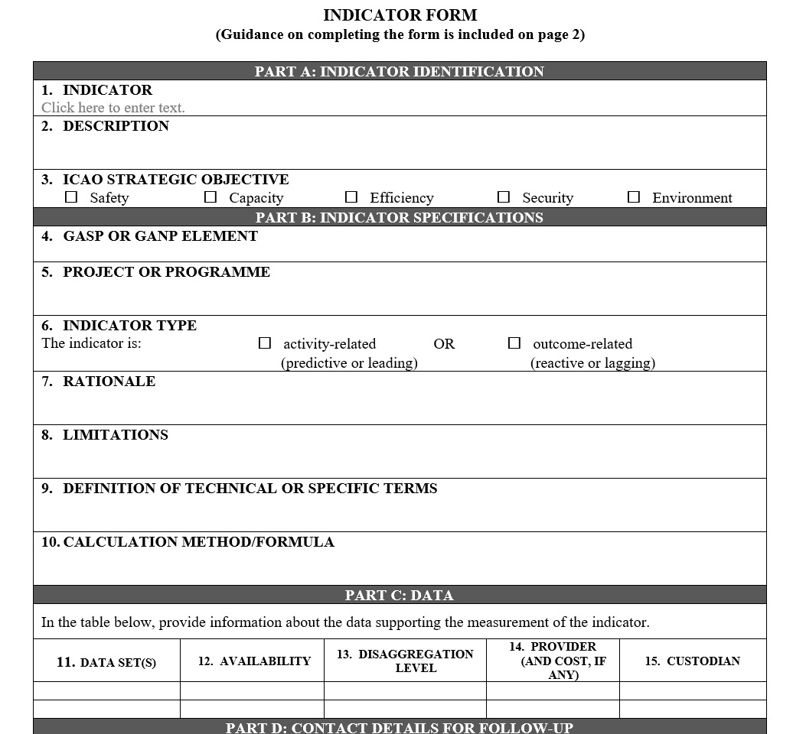
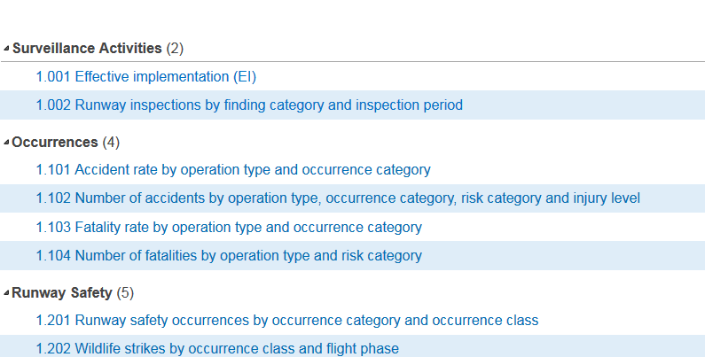
Indicator Catalogue
It is good practice to publish and list the indicators used to measure performance in an organization.
Such a catalogue should clearly specify the metrics used, as well as the data sources.
An indicator form can be used to guide and standardize the definition of indicators.
Use an indicator form or spreadsheet to capture all the necessary information to clearly understand and explain each indicator.

Slide 10
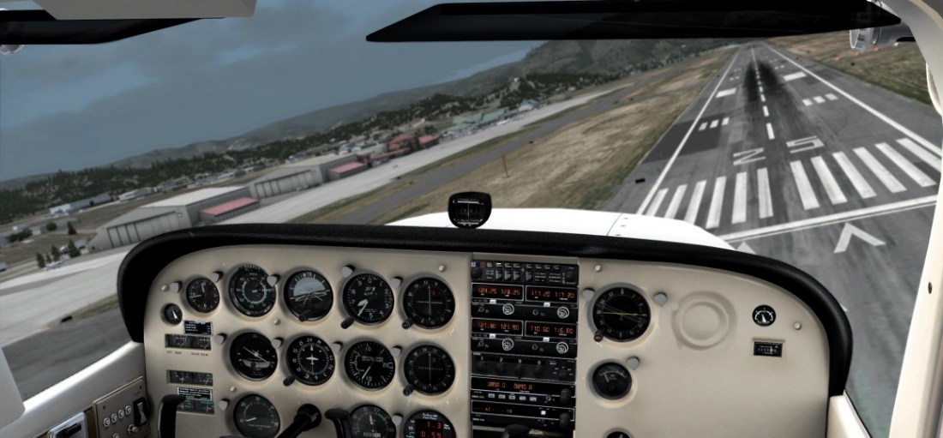
Examples - Safety Indicators
Safety Performance Indicators are meant to measure the level of safety risk present in the system.
Lagging Indicators measure a company’s incidents in the form of past accident statistics.
A Leading Indicator is a measure preceding or indicating a future event used to drive and measure activities that are carried out to prevent and control injury.
Leading safety indicators are events (e.g. unstable approaches).

Slide 11
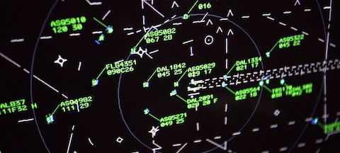
Examples - Traffic Indicators
Traffic is a primary indicator for aviation activity.
Traffic is used to measure the size and importance of an aviation component such as: an airport, an airspace, an airline, or even a State.
Traffic can be represented by various metrics including: number of departures, number of movements, and number of overflights (e.g. over cities) by aircraft size or operation type.
Air traffic has been shown to be correlated to Gross Domestic Product (GDP) at the level of a State.
Traffic growth is a sign of good economic health.

Slide 12
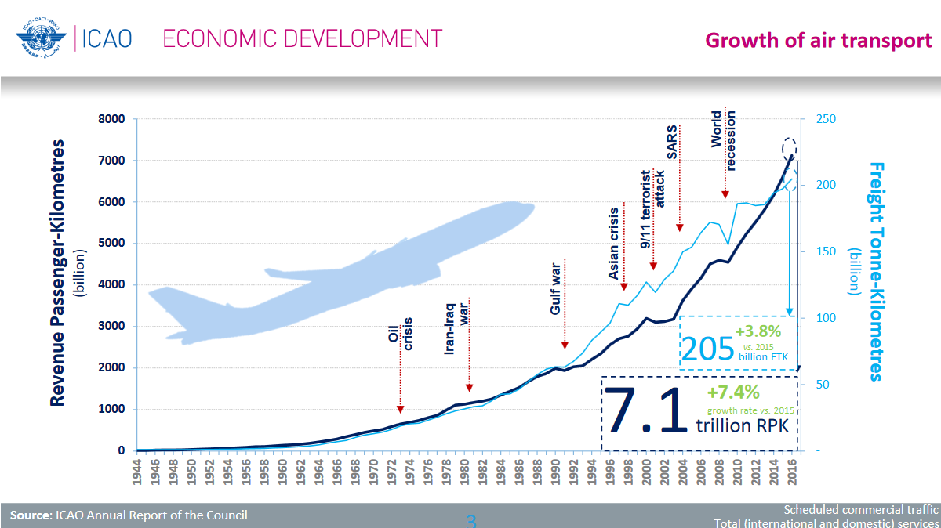
Example - Revenue Passenger Kilometers (RPK)
Revenue Passenger Kilometers (RPK) is a measure of the volume of passengers carried by an airline.
A revenue passenger kilometer is flown when a revenue passenger is carried one kilometer.
The global RPK is approximately 7 trillion per year.
The RPK of an airline is the total number of kilometers travelled by all passengers.
RPK is a measure of sales volume of passenger traffic.
Source IATA

