Slide 1
Module 2B - Data Systems
Marco MERENS
Chief
Integrated Aviation Analysis / Air Navigation Bureau
International Civil Aviation Organization (ICAO)
Nevin MURAD
Associate Analysis Officer
Integrated Aviation Analysis / Air Navigation Bureau
International Civil Aviation Organization (ICAO)
Lima, March 2019

Slide 2
Definition
Safety Data Collection and Processing Systems (SDCPS) refers to processing and reporting systems, databases, schemes for exchange of information, and recorded information
SPCPS are designed to capture, store, aggregate, and enable the analysis of safety data and safety information
A State should have multiple SDCPS

Slide 3
Safety Data vs Information
Safety information refers to information contained in SDCPS established for the sole purpose of improving aviation safety, and qualified for protection
Safety data is what is initially reported or recorded as the result of an observation or measurement

Slide 4
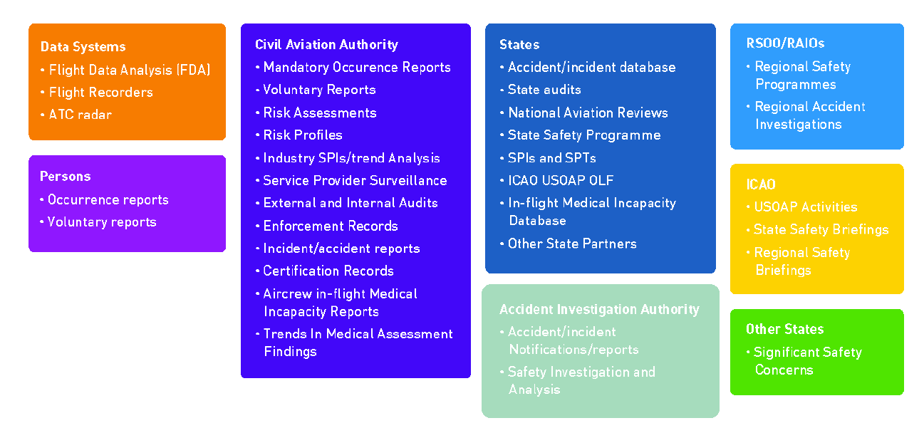
Data and Information Ressources

Slide 5
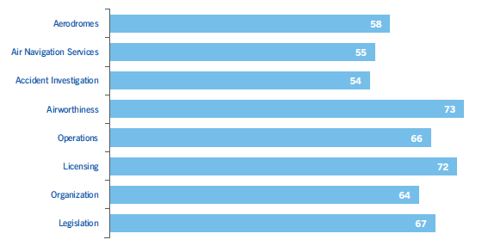
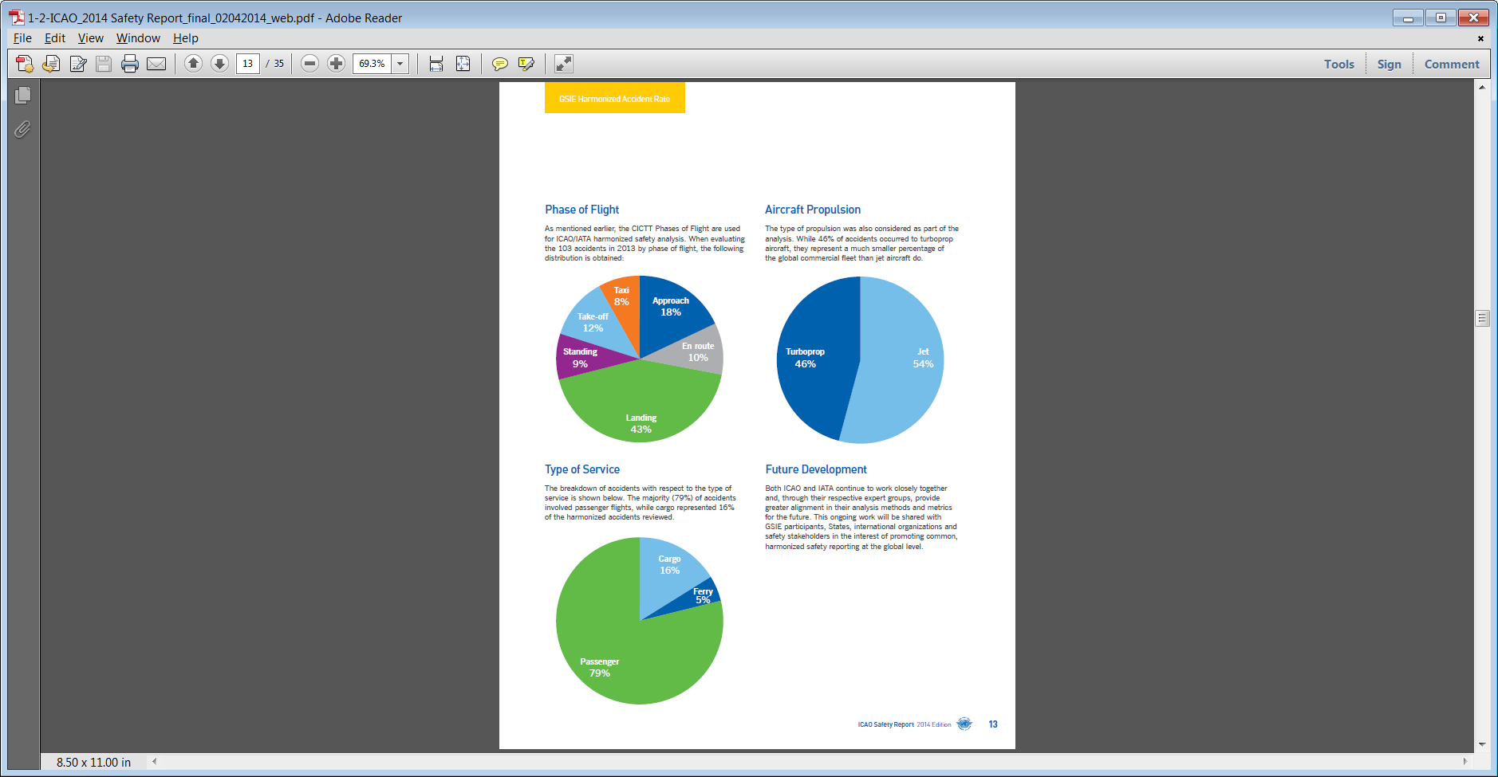
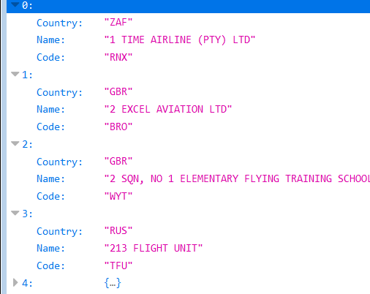
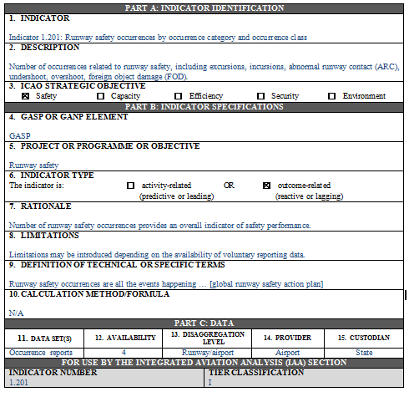
System Overview
SDCPS
Information
Collect&Store
Aggregate
Access
Protect
Information
Data
Taxonomies

Slide 6



State Network of SDCPS
Reports
Occurrences
Risk Profiles
SPIs
Inspections
Checklist
Industry SPIs
SDCPS
FDM
Traffic/ADSB
Internet
Information
Data
Cloud Services (Storage, processing, AI, translation …) Google, AWS, MS

Slide 7
Collect and Store
An SDCPS needs to provide one or more data entry features:
  Form entry
  Spreadsheet upload (CSV, XLS, …)
  Data Feed (automatic services)
An SDCPS needs a database or filesystem to store its information

Slide 8
Aggregation
An SDCPS needs aggregation functions to build indicators
Aggregation functions allow to query, group, select, sort and perform calculations on data to generate information

Slide 9
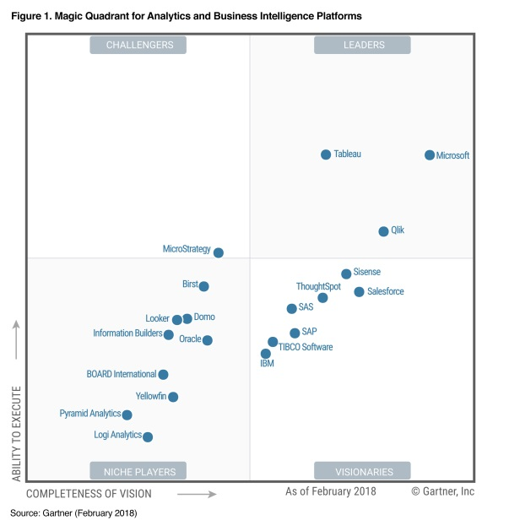
Enable Analysis
Specialized Business Intelligence (BI) tools exist to analyze data (e.g. Qlikview, Tableau Software, Microsoft BI)
To be analyzed, the data of the SDCPS must be accessible in standard formats (CSV, JSON)
Access can be provided through export or programming interfaces (APIs)

Slide 10
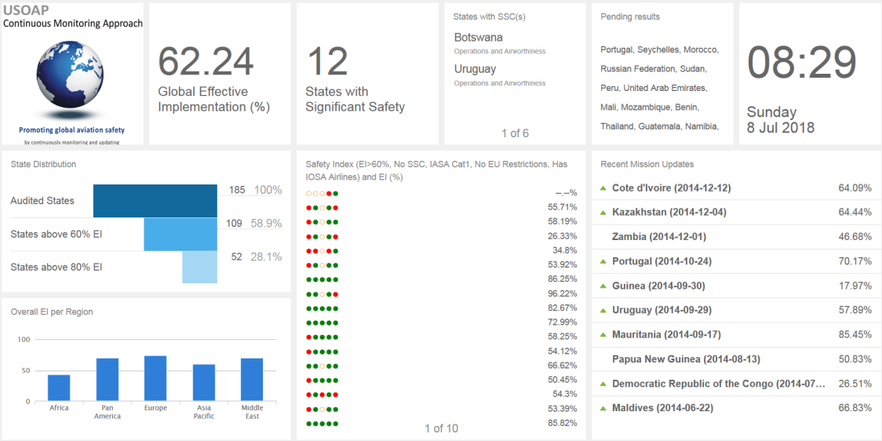

Dashboards
Audits
Audit stats
csv
SDCPS

Slide 11
Data Protection
Protecting safety information from inappropriate use is to ensure its continued availability so that proper and timely preventive actions can be taken and aviation safety improved
An SDCPS should allow for user identification and rights management

Slide 12
Taxonomies
Every data or information element needs to have a definition and a predefined set of possible values
That list of values and their definitions is an integral part of the SDCPS
Global taxonomies/references exist for flight phases, occurrence categories, airports, States etc.
The use of public taxonomies ensures compatibility between SDCPS

Slide 13
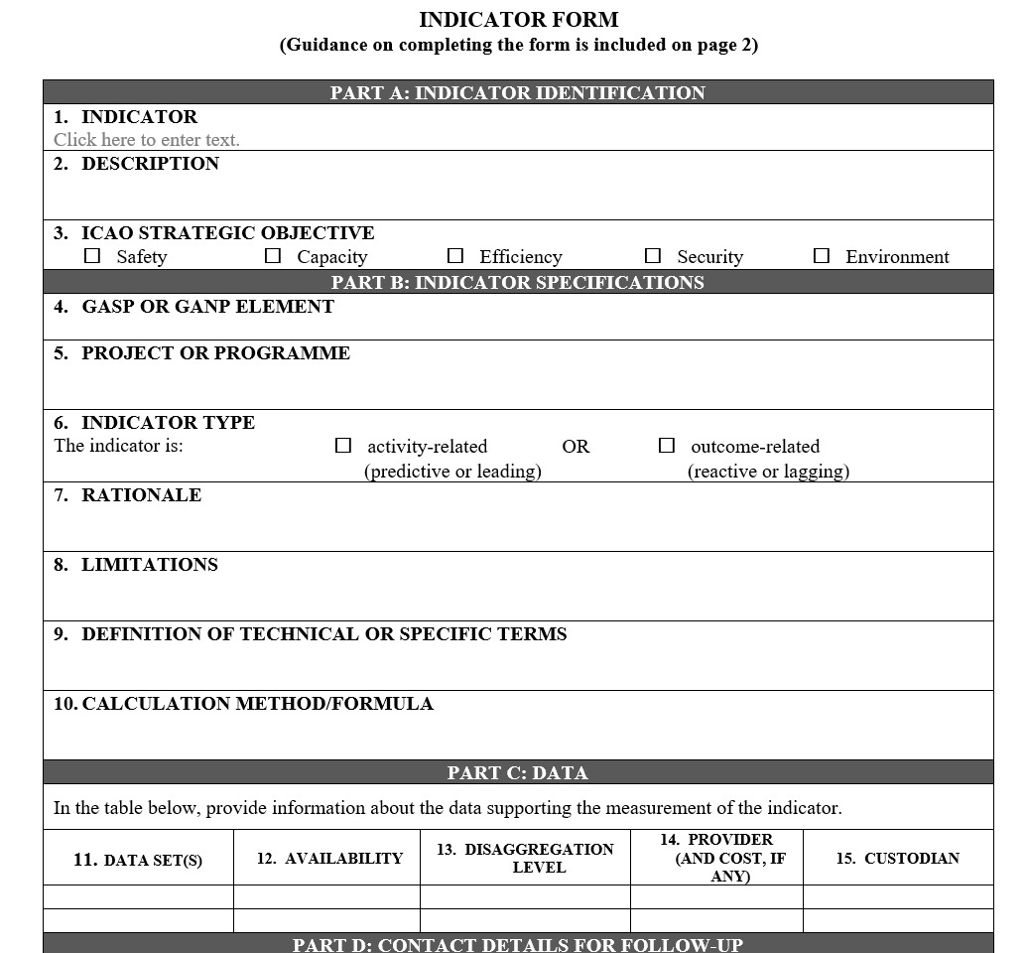
Indicators
The SDCPS provides its safety information in form of indicators
Indicators should be defined with more than just a name
Algorithms, rationals and data sources need to be attached to each indicator
Each indicator should be given a reference ID and kept in a catalogue

Slide 14


SDCPS Summary
Protect
Manual Entry
Collect
Store
Aggregate
Access
Human
Export
Upload
SDCPS
API
Data feed
Machine
SDCPS

Slide 15
Tools to build an SDCPS
System | Collect | Store | Aggregate | Access | Protect
Google Forms&Sheets | Online forms | Google Drive | Very few formulas | API | Key
EXCEL | No specific forms | File system | Formulas & Macros | Export / Save | No user identification
Sharepoint | Online forms and lists | Sharepoint lists limited | Very few functions | API | User ID
Some programming skills are required when building an SDCPS using those tools

Slide 16
Specific SDCPS
System | Ressource | Collect | Store | Aggregate | Access | Protect
EMPIC (EMPIC) | Audit, Certificates, Licenses, Registrations | Desktop form | Database | Summary reports | Export | User ID
SAFA (EASA) | Ramp inspections | Online form | Database | Summary reports | System Export | User ID
ECCAIRS (EU) | Occurrence reports | Customizable forms | Database | Query Functions | Export | User ID
SIMS (ICAO) | Performance indicators | Online form or upload | Database | Predefined indicators | API or Export | User ID

Slide 17
Build or Buy
Less than 10 reports per month
  Build using generic SDCPS, focus on manual entries and exports
Over 10 reports per month
  Buy if SDCPS exists for selected ressource, otherwise
  Build using generic SDCPS, focus on automation and access

Slide 18
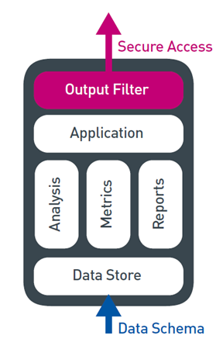
ICAO SIMS
Web-based information system
Generate indicators in applications
Support State Safety Programmes (SSP) and Safety Management Systems (SMS)
SIMS is an SDCPS for SDCPS

Slide 19
SIMS as SDCPS Integrator
Occurrences
SIMS
Accident&Incident Rates
SDCPS
Monitor
Inspections
Finding Ratios
SDCPS
Industry SPIs
TCAS Rates
SDCPS
SDCPS
SDCPS
ICAO SPIs
State
ICAO
State

Slide 20
SDCPS vs Ressources
One SDCPS can cover multiple data ressources
When combined, the ressources need to share the same attributes such as data structure and protection needs
Data which can be in the same SDCPS
  Occurrence data
  audit/inspection data
  Operational hazards/risk/low-level events (TCAS, long landings etc.)

Slide 21
Setting up your SDCPS
Identify the safety related ressources you have
Define the number of SDCPS you need
For each SDCPS:
  Estimate the number of monthly reports received to evaluate build or buy
  If you decide to build
    Choose a platform (EXCEL, Google, Sharepoint …)
    Design data input forms
    Define data storage structure
    Define aggregations and indicators (use the indicator forms)
    Develop the SDCPS
  Write a procedure which describes the way you use and secure the system as well as the input data and indicators produced
  Integrate minimal amount of historic data to build a reference (e.g. 1 year)
Connect the different SDCPS together as needed
Connect each SDCPS to analysis software
Build a global dashboard with key values from each SDCPS

