Slide 1
Becoming Risk-Based
Lima, March 2019
Marco MERENS
Chief
Integrated Aviation Analysis / Air Navigation Bureau
International Civil Aviation Organization (ICAO)
Nevin Murad
Associate Analysis Officer
Integrated Aviation Analysis / Air Navigation Bureau
International Civil Aviation Organization (ICAO)

Slide 2
Regulatory Provisions

Slide 3

Overview
Annex 19, Amendment 1
  Surveillance vs. Oversight
  State safety management responsibilities
  Surveillance obligations
Safety Management Manual, (Doc 9859), 4th ed
  Data-driven decision making process
  Prioritizing surveillance activities
  Service provider organizational safety risk profiles
  Sector safety risk analyses
  Impact of SRBS
Safety Management Implementation (SMI) website
F
S

Slide 4

Amendment 1 to Annex 19
New definitions
  *Safety oversight. A function performed by a State to ensure that individuals and organizations performing an aviation activity comply with safety-related national laws and regulations.
  *Surveillance. The State activities through which the State proactively verifies through inspections and audits that aviation licence, certificate, authorization or approval holders continue to meet the established requirements and function at the level of competency and safety required by the State.
Notes:
1) Integration
Integrates the eight CEs of the SSO system with the SSP framework elements into a streamlined set of SARPs to facilitate implementation.
The integration of provisions related to a State’s safety management responsibilities, elevates the elements of the SSP framework to SARPs.
2) Enhancement
Extends the applicability of SMS to organizations responsible for the type design and manufacture of engines and propellers.
Provides new and amended safety management system (SMS) SARPs to facilitate implementation, including the addition of several explanatory notes.
3) Protection
Elevating Attachment B of Annex 19 to the status of an Appendix that will move the principles of protection from guidance material to SARPs and thus provide greater impetus for their implementation.
Another important element is that safety data and safety information in voluntary reporting systems are accorded a higher level of protection through a Standard to ensure their continued availability and greater uniformity among States.
The protection of safety data and safety information in mandatory reporting systems, which differs among various legal systems, is reflected in a Recommendation.
Amendment 1 ensures that there is no overlap with the protection provisions in Annexes 6 and 13.

Slide 5
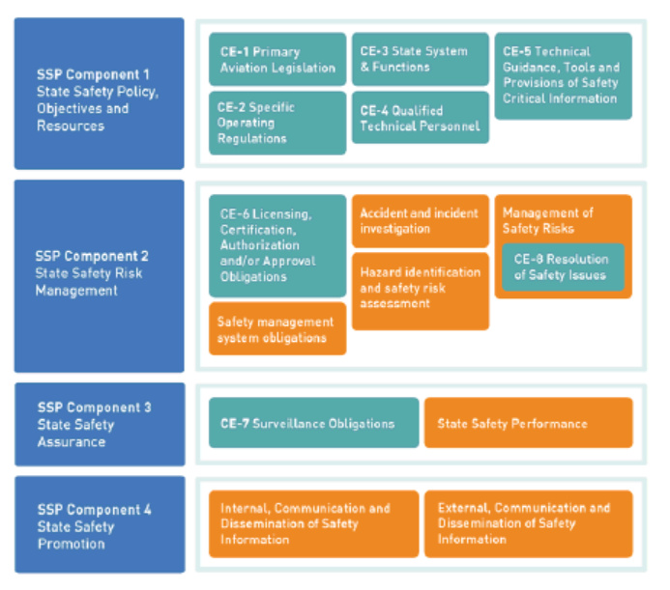
Amendment 1 to Annex 19
In recognition of the need to clarify the relationship between the eight critical elements (CEs) of a State safety oversight (SSO) system found in Appendix 1 and the detailed SSP framework elements previously found in Attachment A, Amendment 1 to Annex 19 consolidates, in Chapter 3, the provisions related to States’ safety management responsibility.
The CEs of an SSO system constitute the foundation of an SSP. Chapter 3 integrates the eight CEs of the SSO system with the SSP framework elements into a streamlined set of SARPs to facilitate implementation. The CEs remain visible in Appendix 1.
Notes:
1) Integration
Integrates the eight CEs of the SSO system with the SSP framework elements into a streamlined set of SARPs to facilitate implementation.
The integration of provisions related to a State’s safety management responsibilities, elevates the elements of the SSP framework to SARPs.
2) Enhancement
Extends the applicability of SMS to organizations responsible for the type design and manufacture of engines and propellers.
Provides new and amended safety management system (SMS) SARPs to facilitate implementation, including the addition of several explanatory notes.
3) Protection
Elevating Attachment B of Annex 19 to the status of an Appendix that will move the principles of protection from guidance material to SARPs and thus provide greater impetus for their implementation.
Another important element is that safety data and safety information in voluntary reporting systems are accorded a higher level of protection through a Standard to ensure their continued availability and greater uniformity among States.
The protection of safety data and safety information in mandatory reporting systems, which differs among various legal systems, is reflected in a Recommendation.
Amendment 1 ensures that there is no overlap with the protection provisions in Annexes 6 and 13.

Slide 6
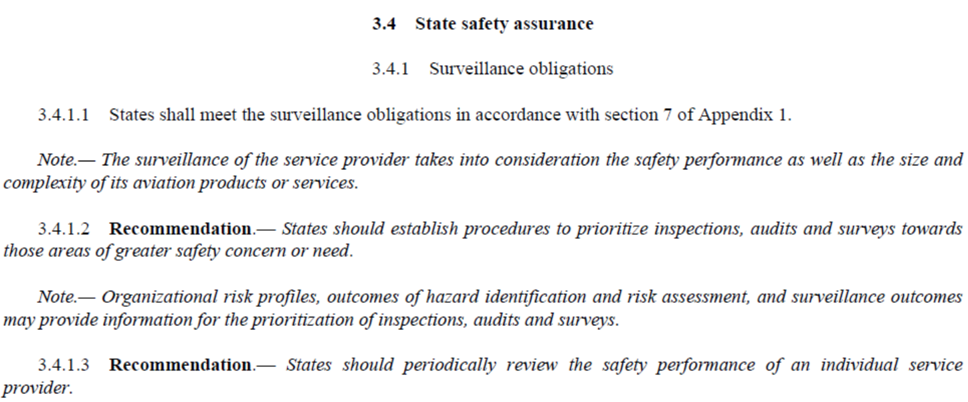
Amendment 1 to Annex 19
Notes:
1) Integration
Integrates the eight CEs of the SSO system with the SSP framework elements into a streamlined set of SARPs to facilitate implementation.
The integration of provisions related to a State’s safety management responsibilities, elevates the elements of the SSP framework to SARPs.
2) Enhancement
Extends the applicability of SMS to organizations responsible for the type design and manufacture of engines and propellers.
Provides new and amended safety management system (SMS) SARPs to facilitate implementation, including the addition of several explanatory notes.
3) Protection
Elevating Attachment B of Annex 19 to the status of an Appendix that will move the principles of protection from guidance material to SARPs and thus provide greater impetus for their implementation.
Another important element is that safety data and safety information in voluntary reporting systems are accorded a higher level of protection through a Standard to ensure their continued availability and greater uniformity among States.
The protection of safety data and safety information in mandatory reporting systems, which differs among various legal systems, is reflected in a Recommendation.
Amendment 1 ensures that there is no overlap with the protection provisions in Annexes 6 and 13.

Slide 7
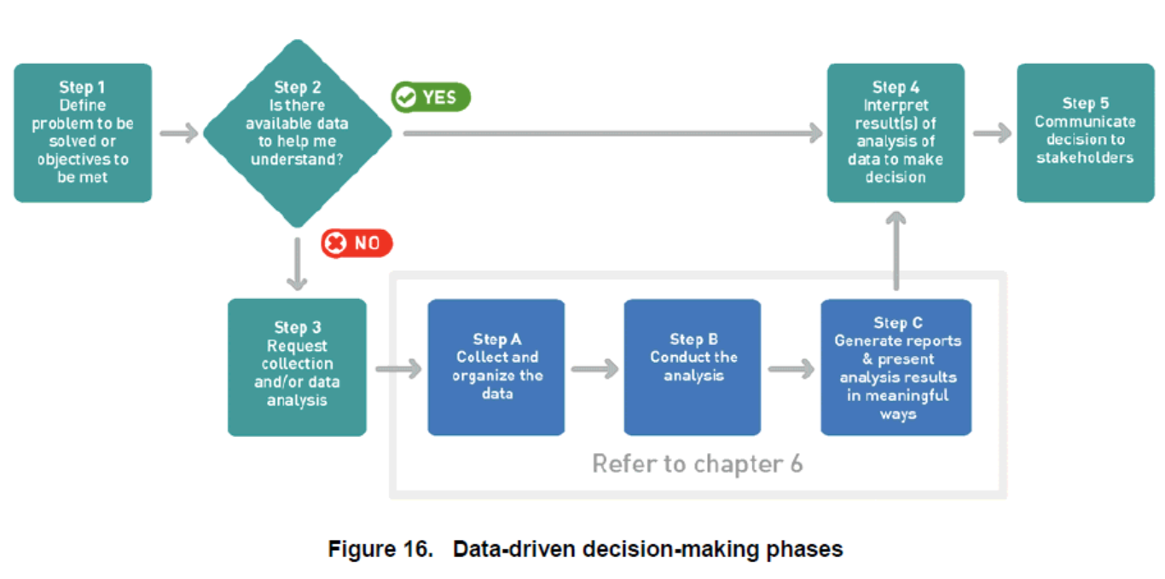
Safety Management Manual, 4th edition

Slide 8
Safety Management Manual, 4th edition
Prioritizing Surveillance Activities
A safety risk-based surveillance (SRBS) approach enables prioritization and allocation of State’s safety management resources commensurate with the safety risk profile of each sector or individual service provider.
States gain experience and familiarity with each service provider by monitoring the steadily developing maturity of their safety assurance process, and in particular, their management of safety performance.
The State may choose to amend the scope and/or frequency of surveillance as their confidence and evidence of the service provider’s safety capability develops.

Slide 9
Safety Management Manual, 4th edition
Prioritizing Surveillance Activities
The foundation of effective SRBS is reliable enough and meaningful data. Without reliable and meaningful data, it is difficult to defend adjustments to the surveillance scope or frequency.
States should develop or reinforce their data management capabilities to ensure they have reliable and comprehensive data upon which to base their (data-driven) decisions.

Slide 10
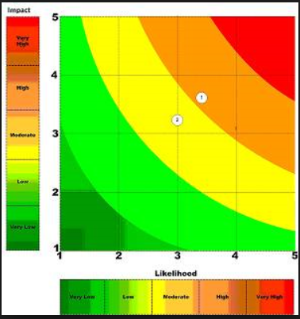
Safety Management Manual, 4th edition
Service provider organizational safety risk profiles
States may wish to develop organizational safety risk profiles using information that may already be available for service providers including:
the financial health of the organization;
number of years in operation;
turnover rate of the key personnel such as the accountable executive and safety manager;
competence and performance of the accountable executive;
competence and performance of the safety manager;
results of previous audits;
timely and effective resolution of previous findings;
measures of relative level of activity (exposure to safety risk);
indicators of the relative scope and complexity of the activities being performed;
maturity of the hazard identification and safety risk assessment process; and
measures of safety performance from State safety data analysis and performance monitoring activities.

Slide 11
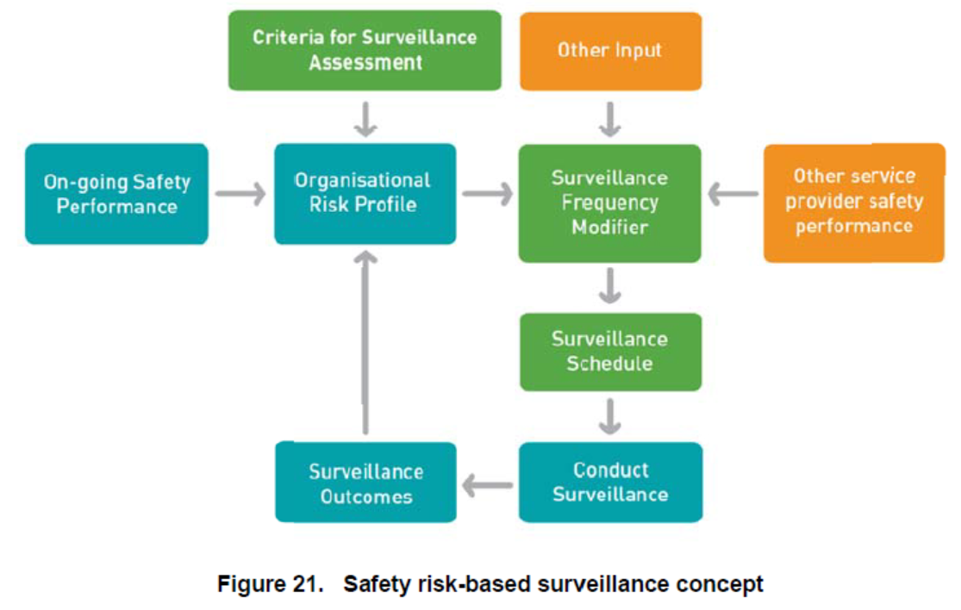
Safety Management Manual, 4th edition

Slide 12
Safety Management Manual, 4th edition
Sector safety risk analyses
Individual sector safety risk analyses may also allow the State to evaluate common safety risks that affect multiple service providers with similar types of operations (for example, short-haul airlines).
Analyses at the sector level allows the State to view the aviation system in context: how the parts contribute to the whole. It empowers the State to identify which sector(s) will benefit from higher levels of support or intervention, and which sectors are the best candidates for a more collaborative approach.
This gives the State assurance that regulation across the aviation system is commensurate and targeted at the areas with greatest need.
Notes:
Analyses at the sector level allows the State to view the aviation system in context: how the parts
contribute to the whole. It empowers the State to identify which sector(s) will benefit from higher levels of support or
intervention, and which sectors are the best candidates for a more collaborative approach. This gives the State
assurance that regulation across the aviation system is commensurate and targeted at the areas with greatest need.
It is easier to identify where changes to specific regulations are needed to achieve maximum regulatory effectiveness
with minimal interference.
8.5.3.6 SRBS comes at a cost. It requires ongoing interactions between the State and the aviation
community beyond compliance-based audits and inspections. An SRBS approach uses the safety risk profile of the
service provider to adapt its surveillance activities. The output of internal reviews, analysis and decision-making
within the service provider’s system becomes a targeted action plan addressing key safety risks and the mitigations
that effectively address them. The analysis from both the State and the service provider define the priority areas of
safety concern, and outline the most effective means of addressing them.
8.5.3.7 Importantly, safety risk-based surveillance may not necessarily reduce the amount of surveillance
conducted or the resources, the quality of the surveillance and the quality of the interaction between the regulator and
the service provider will however improve greatly.

Slide 13

Safety Management Manual, 4th edition
Impact of safety risk-based surveillance
SRBS requires ongoing interactions between the State and the aviation community beyond compliance-based audits and inspections.
The output of internal reviews, analysis and decision-making within the service provider’s system becomes a targeted action plan addressing key safety risks and the mitigations that effectively address them. The analysis from both the State and the service provider define the priority areas of safety concern, and outline the most effective means of addressing them.
Safety risk-based surveillance may not necessarily reduce the amount of surveillance conducted or the resources, however, the quality of the surveillance and the quality of the interaction between the regulator and the service provider will improve greatly.
Notes:
Analyses at the sector level allows the State to view the aviation system in context: how the parts
contribute to the whole. It empowers the State to identify which sector(s) will benefit from higher levels of support or
intervention, and which sectors are the best candidates for a more collaborative approach. This gives the State
assurance that regulation across the aviation system is commensurate and targeted at the areas with greatest need.
It is easier to identify where changes to specific regulations are needed to achieve maximum regulatory effectiveness
with minimal interference.
8.5.3.6 SRBS comes at a cost. It requires ongoing interactions between the State and the aviation
community beyond compliance-based audits and inspections. An SRBS approach uses the safety risk profile of the
service provider to adapt its surveillance activities. The output of internal reviews, analysis and decision-making
within the service provider’s system becomes a targeted action plan addressing key safety risks and the mitigations
that effectively address them. The analysis from both the State and the service provider define the priority areas of
safety concern, and outline the most effective means of addressing them.
8.5.3.7 Importantly, safety risk-based surveillance may not necessarily reduce the amount of surveillance
conducted or the resources, the quality of the surveillance and the quality of the interaction between the regulator and
the service provider will however improve greatly.

Slide 14

Safety Management Implementation Website
To complement the 4th Edition of the SMM:
https://www.icao.int/safety/SafetyManagement/Pages/Practical-examples-and-tools.aspx
Will include the examples currently found in the SMM and provide a mechanism for the sharing of best practices. We hope to collect examples during this workshop!

Slide 15
Prescriptive Surveillance
3 most common methods of resource allocation:
One size fits all
Based on size
Completely random

Slide 16

944 IDISR Ramp inspections 2016

Slide 17
Only 201 Unsatisfactory

Slide 18
Barely 64 properly closed

Slide 19
4 hours
2 inspectors
8 man-hours
742 Satisfactory inspections
8 man-hours/inspection
5933 man-hours

Slide 20

Probabilistic approach
Every week ask
What is the chance to FIND something at operator X?
>40%
<=40%
Dynamic Risk Model
Inspect
Wait
Past findings, time, traffic etc.

Slide 21
Risk Based Surveillance
One size fits all
Based on size
Completely random
Risk Based

Slide 22
Risk Based Surveillance
Resource allocation based on individual service provider risk profile = EFFICIENCY

Slide 23
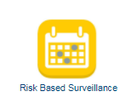

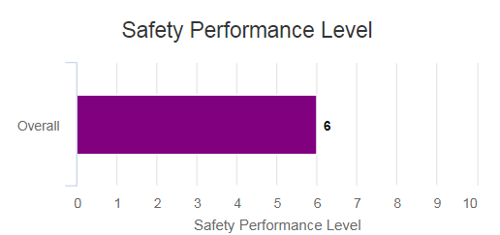
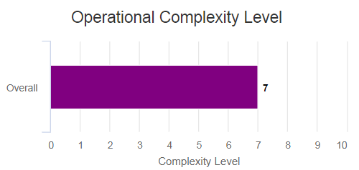
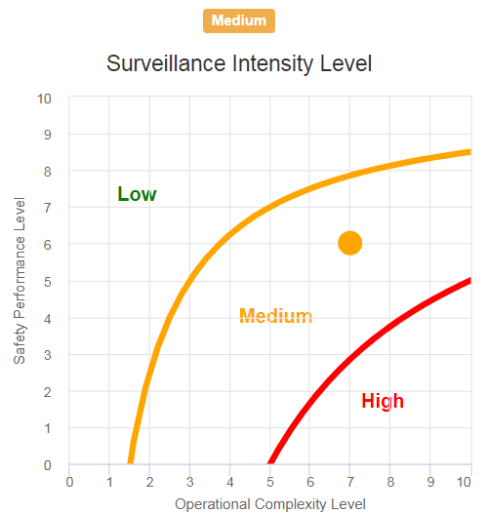
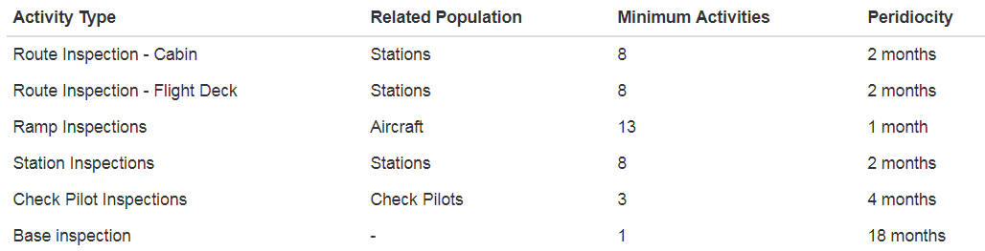
Risk Based Surveillance Planning
+
=

Slide 24
Findings follow-up and control
States to implement suitable means to ensure:
Easy and fast consultation of findings status
Timely resolution of open findings
Timely warnings are received when deadlines are about to expire
Timely warnings are received when deadlines expire
Easy and comprehensive data analysis for trend identification

Slide 25

Surveillance metrics
Set of 3 complementary metrics as part of State SSP:
Surveillance Compliance Rate
(1.0)
Finding per Inspection Ratio
(1.0)
Closed findings rate
(1.0)
States to set annually SMART targets

Slide 26
“The highest type of efficiency is that which can utilize existing material to the best advantage”.
(Jawaharlal Nehru)

