Slide 1
The Use of Safety Data and Safety Information
Gabriel Acosta
Assistant Director, IATA

Slide 2



Notes:
March 2016 ICAO adopted A19 Amendment 1
Applicability November 2019
Enhanced SSP provisions
Integrated SSP / SSO Framework
Protections
Data vs. Information
Information Sharing
State SDCPS (upgraded SSP provisions – integrated with SSO and Ces)

Slide 3

Flight Data Exchange

Slide 4
What is FDX?
        Objective: to mitigate safety risks and improve flight efficiency
Global aggregate de-identified program using FDA data to help airlines identify safety trends
Allows the airline to look at data beyond their limited airline dataset
Airlines use benchmarking tool to compare safety performance and issues against global and regional safety trends
Not a FOQA program
Allows airlines to query information and compare performance using a web based platform
FDX runs in Flight Data Services’ (FDSL) Polaris analysis platform
Supports airlines through providing in-depth analyses when required

Slide 5


How does it work?
de-identified results are integrated into a database with inputs from multiple operators,
to generate global trends, rates and training materials and to support advocacy work
In FDX, airlines submit flight data to IATA*
where it is processed using a common event set,
Airline A
Airline B
Raw data from the aircraft is downloaded routinely for FOQA/FDM/FDA
(*) IATA works with Flight Data Services as its collaborative partner for FDX data processing. Data is displayed only when there are at least 3 operators with the same aircraft type. De-identification includes: no airline information is available, the tail numbers and the flight numbers are written off, the flight date is set to the first day of the month.

Slide 6
FDX Statistics
More than 80 participants and growing
More than 6,853,133 flights globally
More than 4,127 aircraft

Slide 7

Need for growth
FDX is expanding
Important to meet the growing needs of participants and internal stakeholders
Need to provide data that is valuable to the a participants and useful in mitigating safety risk

Slide 8
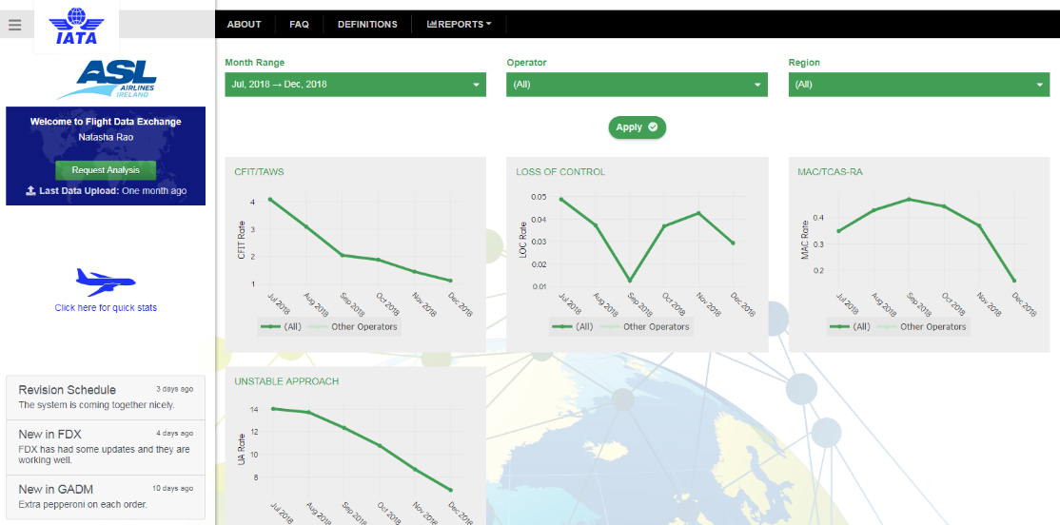
Reinventing FDX
Interactive and user-friendly web platform based on Safety Performance Indicators
** In order for the ‘Crop’ button to appear, please make sure you keep the shape selected at all times

Slide 9
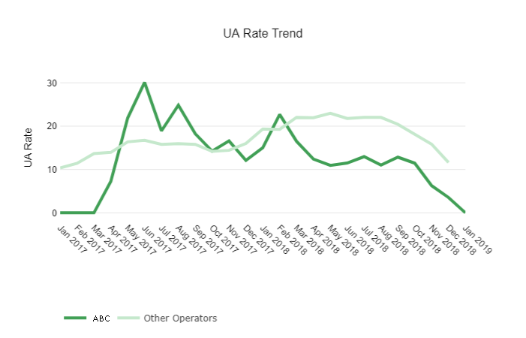
Benchmarking
Ability to compare performance against aggregate of other operators
** In order for the ‘Crop’ button to appear, please make sure you keep the shape selected at all times

Slide 10
Personalization: Views of Information
Based on log in the information can be viewed in a multitude of ways

Slide 11
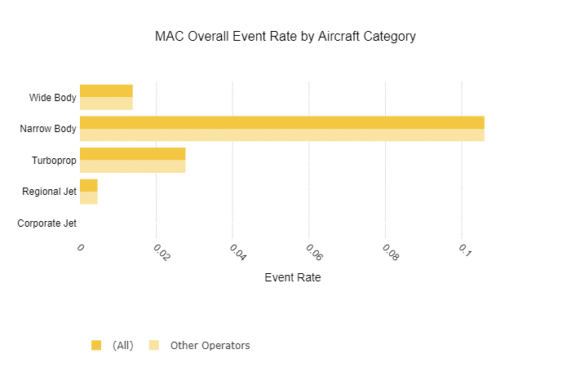
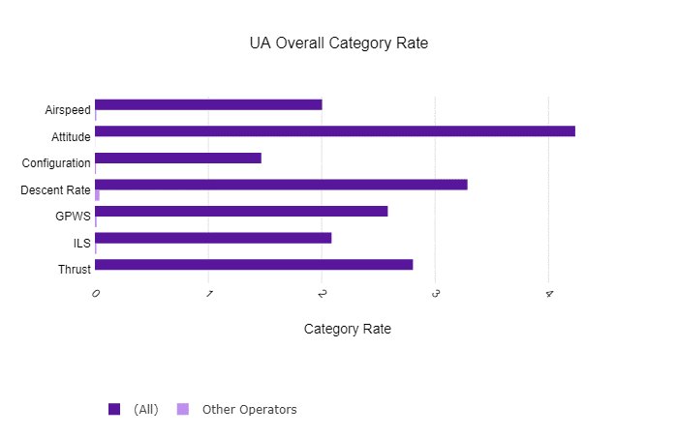
Ability to compare data by
Contributing Events:
Aircraft Type:

Slide 12

The Use of Safety Data and Safety Information

Slide 13
Requirements
States must establish a State Safety Program (SSP)
States are further required to ensure that SMS is implemented by Service Provider’s
Both systems have similar framework elements
Complement each other to achieve effective safety management in a civil aviation system
State safety policy and objectives
State safety risk management
State safety assurance
State safety promotion
Safety policy and objectives
Safety risk management
Safety assurance
Safety promotion
Notes:
States must establish a State Safety Program (SSP) to ensure an acceptable level of safety is established and maintained in their civil aviation systems.
States are further required to ensure that SMS is implemented by Service Provider’s
Both systems have similar framework elements and complement each other, in order to achieve effective safety management in a civil aviation system.

Slide 14
Requirements
States must identify and manage safety risks to the State’s entire civil aviation system
A Safety Data Collection and Processing Systems (SDCPSs) must be established, to support their respective safety management activities
All safety data and safety information deemed relevant by a State is in scope for their SSP activities
Notes:
Just like a Service Providers SMS must identify and manage safety risks, as well as monitor the ongoing safety performance of their respective organizations……..States must identify and manage safety risks to the State’s entire civil aviation system and measure safety performance of the State, and not individual SPs
A Safety Data Collection and Processing Systems (SDCPSs) must be established, to capture, store, aggregate, and enable the analysis of safety data and safety information to support their respective safety management activities

Slide 15
SDCPS
Note 1.— SDCPS refers to processing and reporting systems, safety databases, schemes for exchange of information, and recorded information including but not limited to:
a) data and information pertaining to accident and incident investigations;
b) data and information related to safety investigations by State authorities or
aviation service providers;
c) mandatory safety reporting systems as indicated in 5.1.2;
d) voluntary safety reporting systems as indicated in 5.1.3; and
e) self-disclosure reporting systems, including automatic data capture systems, as
described in Annex 6, Part I, Chapter 3, as well as manual data capture systems.
Annex 19, 2nd Ed.
Notes:
Safety reporting provisions in existing Annexes and PANS
Language proposed by the SMP to change to “SDCPS”
Note 5.— Sector-specific safety reporting provisions are contained in other Annexes, PANS and SUPPs. There is a recognized benefit to the effective implementation of an SSP in having an integrated approach for the collection and analysis of the safety data and safety information from all sources.
Can’t rely on one source

Slide 16
Requirements
Airline operators and Air Navigation Service Providers have collected a wealth of safety data and safety information in their respective SMS programs from both voluntary reporting and auto-data capture systems
States have recognized the value of using this aggregated, de-identified Operator information to support State safety activities
Notes:
States require safety management inputs by both the State and Service Providers to manage the safety performance of its aviation system
States have recognized the value of aggregate, de-identified Operator and ANSPs safety information to support their SSP activities, and a variety of CAAs have expressed interest in using this data to support their SSP activities.
It has been stressed that they are not interested in the specific source of the information, but rather the identified trends.

Slide 17
Concern Raised
In a WP to the 39th Assembly IATA raised concerns that States may misinterpret Annex 19 SARPs, making voluntary or auto-data capture systems mandatory
The Assembly resolved that ICAO facilitate Industry/State collaboration in establishing Safety Data Collection and Processing System (SDCPS) models
Notes:
August 2016
In response, the Assembly resolved that ICAO facilitate Industry/State collaboration in establishing Safety Data Collection and Processing System (SDCPS) models that meet the needs of Annex 19 while also addressing the raised concerns

Slide 18
Concern Realized
Some States have indicated their intent to mandate the collection of raw flight data, and other voluntary and internal reports as submitted
Notes:
Unfortunately, since then, a number of CAA’s have indicated their intent to mandate the collection of raw FDM data and other voluntary and internal reports, in their original form, which is highly sensitive to both the airline or ANSP and its employees, and if applicable, their unions or associations.

Slide 19
Concern Realized
Recognize it is within a States authority to do so
Contrary to the information protection principles contained within Annex 19 as amended
Diminishes the spirit of collaboration between Service Providers and State Authorities
Conflicts with the purpose of Safety Management principles
Notes:
It is widely recognized that the aviation community as a whole benefits when the integration of information can provide a more complete picture. As such, there are requirements in Annex 19 for States to not only share and exchange safety information with SPs and other States as appropriate, but also to promote the establishment of safety information sharing and exchange networks amongst all stakeholders.
Mandating the submission of data without collaboration diminishes this spirit between SPs and States

Slide 20
Specific Concerns
Straight data submission with no context is dangerous
No collaboration
No protection for ‘mandatory’ reporting
Notes:
Straight data submission with no context is dangerous
The context of safety data and information, must be understood in order to come to correct conclusions. Due to a lack of context, significant risks such as unwarranted punitive action, erosion to just culture elements, decreased safety reporting, and breach of data protections including reporter and operator de-identification, may be introduced if safety data and information is misinterpreted due to the lack of context.
Not to mention the degradation of voluntary safety reporting systems
All of this contrary and damaging to Safety Management as a whole.
No collaboration, therefore no opportunity to gain the context.
No collaboration, therefore no ongoing relationship building between State and Service Providers
Reports will provide the bare minimum of what happened, will not understand why
Go back to safety as it was 30 years ago
ICAO / IATA Legal interpretation of mandatory

Slide 21
Position
IATA, IFATCA and IFALPA, recognize that this sensitive information is extremely valuable to an SMS or SSP in the interest of maintaining or improving aviation safety
Fully support safety information sharing aligned with the SARPs and intent of Annex 19

Slide 22
Position
IATA and IFALPA continue to espouse the notion of Industry / State collaboration models that:
  Meet the needs of a State SSP to manage safety at the State level;
  Address the concerns of airline Operators and other aviation stakeholders on the use of information from voluntary reporting and auto data capture systems;
  Establish protocols to maintain the de-identification of individual service provider data; and
  Adhere to the protection principles as outlined in Annex 19

Slide 23
Requested Action
IATA, IFALPA and IFATCA invite the Conference to:
Acknowledge that significant risks may be introduced if safety data and safety information is misinterpreted due to the lack of context;
Reiterate the importance of collaborative information sharing models to assure context is understood, and that protection of safety data and safety information is applied as per A19

Slide 24
Collaborative Safety Teams (CST)

Slide 25
Industry / State Collaboration Model
  Meet the needs of an SSP to manage safety at the State level
  Address Industry concerns
  Adhere to Annex 19 protection principles
  Streamline global safety-sharing channels and harmonize metrics
Notes:
We continue to work with ICAO to ensure Safety Information Exchange initiatives are based on principles which assure proper use of the information and protections aligned with ICAO Annex 19 provisions in the best interests of our members

Slide 26
Industry / State Collaboration Model
Establishment of a Collaborative Safety Team
  Mechanism for safety information sharing and exchange to identify top safety risks, and develop mitigation strategies to improve the safety performance of the respective State aviation system
  Team includes representation from the State and aviation system Service Providers
  Team establishes the protocols for the Safety Information Exchange (SIE)
  Frequency of the meeting based on the need and desire of the State and participating Service Providers

Slide 27
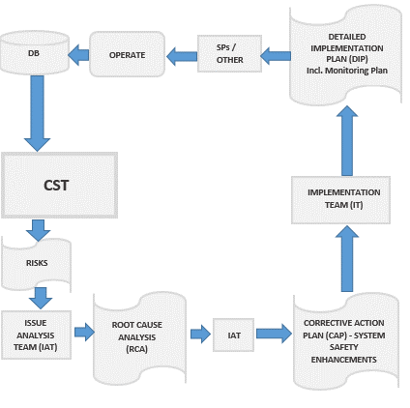
Collaborative Safety Team (CST)
Notes:
State and local Service Provider representative will serve as Co-Chairs

Slide 28
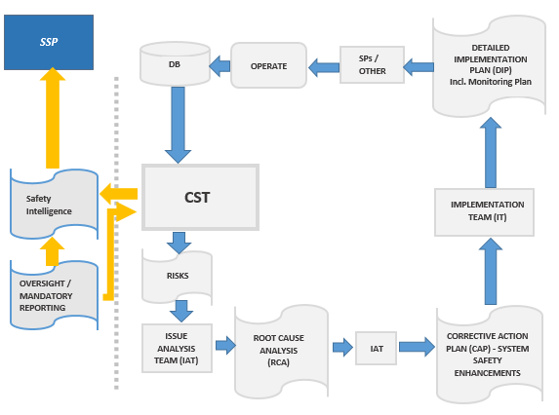
CST ~ SSP Interface
Notes:
State and local Service Provider representative will serve as Co-Chairs

Slide 29
IATA Safety Information Exchange Program
Enables States access to de-identified aggregate Safety information
Supports both State and Regional Safety Oversight Organization (RSOOs) Safety Management activities
Also supports the ICAO Global Aviation Safety Plan (GASP) objectives and the work of the Regional Aviation Safety Groups (RASGs)
Notes:
State access includes query tools to aggregate information
Support SSP activities; namely, to identify and manage safety risks to a respective State’s civil aviation system and measure their safety performance ~ not individual SPs

Slide 30
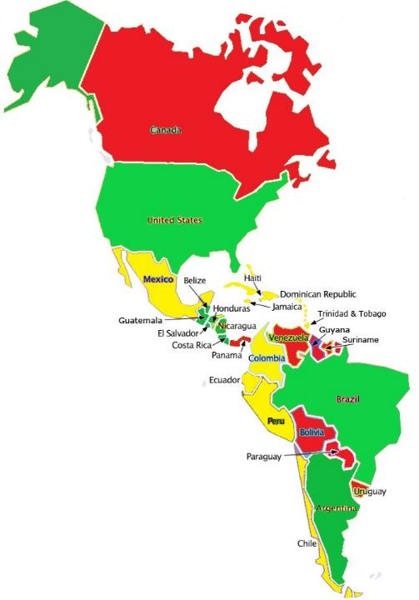
Regional Status of
Collaborative Safety Teams & IATA Safety Information Exchange Program
Active
In Progress
Stand By

Slide 31

Thank You!
Thank You
Notes:
31

