Slide 1
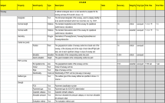
The
Data Catalogue
Seminar on PANS-AIM – Annex 15 to the Convention of Civil Aviation
Lima, Peru, 14 to 16 November, 2018

Slide 2
Content
1. Introduction
2. Institutional significance and potential benefits
3. Data Catalogue Implementation

Slide 3
The intent
Introduction
Aeronautical Information Services to Aeronautical Information Management Study Group
AIS-AIMSG
Data
Centricity
Product Centricity

Slide 4




The process
Introduction
2013
2015
ICAO Annex 4
ICAO Annex 11
ICAO Annex 14
ICAO Annex 15
PANS-OPS
AIXM 5.1
RTCA/EUROCAE AMDB
  AIS-AIMSG/7
  PANS AIM Chapter 4 to contain the collection and a detailed description of the data and information requirements.
  AIS-AIMSG/12
  Last review of the Data Catalogue within the Study Group.

Slide 5
The challenges
Introduction
Time was short
Multiple sources of data had to be managed
Data elements to be managed were numerous
Knowledge from multiple domains was needed
Source: https://www.tatacapital.com

Slide 6

The team
Introduction
AIS-AIMSG
Support through organizations / companies of AIS-AIMSG Members
IFPP/IWG
Instrument Flight Procedure Panel / Integration Working Group
Source: https://www.tatacapital.com
http://www.tax-hell.co.uk/help-me-to-help-you/

Slide 7
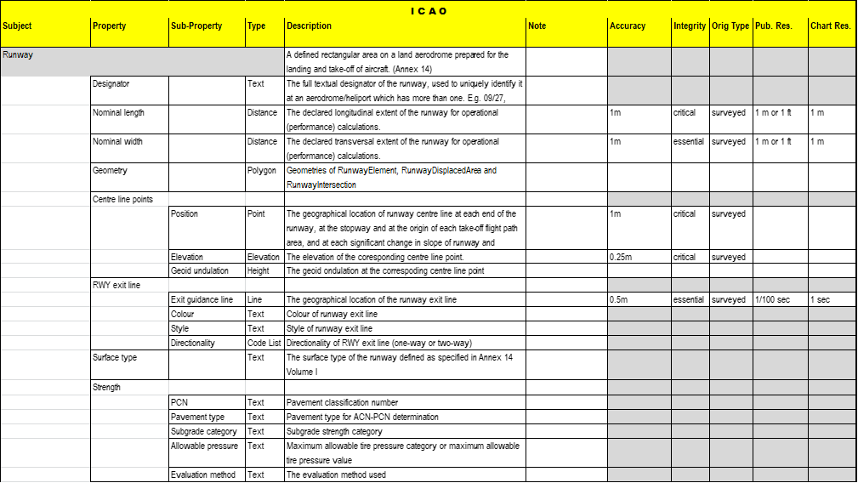
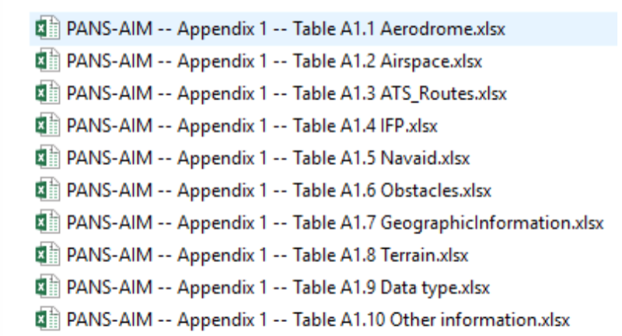
The result
Introduction

Slide 8
The result
Introduction
PANS-AIM Extract:
The Data Catalogue symbolizes
the shift from product-centric to data centric environments,
is considered the point of reference for all provisions related to aeronautical data origination and publication and
represents the common language for data originators and AIS organizations.

Slide 9
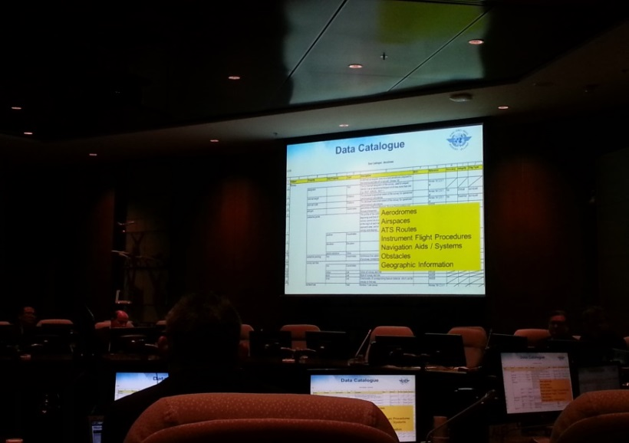
The result
Introduction
In other words:
The Data Catalogue is not just an ICAO SARPs, but a tool to ease your job.
DC first time shown to ANC on 10.11.2014

Slide 10
One-Stop-Shop for AIS Data
Institutional significance and potential benefits
Aerodrome data
Airspace data
ATS and routes data
Instrument flight procedure data
Radio navigation aids data
Obstacle data
..and more
Notes:
Al

Slide 11

One-Stop-Shop for DQR
Institutional significance and potential benefits
Aerodrome data
Airspace data
ATS and routes data
Instrument flight procedure data
Radio navigation aids data
Obstacle data
..and more

Slide 12
Distribution of responsibilities
Institutional significance and potential benefits
Who / Which organization is responsible for originating a certain data or set of data?
Aerodrome data
Aerodrome Operator
Customs regulations
Aerodrome Operator
The granularity can vary, depending on the situation – DC Subject, Property, Sub-property

Slide 13

Service Level Agreements
Institutional significance and potential benefits
Service Level Agreements between data originators and AIS could be based on elements of the Data Catalogue.

Slide 14
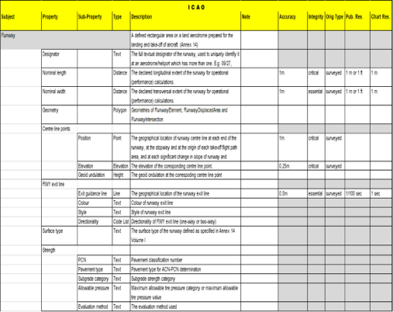
Expand the DC for own needs
Institutional significance and potential benefits
New columns can be added to the table.
  For example: “Fit for IFR /VFR”
New additional properties can be added.
  For example: “Registration number”

Slide 15
Expand the DC for own needs
Institutional significance and potential benefits
New DQR could be defined for specific purposes.
    For example: more stringent DQRs could be defined for IFR data
List of values for code lists can be expanded.
  For example: Aerodrome/Heliport, Type of traffic permitted can include “GA”, “CIV”, “MIL”, and others as needed

Slide 16
Expand the DC for own needs
Institutional significance and potential benefits
The current DC is at international level, as published under ICAO (PANS).
“Own” could mean national or regional level.
Both States and regions could add their requirements as to fit to their own need in terms of:
  aeronautical data origination and publication and
  common language for data originators and AIS organization.

Slide 17

ICAO implementation mean
Data Catalogue Implementation
As published by ICAO, the Data Catalogue has no strict implementation mean.
The Excel tables provided represent just a container for the text information and are not an implementation mean.

Slide 18
ICAO Digital Data requirements
Data Catalogue Implementation
“Globally interoperable aeronautical data and aeronautical information exchange models shall be used for the provision of data sets.” (Annex 15, Ed.16)
PANS-AIM defines requirements on:
  aeronautical information model used,
  aeronautical data exchange model,
No specific model is mentioned.

Slide 19
ICAO DC Implementation
Data Catalogue Implementation
As Data sets are based on DC elements, the implementation of the DC should support their generation.
Possible methods:
  MS Excel,
  Update of the current static databases to support the DC, or
  Specific software development.

Slide 20

Muchas gracias por su atención

