Slide 1
Paradigmen Shift in AIS/AIM
Annex 15 –AIS, 16th Edition (Amd 40)
PANS-AIM, 1st Edition (Doc 10066)
ICAO SAM PANS-AIM Seminar – Annex 15 to Convention of International Civil Aviation
Lima, Peru, 14 – 16 November 2018

Slide 2
Trends to A40
Block 0
2013
2018
Block 1
2019
2024
Block 2
2025
2029
Block 3
2031
onwards
Aviation System Block Upgrads (ASBU)
GANP, ASBU, AIM, IM
// GANIS & SANIS Industry Meeting 10. – 15.12.2017, Montreal, Canada
// AN-Conf/13 9. – 17.10.2018
// ICAO A40 in Q/3 2019
// Ed. 6 Revises the Blocks
// Digital AIM (DAIM) is part of it
GANP – Global Air Navigation Plan
GASP - Global Aviation Safety Plan
ASBU Document
GANP
GASP
ASBU

Slide 3

Content / Discussion
// 01 Rational for a PANS-AIM
// 02 AIS-AIMSG Focus
// 03 Origination & Process
// 04 Data Catalogue & DQR
// 05 Data Sets
// 06 What is the difference?
// 07 National Planning
© 2016 A4F GmbH – GAF MRCA PA-200 Tornado, Eurofighter & A310 MRTT at ILA Berlin

Slide 4
A15 & PANS-AIM - Impact on implementation – what is the difference?
ICAO Asia/Pacific AIS – AIM Transition Workshop
Nadi, Fiji, 22 – 24 October 2018

Slide 5
// 01 Rational for a PANS-AIM

Slide 6
Rational
Annex = performance based SARPs
PANS = technical & procedural provisions
Elevate certain procedures from guidance to PANS
Support data centricity with processes & procedures
Support interoperability
PANS deviation to be published in AIP only
  Supports stepwise transition/migration
Best practice example is PANS-ATM (Doc 4444) which exists since 1946 (Annex 2 & 11 contain no formats)

Slide 7
Timeline (How did we get there)
Initial ideas on AIS-AIMSG/3, Montreal, Nov 2010
ANC on site May 2011
Ad hoc group PANS-AIM on AIS-AIMSG/4, Bordeaux, May 2011
Data and information scope in AIS-AIMSG/7, Montreal, Jan 2014
Since then involvement of IFPP/IWG
Origination & Terminology on AIS-AIMSG/9, Tokyo, April 2014
DQR on AIS-AIMSG/10, Montreal, Nov 2014
Final on AIS-AIMSG/12 in Oct 2015

Slide 8





AIS → AIM
State provisions
(or „what“)
150 pages
Operational Provisions /
„AIM Practitioners“ instructions
(or „how to“)
41 pages
118 pages
Guidance / Explanations
480 pages (190 AIP)
??? pages (190 AIP)

Slide 9
// 02 AIS-AIMSG Focus

Slide 10
Focus
Split of data origination from data publication requirements
Introduction of the aeronautical data catalogue
Introduce digital data sets
Aeronautical information product (standard or electronic)
Data quality requirements at one place (PANS-AIM)
Separating obstacles & terrain
Bring in AMDB harmonised
NOTAM improvement proposal
CRC performance-based requirements

Slide 11
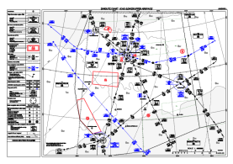

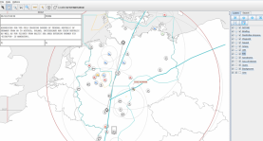
Rules
Properties
Parameters
Models
Features
…
Products
Annex 4 (Amd 59)
Thematic Data Sets (e.g. IFP)
Focus: Data Centric
Approach
Paper Chart
Source
Def
Products
Annex 2, 3, 4, 5, 7, 9, 10v1, 10v2, 10v3, 10v5, 11, 12, 13, 14v1, 14v2, 15, 16v1, 16v2, 17, 18, 19
PANS-OPS
(y)
Electronic Chart
Products, Applications, Services
Data Sub-sets
Tables
Next
Intended
User
(SWIM?)
F(x:y)
Data Sub-sets
Books
Text
(electronic form)
Applicable
8. Nov 2018
(x)
Data
Text
Data Management
Origination
Data
Metadata
Annex 15 (Amd 40)
PANS-AIM (new)
Data catalogue
Data ?
Super Set
V4.0

Slide 12
Main News in Annex 15 Ed. 16
PANS-AIM Ed 1 introduced
Strengthening of Data Originators
Data Exchange Points
Formal Arrangments (SLAs)
Data Catalogue with DQR
DQR in one document not distributed over several Annexes & PANS
Data Sets
Applicability 08.11.2018 (AIRAC)

Slide 13
// 03 Origination & Process

Slide 14
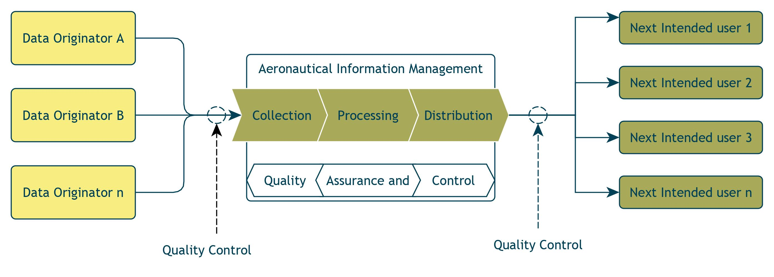
Aeronautical Information Management Process

Slide 15
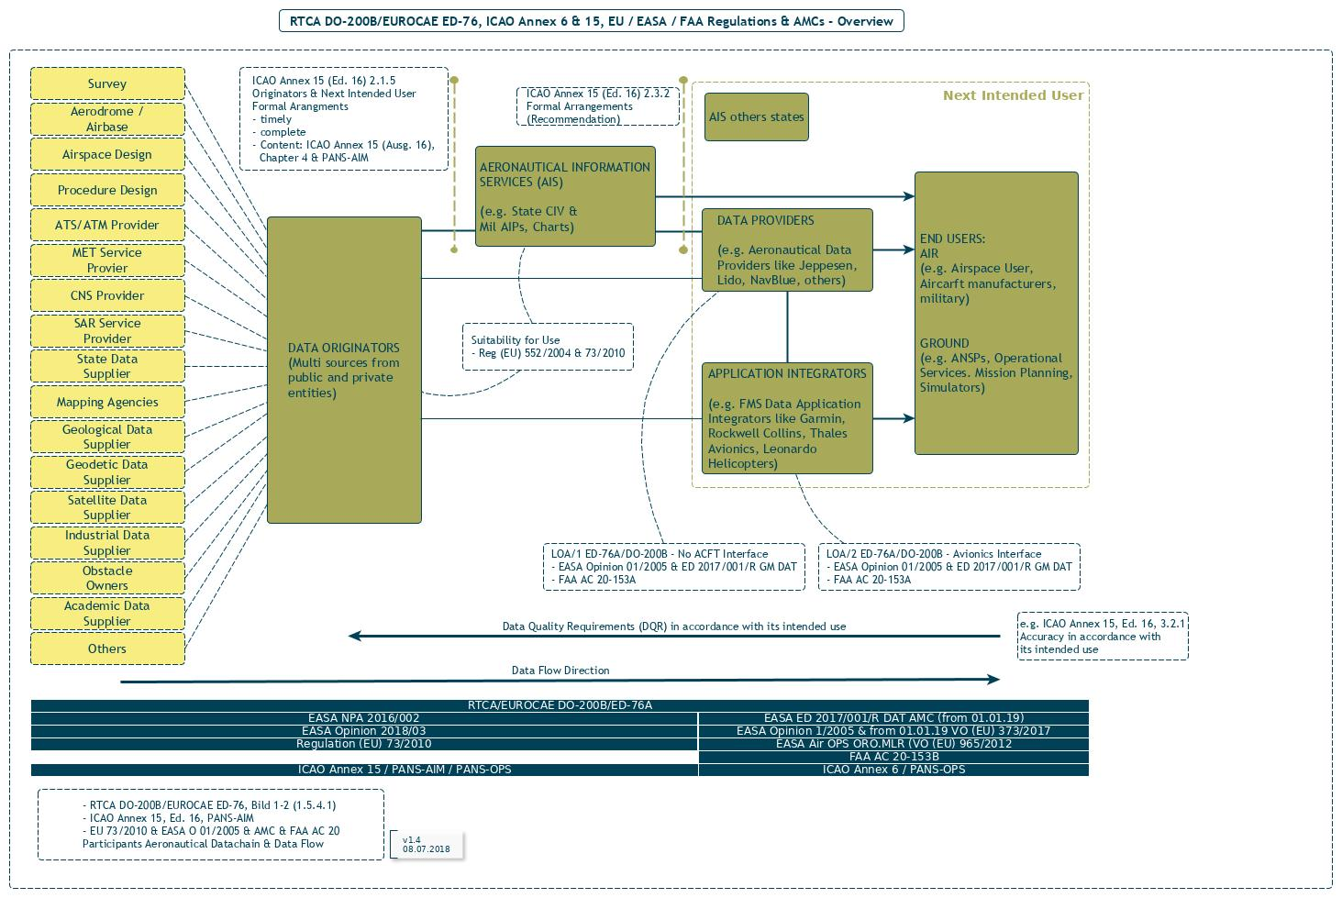
Processes
Focus:
Processes &
Data Chains
Data Exchange Point
Formal Arrangement

Slide 16
Formal Arrangements
Between
  Originators & State AIS
  Also parties acting on behalf of states (recomendation)
Minimum Content
  Regulatory framework
  Data origination
  Quality assurance
  Metadata and quality reporting
  Data delivery
  Error handling

Slide 17
// 04 Data Catalogue & DQR

Slide 18
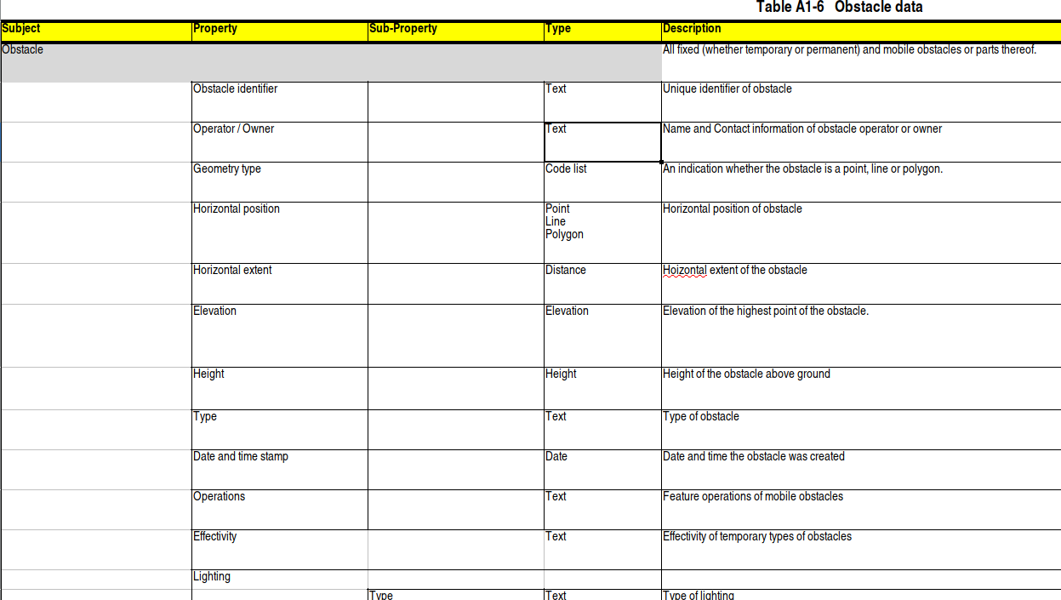
ICAO Data Catalogue
Around 65 subjects, 350 properties, ca. 500 subproperties
Basis for Data Sets!

Slide 19
ICAO Data Catalogue
10 Tabels
  Aerodrome data (A1-1)
  Airspace data (A1-2)
  ATS & other routes data (A1-3)
  Instrument Flight Procedure data (A1-4)
  Radio Navigation aids/systems data (A1-5)
  Obstacle data (A1-6)
  Geographic data (A1-7)
  Terrain data (A1-8)
  Data types (A1-9)
  Information about national and local regulation, services and procedures (A1-10)

Slide 20
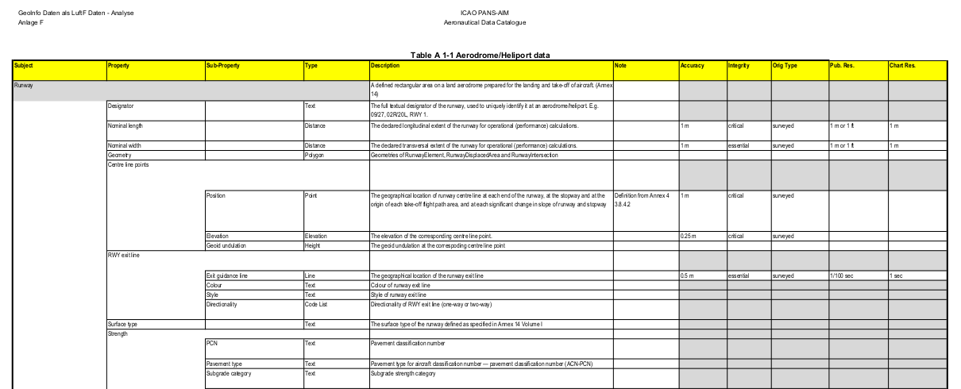
Focus: Data Catalogue (Example AD/HP)

Slide 21
Obstacles & Terrain
Separated now in Annex 15, Ed. 16
Common presentation like in Annex 15, Ed. 15 no longer used
Obstacle requirements are moved into the data catalogue including DQR
Terrain unchanged for Area 1, 2, 3, and 4
  Former Annex 15, Appendix 8, Table A8-1
  Now in PANS-AIM Appendix 1, Table 8

Slide 22
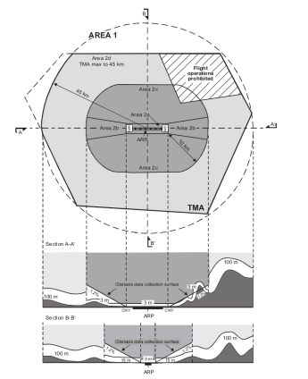
Obstacles & Terrain
Annex 15 Ed. 15 (Amd 39)
  Chapter 10
    SARPs
  Appendix 7
    Publication Resolution
    Integrity Classification
  Appendix 8
    Terrain & obstacle data collection surfaces
    Numerical requiremnts
Annex 15 Ed. 16 (Amd 40)
  Chapter 4 – Scope
  Chapter 5 – Products & Services
PANS-AIM Ed. 1
  Appendix 6
    Terrain & Obstacle attributs provision requirements
  Appendix 8
    Terrain & Obstacle dat requiremenst

Slide 23




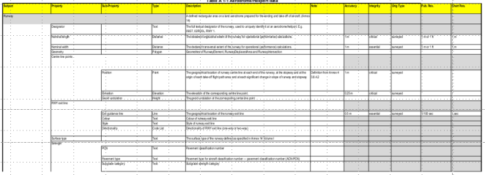
Data Quality Requirements (DQR)
PANS-AIM
DQR
Appendix 1
Data quality. A degree or level of confidence that the data provided meet the
requirements of the data user in terms of accuracy, resolution, integrity (or equivalent
assurance level), traceability, timeliness, completeness and format.
Annex 4, 11, 14, 15, & PANS-OPS

Slide 24
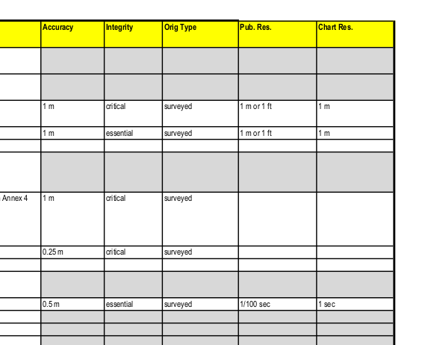
ICAO Datencatalogue (DQR)

Slide 25
DQR Components
Data accuracy
  A degree of conformance between the estimated or measured value and the true value.
Data integrity
  (assurance level). A degree of assurance that an aeronautical data and its value has not been lost or altered since the origination or authorized amendment.
Data resolution
  A number of units or digits to which a measured or calculated value is expressed and used.
Data timeliness
  The degree of confidence that the data is applicable to the period of its intended use.
Data tracebility
  The degree that a system or a data product can provide a record of the changes made to that product and thereby enable an audit trail to be followed from the end-user to the originator.
  Data Completness
  The degree of confidence that all of the data needed to support the intended use is provided.
Origination Type
  calculated
  declared
  surveyed
Meta Data
Collected for process & exchange points
Provided with each data set
ISO 19115
Format
Descretion of State
Note: Commonly used data encoding formats
Note: XML, GML, JSON

Slide 26
// 05 Data Sets

Slide 27
Data Sets in PANS-AIM
Exchange between data providers and data users (ISO 19100)
Based on a product specification (ISO 19131)
Common encoding models (UML, XML, GML, JSON)
Complemented by charts, maps & diagrams
Metadata (ISO 19115)
AIP data set
Terrain data set
Obstacle data set
Aerodrome mapping data set (shall be supported by terrain & obstacle data for area 3)
IFP data set
Distribution
  Different ways
  SWIM

Slide 28
„Incentives (1)“ in Annex 15 Ed. 16
!
Chapter 3.2 says, inter-alia:
  3.2.1 Data Accuracy
    The order of accuracy for aeronautical data shall be in accordance with ist intended use.
  This means, when the intended use of aeronautical data IS KNOWN, the accuracy can be higher or lower, depending on intended use.
  This brings flexibility in the system.

Slide 29
„Incentives (2)“ in PANS-AIM 1 Ed
Chapter 5.2.1.1.3 says, inter-alia: When the AIP Data Set (as specified in 5.3.3.1) is provided, the following sections of the AIP may be left blank and a reference to the data set availability shall be provided:
!
  ENR 2.1 FIR, UIR, TMA
  ENR 3.1 Lower ATS Routes
  ENR 3.2 Upper ATS Routes
  ENR 3.3 Area Navigation (RNAV) Routes
  ENR 3.4 Helicopter Routes
  ENR 3.5 Other Routes
  ENR 3.6 En-route Holding
  ENR 4.1 Radio navigation aids — en-route
  ENR 4.4 Name-code designators for significant points
  ENR 4.5 Aeronautical Ground Lights — En-route
  ENR 5.1 Prohibited, Restricted and Danger Areas
  ENR 5.2 Military exercise and training areas and air defence identification zone (ADIZ)
  ENR 5.3.1 Other activities of a dangerous nature
  ENR 5.5 Aerial sporting and recreational activities
  **** AD 2.19 Radio navigation and landing aids
  **** AD 3.18 Radio navigation and landing aids
  “****” = relevant ICAO location indicator

Slide 30
„Incentives (3)“ in PANS-AIM 1 Ed
Chapter 5.2.1.1.4 says, inter-alia: When the Obstacle Data Set (as specified in 5.3.3.2.2) is provided, the following sections of the AIP may be left blank and a reference to the data set availability shall be provided:
!
  ENR 5.4 Air navigation obstacles
  **** AD 2.10 Aerodrome obstacles
  **** AD 3.10 Heliport obstacles
  “****” = relevant ICAO location indicator

Slide 31
// 06 What is the difference?
What moved where?
What is new?
What is the effort to understand that?

Slide 32
Changes in PANS-AIM
State provisions
(or „what“)
About 120 text relocations
150 pages
41 pages
About 20 text relocations
118 pages
Guidance / Explanations
480 pages (190 AIP)
??? pages (190 AIP)

Slide 33
Assessment of Changes (1)
About
  100 text relocations from Annex 15
  20 text relocations from AIS Manual
  70 deleted text phrases
  240 new text phrases
Effort will be different
  Relocated text is known, no new provisions
  Some chapters have little change
  A lot of changes is because of changed references
  Need: to understand what is really NEW!

Slide 34
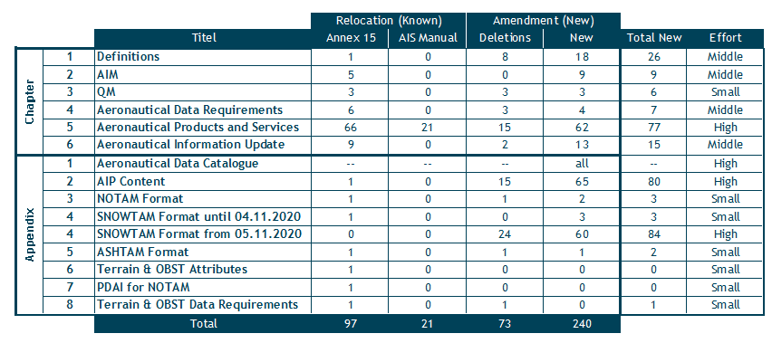
Assessment of Changes (2)

Slide 35
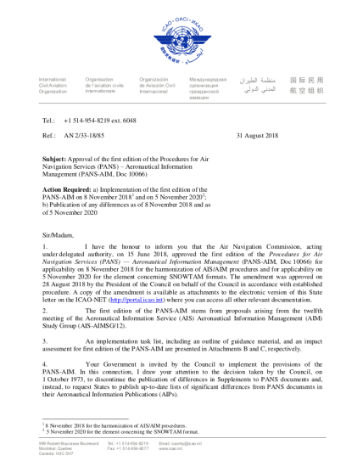
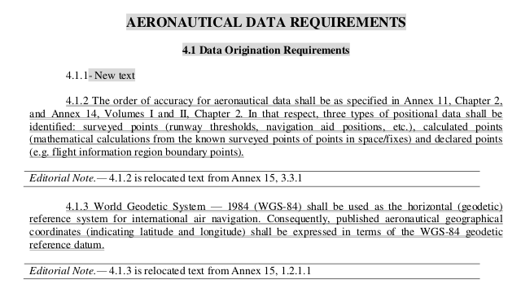
State Letter could be used
Identification & understanding what is really NEW is most important
AN 2/33–18/85, 31.08.2018

Slide 36
// 07 National Planning & Implementation

Slide 37
Initial steps to move
Get your managment on board
Think about your natural internal alleys
  Talk to them
Get your regulator on board
Initiate a work shop
Plan the work, work the plan
PANS-AIM & the paradigm shift AIS → AIM supports GANP Ed. 6 (2019) DAIM
AP, airlines, data houses, MIL, …
Plan
Do
Check
Act

Slide 38
Next Steps (1 to 5 years)
Understand information managment requirements in PANS-AIM (para 2.1)
  Collection
  Processing
  Quality Control
  Distribution
Assess impact on
Make an implementation plan with firm dates for
  Personal (training)
  Processes (modelling, if not yet available)
  Sofware (procurment)
  Hardware (procurment)
Publish the plan in AIP GEN 1.7 when knowledge of differences is important for the saftey of air navigation
Personal
Software
Processes
Hardware
Assess all

Slide 39
Continue – Keep going!
Further work shops with:
  your natural allies,
  your regulator
Keep informed your managament
  Justify investment where needed
Verify your work
Plan
Do
Check
Act

Slide 40

Happy & smooth touch down!
ADDRESS
ASBU for Future GmbH
Römerstrasse 17 88690
Uhldingen-Mühlhofen, Germany
INFO
Phone: +49-7556-4521-78-0
E-mail: info@a4f.aero
Website: http://asbu4future.aero

