Slide 1
AIS Manual (Doc 8126)
Air Navigation Procedures for AIM Seminar
Lima, 14-16 November 2018
Roberta Luccioli, ICAO AIM Technical Officer

Slide 2

Outline
New! Restructured AIS Manual:
  Volume I
  Volume II
  Volume III
  Volume IV
Air Navigation Procedures for Aeronautical Information Management Seminar (PANS/AIM)

Slide 3




AIS Manual
Volume I – AIS Organizational Development
Volume II – The Aeronautical Data Process
Volume III – Aeronautical Information in a standardized presentation
Volume IV – Digital Products and Services
AIS
Manual
Advantages
Addressing target audiences
Faster delivery
Easier maintenance
Air Navigation Procedures for Aeronautical Information Management Seminar (PANS/AIM)

Slide 4

Volume I
Global Overview
Air Navigation Procedures for Aeronautical Information Management Seminar (PANS/AIM)

Slide 5

Volume I: AIS Organizational Development
  State Responsibilities for aeronautical information services
  AIS Responsibilities and Functions
  Aeronautical Information Management
Air Navigation Procedures for Aeronautical Information Management Seminar (PANS/AIM)

Slide 6
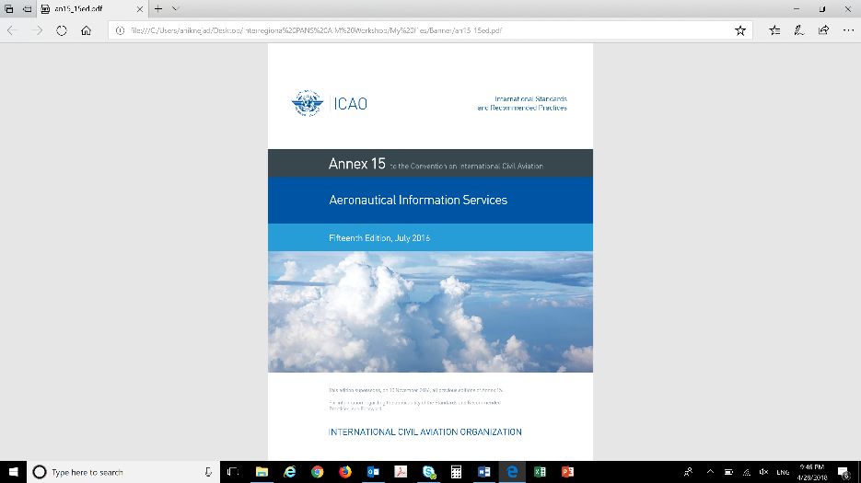
Volume I
State perspective
  State Safety Oversight – 8 Critical elements
    CE-1: primary aviation legislation
    CE-2: specific operating regulations
    CE-3: State system and function
    CE-4: qualified technical personnel
    CE-5: technical guidance, tools and provision of safety critical information
    CE-6: licensing, certification, authorization and approval obligations
    CE-7: surveillance obligations
    CE-8: resolution of safety issues
Doc 8126
Aeronautical Information Services – VOLUME I
3th Edition
Air Navigation Procedures for Aeronautical Information Management Seminar (PANS/AIM)
Notes:
State must implement a Safety Oversight System, which is…
States must establish an AIS oversight function

Slide 7
Volume I
AIS Provider perspective
  AIS Provider
    Responsibilities and functions
    Organization of an AIS: organizational structure designed around processes, not products
    Checklist: steps to set-up an AIS organization
    Aeronautical Information Products and Services & Tools and Software
    Guidance concerning AIS/AIM competencies
Doc 8126
Aeronautical Information Services – VOLUME I
3th Edition
Air Navigation Procedures for Aeronautical Information Management Seminar (PANS/AIM)
Notes:
We describe the ideal organizational set-up of an AIS
We highlight the importance to implement a process-approach…
With this in mind we encourage an organizational structure that is designed upon organizational processes… rather than around products.

Slide 8
AIS/AIM Competency Framework
Competency | Description
Information Awareness | Comprehends information requirements, monitors the information flow and detects anomalies and potential threats that can degrade the flow and the quality of information and affect its use.
Coordination | Comprehends and adheres to applicable formal arrangements and if required coordinates with originators, personnel in different operational positions and with other affected stakeholders to ensure that the agreed requirements are met.
Application of procedures | Identifies and applies data procedures in accordance with published operating instructions and applicable regulations and standards.
Information management expertise | Applies and improves technical knowledge and skills related to the collection, management, integration and provision of aeronautical data and information
Communication | Communicates effectively (in oral and written forms) under the operational situations (e.g. for briefings and publishing information).
Workload management | Manages available resources efficiently to prioritize and perform all assigned information tasks in a timely manner.
Team work | Operates effectively as a team member.
Self-management and continuous learning | Demonstrate personal attributes that improve performance and maintain an active involvement in self-learning and self-development

Slide 9
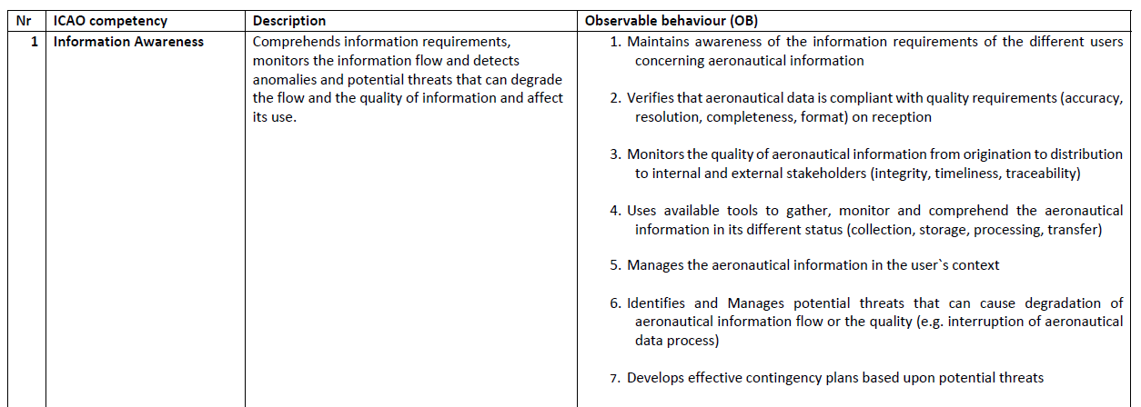
Example for an AIS/AIM competency
How a competency is described and observed…
Observable behaviour (OB):
A single job-related behavior that can be measured and/or observed.
Air Navigation Procedures for Aeronautical Information Management Seminar (PANS/AIM)

Slide 10
Volume I
Transitioning to AIM
  Aeronautical Information Management
    AIM principles
    Implementing AIM in the State
      How the regulatory approach changes in AIM
    Implementing AIM in an AIS
      Focus on quality: provide users with info they can trust (QMS)
      Focus on users : awareness of end-use requirements (feedback mechanisms)
      Encourage digitalization
    Change management considerations
Doc 8126
Aeronautical Information Services – VOLUME I
3th Edition
Air Navigation Procedures for Aeronautical Information Management Seminar (PANS/AIM)

Slide 11
Volume II
Global Overview
Air Navigation Procedures for Aeronautical Information Management Seminar (PANS/AIM)

Slide 12
Volume II: Aeronautical Data Process
How automation is applied to the aeronautical data process
Air Navigation Procedures for Aeronautical Information Management Seminar (PANS/AIM)

Slide 13
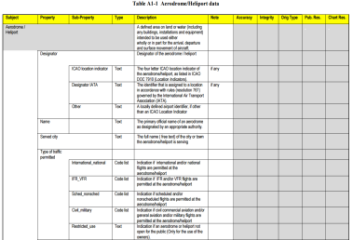
Collection
  High focus on the collection phase to ensure quality
  Clear roles, resources, metadata
  Different constellations for data origination
  The new tool: the Aeronautical Data Catalogue
    What it is, What it isn`t
    How to use it to map every data element to an identified data originator
    How to use it in the formal arrangements
    How to customize it
    How to provide valid codes for properties and sub-properties
    Examples
  Content of a formal arrangement and template
COLLECTION
Data originator A
Collection
Data originator B
Air Navigation Procedures for Aeronautical Information Management Seminar (PANS/AIM)

Slide 14
Data Processing
PROCESSING
  Difference between validation and verification
  Validation and Verification as critical components of the Quality Management System
  Validation, examples of techniques:
    Validation based on metadata
    Plausibility check of the data
  Verification examples of techniques:
    Digital data error detection
    Feedback testing
    Independent redundancy
Validation, Verification
Air Navigation Procedures for Aeronautical Information Management Seminar (PANS/AIM)

Slide 15
Quality Assurance and Control
THE QUALITY SYSTEM
  Quality Assurance (PROCESS)
  Data traceability
  Assurance of data integrity along the process
  Quality Control (PRODUCT)
  Data error detection and reporting
  Quality checks to ensure compliance with product specifications
  Consistency checks across the information products
Quality Assurance & Control
Air Navigation Procedures for Aeronautical Information Management Seminar (PANS/AIM)

Slide 16
Automation
  Objectives and basic principles of automation
  Different levels of automation:
    LEVEL 0: Manual
    LEVEL 1: Data centric
    LEVEL 2: Automated workflow
    LEVEL 3: Full AIM environment
Doc 8126
Aeronautical Information Services – VOLUME I
3th Edition
Air Navigation Procedures for Aeronautical Information Management Seminar (PANS/AIM)

Slide 17
Service Level Agreement Template
Air Navigation Procedures for Aeronautical Information Management Seminar (PANS/AIM)

Slide 18
Volume III
Global Overview
Air Navigation Procedures for Aeronautical Information Management Seminar (PANS/AIM)
Notes:
[

Slide 19
Aeronautical information products and services
Standardized presentation
Instrument flight procedure data set
Digital data sets
AIP data set
Terrain and Obstacle data sets
Aerodrome mapping data sets
NOTAM
AIP, AIP Amendment, AIP Supplement
AIC
Aeronautical Charts
Aeronautical information products
Services
Distribution services
Pre-flight information services
Post-flight information service
Air Navigation Procedures for Aeronautical Information Management Seminar (PANS/AIM)

Slide 20
Volume III: AI in a standardized presentation
  Mostly relocated text from the existing AIS Manual
  Up to speed with the latest provisions (Annex 15, PANS-AIM)
  Electronic AIP (expanded guidance)
  NOTAM (expanded guidance, based on the OPADD material)
  General improvements (clarification of material when needed)
Doc 8126
Aeronautical Information Services – VOLUME III
3th Edition
Air Navigation Procedures for Aeronautical Information Management Seminar (PANS/AIM)

Slide 21
Volume IV
Global Overview
Air Navigation Procedures for Aeronautical Information Management Seminar (PANS/AIM)

Slide 22
Volume IV: Digital Products & Services
  Aeronautical Information and data Exchange Models: what are they?
  AIXM:
    Conceptual model
    The encoding format
    The extension mechanism
  Data product specifications
  Digital data sets (based on the AIXM confluence site):
    Interoperability rules
    Business rules
    Coding rules
Doc 8126
Aeronautical Information Services – VOLUME IV
3th Edition
Air Navigation Procedures for Aeronautical Information Management Seminar (PANS/AIM)

