Slide 1
PANS-AIM (Doc 10066)
Air Navigation Procedures for AIM Seminar
Lima, 14-16 November 2018
Roberta Luccioli, ICAO AIM Technical Officer

Slide 2

Outline
The new PANS-AIM:
  Guiding principles
  Highlights
  Current Status
  Impact
Air Navigation Procedures for Aeronautical Information Management Seminar (PANS/AIM)

Slide 3
Procedures for Air Navigation Services (PANS)
  Procedures for Air Navigation Services (PANS) for the most part comprise material:
    which may eventually become Standards when it has achieved the maturity and stability necessary for adoption as such;
    considered too detailed for SARPs; and
    amplifying the basic principles contained in corresponding SARPs to assist in their application.
  States are expected to publish in their AIPs up‑to‑date lists of significant differences between their procedures and the related PANS
  With PANS, we are trying to identify those practices that require global harmonization
Air Navigation Procedure for Aeronautical Information Management Seminar (PANS/AIM)

Slide 4

How this applies to AIM?
Since PANS primarily consist of material related to the standardization of how something is to be done material such as product specifications, standard procedures, and protocols are ideal material for promulgation as PANS.
  Appendix 1 of Annex 15 concerning the formatting of an AIP;
  Appendices 2, 3, 5, and 6 of Annex 15 and material from Doc 8126 concerning NOTAM, SNOWTAM, and ASHTAM; and
  Material from Doc 8126 concerning AIP, AIP Supplements and AIC where it is desirable to elevate the material to a status beyond guidance.
Air Navigation Procedure for Aeronautical Information Management Seminar (PANS/AIM)

Slide 5
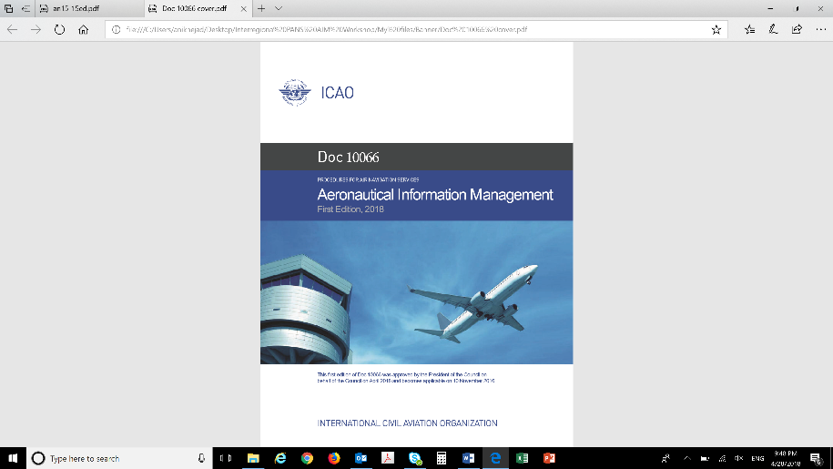
How this may apply to AIM (future)?
PANS-AIM will be a vehicle for expanded and/or new specifications in the future:
  Quality management practices;
  Data handling to achieve integrity requirements
  Expanded and/or new specifications for digital datasets
  data exchange procedures
  Any material where it is found desirable to have a level of standardization but the material is too detailed or not appropriate for inclusion in Annex 15 as a SARP.
Doc 10066
PANS - Aeronautical Information Management
1st Edition
Air Navigation Procedure for Aeronautical Information Management Seminar (PANS/AIM)

Slide 6

PANS-AIM,
GUIDING PRINCIPLES
Global Overview
Air Navigation Procedures for Aeronautical Information Management Seminar (PANS/AIM)
Notes:
[

Slide 7
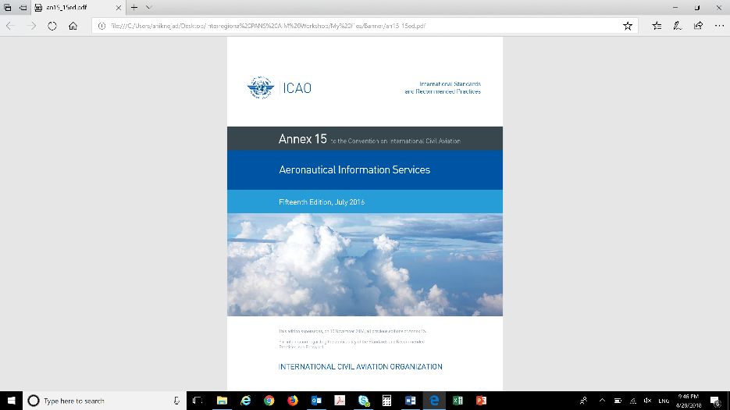
Chapter 2: Aeronautical Information Management
 | AIM functions: Collection: Record of data originators Data mapped to authorized sources The content of formal arrangements (examples) Processing: Validation & Verification Automation Distribution To be developed Quality Assurance and Control: QC: Compliance and Consistency in AI products QA: Data integrity monitoring and assurance
Doc 10066
PANS-AIM
16th Edition

Slide 8
Chapter 3: Quality Management
 | Quality Management System (general requirements) Quality manual Main processes, sequence, interaction Effective operation and control of these processes Availability of information to support operations/monitoring Measure, monitor, analyze those processes Records Feedback mechanisms To be further developed together with the guidance material
Doc 10066
PANS-AIM
16th Edition
Air Navigation Procedure for Aeronautical Information Management Seminar (PANS/AIM)

Slide 9
Chapter 4: Aeronautical Data Requirements
 | Specifications on: Data origination requirements How to classify positional data How data shall/should be collected (e.g. compliance with WGS84) How to deal with those coordinates whose accuracy of original field work does not meet the applicable requirements Minimum metadata requirements Source, action performed, date
Doc 10066
PANS-AIM
16th Edition
Air Navigation Procedure for Aeronautical Information Management Seminar (PANS/AIM)

Slide 10
Chapter 5: Aeronautical Information Products and Services
 | Aeronautical information in a standardized presentation: Mostly text relocated from Annex 15 Encouragement! AIP sections may be replaced with digital data, when available (#AIP-DS, #OBS-DS) NOTAM improvements: Language used; series management Digital Datasets: Performance requirements for aeronautical data exchange Digital datasets detailed description Distribution services and pre-flight info service: Mostly relocated text from Annex 15
Doc 10066
PANS-AIM
16th Edition
Air Navigation Procedure for Aeronautical Information Management Seminar (PANS/AIM)

Slide 11
Chapter 6: Aeronautical Information Updates
 | Aeronautical information updates: The same update cycle shall be applied to the AIP and the digital data sets in order to ensure the consistency of the data items that appear in multiple aeronautical information products Legacy products updates: Mostly relocated text from Annex 15 Digital products updates: AIRAC Applicable to operationally significant changes NOTAM improvements: NOTAM timeliness NOTAM validity Trigger NOTAM
Doc 10066
PANS-AIM
16th Edition

Slide 12
HIGHLIGHTS
Global Overview
Air Navigation Procedures for Aeronautical Information Management Seminar (PANS/AIM)
Notes:
[

Slide 13
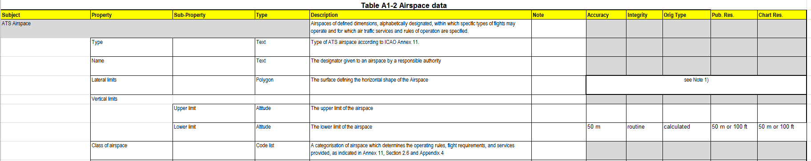
The Aeronautical Data Catalogue
(Appendix 1 of PANS-AIM)
    The Data Catalogue is a general description of the AIM data scope and consolidates all data that can be collected and maintained by the aeronautical information service. It provides a reference for aeronautical data origination and publication requirements
Air Navigation Procedure for Aeronautical Information Management Seminar (PANS/AIM)

Slide 14
The Aeronautical Data Catalogue
  The Data Catalogue contains the aeronautical data subjects, properties and sub‑properties organized in:
Air Navigation Procedure for Aeronautical Information Management Seminar (PANS/AIM)

Slide 15
Main elements to remember…
  provides a common list of terms and facilitates the formal arrangements between data originators and the aeronautical information service
  means for States to facilitate the identification of the organizations and authorities responsible for data origination
  single source of all data quality requirements
  Contains existing data quality requirements
  Adaptive to future quality requirements
Aeronautical data catalogue
…from product-centric to data-centric
Air Navigation Procedure for Aeronautical Information Management Seminar (PANS/AIM)

Slide 16

Other Appendices
Appendix 2. Contents of the Aeronautical Information Publication (AIP)
Appendix 3. NOTAM Format
Appendix 4. SNOWTAM Format
Appendix 5. ASHTAM Format
Appendix 6. Terrain and Obstacle Attributes Provision Requirements
Appendix 7. Predetermined Distribution System for NOTAM
Appendix 8. Terrain and Obstacle Data Requirements
RELOCATED TEXT FROM ANNEX 15
Air Navigation Procedure for Aeronautical Information Management Seminar (PANS/AIM)

Slide 17
ACTUAL STATUS
Global Overview
Air Navigation Procedures for Aeronautical Information Management Seminar (PANS/AIM)
Notes:
[

Slide 18
PANS-AIM - Status
Approved by the ICAO Council: Aug 2018
State Letter: Aug2018
App. Date: 8 Nov 2018
NOW APPLICABLE!
Annex 15
PANS-AIM
16th Edition
Air Navigation Procedure for Aeronautical Information Management Seminar (PANS/AIM)

Slide 19
THE IMPACT
Global Overview
Air Navigation Procedures for Aeronautical Information Management Seminar (PANS/AIM)
Notes:
[

Slide 20

Benefits
  Increased harmonization within the AIM domain
  Vehicle for the emerging technical requirements of AIM
  Better means for implementations:
    Procedures are provided to States to increase quality at origination and to maximize data integrity along the aeronautical data process
    Specifications are provided to States to facilitate the use of new digital aeronautical information products (“digital data sets”) therefore increasing efficiency in the process
Air Navigation Procedure for Aeronautical Information Management Seminar (PANS/AIM)

Slide 21




Impact
Flight safety impact:
Financial Impact:
POSITIVE!
Clear AIM procedures
Initial major investments
Phased-approach is recommended
Efficiency impact:
Implementation time
POSITIVE!
Automation/Digitalization increase efficiency
  2 to 5 years (Change of Reg. Framework references)
Air Navigation Procedure for Aeronautical Information Management Seminar (PANS/AIM)

