Slide 1
Amendment 40 to ANNEX 15
Air Navigation Procedures for AIM Seminar
Lima, 14-16 November 2018
Roberta Luccioli, ICAO AIM Technical Officer

Slide 2

Outline
From Aeronautical information services (AIS) to Aeronautical Information Management (AIM) environments
ICAO Actions
Amendment 40 to Annex 15
  Guiding principles
  Highlights
  Current Status
  Impact
Air Navigation Procedures for Aeronautical Information Management Seminar (PANS/AIM)

Slide 3

From the traditional AIS...
  Product-centric mindset;
  Reliance on manual processing and manipulation;
  Duplication of information, quality issues;
  use of non-harmonized formats across the exchange interfaces;
  “Point to point” or “application to application” exchanges;
  Insufficient awareness of the quality requirements of end-use applications.
Air Navigation Procedure for Aeronautical Information Management Seminar (PANS/AIM)

Slide 4
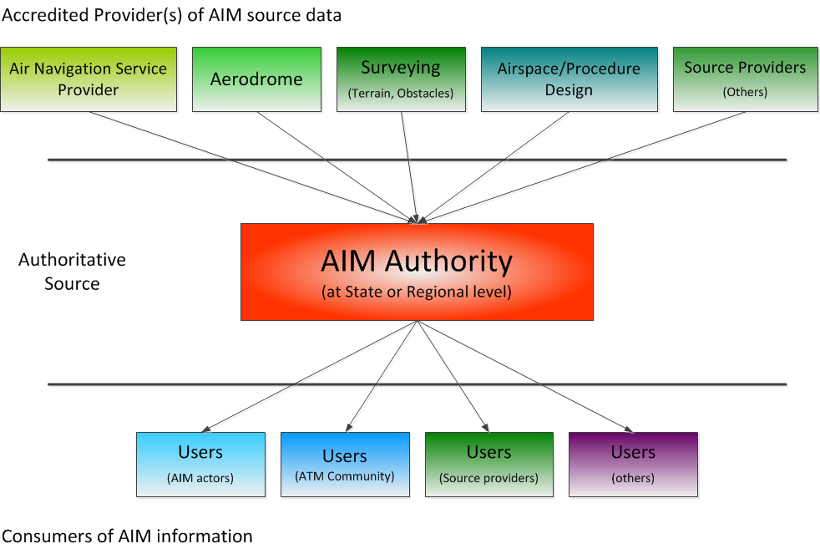
… to the new AIM environments
  Focus is on the data and information
  Quality-assured aeronautical information
  Authoritative sources of AI;
  Aeronautical information is digitally represented;
  Aeronautical information is globally harmonized and interoperable;
  Producers of information decoupled from possible consumers;
  Better awareness of the end-use requirements (feedback mechanisms)
Air Navigation Procedure for Aeronautical Information Management Seminar (PANS/AIM)

Slide 5

ICAO ACTIONS
Global Overview
Air Navigation Procedures for Aeronautical Information Management Seminar (PANS/AIM)
Notes:
[

Slide 6

ICAO AIS to AIM Study Group
(2008 -2015)
Objectives:
  Global strategy/roadmap for the transition from AIS to AIM
  SARPs/Guidance for a standard AICM/AIXM to enable global digital data exchange
  Other material required to support AIM implementation
Air Navigation Procedure for Aeronautical Information Management Seminar (PANS/AIM)

Slide 7

Restructuring of ICAO AIM Documentation
  Answering “ the big questions”:
    Scope of AIM
    Role of AIM
    Functions of AIM
    Products and services of AIM
    Aeronautical information updates
  The revised provisions address the needs of defined groups
Air Navigation Procedure for Aeronautical Information Management Seminar (PANS/AIM)

Slide 8
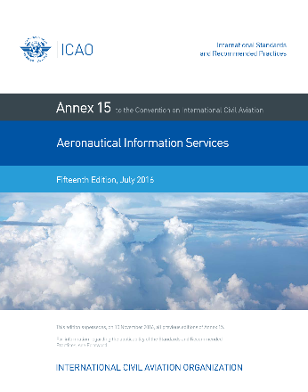
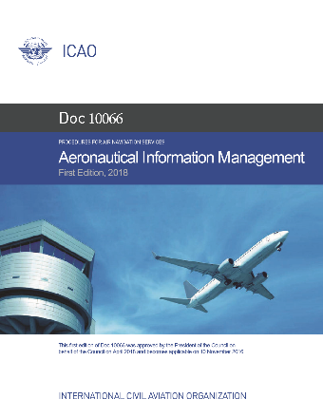



ICAO AIM framework of documents
Annex 15
Doc 10066
Doc 8126
Aeronautical Information Services
PANS - Aeronautical Information Management
Aeronautical Information Services
Fourth Edition
16th Edition
1st Edition
What…
How…
Guidance…
Air Navigation Procedure for Aeronautical Information Management Seminar (PANS/AIM)

Slide 9
ANnex 15,
Guiding Principles
Global Overview
Air Navigation Procedures for Aeronautical Information Management Seminar (PANS/AIM)
Notes:
[

Slide 10


Main elements
  Amendment 40 cause major changes to Annex 15…
  Introduces new AIM requirements :
    Splits data origination from publication requirements
    Strengthens the importance of quality
    Encourages digitalization of products and services
  Reorganizes chapters 4 to 11 into:
    Chapter 4 - Scope of Aeronautical Data and Information
    Chapter 5 - Aeronautical Information Products and Services
    Chapter 6 - Aeronautical Information Updates
  Annex 15 significantly reduced in size ( 6 chapters, 40 pages)
Air Navigation Procedure for Aeronautical Information Management Seminar (PANS/AIM)

Slide 11
Annex 15 – Chapter 4
Scope of Aeronautical data and Aeronautical Information:
  Data origination/collection:
  minimum data set or scope ;
  aeronautical information and data to be collected and managed;
  information and data should be at least sufficient to assemble an AIP;
  To extend beyond current “publication requirements”
  focus on “what” is to be collected by the State;
  be used to facilitate formal arrangements between AIS and data originator
Annex 15
Aeronautical Information Services
16th Edition
Air Navigation Procedure for Aeronautical Information Management Seminar (PANS/AIM)

Slide 12
Annex 15 – Chapter 5
Aeronautical Information Products and Services:
SERVICE 1 (legacy)
SERVICE 2 (new)
OTHER SERVICES
  Provision of AI in a standardized presentation:
    AIP
    AIP Amendments
    AIP Supplements
    AICs
    NOTAMs Aeronautical Charts
    Electronic encouraged
  Provision of AI as digital datasets:
    New! AIP data sets
    New! IFP data sets
    Terrain data sets
    Obstacle data sets
    Aerodrome Mapping data sets
  New data sets: recommended
  Distribution of AI
    Use of internet is recommended
  Pre-flight Service
    Relocated text
  Post-flight Service
    Relocated text
Continuity
Evolution
Improvement
Air Navigation Procedure for Aeronautical Information Management Seminar (PANS/AIM)

Slide 13
Annex 15 – Chapter 6
Aeronautical Information Updates:
  Legacy products updates: no changes
  NOTAM, as an update mechanism
  Digital data-set updates (generic requirements):
    data sets to be amended as necessary;
    permanent and temporary changes (long duration) as full data set or sub-set of data ;
    full data-sets: the differences should be indicated;
    temporary changes (short duration) – Digital NOTAM
    updates to the AIP and the digital datasets shall be synchronized
Annex 15
Aeronautical Information Services
16th Edition
Air Navigation Procedure for Aeronautical Information Management Seminar (PANS/AIM)

Slide 14
HIGHLIGHTS
Global Overview
Air Navigation Procedures for Aeronautical Information Management Seminar (PANS/AIM)
Notes:
[

Slide 15
Data quality requirements
Accuracy, Resolution, Integrity
+ Completeness, format, timeliness, traceability
Upstream
Downstream
ORIGINATION
Origination of aeronautical data and information
AIM
Collection
Validation/Verification
Processing
Distribution
END-USE:
End use of aeronautical data and information
DQR before AMD. 40
DQR after AMD. 40 (EUROCAE ED76A / RTCA DO200B)
Air Navigation Procedure for Aeronautical Information Management Seminar (PANS/AIM)

Slide 16
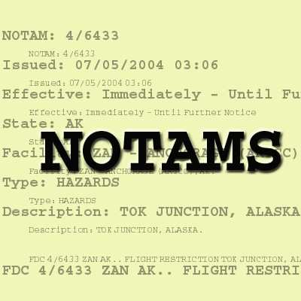
NOTAM improvements
  Make the NOTAM more fit for purpose:
  Additional operational conditions are included in the provisions to identify when a NOTAM shall/shall not be originated
  Improved requirements for NOTAM distribution:
    States obligations on NOTAM distribution
    !New requirement to grant the distribution of NOTAM series other than those distributed internationally
Air Navigation Procedure for Aeronautical Information Management Seminar (PANS/AIM)

Slide 17

Role of automation…
Essential! However…
3.5.2 Due consideration to the integrity of data and information shall be given when automated processes are implemented and mitigating steps taken where risks are identified.
Note.— Risks of altering the integrity of data and information may be introduced by automated processes in case of unexpected systems behaviors.
Air Navigation Procedure for Aeronautical Information Management Seminar (PANS/AIM)

Slide 18
New Terminology
  Aeronautical Information Product → to compile all AI deliverables to be provided in either digital data sets or as a standardized presentation in paper or electronic media;
  Originator, Origination → to introduce and clarify an entity that is accountable for data origination, from which the AIS organization receives aeronautical data and information;
  Next Intended User → to better specify the role of the user in the aeronautical data chain;
  Provide VS publish → to encourage the move to digital environments;
  More consistent use of “form, formats or media” and “printed”, based on the differences between electronic, digital and paper requirements.
Air Navigation Procedure for Aeronautical Information Management Seminar (PANS/AIM)

Slide 19
ACTUAL STATUS
Global Overview
Air Navigation Procedures for Aeronautical Information Management Seminar (PANS/AIM)
Notes:
[

Slide 20
Annex 15, Amendment 40 - Status
Adopted by ICAO Council: Feb 2018
State Letter: April 2018
App. Date: 8 Nov 2018
NOW APPLICABLE!
Annex 15
Aeronautical Information Services
16th Edition
Air Navigation Procedure for Aeronautical Information Management Seminar (PANS/AIM)

Slide 21
THE IMPACT
Global Overview
Air Navigation Procedures for Aeronautical Information Management Seminar (PANS/AIM)
Notes:
[

Slide 22

Benefits
  Conceptual Convergence (explain what is “AIM”)
  Important reference for National AIM Regulatory Framework
  Progressive and incentive (smooth transition to AIM)
  Reflect today`s practice (improved consistency with industry standards)
  Prepare for Future (key foundation for SWIM)
Air Navigation Procedure for Aeronautical Information Management Seminar (PANS/AIM)

Slide 23




Impact
Flight safety impact:
Financial Impact:
POSITIVE!
Better understanding of AIM
Strengthens quality controls
Initial major investments
Phased-approach is recommended
Efficiency impact:
Implementation time
POSITIVE!
Going digital minimize errors
  2 to 5 years (based on States` current status of implementation)
Air Navigation Procedure for Aeronautical Information Management Seminar (PANS/AIM)

