Slide 1
ICAO SAM PANS AIM Seminar
AIM in SWIM – Jeppesen Perspective
Lima, Peru
November 2018
John Moore,
Jeppesen, Industry Relations & Standards
Notes:
Good afternoon. This will be a relatively short briefing on AIM in SWIM from our perspective. First, I’ll cover a bit of what ICAO’s Aviation System Block Upgrades have to say about it. Then PANS AIM. And wrap up with a few slides on what we see are the issues with moving toward AIM in a potential SWIM environment.

Slide 2
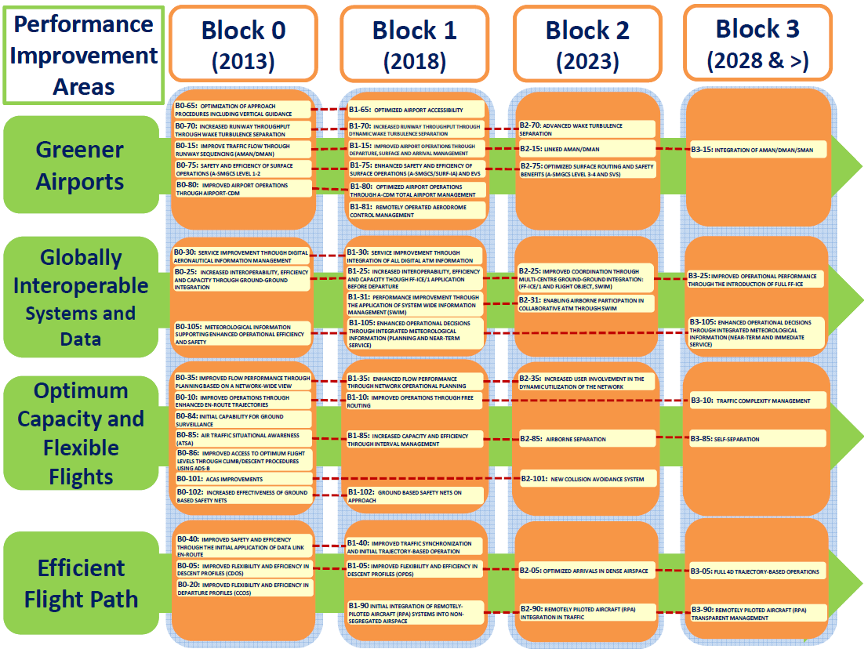
Aviation System Block Upgrades
Notes:
A busy slide, but let’s just focus on the left side, the Performance Improvement Areas and the second one: Globally Interoperable Systems and Data. As we will see on the next two slides, the thread number 30 (a Performance Improvement Area or PIA) on AIM runs through Blocks 0 and 1, and the thread number 31, a different Performance Improvement Area on SWIM runs through Blocks 1 and 2. Note the dates on the blocks when the capability is to start deployment.

Slide 3
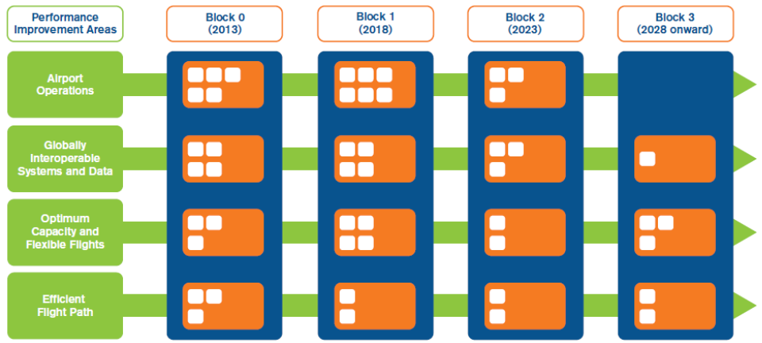
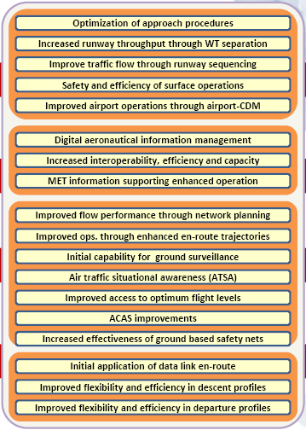
Aviation System Block Upgrades
Performance Improvement Areas
Notes:
Here is a slightly different view on the Performance Improvement Area on AIM.

Slide 4
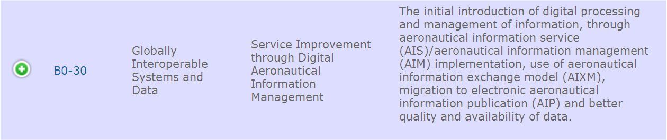
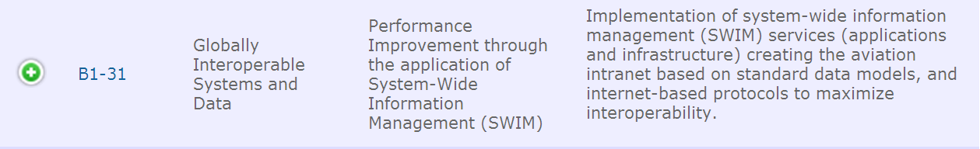
Aviation System Block Upgrades
Performance Improvement Areas (PIA)
Aeronautical Information PIA
Notes:
And finally, specifics on the two Performance Improvement Areas – 30 on AIM and 31 on SWIM. Block 30 introduces digital processing and digital management of aeronautical information, along with an exchange model – AIXM. It also introduces better quality of data and the electronic, or digital, publication. It is this transition to digital that is addressed in PANS AIM.

Slide 5
PANS AIM
6.1 Aeronautical Information Product updates
6.1.1 The same update cycle shall be applied to the
AIP Amendments, the AIP data set and the Instrument Flight Procedures data set
in order to ensure the coherence of the data items that appear in multiple Aeronautical Information Products.
Notes:
It is critical to the whole aeronautical data chain that data – no matter the format, paper, pdf or digital dataset – is published in accordance with the quality requirements and the AIRAC cycle timelines in Annex 15. And now we add to that the provisions in the new PANS AIM. Never has it been so important for the AIS, the ATC, the Airport, and the Aircrew to all be using the same current aeronautical information published in a timely manner.

Slide 6
SWIM
SWIM consists of standards, infrastructure and governance enabling the management of ATM information and its exchange between qualified parties via interoperable systems
SWIM Services, which access authoritative data, are identified through a SWIM Registry
Authoritative data is used across multiple Services
Notes:
How does AIM fit into or enable SWIM? Unless the data is in a format that can be used by the different State (or ANSP) functional organizations (ATC, AIS, NOTAMs, Aerodromes), SWIM will not be possible. This data format, AIXM, is the foundation for interoperability and without interoperability there will be no SWIM. The data services that a State could provide would be in AIXM format and listed in a SWIM Registry, where potential users would be able to identify them. It’s important to note that data would be originated only once, but could be sourced or used by several State services. It would hopefully mean the end of a piece of aeronautical data being maintained by multiple systems with different update cycles and potential different data. Interoperability will be the key.

Slide 7
Data Set Interoperability
Cross border data identical?
Mature specification for AIXM data set?
Mature coding rules for each data set?
Service specification for the provision of each data set?
Notes:
Here are some of the challenges that we see as States begin to move toward AIM. Are bordering States data such as boundaries, waypoints, routes, etc. identical or do they differ? If they differ, which is correct? Are both? As for providing AIXM data sets, do States have enough ICAO guidance on the specifications, the coding rules and the provision of these data sets? It is evolving and maturing and the AIXM Configuration Control Board is leading the way in addressing these challenges. But even though other organizations are contributing to the progress, the focus of States today should be internal.

Slide 8
AIM Starts Internally
Capability to seamlessly transfer data internally within a State between its:
AIM Office
Airports
Air Traffic Management Systems (ATC)
NOTAMs Office
Notes:
The focus now may be on moving toward a more digital and automated aeronautical information management, but this focus cannot remain in the AIM or AIS office. The real progress – and the even harder part of it – will be made when the rest of a State’s functional organizations are able to seamlessly process the AIM data – aerodromes, the Air Traffic Control and Management systems, and the NOTAM office. Interoperability within a State is really the next focus if we are going to use AIM to enable SWIM.

Slide 9
AIM Focus for SWIM
ANSP transition from ICAO SARPs to ‘End User’?
  Who is the ‘End User’?
    State Air Traffic Organization
    National Airline
    Next Organization in the Data Chain
    All Airlines
    The Cockpit
Who establishes priority with multiple ‘End Users’?
Notes:
States should rightly focus on implementing the ICAO SARPs and following Guidance Material as we move toward a SWIM system. But part of the ICAO terminology is ‘end user’. Who is the ‘end user’? Is it the next organization in the data chain? Is it the cockpit? Is it the national airline? Or all airlines? Or the State Air Traffic organizations? If there are multiple end users, how will a State prioritize these different end users’ requirements? Should the State provide different services depending on the different end users’ requirements? Should a State be concerned about ‘End Users’ or about following ICAO SARPs and Guidance Material? My recommendation would be to let the next element in the data chain be concerned about their end users. States’ focus should be on ICAO. Thank you for your attention. Questions?

