Slide 1
ICAO SAM PANS AIM Seminar
Data Quality – Jeppesen Perspective
Lima, Peru
November 2018
John Moore,
Jeppesen, Industry Relations & Standards
Notes:
Good afternoon. Quality matters in most everything we do, but especially in aviation. In this relatively short briefing, I’d like to cover why that is. I’ll cover the integral links in the aeronautical data chain, quality required now by PBN, some of the quality issues that we see, and a bit about the new Annex 15 definition of data quality. First, let’s look at the aeronautical data chain.

Slide 2
Aeronautical Data Chain Links
Upstream Originators flow through Data Houses to Downstream Users
Data Originators
Information and Data Flow
End User
Airports
Airlines
CNS
Infrastructure
Pilots
State AIS
Organizations
IAIP
NOTAMs
PIB
Commercial
Data
Providers
Avionics
Database
Processors
Airspace
designers
ATC
Other Airspace
Users
Others
ICAO Standards
Industry Standards
Notes:
The data chain has numerous links and they each play a critical role ensuring that accurate and timely aeronautical information reaches the end users. From our perspective in the middle of the data chain, we see the originators as ‘upstream’ with their data flowing downstream through us and eventually to the end user. The chain is governed from start to finish in order to ensure the most accurate and current data is available and used. It is important to note that the data chain follows two different standards. Upstream, States follow ICAO Standards and Recommended Practices in Annexes 4, 11, 14 and 15. Downstream, data houses and integrators like us, as well as the Flight Management System (FMS) companies are required by State Regulatory Authorities to follow EUROCAE and RTCA Industry Standards such as DO- 201B, 236C, 272B, 276B, 278C and 291C .

Slide 3
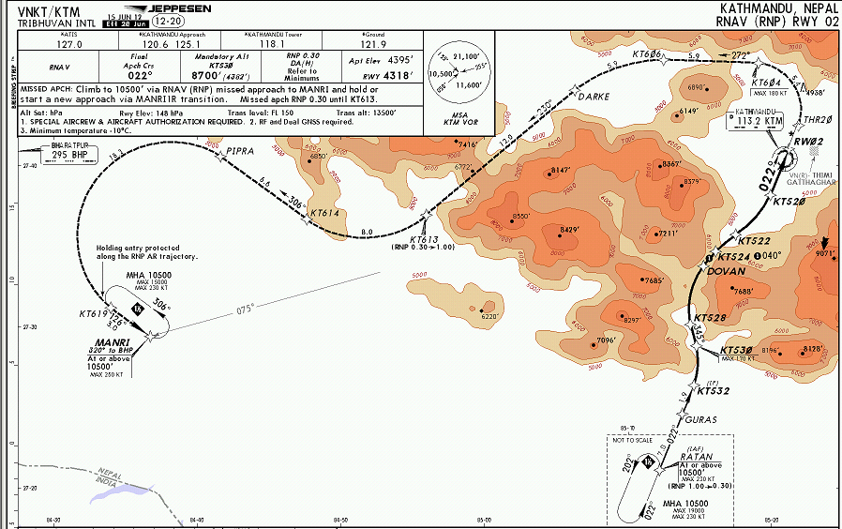

Quality in a PBN World
Dependent on accurate data
Nav system provides guidance to waypoints
Wherever the database says they are!
Data is mission critical
Data Quality - The “Dark Side”?
Notes:
Does quality take on more importance now in Performance Based Navigation procedures? I believe so. Here is chart of a PBN procedure (an RNAV RNP approach) into Kathmandu, Nepal. As you can see, the flight track goes through and over some significant terrain. It does so because it has been designed using very tight navigation performance requirements. If the waypoint information is not accurate, that procedure may not be safe to fly. Data quality is a two edged sword – or light saber – there definitely is a dark side to poor quality. The next slide is an actual example of what happened.

Slide 4
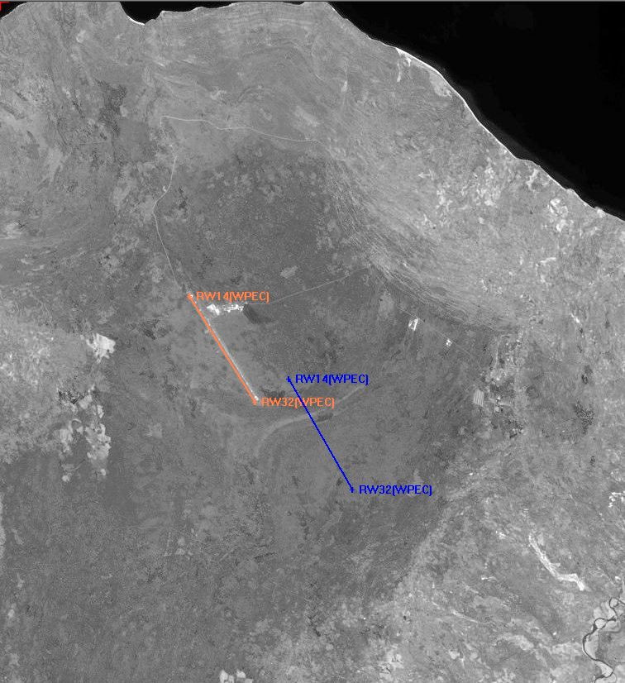

The Airplane Flies to the Waypoint
Right or Wrong
Actual Location
State AIP Location
Actual Location
State AIP Location
Notes:
This actually happened. Luckily, the crew discovered it early in their approach and they were in visual meteorological conditions and could see the actual runway. They broke off their instrument procedure, declared themselves visual and asked for clearance to land visually. How does this type of thing happen? We’ll see on the next slide.

Slide 5
Aeronautical Data Quality Problems
Conflicting data within and between AIP sections
Data change w/o corresponding procedure change
Inconsistent common data between procedures
Common data not changed in all affected uses
Inconsistent data across State boundaries
Uncertain clarification channels
Notes:
Unfortunately, these are problems that we’ve seen for literally decades. Nothing new. But worth a read anyway. Finally, on the last slides, what does ICAO now say about data quality?

Slide 6
Annex 15 – Data Quality Definition
Data quality. A degree or level of confidence that the data provided meet the requirements of the data user in terms of accuracy, resolution, integrity
(or equivalent assurance level),
traceability,
timeliness,
completeness and
format.
Notes:
Five new aspects of data quality have been added. An equivalent assurance level is now allowed in the integrity aspect. Traceability, timeliness, completeness and format have all been added and are further explained in the Annex as well as PANS AIM. But this is the definition. The SARP is on the next slide.

Slide 7
Annex 15 – Data Quality
2.1 State Responsibilities
2.1.4 Each Contracting State shall ensure that the aeronautical data and aeronautical information provided are complete, timely and of required quality in accordance with 3.2
3.2 Data quality specifications
  3.2.1 Data Accuracy
  3.2.2 Data Resolution
  3.2.3 Data Integrity
  3.2.4 Data Traceability
  3.2.5 Data Timeliness
  3.2.6 Data Completeness
  3.2.7 Data Format
Notes:
And the SARPs. Para 2.4 notes that States SHALL ensure the provision of data in accordance with Para 3.2. And 3.2 is where we see the new specifications for data quality. So how does all this fit into the move toward AIM?

Slide 8
Annex 15 – Automation
3.5 Use of Automation
3.5.1 Automation shall be applied in order to ensure the timeliness, quality, efficiency and cost-effectiveness of aeronautical information services.
Notes:
Without automation, AIM cannot be fully implemented, nor will SWIM become a reality. And this Annex 15 SARP requires automation in order to ensure data quality. One last slide on quality.

Slide 9
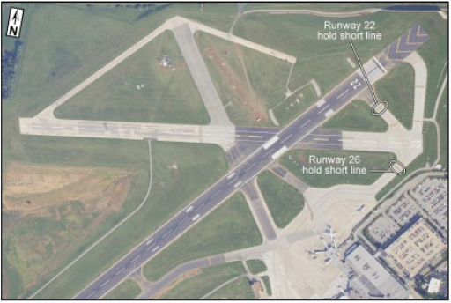
CL600, Lexington Kentucky USA, 2006
Bombardier Challenger CL600 crashed after attempting to take off from the wrong runway.
Findings:
  Because of an ongoing construction project, the taxiway identifiers represented in the airport chart available to the flight crew were inaccurate
  Information contained in a local NOTAM about the closure of taxiway was not made available to the crew via ATIS broadcast or the flight release paperwork.
  ‘Inaccurate Airport Chart’ and ‘NOTAM missing in dispatch release’

Slide 10
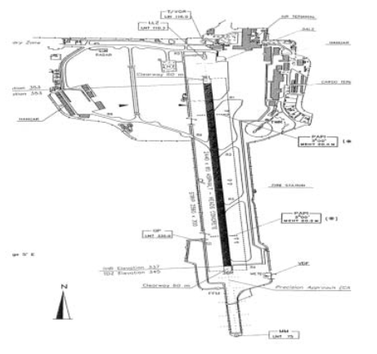
Taxiway Markings
Italy 2001
Markings that existed on TWY were not reported in AIP Italy
  White flashing lights had been deactivated
  Alternate green/yellow lead lights substituted
  Official documentation showed none of these changes.
Safety recommendations
The national competent Authority, to ensure that all required information to operate safely is contained in the AIP Italy and updated as needed.
The state of airport Visual Aids of all domestic airports as well as the published taxi procedures shall be checked and found to be in accordance to published AIP.

Slide 11
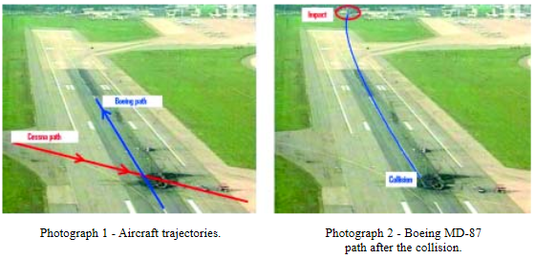
MD87 / C525, Milan Linate, Italy 2001
Boeing MD-87 departing on in thick fog in daylight collided at high speed with a Cessna Citation taxiing for departure
The MD-87 failed to get airborne and continued along the ground until it impacted, still at high speed, a ground handling building.
Both aircraft caught fire and were destroyed.

Slide 12

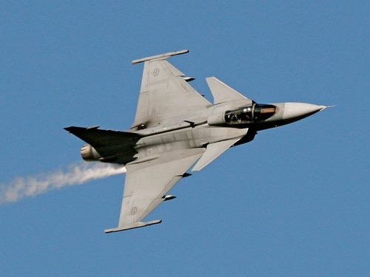
Obstacle and Terrain
2013 Sweden
  A low flying (30 metres) miltary aircraft passed a mast at very close range
  The lateral clearance was assessed to be approximately 10–20 metres
  The mast was not recorded in the chart documentation used.

Slide 13
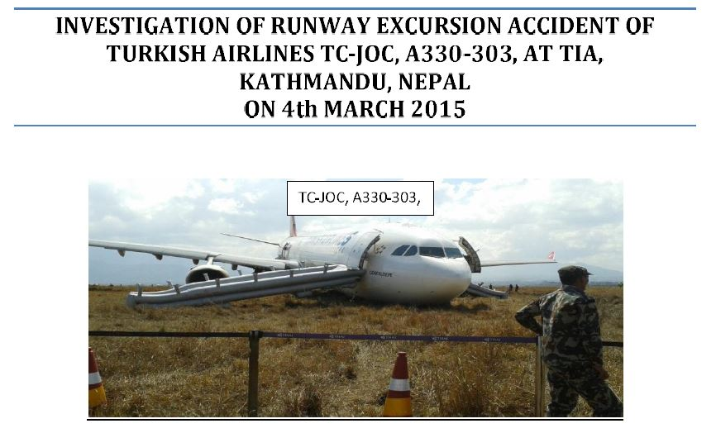

Slide 14
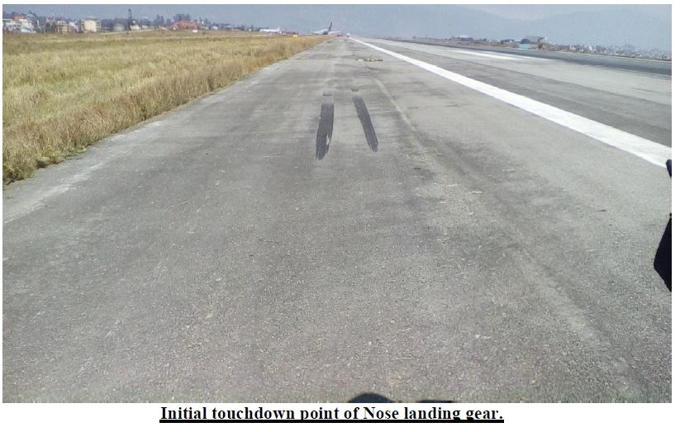

Slide 15
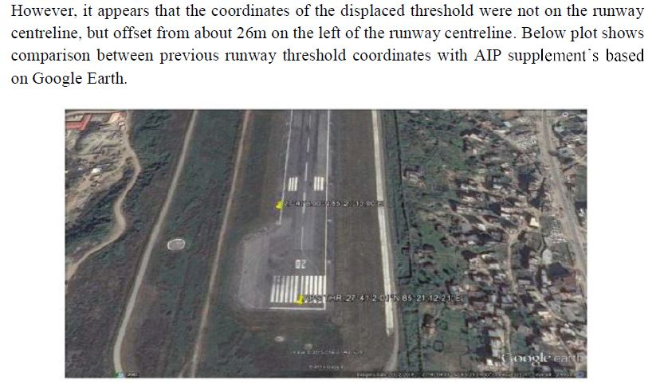

Slide 16
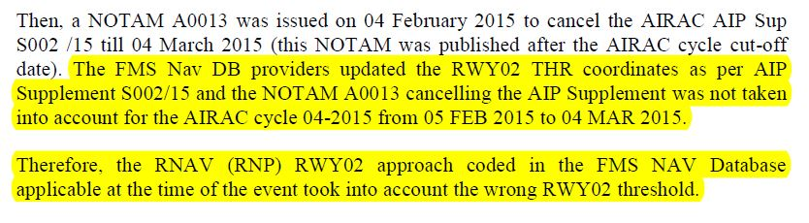

Slide 17
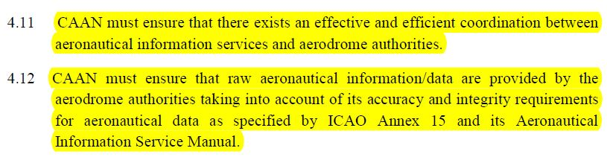

Slide 19

Notes:
We all recognize the message here. The display monitor in the center of the picture COULD represent ANSP automation and technology. Although the data on either sides of the ‘monitor’ might be packaged differently, poor quality information being fed into the automation will still come out as poor quality information. Thank you for your time and attention. Questions?

