Slide 1
ICAO SAM PANS AIM Seminar
AIRAC – Jeppesen Perspective
Lima, Peru
November 2018
John Moore,
Jeppesen, Industry Relations & Standards
Notes:
Good afternoon. In this briefing, I hope to be able to give you a bit of background on how we see the AIRAC – the Aeronautical Information Regulation and Control – cycle. I’ll start with a couple of slides on the players and the cycle, then move on to some of what ICAO has to say about it, and end up with a couple of examples of the consequences of not complying with the AIRAC cycle. So first, here are the players.

Slide 2
Aeronautical Data Flow
Data Streams
Commercial Data Provider
Products
Gather
Analyze
Aggregate
Standardize
Reconcile
Configure
Integrate
Add value
Distribute
State provided data
Navigation Data
Services
❖
Charting Services
❖
Operation Services
Customer provided data
Supplier derived data
Notes:
Aeronautical data flows like a river from upstream originators through the data houses and continues downstream to the end users. We are all part of the data cycle as well.

Slide 3
Aeronautical Data Chain Timelines
Aeronautical Information Regulation and Control
ICAO Annex 15, 16th Edition | Jeppesen | Avionics | ICAO
States Publish
AIRAC Cycle Number | Major Changes to Reach Recipients (56 days in advance) | Normal Changes (42 days in advance) | Normal Changes to Reach Recipients (28 days in advance) | Navigation Data Extract Processing Begins | ARINC 424 Data Set Deliveries to OEMs Begin | OEM Database Deliveries to FMS Begin | AIRAC Effective Date
1806 | 29 Mar 18 | 12 Apr 18 | 26 Apr 18 | 4 May 18 | 7 May 18 | 10 May 18 | 24 May 18
1807 | 26 Apr 18 | 10 May 18 | 24 May 18 | 1 Jun 18 | 4 Jun 18 | 7 Jun 18 | 21 Jun 18
1808 | 24 May 18 | 7 Jun 18 | 21 Jun 18 | 29 Jun 18 | 2 Jul 18 | 5 Jul 18 | 19 Jul 18
1809 | 21 Jun 18 | 5 Jul 18 | 19 Jul 18 | 27 Jul 18 | 30 Jul 18 | 2 Aug 18 | 16 Aug 18
56 days
42 days
28 days
20 days
17 days
14 days
Notes:
Lots of small print here, but focus if you will on the top two rows: who the players are and when they have to do something. The rest of the rows are just dates that reflect the top two, although, the bottom of this slide also shows the number of days prior to each AIRAC effective date when something is required. Let’s look at just one aspect of this timeline, the Jeppesen columns. In AIRAC cycle 1807, on the 24th of May, we should have received all State data. We have exactly 8 days to process that data and then on June 1st we started the Nav Data Extract process. When we start that nav data extract, the data is ‘locked in’ and changes are not allowed, because these extracts have to be delivered three days later to the next link in the chain, the OEMs (Honeywell, GE, Rockwell-Collins, Universal, etc.). Sometimes this is not well understood. States might believe that since they hand off their data to us 28 days before the effective date, that we have 28 days to work with their data. Not so. We have 8 days to handle all the data – globally – before it has to be handed off to the next link in the chain.

Slide 4
Timeline for Data Processing
Data
origination
Publication
date
Data due to
recipients
Effective
date
Avionics
packing
Aircraft load
Variable
time
14 Days
Shipping
7-10 Days
42 Days
Prior
28 Days
Prior
0 Days
Prior
ICAO recommends 56 days or more for major changes
Opportunity to improve timeliness
Time window for commercial data provider to do their job
Notes:
Here is another view of that. If States provide their data to us electronically 42 days prior, then we have more time to process it, and that helps if there are an unusually large number of changes or clarifications that need to be made. Many times though, we see the data only the AIRAC required 28 days prior. States realize that the 42 day prior Publication Date was set that way because it might take the mail up to 14 days to reach us. Electronically, it can be done the same day. So States are taking back those 14 days of mail time to use for the actual processing of their data. It would help if States started incrementally moving back toward a publication date that is earlier than the 28 days prior. Here’s a global data snapshot from two years ago.

Slide 5
Global Data Challenge
14,600 Airports
89,200 Airport Details
10,600 Airport Comms
28,600 Navaids
4,600 ILS Approaches
6,300 VOR Approaches
3,600 NDB Approaches
7,100 RNAV Approaches
17,500 Departures
13,200 Arrivals
72,000 Terminal Waypoints
3,400 High Airways
3,000 Low Airways
2,800 High/Low Airways
22,600 Enroute Waypoints
Very large and growing
Increasingly difficult to manage with required quality
Notes:
As you can see, some truly large numbers that we work with every AIRAC cycle. Let’s next take a look at what some of the new Annex 15 and PANS AIM paragraphs have to say about the AIRAC cycle and the provision of information.

Slide 6
Annex 15 – AIRAC
6.2 Aeronautical Information Regulation and Control (AIRAC)
6.2.3 Information provided under the AIRAC system shall be made available by the AIS so as to reach recipients at least 28 days in advance of the AIRAC effective date.
  Note. — AIRAC information is distributed by the AIS at least 42 days in advance of the AIRAC effective dates with the objective of reaching recipients at least 28 days in advance of the effective date.
Notes:
As was mentioned a couple of slides ago, 28 days in advance is when the data has to reach us. And it is only a Note, not a SARP, that mentions when the distribution of that data takes place – 42 days in advance. And as before, we will all benefit if States can start incrementally giving back some of those 14 days they have for ‘mailing’. Instead of using all 14 days for themselves, use 12 days or 10 days and distribute it 32 days in advance.

Slide 7
Annex 15 – AIRAC Major Changes
6.2 Aeronautical Information Regulation and Control (AIRAC)
6.2.7 Recommendation.— Whenever major changes are planned and where advance notice is desirable and practicable, information should be made available by the AIS so as to reach recipients at least 56 days in advance of the effective date. This should be applied to the establishment of, and premeditated major changes in, the circumstances listed below, and other major changes if deemed necessary.
  Note. — Guidance material on what constitutes a major change is included in Doc 8126.
Notes:
The SARPs for Major Changes requires them to reach us not 28 days in advance, but 56 days. This is sometimes a problem for us when we don’t have the full 56 days because a State may not be able to distribute the data then or maybe their interpretation of a major change is different from 8126. If they interpret their change as normal – and not major – then they distribute it the normal 28 days in advance. If it really is a major change, sometimes we will not be able to publish or include in the nav data base. The next slide shows what Doc 8126 considers to be a major change.

Slide 8
Doc 8126 AIS Manual – Major Changes
2.6.10 In cases where major changes (i.e. extensive changes to procedures or services which will impact international air transport) are planned and more advance notice is desirable and practicable, a distribution date of at least 56 days (or even longer) in advance of the effective date should be used. Examples of major changes are:
a) the introduction of a new aerodrome;
b) the introduction of new approach and/or departure procedures at international aerodromes; and
c) the introduction of new ATS routes.
Notes:
Major changes are also known as extensive changes. Also, we have noted that some States read ‘more advance notice is desirable and practicable’ as an easy rationale for not distributing major changes 56 days in advance. They say it is not ‘practicable’ and so they distribute 28 days in advance. This hurts all their airspace users if we are unable to process all the changes in time and have to defer these changes to the next cycle. In the next slide, we look at synchronizing the updates.

Slide 9
PANS AIM – Data Set Update Cycle
6.1 Aeronautical Information Product updates
6.1.1 The same update cycle shall be applied to the AIP Amendments, the AIP data set and the Instrument Flight Procedures data set in order to ensure the coherence of the data items that appear in multiple Aeronautical Information Products.
Notes:
When a State starts producing data sets, some of them MUST be synchronized. Specifically, the AIP Amendments, the AIP data set, and the IFP data set. The next slide shows us what ICAO wants with regards to updates.

Slide 10
PANS AIM – Digital Data Updates
6.1.5 Specifications for digital data updates
6.1.5.1 The update interval for the AIP data set and Instrument Flight Procedures data sets shall be specified in data product specification.
6.1.5.2 Data sets that have been made available in advance (according to the AIRAC cycle) shall be updated with the non-AIRAC changes that occurred in between the publication and the effective date.
Notes:
Once a data set has been published, or distributed by the State, if there are changes to the data before the AIRAC effective date, then those changes must be incorporated into the next data set. Finally, a few of the typical issues that we confront and some examples of non-compliance with ICAO SARPs on the AIRAC cycle.

Slide 11
Typical Aeronautical Data Problems
Late (per AIRAC) publication of information
Late (per AIRAC) postponement of information
Publications not received (numbers missing in the sequence)
Notes:
These are typical issues that we see. Late publication or postponement of data and sometimes no publication. The next slide is one example of the consequence.

Slide 12
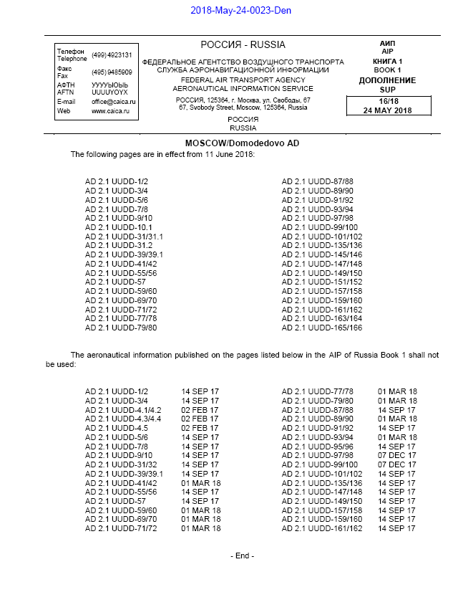
Non-AIRAC Effective Date
65 pages of SIDs, STARs & Approach Procedures
Notes:
New SID and STAR procedures, at new runway, were published (65 pages) with a non-AIRAC effective date (11 June vs 21 June – 10 days early).
Pressure to include new airport diagram, new procedure charts and all changes in the Nav Database.
A week after publication by State – and considerable work by Jeppesen – the runway is NOTAM’d out of service.

Slide 13
A Result of Late State Source
Notes:
In this final example, a Jeppesen Chart Alert had to be published. It noted, specifically, that the reason was that an ‘AIP SUP was received after the date specified by ICAO for aeronautical information distribution’. And that, ‘As a result, changes could not be processed for the effective date’.
We are all tied together in this AIRAC cycle and the aeronautical data chain. We rely on each other to do our individual parts to the absolute best of our ability so that timely data is available to all of the users of the data. Thank you for your attention. Questions?

