Slide 1
GASP implementation status in the Panamerican Region
Thirty First Regional Aviation Safety Group — Pan America Executive Steering Committee Meeting
(RASG-PA ESC/31)
Buenos Aires, Argentina 8 to 9 November 2018

Slide 2
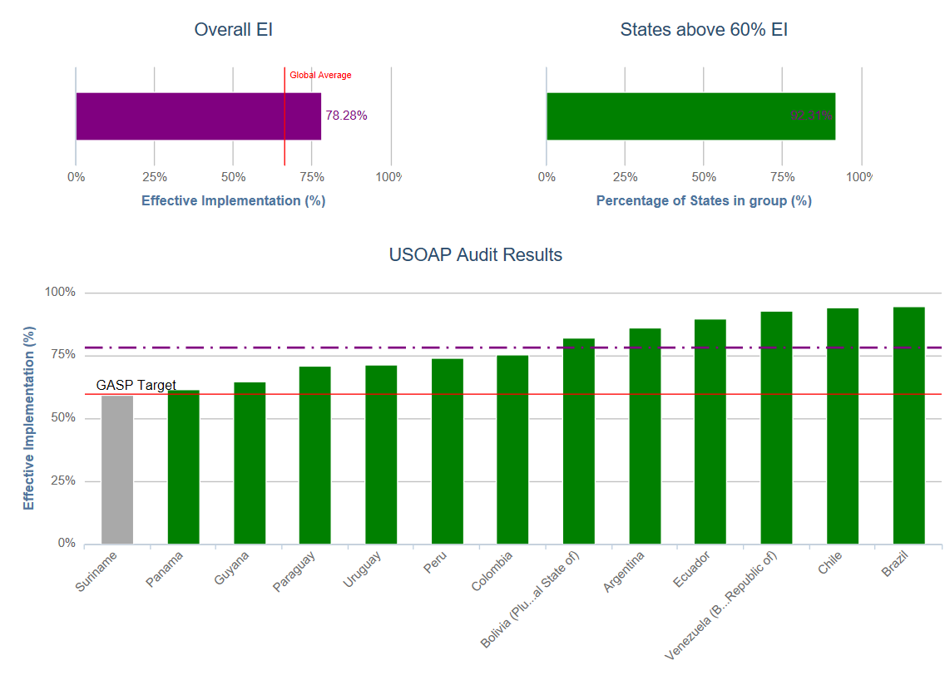
GASP Objectives and timelines
SAM Effective implementation

Slide 3
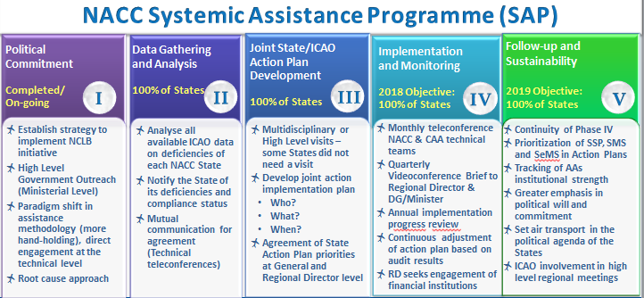
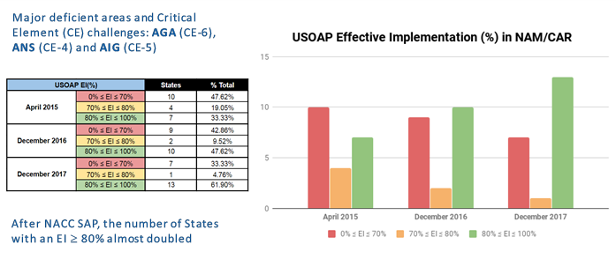
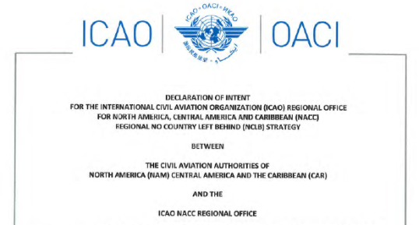
Effective Safety Oversight: NAM/ CAR Regions
https://www.icao.int/NACC/Pages/nacc-nclb.aspx
Tailored committed State Action Plans
Enhancement of RSOOs: ACSA, CASSOS
Champion State initiative

Slide 4
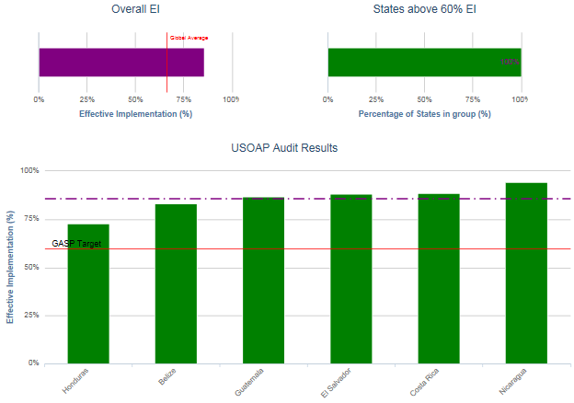
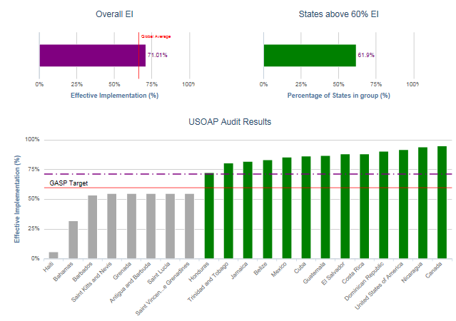
NACC USOAP Effective Implementation
2018-2019 Targets:
All Central American States with EI above 80%
SSC Resolution – Haiti
Improving Caribbean States- target
Specific TC Project and Champion State support
Support to Bahamas
working with Barbados
Challenge: OECS States

Slide 5
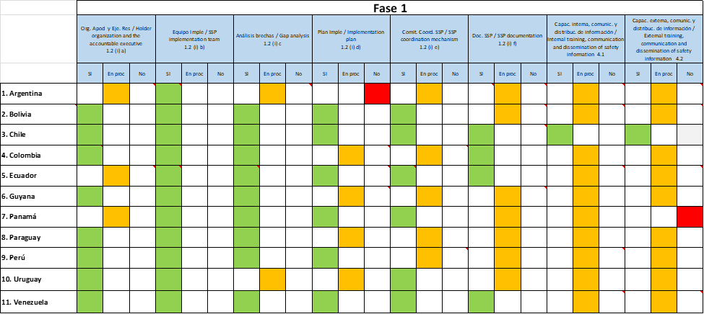
SAM SSP Implementation Project (Phased Approach) Phase 1 Status

Slide 6
SAM SSP Implementation Project (Phased Approach) Phase 2 Status

Slide 7
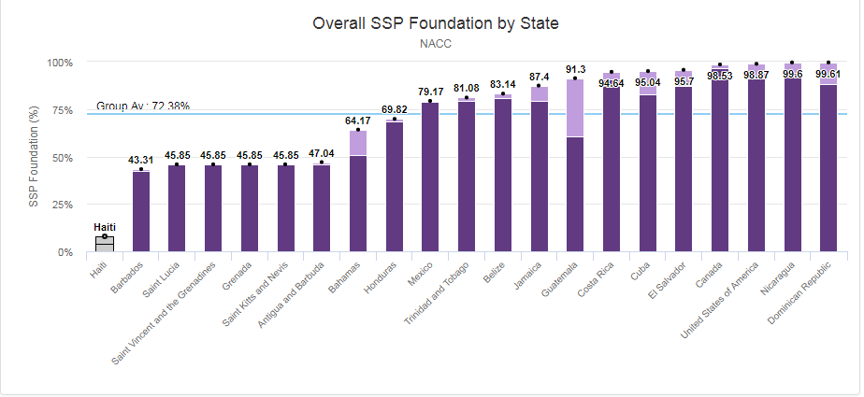
NACC SSP Regional Implementation Strategy
(WP/22)
Tier 1: States that currently have a SSP Foundation Index Above 95% -> to implement SSP by 2020;
Tier 2: States that have a SSP Foundation Index Above 85% -> to implement SSP by 2021;
Tier 3: States that have a SSP Foundation Index Above 75% -> to implement SSP by 2022;
Tier 4: States that have a SSP Foundation Index Above 60% -> to implement SSP by 2023;
Agreement on Action Plan and commitment on assistance and implementation
NAM/CAR States that complete any phase of the SSP implementation can be considered as Champion States to support other States in the implementation of the phases that have already implemented

Slide 8
GASP 2020 – 2022 The way forward
Goals, targets and indicators
Achieve a continuous reduction of operational safety risks
Strengthen States’ safety oversight capabilities
Implement effective State safety programmes (SSPs)
Increase collaboration at the regional level
Expand the use of industry programmes
Ensure the appropriate infrastructure is available to support safe operations

Slide 9
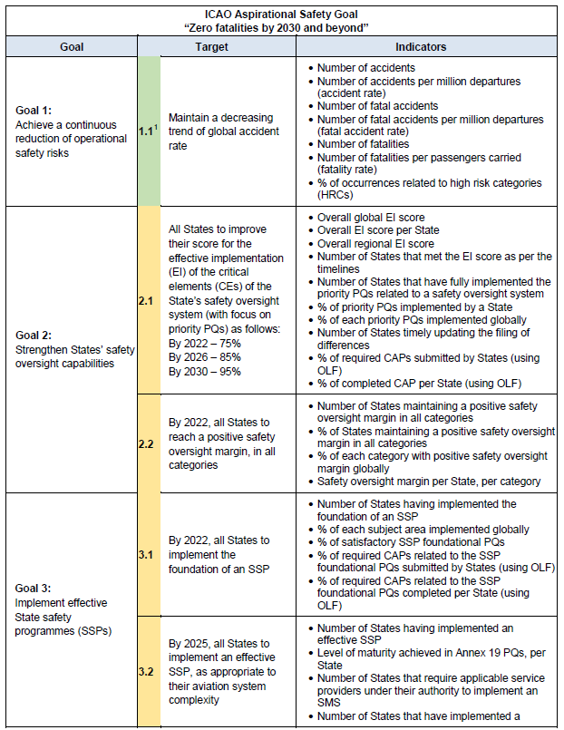
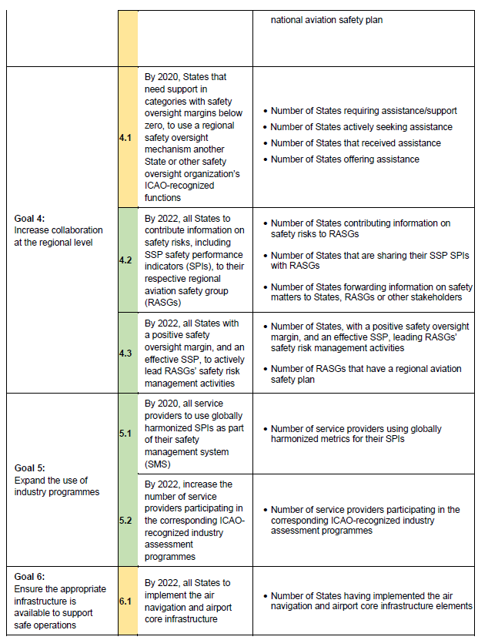
GASP 2020 – 2022 The way forward

Slide 10
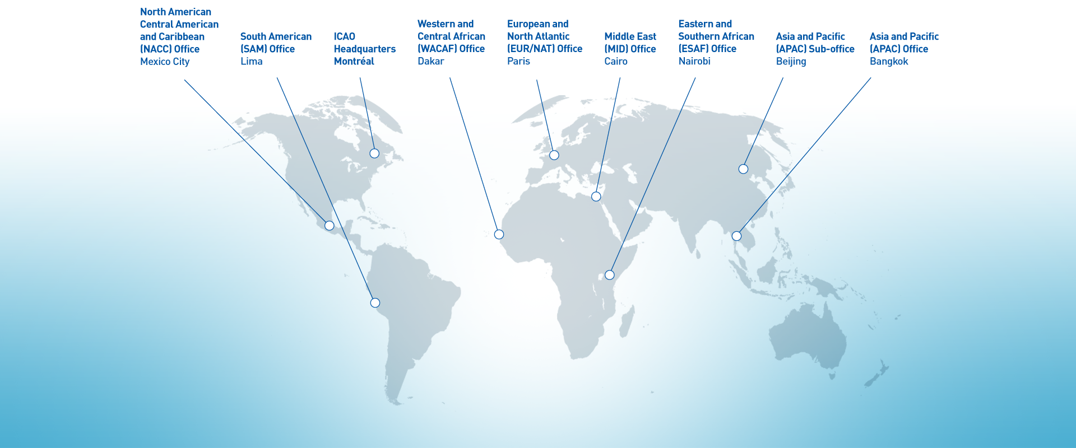
No Country Left Behind initiative:
Council Informal Briefing
GRACIAS!

