Slide 1

United States Update on Flight Planning In the North American, Central American and Caribbean (NACC) Region – 2018
Federal Aviation
Administration
Presented To: NAM/CAR/SAM Regions Air Traffic Services Inter-Facility Data Communication (AIDC) Implementation Meeting
By: Dan Eaves, FAA ATO Mission Support - En Route Requirements and Validations
Date: April 16 - 20, 2018
Notes:
1

Slide 2
ERRORS, MISSING AND DUPLICATION OF FLIGHT PLANS
As early as October 2009 in E/CAR/WG/31 a working paper was provided titled “Missing Flight Plans” by France . An ad hoc AIS group from this meeting suggested an initiative to conduct an analysis to determine the extent of the identified problem be undertaken. The group recommended that an investigation of duplicate flight plans take place simultaneously with the missing flight plan issue.
Within the NACC Thirty-Second Eastern Caribbean Working Group Meeting. 15-18 June 2010 IP/10 was presented detailing the deficiencies associated with Missing and duplicate flight plans within the Piarco FIR.

Slide 3
ERRORS, MISSING AND DUPLICATION OF FLIGHT PLANS
The main causes of duplication cited by the Piarco analysis of flight plans were:
  the issuing of flight plans by multiple originators,
  the multiple transmissions of flight plans by the same originator and
  the re-issuing flight plans due to changes.
The causes accounted for 67%, 32% and 24% respectively . There was some over lapping causes as noted by the percentages.
In the 2012 NACC/WG/3 an ad hoc working group was formed met to discuss the topic of “Actions to Avoid Errors, Missing and Duplication of Flight Plans”. From this discussion came Conclusion 3/3 that NAM/CAR States/Territories and COCESNA implement actions to avoid errors, missing and duplication of flight plans.

Slide 4
AIDC Implementation Task Force/FPL Monitoring Group
Background
The AIDC Implementation Task Force was formed in 2014 during the first ANI/WG meeting to streamline related air navigation implementation activities.
  A Task was formed to analyze and coordinate and mitigate solution actions for duplicate/missing FPLs.
During the 4th teleconference of the Task Force the FPL Monitoring Group was proposed to report on problems and follow up on their solution in the matter of duplicate and erroneous FPLs. Responsibilities Included:
  Reporting FPL duplication/error issues occurring in their State.
  Overseeing the execution of the FPL mitigation/solution action plan.
  Providing statistical data of the errors detected in the filing of flight plans in their State.
The goal of the group was summarized by a “One Flight, One Flight Plan” philosophy to achieve quality improvements in the regional flight planning environment.

Slide 5
ERRORS, MISSING AND DUPLICATION OF FLIGHT PLANS
These categories provide the greatest challenges impacting efficiency and safety of flight, impacts include
  Controller workload
  Controller Situational Awareness
  Safety

Slide 6
Errors - Duplicate/Altered Flight Plans
Changing a Filed FPL can cause downstream difficulties
  Wrong PBN Equipment qualification
  FIRs having different versions of flight plan
  Disparity between aircraft and FIR flight plans
  Wrong aircraft information used when previously filed similar aircraft used as a template

Slide 7
Multiple Flight Plans Filed for the Same Flight
  The primary issue in flight plans is multiple flight plans for the same flight, which has been termed ‘duplicate’ flight plans in other forums.
  These are multiple flight plans filed for the same flight. Airlines or filing authorities (AOCs) transmit flight plans for departures in Caribbean, Central America and South America. Many of the countries retransmit these flight plans.
  Errors in retransmitted flight plans include format, conflicting data, missing data and erroneous data. Issues revolving around multiple flight plans have been noticed in border ARTCCs for several years. Occurrences of aircraft arriving from international locations with the wrong aircraft type, incorrect routes and wrong PBN equipment have brought more attention to the problem.

Slide 8
Duplicate FPL Entries Can Lead to inconsistencies between aircraft trajectories flown versus trajectories known to automation
Multiple FPLs for Same Flight
If there is any change to the route of flight or proposed departure time, a duplicate FPL may be accepted by automation

Slide 9
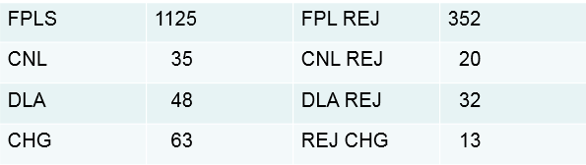
ERRORS, MISSING AND DUPLICATE FLIGHT PLANS
Summary SAM Flight Plan Messages 05-11 March 2018 Filed to/through Miami ARTCC

Slide 10
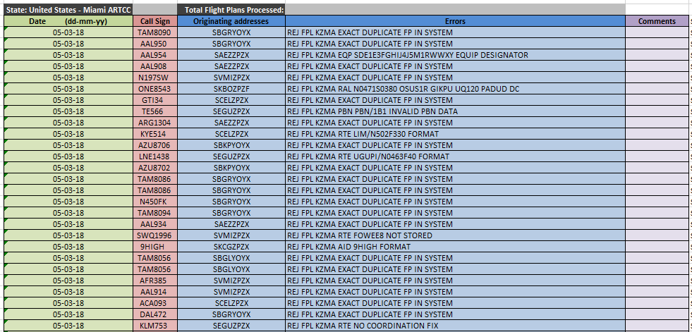
Flight Plans Rejected from South America

Slide 11
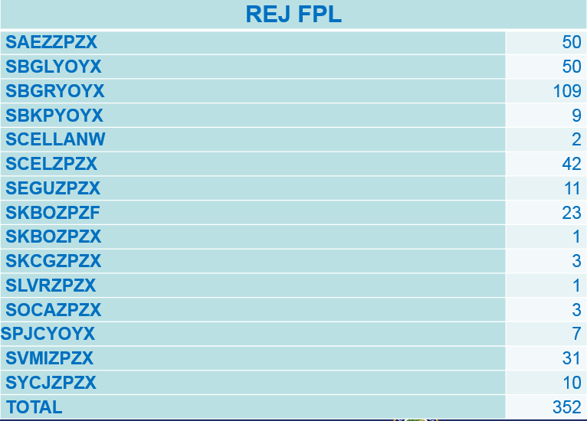
Rejected South American FPLs by Airport/Facility

Slide 12
FPL Message Notes
Approximately 31% of the FPLs filed from South America to US are rejected
The 352 REJ messages returned to SAM FIRs contained 260 “REJ FPL KZMA EXACT DUPLICATE FP IN SYSTEM”

Slide 13
Examples:

Slide 14
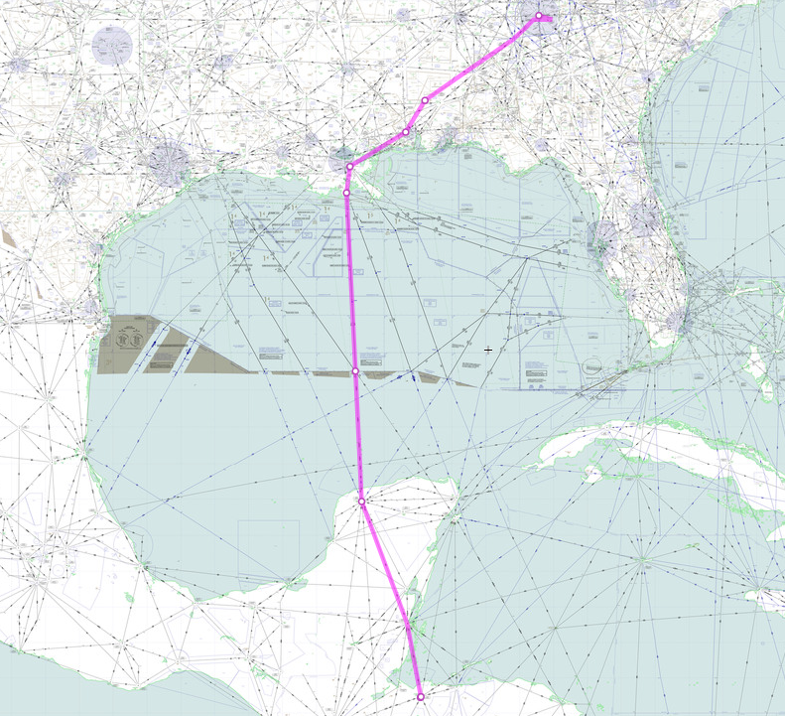
Example DAL504 - 7 March 2018

Slide 15
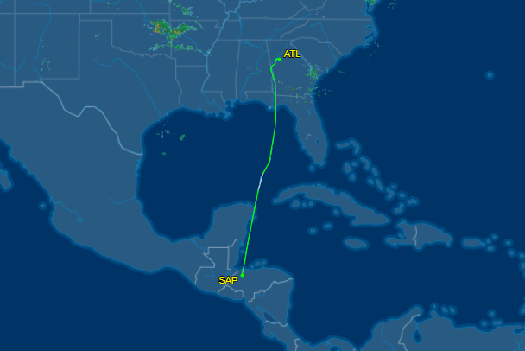
DAL504 MHLM - KATL
KZTL
KZHU
MMID
MHLM

Slide 16
Filed Flight Plan From KATLDALQ
1712:20.41 DAL504 FPL
KZHUZZQA-071712 KATLDALQ
MHLM1947
N0461F360 DCT LMS UB753 MID UA770 KEHLI A770 LEV J31 HRV/N0449F370 J37 SJI DCT SHYRE HOBTT2 KATL0256

Slide 17
Flight Plan From MHLMZPZX
1755:34.40 DAL504 FPL
KZHUZZQA-071755 MHLMZPZX
MHLM1947
N0461F360 UB753 MID UA770 KEHLI A770 LEV J31 HRV/N0449F370 J37 SJI DCT KATL0256

Slide 18
Delta 504 MHLM to KATL
The flight was Filed, was cleared, and flew:
  SJI DCT SHYRE HOBBT2 KATL0256
But 2nd FPL that was activated showed: SJI DCT KATL0256

Slide 19
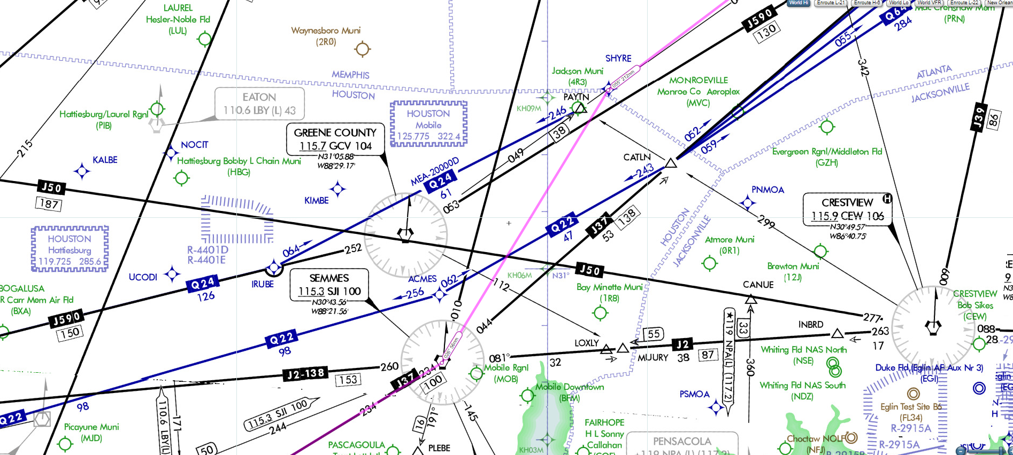
DAL504 Filed and Flown Route

Slide 20
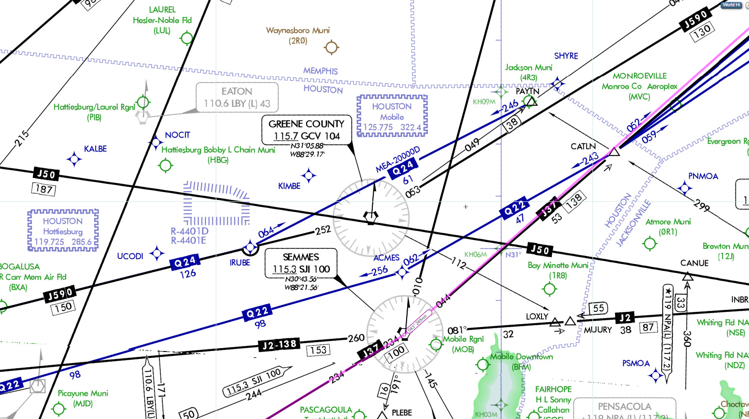
DAL504 2nd FPL Different Than Filed and Flown Route

Slide 21
Problems with Modified FPLs
Creates extra workload for controllers
  Controllers have to ask pilots if they have been cleared via the STAR, or
  Controllers have to reissue the STAR
  Either way it can cause unnecessary radio conversation
Possible Safety concerns if FPL and actual route flown are not the same

Slide 22
Summary – One Flight, One Flight Plan
One recommendation of the FPL Monitoring Group First Aeronautical Information Management (AIM), Flight Plan (FPL) Error Management and Air Traffic Services Inter-Facility Data Communication (AIDC) Meeting (AIM/FPL/AIDC/1) could be summarized by a “One Flight, One Flight Plan” philosophy to identify flight planning errors, correct those errors and reduce problems associated with multiple flight plan submission. It has been recognized as an international issue that is adversely impacting quality of the data being input and processed by ATC automation systems.

