Slide 1
ARCM – SAM
MECANISMO REGIONAL DE COOPERACIÓN AIG
DE SUDAMÉRICA
Notes:
Good morning ladies and gentlemen.
The purpose of my presentation today is to give you an overview of the AIG Regional Cooperation Mechanism of South America - known as ARCM.
Although the ARCM is not a fully structured Regional Accident and Incident Investigation Organization (RAIO), this mechanism was created to meet the needs of the SAM Region in accidents and incidents investigation.

Slide 2


PRIMEROS PASOS DEL ARCM
Notes:
The ARCM was established in two years, from march 2014 to march 2016, during this period, the AIG Authorities of the SAM States carried out three meetings with the following outcomes and achievements:
A strategic plan to outline the route to be followed in the creation of the ARCM was agreed in the first meeting.
In the second meeting, the ARCM was established and the AIG regulations and procedures were approved by the meeting.
A memorandum of understanding (MoU) was signed by the majority of SAM States in the Third meeting to allow AIG cooperation among the SAM States.
Up to now, eleven (11) out of thirteen (13) States have signed the ARCM agreement.

Slide 3
ESTRUCTURA DEL ARCM
ARCM
Comité Ejecutivo
Presidente
Comité técnico
Paneles de expertos
Notes:
The ARCM is comprised by fourth main bodies, the Executive Committee, its Chairperson, the Technical Committee and the Expert Panels.
The Executive Committe is integrated by the AIG Authorities of the SAM States and its Chairperson is elected among them.
The AIG Technical Committee, whose main functions are: develop the AIG documentation, execute the working programmes and manage the ARCM, is made up of AIG specialists of different States, who have different specialties, such as investigators, ADREP/ECCAIRS operators and safety analysts.
The expert panels are composed mainly by investigators and safety analysts and their main function is to collaborate with the Technical Committee in the execution of the work programme.

Slide 4




Miembros del ARCM
Notes:
All thirteen States of the SAM Region are members of the ARCM
The French BEA, the United States NTSB and the Caribbean Aviation Safety and Security Oversight System (CASSOS) are also part of the ARCM as special observers.
The BEA and NTSB have offered to cooperate with the ARCM in the areas of training and technical assistance, when required.

Slide 5

VISIÓN DEL ARCM
Notes:
The vision of the ARCM is:
to become a Mechanism that ensures the highest standards in aircraft accident and incident investigation and;
be recognised in the regional aeronautical environment for its contribution to safety.

Slide 6

MISIÓN DEL ARCM
Notes:
The mission of the ARCM is:
support SAM States when so requested on aspects related to aircraft accident and incident investigation in a regional cooperation environment that enables improved effective implementation in the AIG area;
and contribute in the reduction of the rate of aircraft accidents and incidents in the SAM Region to a level below the global rate in all segments of aviation.

Slide 7
PROGRAMAS DE TRABAJO
Armonización
Asistencia técnica
Cooperación
Instrucción regional
Banco de investigadores
Notes:
To fulfill its goals, the ARCM has established the following working programmes: harmonization, technical assistance, regional training, investigators bank and cooperation.
Only in an harmonized environment the ARCM will be able to provide cooperation, therefore the ARCM is harmonizing its regulations, procedures, checklists and training.
Technical assistance will be provided upon request and agreed by the parts.
The ARCM will provide training on a regional level to foster the harmonization.
A pool of investigators will be needed to implement cooperation.

Slide 8
Sistema de recopilación y procesamiento de datos de seguridad operacional (SDCPS)
ARG
BOL
BRA
CHI
SDCPS
COL
ECU
GUY
PAN
PAR
PER
SUR
URU
VEN
Notes:
In order to manage the accidents and incidents data, a regional safety data collection and processing system (SDCPS) has been developed for the ARCM.
This system utilizes the ADREP/ECCAIRS system as its platform.
The ARCM SDCPS will allow SAM States to analyze and exchange AIG information among them and at a regional level.
At the present time is being implemented successfully.

Slide 9
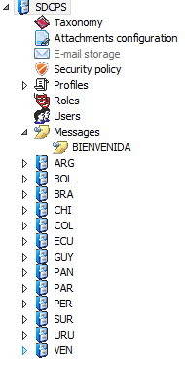
Repositorios: (SDCPS) ECCAIRS
Repositorios de los Estados miembros
Notes:
Each SAM State has a repository in the ARCM SDCPS

Slide 10
SDCPS ARCM
SDCPS
Base de datos AIG del Estado
Base de datos AIG del Estado
Sincronización
Estado
ARCM
Notes:
From its platform, each SAM State AIG Authority may interact with its own database and SDCPS of the ARCM.
The SAM States AIG databases are syncronized with the SDCPS database.

Slide 11

Objetivo del ARCM
EI 95-100%
2030
64.39 %
Notes:
One of the main goal of the ARCM is to achieve an AIG effective implementation (EI) above 80 % at the end of 2019 for all SAM States.

Slide 12
OBJETIVO ARCM: Reducir la tasa de ACCD de acuerdo con las metas del plan de seguridad operacional de la Región SAM
Notes:
Another goal is to reduce accidents rate 25 % below the global average.
For the first time, in 2015, the SAM Region reduced significantly the accidents rate below the world average rate (schedule commercial operations with aircraft of more than 5 700 kg)

Slide 13
OBJETIVO ARCM: Reducir la tasa de ACCD de acuerdo con las metas del plan de seguridad operacional de la Región SAM
Notes:
Another goal is to reduce accidents rate 25 % below the global average.
For the first time, in 2015, the SAM Region reduced significantly the accidents rate below the world average rate (schedule commercial operations with aircraft of more than 5 700 kg)

Slide 14
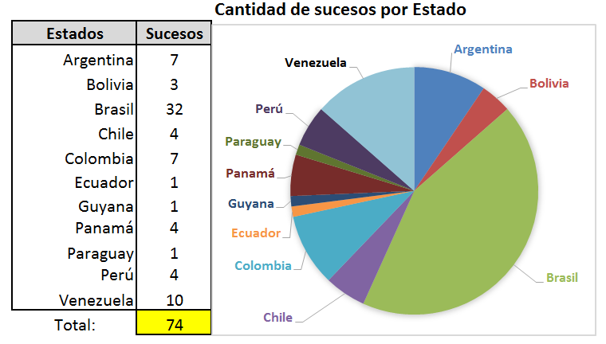
OBJETIVO ARCM: Reducir la tasa de ACCD de acuerdo con las metas del plan de seguridad operacional de la Región SAM
Notes:
Another goal is to reduce accidents rate 25 % below the global average.
For the first time, in 2015, the SAM Region reduced significantly the accidents rate below the world average rate (schedule commercial operations with aircraft of more than 5 700 kg)

Slide 15
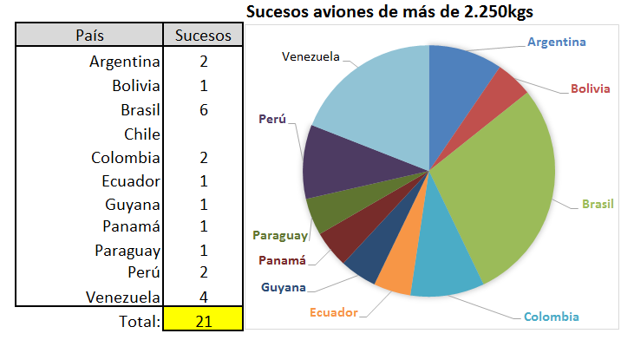
OBJETIVO ARCM: Reducir la tasa de ACCD de acuerdo con las metas del plan de seguridad operacional de la Región SAM
Notes:
Another goal is to reduce accidents rate 25 % below the global average.
For the first time, in 2015, the SAM Region reduced significantly the accidents rate below the world average rate (schedule commercial operations with aircraft of more than 5 700 kg)

Slide 16
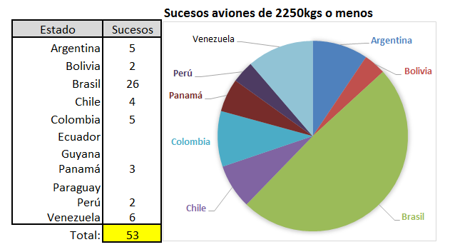
OBJETIVO ARCM: Reducir la tasa de ACCD de acuerdo con las metas del plan de seguridad operacional de la Región SAM
Notes:
Another goal is to reduce accidents rate 25 % below the global average.
For the first time, in 2015, the SAM Region reduced significantly the accidents rate below the world average rate (schedule commercial operations with aircraft of more than 5 700 kg)

Slide 17
OBJETIVO FINAL DEL ARCM
SALVAR VIDAS
Notes:
The final goal of the ARCM is TO SAVE LIVES

Slide 18
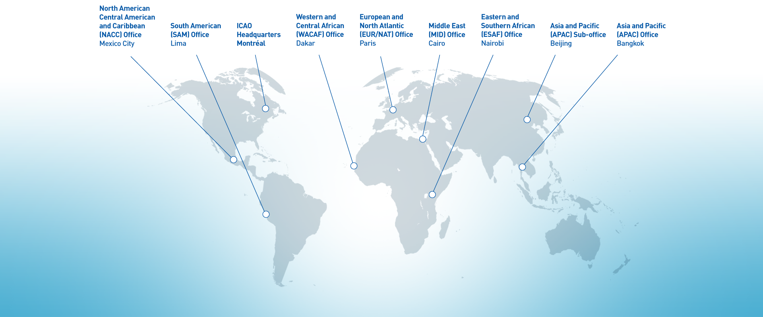
No Country Left Behind initiative:
Council Informal Briefing
Muchas gracias

