Slide 1


An X-Ray of Fatigue in Aviation Safety
Fatigue Management from
a Pilot´s Perspective
Capt. German Diaz-Barriga Martinez.
FRMS Seminar, ICAO/IATA/IFALPA, 26 June 2012, LIMA - PERU

Slide 2
Charles A. Lindbergh
“The nose is down, the wing low, the plane is diving and turning. I've been asleep with open eyes... I kick left rudder and pull the stick back... My eyes jump to the altimeter...I'm at 1600 feet. The turn-indicator leans over the left - the airspeed drops - the ball rolls quickly to the side...My plane is getting out of control!”

Slide 3
Is Fatigue a Concern in
Flight Operations?
Incidents
  About 20 percent of reported incidents to NASA Aviation Safety Reporting System (ASRS) mention factors that are fatigue-related
Accidents
  Hard to document, but NTSB cited fatigue as a factor in 1993 DC8 accident
  American 1420 at Little Rock
  Colgan Air
Research

Slide 4
Can we measure fatigue ?
Fatigue, per se, can not be measured.
Alertness and degradation to alertness, on the other hand, can be measured, by response time in visual watchfulness, complex reactions and lost reactions
They can be compared to:
  Blood alcohol content
  Karolinska scale of sleep
  Samn-Perelli fatigue scale.

Slide 5
NASA Fatigue Countermeasures Program
Since 1980, research on fatigue, sleep, and circadian rhythms
  evaluated over 500 pilot volunteers
  line operations, simulations, laboratory
Now providing feedback to the aviation industry
  “Alertness Management in Flight Operations”

Slide 6
Primary Physiological Causes of Fatigue
Sleep loss
Circadian rhythm disruption

Slide 7
Fatigue’s affect on operations
Sleep loss
Circadian
Rhythms
Fatigue
Effects of fatigue
in aviation operations

Slide 8
Sleep and Sleep Loss

Slide 9
Charles A. Lindbergh
“My mind clicks on and off... I try letting one eyelid close at a time when I prop the other open with my will. But the effort's too much. Sleep is winning. My whole body argues dully that nothing, nothing life can attain is quite so desirable as sleep. My mind is losing resolution and control.”

Slide 10
What Research Shows
Sleep is a vital physiological function
Sleep loss is cumulative
Sleep loss and sleepiness can degrade essentially every aspect of human performance
Sleepiness should be taken seriously

Slide 11
Sleep loss can affect performance like alcohol
After being awake for 18 hours, mental and physical performance on many tasks can be like having a blood-alcohol content (BAC) of 0.05.
After being awake for 23 continuous hours, people perform as badly as people who have a BAC of 0.12.
  Dawson and Reid, as reported in Reason’s “Managing Maintenance Error.”
  BAC = Blood Alcohol Content

Slide 12
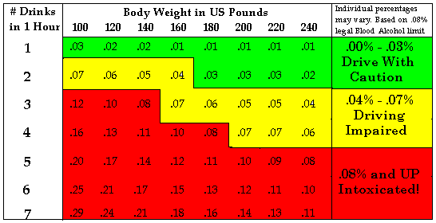
BAC Chart

Slide 13
In Mexico
El Artículo 100 del Reglamento de Tránsito del Distrito Federal, establece que "ninguna persona podrá conducir vehículos por la vía pública si tiene una cantidad de alcohol en la sangre superior a 0.8 gramos por litro, o de alcohol en aire expirado superior a 0.4 miligramos por litro.

Slide 14
How Sleepy Are You?
It is difficult for most people to accurately estimate their own fatigue level and alertness
  It may actually be worse than you think

Slide 15
Sleep Changes with Age
Amount of sleep and structure of sleep change as a person gets older
  Less deep sleep, and more disrupted sleep
  Daily percentage sleep loss is 3.5 times greater in long-haul pilots aged 50-60, compared than pilots aged 20-30

Slide 16
Quality versus Quantity
8 hours of disrupted sleep can be like getting very little sleep

Slide 17

The “Body Clock”
Programmed for two times of maximal sleepiness during a 24-hour period
  3-5 AM and 3-5 PM
Performance and alertness can also be decreased
  2 AM to 6 AM

Slide 18
According to NASA
"Sleep loss and sleepiness can decrease physical, psychomotor, and mental performance, and negative mood can increase and positive mood can decrease"
“It can lead to a reduced safety margin and increased potential for operational incidents and accidents."

Slide 19
Alertness Management Strategies
What crews can do to minimize the effects of fatigue

Slide 20
Go to FSF AeroSafety World

Slide 21
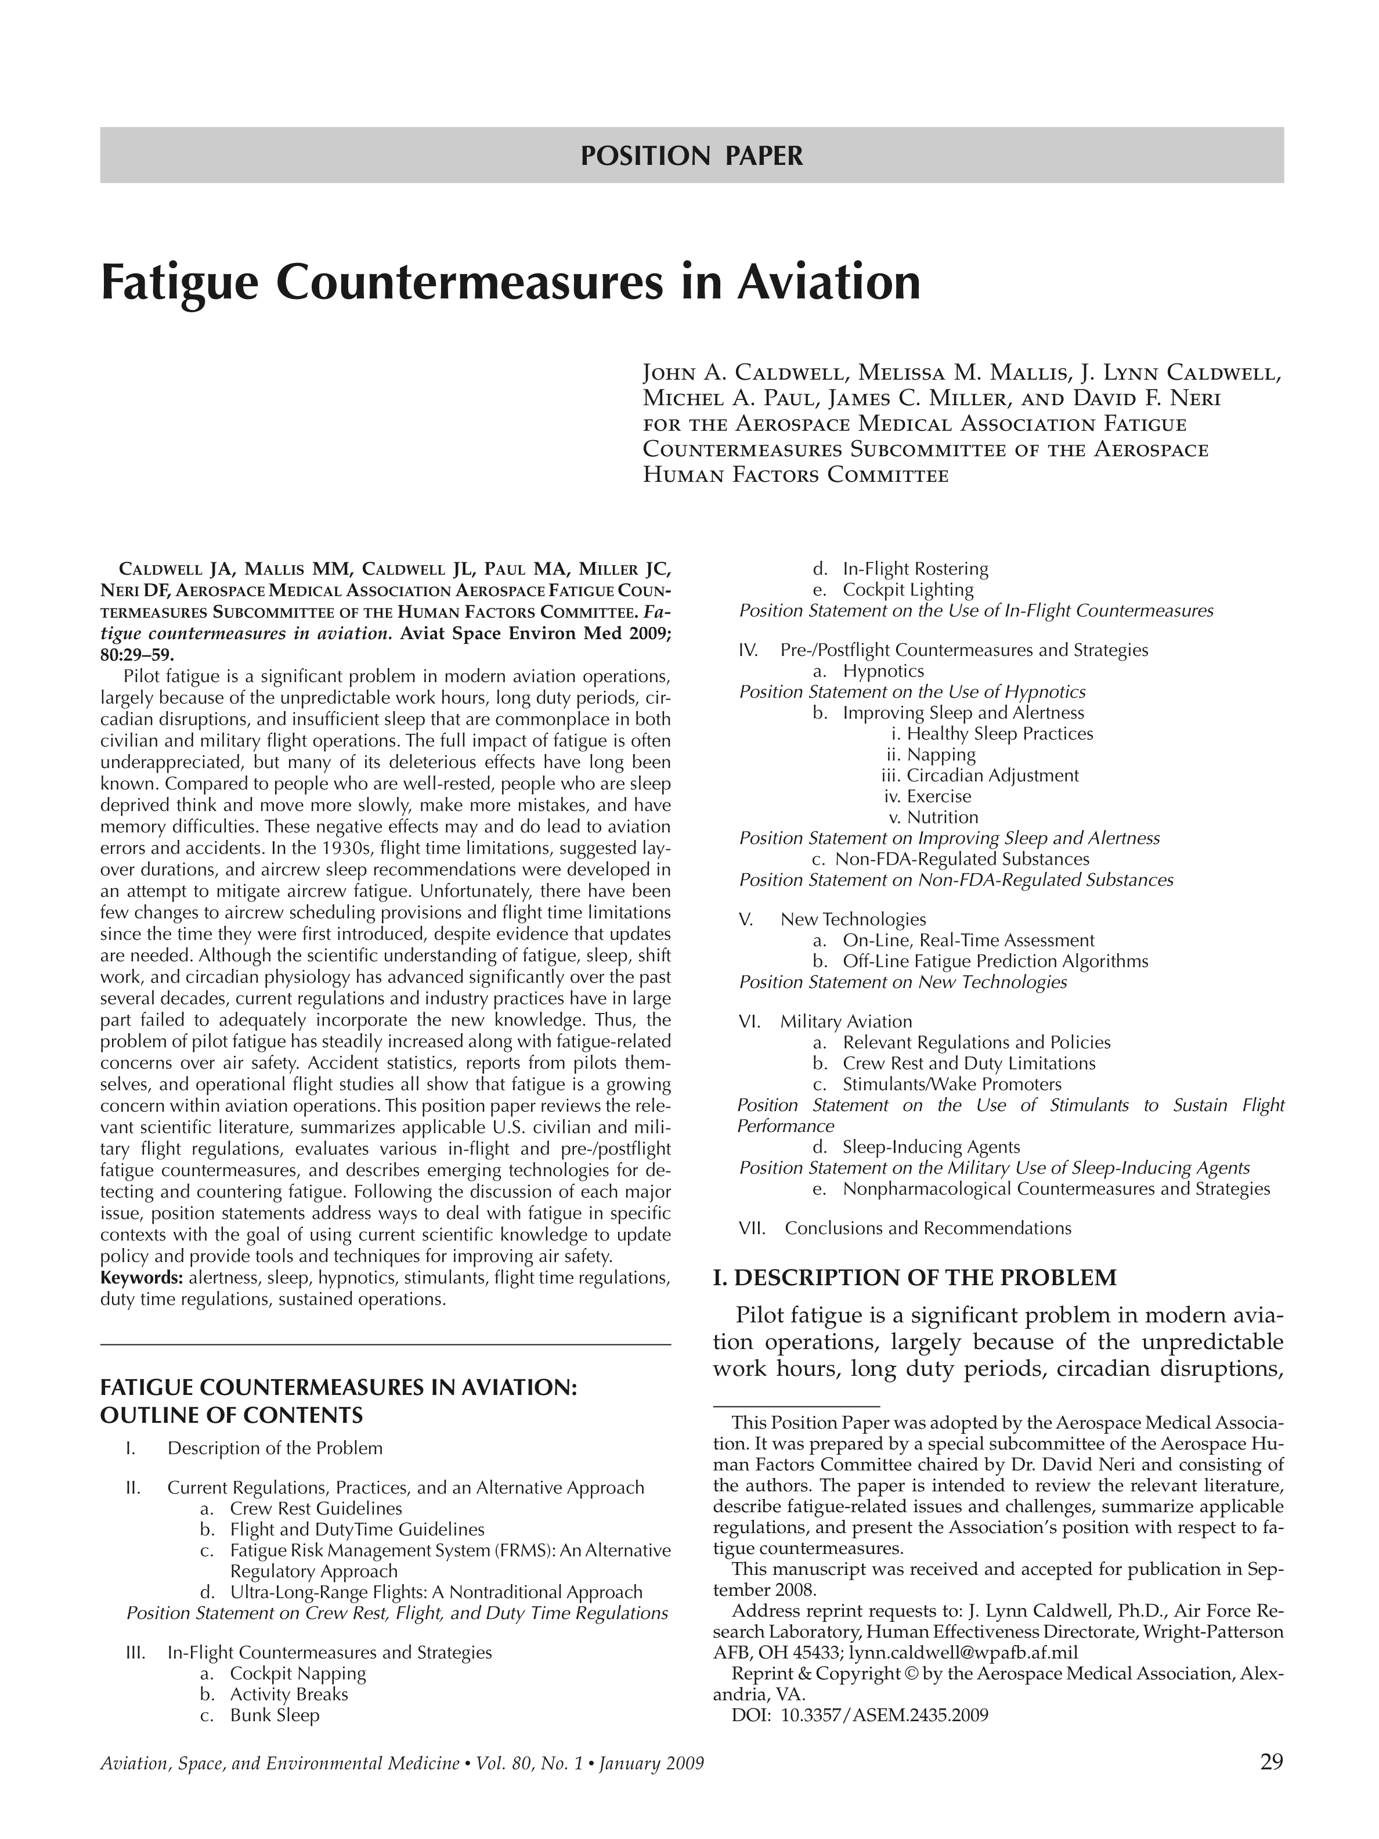

Slide 22
Alertness Management Strategies
Preventive strategies
  Used before duty and on layovers to reduce adverse effects of fatigue, sleep loss, and circadian disruption
Operational strategies
  Used in-flight to maintain alertness and performance

Slide 23
Preventive Strategies
Begin a trip as rested as possible
At home
  Maximize sleep 1-2 days before departing on trip
Layovers, too
Strategic napping can be very effective
  45 minutes or less, if just before duty

Slide 24
Preventive Strategies
Alcohol consumption can have “major disruptive effects” on sleep quality
Exercise regularly, but avoid just before bedtime
If you can’t fall asleep in 30 minutes, get up and engage in some relaxing activity
  Don’t just lay in bed and be frustrated

Slide 25
Operational Strategies
Strategic caffeine consumption
  Best not to constantly drink caffeine before, during and after duty
  Use it to best increase alertness
  Don’t use it when already alert (start of duty or after a nap)
  Avoid caffeine near bedtime
Sensible nutrition and stay hydrated

Slide 26

Know your Caffeine Content
8-Ounce Coffee Beverage
  Instant 25 – 102 milligrams
  Drip 115 – 250
  Brewed 80 – 135
  Expresso (4 ounce) 120 - 200
  Decaf 2 – 10
8-Ounce Tea Beverage
  Instant 15 – 30
  Brewed 25 - 83
  Iced Tea 10 – 50
  Decaf 1 - 5
Source: NBAA “Alert Traveler”

Slide 27

Know your Caffeine Content
12-Ounce Soft Drinks
  Cola 35 - 47 milligrams
  Orange Soda 40
  Mountain Dew 55
  Jolt 71
Food
  Frozen Desserts 8 - 85
  Chocolate 5 - 31
  Yogurt 1 - 45
Source: NBAA “Alert Traveler”

Slide 28
Stay Active In-flight
Engage in conversations with other crewmembers
Frequent stretching helps, too

Slide 29
NASA Recommends
Sleepiness can have severe consequences - take it seriously
People are different - tailor this information to your own needs
There is no one single answer - find out what works for you

Slide 30
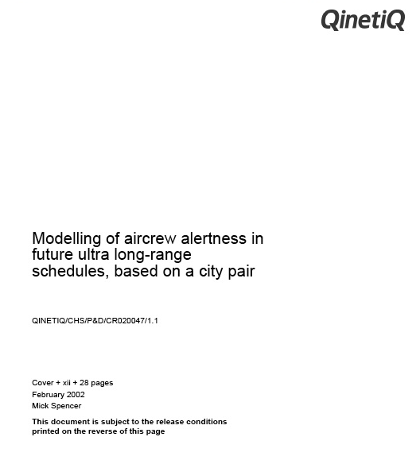
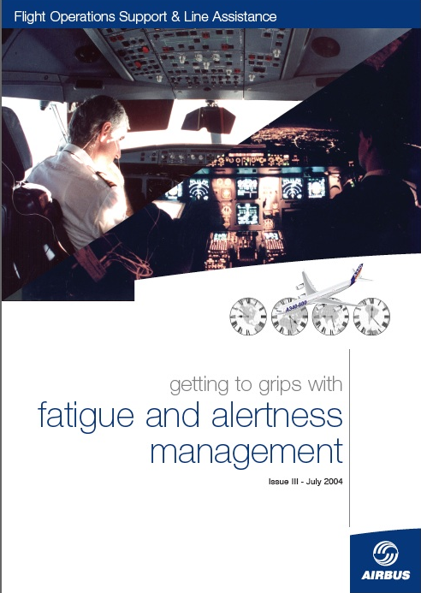
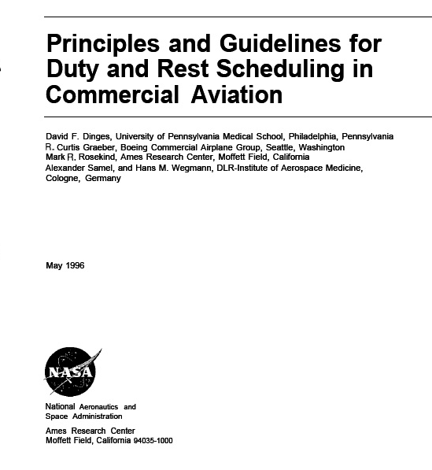
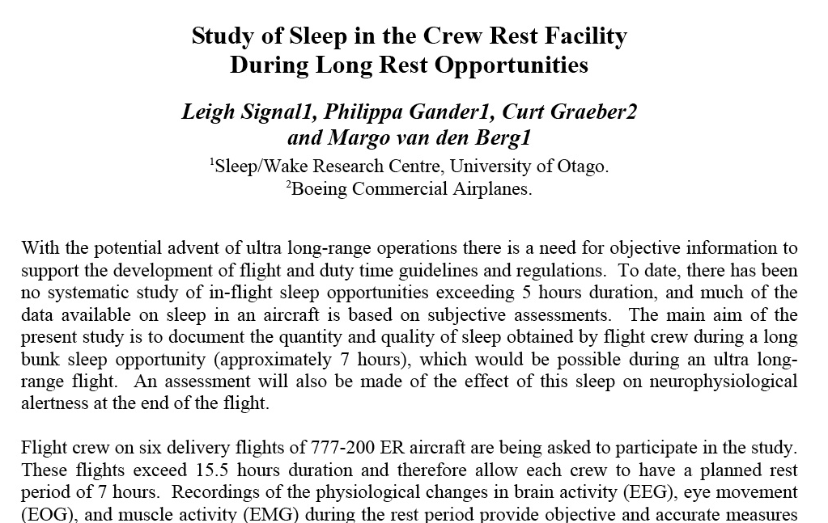
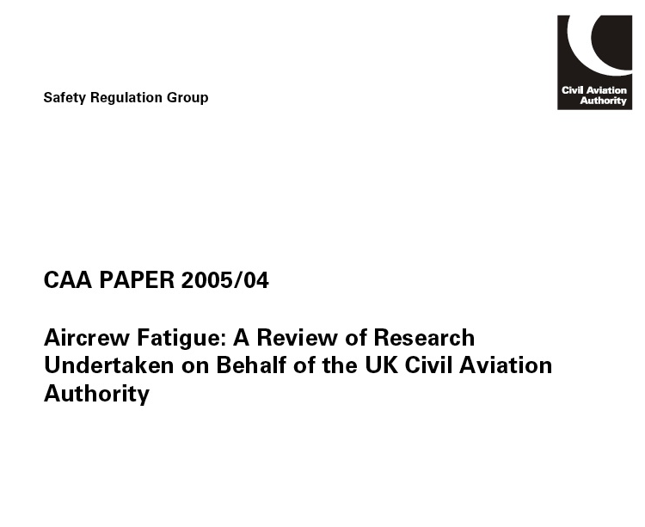
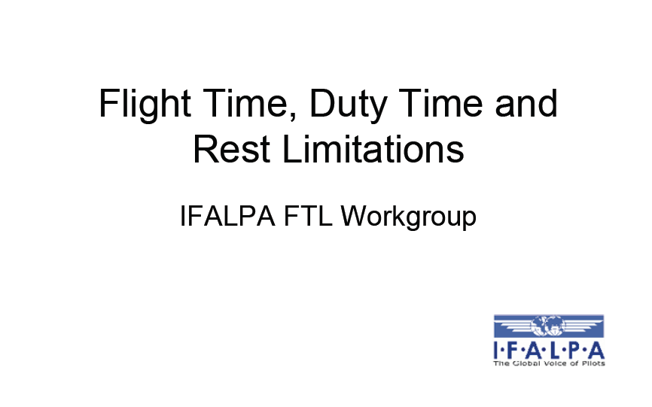
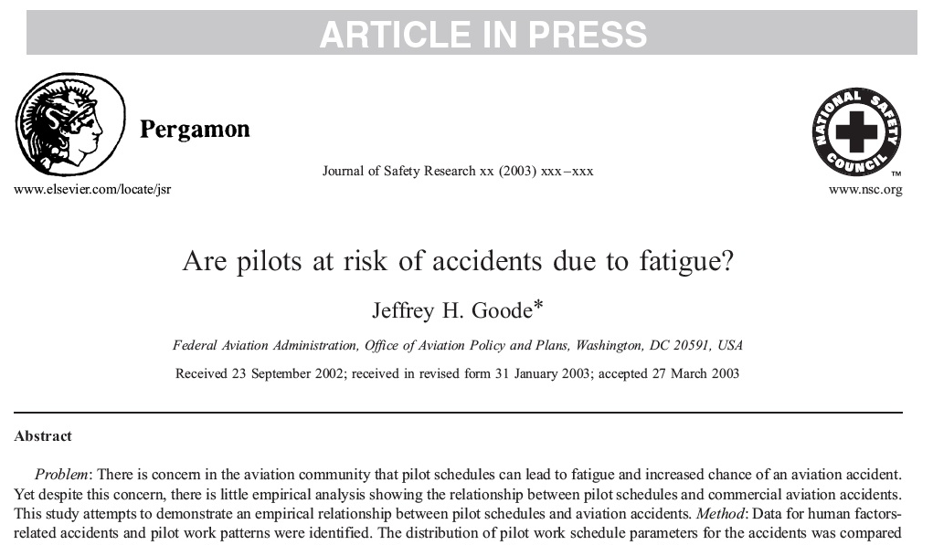
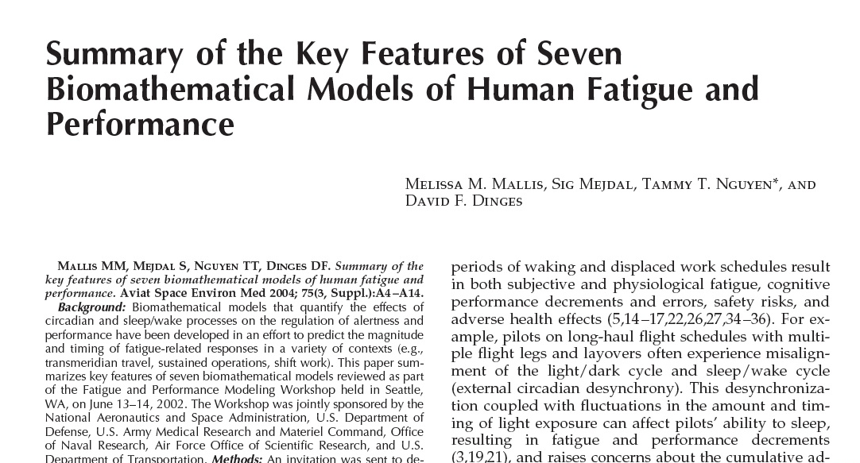

Slide 31



Slide 32
ICAO Annex 6 Operation of Aircraft
Fatigue. A physiological state of reduced mental or physical performance capability resulting from sleep loss or extended wakefulness and/or physical activity that can impair a crew member’s alertness and ability to safely operate an aircraft or perform safety related duties.
Fatiga. Estado fisiológico de capacidad reducida de desempeño mental o físico resultado de la perdida de sueño o vigilia de sueño extendida y/o actividad física que puede deteriorar la vigilancia y habilidad de operar una aeronave o desempeñar trabajos relacionados a la seguridad de un tripulante

Slide 33
ICAO Annex 6 Operation of Aircraft
9.6 Flight time, flight duty periods, duty periods and rest periods for fatigue management
  For the purpose of managing fatigue, the State of the Operator shall establish regulations specifying the limitations applicable to the flight time, flight duty periods, duty periods and rest periods for flight crew members. These regulations shall be based upon scientific principles and knowledge, where available, with the aim of ensuring that flight crew members are performing at an adequate level of alertness.

Slide 34
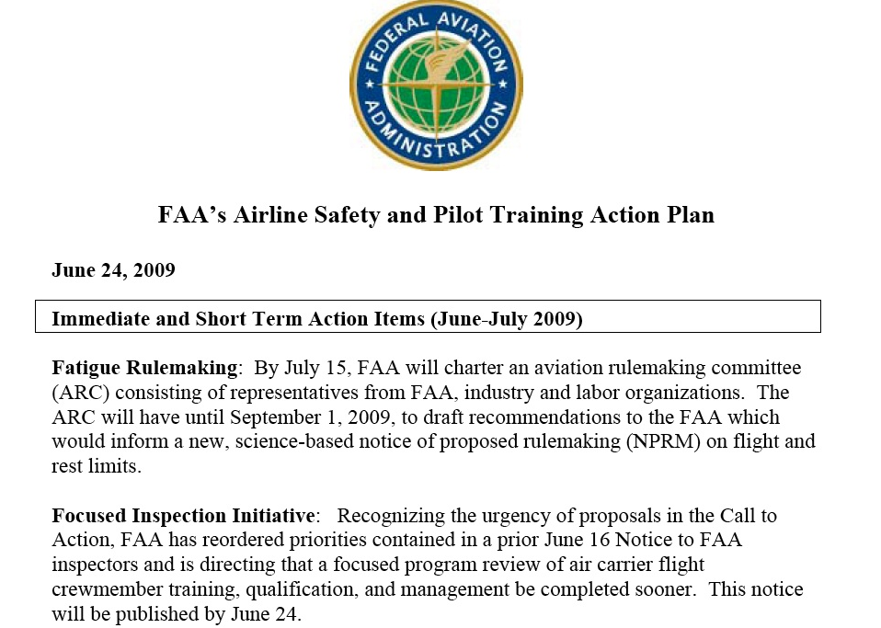

Slide 35








Aviation Rulemaking Committee

Slide 36
Beyond ARC – EASA- CAP 371…..
FRMS- should be implemented
ULR flights
  Must develop a process for a “Basic” and “ mature FRMS
  Should develop a Central FRMS office
Advisory Circulars
  FRMS
  Flight Crew Rest Facilities

Slide 37
Fatigue Risk Management-en Español
Fatigue Risk Management: Un método de administración empresarial de la fatiga que incluya proceso de medición , mitigación y gestión del riesgo de la fatiga
FRMS: Un sistema de gestión basado en evidencia para el control del riesgo de fatiga

Slide 38
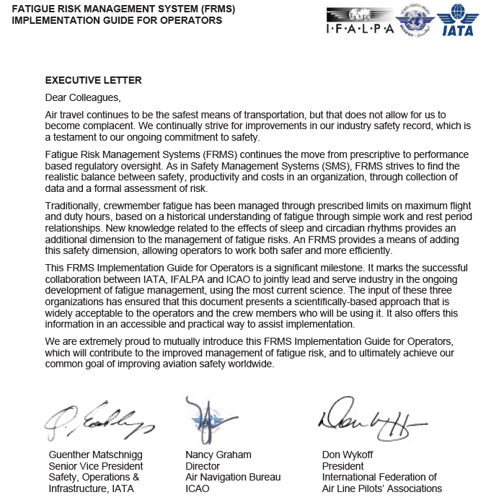
FRMS ¿Qué hay de nuevo?

Slide 39
FRMS – Who is responsible?
STATE – INDUSTRY – AIRLINE - INDIVIDUAL
The Objective is always AN ACCEPTABLE LEVEL OF SAFETY ….. still
  We should capitalize on everybody’s experience
  Work as a team
  Gather and SHARE data
  Norm on a Scientific base
  Use of Technology
Notes:
México/Latinoamérica ¿Dónde Estamos?
Fallido Proyecto NOM 121
Intención de nuevo proyecto NOM sobre Jornadas vuelo/servicio
Cumplimiento ICAO
El objetivo “Seguridad”
Capitalizar la experiencia
Recabar información
Normar sobre base científica
Uso de Tecnología existente

Slide 40

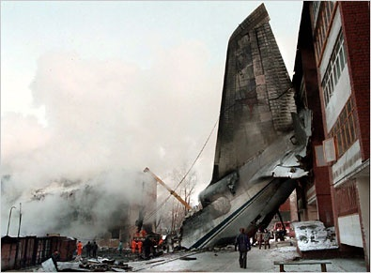
The New York Times
http://www.nytimes.com/
GLOBAL EDITION
- Since 1879
LACK OF FATIGUE REGULATION
KILLS 300 IN RUNWAY EXCURSION
Even after aviation authorities were gathered in a safety seminar, early this year in LIMA, PERU, nothing was done. There is no fatigue Regulation and no one is even worried about the increased work hours for pilots and crewmembers. Market is dictating new labor rules everyday and authorities around the world are too startled to react, or play the game of the capitals.
In efforts to cut costs, pilots are asked to be more productive, or they will be left jobless.
Manufacturers are suggesting bizarre solutions too, they are offering new harnesses for passengers to travel standing up, and went as far as proposing only one pilot in the cockpit during long-range flights.

Slide 41
¿Preguntas?
MUCHAS GRACIAS

