Slide 1
SAM Regional Seminar/Workshop
Tom Brady
ICAO Air Navigation Bureau
May 2011
2012 Flight Plan Implementation and Transition

Slide 2
Topics
Impact of the ICAO Flight Plan changes
Implementation and Transition Strategy
Regional Progress
Stakeholder position
Issues and Concerns
Next Steps

Slide 3
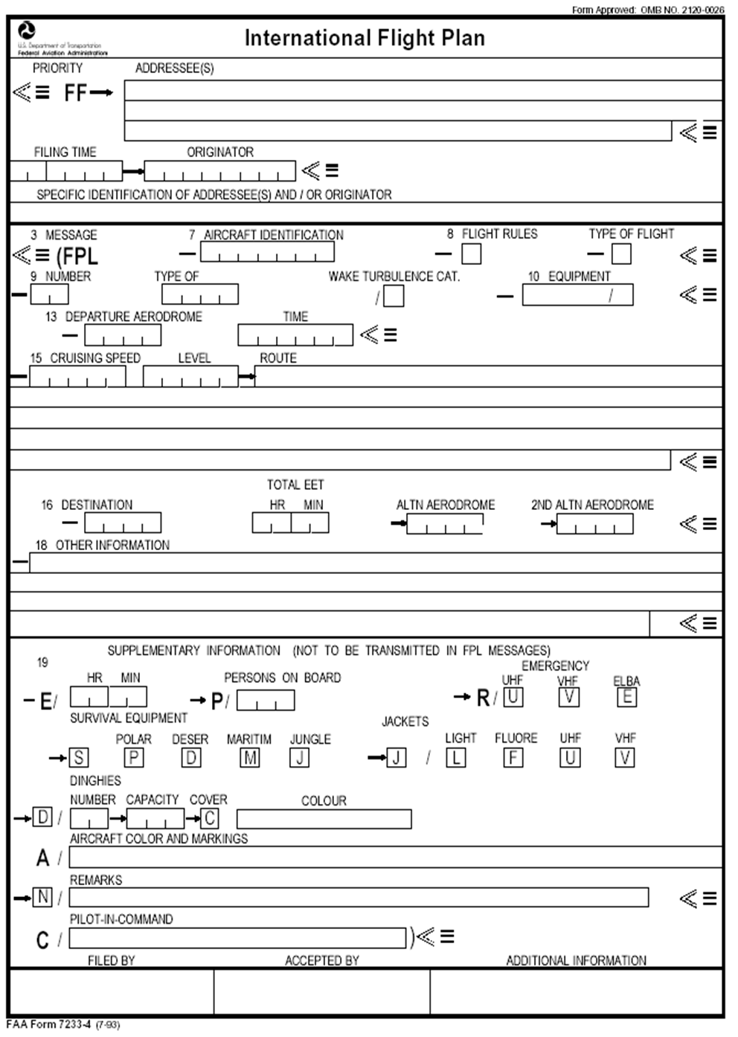
ICAO Flight Plan Form

Slide 4
Impact of the ICAO Flight Plan changes
Will require global software and possibly hardware changes.
There are implementation costs for States and Airlines.
There will be changes to procedures.
There will be a need for staff training.
Likely to be aviation disruption if the harmonized changes are not completed by the applicability date.
The implementation could be compared to that of the year 2000 changes.

Slide 5
Implementation and Transition Strategy
ICAO HQ is working with the ICAO Regional Offices (RO) to ensure a harmonized application of the changes.
ICAO Regional offices providing facilitation for Task Force meetings.
ICAO Regional offices providing Workshops and Seminars for their respective States.
ICAO HQ has provided guidance material to States.
A comprehensive Implementation and Transition Schedule has been made available.
ICAO secretariat is demonstrating its full commitment to the role-out and implementation of proposed changes

Slide 6
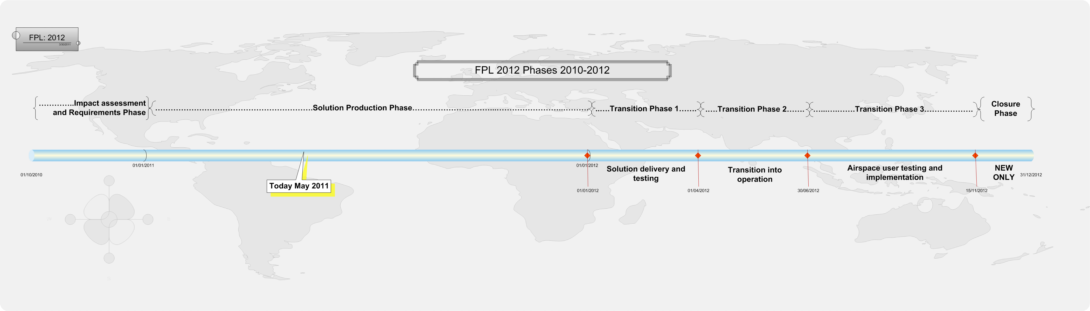

Slide 7
ICAO Regional Progress
All 7 ICAO regions have agreed with the proposed ICAO HQ timeline for Implementation and Transition.
EUR/NAT has a different implementation approach however will meet the ICAO deadlines.
We are asking all ANSPs to be ready to accept filing of both NEW and PRESENT flight plans from 1 July 2012.
Most States have reviewed the impact of the changes on their systems and procedures and some are already testing with NEW flight plan data to verify the changes.
There is a full schedule of regional meetings, workshops and seminars planned for 2011.

Slide 8
Stakeholder Position
ICAO HQ and the Regional Offices working closely with aviation representatives.
IATA being regularly briefed and a good exchange of information between ICAO and IATA.
IATA have issued a comprehensive information paper to their members and have significantly raised the profile of the FPL changes.
ASECNA, ACAC, EUROCONTROL, CANSO and many others are facilitating meetings and encouraging their States to report their implementation status.
Vendors, system providers and Airline operators are being encouraged to attend seminars and workshops.

Slide 9
FPL 2012 phases

Slide 10
Issues and Concerns
Some ICAO States are behind the implementation schedule.
Some States do not see the need for the change “what's in it for me” syndrome.
Many States are not providing their implementation progress for entry into the FITS database. http://www2.icao.int/en/FITS/Pages/home.aspx
Maintaining a harmonized implementation of the FPL change. Editorial clarification of Amendment 1 to be issued.
IATA advising their members to go for a switchover to the NEW FPL around 15 November 2012, the days before this need to be well planned.

Slide 11
Next Steps
Continue the awareness campaign throughout the aviation industry especially among airspace operators.
ANSPs and Aviation users must plan for the change considering especially safety, budgets, training, documentation and testing.
ANSPs in the region need to work together to support each other and share their best practice.
ANSPs should keep in constant contact with their regional ICAO offices to report progress and issues
We need to focus energies to support those States and aviation operators who are behind the implementation schedule.

Slide 12


