Slide 1
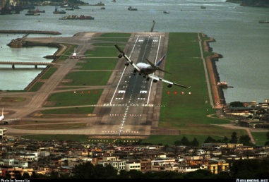
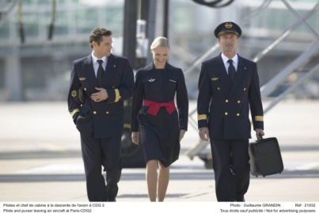
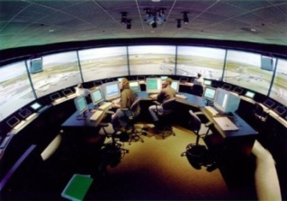
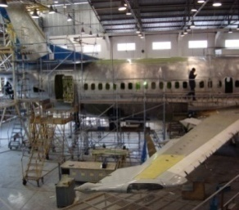
Curso sobre el Programa de intercambio de datos de inspecciones de seguridad en rampa (IDISR)
Módulo 5 – Descripción de los ítems que son evaluados en las inspecciones en rampa
(Parte III)
01 al 05 de agosto 2011
Oficina Regional Sudamericana de la OACI

Slide 2
C – Aircraft External Condition
C1. General condition
Instructions:
Check general condition of the airframe: apparent corrosion; cleanliness; presence of ice, snow, frost, legibility of markings, etc.
References:
For markings: Annex 7, 3, 4 and 5.
Seriousness:
Minor: Minor defects
Significant: The defects need not necessarily be corrected before flight (visible corrosion, marking not legible, etc.)
Major: Safety related defect (correction required before departure) / Inadequate de-icing

Slide 3
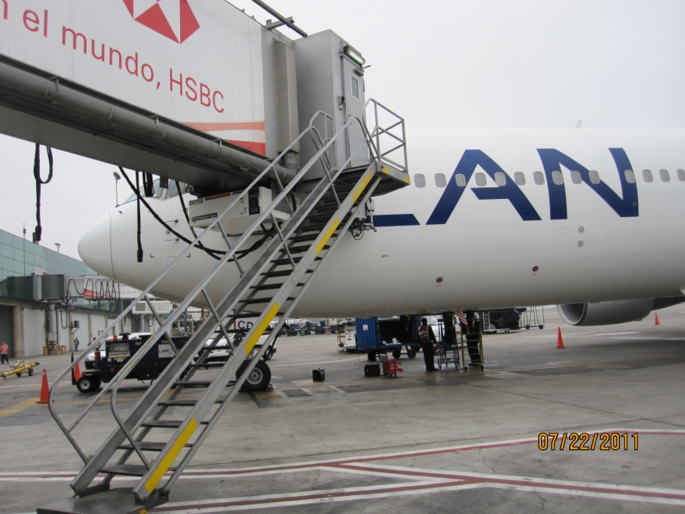
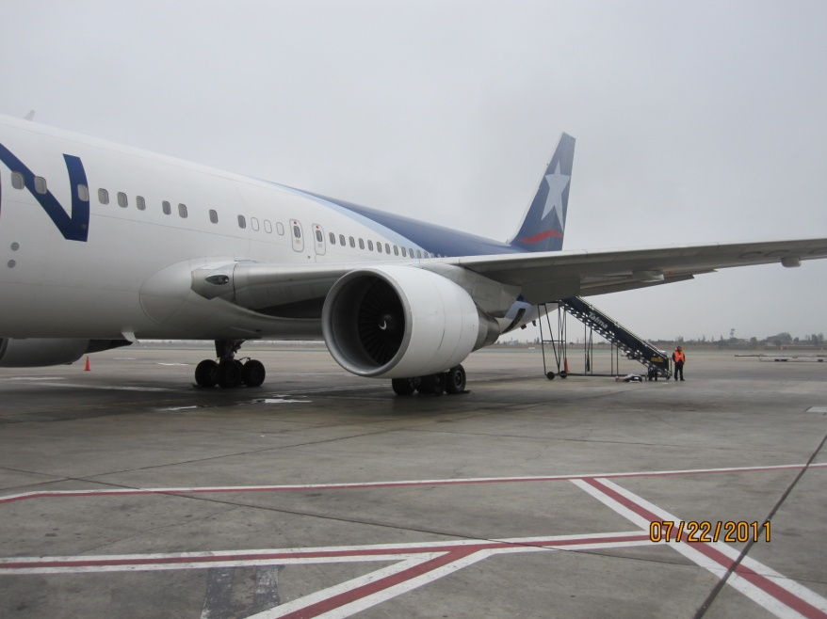
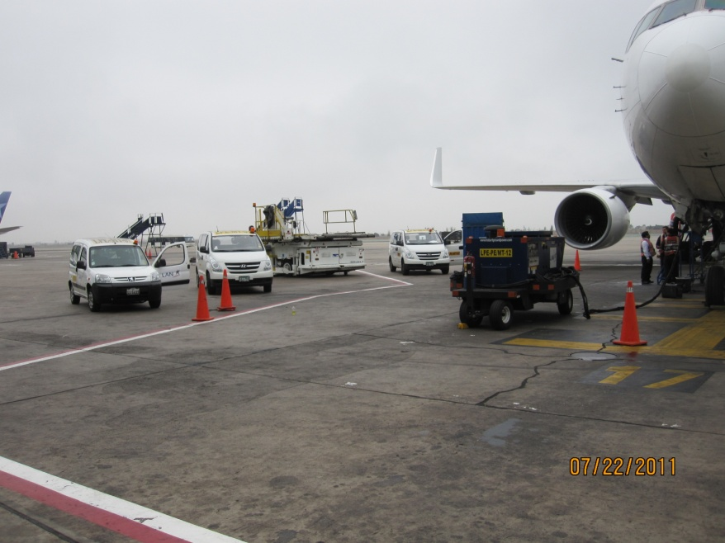
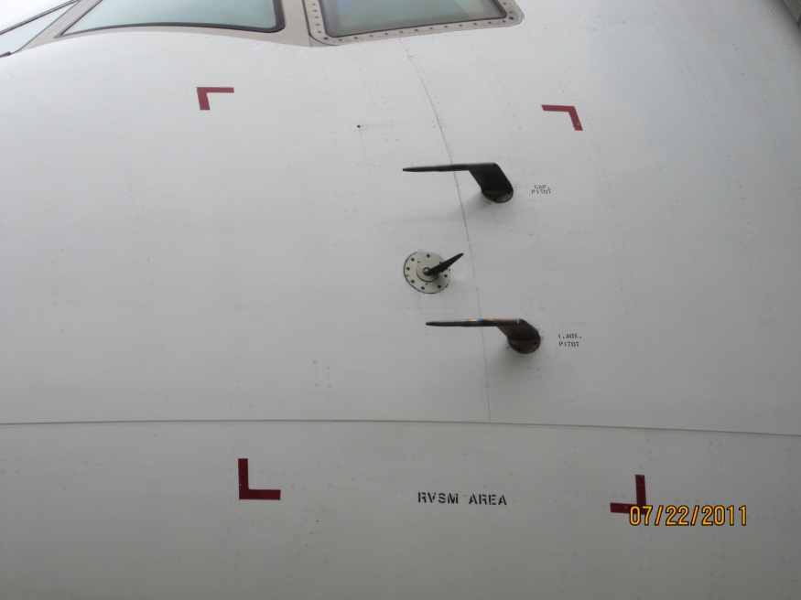

Slide 4
C – Aircraft External Condition
C2. Doors and hatches
Instructions:
Check for passenger and cargo door condition, external markings, seals operating instructions and condition of hatches.
References:
Nil
Seriousness:
Minor: Minor defects but serviceable
Significant: Door operation instructions missing or unclear / Seal slightly damaged
Major: Unserviceable and not compatible with passenger number / Seal missing or badly damaged

Slide 5
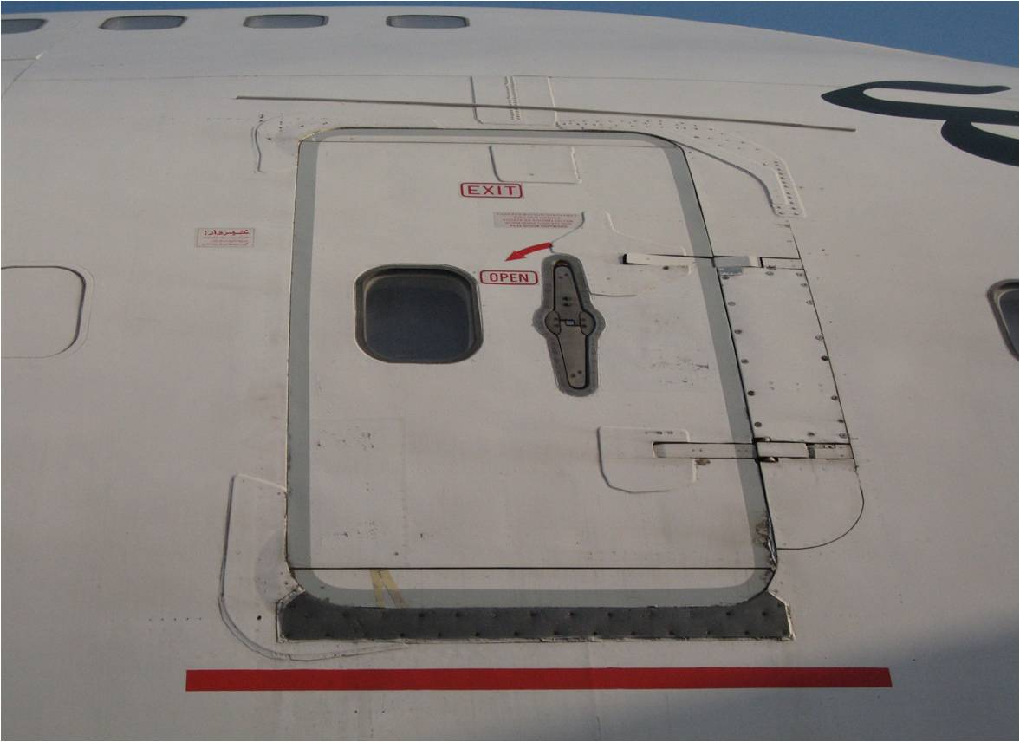
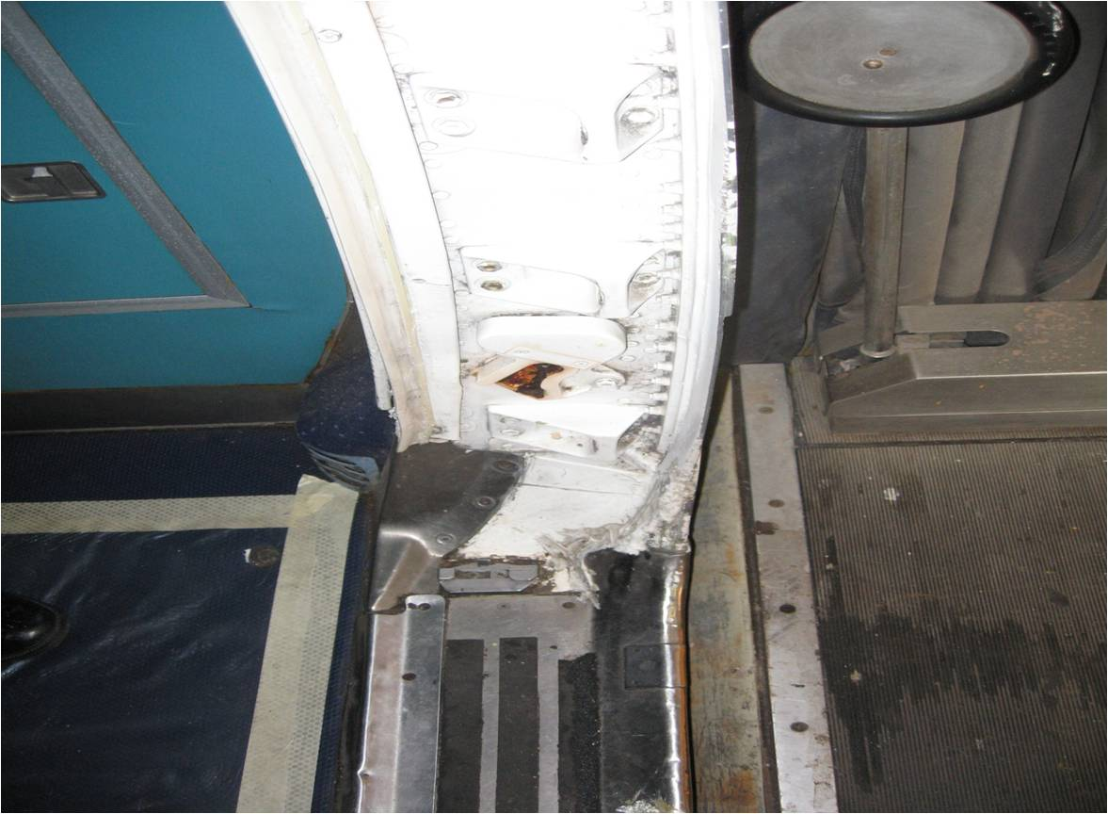
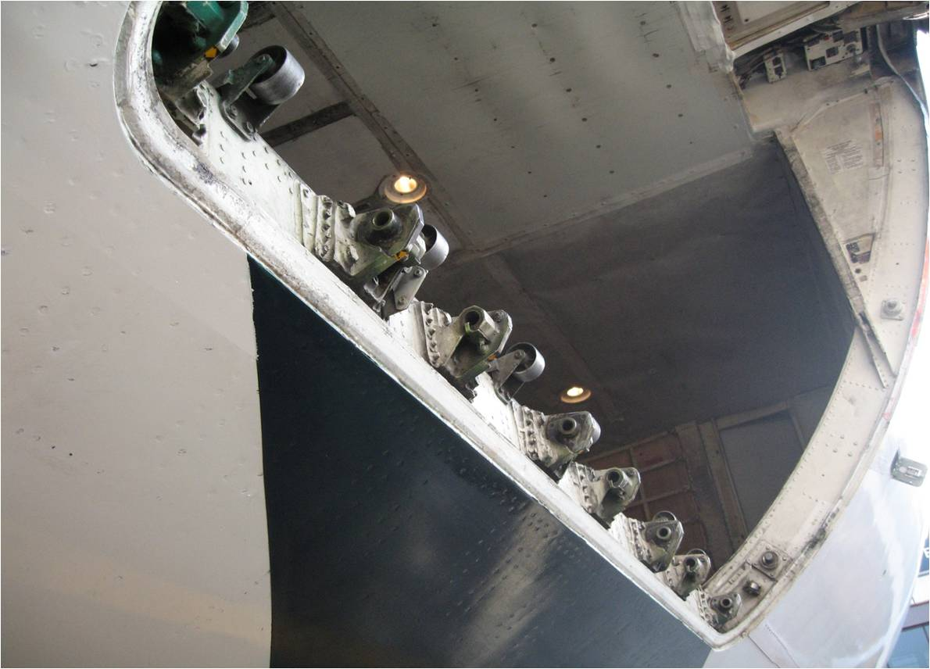
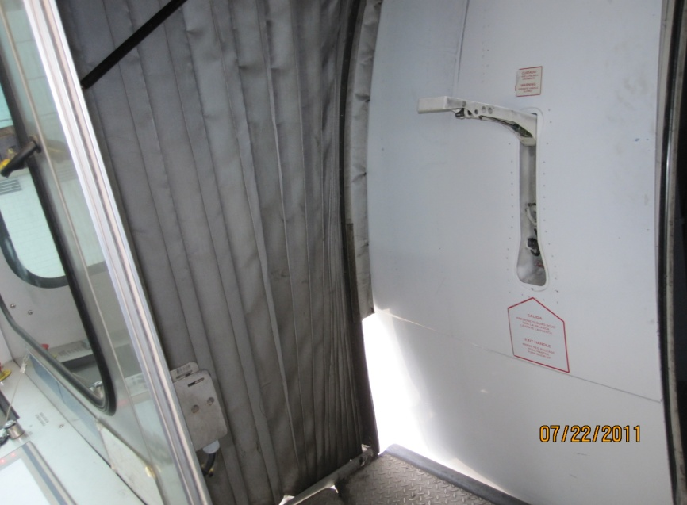

Slide 6
C – Aircraft External Condition
C3. Wings and Tail
Instructions:
Check wings, vertical and horizontal stabilizers, including all flight control surfaces. Check for obvious damage, corrosion, disbonding, evidence of lightning strikes, dents, looseness of fittings, missing static discharges, etc.
References:
Nil
Seriousness:
Minor: Minor defects
Significant: Poor condition (damage, missing bonding strips or static discharges, play, lack of lubrication, disbanding)
Major: Damage, corrosion, leaks or wear outside limits of MEL, SRM,etc.

Slide 7
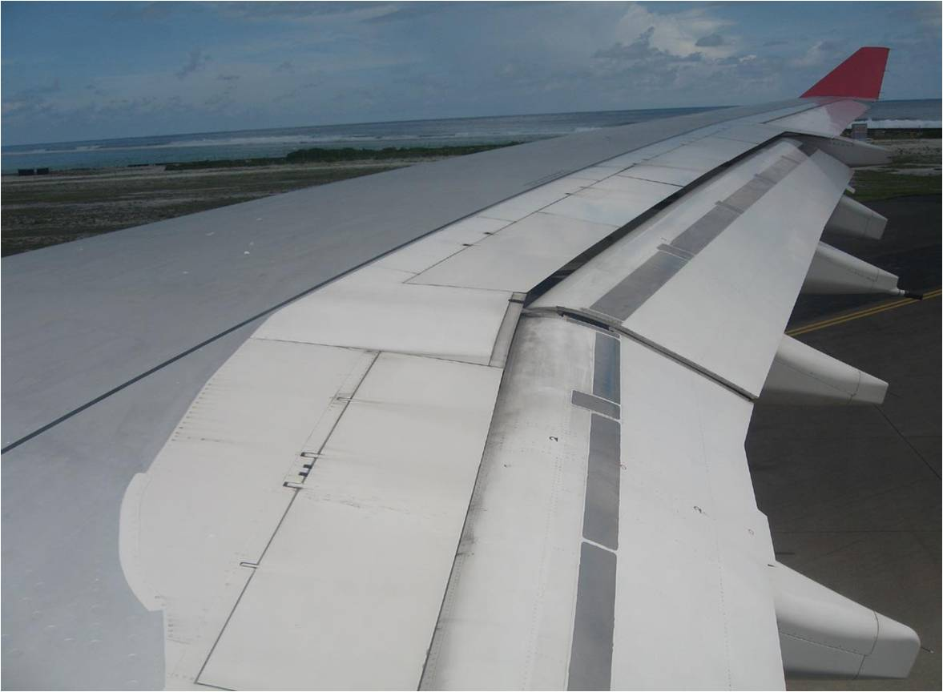

Slide 8
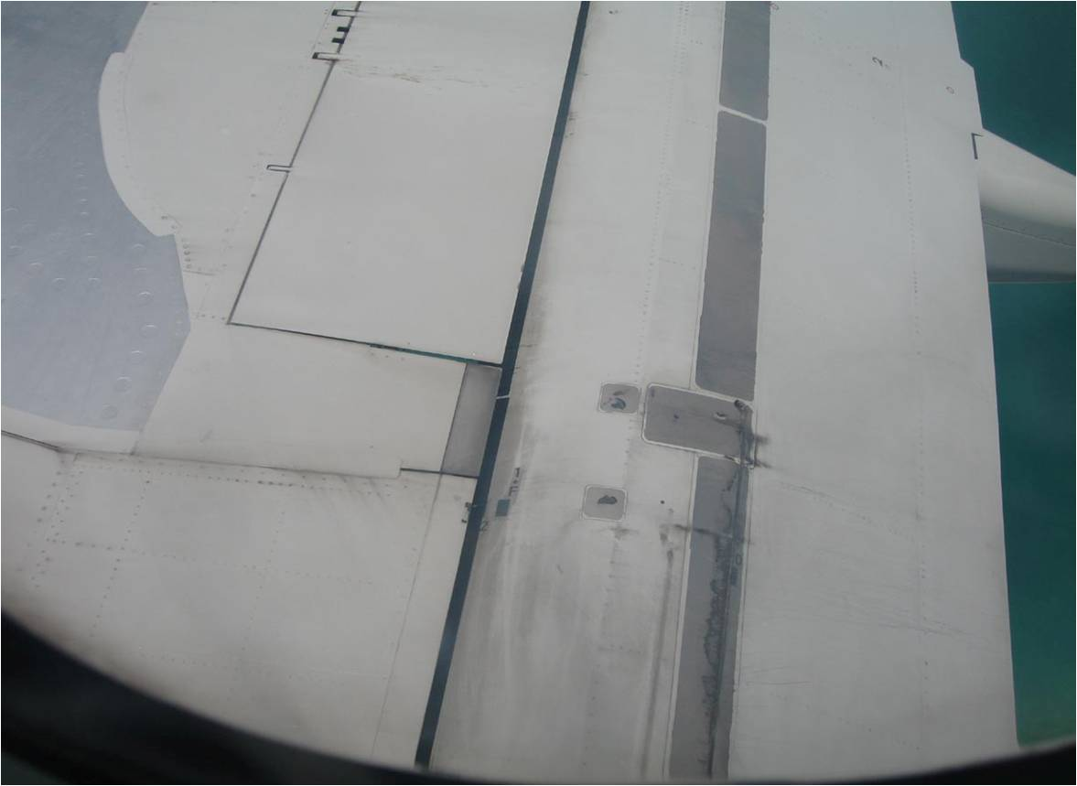

Slide 9
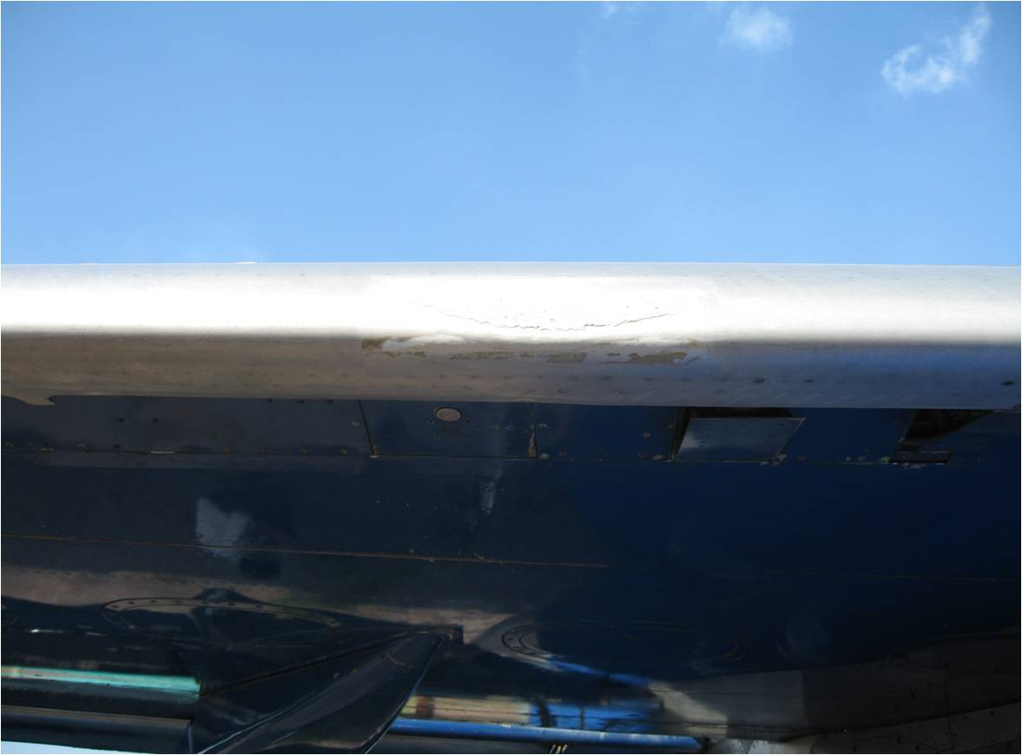

Slide 10
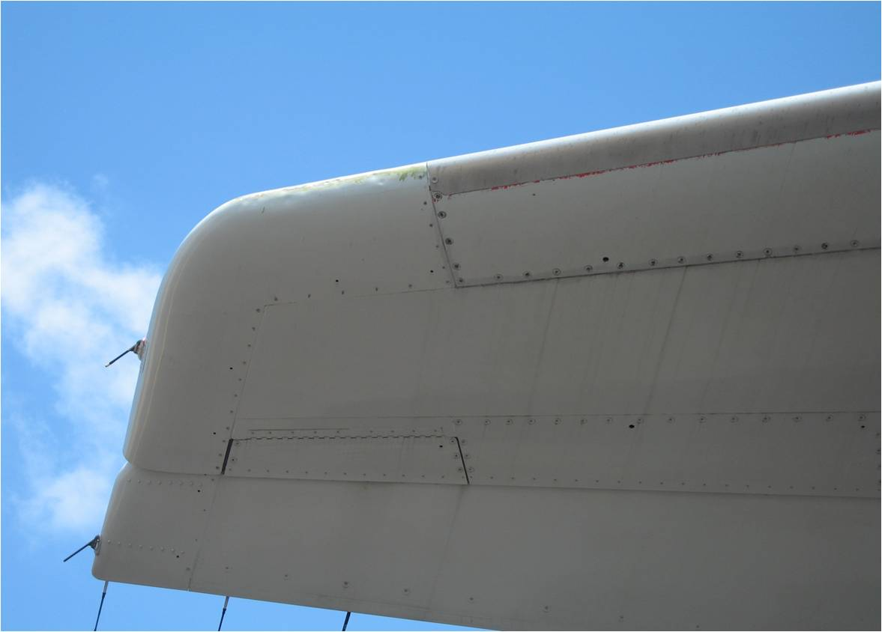

Slide 11
C – Aircraft External Condition
C4. Wheels, brakes and tires
Instructions:
Inspect for damage, wear and signs of tire under inflation
References:
Nil
Seriousness:
Minor: Minor defects
Significant: Signs of under inflation / Incorrect tire pressure / Unusual wear and tear
Major: Tires worn out or damaged beyond limits / Brakes worn out, leaking or damaged beyond limits / Damaged components or missing parts (i.e., tie bolts, heat sensors…)

Slide 12
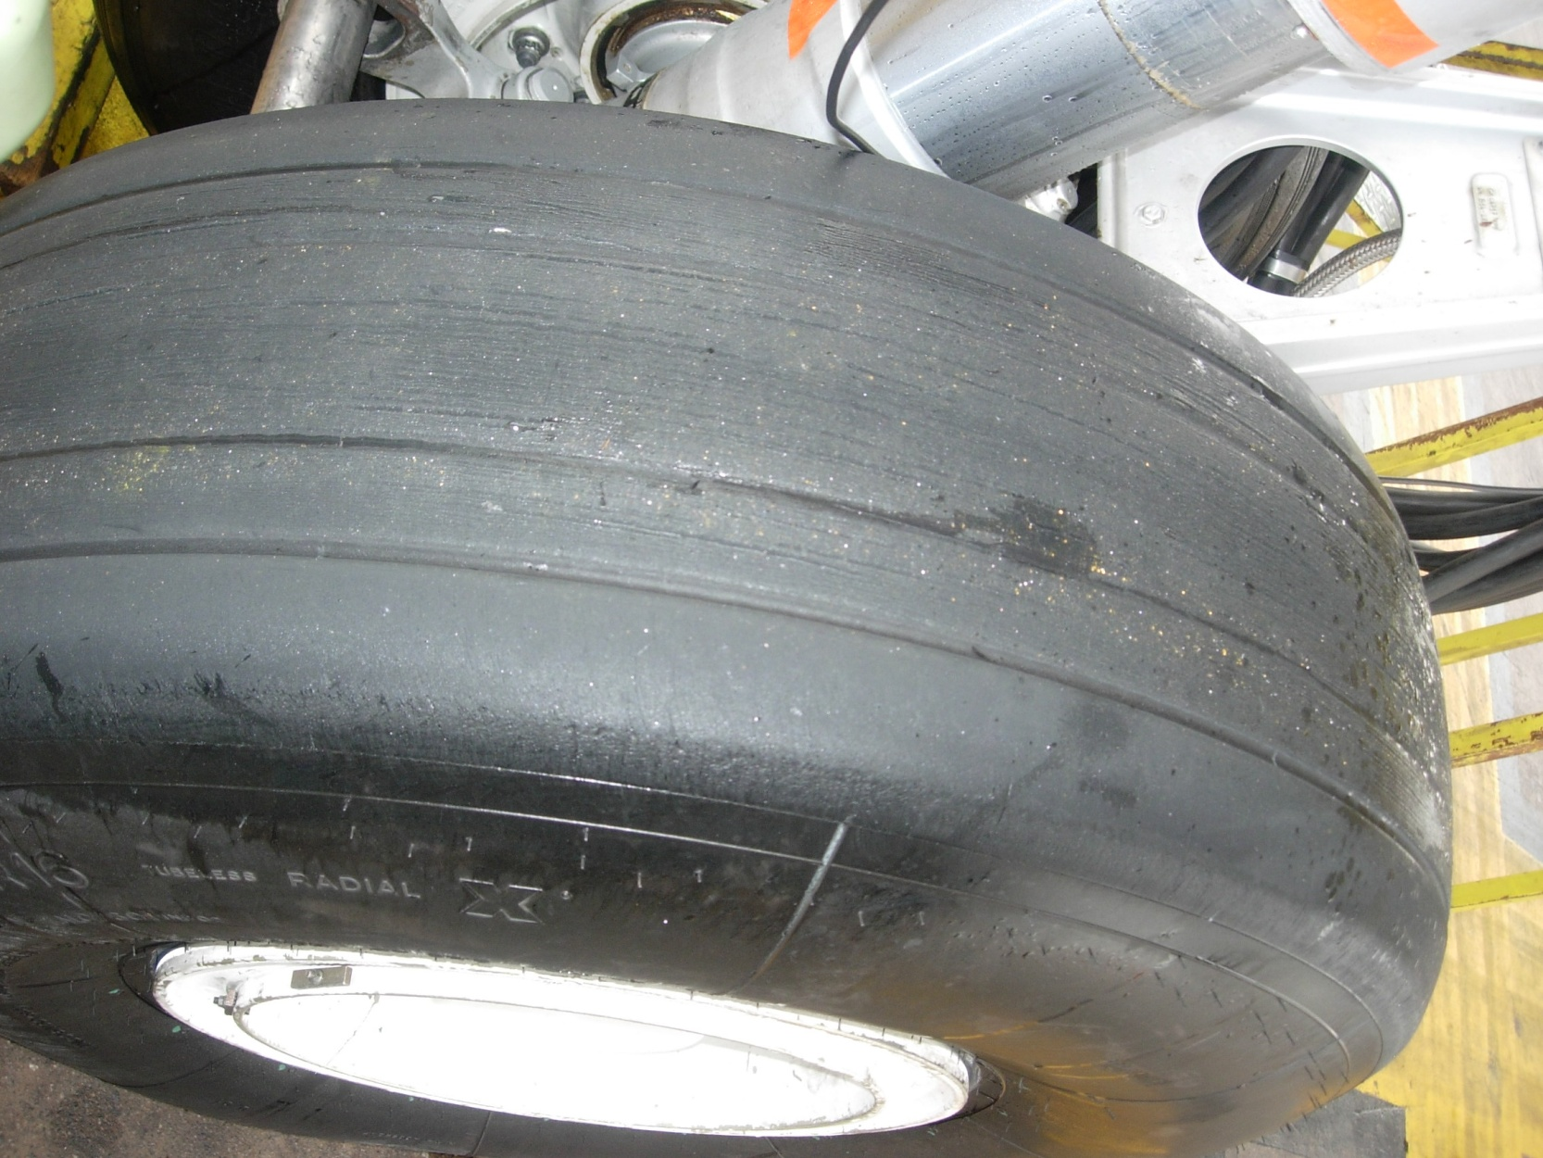

Slide 13
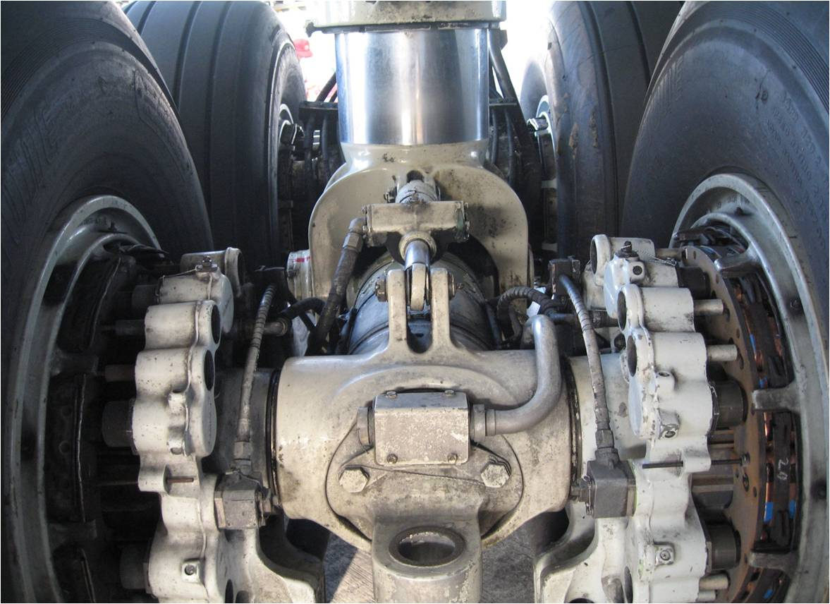
13

Slide 14
C – Aircraft External Condition
C5. Undercarriage
Instructions:
Visual inspection. Focus on lubrication, leakage and corrosion and wear on door fittings and hinges.
References:
Nil
Seriousness:
Minor: Minor defects
Significant: Significant signs of leakage, strut under-pressure, corrosion and obvious lack of lubrication
Major: Damage, corrosion, missing parts and/or leakage outside limits

Slide 15
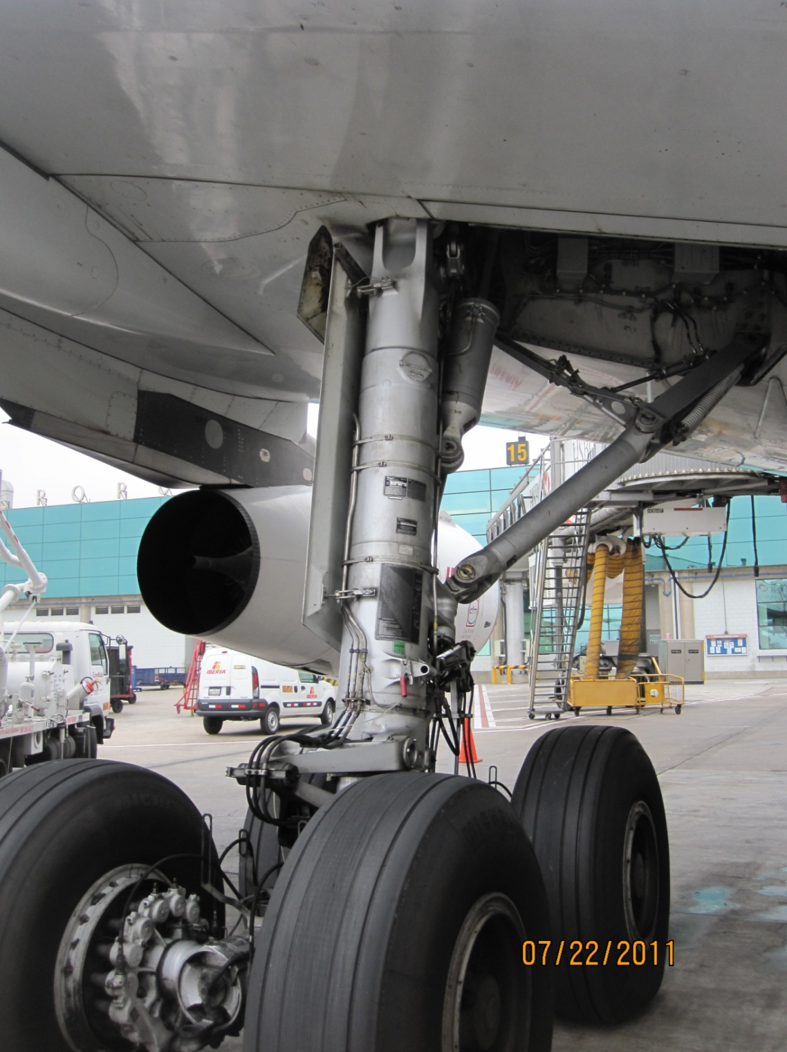

Slide 16
C – Aircraft External Condition
C6. Wheel well
Instructions:
Visual inspection. Focus on cleanliness, leakage and corrosion.
References:
Nil
Seriousness:
Minor: Minor defects or dirty
Significant: Signs of leakage, corrosion and obvious lack of lubrication
Major: Damage, wide spread corrosion, leakage outside limits

Slide 17
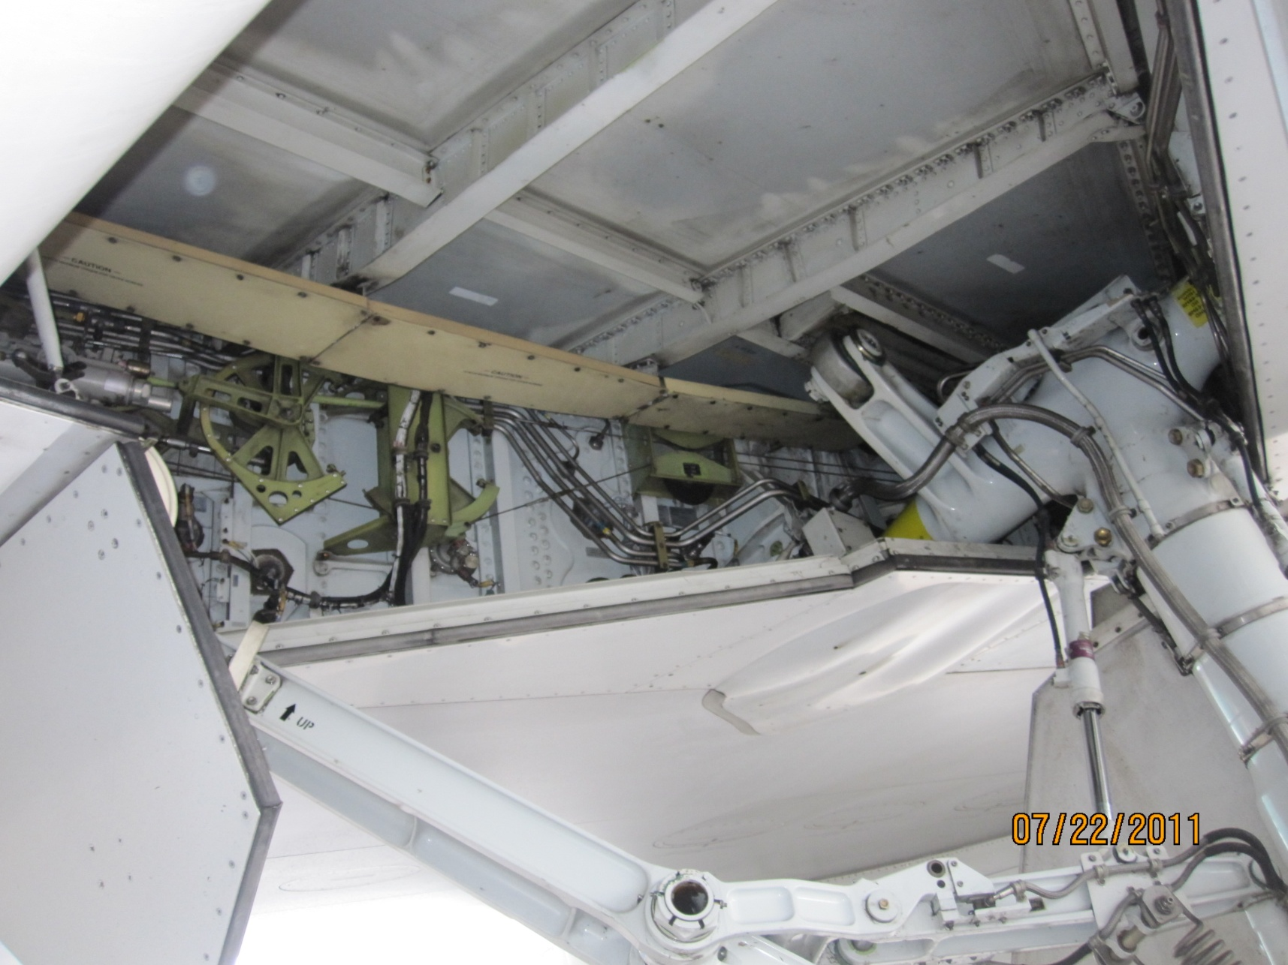

Slide 18
C – Aircraft External Condition
C7. Intake and exhaust nozzle
Instructions:
Visual inspection. Focus on damage, cracking, dents and loose/missing fasteners (intake) and LPT blades (where visible), obvious damage to sensors, jet pipe nozzle, exhaust, thrust reversers, etc.
References:
Nil
Seriousness:
Minor: Minor defects
Significant: Damage to casing or lining / Dents and cracks in exhaust area all within limits, but not recorded in Technical Log or equivalent / Minor leak of oil and fuel
Major: Damage, wide spread corrosion, leakage outside limits

Slide 19
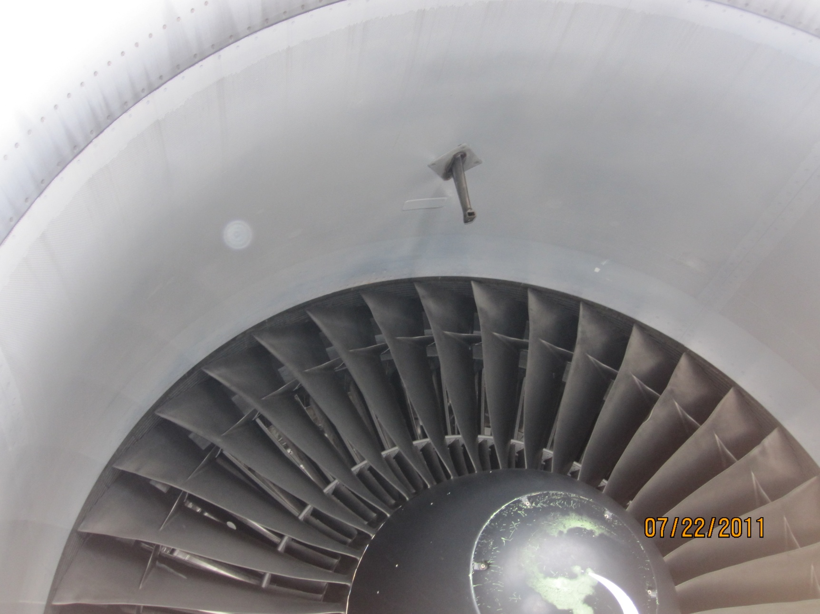

Slide 20
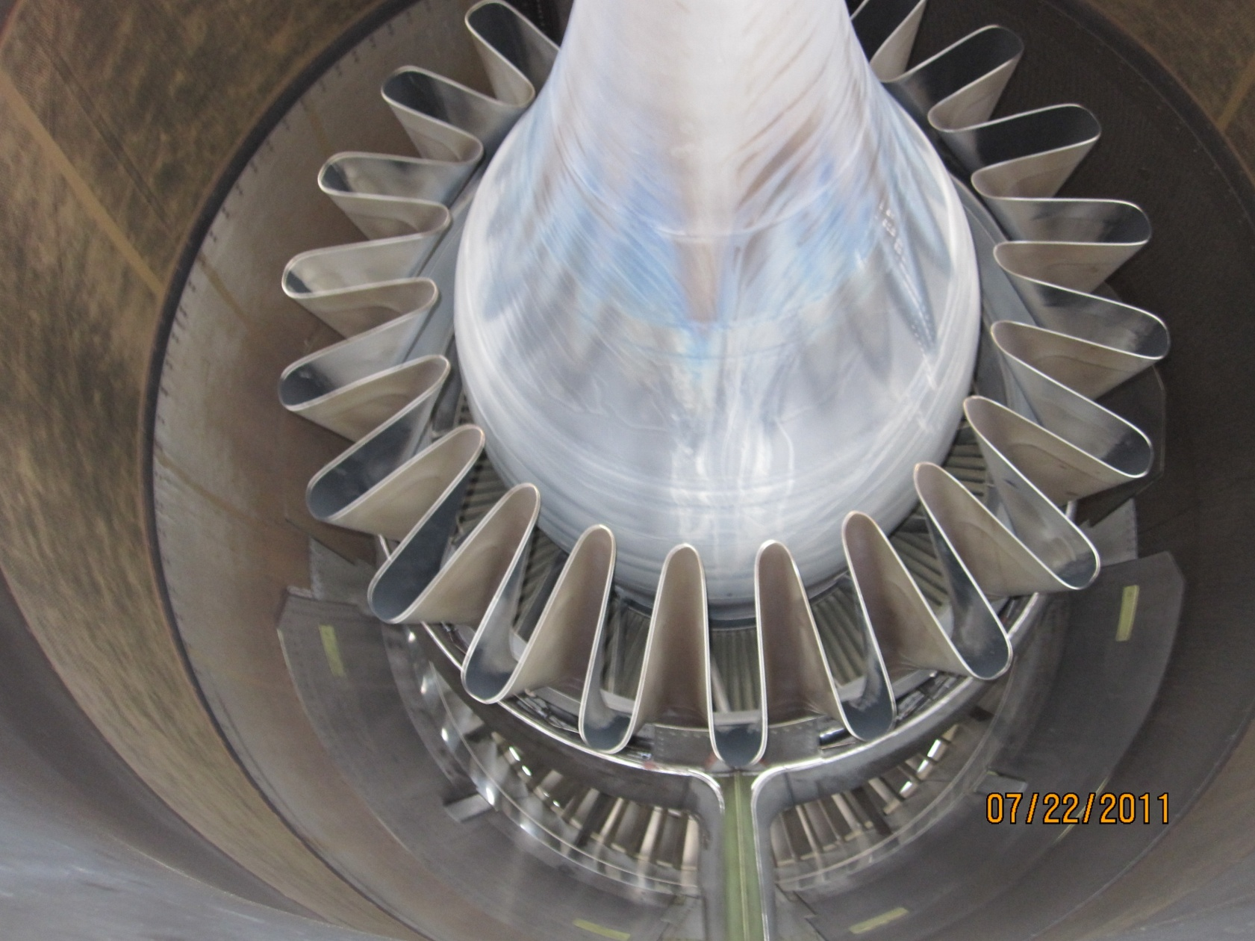

Slide 21
C – Aircraft External Condition
C8. Fan blades (if applicable)
Instructions:
Visual inspection. Check for foreign object damage, cracks, cuts, corrosion, erosion etc.
References:
Nil
Seriousness:
Minor: Minor defects
Significant: Damage to fan blades within limits but not recorded in Technical Log or equivalent
Major: Damage (nicks, dents, cracks, etc) outside the MEL, AMM, SRM, etc limits

Slide 22
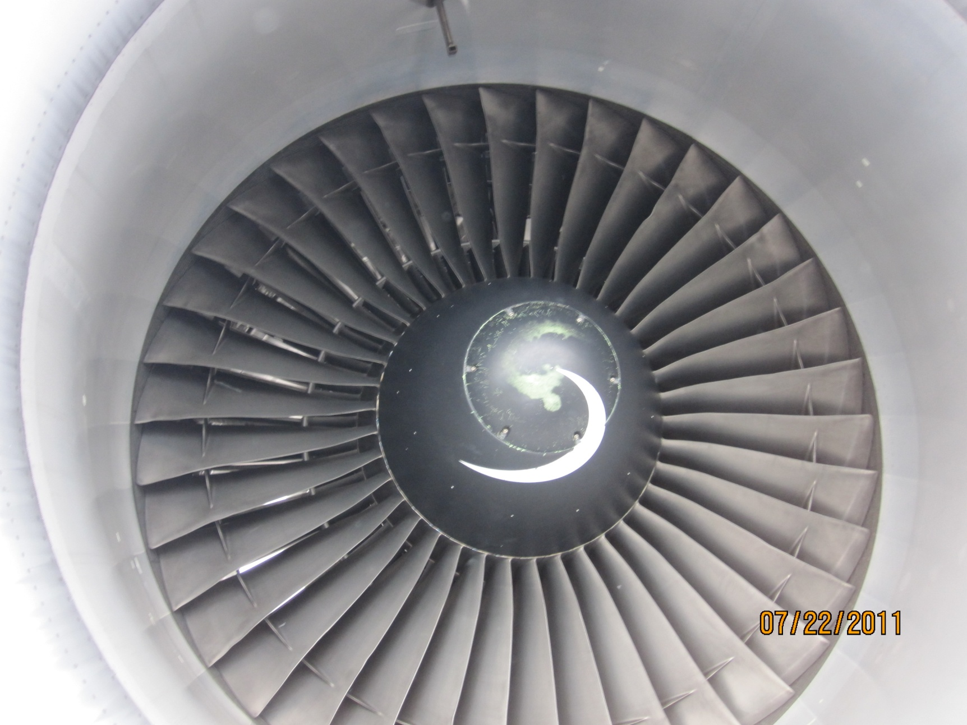

Slide 23
C – Aircraft External Condition
C9. Propellers (if applicable)
Instructions:
Visual inspection. Check for corrosion, looseness of blades in hub, erosion, stone damage, anti/de-icing system, etc.
References:
Nil
Seriousness:
Minor: Minor defects
Significant: Damage to propellers within limits but not recorded in Technical Log or equivalent
Major: Damage (nicks, cracks, etc), leakage, looseness of blades outside the MEL, AMM, SRM,etc limits

Slide 24
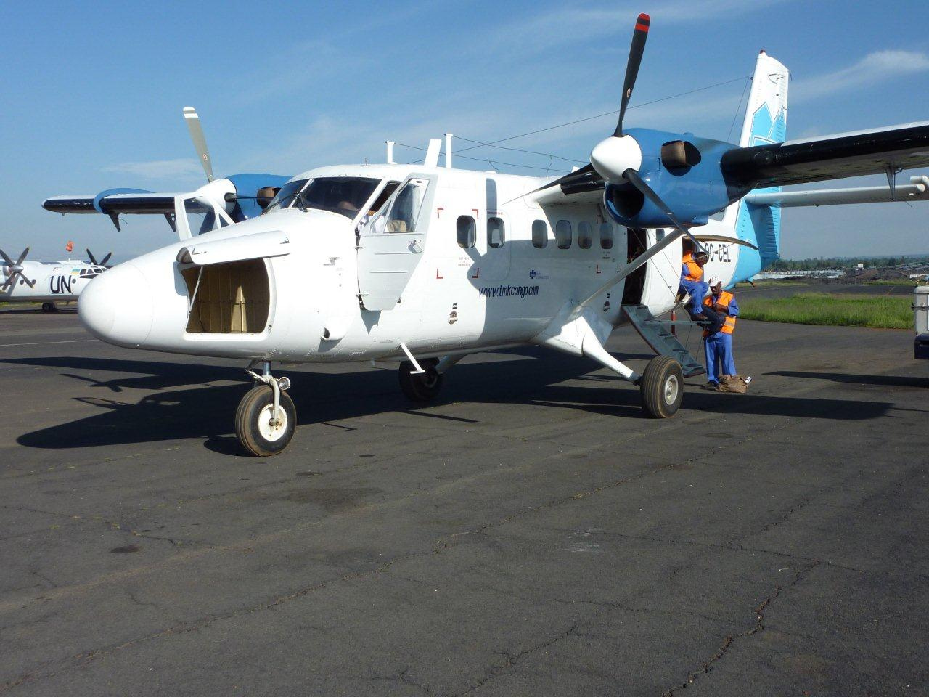

Slide 25
C – Aircraft External Condition
C10. Previous structural repairs
Instructions:
Visual inspection. Note any previous repairs – check condition and verify compliance to standard practices.
Reference:
Nil
Seriousness:
Minor: Minor defects
Significant: No information about temporary repairs, doubts about old repairs, and repairs acceptable for continuation of flight
Major: Improperly performed repairs or apparent unsatisfactory design / Damage to old repair

Slide 26
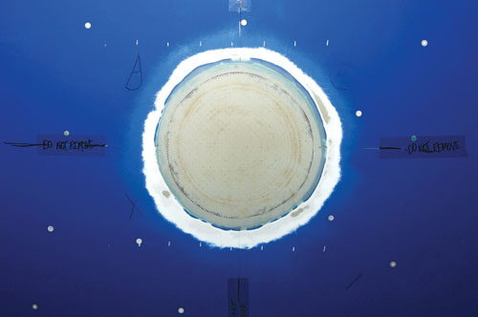

Slide 27
C – Aircraft External Condition
C11. Obvious un-repaired damage
Instructions:
Visual inspection. Note unassessed and unrecorded damage including corrosion, lightning strike damage, and bird strikes etc.
References:
Annex 8, Part II, 3.6
Seriousness:
Minor: Within limits
Significant: Within limits but not recorded
Major: Unassessed and not recorded damage affecting airworthiness

Slide 28
C – Aircraft External Condition
C12. Leakage
Instructions:
Visual inspection. Fuel, oil, hydraulic leaks. Inspect for toilet leaks at service locations.
References:
Nil
Seriousness:
Minor: Within limits
Significant: Long standing water and lavatory leaks (blue ice)
Major: Leakage (oil, fuel, hydraulic, water) outside limits

Slide 29
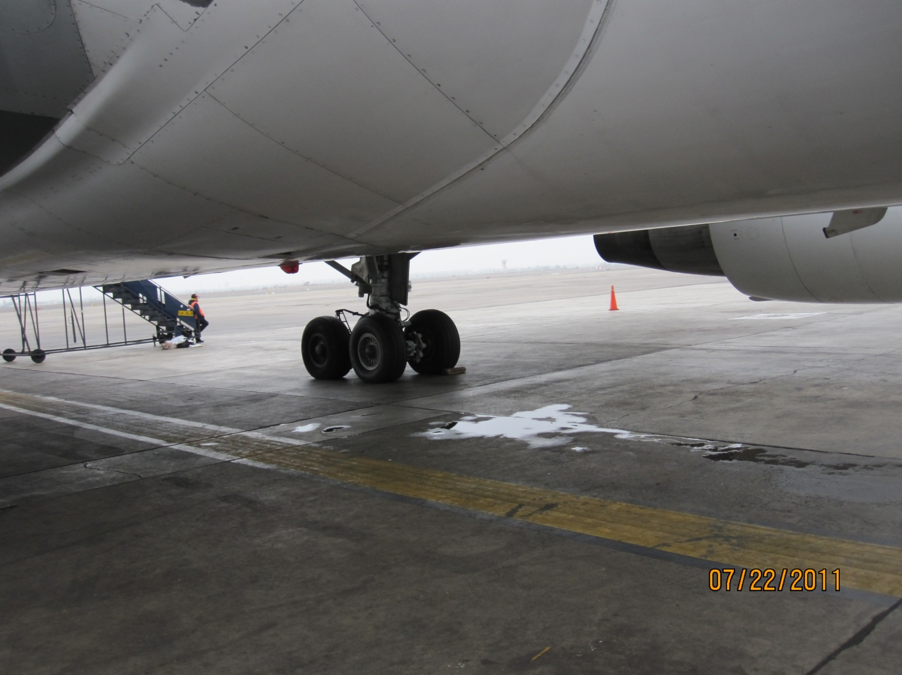

Slide 30
D - Cargo
D1. General condition of cargo and Containers
Instructions: Check for cleanliness and general condition of cargo compartment and containers. Check damage to compartment liners and condition of the fire protection, detection & extinguishing system (if appropriate). Check condition of container locking devices.
References:
Nil

Slide 31
D - Cargo
D1. General condition of cargo and Containers (cont)
Seriousness:
Minor: Partly defective lights / Minor defects but safe condition
Significant: Partly damaged paneling / Partly damaged containers / Defective lights / Floor locks (partly) u/s / Limited access to cargo (for combi) / Dividing net or door protection net damaged
Major: Damaged paneling out-of-limits / Damaged containers / Structural damage out of limits / Defective or missing fire extinguishing system (where applicable) / Cargo area not used in accordance with classification / No access to cargo area (for combi) / No barrier net (combi and cargo aircraft) / No smoke barrier/curtain / Floor locks unserviceable and outside MEL limits

Slide 32
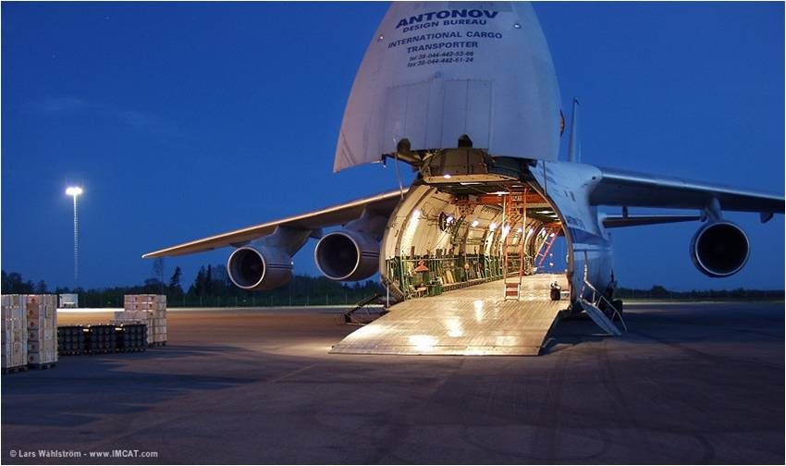

Slide 34
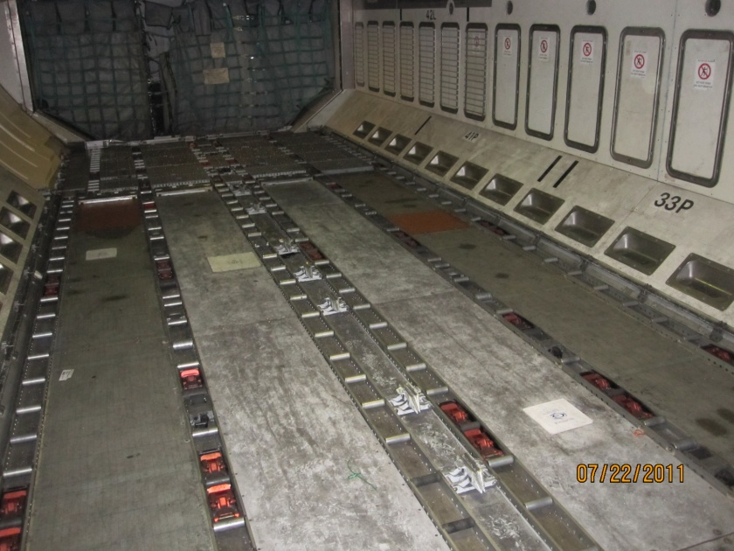
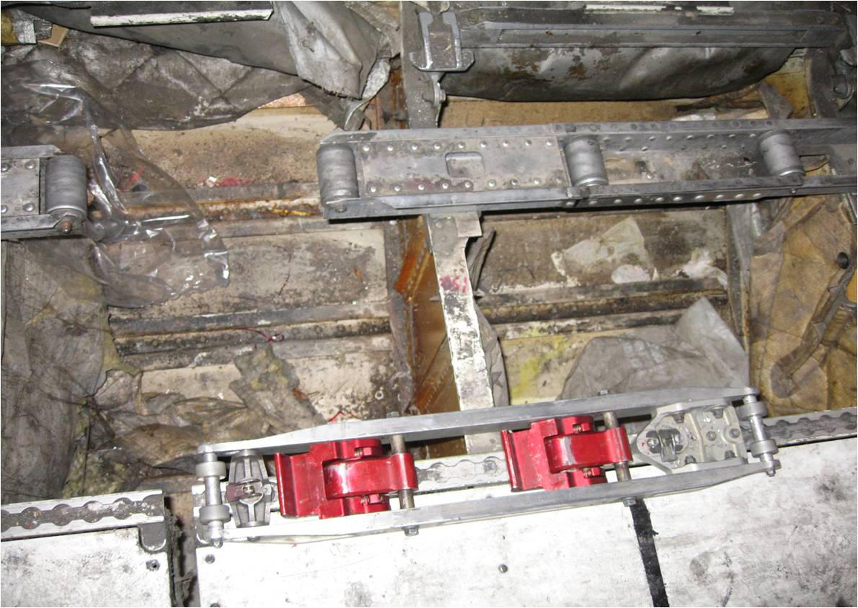
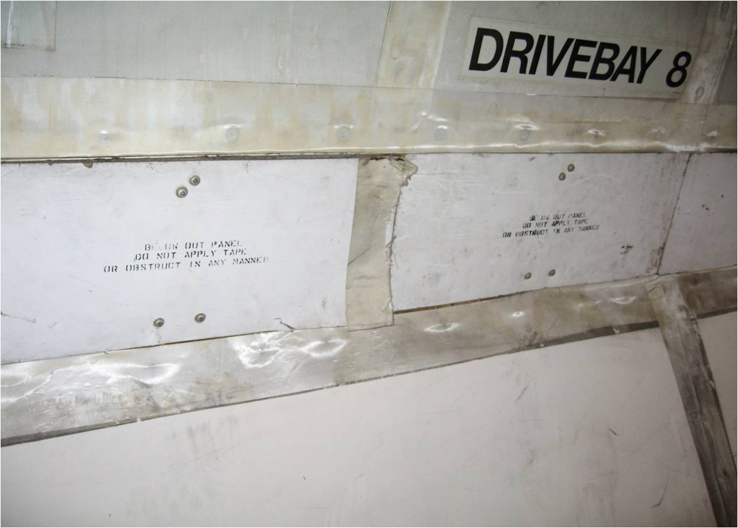
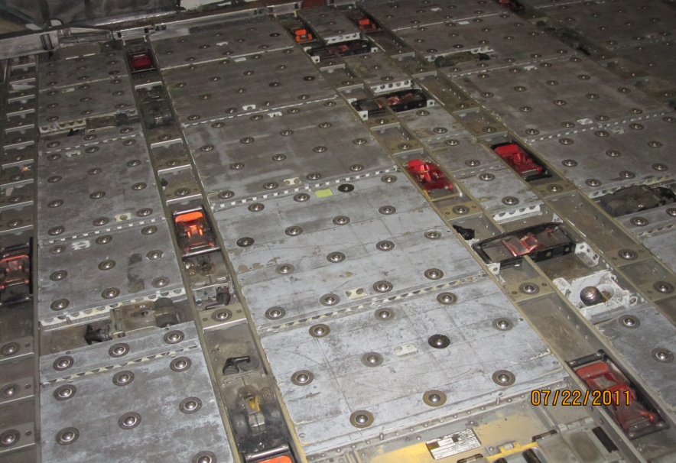

Slide 35
D - Cargo
D2. Dangerous Goods
Instructions: If dangerous good are on board, check that the pilot has received appropriate notification, Check that the OPS Manual includes relevant information as required by ICAO Annex 18.
References: Annex 6, Part I, Appendix 2, 2.1.35; Part III, Attachment H, 2.1.28; and Annex 18, 9.1 and 9.2

Slide 36
D - Cargo
D2. Dangerous Goods (cont.)
Seriousness:
Minor: Unable to recognize dangerous goods presented to operator for shipment
Significant: No dangerous goods regulations or references
Major: No or incomplete information to the captain of dangerous goods carried, in contradiction to Doc. 9284 provisions / Deficiencies : leakage, wrong packaging, label missing / Dangerous Goods not correctly secured / Loading not performed in accordance with ICAO Annex 18 / Dangerous Goods carried without authorization or in contradiction to Annex 18 or Doc.9284

Slide 37
D - Cargo
D3. Safety of cargo on board
Instruction:
Check that loads are properly distributed and safely secured
Reference:
Annex 6, Part I, 4.3.1; Part III, Section II, 2.3.1
Seriousness:
Minor: Minor damage to : lashing, tie down equipment, pallet/container and/or locks
Significant: Damaged pallet container or net
Major: Cargo not correctly secured and/or safety distributed: lashing, tie down equipment, pallets and containers, locks / Load distribution/floor load limit exceeded

Slide 38
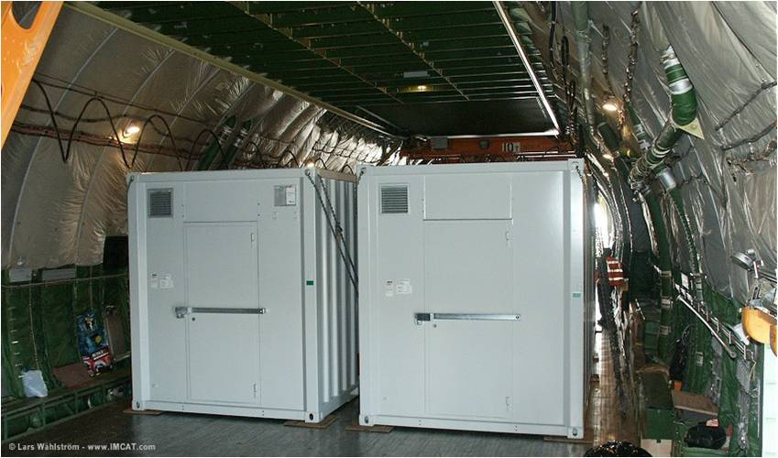

Slide 39
E - General
E1. Additional Remarks
Instruction:
Record and report any items of significant nature that may be observed which are not covered by this guidance.
Reference:
Nil
Seriousness:
Minor: General findings with minor safety impact
Significant: General findings with significant safety impact
Major: General findings with major safety impact

Slide 40
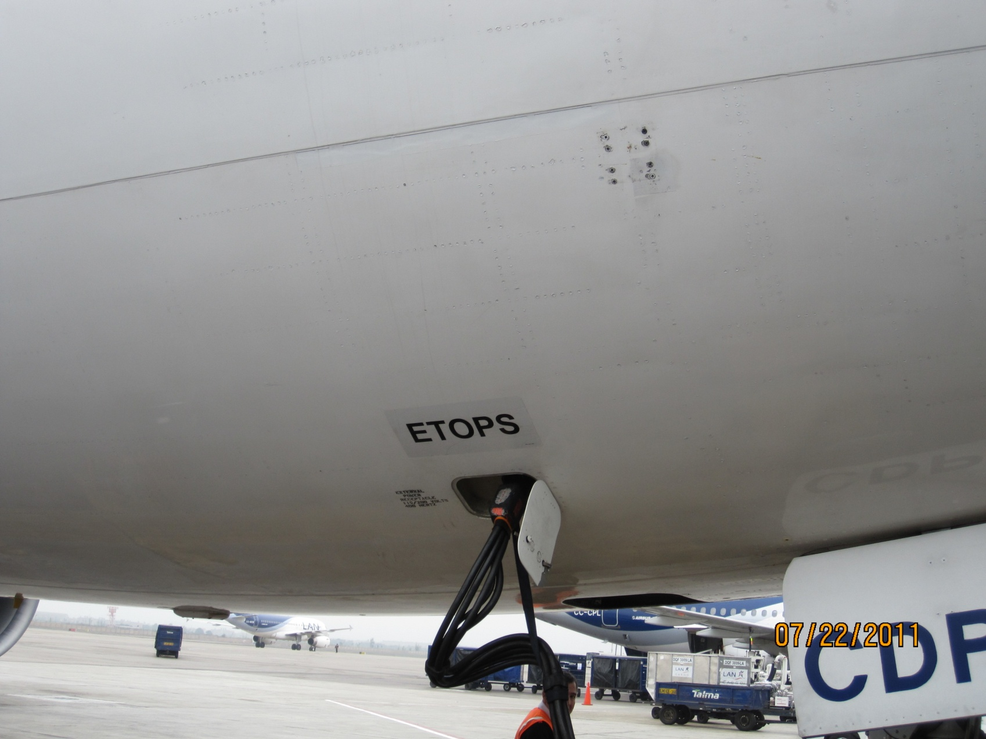

Slide 41
E - General
E2. Refuelling
Instructions:
Check that the procedures relating to refuelling with passengers on board
are complied with.
References:
Annex 6, Part I, 4.3.7; and Part III, Section II, 2.3.7
Seriousness:
Minor: Cabin crew not aware of refuelling with passengers on board
Significant: No procedures in place for refuelling with passengers on board
Major: Procedures in place but not carried out

Slide 42
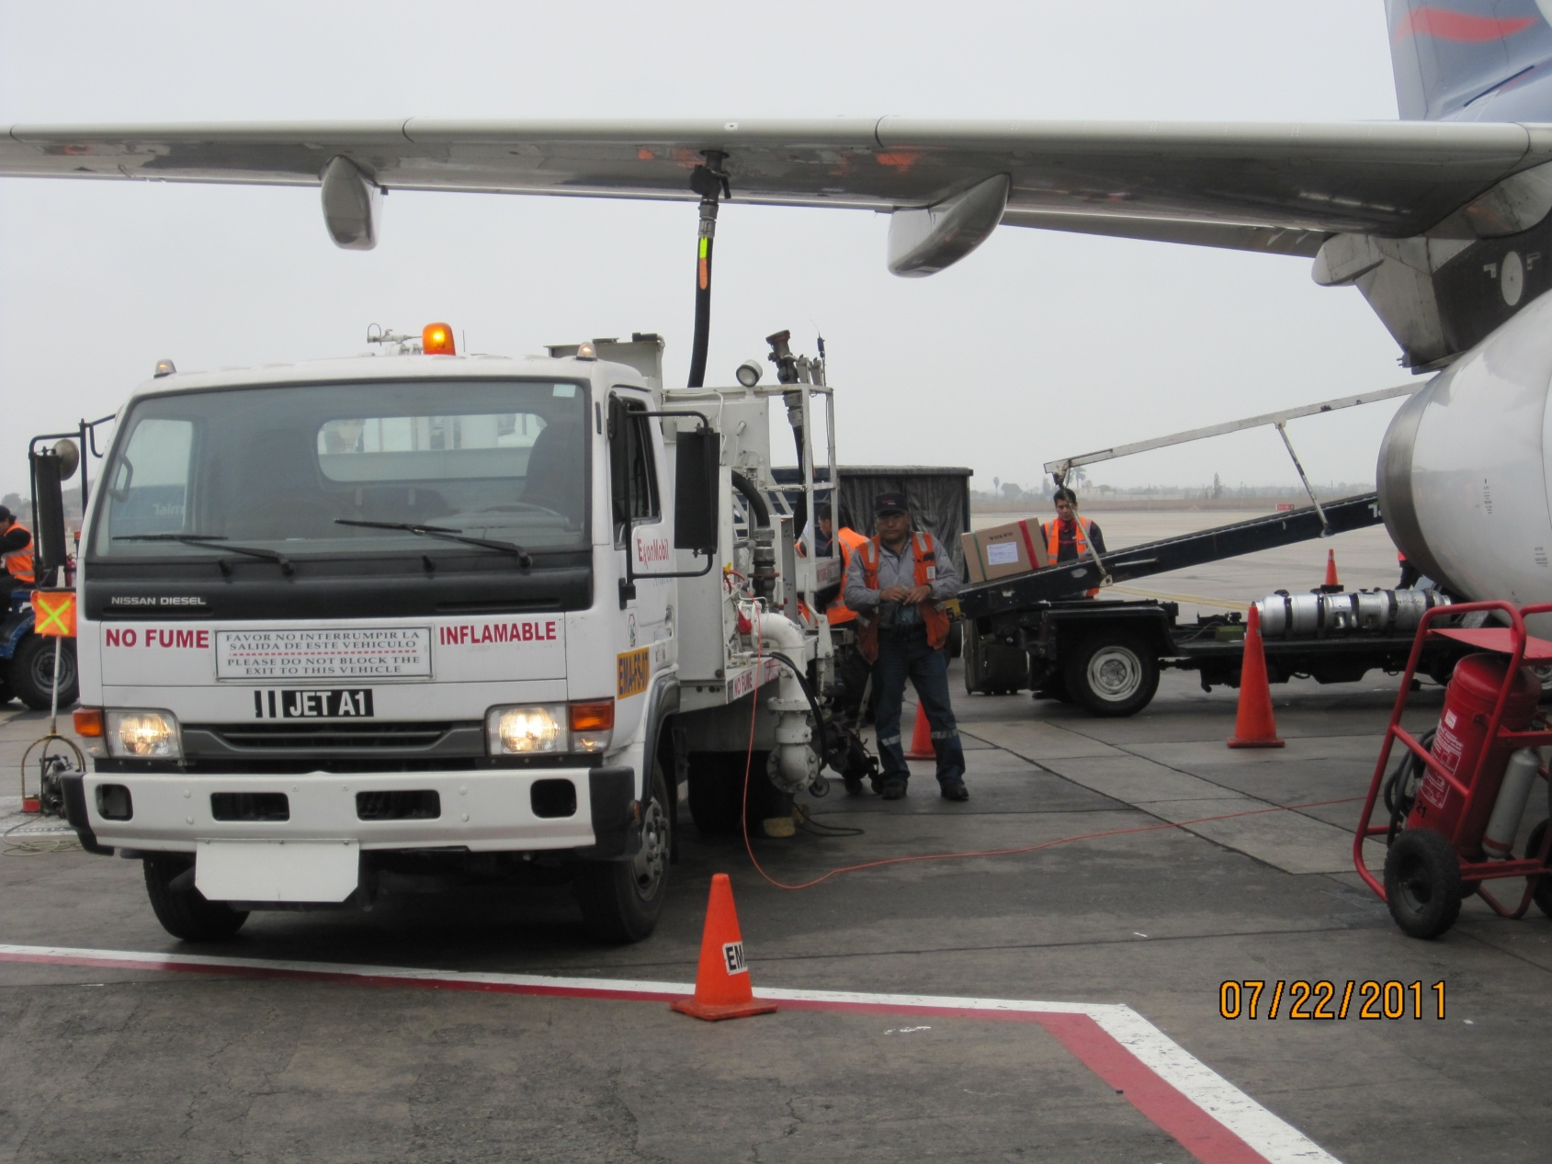

Slide 43
E - General
E3. English Language
Instructions:
Check that all pilots, and those flight navigators required to use the radio telephone, are fluent in the language used for radiotelephony communications or in the English language.
References:
Annex 1, 1.2.9 and Annex 10, Volume II, 5.2.1.2
Seriousness:
Significant: Pilot licences with no language proficiency endorsement, in the English language used in radiotelephony (except if implementation plan made available by State of issuance – until 5 March 2011)
Major: Pilots not fluent in the English language or the language used in radiotelephony

Slide 44
Resumen
Objetivos del módulo
Cabina de pilotaje
Condición externa del avión
Carga y compartimiento de carga
Cabina de pasajeros e ítems de seguridad
Preguntas
General

Slide 45
Preguntas por favor

Slide 46
Charles Robles
Inspector de Aeronavegabilidad
DGAC del Perú
chrobles@mintc.gob.pe

Slide 47
Gracias por su atención

