Slide 1
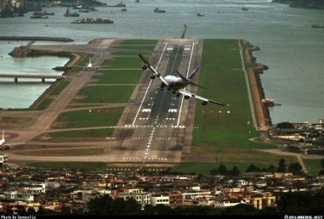
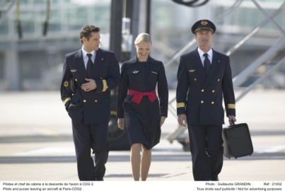
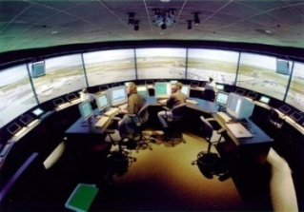
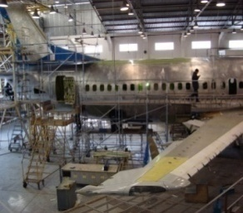
Curso sobre el Programa de intercambio de datos de inspecciones de seguridad en rampa (IDISR)
Módulo 5 – Descripción de los ítems que son evaluados en las inspecciones en rampa
(Parte II)
01 al 05 de agosto 2011
Oficina Regional Sudamericana de la OACI

Slide 2
B - Cabin / Safety

Slide 3
B - Cabin / Safety
B1. General Condition
Instructions:
Check for cleanliness, tidiness and general condition.
References:
Annex 8, Part III, 8.3
Seriousness:
Minor: Dirty, untidy and in bad condition
Significant: Loose carpet / Loose or damaged floor panel / Unserviceable seats (and not identified as such)

Slide 4
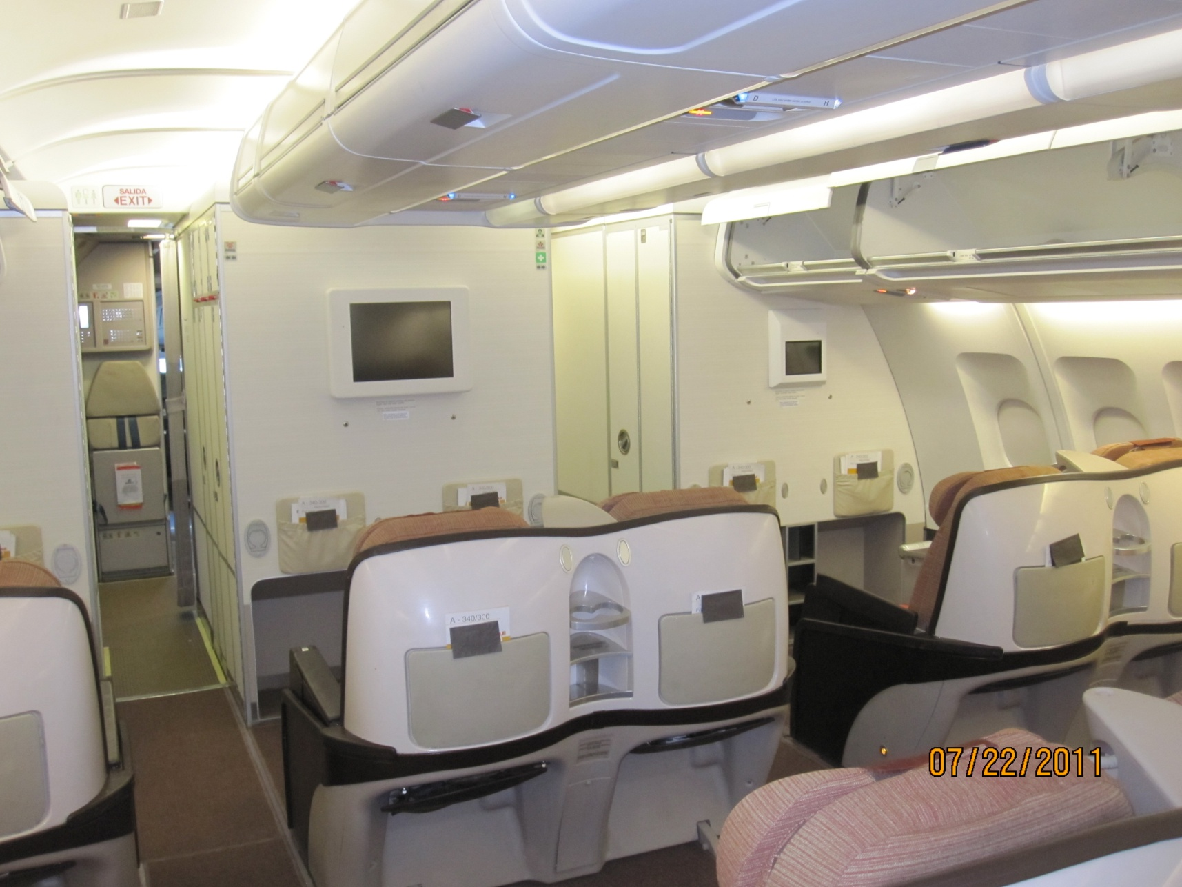

Slide 5
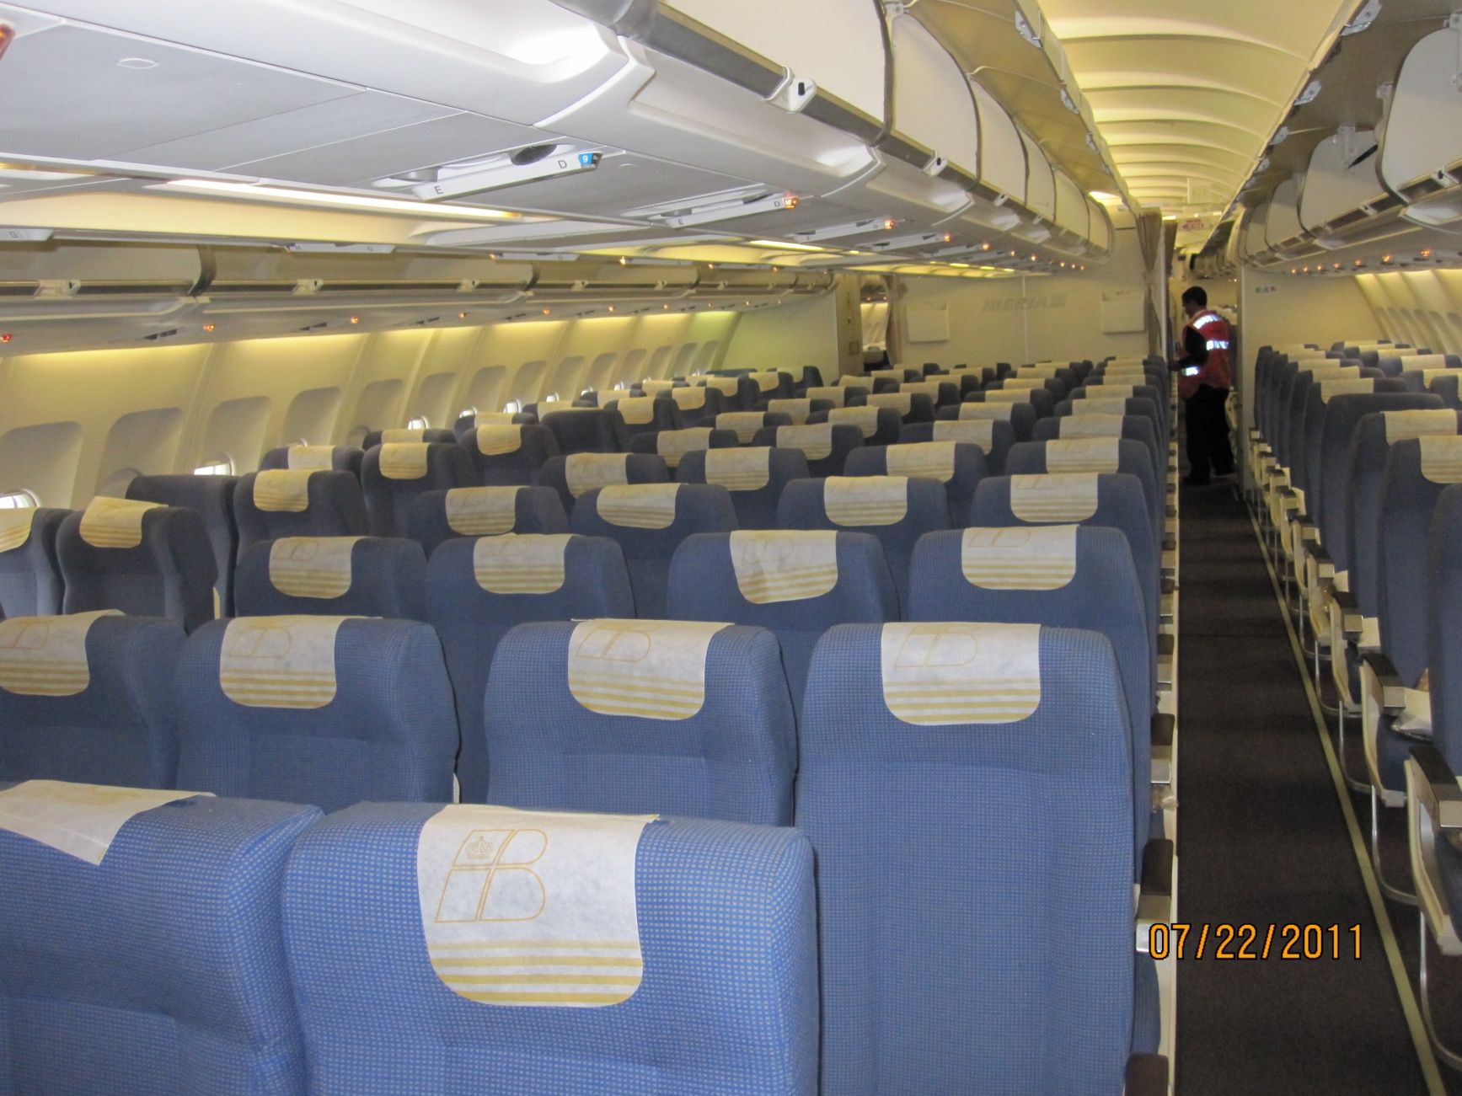

Slide 6
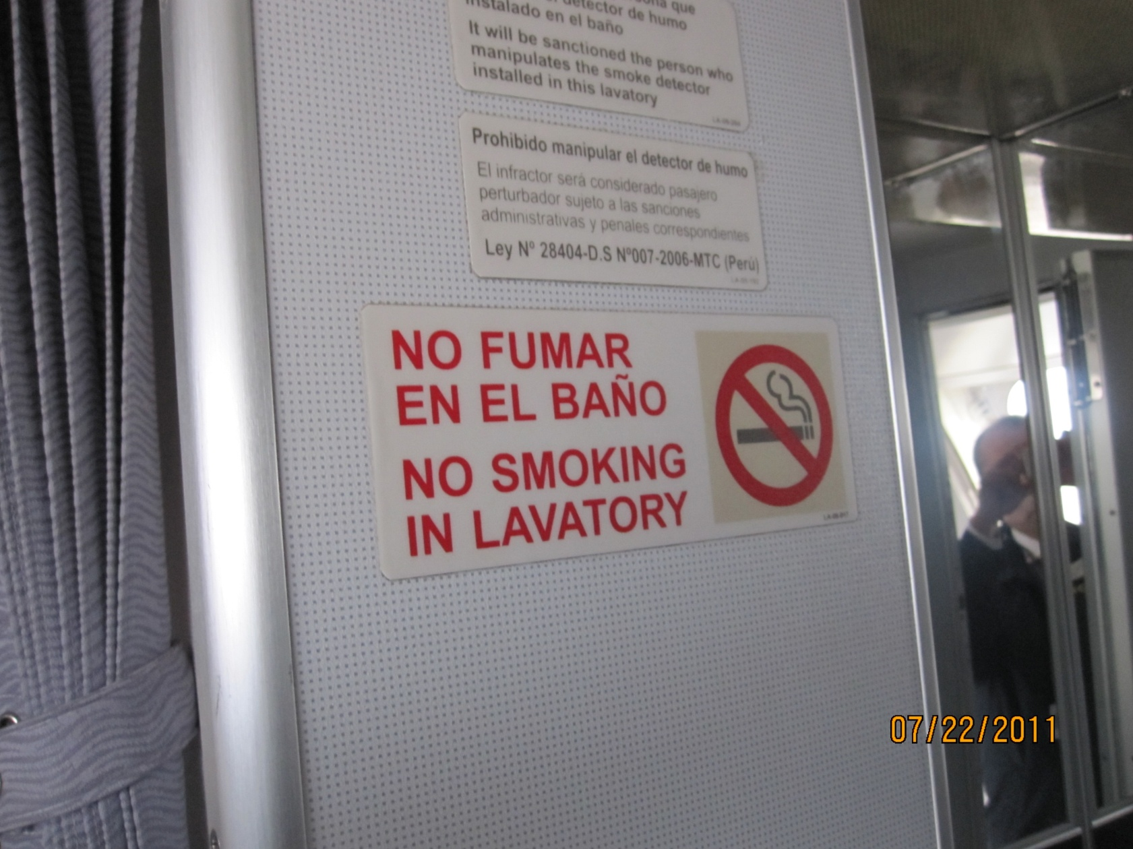

Slide 7
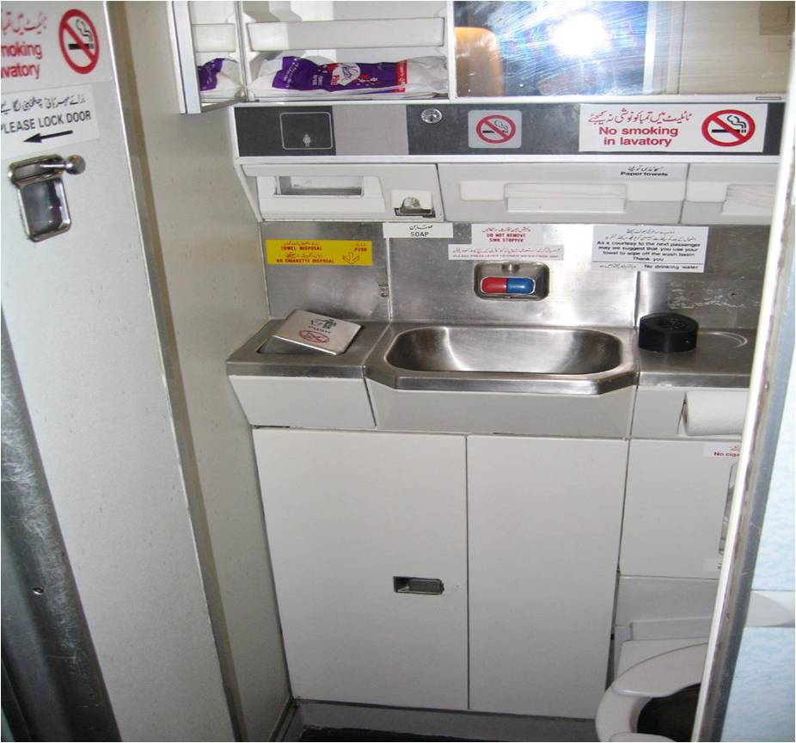

Slide 8
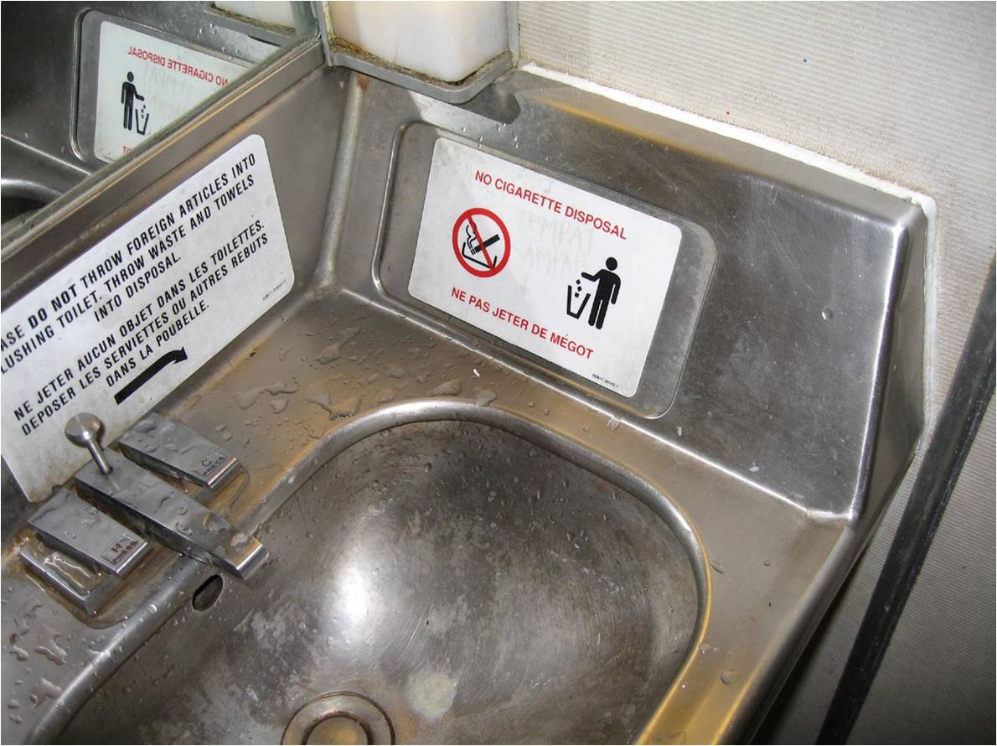

Slide 9
B - Cabin / Safety
B2. Cabin crew seats and safety harness
Instructions:
Check for presence and compliance with the requirement.
References:
Annex 6, Part I, 6.16; and Part III, Section II, 4.12
Seriousness:
Minor: Harness/belt is difficult to operate
Significant: Strap or buckle worn out or damaged-item is not serviceable
Major: For any member of the minimum required cabin crew a seat is not available; or proper harness and seat belt not available or not serviceable

Slide 10
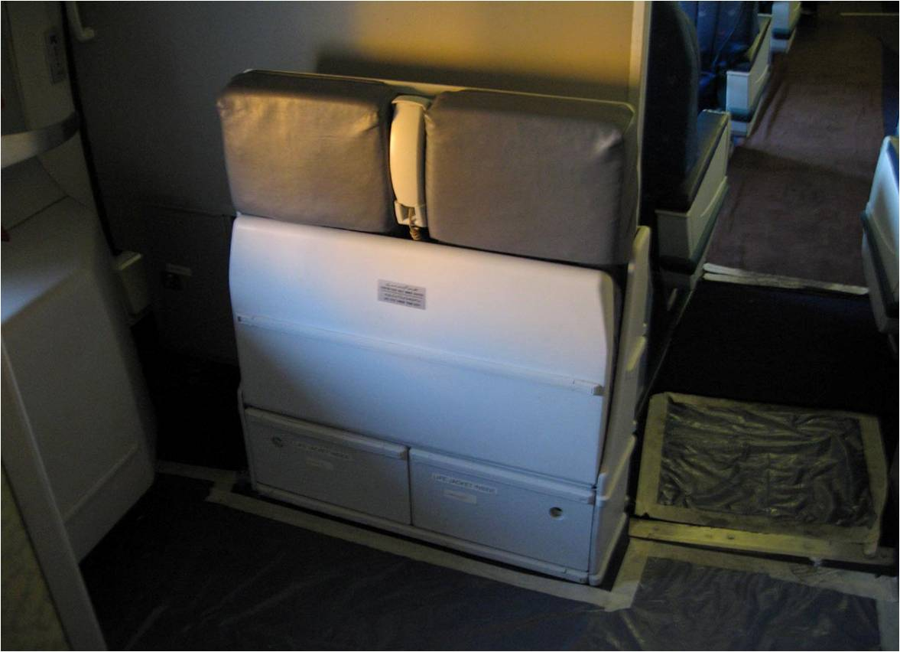

Slide 11
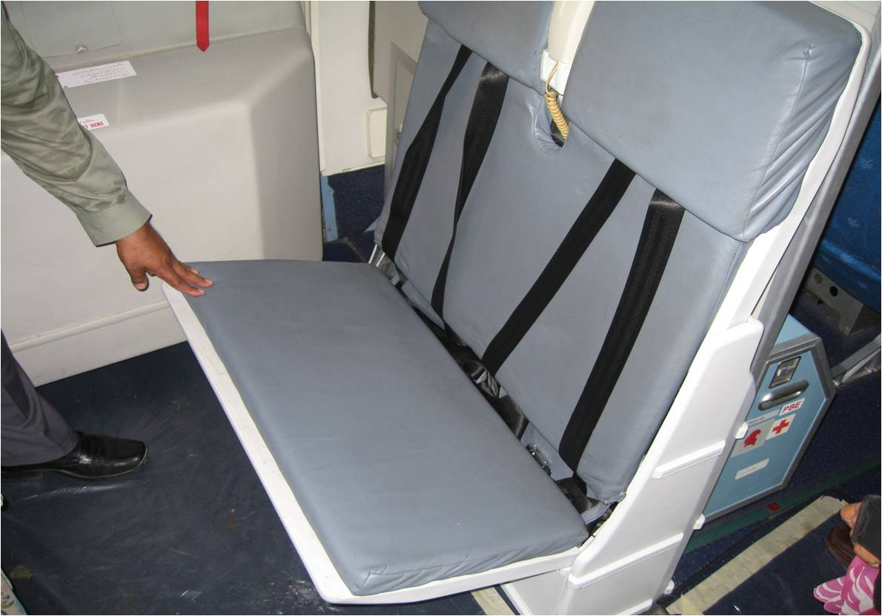

Slide 12
B - Cabin / Safety
B3. First Aid kit/Emergency Medical kit
Instructions:
Check for presence, condition, location and expiry date if available.
References:
Annex 6, Part I, 6.2.2; and Part III, Section II, 4.2.2
Seriousness:
Minor: Expired / Incomplete / Not at the indicated location
Major: Not available

Slide 13
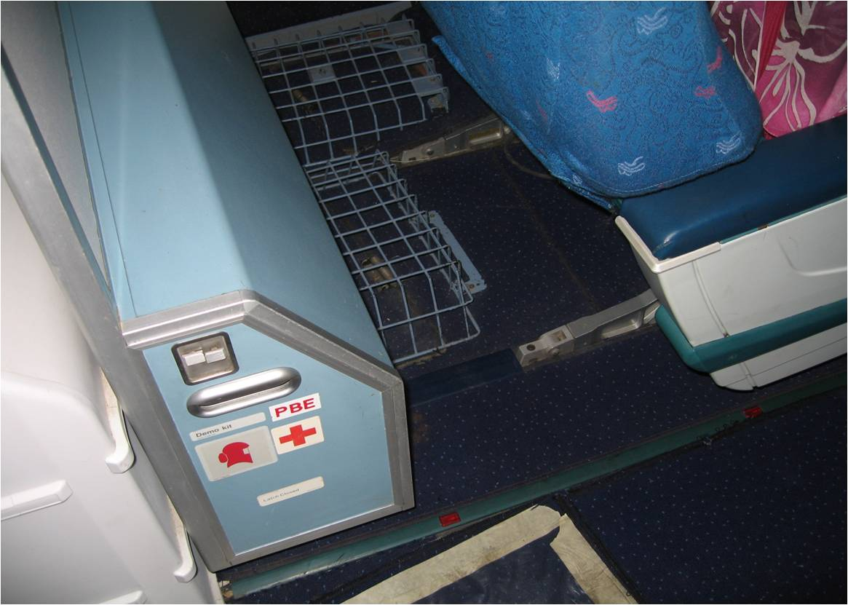

Slide 14
B - Cabin / Safety
B4. Portable fire extinguishers
Instructions:
Check for presence, number, condition and expiry date if available.
References:
Annex 6, Part I, 6.2.2; and Part III, Section II, 4.2.2
Seriousness:
Minor: Not directly accessible
Significant: Expired / Not correctly secured
Major: Empty, Significantly low pressure or missing or not serviceable

Slide 15
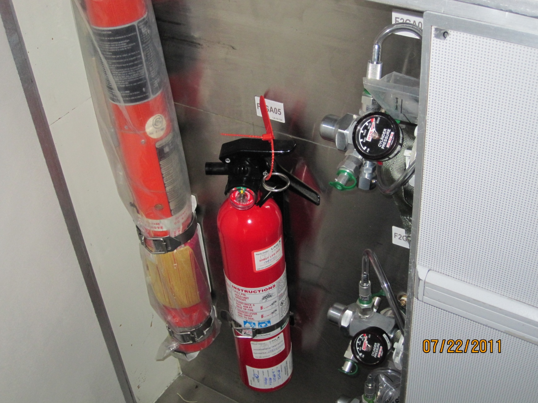

Slide 16
B - Cabin / Safety
B5. Life jackets/Flotation device
Instructions:
Check for presence, condition and expiry date as applicable.
References:
Annex 6, Part I, 6.5; and Part III, Section II, 4.5
Seriousness:
Minor: Not directly accessible
Significant: Expired, as applicable
Major: Not available for each person to be carried

Slide 17
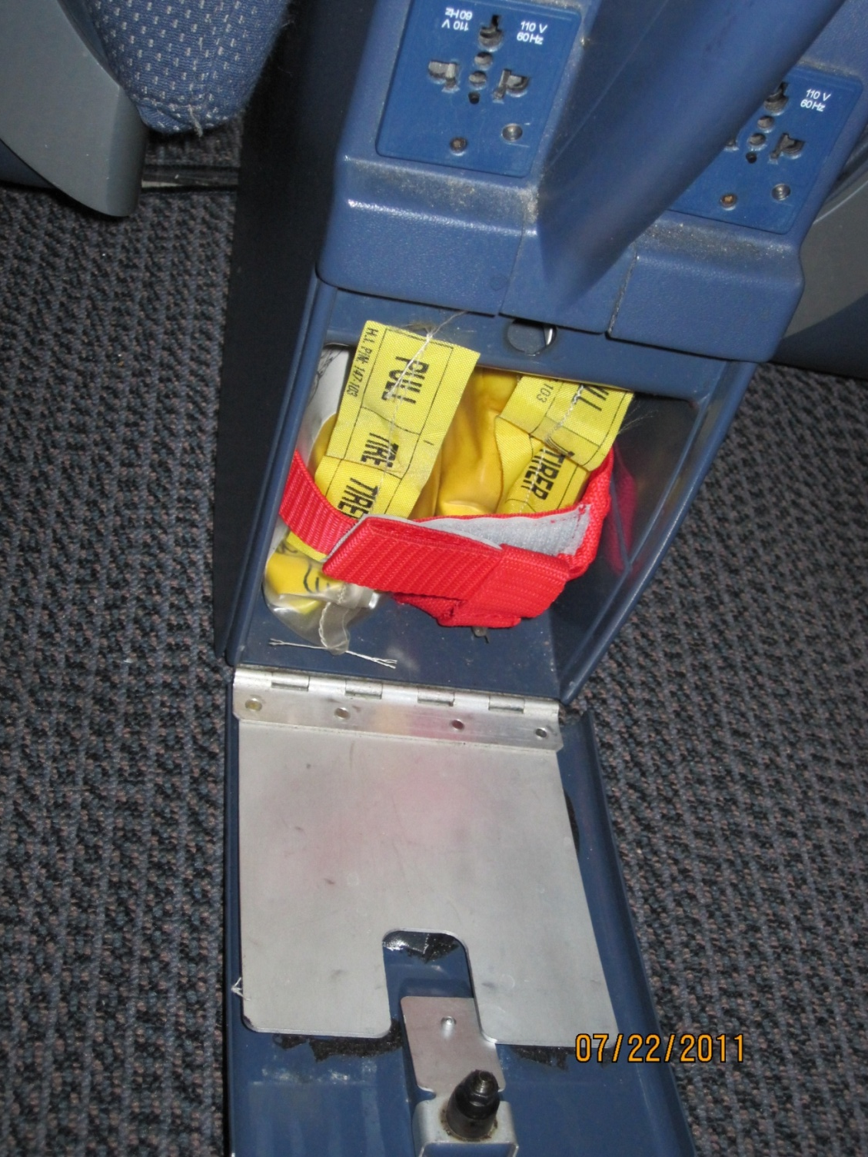

Slide 18
B - Cabin / Safety
B6. Seat belts
Instructions:
Check for presence and condition
References:
Annex 6, Part I, 6.2.2; and Part III, Section II, 4.2.2
Seriousness:
Minor: Strap worn or buckle worn out or damaged / Not available or serviceable for all passenger seats and aircraft dispatched in accordance with MEL
Significant: Not available or serviceable for all passenger seats and aircraft not dispatched in accordance with MEL
Major: Not available or not serviceable for any passenger

Slide 19
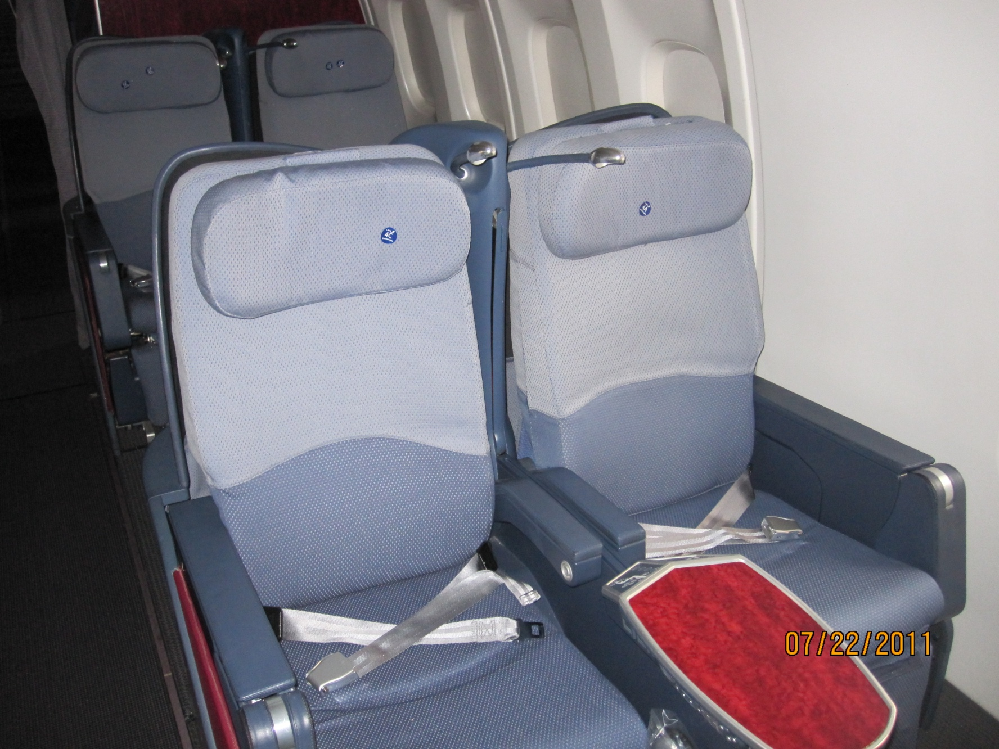

Slide 20
B - Cabin / Safety
B7. Emergency exit lighting and marking, emergency flashlights
Instructions:
Check for presence of emergency exit signs, lighting and marking, and emergency flashlights (one per cabin crew member). Where possible, check condition of floor path lighting / marking and of flashlights.
References:
Annex 6, Part I, 6.10; Part III, Section II, 4.22.2; and Annex 8, Part III A, 4.1.7.3 and Part IIIB, D.6.3
Seriousness:
Significant: Some emergency exit signs out of order / Insufficient number of emergency flashlights / Emergency flashlights not correctly located / Emergency flashlight batteries weak or flat.
Major: Emergency facilities defects not acceptable according to MEL provisions

Slide 21
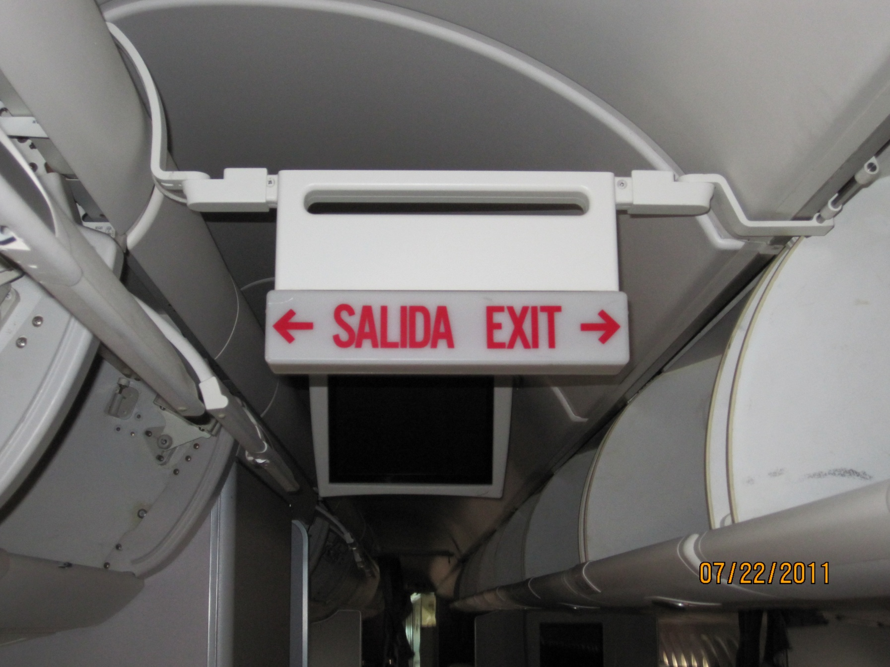

Slide 22
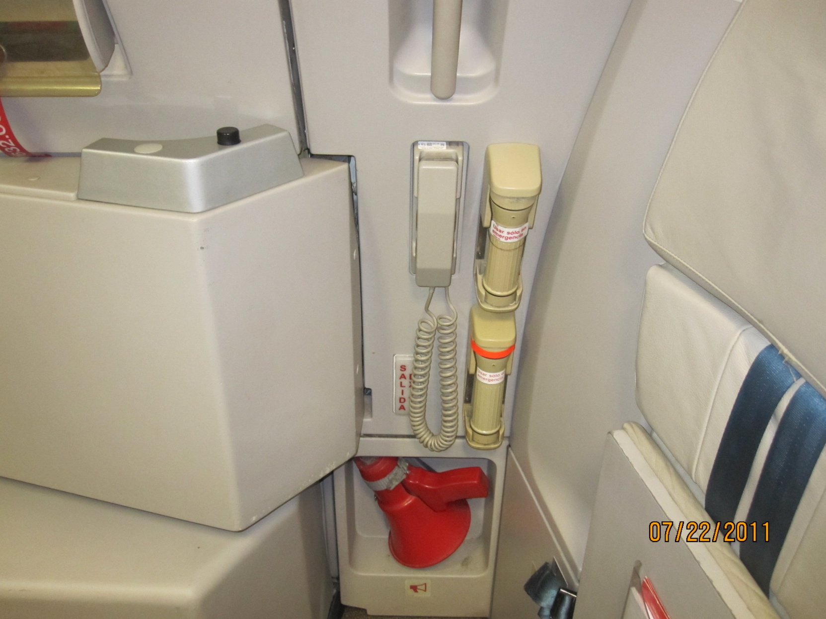

Slide 23
B - Cabin / Safety
B8. Slides / Life Rafts and pyrotechnical distress signalling devices (as required)
Instructions:
Check bottle pressure gauge, slide bar and slide expiration date; Check presence of life raft, when required.
References:
Annex 6, Part I, 6.5 and 6.6; Part III, Section II, 4.5 and 4.6; Annex 8 Part III A, 4.1.7 (and Part IIIB, D.6.2 to D.6.4)
Seriousness:
Minor: Not in specified location, as established by the State of the Operator
Significant: Incorrectly installed
Major: Insufficient number / Not serviceable

Slide 24
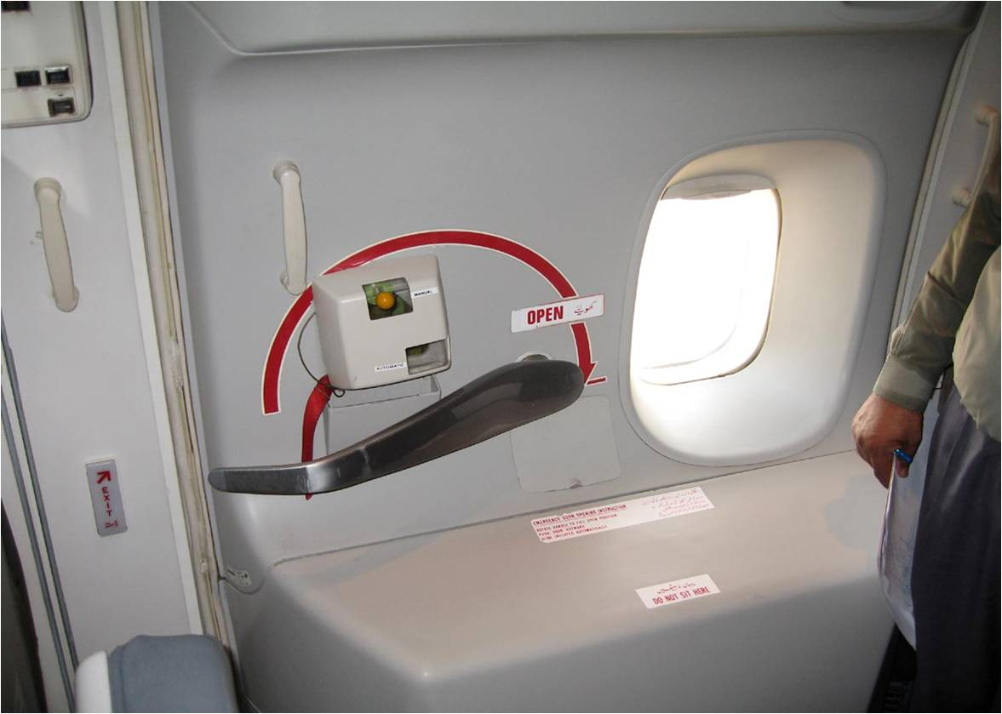
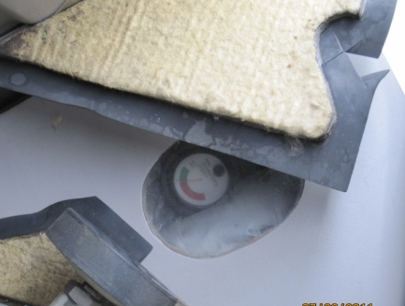

Slide 25
B - Cabin / Safety
B9. Oxygen Supply (Cabin crew & Passengers)
Instructions:
Check for presence and condition where applicable
References:
Annex 6, Part I, 4.3.8 and 6.7; and Part III, Section II, 2.3.8 and 4.8 and Section III, 2.9 and 4.5.
Seriousness:
Minor: Insufficient quantity of oxygen or insufficient quantity of masks for passengers and crew members
Significant: Insufficient quantity of oxygen or in sufficient quantity of masks for passengers and crew members, and flight performed above level 250

Slide 26
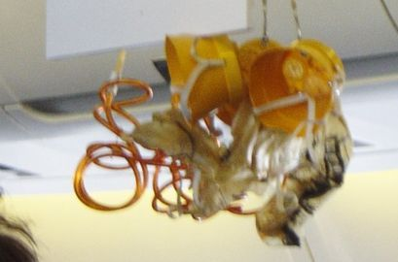

Slide 27
B - Cabin / Safety
B10. Emergency Briefing Cards
Instructions:
Check for presence and accuracy
References:
Annex 6, Part I 4.2.11.1 and 6.2.2;
Seriousness:
Minor: Not enough emergency briefing cards for all passengers
Significant: Briefing cards from another aircraft or from obviously different versions / Some information missing or incorrect
Major: No emergency briefing cards on board

Slide 28
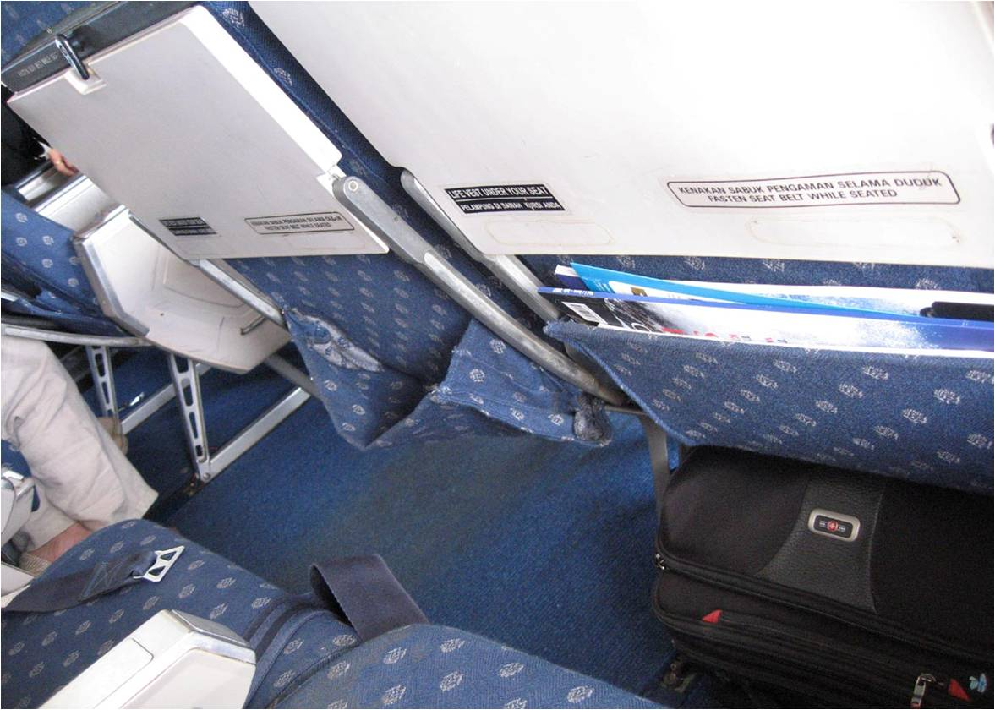

Slide 29
B - Cabin / Safety
B11. Cabin crew members
Instructions:
Check for presence and accuracy.
References:
Annex 6, Part I, 12.1; and Part III, Section II, 10.1
Seriousness:
Significant: Cabin crew members not in specified location
Major: Insufficient number of cabin crew members

Slide 30
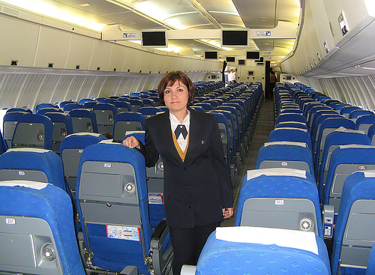

Slide 31
B - Cabin / Safety
B12. Access to emergency exits
Instructions:
Check that appropriate access to emergency exits is provided and that it is not impeded.
References:
Annex 8, Part IIIA, 4.1.7; (and Part III D.6.2 and D.6.3)
Seriousness:
Major: Impeded by luggage or cargo, etc / Impeded by seats

Slide 32
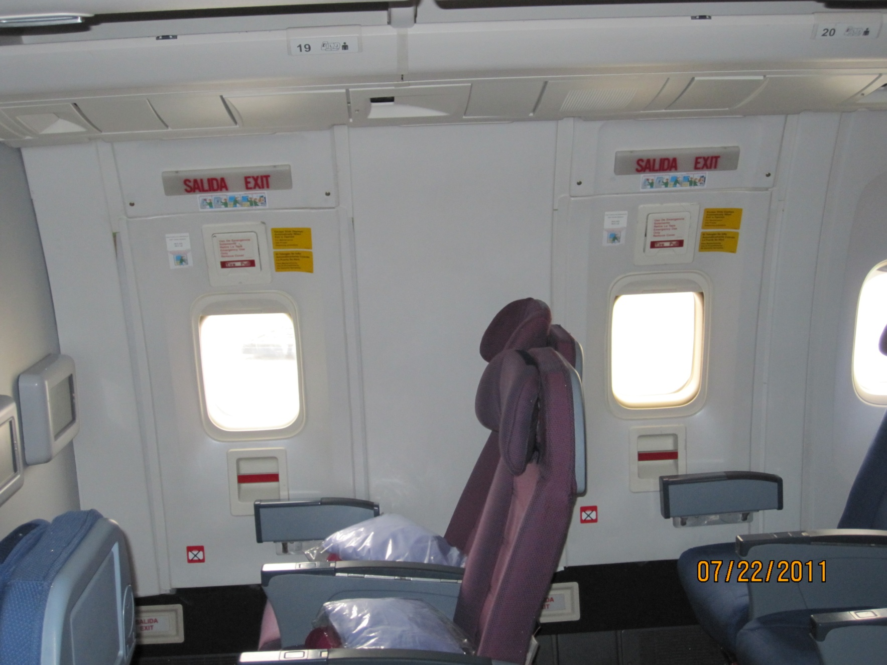

Slide 33
B - Cabin / Safety
B13. Safety of cabin baggage
Instructions:
Check that the passengers do not carry oversized hand baggage for the
stowage capacity of the aircraft. Check proper stowage of cabin baggage
References:
Annex 6, Part I, 4.8; and Part III, Section II, 2.7
Seriousness:
Major: Not securely stowed

Slide 34
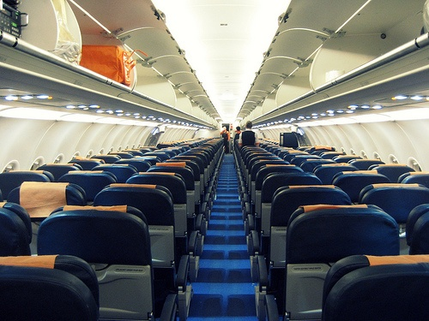

Slide 35
B - Cabin / Safety
B14. Seat capacity
Instructions:
Check that the number of persons boarding does not exceed the number
permitted (number of seats normally, except specific circumstance)
References:
Annex 6, Part I, 6.2.2; and Part III, Section II, 4.2.2
Seriousness:
Major: More seats than certified capacity / Insufficient serviceable seats for all passengers on board

Slide 36
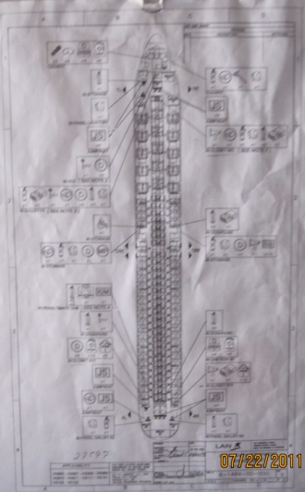
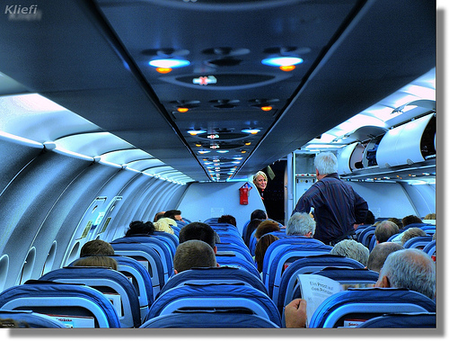

Slide 37
B - Cabin / Safety
B15. Security of the flight crew compartment door (if applicable)
Instructions:
Check that the flight crew compartment door, if provided, is lockable. Where applicable, check that the flight crew compartment door is penetration resistant.
References:
Annex 6, Part I, 13.2
Seriousness:
Minor : Door not installed or unserviceable (ref. Annex 6, 13.2)

Slide 38
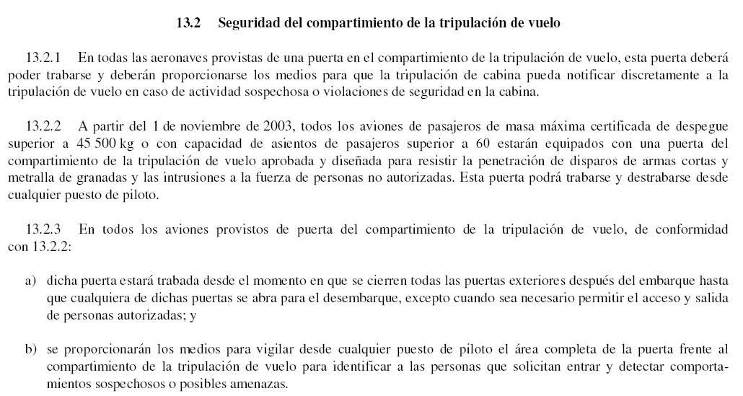

Slide 39
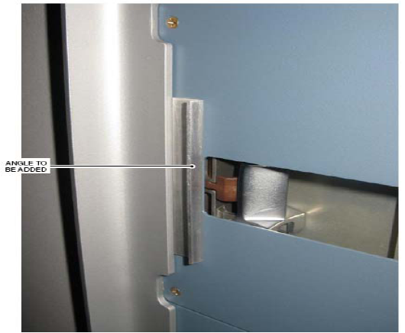
AD (EASA) 2009-0252
Reinforced CockpitDoor
SB (Airbus) A320-25-1666

Slide 40
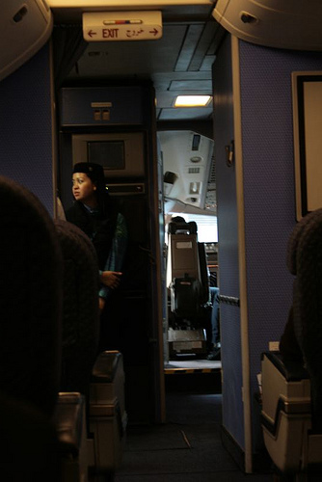

Slide 41
Preguntas por favor

Slide 42
Víctor Suárez
Inspector de Operaciones
DGAC del Perú
vsuarez@mintc.gob.pe

Slide 43
Gracias por su atención

