Slide 1
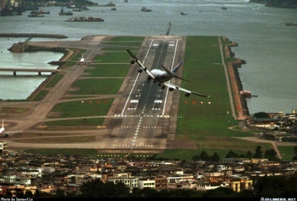

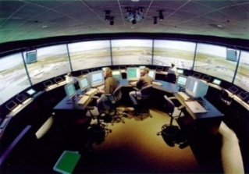
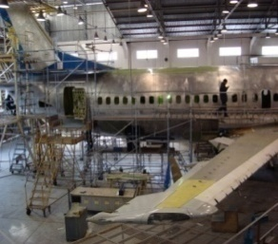
Curso sobre el Programa de intercambio de datos de inspecciones de seguridad en rampa (IDISR)
Módulo 5 – Descripción de los ítems que son evaluados en las inspecciones en rampa
(Parte I)
01 al 05 de agosto 2011
Oficina Regional Sudamericana de la OACI

Slide 2
Objetivo del Módulo 5
Al final de este módulo los participantes habrán recibido los conocimientos y las guías necesarias para familiarizarse con los ítems que deben ser evaluados durante las inspecciones en rampa de acuerdo con los requerimientos del Programa IDISR.

Slide 3
Contenido
Objetivos del módulo
Cabina de pilotaje
Condición externa del avión
Carga y compartimiento de carga
Cabina de pasajeros e ítems de seguridad
Preguntas
General
Resumen

Slide 4
Article 3 Civil and State aircraft
a) This Convention shall be applicable only to civil aircraft, and shall not be applicable to State aircraft.
(El presente Convenio se aplica solamente a las aeronaves civiles y no a las aeronaves de Estado)
b) Aircraft used in military, customs and police services shall be deemed to be State aircraft.
(Se consideran aeronaves de Estado las utilizadas en servicios militares, de aduanas o de policía).
c) No State aircraft of a contracting State shall fly over the territory of another State or land thereon without authorization by special agreement or otherwise, and in accordance with the terms thereof.
(Ninguna aeronave de Estado de un Estado contratante podrá volar sobre el territorio de otro Estado o aterrizar en el mismo sin haber obtenido autorización para ello, por acuerdo especial o de otro modo, y de conformidad con las condiciones de la autorización)

Slide 5
Inspección en Rampa (Ramp Check)
Los items que se verificarán durante la inspección en rampa están resumidos en el formato “Ramp Inspection Worksheet” e incluyen las siguientes áreas:
  A - Flight Deck,
  B - Cabin/Safety items,
  C - Aircraft External Condition,
  D - Cargo and the Cargo Compartment, and
  E - General

Slide 6
A – Flight Deck
A1. General Condition
Instructions:
Check cleanliness, tidiness and general condition
References:
Nil
Seriousness:
Minor: Dirty and untidy
Major: Large unsecured objects (e.g. cargo or baggage) / Unserviceable flight crew seats

Slide 7
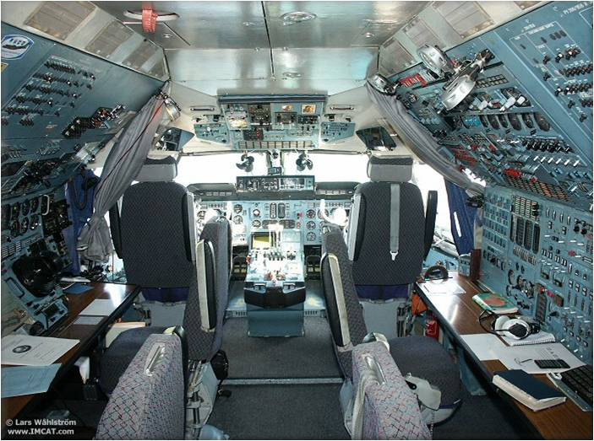

Slide 8
A – Flight Deck
A2. Emergency Exit
Instructions:
Check if in compliance with ICAO Standard and Recommended Practices.
References:
Annex 8, 4.1.7 - Emergency landing provisions
(Seat design, Evacuation, Number of exit and ditching.
Generally designed standards of aircraft ensure as these requirements).
Seriousness:
Minor: Not all exits are serviceable, but properly deferred in accordance with MEL provisions
Significant: Not all exits are serviceable and MEL provisions not applied.
Major: No emergency exits serviceable / no provisions in MEL for continued operation.

Slide 9
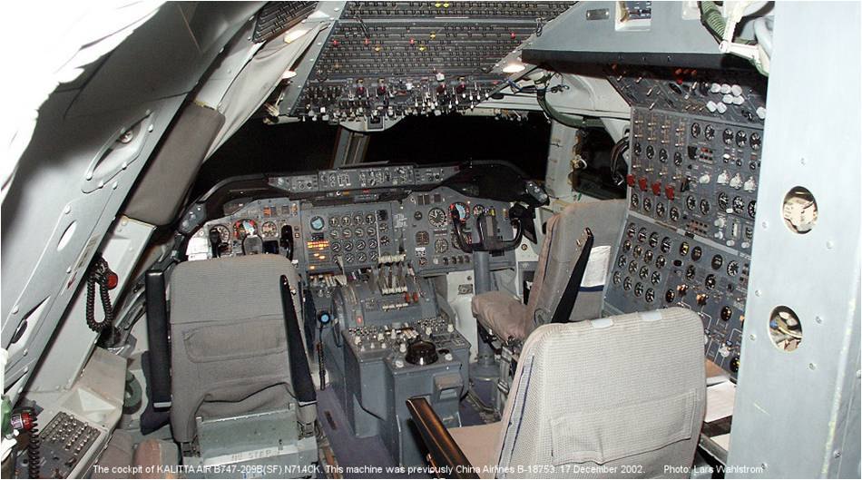

Slide 10
A – Flight Deck
A3. Equipment
Instructions:
Check for the presence of the following equipment where required:
  Airborne collision avoidance system (ACAS);
  Cockpit voice recorder (CVR) and Flight data recorder (FDR);
  Flight management computer (FMC) is provided – valid database.
  Emergency Locator Transmitter (ELT)
  Ground proximity warning system (GPWS)
  Where a flight management computer (FMC) is provided – valid database

Slide 11
A – Flight Deck
A3. Equipment (cont)
References:
  ACAS II: Annex 6, Part I, 6.18
  CVR and FDR: Annex 6, Part I, 6.3; and Part III, Section II,
  GPWS: Annex 6, Part I, 6.15
  ELT: Annex 6, Part I, 6.17 and Pat III, Section II, 4.7
  Database: Annex 6, Part I, 7.4.2

Slide 12
A – Flight Deck
A3. Equipment (cont)
  Seriousness:
  GPWS:
  Minor: Inoperative and in accordance with MEL provisions
  Significant: Inoperative and MEL provisions not applied
  Major: Forward looking GPWS (EGPWS/TAWS) required and not installed
  FMC:
  Significant: FMS database recently outdated (<28days).
  Major: FMS database more than 28 days outdated
  ACAS/CVR/FDR/ELT:
  Minor: Inoperative and in accordance with MEL provisions
  Significant: Inoperative and MEL provisions not applied
  Major: Required and not installed

Slide 13
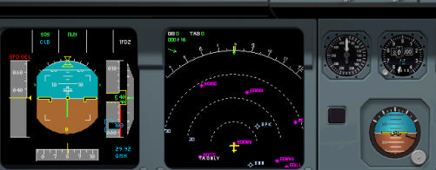
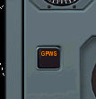
GPWS - A- 320
Indicador del GPWS
Cuando existe una alerta se encienda
esta luz.

Slide 14
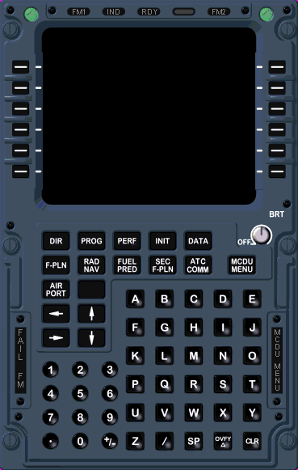
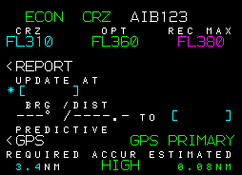
FMS - A- 320
Solicitar se verifique
la actualización de
la base de datos de
navegación

Slide 15
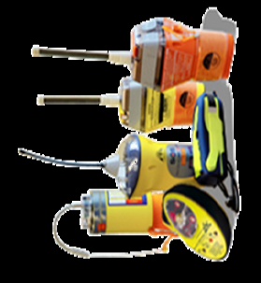
ELT

Slide 16
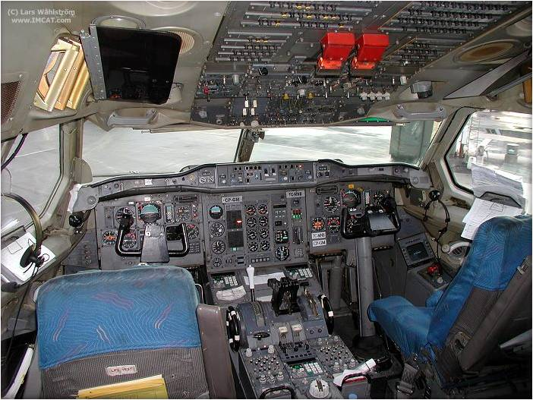

Slide 17
A – Flight Deck
A4. Manuals – All requirement manuals
Instructions:
Check for presence. Check if manuals are up-to-date and accepted or approved as required. Flight manual data may be included in the operations manual which may itself be in several parts, some of which are dealt with in A5, 6 and 7 below .
References:
Flight Manual - Annex 6, Part I, 6.2.3, 11.1 and Part III, Section II, 4.2.3, 9.1;
Operations manual - Annex 6, Part I, 4.2.2, 6.2.3 and Appendix 2 and Part III, Section II, 2.2.2, 4.2.3 and Attachment H; and
Aircraft Operating Manual - Annex 6, Part I, 6.1.4 and Appendix 2, 2.2 and Part III, Section II, 4.1.4 and Attachment H, 2.2

Slide 18
A – Flight Deck
A4. Manuals – All requirement manuals (cont.)
Seriousness:
Flight manual:
Significant: No evidence of State of Registry approval / Incomplete but performance calculations possible
Major: Not on board and performance calculations not possible
Operations manual:
Significant: Incomplete (see Appendix 2 of ICAO Annex 6) or not approved by State of the Operator or not the current version
Major: Not on board

Slide 19
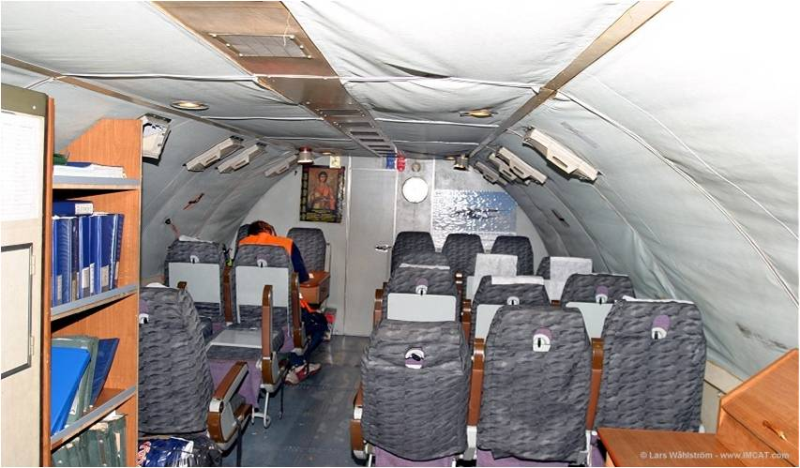

Slide 20
A – Flight Deck
A5. Checklists
Instructions:
Confirm checklists are available and up-to-date. Check if their content is in compliance with the requirement. Normal, non-normal and emergency checklists are sometimes combined in a ‘ Quick Reference Handbook ’,
Check the availability of an aircraft search procedure checklist; and
Confirm availability of the checklist of emergency and safety equipment.
  References:
  Flight crew checklists - Annex 6, Part I, 4.2.5, 6.1.4 and Appendix 2,
  2.2.2; and Part III, Section II, 2.2.5, 4.1.4 and Attachment H, 2.2.10
  Aircraft search procedure checklist - Annex 6, Part I, 13.3 and
  Part III, Section II, 11.1
  Checklist of emergency and safety equipment - Annex 6,
  Part I, Appendix 2, 2.2.10 and Part III, Attachment H, 2.2.8

Slide 21
A – Flight Deck
A5. Checklists (cont.)
Seriousness:
Minor: Not within reach
Significant: Not readily available and used or not the current version
Major: Not on board

Slide 22
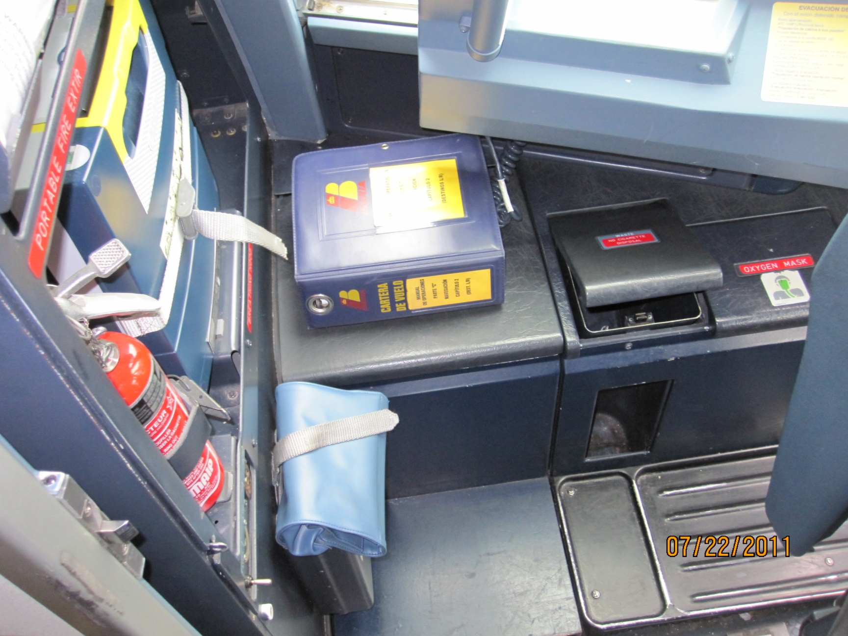

Slide 23
A – Flight Deck
A6. Route Guide
Instructions:
Check if a route guide, including charts, is available, suitable and
up-to-date.
References:
Annex 6, Part I, 6.2.3 and Appendix 2, 2.3.1; and Part III, Section II,
4.2.3 and Attachment H, 2.3.1
Seriousness :
Minor: Not within reach
Significant: Recently out of date (<=28 days) / Photocopies of current charts
Major: Significantly out of date (> 28 days) / Not on board

Slide 24
A – Flight Deck
A7. Minimum Equipment List (MEL)
Instructions:
Check if the MEL is available, up-to-date and approved.
References:
Annex 6, Part I, 6.1.3, Appendix 2, 2.2.9 and Attachment G; and Part III
Section II, 4.1.3, Attachment E and Attachment H, 2.2.7
Seriousness:
Significant: Not on board or MMEL used, but no deferred defects / MEL content does not reflect aircraft equipment fitted / MEL not approved
Major: Not on board or MMEL used, with deferred defects

Slide 25
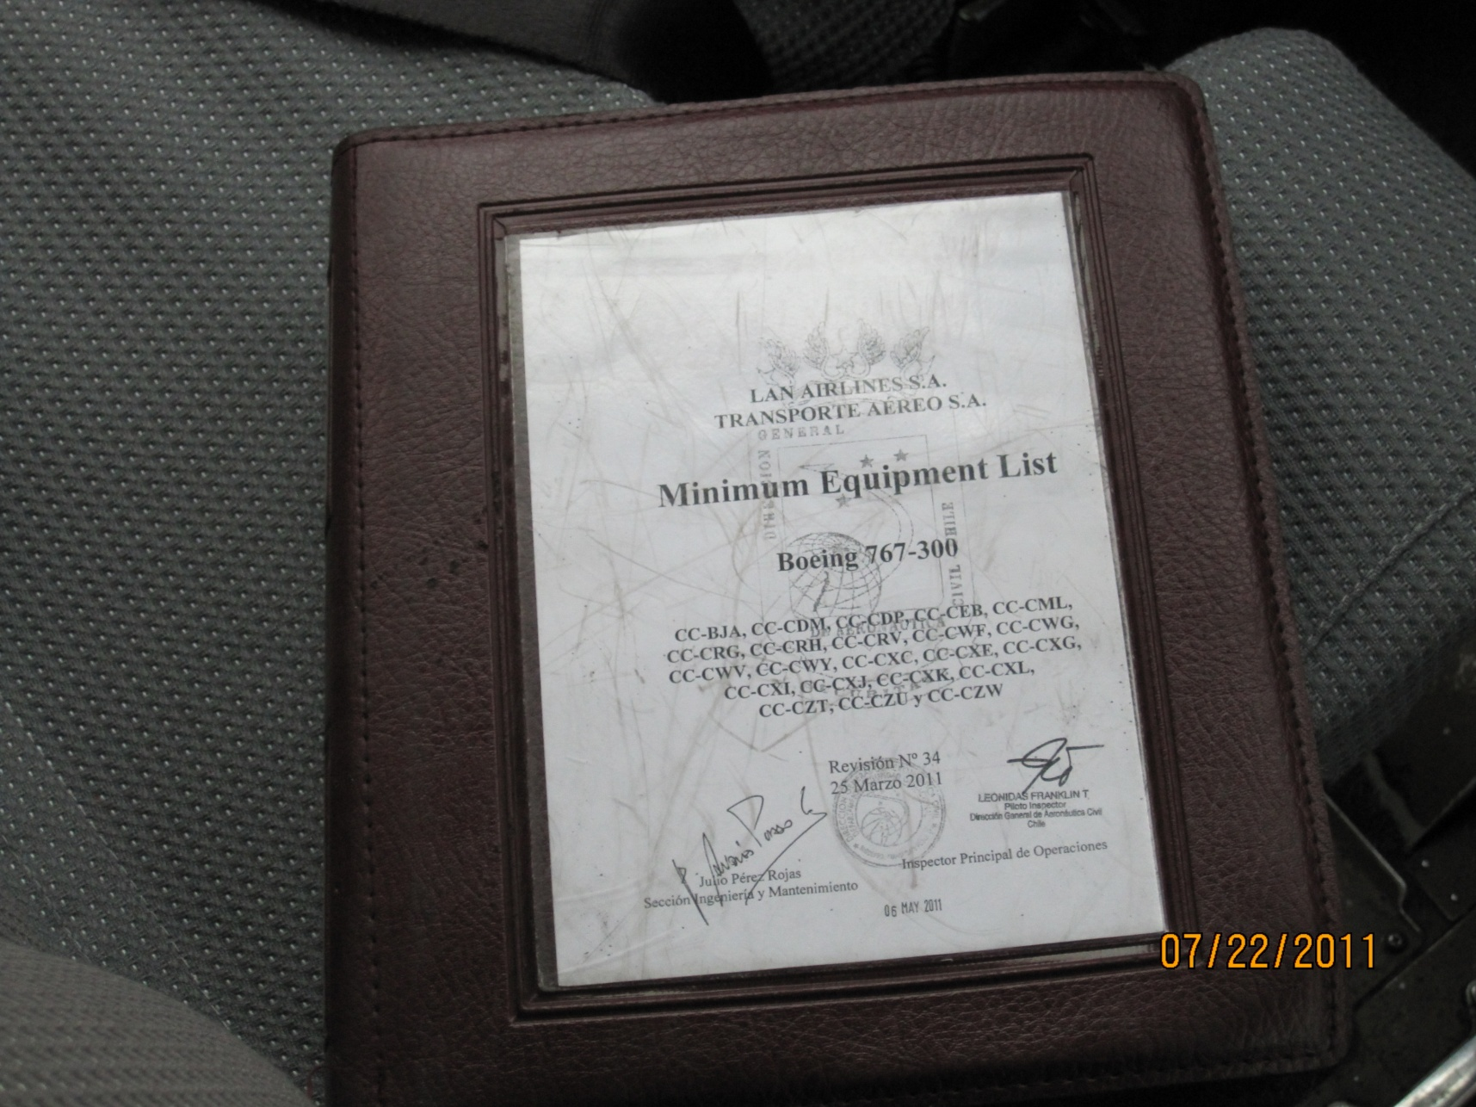

Slide 26
A – Flight Deck
A8. Documents required to be carried on board
a) Certificate of registration
Instructions:
Check for presence and accuracy and format
References:
Convention on International Civil Aviation, Article 29; and Annex 7, 7
Seriousness:
Minor: Non-certified copy
Significant: Not on board / No English translation

Slide 27
A – Flight Deck
A8. Documents required to be carried on board cont)
b) Identification Plate
Instructions:
Check presence and location
References:
Annex 7, 8
Seriousness:
Minor: Not installed or not able to read

Slide 28
A – Flight Deck
A8. Documents required to be carried on board (cont)
c) Certificate of Airworthiness
Instructions:
Check that the Certificate of Airworthiness of the aircraft is on board and valid
References:
Convention on International Civil Aviation, Article 29 and 31; Annex 8 Part II, Chapter 3
Seriousness:
Significant: Not an original or certified true copy / No English translation
Major: Not on board / Out of date

Slide 29
Anexo 8 – Figura 1

Slide 30
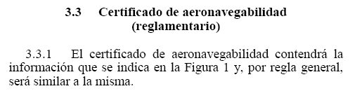
A – Flight Deck
A8. Documents required to be carried on board (cont)
c) Certificate of Airworthiness

Slide 31
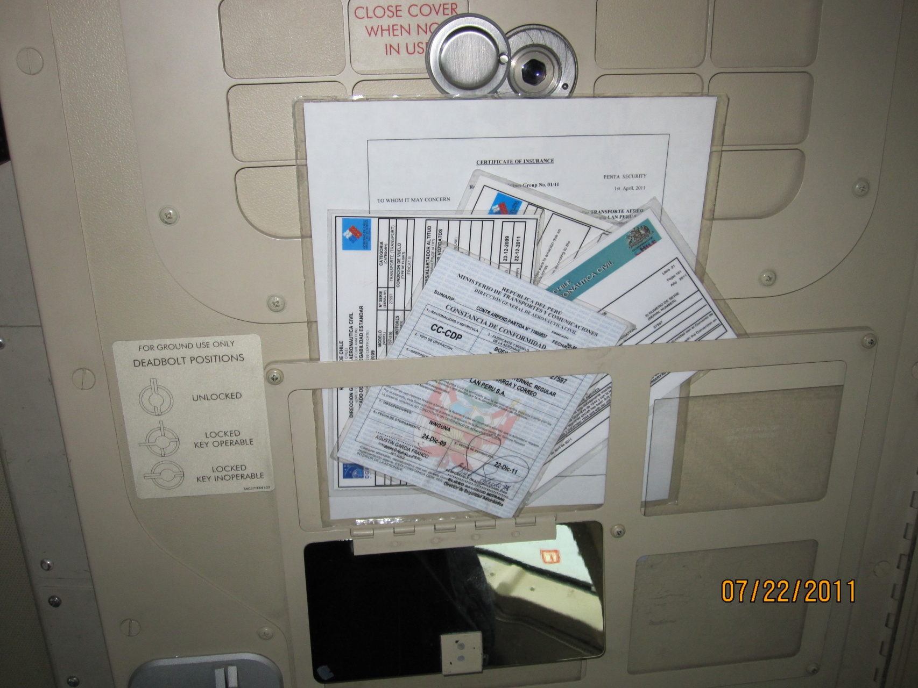

Slide 32
A – Flight Deck
A8. Documents required to be carried on board (cont)
d) Crew Member Licenses
Instructions:
Check valid in: date; type rating; instrument rating; competency check; language proficiency endorsement; medical assessment; and format(see also item E 3 below).
References:
Convention on International Civil Aviation, Article 29; Annex 1; Annex 6, Part I, 9.4.4
Seriousness:
Minor: Form or content not in compliance with ICAO standard
Significant: No English translation
Major: Not valid for the type of aircraft / Not on board or no proper validation from the registration authority / Expired or no class 1 medical assessment

Slide 33
A – Flight Deck
A8. Documents required to be carried on board (cont)
e) Journey log book or technical log and voyage report
Instructions:
Check entires up-to-date, validity of maintenance release. Check number of deferred defects (specify in the report where necessary). Check that defect deferments include time limits and comply with the stated time limits. Where applicable, check compliance with the aircraft MEL.
References:
Convention on International Civil Aviation, Articles 29; Annex 6, Part I, 4.3.1 and 11.4;
Seriousness:
Minor: Minor defects not documented
Significant: On board but not properly filled in
Major: Not on board or no equivalent document / Maintenance release expired or not valid / Defects MEL deadline expired

Slide 34
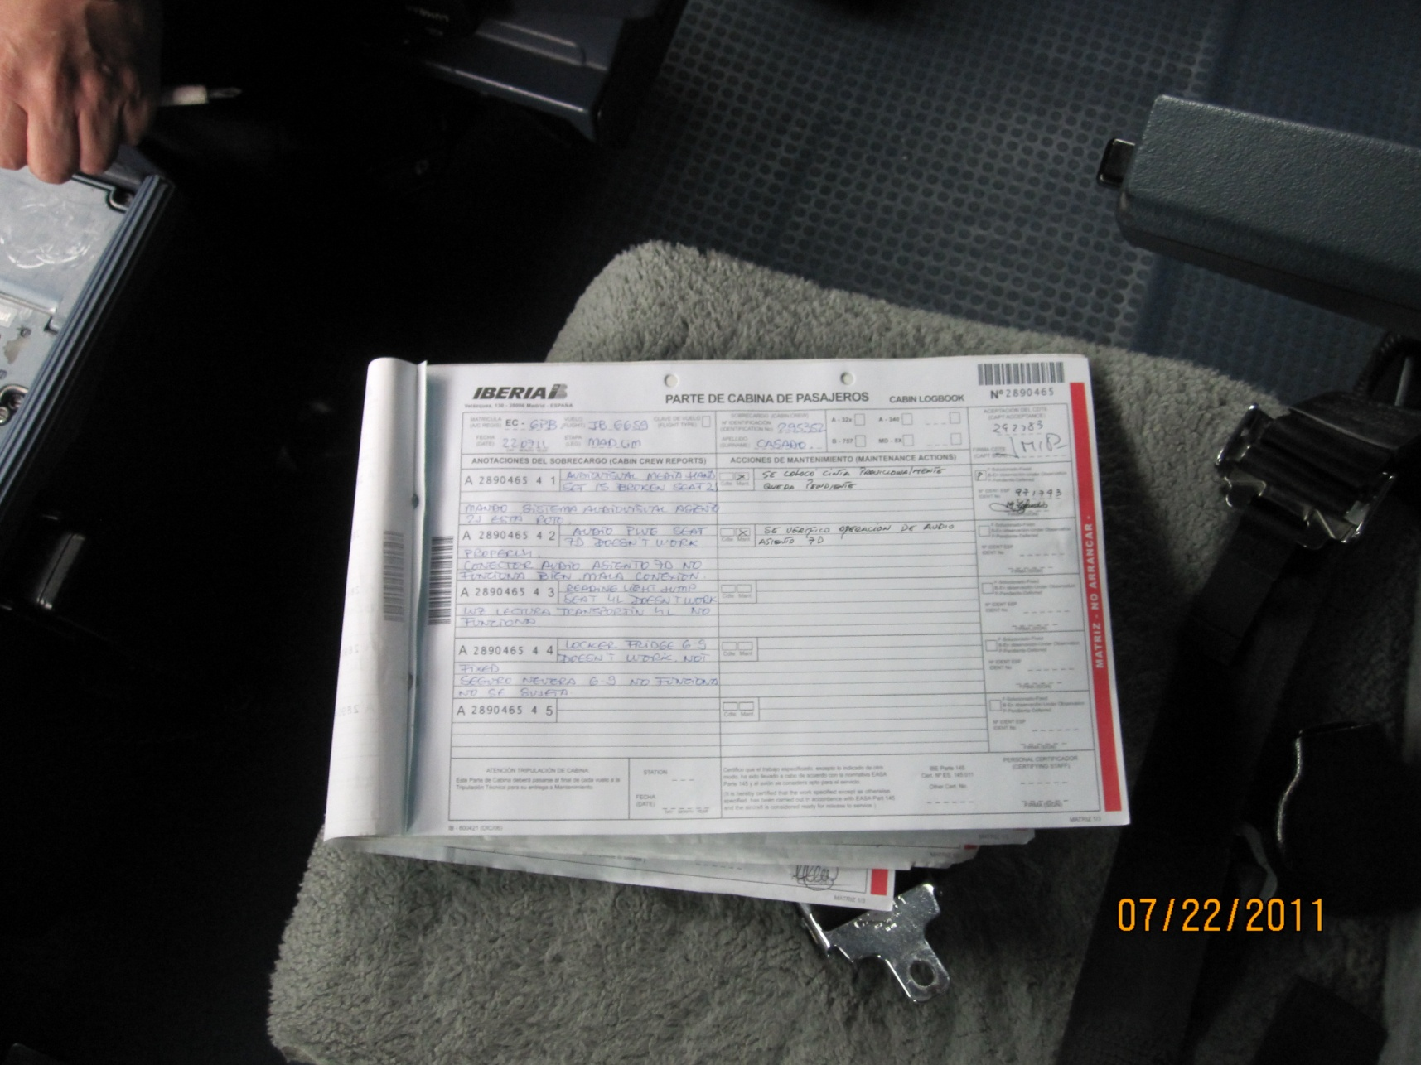

Slide 35
A – Flight Deck
A8. Documents required to be carried on board (cont)
f) Radio Station licenses
Instructions:
Check available and up-to-date
References:
Convention on International Civil Aviation, Articles 29; and 30; Annex 6, Part I, 7.1; and Part III, Section II, 5.1
Seriousness:
Minor: Non-certified copy
Significant: Not on board

Slide 36
A – Flight Deck
A8. Documents required to be carried on board (cont)
g) Noise certification document of statement, where applicable
Instructions:
Check available and valid
References:
Annex 6, Part I, 6.13; and Annex 16 Volume I, Parts I and II
Seriousness:
Minor: Not on board / No English translation

Slide 37
A – Flight Deck
A8. Documents required to be carried on board (cont)
h) Air Operator Certificate (certified true copy) and Operations
Specifications (copy)
Instructions:
Check available, applicable and valid
References:
Annex 6, Part I, 4.2.1, 6.1.2, Appendix 5, 7 and Appendix 6;
Seriousness:
Minor: Non-certified copy
Significant: Not accurate (out of date, incorrect operation type/route, incorrect aircraft or operator, etc…) or no English translation
Major: Not on board

Slide 38
Enmienda 32, Anexo 6, Parte I
Enmienda 13, Anexo 6, Parte III
Estas enmiendas ya fueron incorporadas en el LAR 119

Slide 39
Enmienda 32, Anexo 6, Parte I
Enmienda 13, Anexo 6, Parte III
Estas enmiendas ya fueron incorporadas en el LAR 119

Slide 40
A – Flight Deck
A9. Operational flight plan
Instructions:
Check for presence, accuracy and signature (s), and for adequate fuel and oil reserve planning and supply on board.
References:
Annex 6, Part I, 4.3.3 and Appendix 2, 2.1.16;
Seriousness:
Minor: Copy not retained on ground
Significant: Actual flight calculations but no actual documents / Lack of fuel monitoring data (arrival flight) / Fuel calculation unsatisfactory (departing flight)
Major: No or incomplete flight preparation / Required fuel calculation not available or not up dated for actual conditions

Slide 41
A – Flight Deck
A 10. Mass and balance sheet
Instructions:
Check for presence of load sheet and accuracy.
References:
Annex 6, Part I, 4.3.1 and Appendix 2, 2.1.14;
Seriousness:
Significant: Incorrect but within a/c limits
Major: Incorrect and outside operational limits or missing / Weight and balance data not available

Slide 42
A – Flight Deck
A11. Aircraft performance limitations using current route, airport
obstacles and runway analysis data
Instructions:
Check for availability of aircraft performance information including limitations and runway performance analysis based on current airport data.
References:
Annex 6, Part I, 5.1, 5.2 and 5.3;
Seriousness:
Minor: Incomplete but not affecting the operation on that date (e.g. no contaminated or wet runway data but these conditions are not present)
Significant: Not current data or data validity date not available
Major: Not available

Slide 43
A – Flight Deck
A12. Cargo and manifest and, if applicable, passenger manifest
Instructions:
Check for availability of completed cargo manifest and, if required, passenger manifest.
References:
Annex 9, 2.12, 2.13 and 4.12 and Appendices 2 and 3
Seriousness:
Significant: Some limited inaccuracy or missing data not affecting safety.
Major: Not available or grossly inaccurate/incomplete

Slide 44
A – Flight Deck
A13. Pre-flight inspection
Instructions:
Check for presence of pre-flight inspection forms (landing documents, air traffic service flight plan).
References:
Annex 6, Part I, 4.3;
Seriousness:
Minor: Form on board but incomplete
Significant: Not performed for inbound flight
Major: Not performed for outbound flight

Slide 45
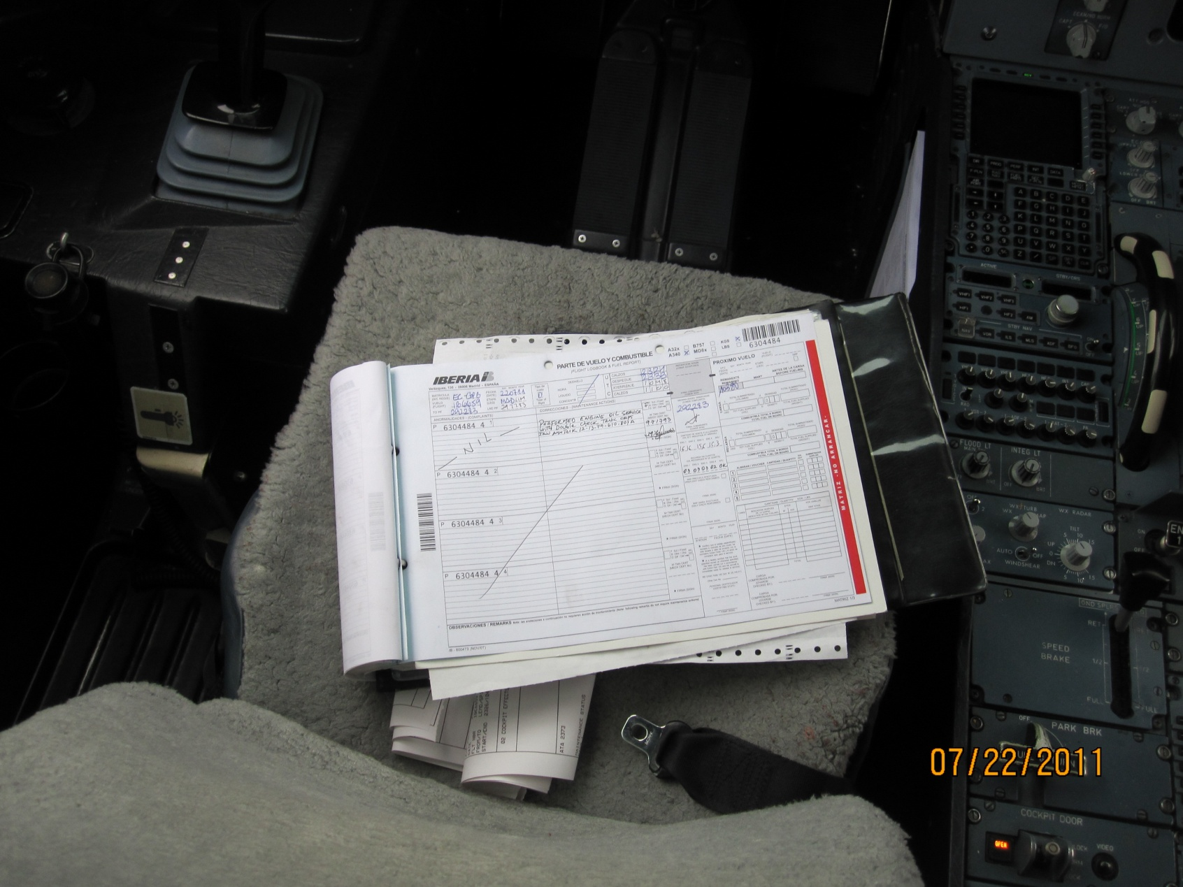

Slide 46
A – Flight Deck
A14. Weather reports and forecasts
Instructions:
Check for availability of weather reports and forecasts adequate for the flight
References:
Annex 6, Part I 4.3.5.2,
Seriousness:
Minor: Not the latest available data but valid
Significant: Not printed but handwritten
Major: Not valid or not available

Slide 47
A – Flight Deck
A15. NOTAM (Notice to Airman)
Instructions:
Check for availability of NOTAMs for the route of flight.
References:
Annex 15, Chapter 5 and Annex 6, Part I, 4.3.3.1, 4.6.1
Seriousness:
Significant: Some en-route relevant data missing
Major: Not available

Slide 48
A – Flight Deck
A16. Portable Fire Extinguishers
Instructions:
Check for presence, number, condition and expiry date.
References:
Annex 6, Part I, 6.2.2 b);
Seriousness:
Minor: Not easily accessible
Significant: Expired / Not properly secured
Major: Empty or insufficient number or missing / Significantly low pressure / Not accessible

Slide 49
A – Flight Deck
A17. Life jackets/ Flotation Devices
Instructions:
Check for presence, condition and expiry date where applicable
References:
Annex 6, Part I, 6.5; Part III, Section II, 4.3
Seriousness:
Minor: Not directly accessible
Significant: Expired, as applicable
Major: Not available for each cockpit crew member on board

Slide 50
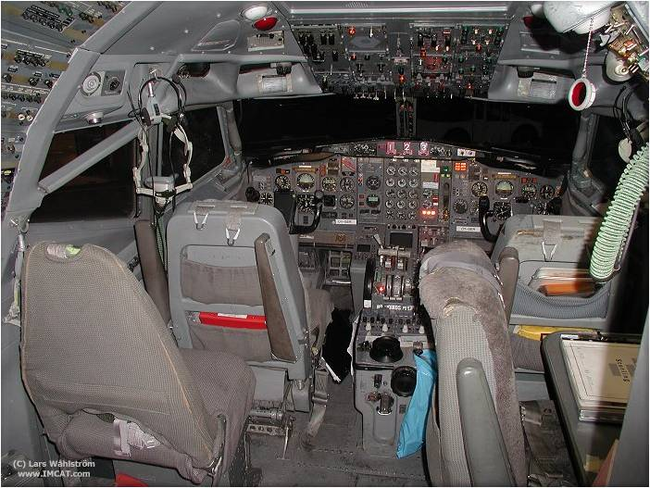

Slide 51
A – Flight Deck
A18. Safety Harness
Instructions:
Check for presence, condition and quantity
References:
Annex 6, Part I, 6.2.2; and Part III, Section II, 4.2.2.
Seriousness:
Significant: Seat belt instead of harness
Major: Not available or serviceable for all flight crew members

Slide 52
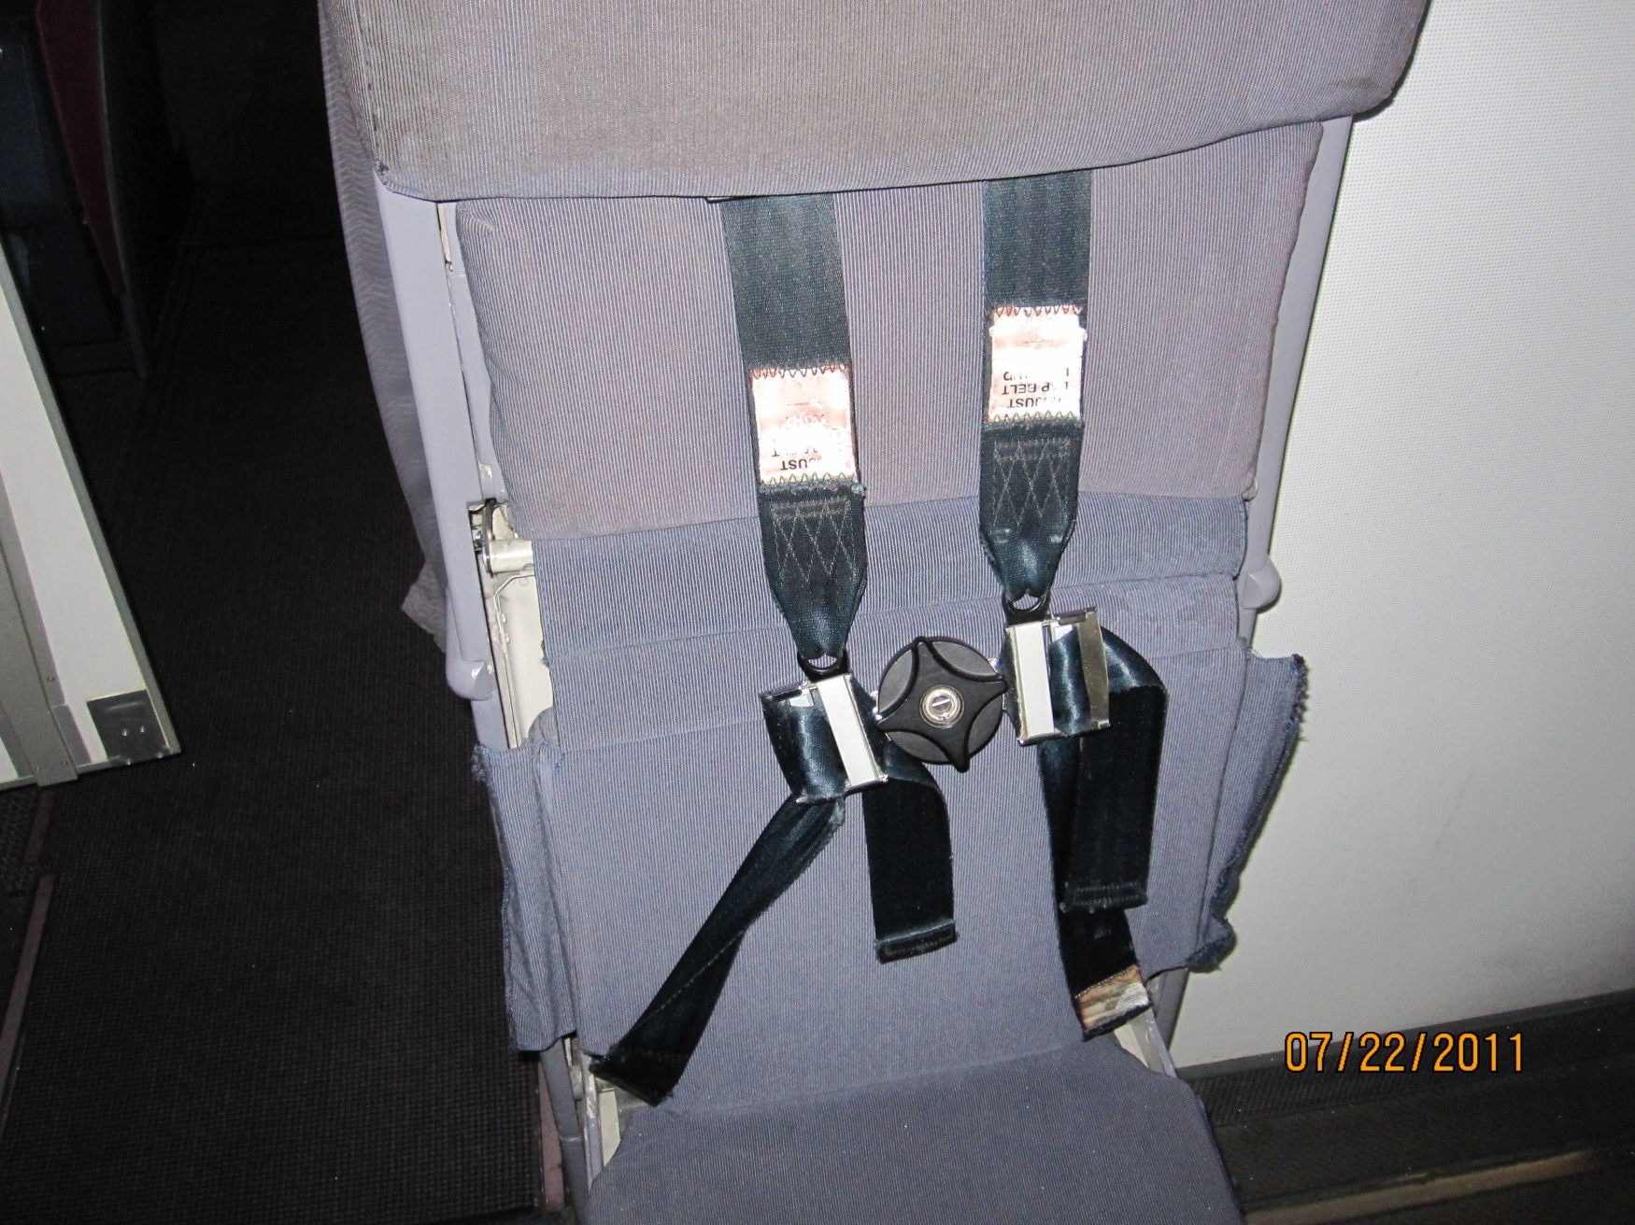

Slide 53
A – Flight Deck
A19. Oxygen equipment
Instructions:
Check for presence, quantity and condition
References:
Annex 6, Part I, 4.3.8 and Part III, Section II, 2.3.8.
Seriousness:
Significant: No direct access
Major: Not available or serviceable for all flight crew members / Oxygen quantity not sufficient

Slide 54
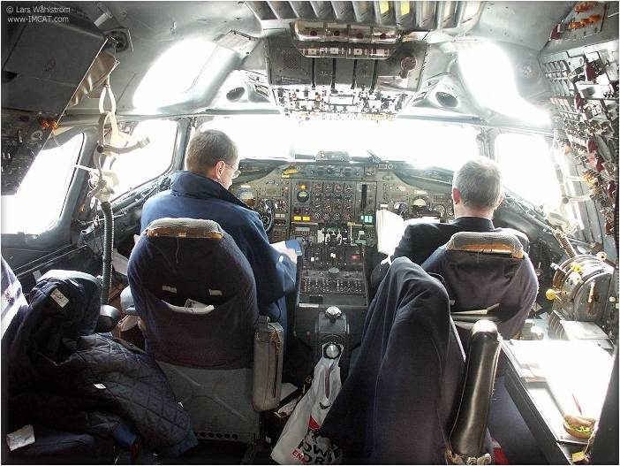
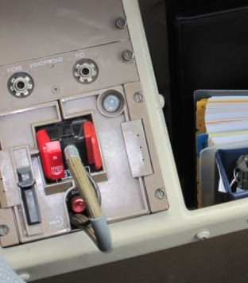

Slide 55
A – Flight Deck
A20. Emergency flashlight
Instructions:
Check for appropriate quantity of emergency. Check their condition if possible
References:
Annex 6, Part I, 6.10; and Part III, Section II, 4.4.2
Seriousness:
Minor: Only one available
Significant: Weak battery
Major: Not in cockpit or unserviceable

Slide 56
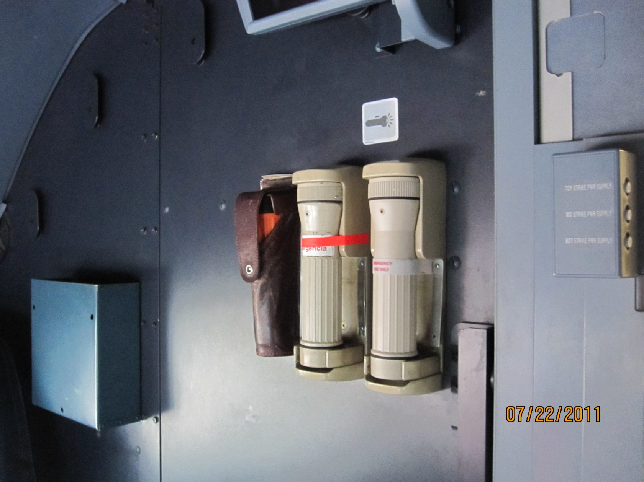

Slide 57
Preguntas por favor

Slide 58
Charles Robles
Inspector de Aeronavegabilidad
DGAC del Perú
chrobles@mintc.gob.pe

Slide 59
Gracias por su atención

