Slide 1
CURRENT AND FUTURE SITUATION OF SURINAME NAVAIDS AND SURVEILLANCE SYSTEM
The Civil Aviation Department of Suriname (CADSUR) under the ministry of Transport, Communication & Tourism is entrusted with the task to provide Air Navigation Services within the airspace of the Republic of Suriname.

Slide 2
CURRENT AND FUTURE SITUATION OF SURINAME NAVAIDS AND SURVEILLANCE SYSTEM
The J.A.Pengel International Airport, the main airport of the country, is the only one that is equipped with Navigational aids systems and recently also with Surveillance systems.

Slide 3
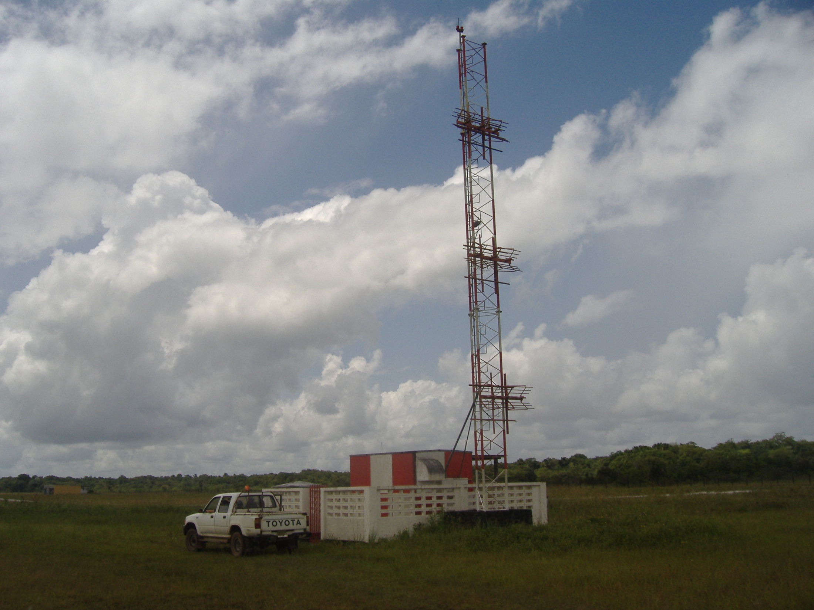
CURRENT AND FUTURE SITUATION OF SURINAME NAVAIDS AND SURVEILLANCE SYSTEM
Following are the Navaids systems that are located at this airport:
1 - Cat I ILS, Rwy 11

Slide 4
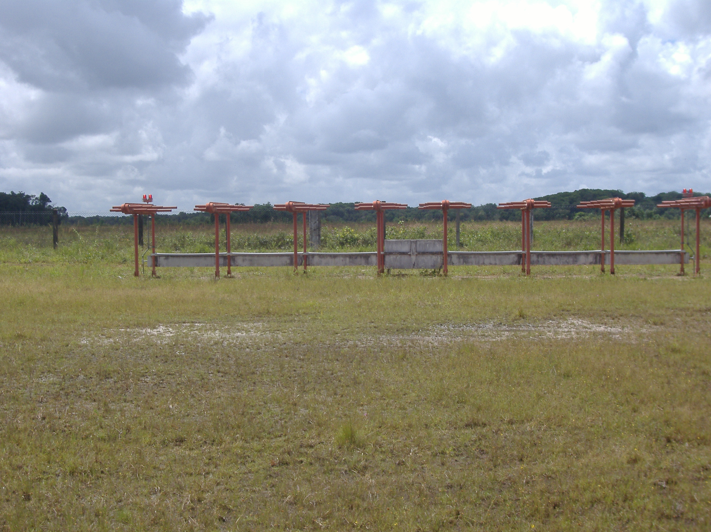
CURRENT AND FUTURE SITUATION OF SURINAME NAVAIDS AND SURVEILLANCE SYSTEM

Slide 5
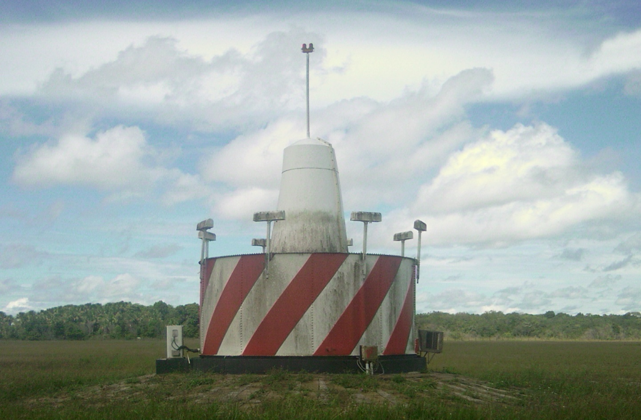
CURRENT AND FUTURE SITUATION OF SURINAME NAVAIDS AND SURVEILLANCE SYSTEM
2 - Conventional enroute VOR collocated with DME

Slide 6
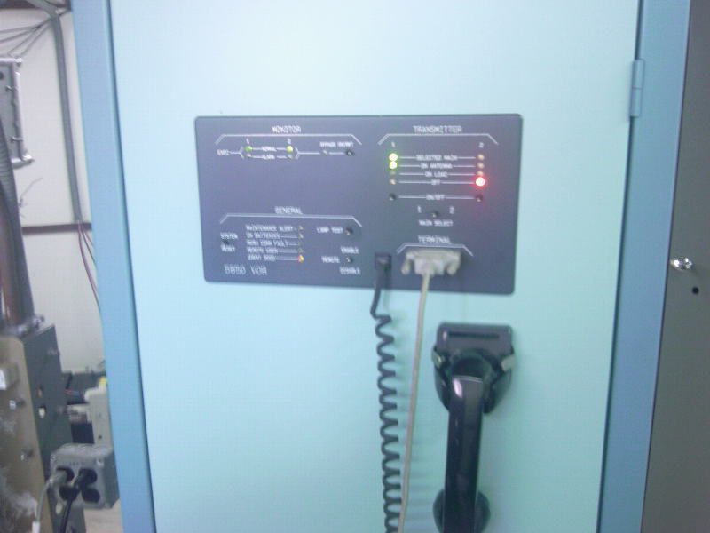
CURRENT AND FUTURE SITUATION OF SURINAME NAVAIDS AND SURVEILLANCE SYSTEM
All these systems are redundant and were commissioned in October 1995 which is 16 years ago but are still operational and in good physical condition.

Slide 7
CURRENT AND FUTURE SITUATION OF SURINAME NAVAIDS AND SURVEILLANCE SYSTEM
Attributing to difficulties in obtaining spare parts these systems will have to be replaced shortly.

Slide 8
CURRENT AND FUTURE SITUATION OF SURINAME NAVAIDS AND SURVEILLANCE SYSTEM
Suriname does not count on its own Flight Inspection Unit. For this reason, it contracted the services from FAA and Sofreavia in the past.
From 1999 up to present the Flight Inspection of the systems are done with the support of and in good cooperation with the company ASECNA from Africa.

Slide 9
CURRENT AND FUTURE SITUATION OF SURINAME NAVAIDS AND SURVEILLANCE SYSTEM
The last Flight Inspection was carried out this year June when all the systems passed the evaluation tests.

Slide 10
CURRENT AND FUTURE SITUATION OF SURINAME NAVAIDS AND SURVEILLANCE SYSTEM
Efforts are made to conduct the inspection annually. However, attributing to difficulties with the allocation of the required funds by the government on time are the cause that sometimes the scheduled date has to be moved to a later date. Since ASECNA is only semi-annually present in the SAM and Caribbean region, the postponement is at least 6 months.

Slide 11
CURRENT AND FUTURE SITUATION OF SURINAME NAVAIDS AND SURVEILLANCE SYSTEM
GROUND TESTS
As part of preventive maintenance activities, regular Ground Inspections are carried out by the technical division of CADSUR according to the instructions given by the manufacturer of the equipment.

Slide 12
CURRENT AND FUTURE SITUATION OF SURINAME NAVAIDS AND SURVEILLANCE SYSTEM
NEW SYSTEMS
During the last Flight Inspection in June, CADSUR has deployed and commissioned an Automatic Surveillance System comprising a Primary Surveillance Radar (60 NM), a Monopulse SSR-Mode S ( 256 NM) and an Air Traffic Management System.

Slide 13
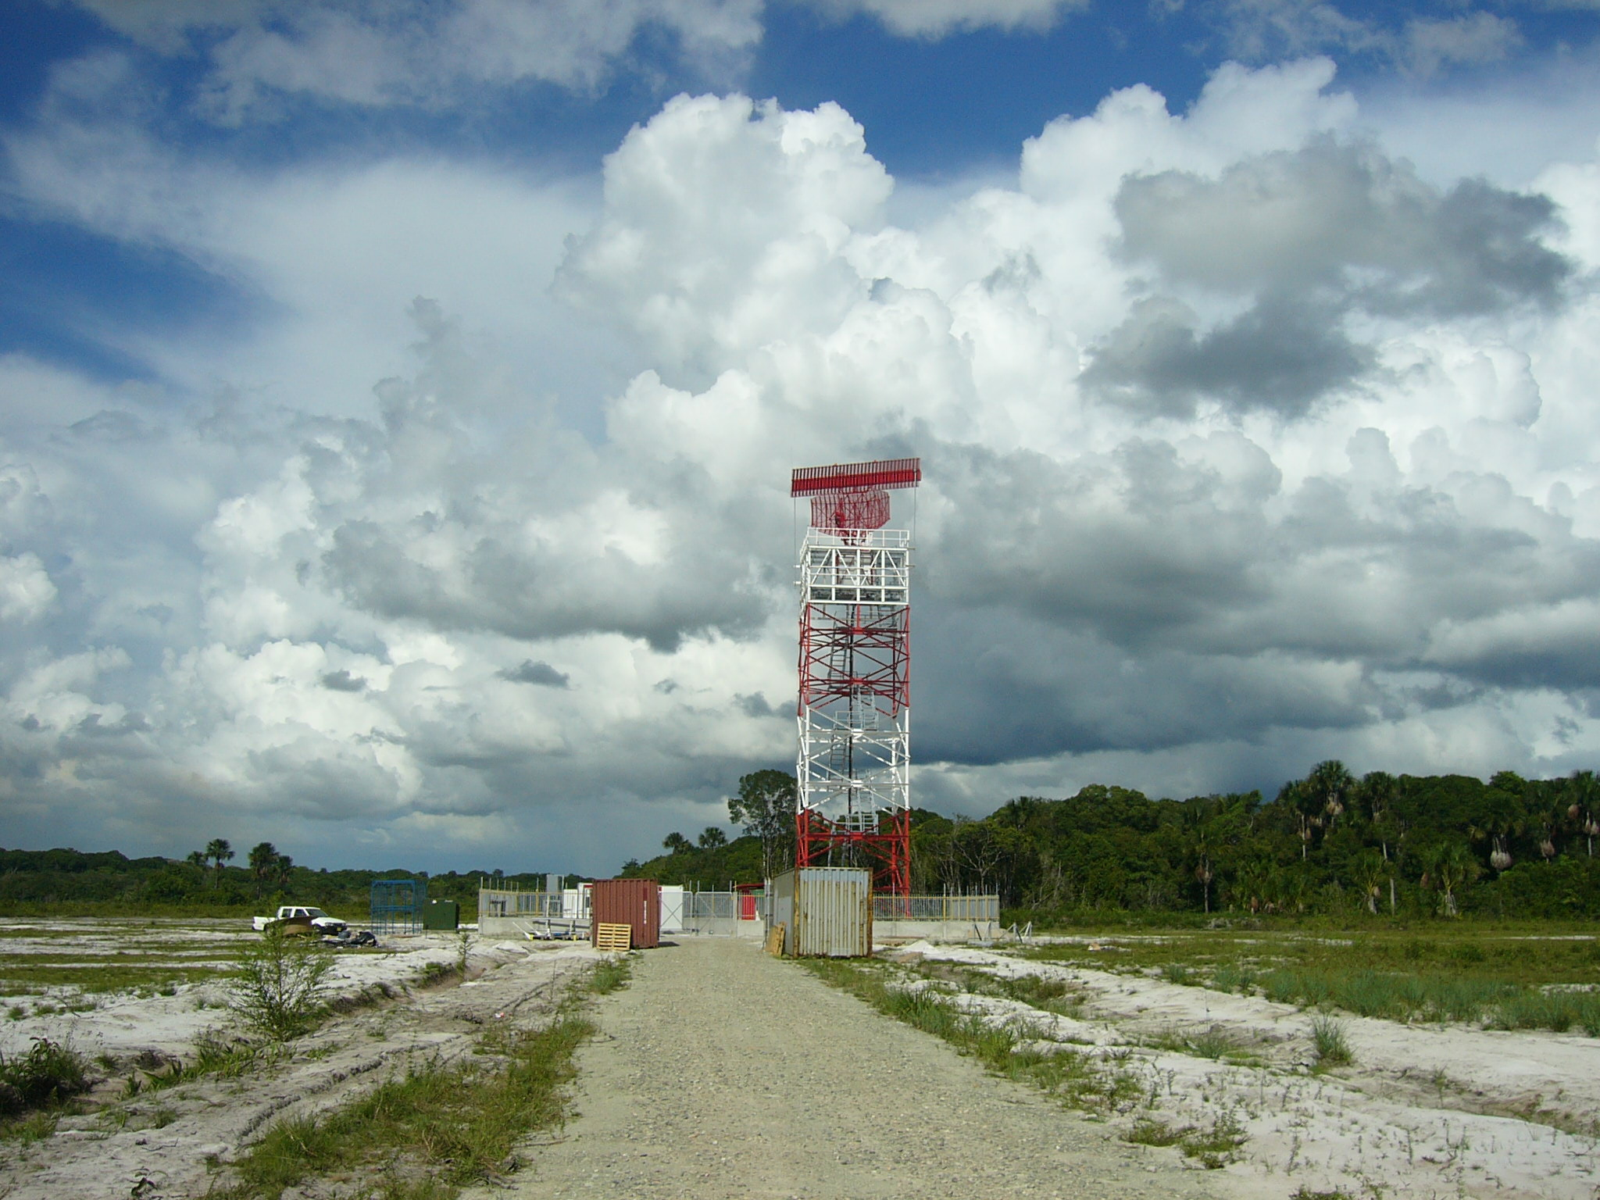
CURRENT AND FUTURE SITUATION OF SURINAME NAVAIDS AND SURVEILLANCE SYSTEM

Slide 14
CURRENT AND FUTURE SITUATION OF SURINAME NAVAIDS AND SURVEILLANCE SYSTEM
NATIONAL DOCUMENT
At present, Suriname does not count on a national document for regulation of Ground and Flight Inspection of its Navaids and Surveillance systems.

