Slide 1
ICAO USOAP CMA Seminar
Exercise 1: LEG/02 – Article 83 bis
Group 5
Verónica Decarlos
Carlos F. Silva Rueda
Ankar Doobay
Tomás Abrego
Clifford Themen

Slide 2
1. Identify audit criteria: The PQ
LEG 1.151 – Ratification and implementation of Article 83 bis
  If the State has ratified Article 83 bis of the Chicago Convention, has it modified the primary aviation legislation, related operating regulations and procedures to reflect the transfer of the duties and responsibilities as envisaged by Article 83 bis?

Slide 3
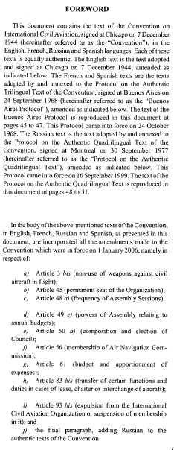
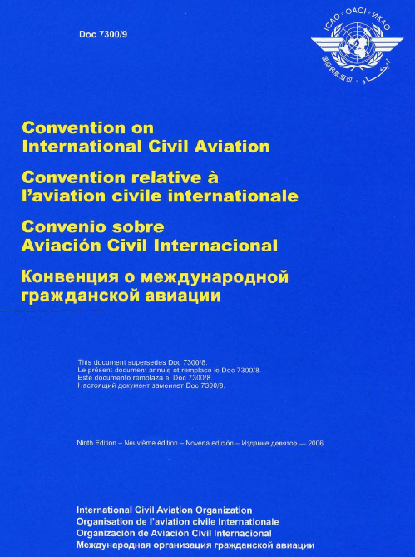
* Article 83 bis *
Article 83 bis*
Transfer of certain functions and duties
a) Notwithstanding the provisions of Articles 12, 30, 3 1
and 32 a), when an aircraft registered in a contracting State is operated pursuant to an agreement for the lease, charter or
interchange of the aircraft or any similar arrangement by an
operator who has his principal place of business or, if he has no such place of business, his permanent residence in another
contracting State, the State of registry may, by agreement with such other State, transfer to it all or part of its functions and duties as State of registry in respect of that aircraft under
Articles 12, 30, 31 and 32 a). The State of registry shall be
relieved of responsibility in respect of the functions and duties transferred.
b) The transfer shall not have effect in respect of other contracting States before either agreement between States in which it embodied has been registered with the Council and made public pursuant to Article 83 or the existence and scope of the agreement have been directly communicated to the authorities of the other contracting States or States concerned by a State party to the agreement.
c) The provisions of paragraphs a) and b) above shall also be applicable to cases covered by Article 77
For all States that have ratified Article 83 bis and have entered into agreements
Establish procedures to:
Transfer its State of Registry’s tasks and functions to another State (State of the Operator).
Accept as a State of Operator relevant tasks and functions of a State of Registry from another State
Provide ICAO and other States concerned with relevant notification or information regarding transfer arrangements
For all States that have ratified Article 83 bis
Recognize certificates of airworthiness, radio licences and/or personnel licences issued/renewed by the State of the Operator operating under an Article 83 bis agreement between third-party States.
h) Article 83 bis (transfer of certain functions and duties in case of lease, charter or interchange of aircraft)
The 23rd Session of the Assembly on 6 October 1980 amended the Chicago Convention by introducing Article 83 bis. This amendment came into force on 20 June 1997.

Slide 4
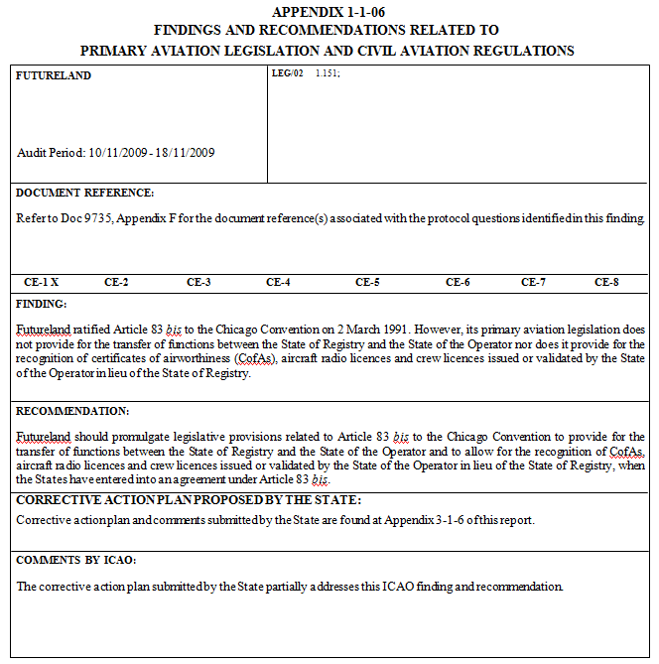
2. Review the F&R
Finding:
The State has ratified Article 83 bis
The State’s primary aviation legislation does not provide for:
  Transfer of functions between States
  Recognition of certificates
Recommendation:
Promulgate legislative provisions on Article 83 bis
Include in the State’s primary aviation legislation provisions for:
  Transfer of functions between States
  Recognition of certificates

Slide 5
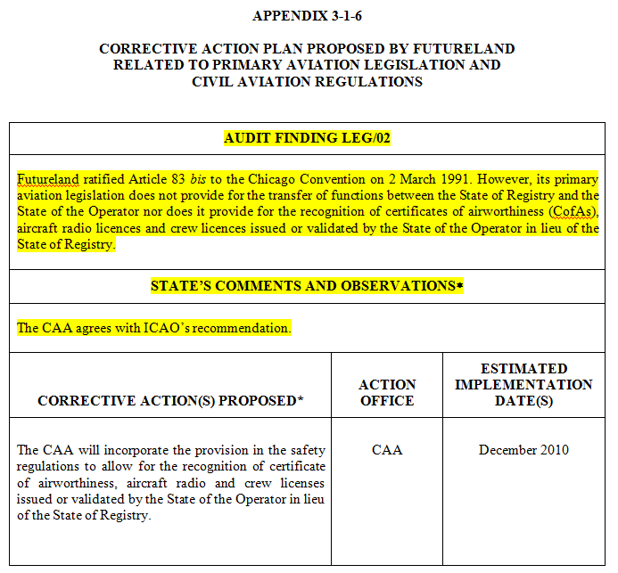
3. State’s CAP
What the Proposed CAP says:
The CAA will make changes to the regulations
The changes will allow recognition of certificates and licences
What the proposed CAP doesn’t say:
No mention of “Transfer of functions from State to State”
No mention of changes to the legislation

Slide 6
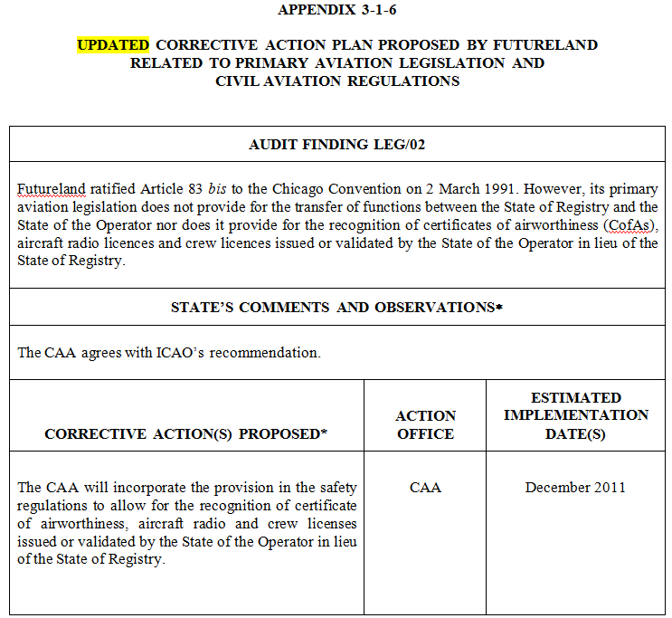
4. State’s CAP Update
What the CAP Update says
The CAA will make changes to the regulations
The changes will allow recognition of certificates and licences
No mention of “Transfer of functions from State to State”
The EID has been moved further by 1 year
No level of progress found

Slide 7
5. Checklist
EXERCISE No. 1 Date:21/SEP/2011 |  | Team: A B C D E F
State: Futureland
Corrective Action Plan (CAP) Evaluation Checklist Form
1. Select one of the following:
1.1 | CAP or CAP update does not address this ICAO finding and recommendation (F&R).
1.2 | CAP or CAP update partially addresses this ICAO F&R. |  | X
1.3 | CAP or CAP update fully addresses this ICAO F&R.
2. Check the applicable column for CAP. |  |  | Yes  | No 
2.1 | The CAP addresses the entire scope of the F&R. All related protocol questions (PQs) have been addressed by corresponding actions. |  |  | X
2.2 | The State has provided sufficient details, especially with regard to implementation. |  |  | X
2.3 | The action office(s) has/have been clearly identified and has/have the authority to complete the corrective action(s). |  |  | X
2.4 | The State has indicated a specific estimated implementation date (EID). |  | X
2.5 | The EID is realistic and commensurate with the risk associated with this F&R. |  |  | X
2.6 | If this F&R has generated a significant safety concern (SSC), sufficient evidence on the immediate action(s) has been provided. |  |  | X
2.7 | Other(s): |  | -- | --

Slide 8
5. Checklist (cont’d)
3. Check the applicable column for CAP updates. |  | Yes  | No 
3.1 | If the Appendix 3 (original) CAP did not fully address the F&R, the CAP has been revised and now fully addresses the F&R. |  | X
3.2 | If the original CAP fully addressed the F&R, the CAP update has provided progress/status for each and every action indicated in the original CAP. |  | X
3.3 | Either a specific completion date or a specific revised EID has been provided for each action. | X
3.4 | The State has clearly indicated the level of progress achieved (e.g. 25%, 50% or 75%) and whether the action has been completed. |  | X
3.5 | Other(s):
4. Indicate the rationale behind your decision(s) regarding acceptability of CAP.
The CAP is not acceptable The PQ and the F&R requests that States establish primary aviation legislation implementing Article 83 bis of the Chicago Convention, and this issue is not addressed in the CAP. Additionally, the CAA is only proposing half of the solution, allowing for the recognition of certificate of airworthiness, aircraft radio and crew licenses.
5. Indicate the rationale behind your decision(s) regarding acceptability of CAP update, if applicable.
The CAP Update is not acceptable The proposed corrective action remains unchanged. Additionally, the EID of it is not realistic, for no action has been taken to date nor have indicated level of progress achieved.

Slide 9
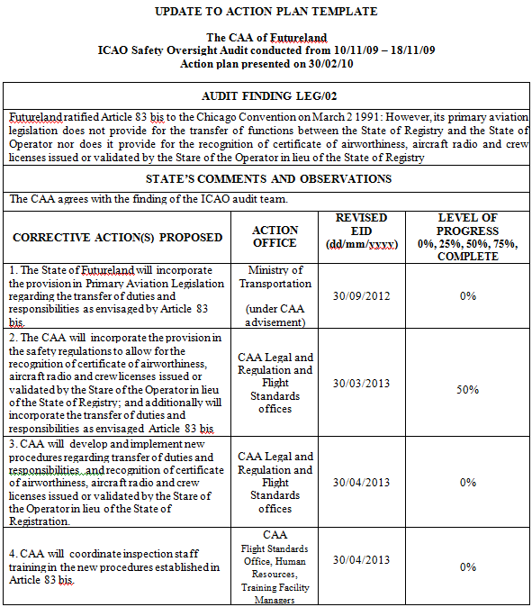
6. (New) CAP Update
In summary:
Implement Article 83 bis provisions in primary aviation legislation (ETA: 1 year)
Implement regulations for the new legislation provisions (ETA: 6 moths after legislation)
Develop new procedures for the new regulations (ETA: 1 month after regulations)
Initiate training for the appropriate CAA staff (ETA: 1 month after regulations)

Slide 10
Thank you
Group 5

