Slide 1
CANSO Safety Standard (CSS) Programme

Slide 2


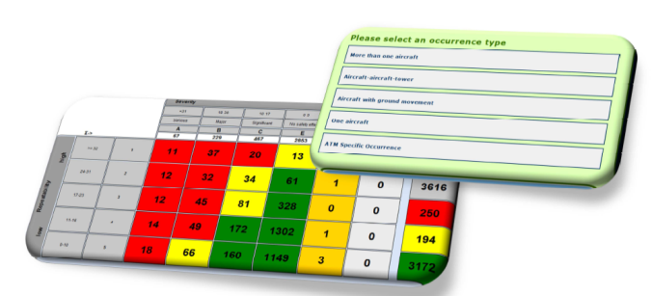
Evolution of CANSO Safety Maturity
CANSO Safety Standard
Programme

Slide 3
CSS Programme Purpose
  Demonstrate the maturity of Safety Management Systems (SMS)
  Measure SMS implementation of CANSO members
  Mechanism for CANSO members to achieve higher levels of safety management
  Increase the influence of the CANSO Standard of Excellence (SoE) in SMS

Slide 4

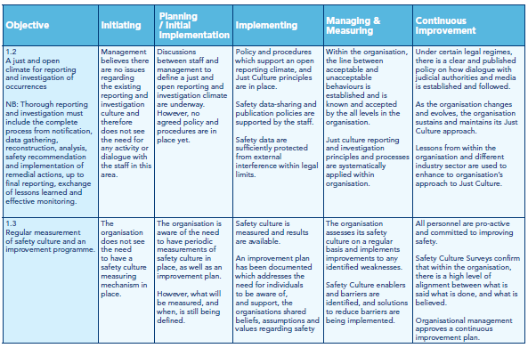
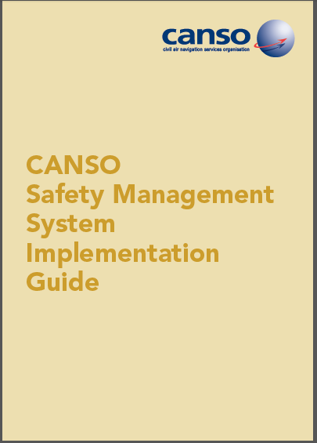
Existing Structure
CANSO Standard of Excellence in SMS
CANSO SMS Implementation Guide
CANSO SMS Maturity Survey

Slide 5
Benefits
Educating members about how higher levels of SMS implementation can be achieved.
Satisfy regulators that Members have met ICAO requirements.
Influence the ICAO view of CANSO safety management products and services.
Avoid regulatory intervention by ICAO to extend its audit programmes to ANSPs.
Secure CANSO’s position as the industry focal point for best practice in safety management.
Motivate current and potential CANSO Full Members.

