Slide 1
AIS/AIM System in South Africa (ATNS)
  Description:
    Dynamic Component comprises of
      Flight Planning and Management
      NOTAM Management (Creation, PIB, etc)
      Internet Briefing and Flight Planning
      AMHS
    Static Component comprises of
      SmartDM (SDO, GV, PAMS, IFS, LRI, etc)
      SmartAIP (AIP production tool)
      SmartCharting (Chart Production Tool)
      Workflow Management (AST for Externel sources to provide data via web-interfaces)
  Specificities:
    Integration with ATC and ATFM (Flow Management)
    Advanced AIS and Internet Briefing component
    Integration to Frequentis NOTAM and Flight Plan Management components
    Integration to any other AIXM databases
    Synchronisation to EAD (Access to Worldwide data)
  Dynamic Component - operational since 2001 (FPL, NOTAM & Briefing Component)
  Static Component - SAT accepted Dec 2012 (Currently populating database with full Dataset)

Slide 2
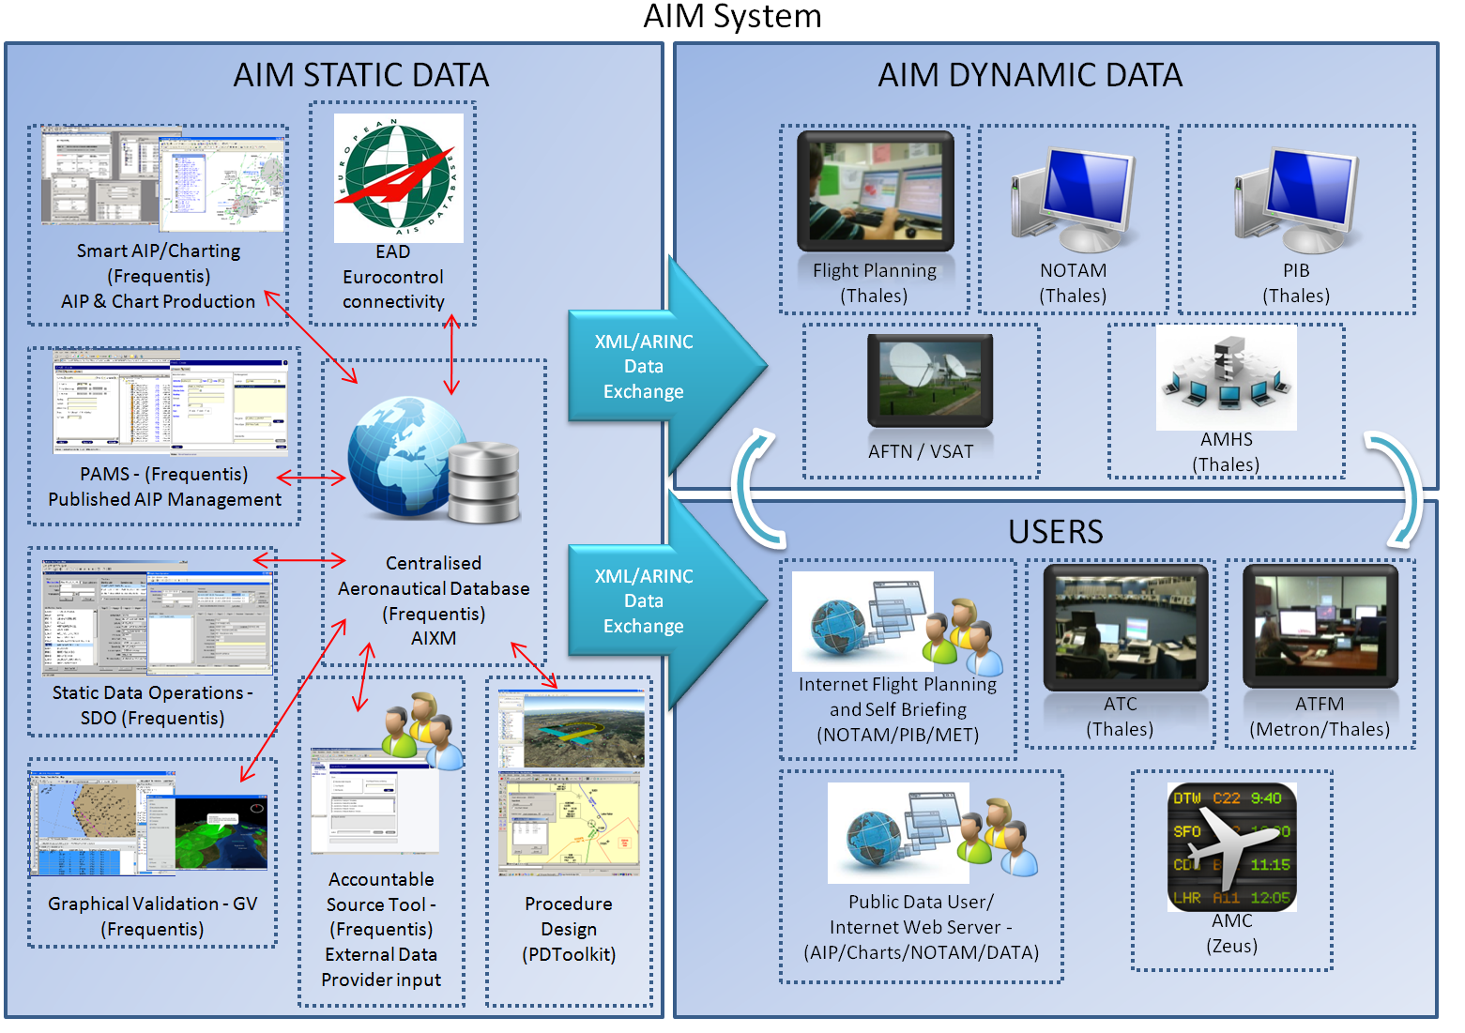
South Africa -AIM system overview

Slide 3
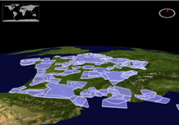
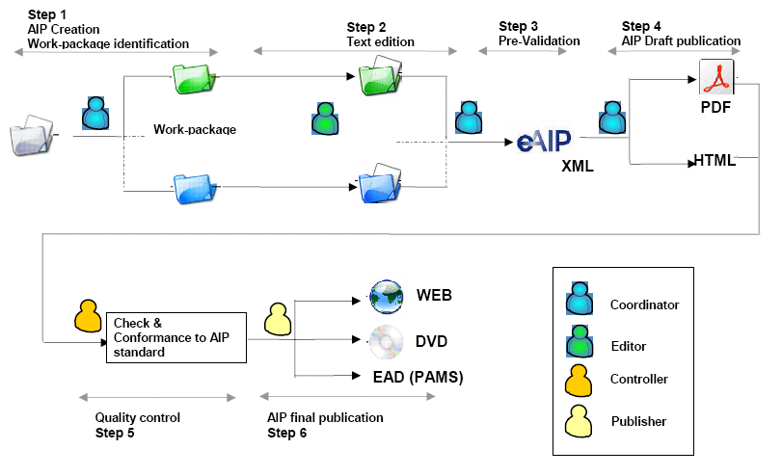
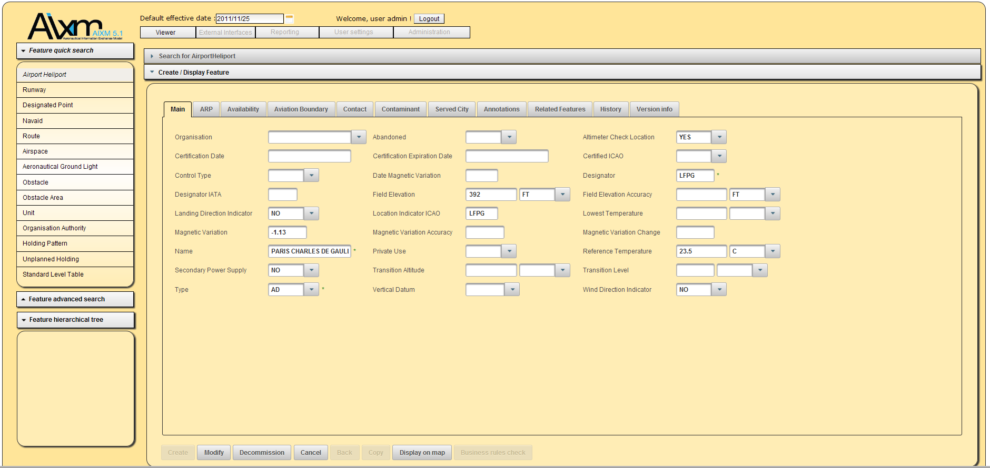
Advantages
Advantages
  AIXM 5.1 Database
    Built on top of latest technical components (JEE6, WFS, NASA World Wind, MDA …)
    Operation oriented input forms for main features in order to mask AIXM5 model complexity to end users
  Electronic AIP
    Integrated workflow
    Automatic generation & publication of PDF, HTML, web site
    Fully compliant with latest Eurocontrol and ICAO specifications
    (XML technologies)
    Full integration with
    AIXM database
    Strong support during AIP migration
  Modular Deployment
Notes:
Note : NANSC a déjà GeoTitan, fourni par EgisAvia

Slide 4
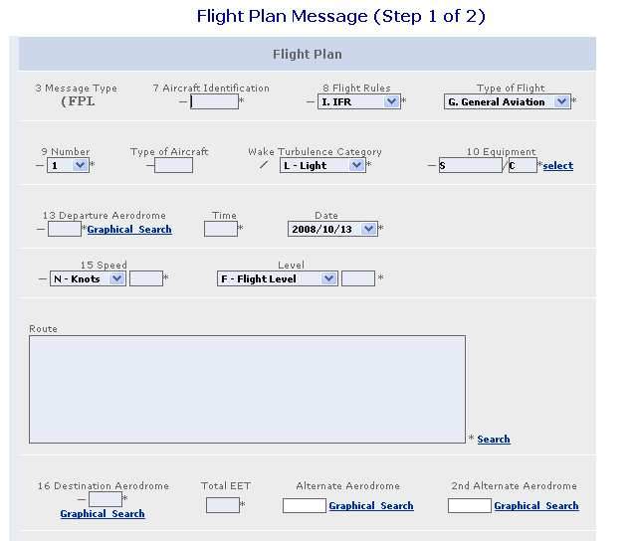
Enabling Innovations - Internet Briefing
  Internet Flight preparation interface
    Self briefing airport position
    Home-briefing internet connexion
  Flight plan submission
    Template
    ICAO format import
    New FPL from existing FPL or template
  Flight plan status (IFPS/CFMU) follow-up
    Users history management in the flight handbook
    Alert via SMS & email
  Integrated PIB (NOTAM + Meteo)
    « FPL from PIB » function
    Narrow route PIB
    Integrated-PIB = NOTAM + Meteo data
    Electronic-PIB = HTML and PDF files

Slide 5
Challenges of ATNS on AIM Capability towards SWIM
Introduction
ATNS is taking a stance on the African Continent and transforming Aeronautical Information Services (AIS) to Aeronautical Information Management (AIM) to Information Management (IM) applying the System Wide Information Management (SWIM) principles by deploying and using leading technologies to the benefit of the ATM Community. Establishing the ATNS Centralized Aeronautical Database (CAD) will proactively contribute towards Global AIM by providing the right quality assumed digital aeronautical information to the right place at the right time and in correct format to support all phases of flight.

Slide 6
Challenges of ATNS on AIM Capability towards SWIM (2)
GENERAL
  System
    ATNS has started the process of acquiring the ATNS CAD that addresses the South African ATM Community requirements;
    The solution contemplated by ATNS provides for the Single National/Regional aeronautical database, with Global interconnectivity, supporting the following applications:
      AIXM 4.5 and 5.1 compatible database;
      Electronic IAIP;
      Published IAIP management tool;
      Charting Tool;
      Procedure Design interconnectivity;
      Static Data Operations (Input and Output) including Remote data input operations;
      Geospatial Information Visualization;
      Internet Services allowing external users to view Static data.

Slide 7
Challenges of ATNS on AIM Capability towards SWIM (3)
  The system has the capability to expand to accommodate future requirements such as:
    x-NOTAM management; and
    integrated METEO Operations.

Slide 8
CONCLUSION
The system identified by ATNS is identical to the European Aeronautical Database(EAD) currently used by EUROCONTROL and the European ATM Community, which will enable the ATNS CAD to synchronize with the European Aeronautical Database, thereby aligning South Africa to comply and contribute towards Global AIM. This database will align with all the Global initiatives in aligning the continent with projects to the like of AIXM, EAD and others.

