Slide 1



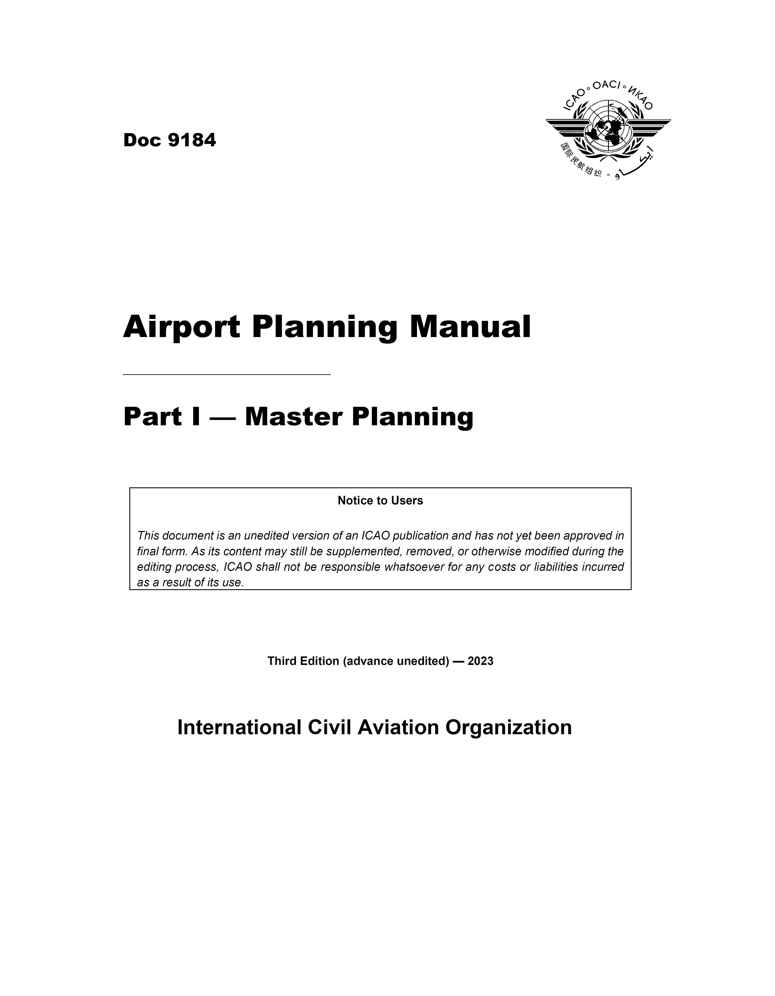
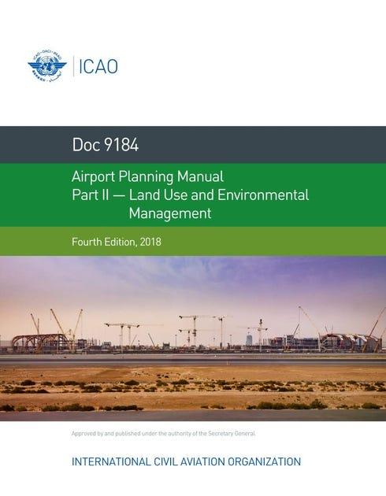
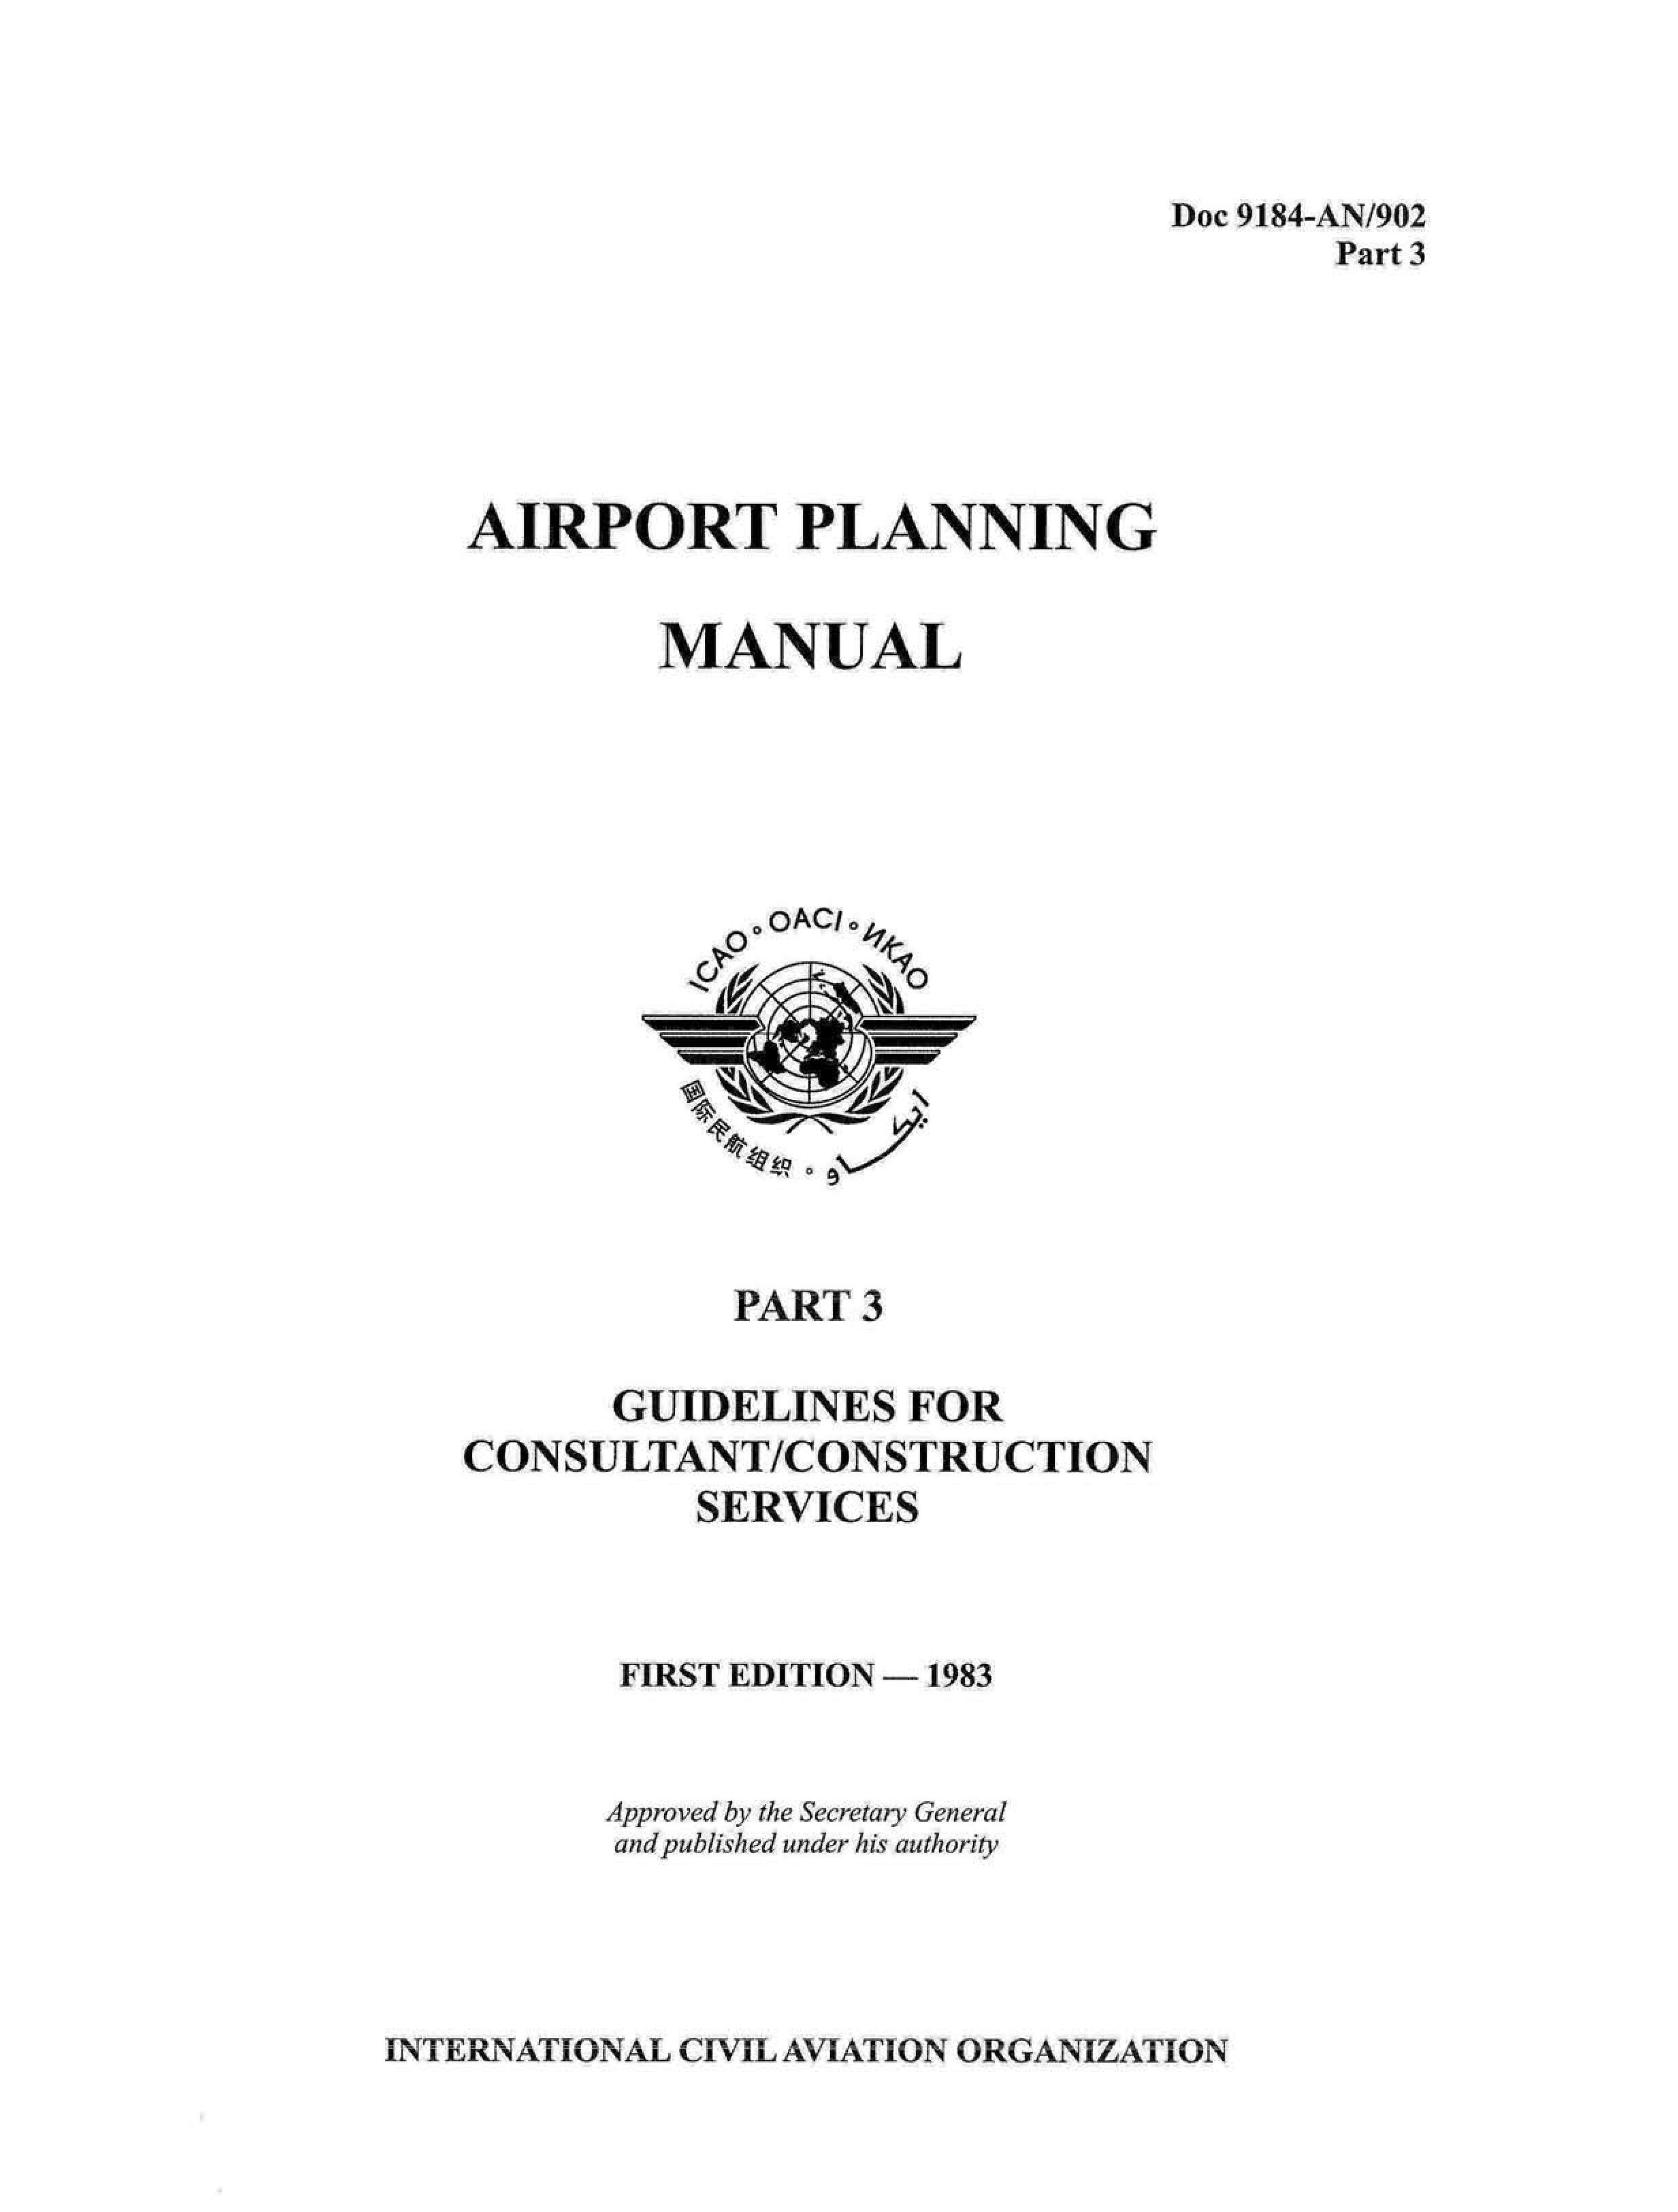


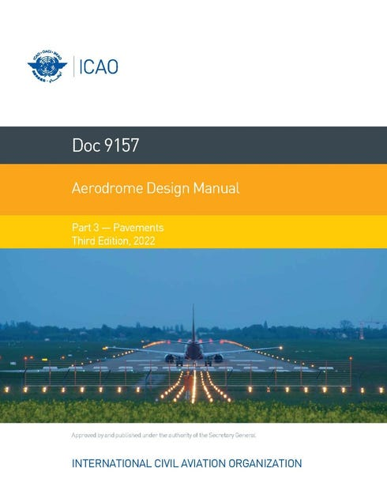



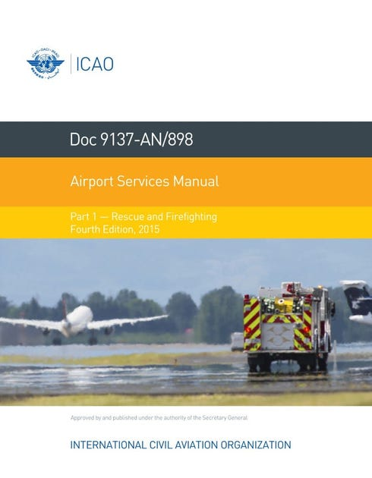
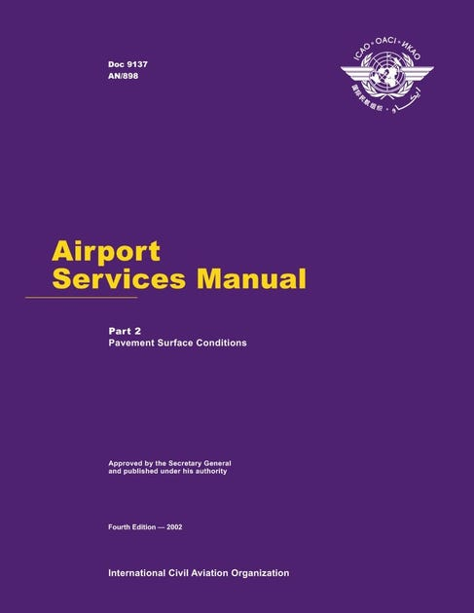
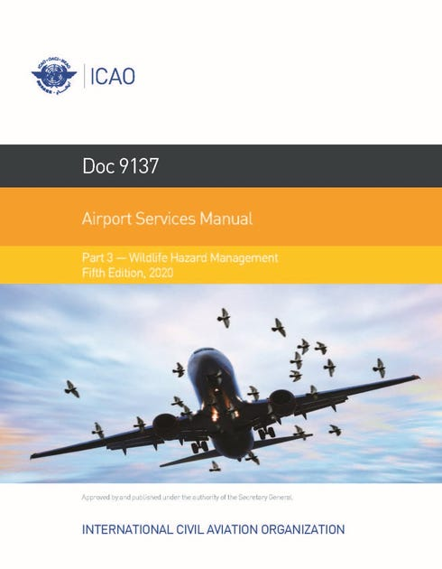
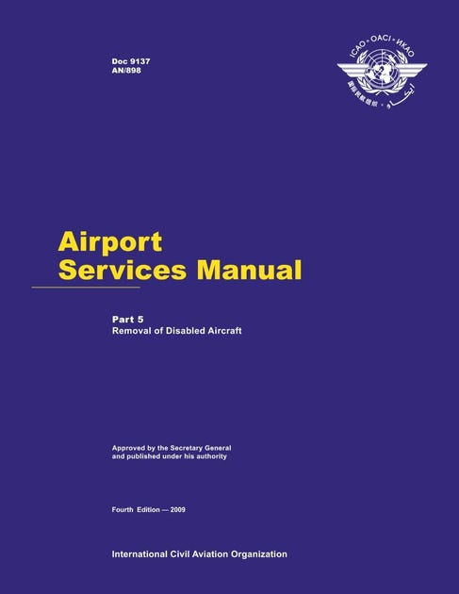
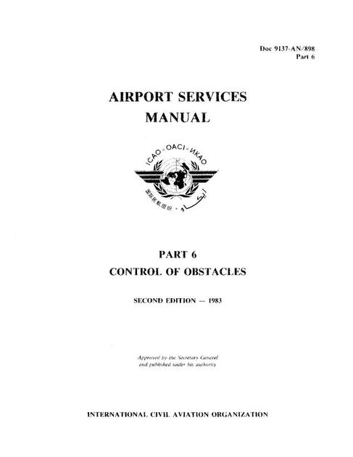
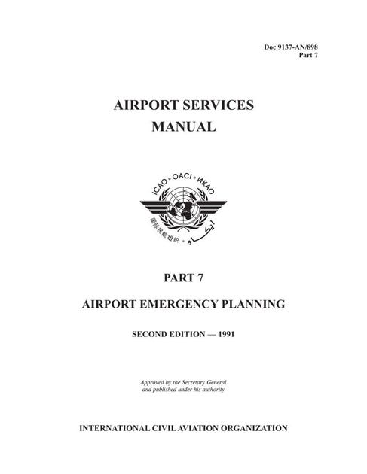

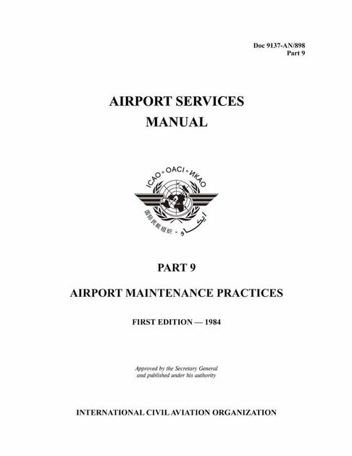





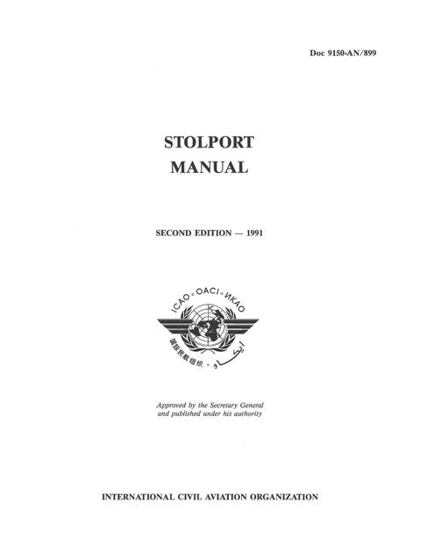
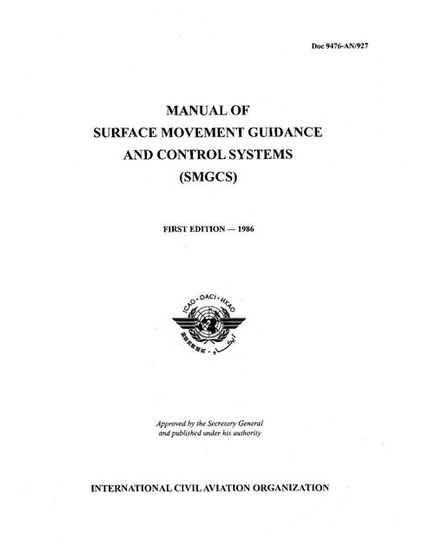
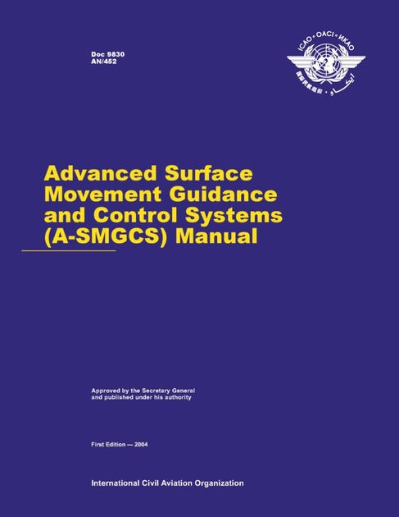


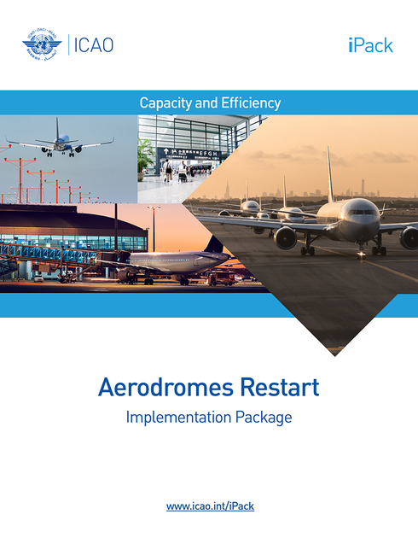
SARPS
Standards and Recommended Practices
Annex 14 – Vol I
Aerodromes Design and Operations
Annex 14 – Vol II
Heliports
PANS
Procedures for Air Navigation Services
Doc 9981
PANS - Aerodromes
Guidelines
Guidance Material
Planning
Doc 9184 – Part 1
Master Planning
Doc 9184 – Part 2
Land Use and Environmental Management
Doc 9184 – Part 3
Guidelines for Consultant/Construction Services
Design
Doc 9157 – Part 1
Runways
Doc 9157 – Part 2
Taxiways, Aprons and Holding Bays
Doc 9157 – Part 3
Pavements
Doc 9157 – Part 4
Visual Aids
Doc 9157 – Part 5
Electrical Systems
Doc 9157 – Part 6
Frangibility
Operations
Doc 9137 – Part 1
Rescue and Firefighting
Doc 9137 – Part 2
Pavement Surface Conditions
Doc 9137 – Part 3
Wildlife Hazard Management
Doc 9137 – Part 5
Removal of Disabled Aircraft
Doc 9137 – Part 6
Control of Obstacles
Doc 9137 – Part 7
Airport Emergency Planning
Doc 9137 – Part 8
Airport Operational Services
Doc 9137 – Part 9
Airport Maintenance Practices
Doc 10163
Manual on High Elevation Aerodrome Operations
Doc 10121
Manual on Ground Handling
Doc 9870
Manual on the Prevention of Runway Incursions
Certification
Doc 9774
Manual on Certification of Aerodromes
Heliports
Doc 9261
Heliport Manual
Others
Doc 9150
Stolport Manual
Doc 9476
Manual of Surface Movement Guidance and Control Systems (SMGCS)
Doc 9830
Advance Surface Movement Guidance and Control Systems
(A-SMGCS)
Doc 9332
Manual on the ICAO Bird Strike Information System
(IBIS)
Cir 305
Operation of New Larger Aeroplanes at Existing Aerodromes
iPack
Aerodrome Restart

