Slide 1

Lecture on ATFM/CDM
ATFM Workshop Asia Pacific 2014 (Day1)

Slide 2


Lecture Plan
Goal
Case study
Quiz
Principle
Doc 9971
ATFM Lecture:
1 day
Warm-up Exercise
You

Slide 3
Warm-up Exercise
“ Water Taps and Containers”

Slide 4
Water Taps and Containers

Slide 5
Water Taps and Containers
Next

Slide 6
Change to a Large Container
Back

Slide 7
Manage the Green Tap
Back

Slide 8
Use the Blue Tap
instead of the Green Tap
Back

Slide 9
Manage the Brown Tap
(Original one)
Back

Slide 10
Original Tab………….Departure Airport
Containers……………ATC Sectors
Size of Container….Capacity
Amount of Water...Traffic Volume
(Demand)

Slide 11
These techniques can be ATFM techniques/measures

Slide 12
Principle
To increase airspace capacity
Notes:
Example : change to large size of container

Slide 13
ATFM can optimize airspace capacity
However, ATFM is NOT a magic word to increase airspace capacity

Slide 14
CNS
Capability
Others
Separation
Standards
To increase
Airspace Capacity
ATC
Procedures
PBN
ATM System
Capability
FUA
Airspace
Design
AIDC
Notes:
The first step : enhance capacity

Slide 15
ATFM can optimize airspace capacity
However, ATFM is NOT a magic word to increase airspace capacity
ATFM is a tool to manage capacity
ATFM is very useful and helpful in case of unexpected runway closure and significant meteorological events

Slide 16

What is ATFM?
ATFM is
demand/capacity balancing
Demand
Capacity

Slide 17
Demand vs Capacity
Demand=80, Capacity=100
80/100=80%
Demand
Capacity

Slide 18
Demand vs Capacity (cont’d)
Demand=125, Capacity=100
125/100=125% (exceeding capacity by 25%)
Capacity
Demand

Slide 19
Demand vs Capacity (cont’d)
Demand=125, Current Capacity=100
125/100=125% (exceeding capacity by 25%)
Enhance capacity
by introducing reduced separation minima

Slide 20


Introducing Reduced separation minima
Sector B
Sector A
Airway xxx
10 minutes
-> 50NM
Airway yyy
Sector C
Sector D

Slide 21
Demand vs Capacity (cont’d)
Demand=125, Current Capacity=100
125/100=125% (exceeding capacity by 25%)
Enhance capacity
by introducing reduced separation minima
or
by introducing PBN PBN: Performance Based Navigation

Slide 22
Introducing PBN
PBN: Performance Based Navigation
Sector B
Sector A
Airway xxx
Sector C
Sector D

Slide 23
Introducing PBN
PBN: Performance Based Navigation
Sector B
Sector A
PBN route xxx
PBN route yyy
Sector C
Sector D

Slide 24
Demand vs Capacity (cont’d)
Demand=125, Current Capacity=100
125/100=125% (exceeding capacity by 25%)
Enhance capacity
by introducing reduced separation minima
or
by introducing PBN PBN: Performance Based Navigation
or
by introducing FUA FUA: Flexible Use of Airspace

Slide 25
Introducing FUA
FUA: Flexible Use of Airspace
Sector B
Sector A
Airway xxx
Military Training Air Space
Sector C
Sector D

Slide 26
CNS
Capability
Others
Separation
Standards
To increase
Airspace Capacity
ATC
Procedures
PBN
ATM System
Capability
FUA
Airspace
Design
AIDC

Slide 27
Demand vs Capacity (cont’d)
Demand=125, Current Capacity=100
125/100=125% (exceeding capacity by 25%)
Enhance capacity
by introducing reduced separation minima
or
by introducing PBN PBN: Performance Based Navigation
or
by introducing FUA FUA: Flexible Use of Airspace
Demand Management
by introducing ATFM
Notes:
ATFM can optimize airspace capacity
ATFM is a tool to manage capacity

Slide 28
Doc 9971
Manual on Collaborative Air Traffic Flow Management
With Doc No. : Global Document
Without Doc No. : Regional Document

Slide 29
Doc 9971
Doc 9971 has been published in 2012 with only Part 1 – Collaborative Decision Making (CDM)
Doc9971 Part 2 – Air Traffic Flow Management (ATFM)
This document was created by “ATFM coordination team” led by ICAO HQ (Brazil, EUROCONTROL, FAA, Hong Kong, India, Japan, Russia, Thailand, IATA, CANSO, ICAO ROs)

Slide 30

Doc 9971 (cont’d)
Doc 9971 is intended to for the following stakeholders;
  Air navigation service providers
  Airspace users
  Airline operation centers
  Airport operators
  Airport ground handlers
  Airport slot coordinators
  Regulators
  Military authorities
  Security authorities
  Meteorological agencies
  Industries related to aviation

Slide 31
Doc 9971 (cont’d)
Doc 9971 shows basic ideas of ATFM
  What is the starting point regarding the development of an ATFM service?
  What are the foundational objectives and principles of ATFM?
  What are the benefits of implementing an ATFM service?
  How does an ATFM service operate?
  How is an ATFM service structured and organized?
  What are the roles and responsibilities of the stakeholders in the ATFM service?
  How is the capacity of an airspace sector and airport determined?
  How are ATFM processed applied in order to balance the demand and capacity within its area of responsibility?
  How is an ATFM service implemented?
  What are ATFM Measures and how are they established and applied?
  What data and information are exchanged in an ATFM service?
  What terminology/phraseology is used in ATFM?
  What resources are available to States regarding the various aspects of ATFM?

Slide 32
Doc 9971 (cont’d)
In addition, as Appendix
  Sample of international ATFM operations planning telephone conference format
  Sample of ATFM data exchange agreement
  Determining airport acceptance rate (FAA)
  Determining sector capacity (FAA)
  Example of capacity planning and assessment process (Euro Control)
  Example of planning process for ATFM implementation
  Template of letter of agreement between flight management units

Slide 33
Doc 9971 (cont’d)
Chapter 1. Introduction
Chapter 2. The ATFM service
Chapter 3. ATFM structure and organization
Chapter 4. Capacity, demand and ATFM phases
Chapter 5. ATFM implementation
Chapter 6. ATFM measures
Chapter 7. Data exchange
Chapter 8. ATFM communication
Appendix A.-G.

Slide 34
Chapter 1

Slide 35
Chapter 1
Introduction
  ATFM philosophy
  ATFM objective and principles
  ATFM benefits

Slide 36
Chapter 1. Introduction
ATFM philosophy
  ATFM is an enabler of air traffic management (ATM) efficiency and effectiveness.
  It contributes to the safety, efficiency, cost effectiveness, and environmental sustainability of an ATM system.

Slide 37

Chapter 1. Introduction (cont’d)
The objectives of ATFM are to:
  Enhance the safety
  Reduce ATC workload
  Optimize airspace capacity
  Maximize operational benefits and global efficiency

Slide 38

Chapter 1. Introduction (cont’d)
Keys to the successful implementation
  The CDM process is a key enabler of an ATFM strategy
  Achieving a robust coordination among aviation stakeholders (CDM)
    All the stakeholders work together to
    improve the overall performance of
    the ATM system
    Such coordination will take place
    within a FIR, between FIRs,
    and ultimately, between regions
Notes:
Stakeholders means all of you, ANSP, AU, Airport, military etc

Slide 39


Chapter 1. Introduction (cont’d)
Keys to the successful implementation
  ATFM and its applications should NOT be restricted to one State or FIR
    because of their far-reaching effects on the flow of traffic elsewhere
    PANS-ATM, Doc 4444 states that ATFM should be implemented on the basis of a regional air navigation agreement or, when appropriate, as a multilateral agreement
  Airspace is a common resource for all users and ensure equity and transparency
Notes:
This is important, especially in Asia region. That’s why Singapore, Thailand, Hong Kong have started their coordination as to ATFM. China, Japan, Korea have just started to establish harmonization group.

Slide 40
Case Study
(ATFM)

Slide 41

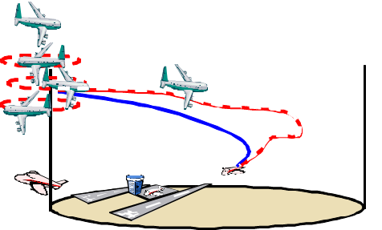
EOBT 1000z
Take off 1015z
ETA (Dest) 1300z
Airborne Holding
For
30min
Push back 1000z
Take off 1015z
Landing 1330z

Slide 42
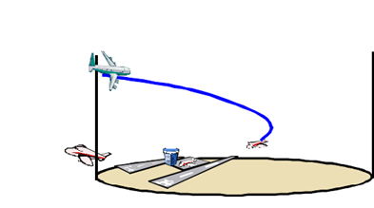
EOBT 1000z
Take off 1015z
ETA (Dest) 1300z
Push back 1000z
Take off 1015z
-> 1030z
-> 1045z
Landing 1330z

Slide 43
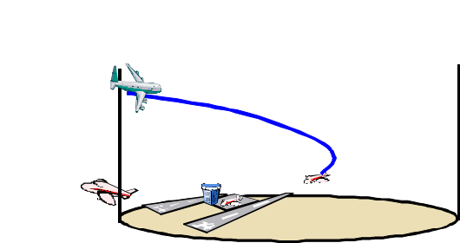




Case 1
EOBT 1000z
Push back 1000z
Take off 1015z
Airborne holding 30min
Landing 1330z
30min
ATFM
Case 2
EOBT 1000z
Push back 1030z
Take off 1045z
Airborne holding 0min
Landing 1330z
Airlines : Save FUEL, Cut CO2 emission
ATC : Reduce workload
Overall : Enhance safety and efficiency
30min

Slide 44
Case Study
(A-CDM)

Slide 45






EOBT 1000z No.10 Departure sequence
Push Back 1000z
Taxiing 5min
Line up 25min
Take off 1030z
16R
34L

Slide 46
EOBT 1000z No.10 Departure sequence
Push Back 1000z
Taxiing 5min
Line up 25min
-> 1020z
-> 4min
Take off 1030z
-> 6min
16R
34L

Slide 47











Case 1
EOBT 1000z
No.10 Dep sequence
Take off 1030z
Push back 1000z
16R
34L
Case 2
EOBT 1000z
No.10 Dep sequence
Take off 1030z
Push back 1020z
16R
34L
A-CDM & DMAN
Airlines : Save FUEL, Cut CO2 emission
ATC : Reduce workload
Overall : Enhance safety and efficiency

Slide 48
ATFM benefits
Operational and societal:
  Enhanced ATM system safety
  Increased operational efficiency and predictability
  Effective management of capacity and demand
  Increased situational awareness among stakeholders
  Reduced fuel burn and operating costs (greenhouse gas emissions)
  Effective management of irregular operations
  And more…
Notes:
As we could see from case studies,
Safety is our priority
Irregular operations means such as runway closure by accident, airport acceptance rate can be 0 for a while. In that case ATFM is very useful

Slide 49
Summary of Chapter 1
The objectives of ATFM
  Enhance the safety
  Reduce ATC workload
  Optimize airspace capacity
  Maximize operational benefits and global efficiency
Keys to the successful implementation
  CDM process is a key enabler of ATFM strategy
  Airspace is a common resource for all users and ensure equity and transparency

Slide 50
Chapter 2

Slide 51
Chapter 2
The ATFM service
  How does an ATFM service operate?
  Collaborative Decision Making (CDM) in the context of ATFM
  CDM organization and structure
  CDM requirements and benefits
  ATFM, CDM, and Civil/Military coordination

Slide 52
Chapter 2. The ATFM service
“first come, first serve” and “equitable access to airspace” have traditionally been very important
To support global ATM evolution, priorities can be changed such as “most capable, best served”
“equitable access to airspace” may be viewed on a longer time scale than the short time “first come, first serve” model

Slide 53
Case Study
(Most capable, Best served)

Slide 54

FL340
FL330
5minutes/40NM
FL320
8minutes/65NM
FL310
RNP4
FL300
RNP10
FL290
Request climb to FL320
No ADS
FL280
ATC separation Minimum
(Oceanic with ADS)
RNP4
30NM
RNP10
50NM
Unable!
No ADS
10minutes

Slide 55
FL340
FL330
5minutes/40NM
FL320
8minutes/65NM
FL310
RNP4
FL300
RNP10
FL290
Request climb to FL320
RNP10
No ADS
FL280
ATC separation Minimum
(Oceanic with ADS)
RNP4
30NM
RNP10
50NM
Climb to FL300
No ADS
10minutes

Slide 56
FL340
FL330
5minutes/40NM
FL320
8minutes/65NM
FL310
RNP4
FL300
RNP10
FL290
Request climb to FL320
RNP4
No ADS
FL280
ATC separation Minimum
(Oceanic with ADS)
RNP4
30NM
RNP10
50NM
Climb to FL320
No ADS
10minutes

Slide 57
9minutes/72NM
REQ FL340
FL340
REQ FL330
FL330
REQ FL320
FL320
No ADS
FL310
RNP4
RNP10
REQ FL310
RNP10
FL300
4minutes/35NM
RNP4
RNP10
45NM
FL290
RNP10
FL280
40NM
RNP4
FL280
ATC separation Minimum
(Oceanic with ADS)
RNP4
30NM
RNP10
50NM
No ADS
10minutes

Slide 58
REQ FL340
FL340
REQ FL330
FL330
REQ FL320
RNP4
FL320
No ADS
FL310
RNP4
RNP10
REQ FL310
RNP10
FL300
RNP4
RNP10
FL290
RNP10
FL280
RNP4
FL280
ATC separation Minimum
(Oceanic with ADS)
RNP4
30NM
FL300
RNP10
50NM
No ADS
10minutes

Slide 59
REQ FL340
FL340
REQ FL330
FL330
REQ FL320
FL320
No ADS
FL310
RNP4
RNP10
REQ FL310
RNP10
FL300
RNP4
RNP10
FL290
RNP10
FL280
No ADS
RNP4
FL280
ATC separation Minimum
(Oceanic with ADS)
RNP4
30NM
FL300
RNP10
50NM
RNP4
No ADS
10minutes

Slide 60

What do you need for ATFM service
ATFM Service relies on a number of supporting systems, processes and operational data in order to function effectively
ATM resources
Traffic demand
Tactical, dynamic traffic situation
Meteorological situation
Airspace status
ATFM tools
Institutional arrangement

Slide 61


ATM resources
ATFM recognizes that airspace and airports are common resources shared by all AUs and that equity and transparency must be maintained to the highest standard

Slide 62

Traffic demand
Data should be aggregated from all available operational data sources
  Airline schedules
  Flight plan data
  Airport slot management systems
  ATM operational systems
  AU intentions
Notes:
AU intentions important as well

Slide 63


Tactical, dynamic traffic situation
Accurate and timely data derived from surveillance and flight information , to increase the accuracy of short to medium term prediction

Slide 64
Meteorological situation
The integration and display of a variety of meteorological data for ATFM planning and operation execution
  Forecast WX
  Dynamic WX

Slide 65
Airspace status
The airspace status and the availability of restricted or reserved airspace resources that affect the flows of air traffic

Slide 66
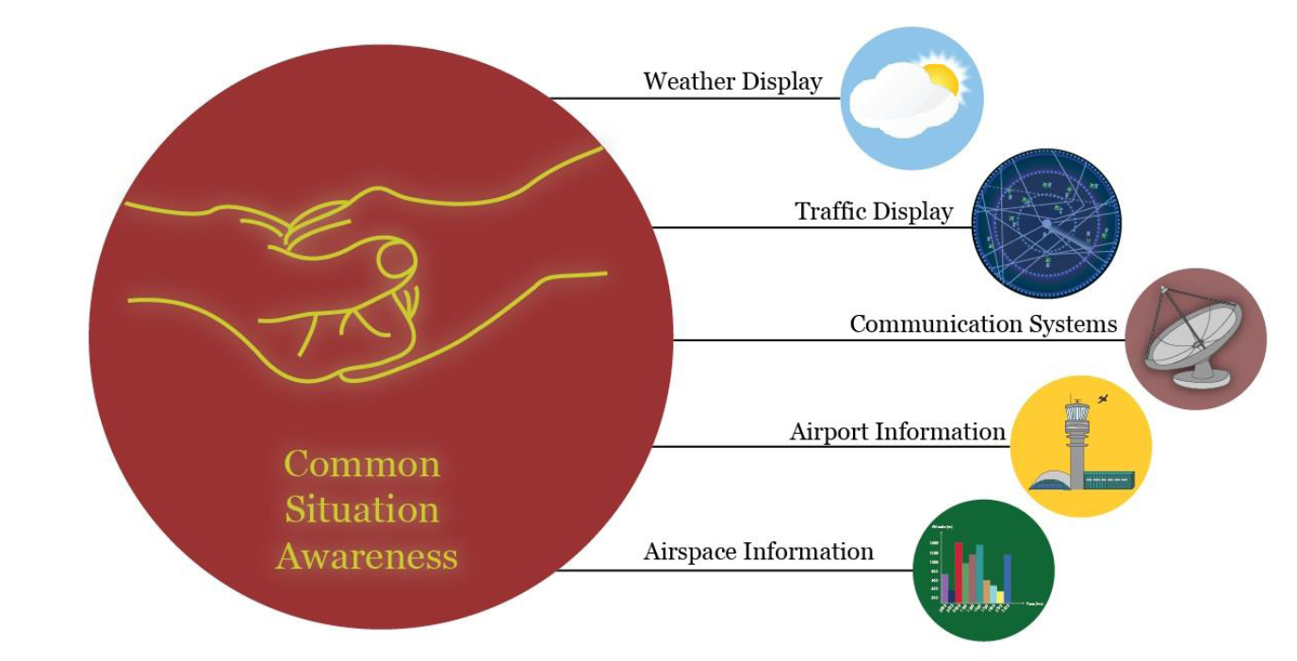
ATFM tools
Tools that enable common situational awareness through the sharing of data and operational information among stakeholders
Notes:
No need such tools from the beginning, we can introduce tools step by step

Slide 67

Institutional arrangements
Formalized agreements between all ATFM stakeholders in the relevant area and appropriate arrangements with adjacent ATFM units
Notes:
I would like to repeat, stakeholders means all of you, not only ANSP but also Airlines, Airport, Military etc

Slide 68


How does an ATFM service operate?
ATFM itself and information regarding ATFM must inform AUs as early as possible
AUs
ATFM
As early as possible
Information of ATFM

Slide 69

How does an ATFM service operate? (cont’d)
A strategy should collaboratively be agreed upon in advance
ATFM
ATS
Facilities
AUs

Slide 70
How does an ATFM service operate? (cont’d)
ATFM measures should;
  be kept to the minimum and, whenever possible, be applied selectively only to that part of the system that is constrained
  be established and coordinated so as to avoid , if at all possible, having cumulative or contradictory effects on the same flights
Notes:
Minimum, this is important

Slide 71

How does an ATFM service operate? (cont’d)
Automated tools should be implemented if needed and utilized to allow for effective collaboration and dissemination of ATFM information
Notes:
Automated tools is useful, but no need from the beginning.

Slide 72
How does an ATFM service operate? (cont’d)
CDM should;
  be utilized to manage flows of traffic through all components of the ATM system
  Occur within and between regions where significant traffic flows force them to interact with each other

Slide 73

How does an ATFM service operate? (cont’d)
ATFM planning should, as much as possible, focus on regional ATFM and be prioritized for the appropriate major traffic flows
Notes:
Again, we need to think about regional ATFM or sub-regional ATFM

Slide 74
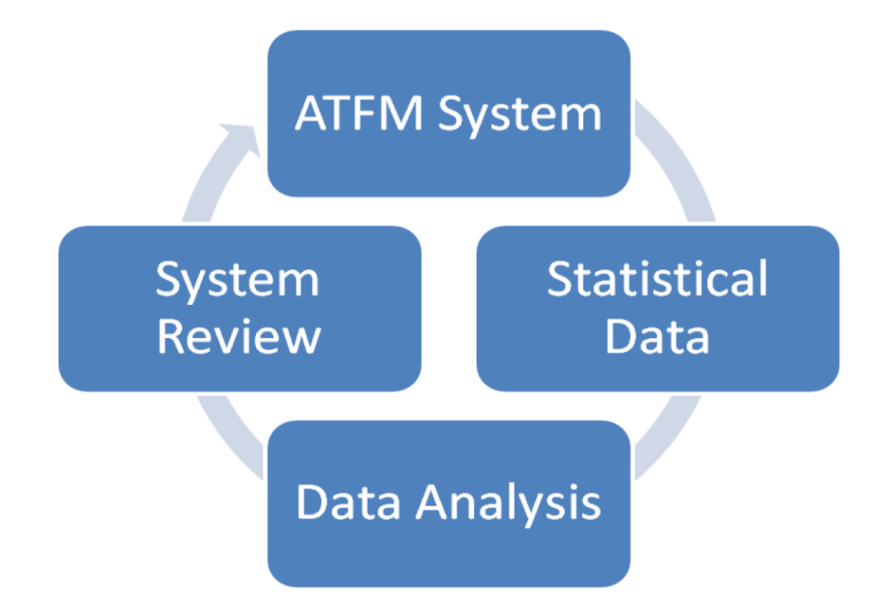
How does an ATFM service operate? (cont’d)
ATFM traffic data analysis can yield significant strategic benefits in terms of future ATM systems and procedure improvements
Notes:
Data analysis is very important. We need to review what was good, what was bad, what we can do for better operation.
For example, FAA does data analysis meeting everyday for operation improvements.

Slide 75
How does an ATFM service operate? (cont’d)
States may choose to prioritize or exempt certain classes of flight from ATFM measures
  Examples of such flights include but are not limited to;
    Flights experiencing an emergency
    Flights on search and rescue or fire fighting missions
    Urgent medical evacuation flights
    Flights with ‘Head of State’ status
    Other flights specifically identified by State authorities

Slide 76

CDM in the context of ATFM
The CDM process is a key enabler of an ATFM strategy
CDM is not an objective in itself
CDM ensures that decisions are taken transparently and are based on the best information available as provided by the participants in a timely and accurate manner

Slide 77

CDM organization and structure
The structure must be designed to ensure that the affected stakeholders, ANSPs and AUs alike, can discuss airspace, capacity and demand issues through regular meeting sessions and formulate plan that take all pertinent aspects and points of view into account

Slide 78
CDM organization and structure (cont’d)
Frequent tactical briefings and conferences
  Provide an overview of the current ATM situation
  Discuss any issues and provide an outlook of operations for the coming period
  Occur at least daily, may more frequently depending on the traffic and capacity situation
  Participants should include involved ATFM and ATS units, AUs, military authorities and airport authorities

Slide 79
CDM organization and structure (cont’d)
ATFM daily plan (ADP)
  The output of daily conferences by the ATFM unit
  The objective is to develop strategic and tactical outlooks that can be used by Stakeholders as a planning forecast
  ADP should be a proposed set of tactical ATFM
  ADP should evolve throughout the day and be periodically updated and published
Notes:
If you are not member of CDM teleconference, you can still get same information from this ADP.

Slide 80

CDM organization and structure (cont’d)
ATFM daily plan (ADP) (cont’d)
  Feedback and review received from ANSPs, AUs, and from the ATFM unit itself represent very important input for further improvement of the pre-tactical planning
  ATFM unit identify reason(s) for ATFM measures and determine corrective actions to avoid reoccurrence

Slide 81

CDM organization and structure (cont’d)
Periodic and event-specific CDM conferences
  In addition to the daily conferences
  The objective should be to ensure that the chosen ATFM measures are decided through a CDM process and agreed to by all affective stakeholders
Notes:
For example, heavy snow forecast next morning, irregular operation

Slide 82
CDM requirements and benefits
The involved stakeholders will gain the necessary situational awareness
This will ensure that the optimum measures are applied in any given situation
CDM conferences provide stakeholders with the opportunity;
  to propose enhancements from which they could benefit
  To monitor the equity of the flow management process
Notes:
Situational awareness
Monitor the equity of the flow management process

Slide 83
Summary of Chapter 2
ATFM information must inform AUs as early as possible
A strategy should collaboratively be agreed upon in advance
ATFM measures should be kept to the minimum
ATFM traffic data analysis is important in terms of future ATFM operation improvements
CDM process is a key enabler of ATFM
CDM decisions are taken transparently with the best information in a timely and accurate manner

Slide 84
Chapter 3

Slide 85
Chapter 3
ATFM structure and organization
  How is an ATFM service structured and organized?
  Roles and responsibilities of stakeholders in an ATFM service
  Training requirements for the stakeholders in an ATFM service

Slide 86
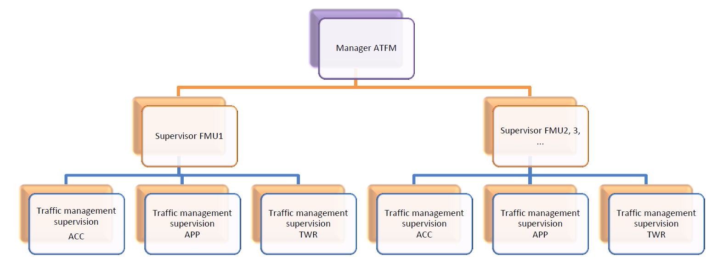
Chapter 3. ATFM structure and organization
Flow management unit (FMU) provides ATFM service for a specific set of ATS units
Flow management positions (FMPs) at specific ATS units responsible for the day-to-day ATFM

Slide 87
ATFM Center
ATFM Center
Traffic management coordination
Traffic planning
Meteorological briefing/forecasting coordination
NOTAM/messaging coordination
Flight calibration/flight check coordination
Airspace user liaison
Military liaison
Information technology coordination and operational data management
Technical operations coordination (concerning infrastructure and systems such as NAVAIDs, radar, VHF communication sites, etc)
Crisis management coordination
Operations analysis

Slide 88
ACC FMU
ACC
FMU
Approach control coordination
Departure control coordination
Enroute coordination
Meteorological briefing/forecasting coordination
Airspace user liaison
Military liaison
Airport coordination
Post-operations analysis
Additional support functions (information technology coordination, crisis management coordination)

Slide 89
Approach FMP
Approach FMP
The approach control unit FMP coordinates with the FMP at an ACC
This duty can be assigned to an existing position in the approach control unit or it may require one or more dedicated positions (depending on the workload)

Slide 90
Tower FMP
Tower
FMP
The control tower FMP coordinates with the FMP at the approach control unit
This duty can be assigned to an existing position in the approach control unit or it may require a dedicated position

Slide 91
FMU/FMP duties
Creating and distributing the ATFM daily plan
Collecting all relevant information
Analyzing and distributing all relevant information
Documenting a complete description of all ATFM measures
Coordinating procedures with the affected stakeholders
Creating a structure for information dissemination
Conducting daily telephone and/or web conferences
Continuously monitoring the ATM system

Slide 92
Example of ATFM organizational structure
High
workload
facilities
ATFM Center
Low
Workload
facilities
Approach
ACC
ACC
Approach
Tower
Tower
can be assigned to
an existing position (ACC supervisor)
may require dedicated staff

Slide 93

Training requirements
FMU/FMP personnel
  Standardized and recurrent training in order to maintain their competency level in a constantly changing environment
Other ATFM stakeholders
  All stakeholders involved in the ATFM system must have the knowledge required to carry out their respective responsibilities

Slide 94
Summary of Chapter 3
Each State will ensure that an ATFM organizational structure that meets the needs of the aviation community is developed.
Not only ATFM personnel but also all stakeholders involved must be trained to enable the provision of an efficient ATFM service.

Slide 95
Chapter 4

Slide 96
Chapter 4
Capacity, demand and ATFM phases
  How is the capacity of an airspace sector and airport determined?
  How are ATFM processed applied in order to balance demand/capacity within a given area?
Notes:
We can not manage demand if we don’t have capacity.

Slide 97
Chapter 4. Capacity, demand and ATFM phases
Capacity
  Capacity defines the maximum number of flights which can safely managed
    Air space capacity (sector capacity)
    Airport capacity (Airport Acceptance Rate(AAR))
Demand
  Demand defines the traffic volume in a certain air space

Slide 98
Capacity
The capacity of an ATM system depends on many factors
  Traffic density and complexity
  ATS route structure
  Capabilities of the aircraft
  Weather-related factors
  Controller equipment and workload

Slide 99

Capacity (cont’d)
The number of aircraft provided with air traffic control service shall not exceed that which can be safely handled by the ATS unit concerned under the prevailing circumstances
The appropriate ATS authority should assess and declare the ATC capacity for control sectors and for airports

Slide 100


Capacity (cont’d)
ATC capacity defines the maximum number of flights which can safely managed
Capacity measurement and calculation methodologies should be developed according to the requirements and conditions of their operational environment
ATC capacities are NOT static values
Notes:
Capacity assessment is not so simple not so easy, because situations are totally different (country A, country B), (sector C, sector D)
Appendix C : AAR by FAA
Appendix D : sector capacity by FAA
Chart or formula, but adjustment part should be considered by each State

Slide 101
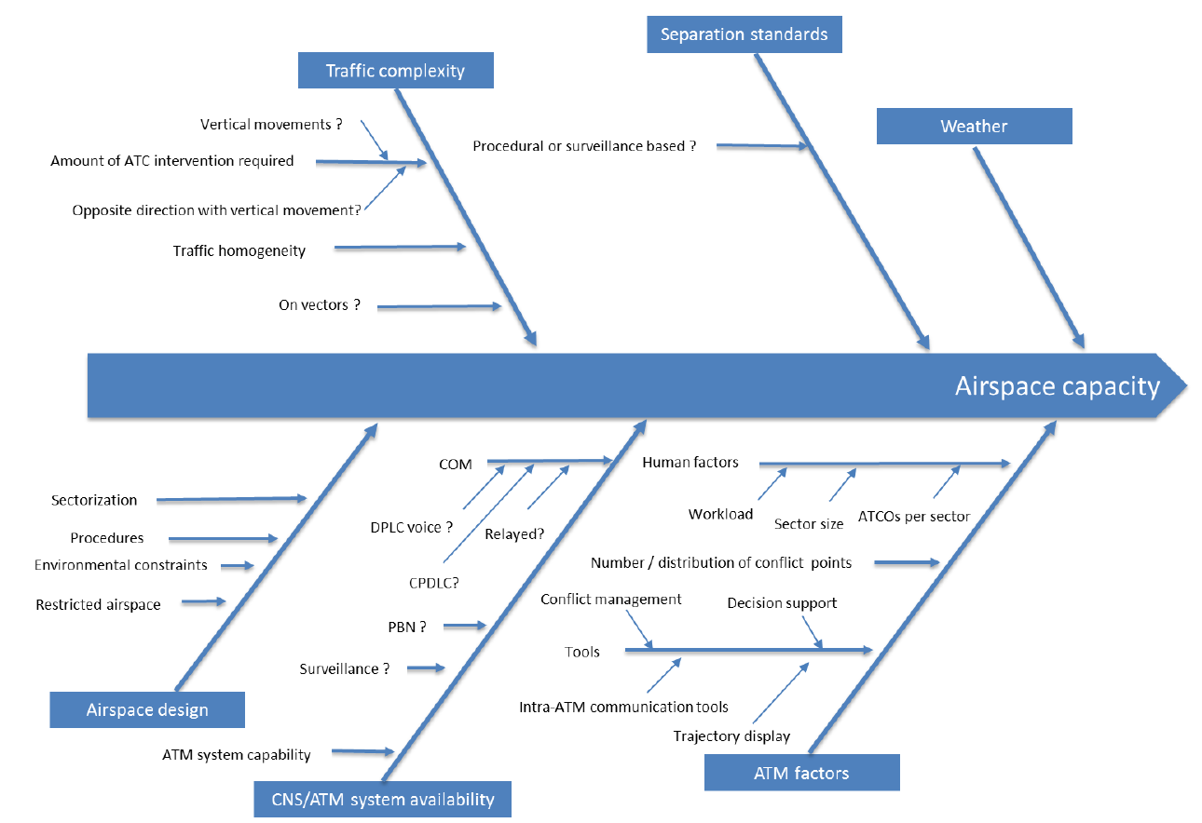
Airspace capacity

Slide 102
Traffic complexity
Sector B
Sector A
Airway xxx
Sector C
Sector D

Slide 103
Traffic complexity (cont’d)
Sector B
Sector A
PBN route xxx
PBN route yyy
Sector C
Sector D

Slide 104
Traffic complexity (cont’d)
Sector B
Airway zzz
Sector A
PBN route xxx
PBN route yyy
Sector C
Sector D

Slide 105



Other factors for Airspace capacity
ATM system availability
(Controller’s equipment)
CNS system availability
ATM factor
(ATC workload)
Separation standards
Air space design

Slide 106
Airspace capacity

Slide 107
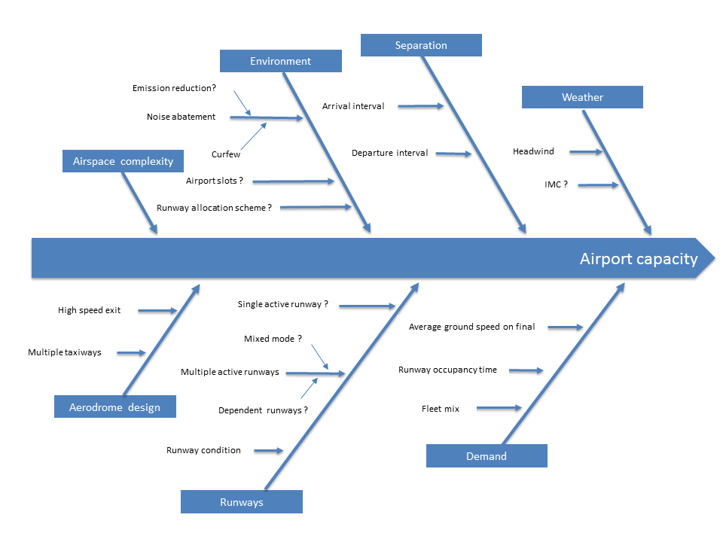
Airport capacity

Slide 108





Airport capacity factors
Separation
Weather
Runways
Slots
Aerodrome design
Demand

Slide 109



Weather impact (Sector A)
Sector B
Sector A
Airway xxx
Airway yyy
Sector C
Sector D

Slide 110


Weather impact (Sector B)
Sector B
Sector A
Airway xxx
Airway yyy
Sector C
Sector D

Slide 111
Variability of capacity

Slide 112



Variability of capacity (cont’d)
82%

Slide 113
Demand
Traffic Forecast
Seasonal Schedule
Initial Traffic Demand
FPL
Updated Traffic Demand
ATS messages
(DLY, CHG)
TOBT
(Target Off Block Time)
Dynamic Traffic Situation
Surveillance
(Radar, ADS-B)
ATM systems

Slide 114
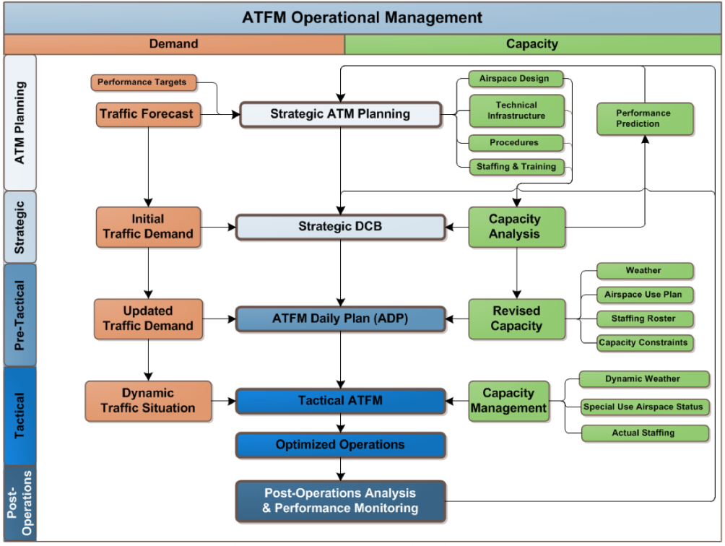
Balancing demand and capacity

Slide 115

Post Operations Analysis
An analytical process is carried out to measure, investigate and report on operational processes and activities
The development of best practices and/or lessons learnt that will further improve the operational processes and activities
All stakeholders within the ATFM service should provide feedback

Slide 116
Post Operations Analysis (cont’d)
Post-operations analysis may be used to;
  Identify operational trends or opportunities for improvement
  Further investigate the cause and effect relationship of ATFM measures
  Gather additional information with the goal of optimizing ATM system efficiency
  Perform analysis of specific areas of interest, such as irregular operations
  Make recommendations on;
    how to optimize ATM system performance
    how to minimize the negative impact of ATFM measures on operations

Slide 117
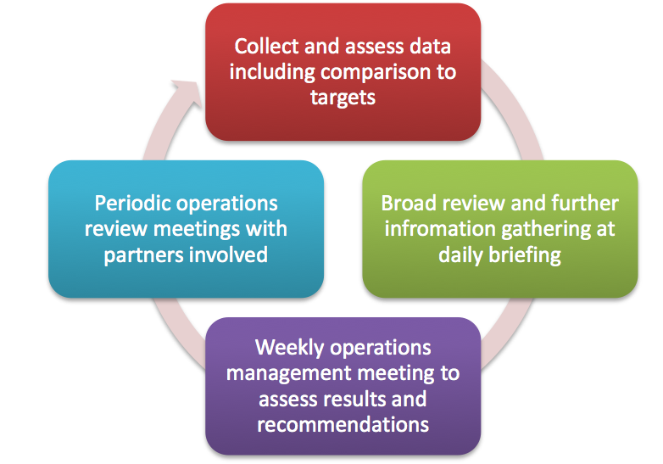
Post Operations Analysis (cont’d)

Slide 118
Summary of Chapter 4
We need to know Capacity, then we can manage Demand
ATS authority should assess and declare Capacity (as standard value)
Capacity depends on many factors and is not static value
Post operations analysis is very important for future operational improvement

Slide 119
Chapter 5

Slide 120
Chapter 5
ATFM implementation
  How is an ATFM service implemented?
  What is an international ATFM service?

Slide 121
Chapter 5. ATFM implementation
ATFM implementation strategy should be developed in phases in order to ensure maximum utilization of available capacity
It also allows all the stakeholders to become gradually familiar with the existence of ATFM and its consequences
Phase 1
Phase 2
Phase 3
Phase 4

Slide 122
ATFM Implementation
In its initial application;
  ATFM need not involve complicated processes, procedures or tools
  ATFM can be performed via point-to-point telephone calls designed to exchange information of operational significance and to relay information on
    factors affecting capacity
    system constraints
    significant meteorological conditions
  The goal is to collaborate with system stakeholders and to communicate operational information to AUs, ANSPs, and to other stakeholders in a timely manner

Slide 123

ATFM Implementation (cont’d)
In any case, it is important that the procedures applied during the implementation process be developed in a harmonized manner among the various States to avoid risks to operational safety and efficiency

Slide 124
ATFM development: Initial steps
Establish the objectives, project management plan, and oversight of ATFM
Identify the personnel who will lead the development of ATFM
  ANSP usually takes the lead
  Key stakeholders from the AUs, airport operators, and military authority should be involved in planning, development and implementation of ATFM
Notes:
A-U 21steps

Slide 125
ATFM development: Initial steps (cont’d)
c) Identify the stakeholders

Slide 126

ATFM development: Initial steps (cont’d)
Brief the stakeholders on:
  the purpose and objectives of the project
  the important terms and definitions used in the project
  the plan for developing the ATFM service
  their respective roles and responsibilities
ATFM

Slide 127
ATFM development: Initial steps (cont’d)
Define the ATFM structure that is needed
Establish the CDM processes that will be used in ATFM
Develop or adopt and apply a model for establishing the airport acceptance rate(AAR) at the relevant airports
Develop or adopt and apply a model for establishing the en-route sector and terminal sector capacity

Slide 128

ATFM development: Initial steps (cont’d)
Identify the appropriate locations for FMUs and FMPs
Identify the personnel in charge, the means of contact and the operational phone numbers for each stakeholder

Slide 129
ATFM development: Initial steps (cont’d)
Define the elements of common situational awareness

Slide 130
ATFM development: Initial steps (cont’d)
Identify the appropriate means of communication that will be used for ATFM
  Telephone conference system
  Web-based conference system
  Blog format
  Electronic chat
  Web page
  Any other appropriate mean

Slide 131
ATFM development: Initial steps (cont’d)
Develop the applicable ATFM Operational Letter of Agreement
Develop the procedures and training materials for FMUs and FMPs
Develop the procedures and training materials for stakeholders
Evaluate the need to apply safety management system processes when new ATFM tools and procedure induce a significant change to existing procedures

Slide 132
ATFM development: Initial steps (cont’d)
Discuss and develop the ATFM measures that will be applied in order to balance air traffic demand and capacity
Establish an implementation data for the ATFM service
Train the appropriate personnel with regards to the processes and procedures necessary for ATFM implementation
Implement the processes and procedures
Evaluate the results and coordinate changes as necessary, through a collaborative working arrangement that will ensure periodic review and provide feedback from users and stakeholders
Notes:
U 21steps

Slide 133
International ATFM Service
It is challenging to achieve the ideal international ATFM setup right from the beginning
International ATFM can, however, be the shortest path to achieving an efficient ATFM environment
The ultimate goal of international ATFM is to achieve, over a region or a sub-region, the creation of a seamless ATM service

Slide 134
Summary of Chapter 5
In its initial application,
  ATFM need not involve complicated processes
  The goal is to collaborate with system stakeholders and to communicate operational information to all stakeholders in a timely manner
The ultimate goal of international ATFM is to achieve, over a region or a sub-region, the creation of a seamless ATM service

Slide 135
Chapter 6

Slide 136
Chapter 6
ATFM measures
  What are ATFM measures and how are they established and applied?
  Types of ATFM measures
  ATFM measure approval authority
  ATFM measures processing
  Application of ATFM solutions
  ATFM efficiency calculation
  Principles of delay analysis
  Attribution and accountability for ATFM measures
  Reporting

Slide 137
Chapter 6. ATFM measures
Notes:
Strategic
Pre-tactical (one day before)
Tactical

Slide 138
How do you manage it?

Slide 139
How do you manage it? (cont’d)

Slide 140


How do you manage it? (cont’d)
Pre-Flight
  Rerouting
  Ground Delay Program
  Ground Stop
  Minutes in Trail
In-Flight
  Rerouting
  Miles in Trail
  Fix Balancing
  Airborne Holding

Slide 141
Rerouting
Sector B
Sector A
Airway xxx
Airway yyy
Sector C
Sector D

Slide 142

Ground Delay Program (GDP)
CTOT will be 1023Z
34L
16R
CTOT will be 1040Z
CTOT will be 1015Z
CTOT: Calculated Take Off Time

Slide 143
Ground Delay Program (GDP) (cont’d)
GDP minimize airborne holding
GDP shall be carried out in a planned manner (at least a few hours prior to the over capacity)
Delays have great impact on AUs
CTOT or TSAT have to be informed AUs as early as possible
CTOT or TSAT may be modified with AUs coordination
CTOT: Calculated Take Off Time
TSAT: Target Start-up Approval Time

Slide 144
Ground Stop
16R
HOLD, CTOT unknown
34L
HOLD, CTOT unknown
Hold, CTOT unknown
CTOT: Calculated Take Off Time

Slide 145
Ground Stop (cont’d)
Ground Stop is typically used:
  In cases destination airports are unavailable due to significant WX or due to accident/incident
  To preclude extended periods of in-flight holding
  To preclude sector reaching near saturation levels or airport gridlock
  In the event of a facility is unable to provide ATC services due to unforeseen circumstances
  In cases routings are unavailable due to severe WX or catastrophic events
AUs need further information as soon as possible

Slide 146
Minutes in Trail (MINIT)
Sector A
surveillance
Sector B
Non-surveillance
Airway xxx
10MIN

Slide 147
Minutes in Trail (MINIT) (cont’d)
Sector A
Approach X
Way Point CC
Way Point DD
Only for Way Point DD, 3min separation
Sector B

Slide 148
Minutes in Trail (MINIT) (cont’d)
MINIT is expressed as the number of minutes required between successive aircraft
MINIT is normally used in airspace without surveillance, or from surveillance to non-surveillance
MINIT is also used when the spacing interval is such that it would be difficult for a sector controller to measure it in terms of miles

Slide 149
Miles in Trail (MINIT)
Normally,
15NM from Sector C to Sector A
Sector B
Sector A
Airway xxx
30NM
Airway yyy
Sector C
Sector D

Slide 150
Miles in Trail (MINIT) (cont’d)
Sector A
Approach X
20NM
Normally,
10NM from Sector A to Approach X
Sector B

Slide 151
Miles in Trail (MINIT) (cont’d)
MIT is expressed as the number of miles required between aircraft (in addition to the minimum longitudinal requirements)
MIT can be carried out without a planned manner (compared with GDP)
MIT may increase the workload of the other sectors

Slide 152
Airborne Holding
Sector A
Approach X
Sector B

Slide 153
Airborne Holding (cont’d)
Airborne Holding is generally used to cope with short notice demand and capacity imbalances
Airborne Holding is complementary to ground delay programmes and ground stops
Airborne Holding generates high workload for ATC and pilots
Consideration must be given to reducing sector capacity during airborne holding periods

Slide 154
ATFM efficiency calculation
ATFM measures should be based on the principle set down in this guidance material
Delays have a great impact on AUs
Notes:
We have to remember all the time that delays have a great impact on Aus.
We need to ATFM because of many reasons, one of them is safety which is our priority.
Delays must be minimum.

Slide 155
Attribution and accountability for ATFM measures
All ATFM actors must share a common understanding of the reasons for ATFM measures and of the entity that should be held accountable for them

Slide 156
Summary of Chapter 6
ATFM measures
  Strategic
  Pre-Tactical
  Tactical
All ATFM actors must share a common understanding of the reasons for ATFM measures
Notes:
ATC: You will be delayed 30min because of Air space congestion at sector A.
AU : We can reroute, change our FPL to avoid sector A airspace instead of 30min delay.

Slide 157
Chapter 7

Slide 158
Chapter 7
Data exchange
  What data and information are exchanged in an ATFM service?
  Benefits of data exchange
  Data exchange policy
  International data exchange specifications
  Data type description and harmonization
  ATFM tools

Slide 159

Chapter 7. Data exchange
The cooperation and coordination of ATFM activities between States must be enhanced
  Therefore States should ensure that operational data from ANSPs are exchanged not only within the regions but also across regional boundaries
  So that more efficient traffic flows can be achieved
Notes:
ATFM can not be done without data exchange.

Slide 160
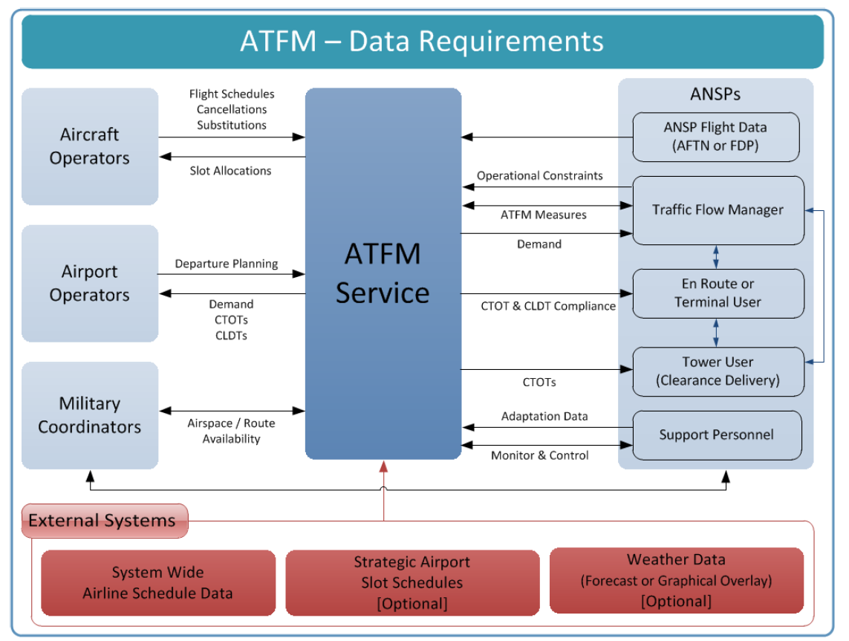
Data Exchange

Slide 161
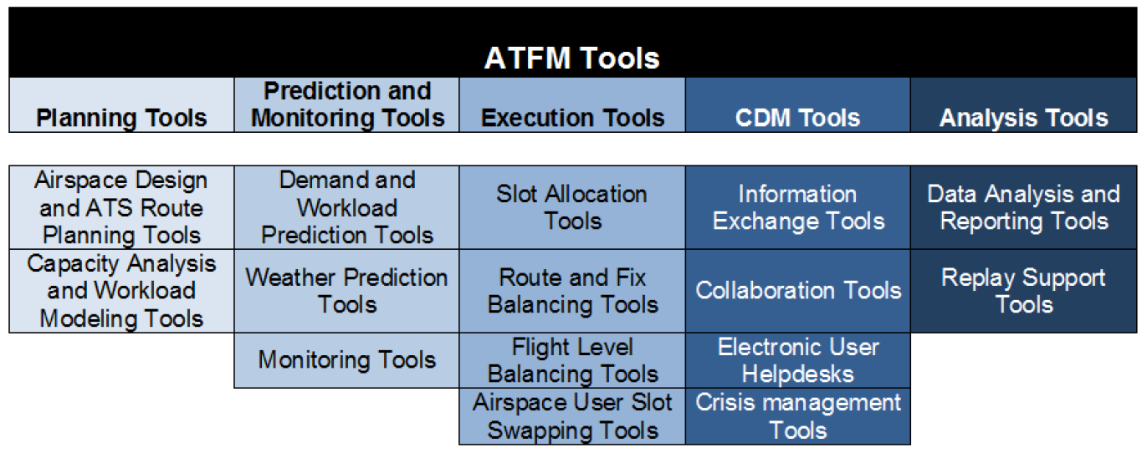
ATFM tools
To achieve further capacity and efficiency benefits
AMAN
DMAN
Notes:
We don’t need all of ATFM tools from the beginning, but when we introduce ATFM we can consider what we need.

Slide 162
Summary of Chapter 7
Data exchange is the sharing of information required for the effective provision of ATFM service
Data sharing and exchange enables common situational awareness
It optimizes contingency responses to unforeseen events and system disruptions
Depending on the size and complexity of ATFM service, ATFM tools may be implemented to enable partial automation of ATFM

Slide 163
Chapter 8

Slide 164
Chapter 8
ATFM communication
  Communication
  Stakeholder ATFM communication
  ATFM communication oversight
  Communicating ATFM information
  ATFM web pages
  ATFM terminology

Slide 165

Chapter 8. ATFM communication
The communication and exchange of operational information among stakeholders on a real-time basis forms the backbone of ATFM
    Telephone calls
    Web conferences
    E-mail messages
    Electronic data exchange
    Web page displays

Slide 166
Summary of Chapter 8
The communication an exchange of operational information among stakeholders on a real-time basis forms the backbone of ATFM
There is a requirement for AUs and ATFM unit to communicate and exchange information for the purpose of CDM and information dissemination

Slide 167
Appendixes
Appendix A.
  Sample of international ATFM operations planning telephone conference format
Appendix B.
  Sample of ATFM data exchange agreement
Appendix C.
  Determining airport acceptance rate (FAA)
Appendix D.
  Determining sector capacity (FAA)
Appendix E.
  Example of capacity planning and assessment process (Euro Control)
Appendix F.
  Example of planning process for ATFM implementation
Appendix G.
  Template of letter of agreement between flight management units

Slide 168

Review Quiz

Slide 169
Question 1.
ATFM has nothing to do with CDM
True or False?

Slide 170
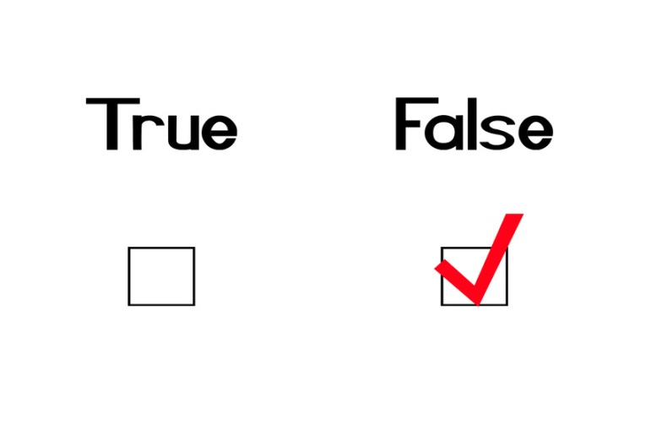
Answer 1.
ATFM can NOT be done without CDM

Slide 171
Question 2.
What are ATFM objectives?
Choose correct answers
  a. Enhance the safety
  b. Reduce ATC workload
  c. Optimize airspace capacity
  d. Maximize operational benefits and global efficiency

Slide 172

Answer 2.
  a. Enhance the safety
  b. Reduce ATC workload
  c. Optimize airspace capacity
  d. Maximize operational benefits and global efficiency
All of them are correct

Slide 173
Question 3.
Airspace is a common resource for all users
True or False?

Slide 174

Answer 3.
Airspace is a common resource for all
users and ensure equity and transparency

Slide 175
Question 4.
ATFM information must inform AUs as early as possible
True or False?

Slide 176
Answer 4.
Their route networks and schedules are built upon
connections.
The reliability of these connections enables passengers
to board connecting flights, ensures that aircraft are
available for the next leg of flight.

Slide 177
Question 5.
ATFM measures should be kept to the minimum
True or False?

Slide 178
Answer 5.
ATFM measures should be kept to the minimum

Slide 179
Question 6.
AUs personnel doesn’t have to have enough ATFM
True or False?

Slide 180
Answer 6.
Not only ATFM personnel but also all
stakeholders involved must be trained to
Enable the provision of an efficient ATFM
service

Slide 181
Question 7.
Capacity assessment is not necessary to manage Demand
True or False?

Slide 182
Answer 7.
We need to know Capacity, then we can
manage Demand

Slide 183
Question 8.
ATC capacities are static value
True or False?

Slide 184
Answer 8.
ATC capacities are NOT static values

Slide 185
Question 9.
Post-operations analysis is very important to improve the quality and accuracy of ATFM
True or False?

Slide 186
Answer 9.
Post-operations analysis is very important
to improve the quality and accuracy of ATFM
All stakeholders within the ATFM service should provide feedback

Slide 187
Question 10.
In its initial application, ATFM can be simple information sharing
True or False?

Slide 188
Answer 10.
In its initial application, ATFM need not involve complicated processes

Slide 189
Question 11.
ATFM measures may only be required during certain periods of time when demand exceeds capacity
True or False?

Slide 190
Answer 11.
Yes, and ATFM measures should be kept to the minimum

Slide 191
Question 12.
ANSP doesn’t have to inform AUs the reason for ATFM measures
True or False?

Slide 192
Answer 12.
All ATFM actors must share a common
understanding of the reasons for ATFM
measures

Slide 193
Question 13.
Data sharing and exchange enables common situational awareness
True or False?

Slide 194
Answer 13.
Data sharing or exchange is very important
for ATFM and can be the first step of ATFM
Notes:
Next question will be the last question.

Slide 195
Question 14.
This workshop was useful for you
True or False?

Slide 196
Answer 14.
I hope so…

