Slide 1
NGAP
Attracting, educating, training and retaining aviation professionals
www.icao.int/ngap
Michiel Vreedenburgh
Chief, Implementation – ANB
Astana, Republic of Kazakhstan
10 October 2017

Slide 2
Next Generation of Aviation Professionals
Since 2008, ICAO, IATA, Airbus and Boeing have forecast a shortage of aviation professionals
pilots, air traffic controllers, aircraft technicians
NGAP Initiative established by ICAO in 2009 with a Task Force
Upgraded by ICAO in 2015 to the NGAP Programme

Slide 3
NGAP: Vision and Mission
NGAP Vision
A global aviation community that has sufficient competent human resources to support a safe, secure and sustainable air transportation system.
NGAP Mission
To develop strategies, best practices, tools, standards and guidelines as applicable and to facilitate information sharing activities that assist the global aviation community in attracting, educating, training and retaining the next generation of aviation professionals.

Slide 4
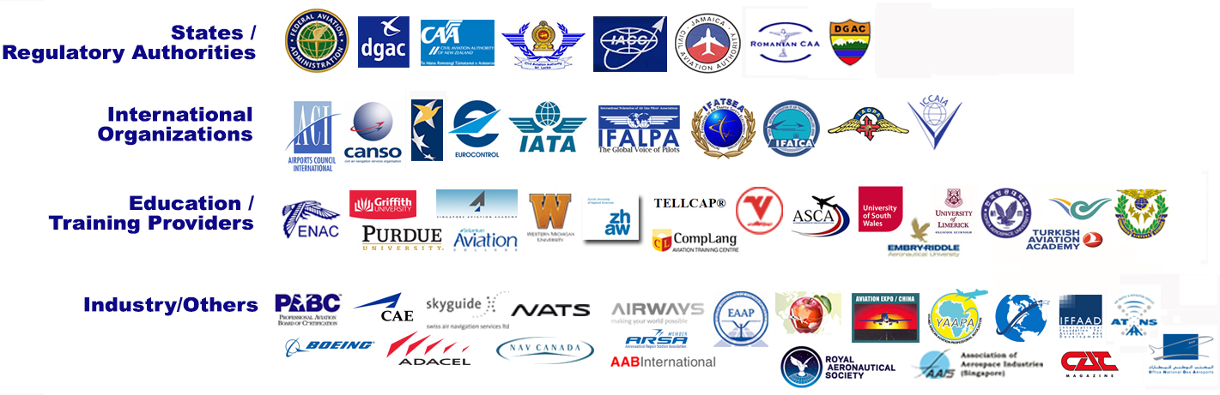
NGAP Partner Organizations
Notes:
Since 2009, ICAO has been working with important stakeholders, such as CAAs, industry, international organizations, ANSPs, training centres and universities to discuss how to address the impending shortage and how to inspire the next generation of aviation professionals.
These organizations have been supporting the NGAP programme in various ways, ranging from the provision of technical experts (i.e. ATCOs and ATSEPs for the development of training manuals) to hosting regional and/or global symposia. Support from these organizations have been critical to the programme, as the work is fully supported by a voluntary workforce.
This is just an example of some of the organizations that have been helping us through the years. Support keeps growing. In fact right now we are working with UNESCO, and UNW to promote NGAP issues.

Slide 5
39th ICAO Assembly
NGAP Programme supported and Resolution adopted:
Urges Member States to work with the aviation community to identify long-term human resources needs and establish strategies to attract, educate and retain in the sector aviation professionals, considering gender equality
Encourages Member States to promote best practices that focus on meeting the needs and values of the next generation of aviation professionals to enable employee productivity, performance, recruitment, retention, and safety;
Encourages Member States, international and regional organizations, academia and industry to support the NGAP Programme, as one of the integral elements of capacity building, by providing technical expertise and guidance, and resources (human, financial and data) to help achieve the Programme’s objectives.

Slide 6
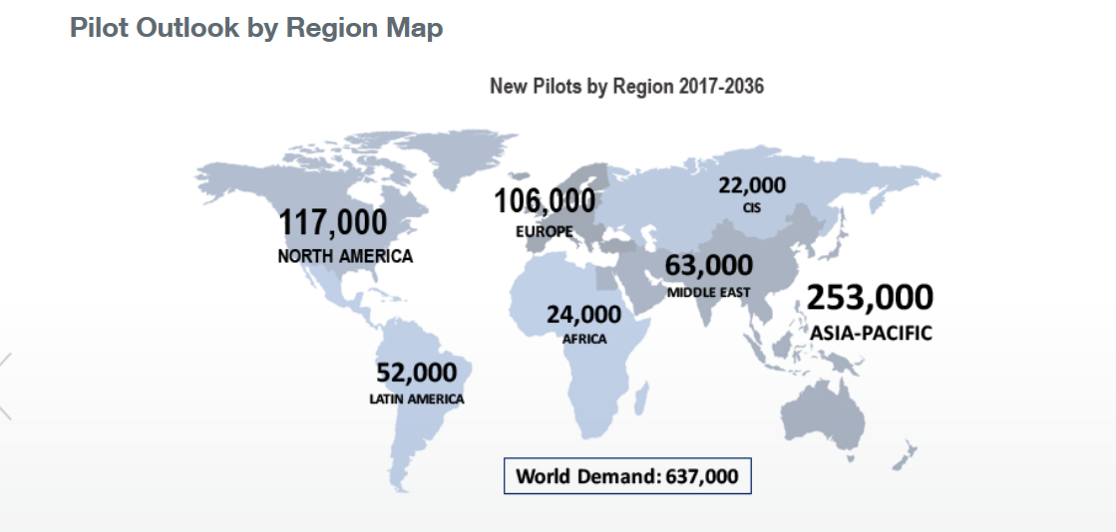
Pilot Forecast 2017-2036

Slide 7
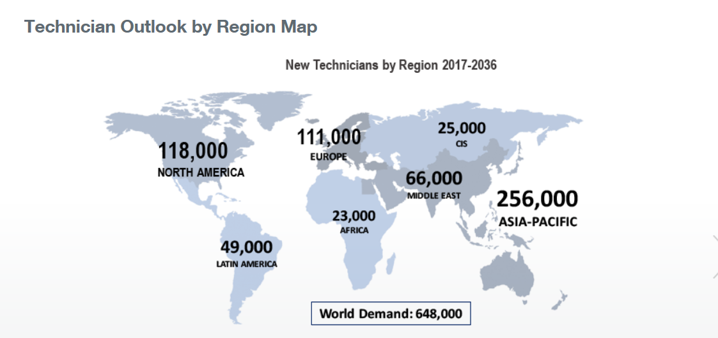
Technician Forecast 2017-2036

Slide 8
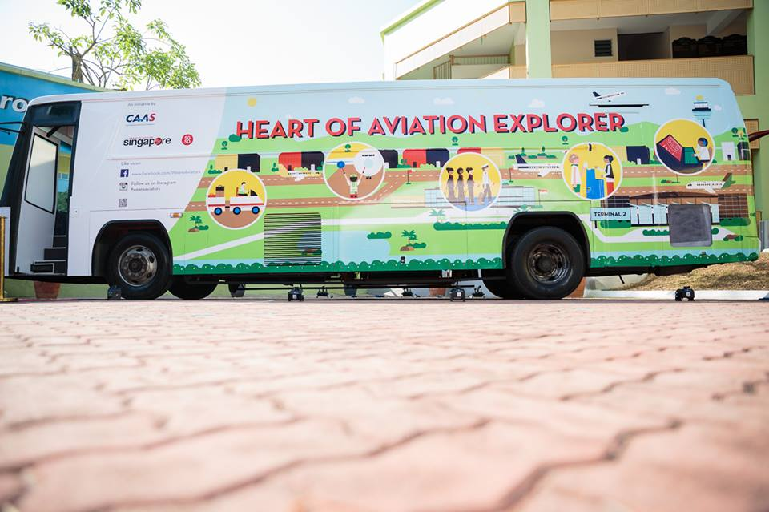
NGAP Programme
In 2015 the ICAO Council recognized importance of the NGAP Initiative and elevated it to an ICAO Programme
NGAP Programme has been incorporated into the ICAO Business Plan and the Global Aviation Safety and Global Air Navigation Plans.
Notes:
It is important for us to get the word out.

Slide 9
NGAP Programme Today
support outreach for attracting youth, from pre-school to university, into aviation education and professions, by promoting career opportunities, at global, regional and national levels
resourced by voluntary contributions from States, international organizations, service providers and industry, academia and training institutions
3 working groups – Outreach, Implementation, Strategies and Planning

Slide 10
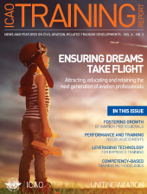
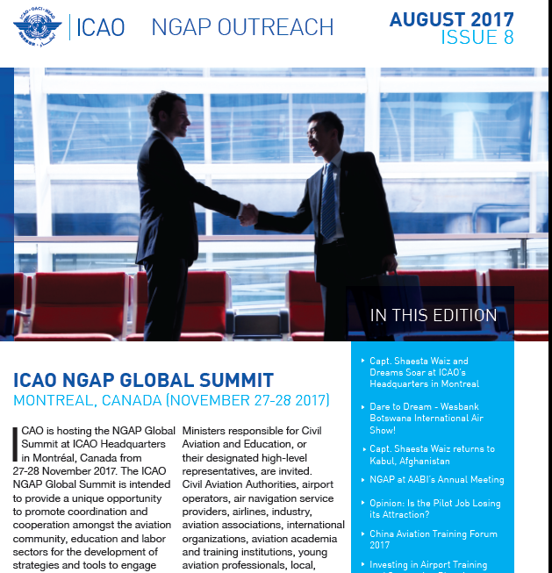
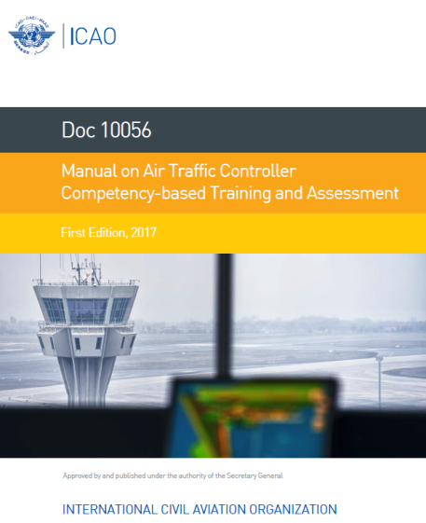
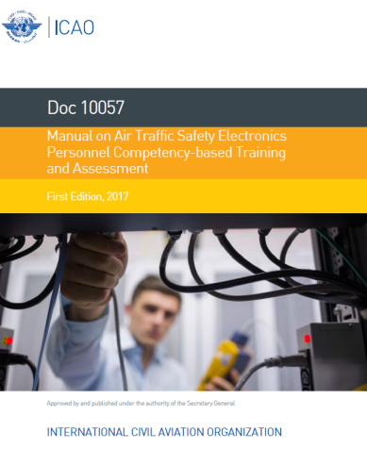
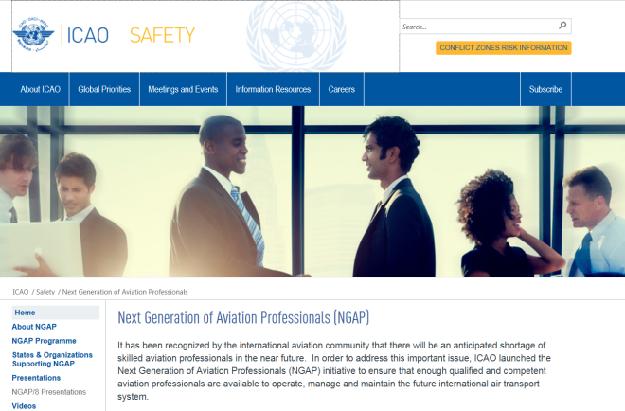
NGAP Outreach and Promotion

Slide 11
NGAP Programme Work Plan
Outreach activities and communication media/products including:
Website; Newsletters; NGAP articles in ICAO Training Reports;
Presentations at regional conferences/events around the world
Dream Soar Initiative – summer 2017
1st NGAP Global Summit – November 2017
Fundamentals of the Air Transport System course - 2017
Aviation Training and Education Directory - 2017
Update of Doc. 9956 aviation personnel forecasts – 2018
Guidance for States to develop a national NGAP Strategy and Action Plan – 2018
Collaboration with IPTA to create outreach videos, gather data on pathways, barriers, and best outreach practices for pilot careers

Slide 12

Gather aviation and education sectors
Promote NGAP including STEM and gender equality
Supported by UNESCO and UNWOMEN
Events:
Summit with panels
Model ICAO Forum for students
Speed mentoring for students
Exhibition and careers fair for students
https://www.icao.int/Meetings/NGAPGS-Montreal/Pages/default.aspx
Notes:
On November, we will also have the ICAO Global NGAP Summit in Montreal.
This event will be supported by UNESCO.
This event will provide a unique opportunity to promote coordination and cooperation amongst the aviation community and education sectors for the development of strategies and tools to engage and retain the next generation of aviation professionals.

Slide 13
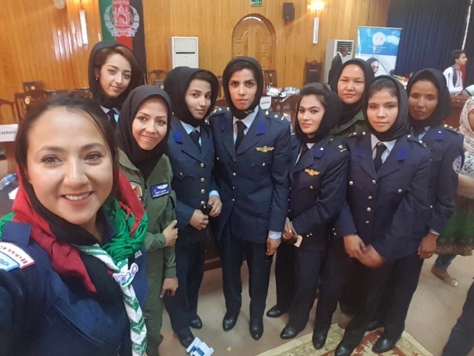
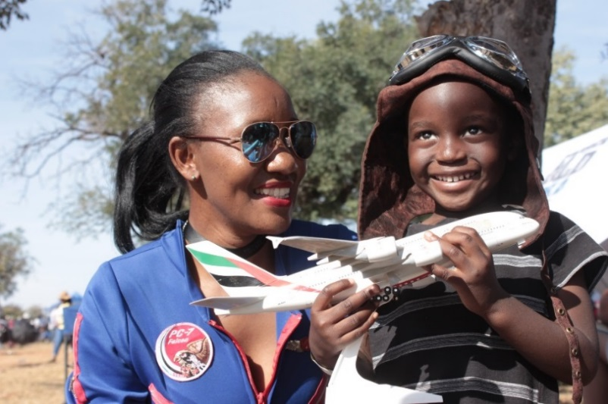
Promoting STEM and Gender Equality
Dreams Soar
YAAPA

Slide 14
NGAP Tomorrow
Unite aviation and education sectors to implement NGAP strategies and plans at national levels
Regions to drive outreach activities, coordinated by the ICAO Regional Offices, supported by the ICAO global NGAP Programme
Assist States with guidance and tools to attract and engage the next generation and promote aviation careers to youth

Slide 15
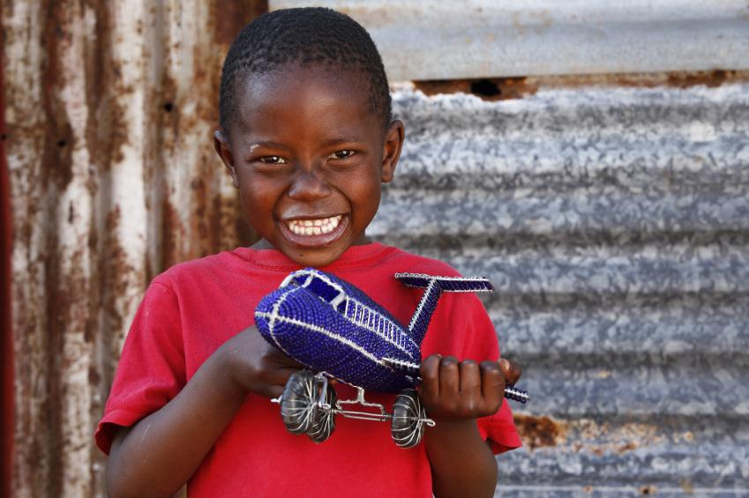
THANK YOU!

Slide 16
Questions?
How to attract, educate, train and retain aviation professionals?
What changes does the aviation sector need to make, to how they do business, in order to attract and retain enough competent personnel?
What links does industry need with education bodies in order to promote aviation careers to students/youth?
How to address the challenge of the attraction of personnel to work in other organizations, countries and industries?
What more can ICAO do to support States with NGAP implementation?
How can the benefit of the ICAO NGAP programme be measured?

Slide 17
NGAP Summit video
https://youtu.be/AGSGmZ9tqWQ

