Slide 1
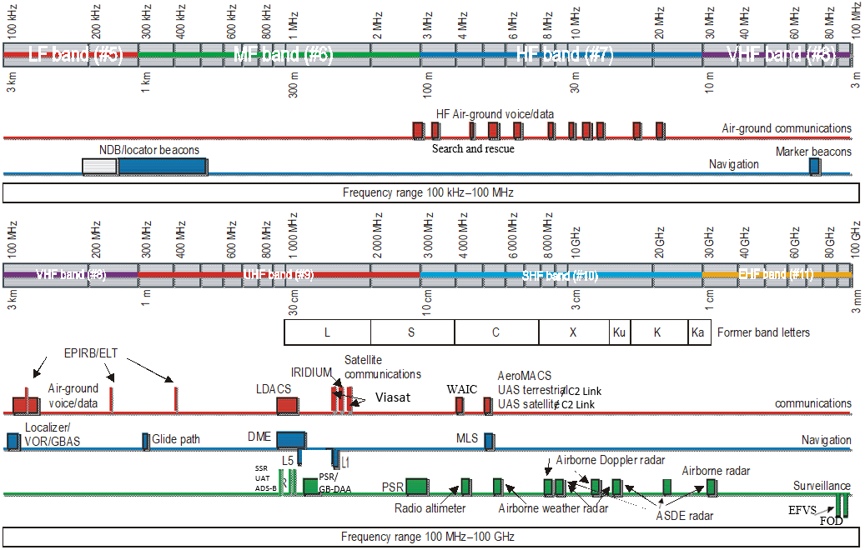
Notes:
Drawing not to scale.
Not all regional or sub-regional allocations are shown.
Band identification (e.g. VHF) and band # per Radio Regulation.
The satellite communication bands used by Viasat are allocated to the mobile satellite service.
Figure 3-2. Overview of spectrum allocation to aeronautical services

