Slide 1


Search and rescue
WAIC
/ C2 Link
/ C2 Link
SSR
UAT ADS-B
PSR/
GB-DAA
EFVS
FOD
FOD
EFVS/ FOD
Figure 3-2. Overview of spectrum allocation to aeronautical services

Slide 2
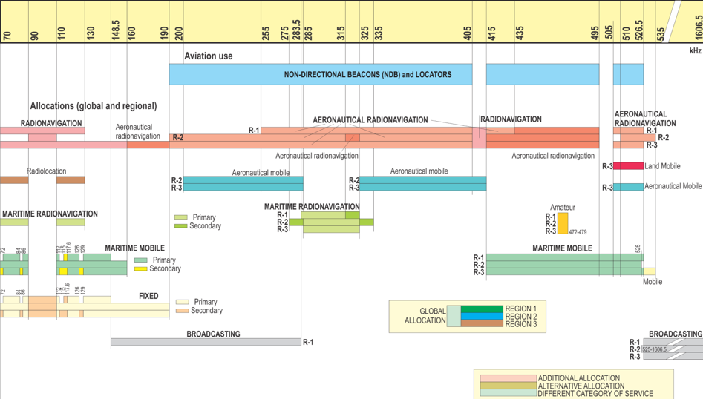
Figure 7-1. 70–1 606.5 kHz

Slide 3
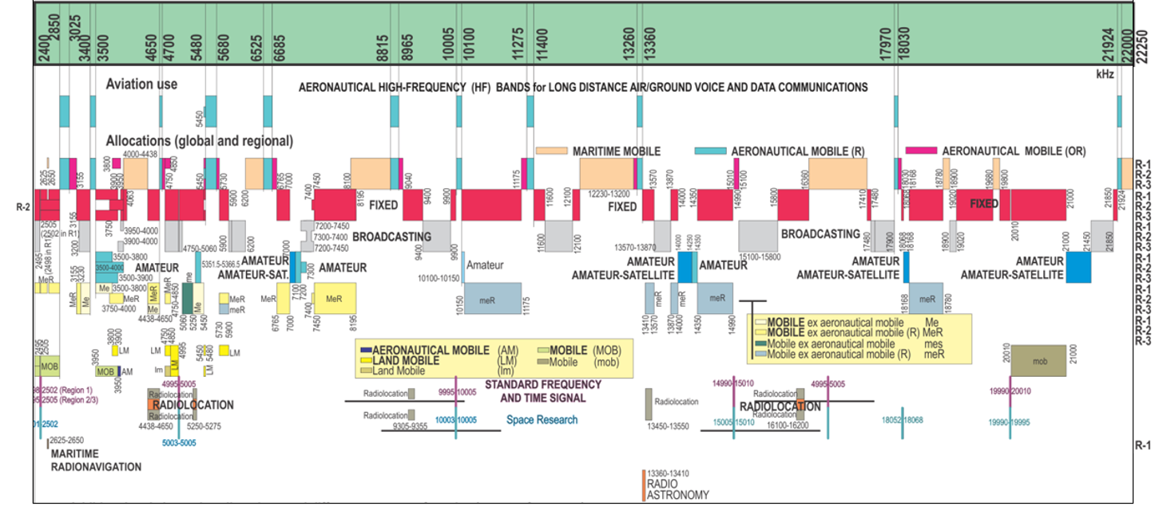
Figure 7-2. 2 400–22 250 kHz

Slide 4
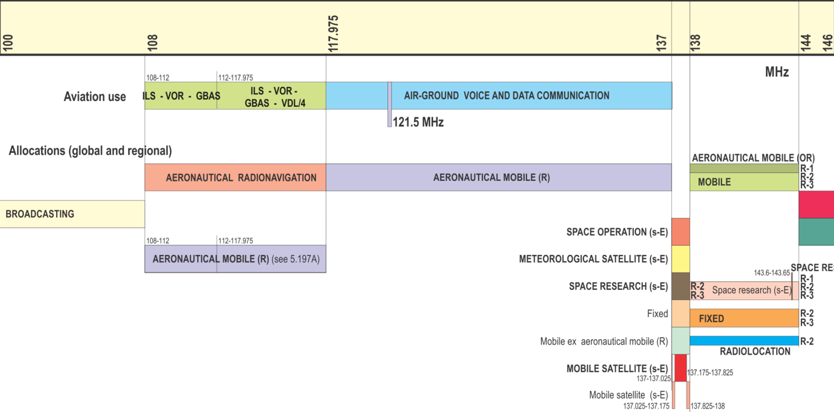

Figure 7-3. 100–146 MHz

Slide 5
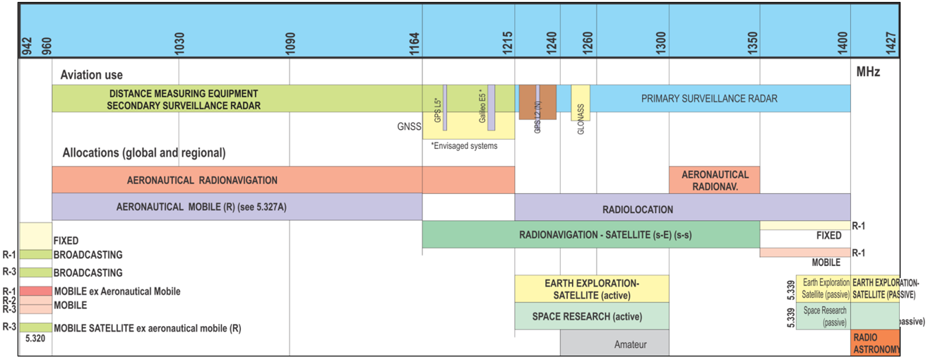
Figure 7-4. 942–1 427 MHz

Slide 6
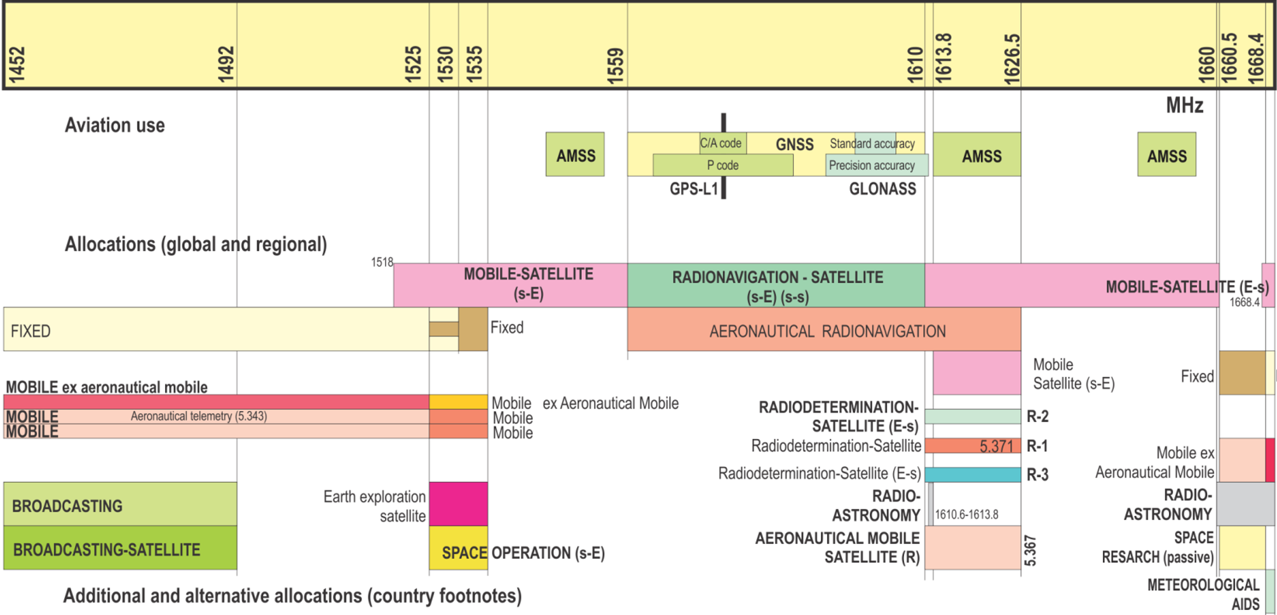
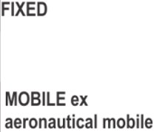
Figure 7-5. 1 452–1 670 MHz

Slide 7
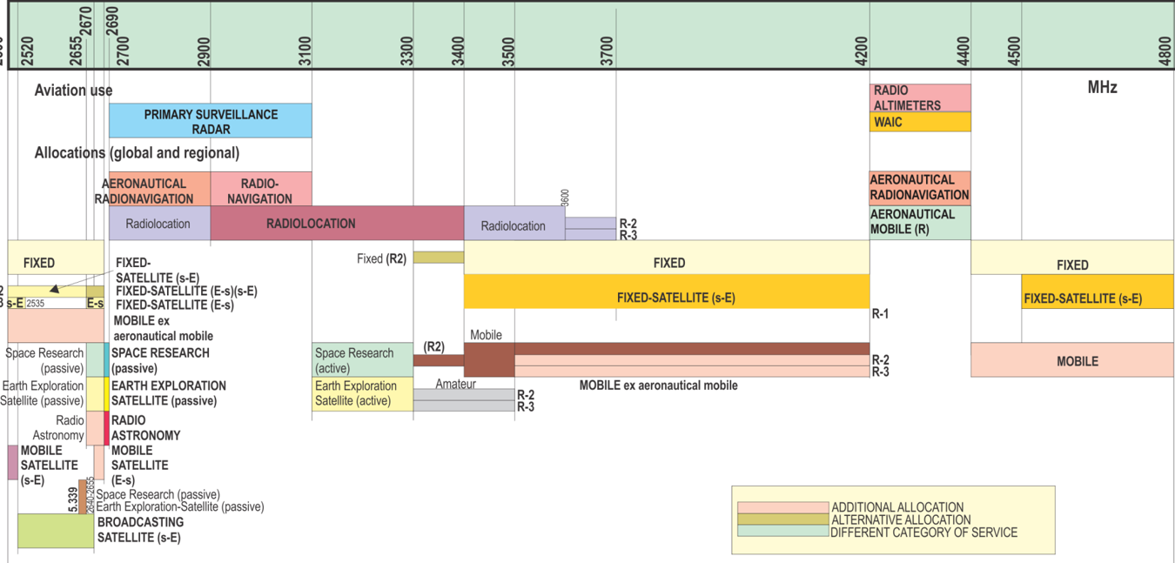
Figure 7-6. 2 500–4 800 MHz

Slide 8
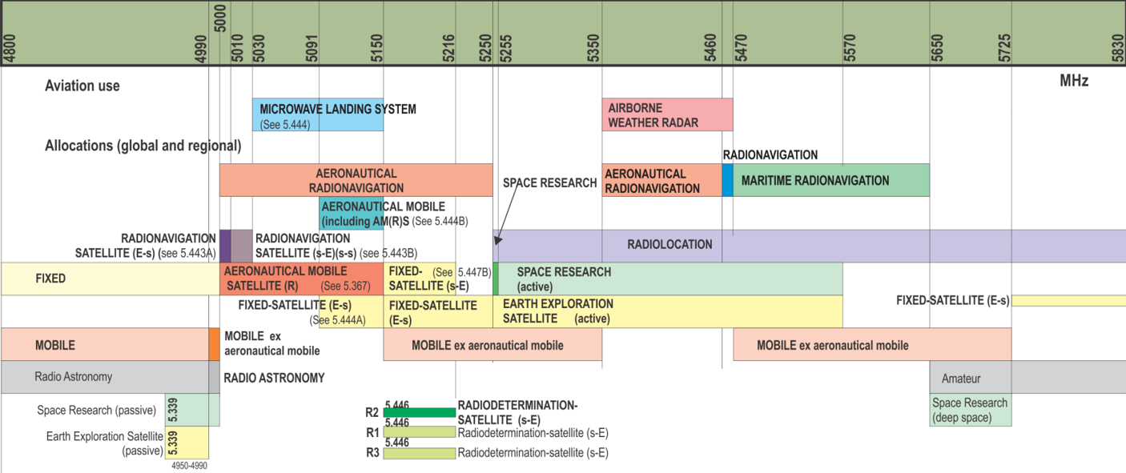
Figure 7-7. 4 800–5 830 MHz

Slide 9
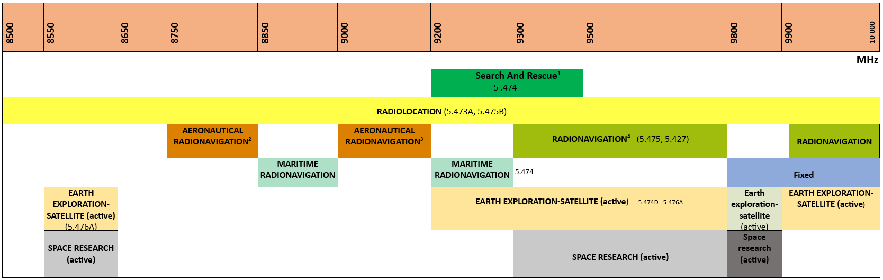
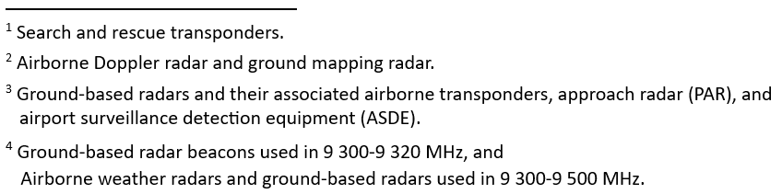
Figure 7-8. 8 500-10 000 MHz

Slide 10
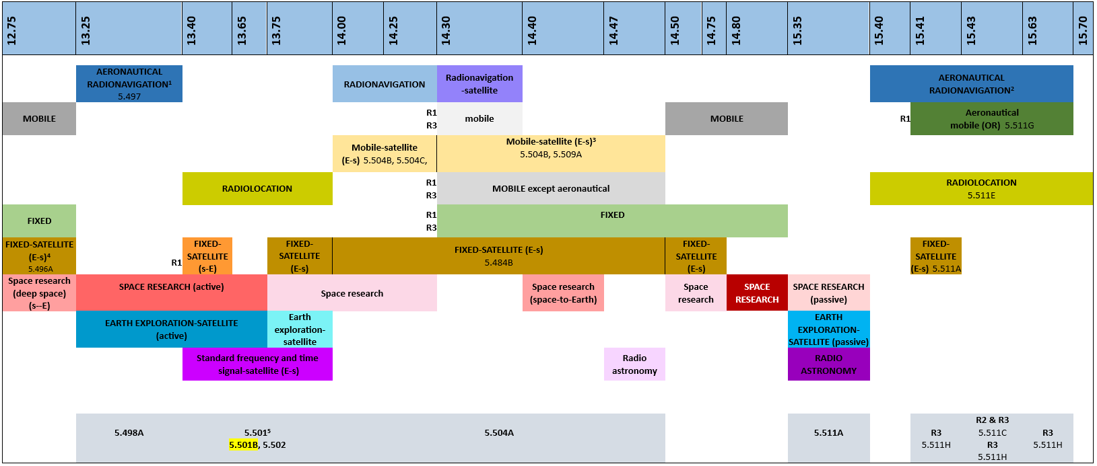
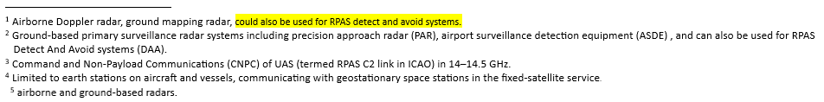
Figure 7-9. 12.75 –15.70 GHz

Slide 11
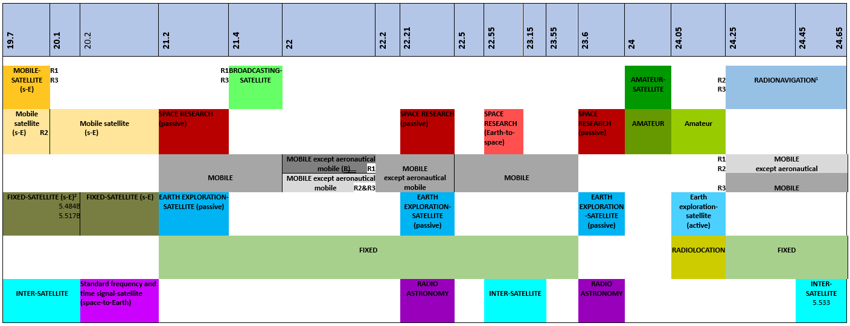

Figure 7-10. 19.7 –24.65 GHz

Slide 12
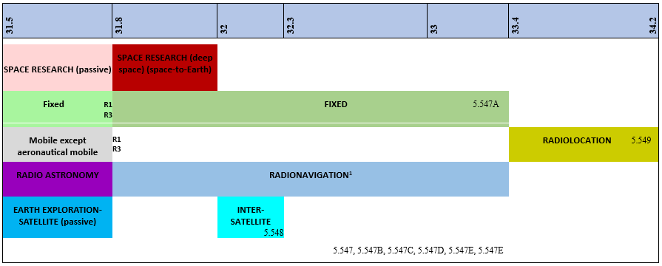
Figure 7-11. 31.5–34.2GHz

Slide 13
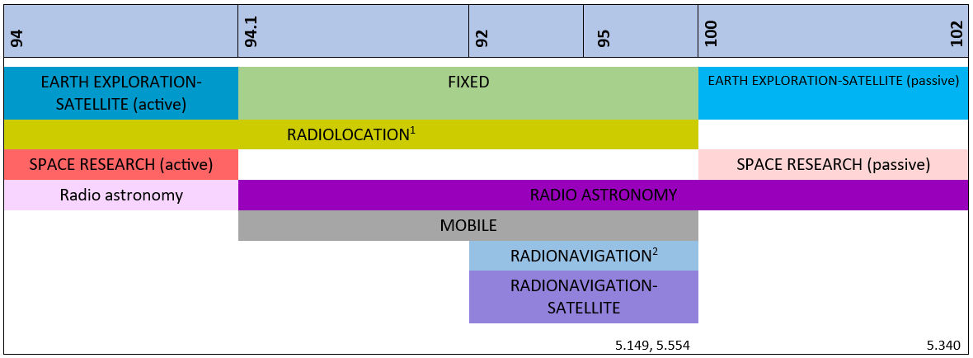

Figure 7-12. 94 – 102 GHz

