Slide 1

  Space-Based Air Traffic Management
  Craig Benson
  Founder, Director, Chief Innovation Officer
Click icon to add picture
  Feb 2023

Slide 2
Communication and Surveillance Issues
Line of Sight Propagation
Poor Coverage at Low Levels
Limited Oceanic Coverage
Infrastructure
Expensive to Deploy and Maintain
High Up-Front Cost
Scales Poorly at Low Traffic Density

Slide 3
Context of Skykraft Service
Communication
VHF voice
Monitor many channels
Transmit on one channel per satellite beam
Full duplex at constellation level
Effective speed about 150km/ms (0.5 c)
VHF data (VDL2 possibly Plain Old ACARS)
Surveillance
ADS-B receive at 1 second typical latency
MLAT

Slide 4
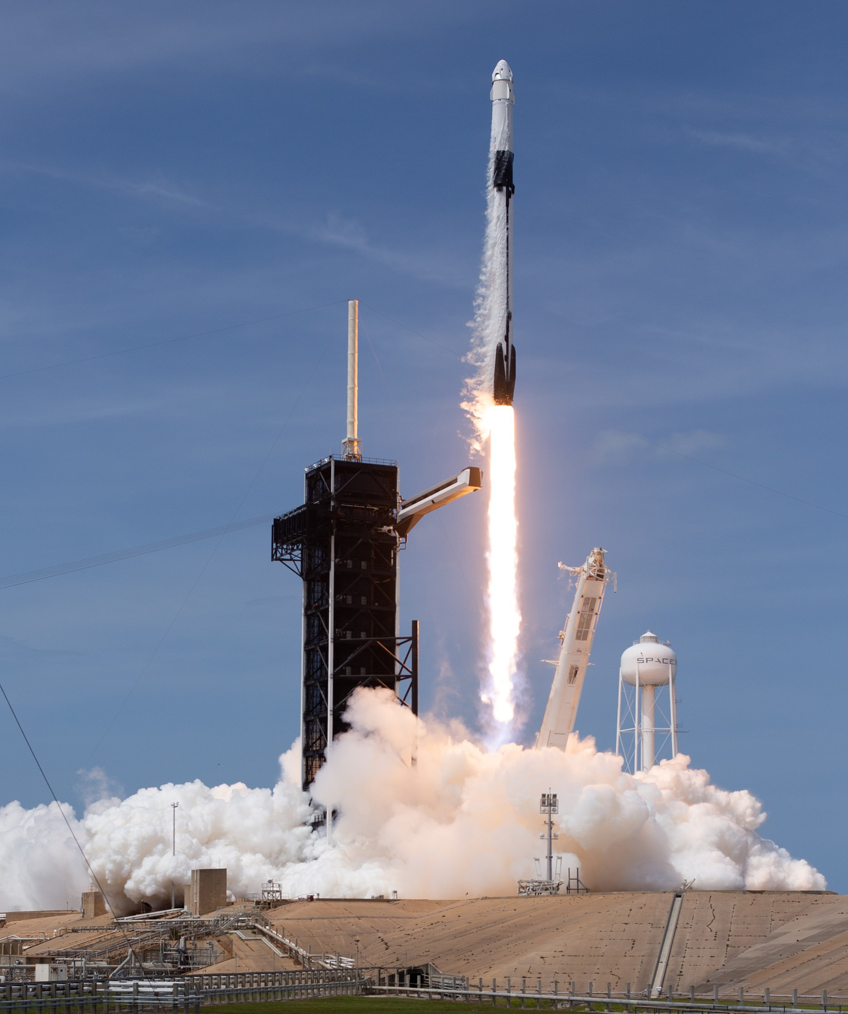
New Opportunities from Space
Convergence of 2 Factors
Lower Launch Costs
Higher Launch Cadence
Less Exotic Designs
Greater Tolerance of Loss
Electronics
Miniaturisation
Global markets
LEO is fairly benign
Falcon 9 Image: NASA

Slide 5
Skykraft ATM Background
Based in Canberra, Australia
Vertically Integrated
Design, Build, Operate Satellites
Constellations
Affordable at Scale
Collaboration Agreement with Airservices Australia
MOUs with other ANSPs
Proof of Concept Launches
Jan 23 – Spacecraft and deployment systems validated
Jun 23 – VHF and ADS-B tests and demonstrations
Jan 24 – Representative sevice on baseline satellite

Slide 6
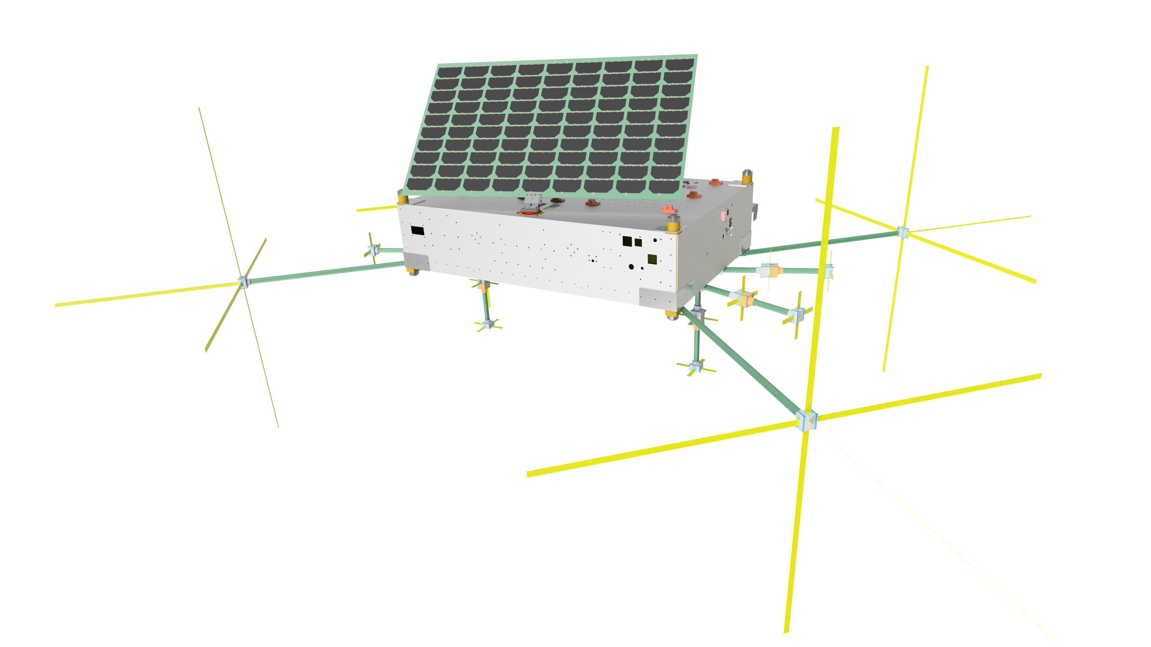
Air Traffic Management Constellation
200+ Satellites
ADS-B Global Surveillance
MLAT verification
UAT where demanded
Direct Pilot-Controller Comms
Push to Talk VHF
VHF Data ( ACARS / VDL2 )
Each Satellite
100 liters internal volume
30 kg total mass

Slide 7
Air Traffic Management Constellation
Hot Redundant Spares (Failover)
5 Year Rolling Refresh
Inter-Satellite Link for Low Latency
Affordable and Scaleable
No interference to existing terrestrial service

Slide 8
Space-based ATM Benefits
Global
Real-time Surveillance
Instant VHF Communication
Oceanic and into Valleys
Affordable
For developing nations
For oceanic and remote routes
For replacing difficult VHF sites
Deployment H2 2024

