Slide 1
SC-242 WG-124 Spectrum Efficiency
A joint RTCA EUROCAE Committee
FSMP WG16 IP/01 - Agenda item 8
Bangkok, February 2023

Slide 2
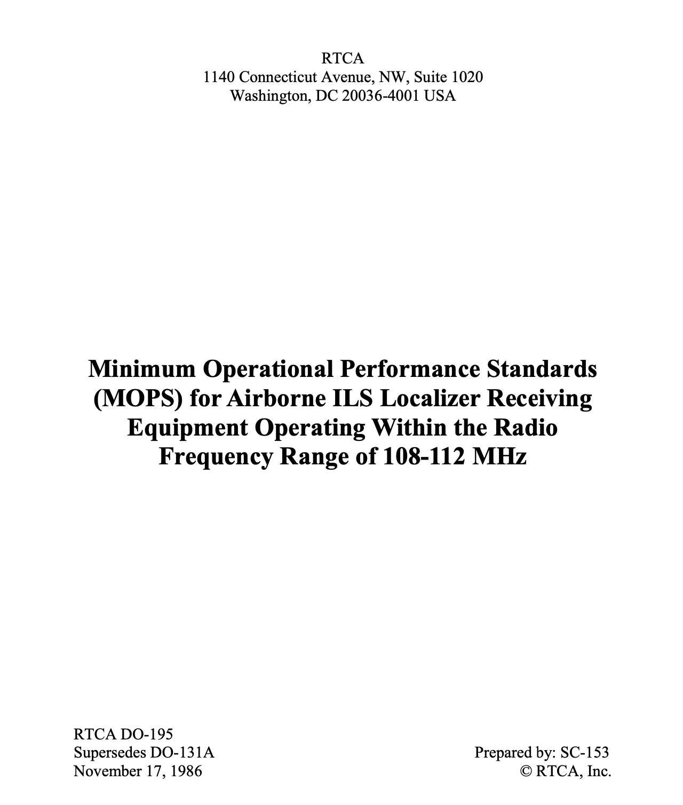
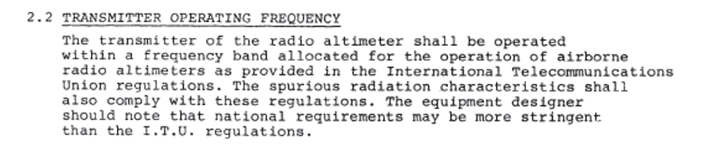

Historical Purpose of MASPS/MOPS
Written For Manufacturers
Meets an Intended Function
Performance Requirements to Mitigate Hazards
Few RF requirements
  ITU set the boundaries
  Radar Altimeters are self-contained – they don’t need to interoperate
  Main consideration is that they don’t interfere with each other
Considerations for spectrum compatibility historically not specified
DO-195: November 17, 1986
golfcharlie232; CC BY-SA 4.0

Slide 3


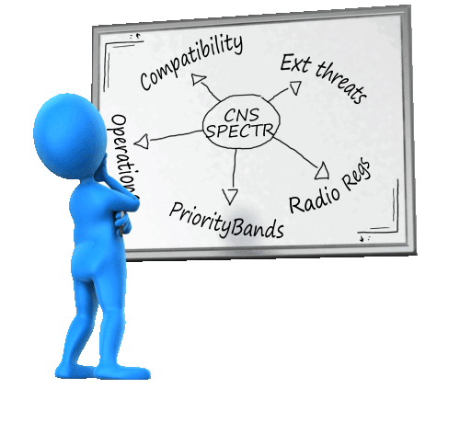
Remaining Relevant in the New World Order
Common aviation position
Ongoing issues
Keep our house in order
Present a coherent front in our external engagement
Equip budget holders and operators with viable options to modernise
Ensure the rulebook is up to date
Ensure the standards are fit for purpose
C-band radio altimeter incompatibilities with 5G
L-band continued integrity - PMSE
Managing GNSS interference - Ligado
State Aviation
regulators
State Telecom regulators
On the horizon
LDACS compatibility
  Testing frequencies
  Compatibility criteria
Space-VHF
  New global allocation
  Compatibility with terrestrial
Mobile Telephony
  5G expansion bands and 6G

Slide 4

A new joint committee is established
Highlights
Inaugural meeting held 10th March 2022
  ToRs agreed and work plan established
  Meeting bi-weekly with monthly ad hoc sessions
  4 plenaries plus one ad hoc so far
Goal
  Ensure that all CNS systems have complete RF parameters in their specifications (fit-for-purpose protection criteria)
Fundamental tasks
  Compile requirements already in existence
  Identify gaps
  Identify best practices to close the gaps
  Issue guidance on how new systems characteristics should be developed in new CNS standards (and update existing ones where possible)
Joint Eurocae/RTCA committee on spectrum (WG124/SC242)
  45 industry participants
  Airframers, radio manufacturers, operators, regulators
  Tasked with developing guidance material document (ED) and a report (ER) articulating aviation specifics for developers to look out for
  Work divided over two subgroups

Slide 5

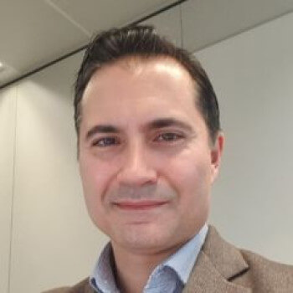

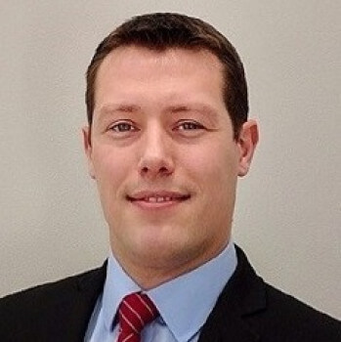

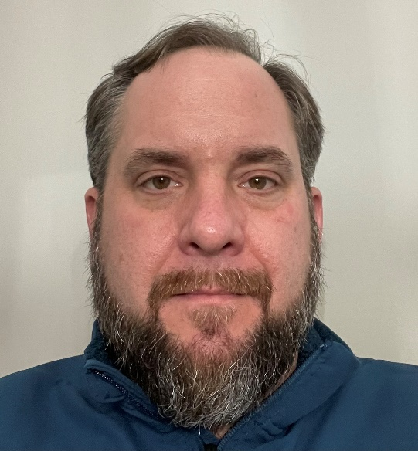
Joint committee leadership
Ed Hahn, ALPA
John Micallef, EUROCONTROL
Clay Barber, Garmin
Andy Roy, ASRI
Capucine Amielh, Airbus
Chris Tourigny, FAA
RTCA co-chair
SG1 Lead
SG2 Lead
EUROCAE co-chair
RTCA Secretary
Government Authorized Representative

Slide 6
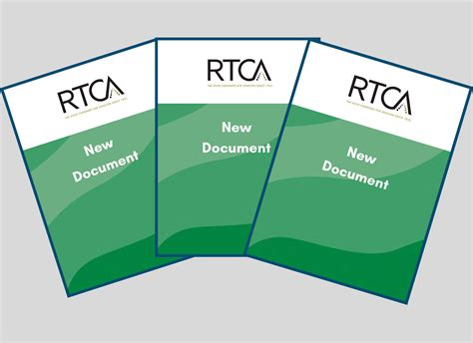
Subgroup 1: Development of Spectrum Report
Problem identification
Survey of Radio Frequency (RF) Performance of Standards for Aeronautical RF Systems
Objectives
  Identify the potential variations in how spectrum performance is documented
    Is there a trend in any gaps in spectrum information (i.e. a fully defined Tx and Rx functions?)
    Are there variations between different standards?
  Highlight examples of extensive work on spectrum considerations that may be used as future models for guidance material
  Identify and catalog unresolved and/or unqualified deficiencies (i.e. all unknowns)
    Explicit or implicit dependencies to external documents for RF parameters
  Raise the questions that need to be resolved in the spectrum guidance document
The report is not:
  A detailed critique of the MOPS’ quality/appropriateness
  A compatibility assessment of a specific MOPS against all other co-frequency and adjacent band systems
  To answer any spectrum question conceivable or to provide direct fixes for existing MOPS
Report audiences
  Primary: SC242/WG124 SG-2
  Secondary: Aviation community
  Secondary: Other standards organizations (including ICAO)

Slide 7
What the report will look like
Parameters – identifies the gaps and their extent
System Context/Environment – helps place the gaps into perspective
Identify gaps with some examples, and the potential reasons for these
  Principle of ‘can you do a study against it from an external interference source?’
  Fully defined Tx/Rx parameters?
  Antenna and installation details?
  Supporting operational parameters/scenarios?
Will not comment of every single parameter
  High level commentary only
  Report is not an assessment, but should be honest about the gaps/variation between different MOPS
Electronic supplement will also be published
  Limited to only the RTCA/Eurocae references for parameters
  Will not publish the remarks for any parameters provided, nor any answers provided in the contextual questions
System summary and purpose
Summary of material contained
Explain context of document
  Age of document, last update, and if a corresponding MASPS/supplements/other sub-system specific MOPS exists for the system
Other information not necessary in the MOPS
  Explanation of nuances that help interpret the technical information (or the lack of it in some instances)
Context of other known standards that may support if not specifically referenced
Any comments made in the survey on responses to contextual questions
  Not direct quotes, but description of substantive points raised

Slide 8
Subgroup 2: Development of recommendations
Problem resolution
Goal: Provide recommendations to benefit standards that are not ready to face new signals in or in near bands
Help other SC/WG on RF interference topics
Gather feedback for new issue
Starting point:
Content of MOPS/ED
Questions raised by experts
ITU/ICAO/CEPT recommendations
SC-242/WG-124 RF specialists
Guidance standard

Slide 9
The Plan
2022 | 2023 | 2024
Report: RF Performance of Aeronautical Standardized RF Systems
For publication 04/2023
SG1
Report: Primer on Aeronautical Radio Frequency Systems, their Regulatory Framework, and Operational Considerations
For publication 12/2023
Standard: Spectrum Guidance for the Developers of Standards for aviation Wireless Systems
Paper: Synthesis of RF survey and first recommendations
For submission 03/2024
For publication 09/2024
Paper: How to fully describe a transmitter spectrum envelope
Paper: How to fully describe a receiver spectrum envelope
Paper: Decision criteria for interference assessment
Paper: Interference scenarios
SG2
Paper: Methodology for interference assessment
Paper: Measurements
Paper: Margins in RF interference assessment
Paper: Interference reduction techniques

