Slide 1

Interference Path Loss Measurement at Wireless Avionics Intra-Communication Band using Beechcraft B300 Aircraft
National Institute of Maritime, Port and Aviation Technology
Electronic Navigation Research Institute
ICAO Frequency Spectrum Management Panel (FSMP) 10th Working Group Meeting, Virtual Meeting, August 2020
S. Futatsumori
Electronic Navigation Research Institute
Notes:
Thank you Mr. Chairman.
Good afternoon ladies and gentleman.
My name is Shunichi Futatsumori of Electronic Navigation Research Institute, Japan.
Today, I would like to present a paper entitled
“Measurement of Radiation Power from an Aircraft FMCW Radar Altimeter for Investigating Spectrum-Sharing Conditions with Wireless Avionics Intra-Communication Systems”

Slide 2
Contents
Aircraft under measurement
Specification of onboard radio altimeter
Interference path loss (IPL) measurement conditions
Measurement set-up and overview
Antenna locations
Measurement results
Inside cabin
Outside cabin
Notes:
First of all, I would like to start with the contents of this presentation.
First, I will briefly introduce the background and objectives.
This includes the “Electromagnetic compatibility (EMC) issue between aircraft radio altimeter and Wireless Avionics Intra-Communication (WAIC) devices at 4 GHz band”.
Second, I will explain the results of
“Radio altimeter radiation power measurement” which is using
“Beechcraft B300 aircraft”.
After that, I will discuss about
“Point source power estimation for investigation of spectrum sharing conditions”
which estimates “Maximum point source power from the radio altimeter”.
Finally, I will summarize with our conclusions.

Slide 3
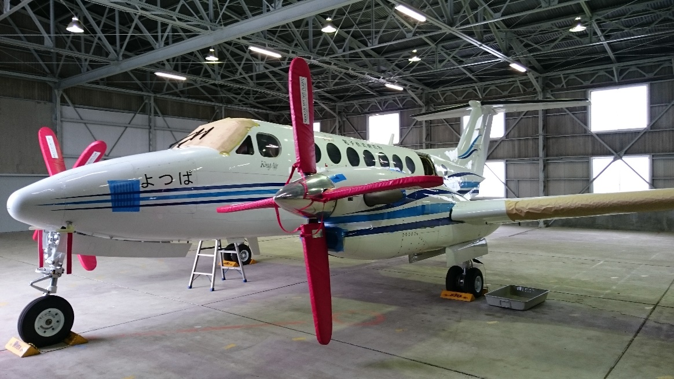
Aircraft under measurement
Beechcraft B300(King Air B350)

Slide 4
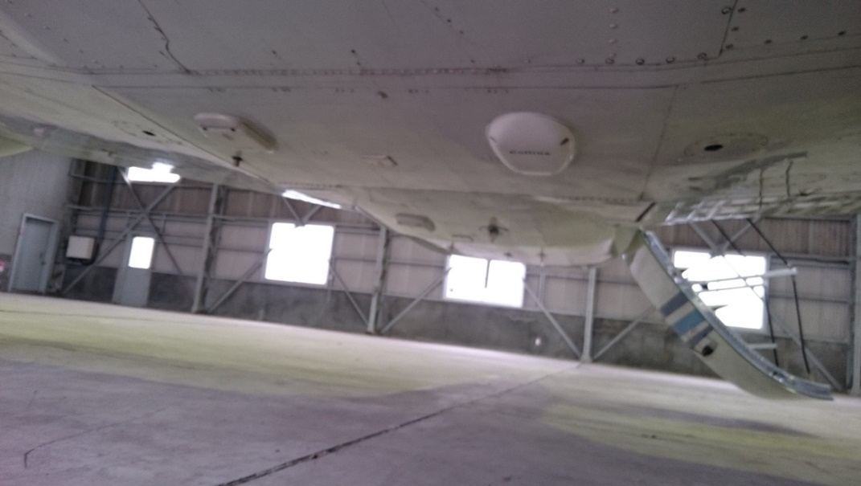
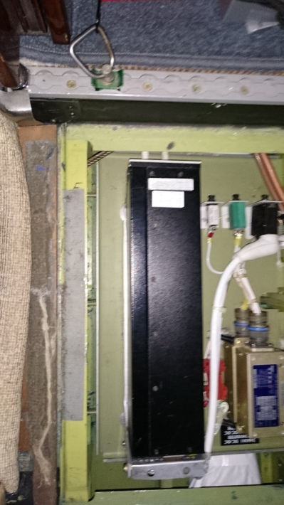
Radio altimeter
FMCW radio altimeter
Transmitting antenna
Receiving antenna
Manufacture | Rockwell Collins
Model | ALT-1000
Center frequency | 4.3 GHz
Bandwidth | 100 MHz
Transmitting power | 27 dBm
Ranging method | FMCW
Antenna gain | 9.5 dBi (Linear polarization)

Slide 5
Measurement set-up
IPL measurement set-up
The path loss between the transmitting antenna and the receiving antenna are measured using the signal generator and spectrum analyzer. The number of the antenna location is 20 points (outside cabin) and 17 points (inside cabin).
IPL measurements are carried out based on the procedure described in DO-307A - Aircraft Design and Certification for Portable Electronic Device (PED).
The all cable loss, transmitting antenna return loss are calibrated at IPL calculation.
Transmitting antenna
(Standard dipole antenna)
Receiving antenna
(radio altimeter antenna)
Signal generator
(Rhode&Schwarz SMB100A)
Spectrum analyzer
(Keysight technologies N9912A)
Pass loss
Widows
Computer
Ethernet
100BASE-T

Slide 6
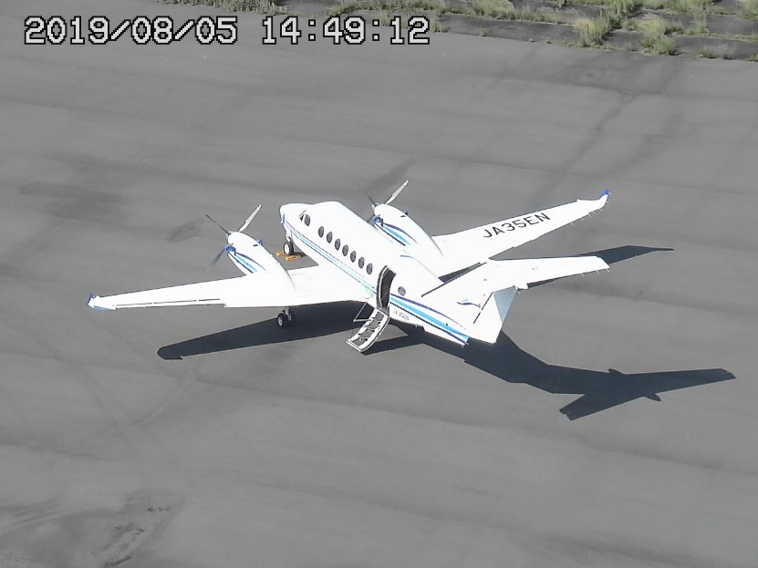
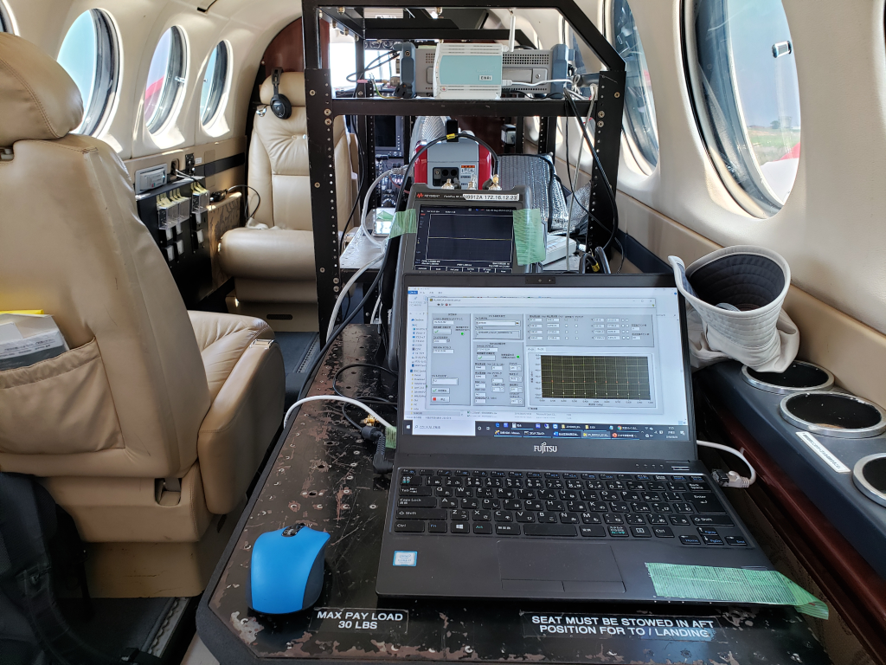
Overview of measurement
Conditions
Location and date: Sendai Airport, 5th August 2019
Tarmac conditions: dry
Measurement frequency band: 4,000 MHz-4,600 MHz (201 points)
Transmitting antenna: Standard dipole antenna
Transmitting antenna polarization: three orthogonal axis
Measurement dynamic range: Approximately 120 dB
Beechcraft B300
Notes:
This slide shows the overview of the measurement.
Measurement was carried out at Sendai Airport, which locate north west of Japan.
Measurement antenna is moving each point and obtain data.

Slide 7
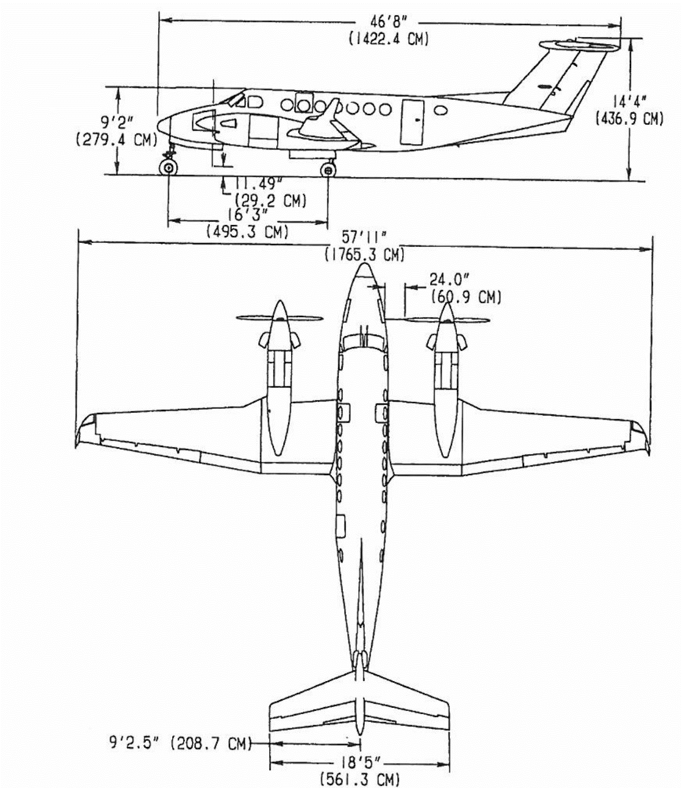
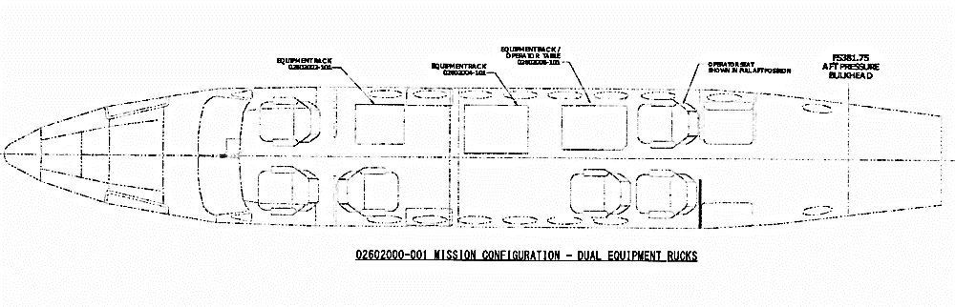
Antenna location
Inside cabin: 17 points
Outside cabin: 20 points
A
B
C
Q
T
R
S
D
A
F
E
G
D
E
H
I
H
F
G
J
K
B
C
L
M
J
I
K
Radio altimeter receiving antenna (bottom of the fuselage, 10 cm offset to center)
L
M
N
O
N
O
P
Q
P

Slide 8
Measurement results: inside cabin 1
No | Transmitting antenna location | IPL minimum (dB) | IPL median (dB)
A | Cockpit (center) | 81.0 | 91.3
B | Cockpit (left seat) | 79.7 | 89.3
C | Cockpit (right seat) | 79.2 | 88.9
D | Left window (2nd row) | 83.7 | 95.2
E | Right window (3rd row) | 81.7 | 94.4
F | Left window (3rd row) | 83.9 | 94.8
G | Left window (4th row) | 82.9 | 91.2
H | Left window (5th row) | 79.6 | 90.1
I | Right window (6th row) | 72.8 | 85.5
J | Left window (6th row) | 78.8 | 89.5
K | Left window (7th row) | 77.8 | 89.9
L | Left window (8th row) | 75.8 | 87.5
M | Right window (8th row) | 74.9 | 88.1
N | Cabin door | 83.2 | 93.2
O | Right window (9th row) | 78.8 | 88.2
P | Left window (10th row) | 82.0 | 92.5
Q | Q: Right window (10th row) | 82.5 | 91.9
 | Total | 72.8 | 90.9
A
B
C
D
F
E
G
H
J
I
K
L
M
N
O
P
Q
Radio altimeter receiving antenna

Slide 9
Measurement results: inside cabin 2
IPL probability
IPL median:
90.9 dB
IPL minimum:
72.8 dB
Total measurement data 132,660 points: 20 (transmitting antenna location) x 201 (Frequency domain) x 11 (time domain) x 3 (transmitting antenna axis)

Slide 10
Measurement results: outside cabin 1
No | Transmitting antenna location | IPL minimum (dB) | IPL median (dB)
A | Nose radome | 74.8 | 83.5
B | Left wingtip (outside) | 80.1 | 93.3
C | Left wingtip (inside) | 70.8 | 85.7
D | Left engine (forward outside) | 79.0 | 90.4
E | Left engine (forward inside) | 60.0 | 76.8
F | Left engine (back outside) | 81.7 | 93.7
G | Left engine (back inside) | 75.2 | 86.2
H | Right engine (forward inside) | 63.2 | 75.6
I | Right engine (forward outside) | 75.7 | 90.7
J | Right engine (back inside) | 70.6 | 83.0
K | Right engine (back outside) | 81.0 | 96.3
L | Right wingtip (inside) | 65.7 | 86.2
M | Right wingtip (outside) | 76.0 | 93.6
N | Left rear fuselage | 67.2 | 78.3
O | Right rear fuselage | 66.0 | 80.0
P | Tail | 70.8 | 84.3
Q | Nose landing gear light | 73.7 | 81.9
R | Nose landing gear | 73.9 | 86.1
S | Main landing gear (right) | 55.0 | 64.9
T | Main landing gear (left) | 61.4 | 75.1
 | Total | 55.0 | 89.4
Q
T
R
S
A
D
E
H
I
F
G
J
K
B
C
L
M
N
O
P
Radio altimeter receiving antenna

Slide 11
Measurement results: outside cabin 2
IPL probability
IPL median:
89.4 dB
IPL minimum:
55.0 dB
Total measurement data 112,761 points: 17 (transmitting antenna location) x 201 (Frequency domain) x 11 (time domain) x 3 (transmitting antenna axis)

Slide 12
Conclusions
Conclusions
IPL of Beechcraft B300 aircraft is measured at WAIC frequency band.
The minimum IPL with the transmitting antenna inside cabin was 72.8 dB, which was not to small compared with that of Airbus A321(74.4 dB)*.
*ACP-WGF29/IP13, "Interference Path Loss Measurements in the Radio Altimeter Band onboard an Airbus A321", Sep. 2013.
The minimum IPL with the transmitting antenna outside cabin was 55.0 dB, which was measured with almost line of sight conditions and 3 m distance.
Even if the transmitting antenna and the radio altimeter antenna are close, minimum IPL more than 65 dB is obtained with non line of sight conditions.
Future works
We will carry out additional measurements employing other measurement parameters.
Notes:
I would now like to conclude this presentation.
We discussed
“Large-scale numerical analysis to estimate the EMF created by PEDs inside aircraft.”
We confirmed following:
Future works is a

